Slide 1
Global Ecosystem Dynamics Investigation (GEDI)
Mahsa Jami
LP DAAC Remote Sensing Scientist​
KBR, Inc., contractor to USGS EROS ​
Sioux Falls, South Dakota​
Work performed under USGS contract G15PD00467 for NASA contract NNG14HH33I.

Slide 2
Global Ecosystem Dynamics Investigation (GEDI) Mission
Mission overview
Provides detailed measurements of the 3D structure of the Earth’s surface.
Aims to characterize ecosystem structure and dynamics to improve quantification and understanding of the Earth’s carbon cycle and biodiversity.
What does it measure?
Surface elevation and structure Canopy height and vertical structure
Science questions
What is the carbon balance of the Earth’s forests?
How will the land surface/forest mitigate atmospheric carbon concentrations in the future?
How does forest structure affect habitat quality and biodiversity?
Please read more here.

Slide 3
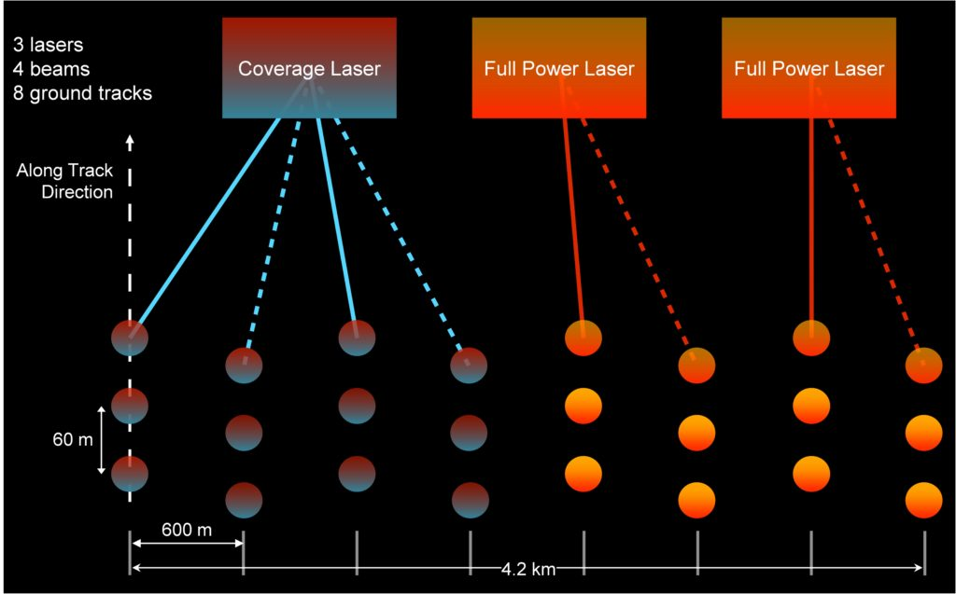
Global Ecosystem Dynamics Investigation (GEDI) Instrument
GEDI instrument
Is a full-waveform light detection and ranging (lidar) instrument on International Space Station (ISS).
Captures reflected laser waveform
Includes 3 lasers with 4 beams and 8 parallel ground tracks of observations (ground transects)
Highest resolution and densest sampling
25 m footprint on the surface
60 m distance between footprints along track
600 m across-track distance
Pulses 242 times per second
Image source: https://gedi.umd.edu/instrument/specifications/
Notes:
Coverage beam scatter in a day – better night scene
Full power beam will penetrate better – better works in day

Slide 4


Global Ecosystem Dynamics Investigation (GEDI) Data Products
Data
Level 1B Geolocated Waveforms product, Version 2 (GEDI01_B)
Level 2A Geolocated Elevation and Height Metrics product, Version 2 (GEDI02_A)
Level 2B Canopy Cover and Vertical Profile Metrics product, Version 2 (GEDI02_B)
Level 3 Gridded Land Surface Metrics, Version 2 (GEDI03)
Level 4A Footprint Level Aboveground Biomass Density, Version 2.1 (GEDI04_A)
Level 4B Gridded Aboveground Biomass Density, Version 2 (GEDI04_B)
Temporal Extent
Publicly available since 2019-04-18 to 2023-03-17
Processed GEDI V2 now available through end of 2022 and data for 2023 will become available
The GEDI is temporarily stored in a storage on ISS and will be returned in 2024
Spatial Extent
Global (Between 51.6° N and 51.6° S latitudes)
4

Slide 5
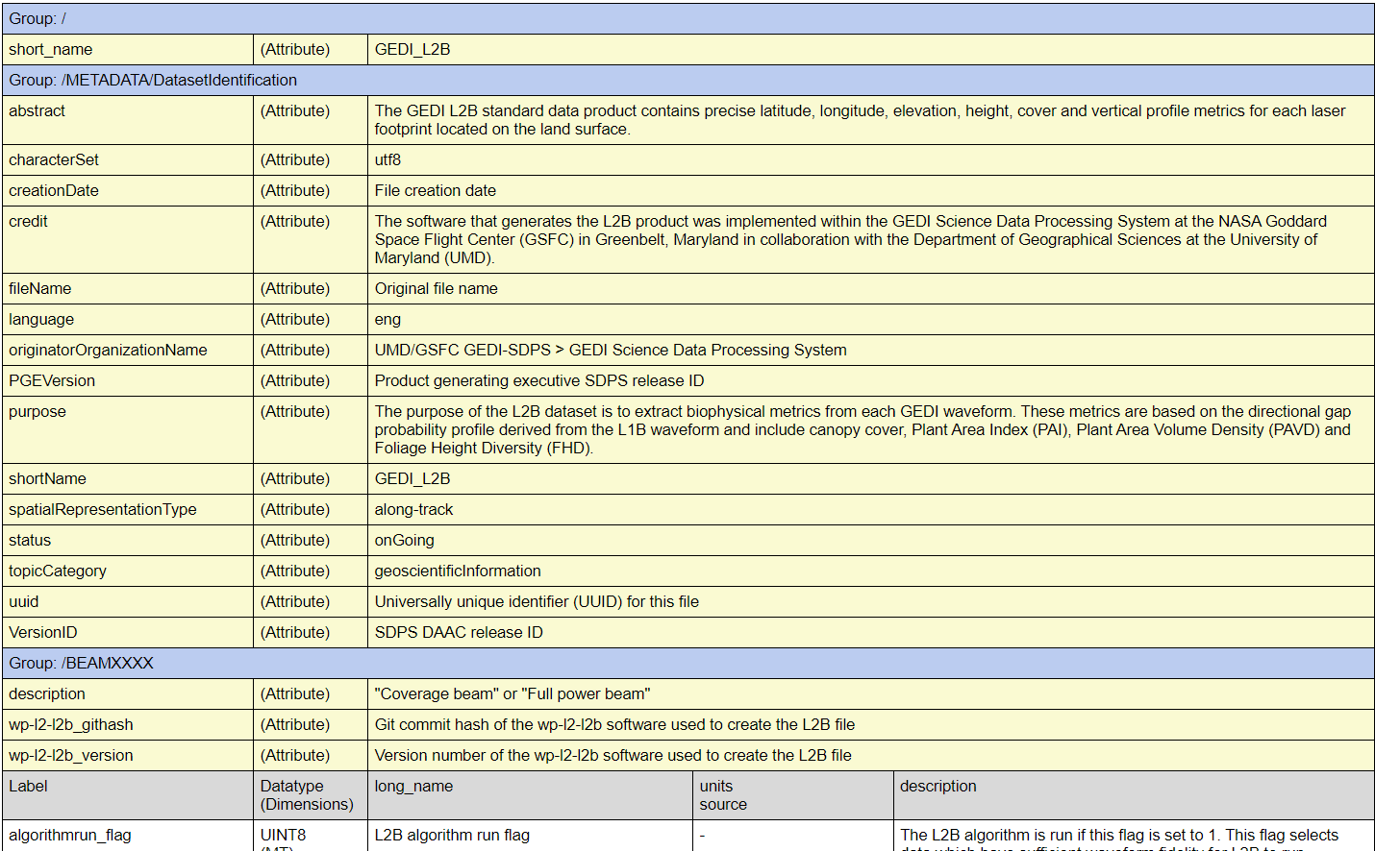
GEDI Data Dictionary
GEDI01_B
GEDI L01B Product Data Dictionary
GEDI02_A
includes 765 science datasets per beam
GEDI L2A Product Data Dictionary
GEDI02_B
includes 251 science datasets per beam
GEDI L2B Product Data Dictionary
5

Slide 6
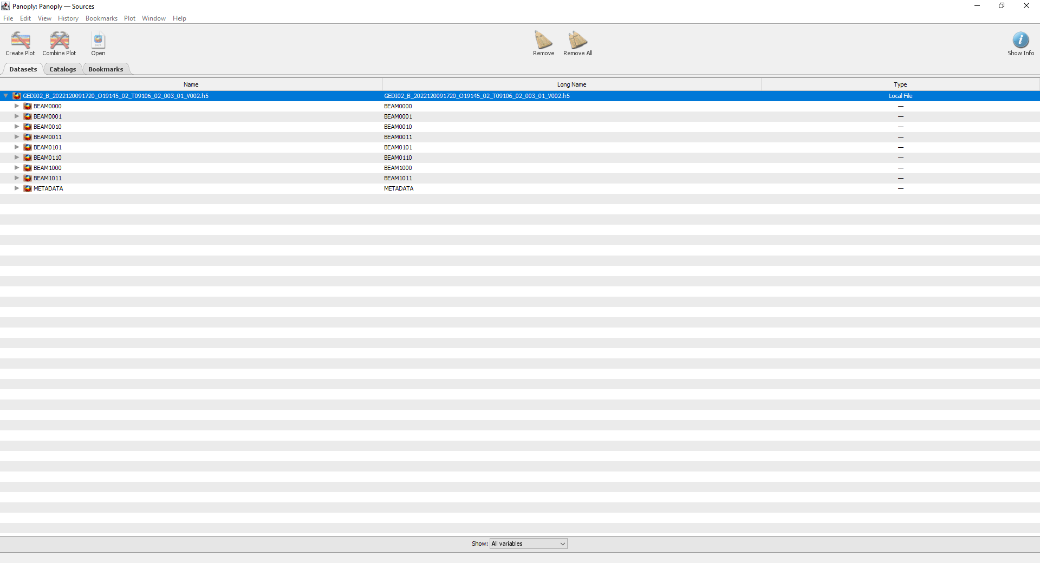
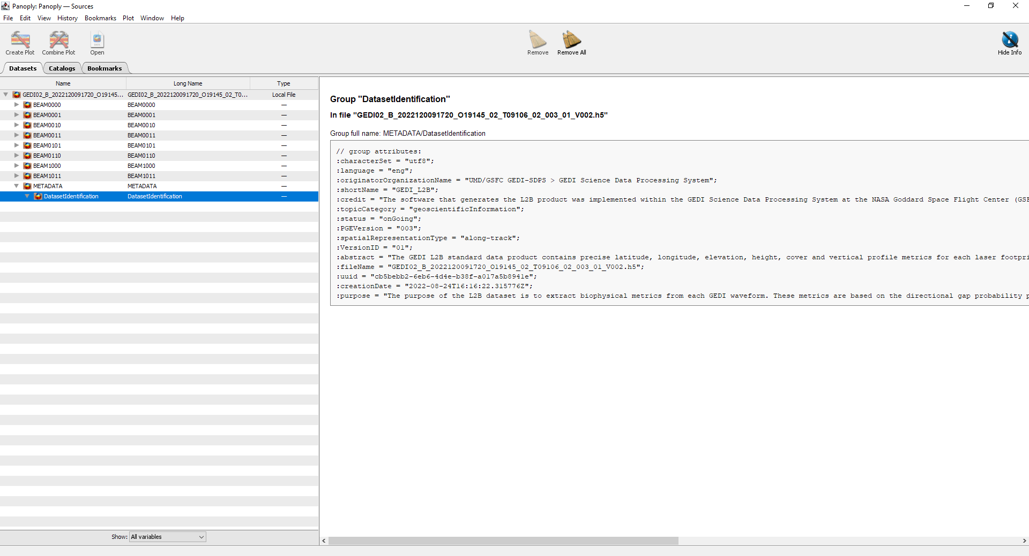
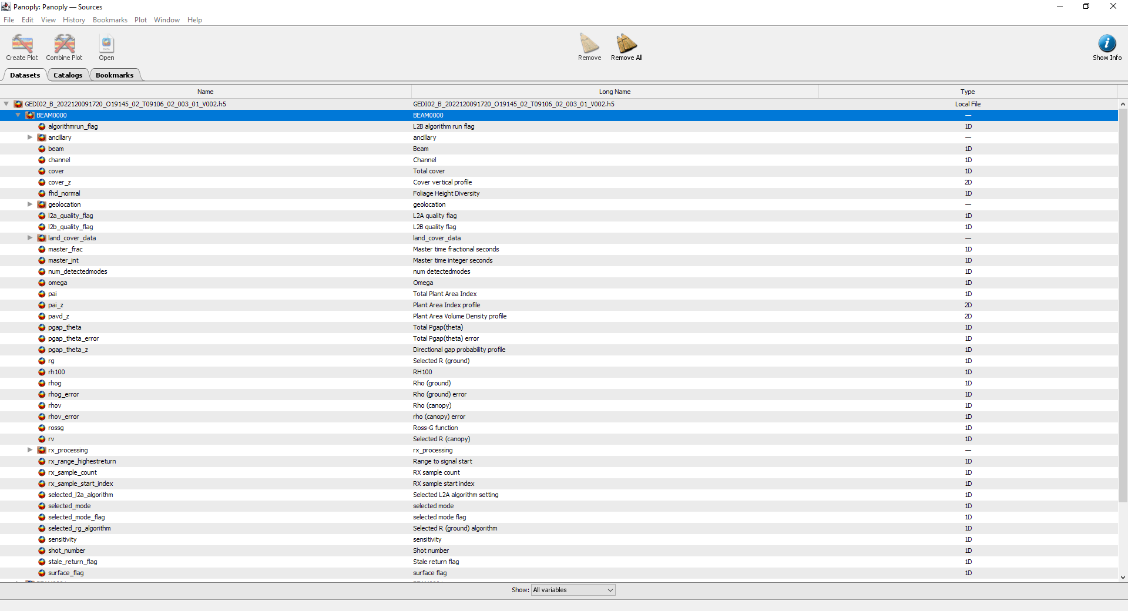
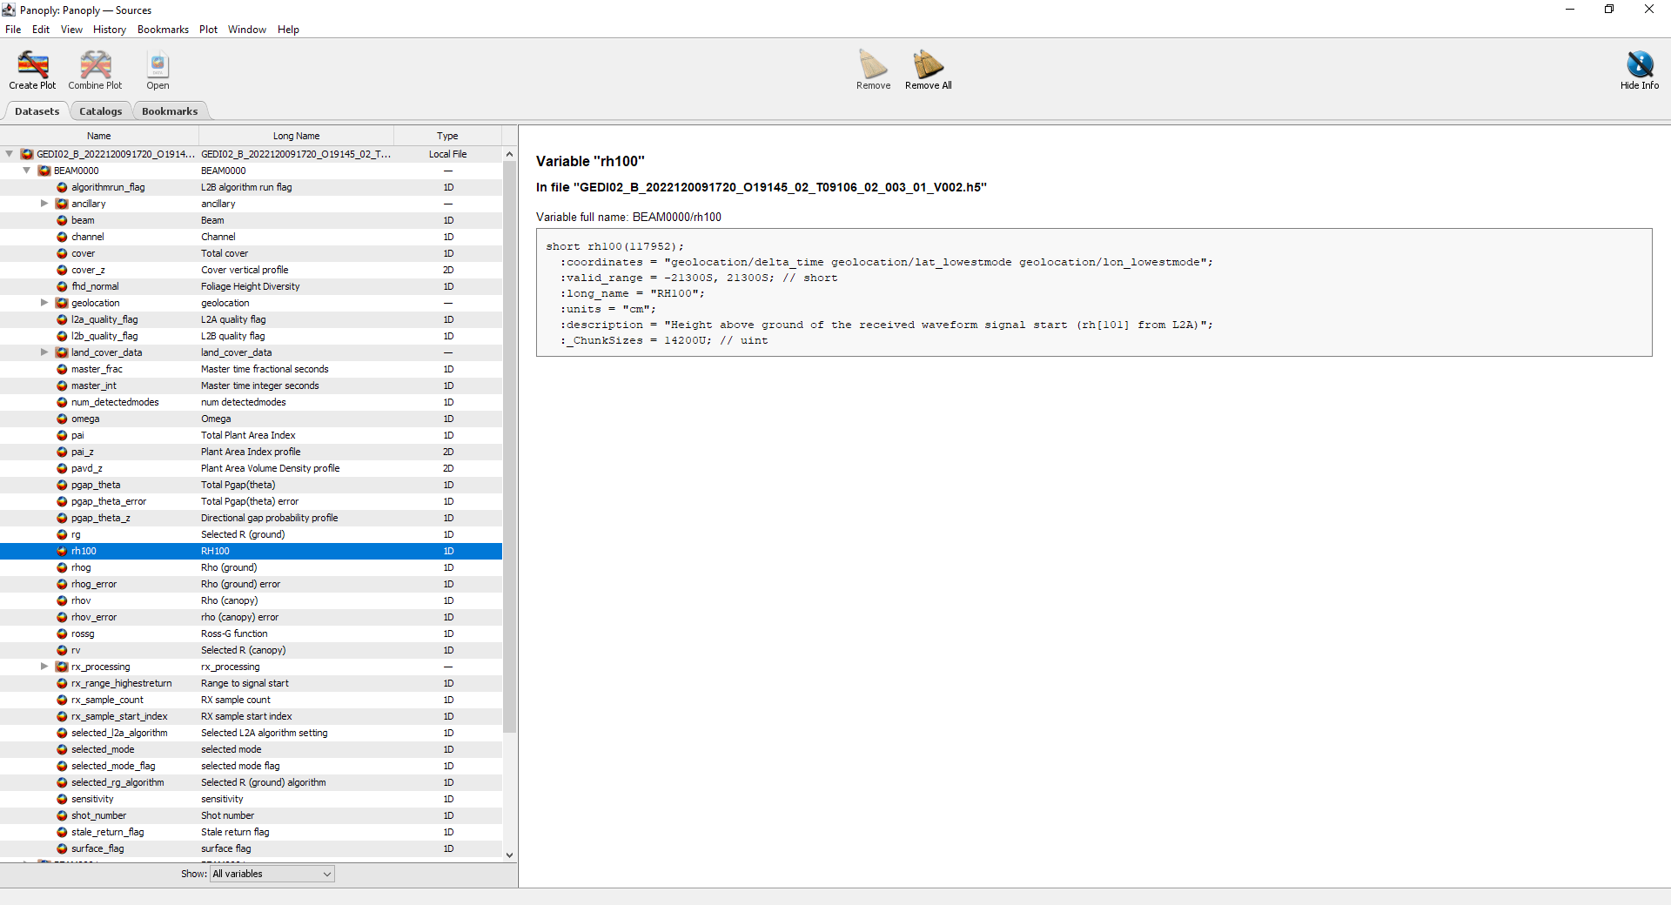
GEDI Data Structure
Panoply
6

Slide 7
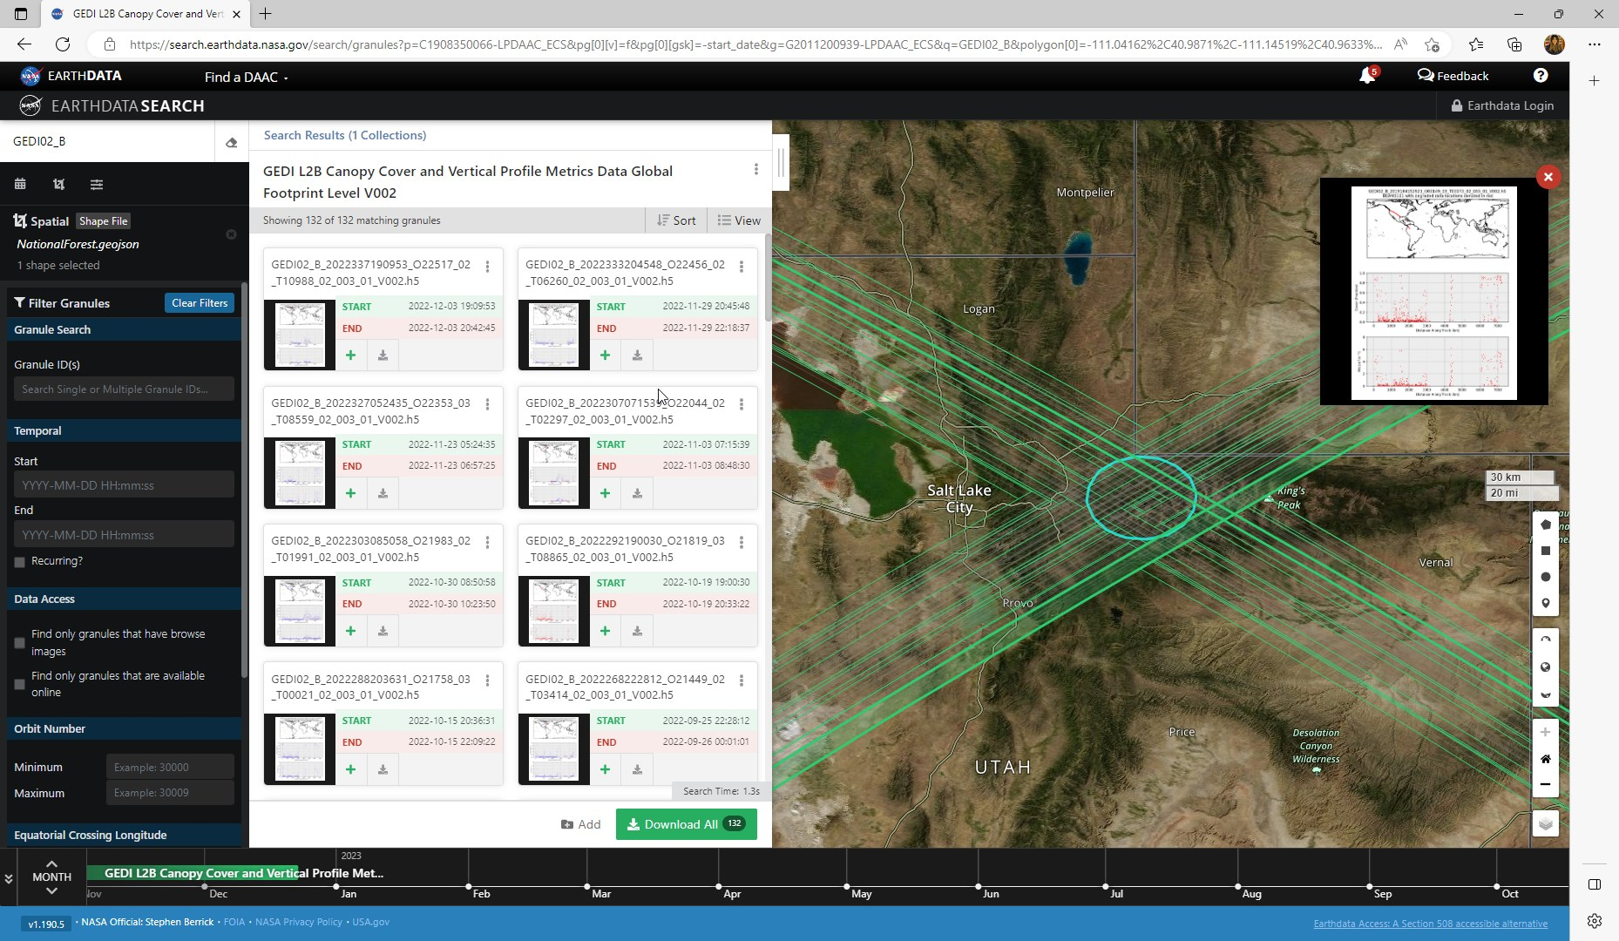
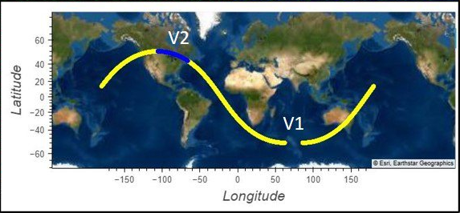
Access GEDI data
NASA Earthdata Search: https://search.earthdata.nasa.gov/search
7

Slide 8
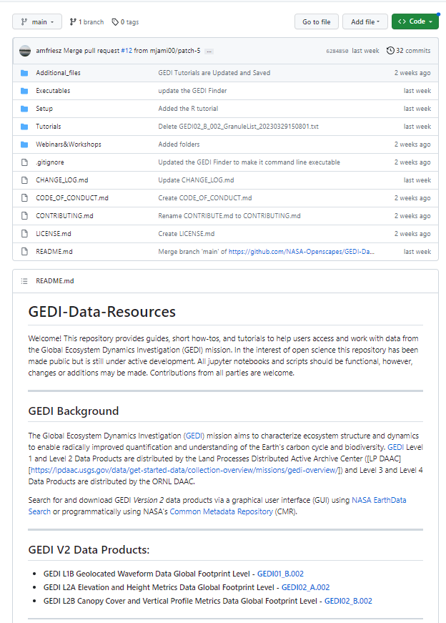
GEDI Data Resources
Tutorial Notebooks:
Getting Started with GEDI L1B Version 2 Data in Python
Getting Started with GEDI L2A Version 2 Data in Python
Getting Started with GEDI L2B Version 2 Data in Python
Spatial Querying of GEDI Version 2 Data in Python
Spatial Querying of GEDI Version 2 Data in R
Command Line Executables:
GEDI Finder performs spatial [bounding box] and temporal queries for GEDI V2 L1B, L2A, and L2B data using NASA's CMR and reformats the CMR response into a list of links that will allow users to download the intersecting GEDI V2 sub-orbit granules directly from the LP DAAC Data Pool.
GEDI Subsetter converts GEDI data products, stored in Hierarchical Data Format version 5 (HDF5, .h5) into GeoJSON files that can be loaded into GIS and Remote Sensing Software.
GEDI Data Resources GitHub
Notes:
GEDI has the highest resolution and densest sampling of any lidar ever put in orbit.

Slide 9
Hands-on Exercise for Accessing, Processing, and Visualizing GEDI Data
Click
Notes:
GEDI has the highest resolution and densest sampling of any lidar ever put in orbit.

Slide 10
Contact Information​
Voice: 605-594-6116​
Toll Free: 866-573-3222 (866-LPE-DAAC)​
Email: lpdaac@usgs.gov​
Web: https://lpdaac.usgs.gov/​
Earthdata Forum: https://forum.earthdata.nasa.gov/​
​
Subscribe to the LP DAAC Listserv:​
Send a blank email to lpdaac-join@lists.nasa.gov ​
Questions?​

