Slide 1
Unverified Connectivity Faces
Root Cause Analysis & Solution

Slide 2
The Problem: lb/ub Doesn't Encode the Correct Point Order
Category | Count | Status
connectivity_face_matches | 14,389 | Verified point-by-point
connectivity_unverified | 10,469 | Geometrically matched, failed directed verification
non_connected_faces | 1,886 | No match found (boundary faces)
lb/ub works for same-plane connections but fails when faces are on different constant planes.

Slide 3
Start Simple: 2D Grid Face Connectivity
A face on a structured grid is a 2D surface defined by two varying axes
Example: a K-constant face varies in i and j
The lb/ub convention encodes the diagonal — start corner and end corner
lb = lower bound (start), ub = upper bound (end)
For two axes (i, j), each can go forward or backward:
i: forward (0 -> 24) or backward (24 -> 0)
j: forward (0 -> 408) or backward (408 -> 0)
2 directions x 2 axes = 4 diagonal combinations — all encodable by lb/ub

Slide 4
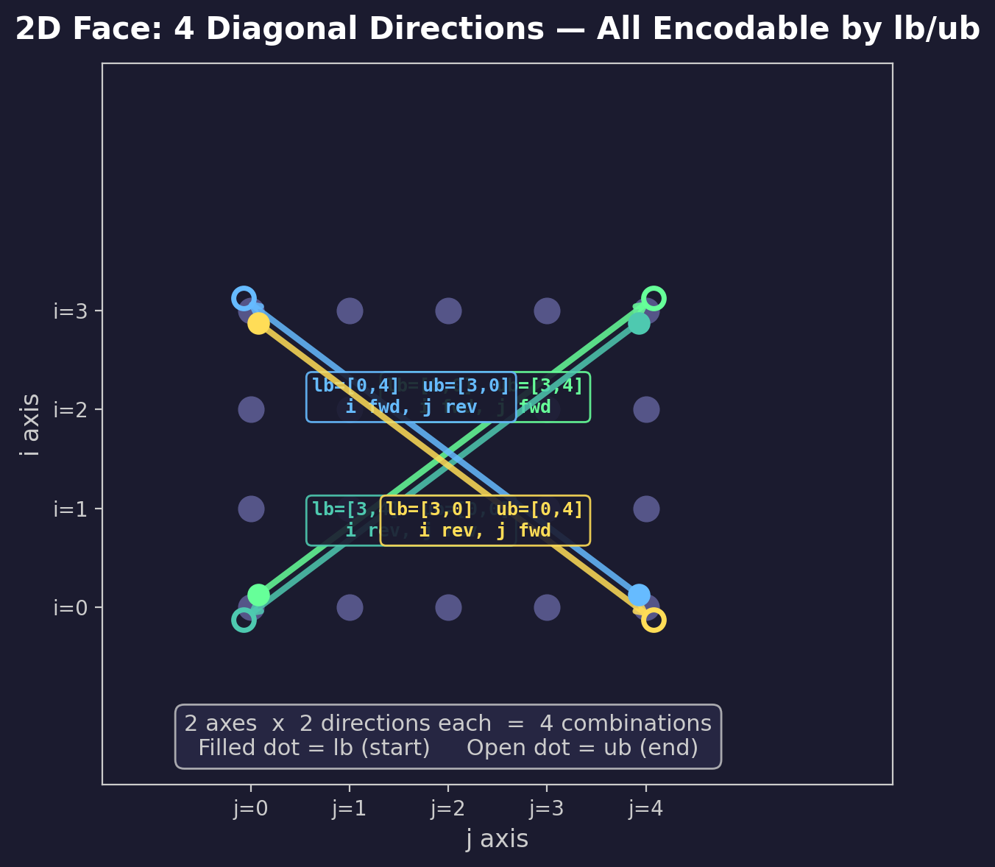
2D Diagonals: 4 Ways to Traverse a Face
Each arrow = one lb/ub encoding. All 4 directions are representable.

Slide 5
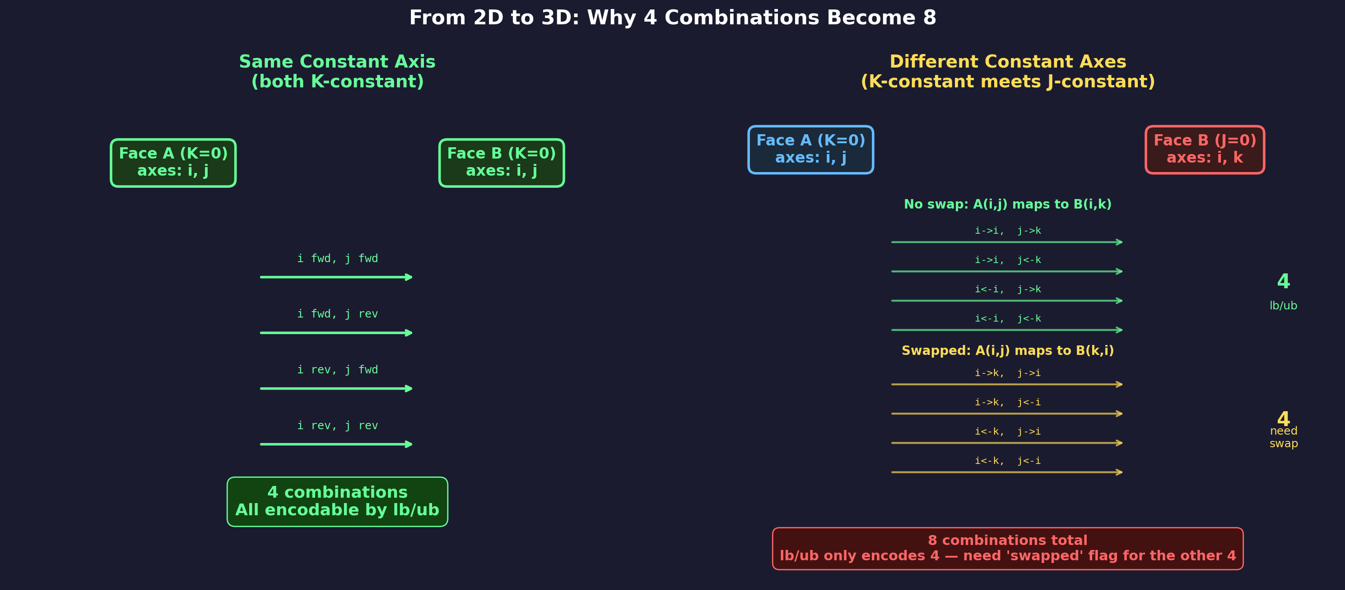
From 2D to 3D: When 4 Combinations Become 8
Same constant axis = 4 combos (lb/ub works). Different axes = 8 combos (need swap flag).

Slide 6
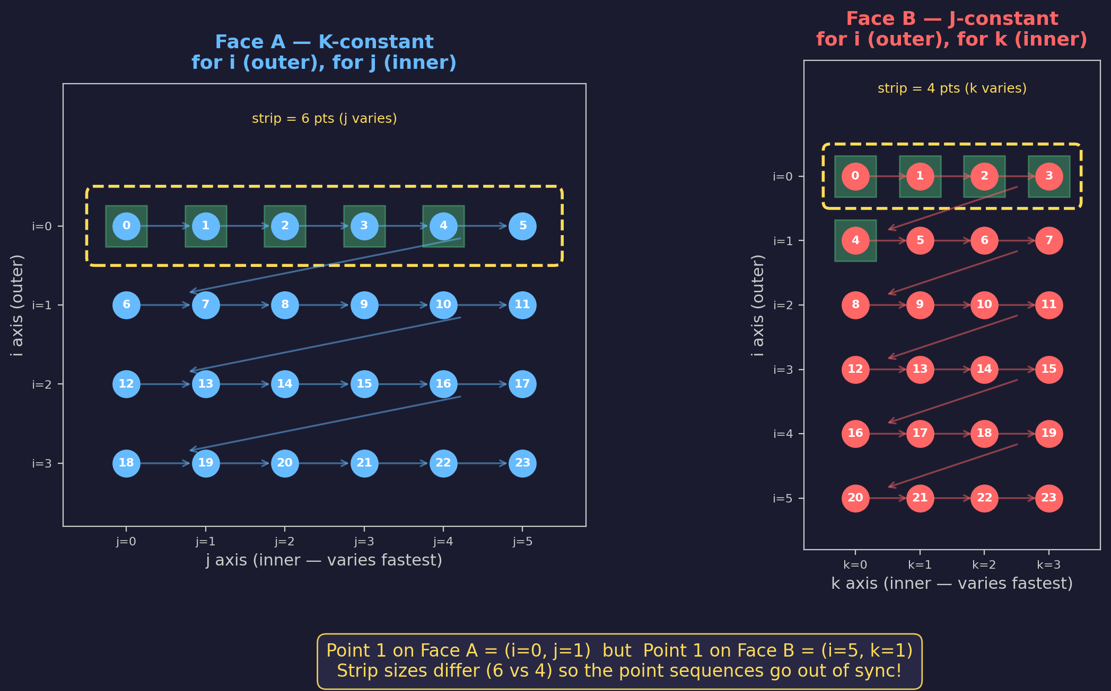
Why It Fails: Different Strip Sizes = Wrong Point Order
Face A numbers points in strips of 6 (j inner), Face B in strips of 4 (k inner) — they don't align.

Slide 7
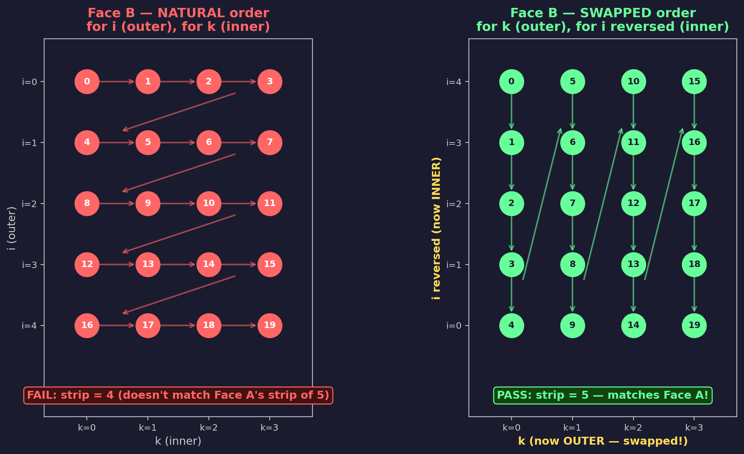
The Fix: Swap the Loop Order So Points Match
swapped=true, v_reversed=true makes Face B's point sequence match Face A exactly.

Slide 8
The Solution: Output the Orientation Flags
Rust's plot3d-rs already computes the correct orientation for every face match:
Orientation { swapped: bool, u_reversed: bool, v_reversed: bool }
8 permutations = 2 (swap) x 2 (u direction) x 2 (v direction)
The bug: orientation was silently dropped during JSON serialization
face_match_to_json() only output block1 and block2 — not orientation
The fix: include orientation in the JSON output
One change in connectivity_finder/src/main.rs
if let Some(ref orient) = fm.orientation { v["orientation"] = ... }
With orientation flags, all 10,469 faces now pass verification

Slide 9
Python Reference: NASA Plot3D_utilities
The Python version already handles orientation correctly:
github.com/nasa/Plot3D_utilities
connectivity.py: _compute_orientation() maps face1 axes to face2 axes
orientation = [d1_maps_to, d2_maps_to, d3_maps_to] (1-indexed: 1=I, 2=J, 3=K)
verify.py: _generate_permutations() tests all 8 combos (4 direct + 4 transposed)
Same 8-permutation approach as Rust — direction is in lb/ub, swap is in orientation
Rust (plot3d-rs) mirrors the Python logic but stores orientation differently:
Python: orientation vector [2, 1, 3] = axis mapping
Rust: Orientation { swapped, u_reversed, v_reversed } = flags
github.com/pjuangph/plot3d-rs

Slide 10
Summary
10,469 unverified faces are geometrically correct connections
Blocks whose faces lie on different constant planes (K <-> J, etc.)
Root cause: lb/ub encodes direction but not loop nesting order
2D: 4 diagonals — all encodable by lb/ub
3D cross-plane: 8 permutations — lb/ub only encodes 4
The 'swapped' flag covers the other 4
The fix: output the Orientation struct already computed by plot3d-rs
Python ref: github.com/nasa/Plot3D_utilities
Rust ref: github.com/pjuangph/plot3d-rs

