Slide 1
Fluid Distributed Interface SIM_CabinAtmo User’s Guide
Prepared by
Jason Harvey, CACI
November 11, 2024

Slide 2
Sim Overview
SIM_CabinAtmo purpose is to demonstrate the Fluid Distributed Interface between two fluid models, for HLA and standalone
Trick sim, using TrickHLA to interface with HLA
Contains simple cabin atmosphere models for 2 docked space vehicles
Typical vehicle cabin configuration
2 interface locations between vehicles: vestibule and IMV duct

Slide 3
Sim Contents
1 Trick sim object of type CabinAtmoSimObject called cabinAtmo containing:
2 instances of type CabinAtmo called modelA, modelB
CabinAtmo is the vehicle cabin atmosphere model
2 instances of type CabinAtmoConfigData: modelConfigA, modelConfigB
Configuration & initial condition values for modelA, modelB respectively
2 instances of type FluidDistributedIfLagBuffer: lagBufferVest, lagBufferImv
Non-HLA data buffers between modelA, modelB
1 instance of type CabinAtmoConserveChecks: conservation
Computes conservation of mass & energy across a combined model A & B
Models, interfaces and conservation checks update @ 10 Hz

Slide 4
CabinAtmo class
Main vehicle cabin atmosphere model
Contains 3 cabin volumes, instances of CabinAtmoVolume:
mCabin (main cabin ~10 m3 volume)
mVestibule (vestibule 1 m3 volume)
mImvDuct (Inter-Module Ventilation (IMV) duct 0.05 m3 volume)
Valves between volumes:
IMV valve between mCabin, mImvDuct
Grill valve between mImvDuct, mVestibule
Manual Pressure Equalization Valve (MPEV) between mCabin, mVestibule
Hatch between mCabin, mVestibule, parallel with MPEV
IMV fan between mCabin, mImvDuct, series with IMV valve

Slide 5
CabinAtmoVolume class
Models an air volume and state of air inside
Air state: pressure, temperature, specific enthalpy, specific heat, moles and mixture of 4 compounds in air (N2, O2, H2O, CO2)
Air properties are homogenous throughout a volume
One air state for the whole volume
Ideal Gas Law and calorically perfect gas:
specific heat Cp of each compound is constant
Specific heat of air mixture depends only on mixture
specific enthalpy h = Cp * T, only a function of mixture and temperature T
Contains a Distributed2WayBusFluid object called mIf
Generic implementation of the Fluid Distributed Interface

Slide 6
Flow Paths (valves, hatch, fan)
Flow ndot (mol/s) is linear with delta-pressure: ndot = G * dP
Valves & Hatch G (mol/s/Pa) is zero when closed, constant > 0 when open
Flows between volumes from higher to lower pressure
Hatch is just a big valve: valves have small G, hatch is large G
CabinAtmo has bool flags to control open (true), closed (false) state:
mHatchOpen, mMpevOpen, mImvValveOpen, mGrillValveOpen
Fan pushes flow from mCabin to mImvDuct
Models an ISS IMV fan: about 2.8 mol/s, 140 cfm flow @ 0.015 – 0.03 psid
Creates delta-pressure, inversely proportional to thru-flow, linear fan curve
Dead-heads @ 0.06 psid, zero flow when flow path cut off
Fan on (true) off (false) bool: mImvFanOn

Slide 7
Initial Conditions (IC)
Defined in CabinAtmo.cpp, CabinAtmoConfigData() constructor, with overrides in Trick input files (RUN_test/input.py, etc.)
Model B has larger cabin volume than A (20 m3 vs. 10 m3)
B side will take Demand role with all valves & hatches open
Both models have equal vestibule (1 m3) and IMV duct (0.05 m3) volumes as required by Fluid Distributed Interface
Air is normal mixture, ~1 atm, 70 F
slight variations in pressure, temperature, mixture between volumes, to show mixing
All valves, hatches, fans closed & off
User can override IC in the Trick input files

Slide 8
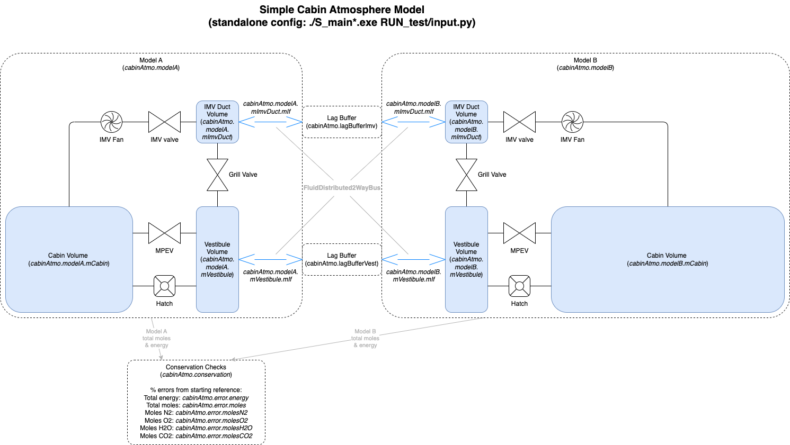
Sim model diagram, Models A + B

Slide 9
Building the Sim
Sim dependencies:
Trick: https://github.com/nasa/trick, recommend master branch
PitchRTI
Define $TRICK_HOME, pointing to Trick clone folder
Add $TRICK_HOME/bin to your $PATH
Define $TRICKHLA_HOME pointing to TrickHLA folder
Define $RTI_HOME pointing to your RTI install folder
This is optional: sim can build & run standalone without it, but no HLA

Slide 10
Building the Sim, contd.
cd to sims/DistIf/SIM_CabinAtmo
To build or rebuild: make clean; trick-CP

Slide 11
Running the Sim Standalone
Start sim with ./S_main*.exe RUN_test/input.py
It will launch Trick Sim Control and Trick View GUI’s
Trick View will load the TV_standalone.tv variable file with some strip charts
Sim will come up in Freeze, User can manually mode to Run
To equalize pressures and get IMV circulation going, set:
cabinAtmo.modelB.mHatchOpen = true, cabinAtmo.modelB.mImvValveOpen = true,
cabinAtmo.modelA.mHatchOpen = true, cabinAtmo.modelA.mImvValveOpen = true,
cabinAtmo.modelB.mFanOn = true
Strip charts will show pressure equalization and mixing, Trick View shows conservation errors
Terminate the sim from the Sim Control window

Slide 12
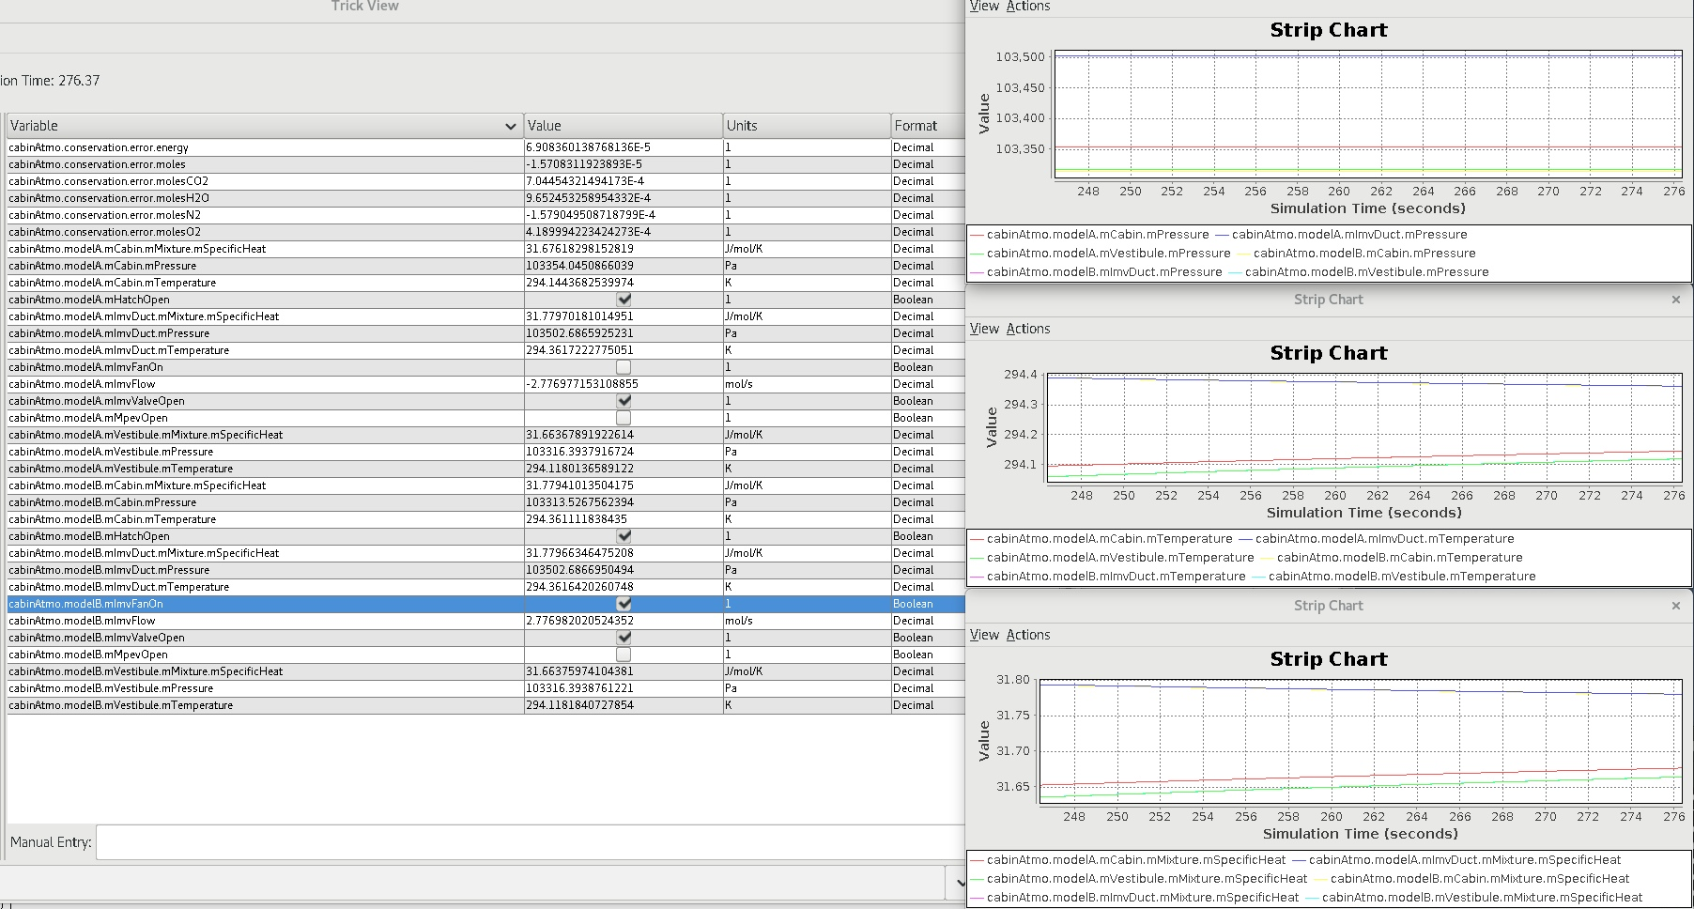
Running the Sim Standalone, screenshot

Slide 13
Running the Sim HLA
To launch the HLA federation (in csh or tsch), cd to the SIM_CabinAtmo folder, then: ./runHLA.csh
This might also work in bash, or you can make a bash version
NOTE: before launching, modify the ./S_main…exe command lines to add –r <RTI CRC Host>, the CRC host name, as needed (default is localhost)
To display available command-line options, do ./S_main*.exe -h
It will launch 2 instances of the sim, from RUN_FED_1/input.py and RUN_FED_2/input.py
It will launch 2 Sim Control and 2 Trick View GUI’s, one for each federate.
Sims start out already in run
TV’s will bring up variables and strip charts for the 1A/2B pair
The 2A/1B pair is also running, you can also look at them

Slide 14
Running the Sim HLA, contd.
Operate the model same way as Standalone, the difference being modelA & modelB are in different federates with their own TV window.
Operation and model performance should be identical to the Standalone case.
The simple ExCo in this TrickHLA sim doesn’t synchronize moding of run & freeze between the federates, so you have to mode both federates manually from their own Sim Control GUIs.
To terminate, shut down both sims from their Sim Control GUIs.

Slide 15
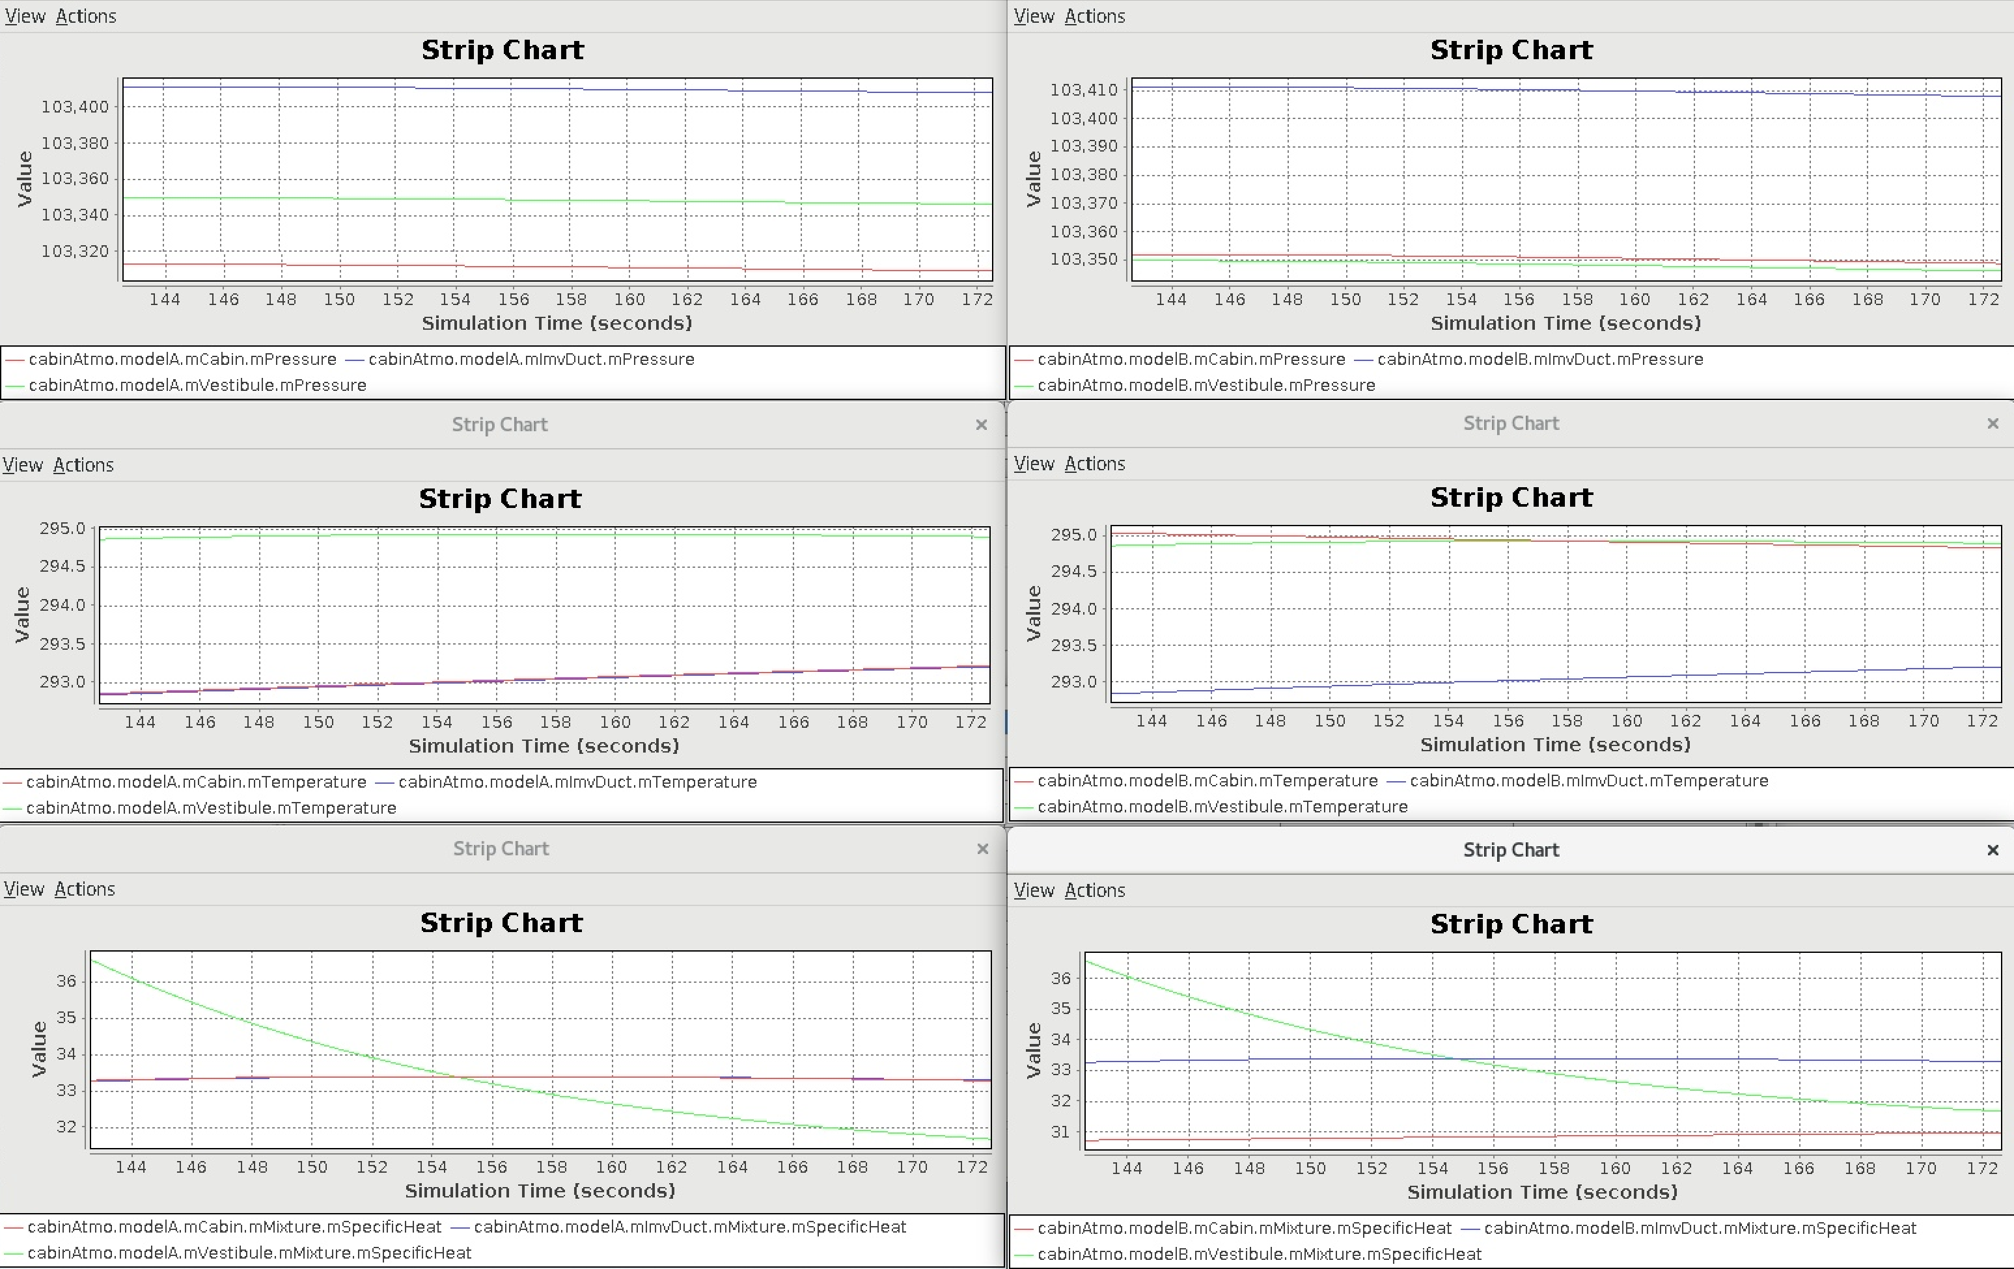
Running the Sim HLA, screenshot

Slide 16
Conservation Errors
The CabinAtmo models are closed, with no external mass (moles) or energy sources/sinks. All starting moles and energy is ideally conserved during the run.
Known conservation error sources:
Role swaps of the Fluid Distributed Interfaces while there is Demand flow
A design limitation of Fluid Distributed Interface
Role swaps can be forced by closing/opening modelB hatch and IMV valve
Causes ~ 0.01 % error per swap during normal IMV fan flow
Different fluid specific heat/enthalpy models
HLA frame drops or repeats
In this demo sim, there should be zero drops or repeats
The conservation check computations don’t include the Demand flow in transit across the lag buffer (standalone) or HLA interfaces, so small error appears in proportion to Demand flow rate and latency
Typically ~ 0.04 % error for normal IMV fan flow and nominal latency
This is not a real error, and it disappears when flow goes to zero

Slide 17
Adjustable Latency (Standalone)
When running the standalone sim, the round-trip data latency of the Fluid Distributed Interfaces can be changed
Set in RUN_test/input.py, prior to sim start:
Modify the value on lines per the comment:
# Set up lag amount in the lag ring buffers
# Loop latency will be 2 + (2 * mDelayFrames)
cabinAtmo.lagBufferVest.mDelayFrames = 0
cabinAtmo.lagBufferImv.mDelayFrames = 0
Max value is 8, going higher will overflow the lag buffer, very bad
Can’t be changed in runtime, only before sim start
Increase latency to see the effect on the interfaces

Slide 18
Error & Info Messages
The CabinAtmo models will output messages to the console:
Initialization errors due to bad config or IC values, e.g.:
ERROR: cabinAtmo.modelA.mCabin initial temperature < DBL_EPSILON!
These should be self-explanatory
Sim will remain up but the model is borked, fix the input data and restart the sim
Info messages whenever a Fluid Distributed Interface swaps roles, e.g.:
cabinAtmo.modelA.mImvDuct from mIf: switched to Demand mode.
cabinAtmo.modelA.mVestibule from mIf: switched to Demand mode.

Slide 19
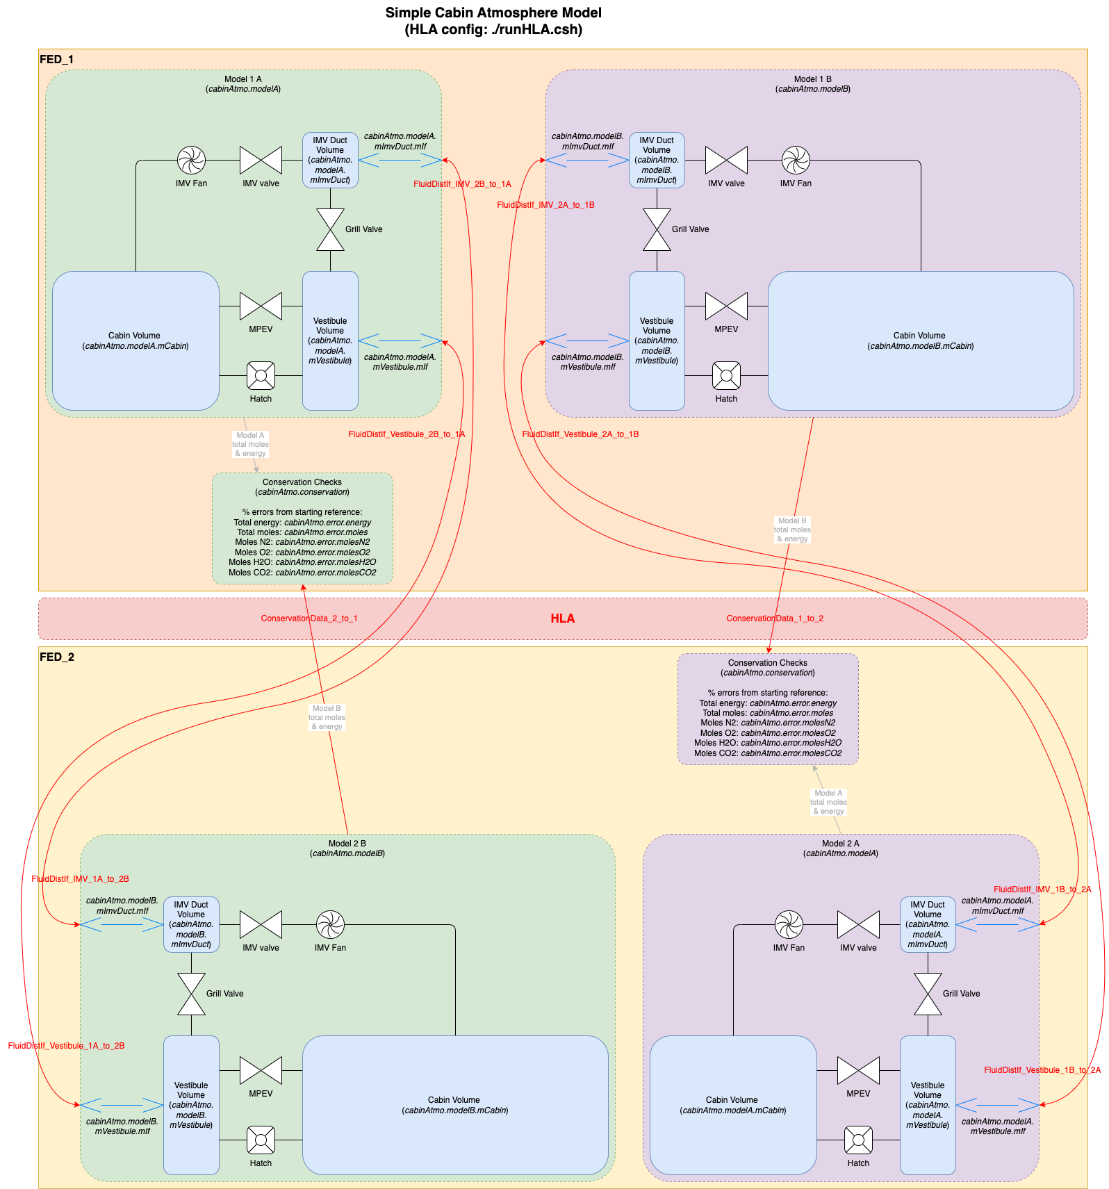
Sim Model Diagram, HLA
HLA object names in red
Shows the 2 independent model pairs, 1A/2B (left), 1B/2A

