Slide 1
V&V Results for CML Extended Planetary Derived State (delta)
ANTARES Artemis 2
Model V&V
Alexandre Masset
Organization (Odyssey Space Research)
Date: 12/2/2025 (version 1) – 12/2/2025 (latest)
Notes:
1

Slide 2
Outline
Purpose and Use
Assumptions and Limitations
Antares Project Status
Location
Associated Merge Requests and Commit Hashes
Inheritance and Dependencies
Model Inventory
Code Review
Coding Standards Compliance
Architecture Review
Code Coverage
Verification / Validation Test Descriptions
Follow-on Work

Slide 3
Model Purpose and Use
Purpose:
Provides an extension to the JEOD PlanetaryDerivedState with additional state options to meet specific requirements. Notably, this model provides transformations and representations including Topocentric/Topodetic NED, Boost Reference, Plumbline, Launch Range, Landing Range, EI Range, Range Safety, Pad SEU and left-handed pad frames, Hang and Roll angles.
Models Using this Model:
CML
atmos_rel_state
atmos_exec
first_order_hold
secondary_chute_atmosphere
chute
eg_chute
CEV
eg_chute
chute_manager
antares_extended_planetary_derived_state
Grok
grok_state
grok_vehicle
grok_main
Assumptions and Limitations
A vector with a magnitude less than std::numeric_limits<double>::min() is zero.
The orientation of planet depends on the models of planet and RNP in JEOD.

Slide 4
Antares Project Status
Antares Requirements Sections E.1.2, F.1.1
Model Locations:
cml/models/dynamics/state_descriptors/extended_planetary_derived_state
Recent Merge Requests
!7310 (V&V)
!6758 (JEOD to CML message)
!4751 (point-to-point capability)
Most Recent Commit
A.Masset, 11/04/25
Adding subscribe pt_to_pt assert. Adding verif that pt_to_pt model can be run midsim
53aa2d6b669856b4a1decfb8e0c33e97f6a901a0

Slide 5
Code Inheritance and Dependencies
Code Inheritance
JEOD PlanetaryDerivedState
Code Dependencies
CML
Subscriptions
Math_utils
Range
CML Message
JEOD v3.4
planet_fixed
ref_frames
dyn_body
Vector3
Matrix3x3
orientation

Slide 6
Model Inventory
Documentation (docs/)
extended_planetary_derived_state.odt
extended_planetary_derived_state.pdf
extended_planetary_derived_state_presentation_VV.pptx
extended_planetary_derived_state_presentation_VV.pdf
Headers (include/)
extended_planetary_derived_state.hh
point_to_point.hh
range_safety_data.hh
topo_container.hh
velocity_set.hh
Source code (src/)
extended_planetary_derived_state.cc
point_to_point.cc
range_safety_data.cc
topo_container.cc
velocity_set.cc
Verification (verif/)
SIM_ei_entry
Log_data
RUN_ei_entry
SIM_planet_rel
Log_data
Modified_data
ERROR_point_to_point
FAIL_vel_set_init_NULL
RUN_all_on
RUN_baseline
RUN_boost_plumbline
RUN_boostref
RUN_double_inits
RUN_entry_range__common_ref
RUN_entry_range__initial_ref
RUN_entry_range__midsim_ref
RUN_hangroll
RUN_inrtl_pfix_misaligned
RUN_landing_range
RUN_launch_range
RUN_plumbline
RUN_point_to_point
RUN_range_safety
RUN_rel_vel
RUN_submodels_on_midrun
RUN_topocentric
RUN_topocentric__with_rel_vel
RUN_topocentric_altitude
RUN_topocentric_topodetic
RUN_topodetic
RUN_topodetic__with_rel_vel
RUN_warning_check
common_input.py
Validation (validation/)
None

Slide 7
Code Review : Coding Standards Compliance
Model is compliant

Slide 8
Code Review : Architecture Review
Class ExtendedPlanetaryDerivedState
Main class where other objects are instantiated
Provides several options to express the state relative to a planet
Added subscribe_pt_to_pt()
Added unsubscribe_pt_to_pt()
Added is_pt_to_pt_subscribed()
Added PointToPointManager submodel instance
Class PointToPointElement
Gathers information (position and name) on a single point, either attached to a planet or to a vehicle
Class PointToPointPosition
Relates two points through a relative position expressed in the planet-fixed frame
Class PointToPointManager
Manages the list of points on the vehicle, the planet and their relative positions

Slide 9
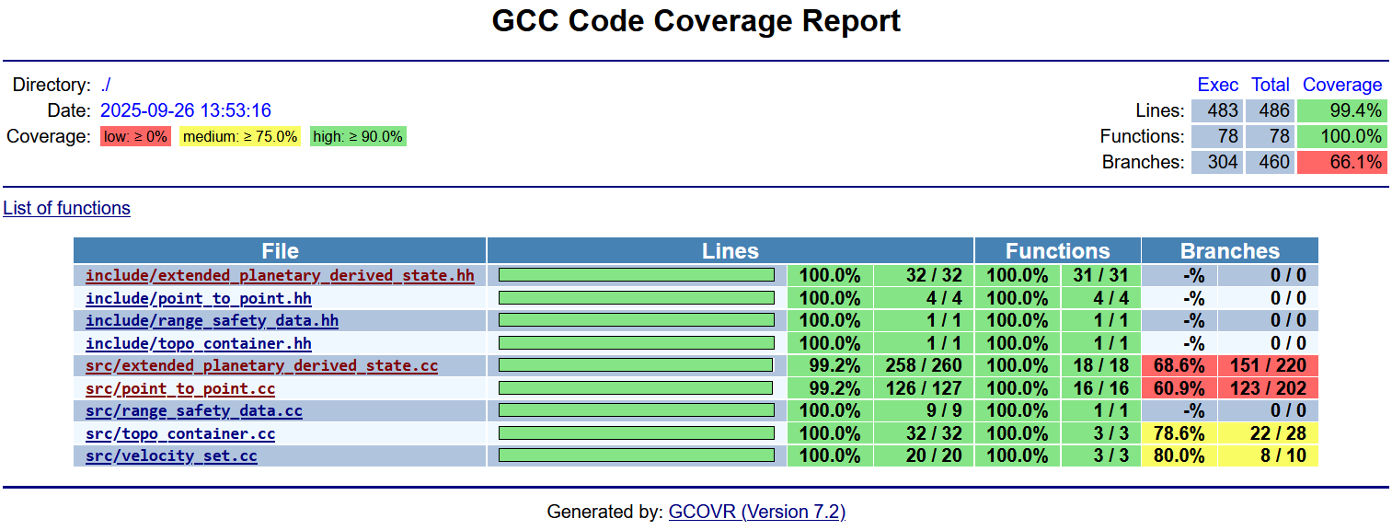
Code Review : Code Coverage
See exceptions in docs, Section 5.1.1

Slide 10
Initial Project Implementation
Extensive use in many CML and CEV models
PointToPointManager added to SIM_orion
relative_state.sm: ground_to_cm (pt_to_pt_manager)
Not used anywhere

Slide 11
Verification: SIM_verif
SIM_entry_ei
SIM_planet_rel
RUN_point_to_point
ERROR_point_to_point
See docs, Chapter 5

Slide 12
Follow-on Work
Documenting effect of rotations on pt_to_pt relative position
Point_to_point: Issue #2968
Relative positions are accessed through pointers to the pt_to_pt_pos list| If multiple models access this list, and relative positions are removed: pointers are left dangling
Using external double*[num_pts] array to log relative positions Same issue as above
FIXME: range_safety_data.hh:38
3 ToDOs: extended_planetary_derived_state.cc

