Slide 1
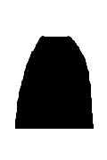

Side view
Bird’s-eye view
θ₁
F₂
2
F₁
$$Δφ_{F_{2}}$$
y
3
1
3
4
2
1
r₃
y
ϕ₁ = 90°
4
x
z

