Slide 1
V&V Results for CML Vent Model (delta)
ANTARES Artemis 2
Model V&V
Alexandre Masset
Organization (Odyssey Space Research)
Date: 11/13/2025 (version 1) – 11/13/2025 (latest)
Notes:
1

Slide 2
Outline
Purpose and Use
Assumptions and Limitations
Antares Project Status
Location
Associated Merge Requests and Commit Hashes
Inheritance and Dependencies
Model Inventory
Code Review
Coding Standards Compliance
Architecture Review
Code Coverage
Verification / Validation Test Descriptions
Follow-on Work

Slide 3
Model Purpose and Use
Purpose:
Model the forces and torques imparted by any number of vents on a dynamic body.
Models Using this Model:
CEV
Ammonia vent
PSA vent
Urine vent
Assumptions and Limitations
Because the model is provided with a mass-derivative rate, it must use a time step to convert that derivative into a mass demand. Therefore, the discrete mass demand of a vent onto a dynamic-mass body is placed post-integration rather than pre-integration to avoid any issue with the first time step.

Slide 4
Antares Project Status
Antares Requirements, Sections F.1.2 and F.1.4
Model Locations:
cml/models/fhw/effectors/vent
Recent Merge Requests
! 7426 (V&V)
! 6771 (Compiler warnings cleanup)
! 6758 (CML Message)
! 6647 (CPPcheck cleanup)
! 5678 (CML Vents update to support new CEV vents)
Most Recent Commit Hash
fb8705fb419535c505a4bde9f958cbd37b9805a2

Slide 5
Code Inheritance and Dependencies
Code Inheritance
N/A
Code Dependencies
CML Message
CML Subscriptions
CML MathUtils
CML DynamicMass
JEOD v3.4

Slide 6
Model Inventory
Documentation (docs/)
vent.pdf
vent.odt
vent_presentation.pdf
vent_presentation.odp
Headers (include/)
simple_vent.hh
vent.hh
vent_set.hh
Source code (src/)
simple_vent.cc
vent.cc
vent_set.cc
Verification (verif/)
SIM_verif
Validation (validation/)
None

Slide 7
Code Review : Coding Standards Compliance
Model is compliant

Slide 8
Code Review : Architecture Review
Class SimpleVent
Produces a force/torque pair, or an instantaneous impulse (linear and angular pair)
Although vents can be instantiated independently, they are not intended to function independently. The main executive methods are restricted to execution from a Vent Set.
Does not account for mass depletion
Class Vent
Standard vent; inherits the capabilities of a simple vent and adds mass depletion capabilities.
Class VentSet
Manager class; the VentSet provides a single access point for a grouping of vents that are to be operated together.
Provides methods for manipulating all the vents at once, or one at a time.
Collects forces and impulses from all the vents, combining them to provide a net force and torque pair, or and instantaneous linear and angular impulse pair.
Inherits from the CML SubscriptionBase class which provides management of the activity status of the model.

Slide 9
Code Review : Delta Updates
01/19/2023: MR !5678
Closes Issue #1542 (11/2022): VentSet deactivation wrap-up preferred behavior
SimpleVent Class:
Added unset methods for direction, force, force mag, impulse, impulse mag, duration
Added hold flags, consolidating force-impulse-duration consistency logic
Added virtual methods for polymorphic extension
Vent Class:
Added unset methods for exhaust speed and flowrate
Added polymorphic stop_venting method to switch vent off
VentSet Class
Added time as constructor argument and dyn_time as protected attribute for timed vents
Added error catch in start_vent/start_vents methods
Verification clean-up and new tests

Slide 10
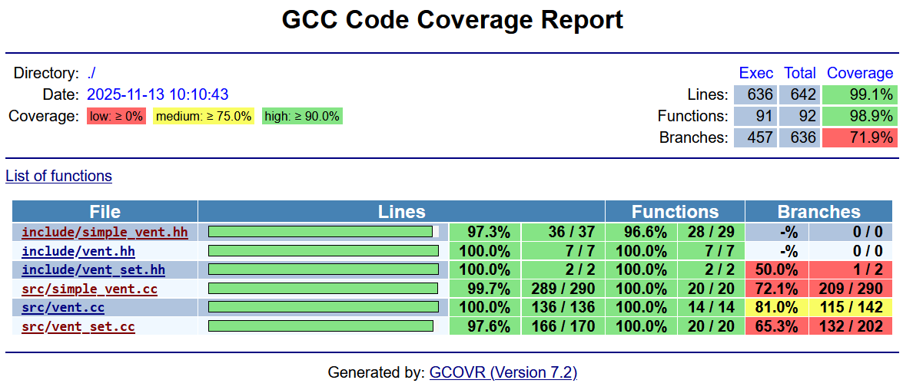
Code Review : Code Coverage
See exceptions in docs Section 5.1

Slide 11
Initial Project Implementation
Not directly used in SIM_orion
Used in ammonia vent, PSA vent and urine vent models

Slide 12
Verification: SIM_verif
SIM_verif
See docs, Chapter 5

Slide 13
Follow-on Work
ToDOs
Turner 01/2023 in vent.cc:
Could make start_venting have an option to support running without mass-flow, like a simple-vent
Turner 2020/01 in vent_set.hh:
Investigate use of varargs or variadic templates to support a set of vents each running off its own specified DynMassBody
Implement a Vent type running off a -DynamicMassString rather than a single tank

