Slide 1
V&V Results for CML Bin Counter Model
ANTARES Artemis 2
Model V&V
Alexandre Masset
Organization (Odyssey Space Research)
Date: 9/29/2025 (version 1) – 9/29/2025 (latest)
Notes:
1

Slide 2
Outline
Purpose and Use
Assumptions and Limitations
Antares Project Status
Location
Associated Merge Requests and Commit Hashes
Inheritance and Dependencies
Model Inventory
Code Review
Coding Standards Compliance
Architecture Review
Code Coverage
Verification / Validation Test Descriptions
Follow-on Work

Slide 3
Model Purpose and Use
Purpose:
Capability to count each time a variable meets each of a set of categorization criteria. The model provides three different counting methods. Based on capabilities in GNC_PAR.
Models Using this Model:
Grok
grok_prop
grok_cnc_analysis
Assumptions and Limitations
None

Slide 4
Antares Project Status
Antares Requirements, Section C.13.10
Model Locations:
cml/models/utilities/bin_counter
Recent Merge Requests
! 7150 (V&V)
! 6353 (Model added to CML from GNC_PAR)
Most Recent Commit Hash
1bcaeb018083927ae06cbd8e0b5ff409e4ebf97b

Slide 5
Code Inheritance and Dependencies
Code Inheritance
N/A
Code Dependencies
CML Message

Slide 6
Model Inventory
Documentation (docs/)
bin_counter.pdf
bin_counter.odt
bin_counter_presentation.pptx
bin_counter_presentation.pdf
Headers (include/)
bin_counter.hh
proximity_counter.hh
target_counter.hh
Source code (src/)
bin_counter.cc
proximity_counter.cc
target_counter.cc
Verification (verif/)
SIM_verif
RUN_01_bin
RUN_02_target
RUN_03_proximity
ERROR_config
Validation (validation/)
None

Slide 7
Code Review : Coding Standards Compliance
Model is compliant

Slide 8
Code Review : Architecture Review
Class CML_BinCounter
Counts the number of times some variable has a value that falls within a set of bins
To use with double (continuous) data type
Class CML_TargetCounter
Counts the number of times some variable is equal to each of a set of target values
To use with integer (discrete) data type
Class CML_ProximityCounter
Counts the number of times some variable is closest to each of a set of target values
To use either for discrete or continuous data type. Use double data type but can pass int
Each counter type has:
specific constructors
its own structure element that stores the counter
an insert(double/int) method to increment the counter
multiple set_data methods to create/reset counters

Slide 9
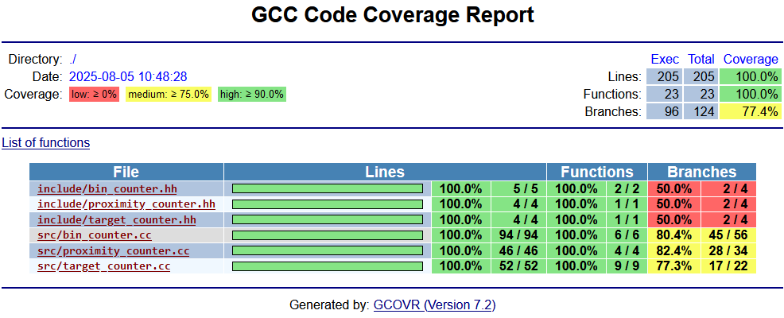
Code Review : Code Coverage

Slide 10
Initial Project Implementation
Used for inline data analysis

Slide 11
Verification: SIM_verif
SIM_verif
See docs, Chapter 5

Slide 12
Follow-on Work
No follow-on work

