Slide 1
EUROPA
Planning and Scheduling Technology
For Human-Robotic Space Exploration
Notes:
I am the Principal Investigator and Software Architect for a project tasked with developing advanced constraint-based planning & scheduling technology for applications in space exploration missions and mission-oriented research. This work builds on many years of research, development, and demonstration by a range of pioneers in AI. Most notably, Nicola Muscettola who developed the original HSTS planner that established much of the core technology concepts and proved their utility in the landmark Remote Agent Experiment on-board Deep Space One. Subsequent to that, Ari Jonsson took the technology to the next level and successfully lead the development efforts of MAPGEN, in use today, to produce command sequences from science goals for commanding Spirit and Opportunity on Mars. Much of the technical material presented today is based on the work of others. However, the views expressed are entirely my own and do not represent any official NASA policy or or perspective.

Slide 2
OUTLINE
Vision: Pervasive Planning & Scheduling
Strategy: Plug-and-play Planning Technology
Theory: Constraint-based Temporal Planning
Practice: The EUROPA Architecture
Conclusion
Notes:
The talks is structured as follows. I will first explain a viewpoint that planning and scheduling technology can be employed in a wide variety of important missions to great effect and that it can be a pervasive technology for engineering safe, effective and affordable space exploration systems. Given this broad need, I will briefly outline the strategic response initiated by the ASR group at Ames that has resulted in the EUROPA project and product. Having got past the high-level background material, I will delve into the main theoretical results underpinning the technology and then go on to show how EUROPA has been built to employ them.

Slide 3
Situated System Component
Environment
Control Program
Sensors
Effectors
Notes:
Lets start with a simple schematic for what I will refer to as a Situated System Component. It is situated in an environment. It is a System Component since we have to recognize that in most cases, a total system design is constructed from building blcoks that have this pattern. I use the term ‘Control Program’ instead of ‘Agent’ to emphasize the relationship to’ traditional’ software engineering and control. A Control Program is a program that receives input from its environment and responds to effect its environment in accordance with its designed operational role. The work we (broadly speaking) do in the Autonomous Systems and Robotics group is very concerned about how to produce control programs, and assembblies of control programs, that accomplish the desired behaviours very well.

Slide 4
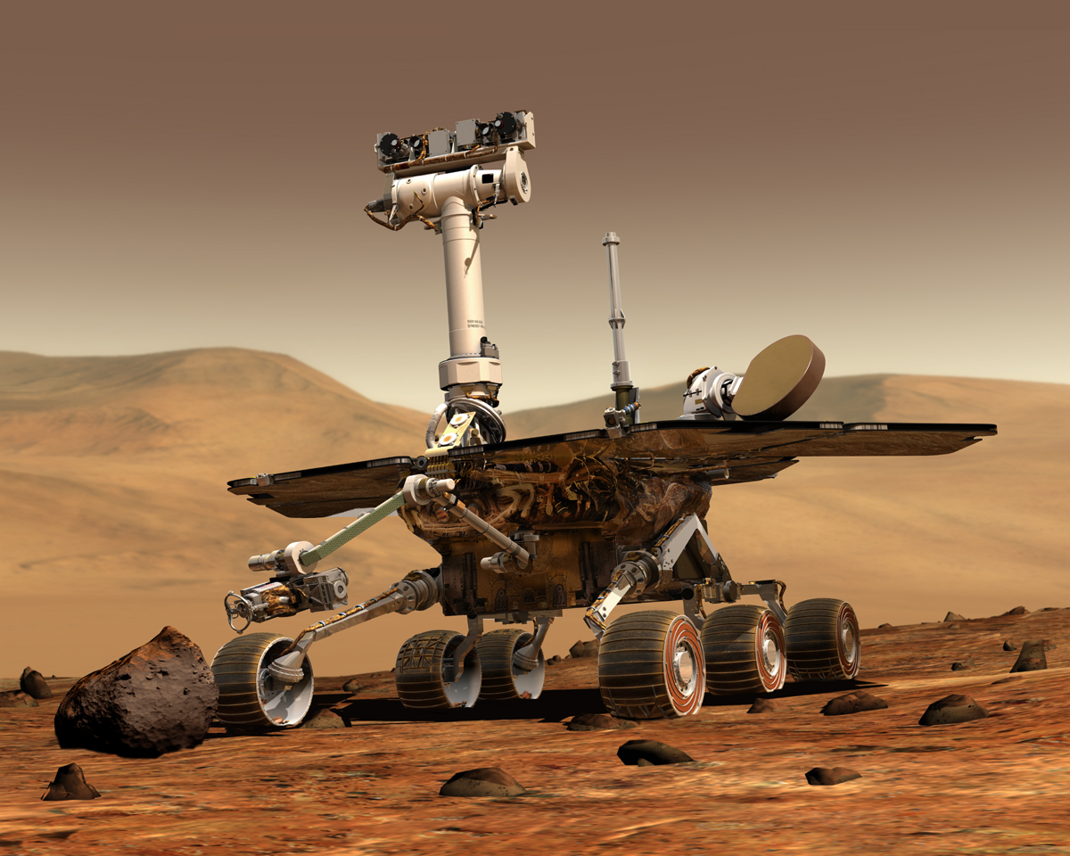
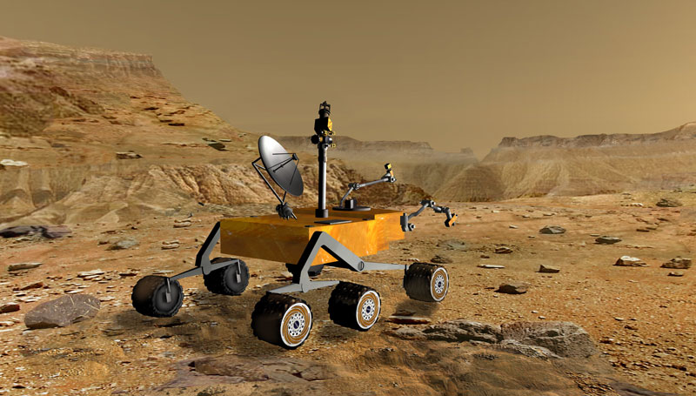
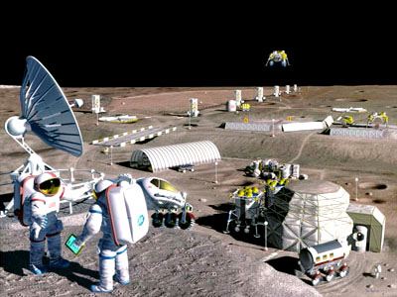

DRIVER: THE EXPLORATION VISION
“Safe, sustained, affordable human and robotic exploration of the Moon, Mars and beyond … for less than 1% of the federal budget”
http://exploration.nasa.gov
Mars Exploration
Rover
Mars Science
Laboratory
Human mission
to the Moon
Human mission
to Mars
Notes:
This next slide gives an idea of where NASA wants to go in terms of exploration. Note that we have icreasingly sophisticated system components. For example, the Mars Science Laboratory will be capable of a wider range of science activities. The image of a lunar field camp shows comlexity in the scope and quantity of system components that might inetract, to accomplish even more sophisticated tasks. For example, assemby of habitats, mining for resources. Finally, the image of surface operations on Mars conveys another dimension of complexity relating to remoteness. Opportunities for assistance are very limited and so assets deployed must be highly self-sufficient. They must be efficient in their use of resources for accomplishing tasks. They must be productive, since it costs and risks a lot to get these assets to these locations. They must respect safety, in particular as we endeavour to land humans in such locations. When we think of such systems, and recall our situated component, we realize that developing the control programs to support the exploration vision is a huge challenge for NASA, and we can’t afford to do it the traditional way, which tends to cost a lot of money to build and test, and which remains a very human, and thus error-prone activity. The process of building software gains very limited leverage from automation today, and when it fails, it can be very consequential.

Slide 5
Plan Based Execution
Planning requires choosing actions to accomplish goals
Scheduling requires resource assignment & action sequencing
The point of impact - execution integrates plans & schedules with reality
Planned Actions
unstowIntrument
takePicture
unstow
notifyUnstowed
Execution Messages
startExposure
endExposure
Notes:
One approach to addressing this issue is to employ automated planning techniques to derive programs to accomplish tasks. The potential advantage of this approach is that it can be based on formal models of system behavior which can be open to manipulation or reasoning by a range of powerful algorithms, thus ensuring programs produced adhere to the requirements and restrictions of the problem domain. Localize the programming context by handling the details of all the interactions!.
Planning addresses the problems of selecting the tasks to accomplish goals. Similarly, what procedures should be used to accomplish a particular program objective. Scheduling is used to order tasks such that they obey system constraints. Execution deals with dispatch of commands according to the plan, or processing in-bound messages.
In the diagram we see a pair of planned activities. Yellow dots indicate timepoints. For plan activities they indicate start and end times. We also see execution messages. These can be outbound commands to dispatch or inbound messages received or expected. They too have timepoints but are identified here as occuring at an instant rather than having duration. The relationships are indicated by arrowed lines. In the above example, they are all equality relations which must be maintaned. This does not imply how they are maintained, or where they are encoded, but simply indicates what a system designer wants to occur.
In any given system, these aspects of developing a program are interleaved in a variety of ways which we will now see by example.

Slide 6
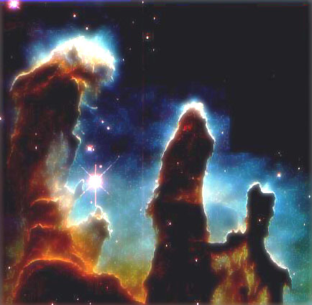
SPIKE [1]: Hubble Space Telescope, 1990+
Ground based observation scheduling
Uplinked ordered activity list for slewing, taking images etc. (New Program)
Constraint-based representation
Maximize science return!
Notes:
The HST is a low-earth-orbit telescope used for making astronomical observations. It’s images are at once awe inspiring and scientifically important. There is a lot of demand for observations using this instrument from scientists around the world, and lots of constraints on its use relating to time an position. SPIKE is a constraint-based observation scheduling system which considers the demands on HST, its constraints and flight rules, and derives a schedule to maximize science return. A schedule is translated into command sequences and uplinked for execution. In a sense this is an example of episodic automated, re-programming. Constraint-based scheduling has been used to great effect to solve this hard combinatorial problem and produce programs over and over which get the job done.

Slide 7
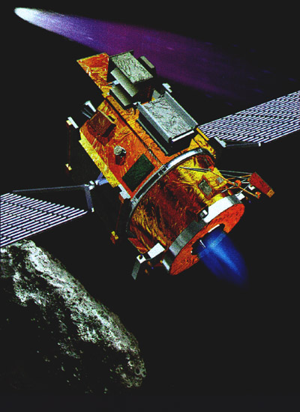
The Remote Agent Experiment [2] - 1999
On-board planning & scheduling
‘SMART’ executive could further refine plans and accommodate temporal flexibility
On-board Fault Detection, and Isolation
Replan for recovery
Constraint-based Temporal Planner (HSTS)
Robust, Adaptive Autonomous Control!
Notes:
The Remote Agent Experiment represented a landmark in AI and space exploration. It was the first demonstration of fully autonomous control of a spacecraft. It consisted of a Planning and Scheduling System (HSTS) for high-level task-plannning, a smart executive for low-level task refinement, execution and monitoring, and a model-based diagnostics engine (Livingstone) for fault detection and isolation. This system demonstrated the potential of these AI technologies to employ reusable components to accomplish overall control with much less manual development, focussed primarily on domain modeling and heuristics.

Slide 8
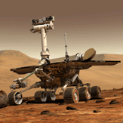
The Mars Exploration Rover [3] – 2004+
Ground-based daily activity planning
Uplink plan as a totally ordered command sequence
Mixed-initiative, constraint-based temporal planner (MAPGEN=APGEN & EUROPA)
Improved science return by finding better plans!
Notes:
The current Mars Exploration mission has 2 robots operating autonomously for each commanding cycle, to do geological exploration. These robots are delivering enormous value and flying the flag in my view for the crucial role of robots in exploration. Their on-board autonomy is very limited. Each commanding cycle, a totally ordered sequence of commands is uplinked and then executed. There is a very limited ability to adapt. This means, for example, that the common pattern of identifying a set of targets and taking samples and these locations can take many mission days. Nevertheless, the command sequence generation is derived in a mixed initiative fashion using a constraint-based reasoning system and a planner to derive high value plans without endangering the robots. Recently, the NASA Ames Research Center has demonstrated a contingent planner and executive capable of doing instrument placement in a single cycle. This effort also used EUROPA.

Slide 9
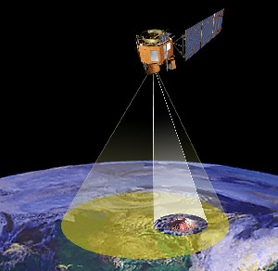
Autonomous Sciencecraft
Experiment on EO-1 [4] - 2004
On-board detection of science events of interest
On-board planning & plan repair (CASPER)
SCL Executive can refine plan and monitor execution, respond to events
Opportunisic Science!
Conserve bandwidth!
Notes:
The AI group at JPL have demonstrated an Autonomous Sciencecraft aboard EO-1. This experiment demonstrates both on-board planning and execution which can conduct opportunistic observations of detected phenomena as make trade-offs on what information to keep and transmit back to ground. The benefits of such a capability are amplified as NASA extends its reach incurring larger latencies and bandwidth restrictions.

Slide 10
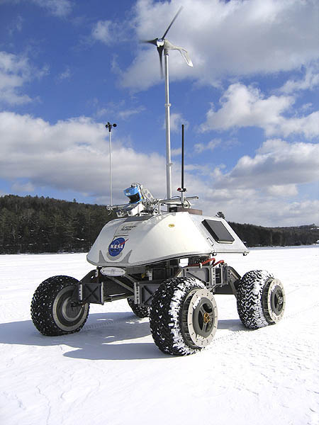
LORAX [5] – Pending
Scenario
100km, 30 day autonomous traverse
Microbial sample aquisition and analysis
Solar and wind-power only
High-degree of uncertainty
Extreme low temperatures
Relatively benign terrain
Autonomy
On-board planning & replanning interleaved with execution
Key resources of energy and internal temperature
One representation for planning & execution
Notes:
LORAX is a research mission in the works. The idea is to autonomously circumnavigate a glacier in Antarctic, periodically obtaining ice-core samples and scanning them for evidence of microbial life. If successful, it could lead to a mission to a Mars Polar Ice Cap. EUROPA is employed for high-level and low-level task planning and scheduling. The Executive also uses the same plan-based representation for tracking state and dispatching commands. They main points of interest here is the need for adaptive closed-loop control for instrument management, and the critical conservation of energy and thermal resources to avoid killing the robot.

Slide 11
OUTLINE
Vision: Pervasive Planning & Scheduling
Strategy: Plug-and-play Planning Technology
Theory: Constraint-based Temporal Planning
Practice: The EUROPA Architecture
Conclusion
Notes:
I hope that these examples give you a sense of the diversity of applications of planning and scheduling and the value this technology can provide in terms of increased safety, greater effectivenss, and reduced cost. This is the driving vision behind the development of EUROPA. When I came to NASA in 2002, the strategy had already been put in place in a general sense. This has guided the project subsequently.

Slide 12
Strategy: Plug-and-play planning technology
Recognition that constraint-based temporal planning (& scheduling) has broad applications and proven success in space exploration
Plethora of Systems: SPIKE[1], IxTet[6], ASPEN[7], EUROPA(1) [8], HSTS [9].
Similar but different
Hard to integrate and/or extend
Notes:
The basic strategy is quite simple. There seem to be lots of applications for planning and scheduling. We have evidence of the success of constraint-based planning and scheduling as the domininat paractical approach in NASA and more braodly in industry. Lots of distinct efforts have been made to do this and they share many common traits but have also some differences in how they chose to represent a domain, how they conduct search etc. Furthermore, none are easily extended and customized, as they have largely been developed as closed systems with many of the internal algorithms and data structures mandated weather they are necessary or sufficient. This is problematic for research pruposes where the goal is often to extend core capabilities. It is also problematic in mission deployment since one needs to integrate to external systems and specialized components in many different ways.

Slide 13
Strategy: Plug-and-play planning technology
Employ state of the art software engineering design methods
Build on powerful representational paradigm
Build on enormous legacy of work done in constraint-based scheduling
Allow large scale re-use of core algorithms and data structures.
Permit extensions as research evolves
Permit escape points to work around limitations!
Notes:
Hence, we embarked on EUROPA-2, a next generation planning and scheduling technology which:… see slide.

Slide 14
OUTLINE
Vision: Pervasive Planning & Scheduling
Strategy: Plug-and-play Planning Technology
Theory: Constraint-based Temporal Planning
Practice: The EUROPA Architecture
Conclusion
Notes:
That’s it for the high-level set-up part of the talk, Now we will briefly the main technical aspects of Constraint-based Temporal Planning that we leverage prior getting into the EUROPA system itself.

Slide 15
Constraint Satisfaction Problem
Variables:
speed ∈ [1 10]
distance ∈ [40 100]
time ∈ [0 +inf]
location1 ∈ [20 25]
location2 ∈ [80 200]
Constraints:
speed * distance == time
location1 + distance == location2
A Solution:
speed = 10, distance = 70, time = 700
location1 = 25, location2 = 95
Solution Techniques:
Heuristic Search
Propagation to prune infeasible values
In theory NP-Complete, in practice efficient
Inconsistent if the domain of any variable is empty
Notes:
The foundation of EUROPA is the notion of a CSP. This may be a familiar idea to many of you. A CSP is defined by a set of variables, each with a domain of values. And a set of constraints, which define relations among the variables that must be observed in any solution. Solution to a CSP is a value assigmnet for all variables such that all constraints are satisfied. In this example we see…..
Solving CSP’s is combinatorial, and NP-Complete in general. The common solution method is heuristics search. If any domain becomes empty, then no further refinement can lead to a solution and so the search will backtrack. The leverage you get from a CSP is in propagating constraints with each variable assigment (or before any variable assigment) to remove values that cannot be in the solution. For example, 0 cannot be in the solution.
Furthermore, a CSP also has an elegant and intuitive encoding mechanism as many problems are naturally conceptualized in terms of constraints.
A DCSP is a CSP where values and variables can be added and removed from the problem. We will see how EUROPA casts planning as a DCSP.

Slide 16
Simple Temporal Networks [10]
STN
X =[10 20]
[30 38]
Y=[30 100]
CONVERSION: Y-X ∈ [30 38] ⬄ Y-X <= 38 ^ X-Y <= -30
Distance
Graph
38
X=[10 20]
Y=[30 100]
-30
20
-10
100
-30
Origin={0}
Upper Bound on Path Length: 20 + 38 -30 = 20
Notes:
While still in the vein of Constraint-Satisfaction, we now look at a very useful mechanism for maintaining global consistency for a set of timepoints and temporal variables. Dechter, Meiri and Pearl converted a Simple Temporal Network (i.e. a network of timepoints and temporal constraints without disjunctions) into a distanc graph and then demonstrated how shortest path algoruthms could be used to propagate bounds and detect inconsistency in polynomial time. The translation is shown here where…..
Note in this example that the cycle from the origin through X and Y has an upperbound of 20, which simply states that any path length <= 20 is possible, including a path length of 0.

Slide 17
Simple Temporal Networks [10]
Distance Graph
38
X=[10 20]
Y=[30 100]
-30
20
-10
100
-30
Origin={0}
If a negative cycle is found in the distance graph, then inconsistent [10]
Single Source Shortest Path sufficient to detect a negative cycle - O(n.e). Incremental algorithms do much better in practive e.g. Adapative Bellman-Ford [11].
SSSP sufficient for backtrack-free search!
All Pairs Shortest Path – Floyd Warshalls algorithm O(n³)
Notes:
A negative cycle is a path of length less than 0. Intuitively this implies that there must be a non-zero distance in time between you and yourself, where you are a timepoint. This cannot be, and thus the network is concluded to be inconsistent.
The really useful part is that SSSP is sufficent to detect a cycle and very efficient. It is also complete (all values in all domains have a solution). As it goes it will propagate the variable values to provide a backtrack free search.

Slide 18
Constraint-based Planning [8]
Plan Representation (DCSP, STN)
Engine
thrusting
off
D12
Camera
off
ready
takePic
Ast
Attitude
pointAt
turnTo
pointAt
D12
Ast
Ast
Intervals have Start, End and Duration
Parameterized Predicates describe actions and states
Token = Interval + Parameterized Predicates
Constraints defined between variables i.e. start, end, duration, predicate parameters
Causal links defined between tokens
Timelines induce ordering constraints among tokens
Notes:
Having established the underlying computational model of CSP, DCSP & STN, we can now look at building upon it a plan representation framework….

Slide 19
Constraint-based Temporal Planning
Modeling (NDDL)
class Camera extends Timeline {
predicate off{}
predicate ready {}
predicate takePic {Position target;}
}
…
/** Required causal links and constraints **/
Camera::takePic{
containedBy(Engine.off); // link 1, c0, c1
meets(ready); // link 2, c2, c3
met_by(ready); // link 3, c4, c5
contains(Attitude.pointAt p); // link 4, c6, c7
eq(p.position, target); // c8
}
Notes:
Given such a framework, here is how you might express such elements to model a problem domain. Note the introduction of types of objects in the world through class declaration. A Timeline is a kind of element that indcues a total order on its tokens. We also see introduction of predicates with and without paramters. Finally, a domain rule expresses the relationships permitted between this token, and its variables, and other tokens and variables. Note the implication of constraints and causal links in an inderyling DCSP as this rule is executed.
Note that in contrast to STRIPS style planning which separate actions and states, preconditions and effects, we simply deal in relationships among temporally scoped predicates and their variables. This permits tremendous flexibility and richness in what you can specify in a domain model e.g. remote effects, durative actions, concurrent or contained consequences.

Slide 20
Constraint-based Temporal Planning
Problem Definition (NDDL)
// Add objects into a partial plan – main system components
Camera camera1 = new Camera();
Attitude attitude = new Attitude();
Engine engine = new Engine();
// Allocate positions of interest
Position p1 = new Position(…);
…
// Close the world – no more objects
close();
// Add tokens for initial states
missionStart = 0;
missionEnd = 50000;
Goal(engine.off g0);
g0.start.specify(missionStart);
Goal(camera.off g1);
Goal(camera.takePic g2);
g1 before g2;
precedes(g2.end, missionEnd);
Notes:
Note that a problem is not defined in specific terms of initial state and goal state. Rather, we are constructing a partial plan. A specific problem requires instances of objects and tokens, which must then be solved such that all domain axioms (rules) are satisfied. Once again we sue NDDL to instatiate objects, tokens and additional constraints on the initial partial plan.

Slide 21
Constraint-based Temporal Planning
Problem Resolution: Flaws & Decisions
Unbound Variables
  Resolved by specifying values
Open Conditions
  Arise due to inactive tokens
  Resolved through insertion, unification or rejection.
Threats
  Arise due to possible contention for a resource (e.g. possible overlap on shared timeline)
  Resolved by imposing ordering constraints
Notes:
The next step is to understand how one goeas from an initial partial plan to a final partial plan. This process is driven by identification and resolution of flaws in the partial plan. A flaw is something that indicates and additional commitment is required in order to consider the plan complete. As a CSP, the maximal completeness is when all variables are bound. However, we are actually more concerned with least commitment planning, where the concept is to plan to the necessary level of detail and no further. The basic types of flaws and methods of resolution in our planning paradigm are:….

Slide 22
Constraint-based Temporal Planning
Problem Resolution: Refinement Search
SOLVE(partial_plan){
flaw = CHOOSE_FLAW(partial_plan);
decisions = {};
while(flaw != NULL){
decision = MAKE_NODE(flaw);
if(RESOLVE(decision)){ // Decisions tried here
decisions.push(decision);
flaw = CHOOSE_FLAW(partial_plan);
}
else if(decisions.empty())
return FAILED;
else // Backtrack to previous decision
decision = decisions.pop();
}
return SUCCEDED;
}
Notes:
What we now want is an algorithm to solve our planning problem. I use the term solve, instead of plan, since in general a partial play may not require task selection decisions (i.e. planning operators) to be solved. This algorithm is a simple chronological backtracking refinement search that finds and fixes flaws.
If no flaws are found then you are done. If there are flaws, but there is now way to resolve them you have failed. Otherwise, you keep working the problem.
The key methods in this algorithm template relate to finding and resolving flaws. These methods involve heuristic selection, but also imply a relationship to completeness. One could force all possible flaws to be resolved (fully grounded plan) but that is rarely desireable. One could force all possible resolution options to be tried, and that is often, though not necessarily desireable.

Slide 23
Constraint-based Temporal Planning
Problem Resolution: Example
enum Location {Hill, Rock, Lander, MartianCity};
class Rover {
predicate At{Location location;}
predicate Going{Location from, to;}
}
Rover::At{
met_by(Going predecessor);
eq(predecessor.to, location);
meets(Going successor);
eq(successor.from, location);
}
Rover::Going{
met_by(At predecessor);
eq(predecessor.location, from);
meets(At successor);
eq(successor.location, to);
noy_equal(from, to);
}
Notes:
Here is an example of how the algorithm might work. The above example is..

Slide 24
Constraint-based Temporal Planning
Refinement Search: Example
Going
At
?
Rock
Rock
Going
Rock
?
Going
Going
?
Lander
Lander
?
Rover:
spirit
At
Lander
Rover:
opportunity
At
MartianCity
Going
MartianCity
?
Going
?
Martian City
Notes:
Consider this as the initial partial plan. Note that we have 2 rovers to work with – spirit and opportunity. Note that initially we have constrained the rovers to be at the lander and martian city. The partial plan also includes a token that has not been assigned to a robot yet. Each of these position tokens are considered master tokens, and become the roots of subsequent causal links to inactive tokens generated by applying the domain axioms expressed in the model.

Slide 25
Constraint-based Temporal Planning
Refinement Search: Example
Going
At
?
Rock
Rock
At
Going
Lander
Rock
?
Going
Going
?
Lander
Lander
?
Rover:
spirit
At
Lander
Rover:
opportunity
At
MartianCity
Going
MartianCity
?
Going
Token Activation
?
Martian City
Notes:
We pick the Going token generated on ‘spirit’. A decision is made to activate it, since there are not other Going Tokens already in the plan (active) that can be unified with it. Activation triggers model rules which infer new open conditions. Note that I have ommitted the successor At token for brevity.

Slide 26
Constraint-based Temporal Planning
Refinement Search: Example
Going
At
?
Rock
Rock
At
Going
Lander
Rock
?
Going
?
Lander
Rover:
spirit
At
Going
Lander
Lander
?
Rover:
opportunity
At
MartianCity
Going
MartianCity
?
Going
Resource Assigment
?
Martian City
Notes:
Next we assign the token to spirit and order it with respect to it’s parent.

Slide 27
Constraint-based Temporal Planning
Refinement Search: Example
Going
At
?
Rock
Rock
Going
Rock
?
Going
?
Lander
Rover:
spirit
At
Going
Lander
Lander
?
Rover:
opportunity
At
MartianCity
Going
MartianCity
?
Going
Token Merging
?
Martian City
Notes:
Now the At Token that was open is unified with the predecessor of Going.

Slide 28
Constraint-based Temporal Planning
Refinement Search: Example
Going
?
Rock
Going
Rock
?
Going
?
Lander
Rover:
spirit
At
Going
At
Lander
Lander
?
Rock
Rover:
opportunity
At
MartianCity
Going
MartianCity
?
Going
Resource Assigment
?
Martian City
Notes:
Similarly we place the as yet unscheduled At token for the rock.

Slide 29
Constraint-based Temporal Planning
Refinement Search: Example
Planning problem is complete.
Result is a new Partial Plan.
WHY NO MORE FLAWS [12] ?
Going
Rock
?
Going
?
Lander
Rover:
spirit
At
Going
At
Lander
Lander
Rock
Rock
Rover:
opportunity
At
MartianCity
Going
MartianCity
?
Going
Token Merging
?
Martian City
Notes:
Finally we merge its predecessor, thereby restricting the to paramter of Going and migrating the equality constraint between the end-points.
Now, in this example I declare that we are done. However, as you can see there remain open conditions and unbound variables. The primary reason is that a temporal horizon is used to filter out open conditions and their related unbound variables. This is not transparent, but the initial At tokens end times were not constrained to be within the horizon.

Slide 30
Constraint-based Temporal Planning
Metric Resources [13]
SPECIFIED PROPERTY VALUES
Initial Capacity (r) = 8
Level Limit(r, H_{s}, H_{e}) = [5, 10]
T1
+5.4
T3
T4
-8
-2
T5
T6
T7
T2
+2
+2
-1
+3.6
H_{S}
t₀
t₁
t₂
t₃
t₄
t₅
t₆
t₇
t₈
H_{e}
20
FLAWS ?
16.4
Level (t₆) _{max}
12
Level
10
Level Limit_{max}
8
VIOLATION ?
Level Limit_{min}
5
3
BENIGN ?
Level (t₃) _{min}
0
H_{S}
t₀
t₁
t₂
t₃
t₄
t₅
t₆
t₇
t₈
H_{e}
Notes:
We have already seen an example of a Timeline inducing constraints in Tokens. Similarly, if tokens are placed on metric resources, ordering constraints may be induced to ensure limits are observed by the resource. In the above example. Events representing production or consumtion on the resource are defined in terms of a quantity and time. Each can be flexible. A resource has limits and an initial capacity. Different orderings interleave producers and consumers in different ways. This picture indicates and envelope of values on the level over time for all possible orderings. In a scheduling problem, where all producers and consumers are known, one can interpret the profile to infer flaws and violations. There are many different algorithms for computing tight envolopes, thus giving strong propagation during search. Incorporation of these algorithms and the data obtained by resources into heuristics is an active area of research and opportunity for imporvement.

Slide 31
Constraint-based Temporal Planning
RECAP
CSP & DCSP handles pruning & detection of inconsistencies
STN provides efficient propagation of temporal constraints
Planning paradigm based on temporally qualified assertions (tokens) is mapped to a DCSP
Planning paradigm provides for sound reasoning and refinement search to completion [8]
Resources fit neatly into the paradigm and global constraint propagation for those can be integrated
Completeness in the eye of the beholder – Managed Commitment Planning
Notes:
This concludes our background section on the underpinnings o fthe EUROPA system. The main points to bear in mind are…

Slide 32
OUTLINE
Vision: Pervasive Planning & Scheduling
Strategy: Plug-and-play Planning Technology
Theory: Constraint-based Temporal Planning
Practice: The EUROPA Architecture
Conclusion
Notes:
Now we turn to the product itself. This is probably of interest mostly to anyone who might care to apply EUROPA, and is concerned at how it can fit into their application.

Slide 33
Batch Planner
Client
Configuration
CbSolver
Server
Configuration
Plan Database
Domain
Model
Initial Partial
Plan
Final Partial
Plan
Notes:
First, start with a simple scenario where EUROPA can be used with its own solver, and addressed at a particular planning problem. The search control framework, and underlying plan database components are all configurable. A Modeling language is provided to express your domain. Custom components can be plugged into the system and refereced in a natural way in the modeling language. A Plan Database stores a Partial Plan, and supports operations on a Partial Plan. It integrates all the capabilities for infererence and propagation.

Slide 34
Mission Simulator Prototype
Agent = Search-based Problem Solver
Scope: What
Priority: When
Choice Selection: How
Model
Mission Profile
System Design
Parameters
Simulator
Problem
Generator
Weather Model
Executive
Environmental
Monitor
Planner
Terrain Model
Execution
Trace
Plan DB
Notes:
A variation on the them uses EUROPA with mutiple different solvers, all working on the same plan database (and thus partial plan) to build a simulator. Each agent is a particular solver configuration addressing the scope of what flaws it is responsible for, the priority of search, and the choices to take. The simulator is intended to reflect an onboard planing and execution system. The planner looks at long range higher level decisions, the Environment Monitor only binds values based on the immediate tempral context of the execution clock. In some cases it picks values randomly within bounds expected in execution. In others it uses sensor data gleaned from site inspections to provide realistics data. The executive is yet another solver that binds or defers timepoints to dispatch commands. The simulator interleaves runs of each as the mission clock is advanced.

Slide 35
EUROPA Architecture
Framework & Components
Timeline
Object
Resource
IntervalToken
Schema
PlanDatabase
Token
EventToken
Flaw
Management
Resource
Transaction
Rules
Engine
Propagator
Constraint
Engine
Constrained
Variable
Specialized
Variables
Default
Propagator
Constraint
Domain
Listener
Eq. Class
Propagator
Resource
Propagator
AddEqual
AbstractDomain
Specialized
Domains
STN
Propagator
calcPower
Notes:
Here we see the main elements of the EUROPA Framework. This part addresses the back-end, or database. The red indicates core APIs and interactions. The yellow shows customization points. For example, …..
The above makes it very easy to plug-in specialized constraints – global or local. It also makes it easy to disconnect components you don’t want or need. Don’t like the langauge, don’t need it. Don’t want to use Resources, don’t use them. Need specialized Variable types, add them in. Only want to do constraint propagation, discard the rest. It can also permit us to easily swap out functionally equivalent components to compare behaviours. This is important for evaluation of research for example and coul dpermit direct comparison across methods.

Slide 36
EUROPA
Rich Representation + Pragmatic Integration
class FuelCell extends Resource {
FuelCell(int arg1, float arg2, …){
…
}
}
Rover::drive {
Path p : { eq(p.from, from); eq(p.to, to);}
Instruments instruments;
forall (i in instruments) {containedBy(i.stowed);}
starts(FuelCell.change tx);
customEnergyConstraint (
tx.quantity,
thermalDissipation,
speed,
terrainType);
}
Notes:
To emphasize further the powerful technology brew assembled, consider this model fragment. We see an example of existential quanitifcation by construction of a variable as a filter according to certain constraints. This variable cannot be empty. Nor does it necessarily have to be grounded.

Slide 37
EUROPA
Rich Representation + Pragmatic Integration
class FuelCell extends Resource {
FuelCell(int arg1, float arg2, …){
…
}
}
Rover::drive {
Path p : { eq(p.from, from); eq(p.to, to);}
Instruments instruments;
forall (i in instruments) {containedBy(i.stowed);}
starts(FuelCell.change tx);
customEnergyConstraint (
tx.quantity,
thermalDissipation,
speed,
terrainType);
}
Notes:
Next we observe an example of universal quanitifcation where we subgoal over all values of a variable.

Slide 38
EUROPA
Rich Representation + Pragmatic Integration
class FuelCell extends Resource {
FuelCell(int arg1, float arg2, …){
…
}
}
Rover::drive {
Path p : { eq(p.from, from); eq(p.to, to);}
Instruments instruments;
forall (i in instruments) {containedBy(i.stowed);}
starts(FuelCell.change tx);
customEnergyConstraint (
tx.quantity,
thermalDissipation,
speed,
terrainType);
}
Notes:
Next we see how specialized resources can be introduced into the model and used within the same paradigm of Objects and Tokens. On metric resources, the Token is an event. The FuelCell can be a custom object in C++ that inetgrates specialized algorithms to derive profiles. It can also require and support specialized tokens to allow extendible set of variables to be passed in.

Slide 39
EUROPA
Rich Representation + Pragmatic Integration
class FuelCell extends Resource {
FuelCell(int arg1, float arg2, …){
…
}
}
Rover::drive {
Path p : { eq(p.from, from); eq(p.to, to);}
Instruments instruments;
forall (i in instruments) {containedBy(i.stowed);}
starts(FuelCell.change tx);
customEnergyConstraint (
tx.quantity,
thermalDissipation,
speed,
terrainType);
}
Notes:
Finally, we introduce a procedural constraint, which is related to an externally defined relation, implemented and integarted as C++ code. This reflects the limits of our ability to define a completely general purpose mdoeling language which is semantcially rich enough to capture everything explcitly. But it does provide us enormouse leverage to manage how and when we bridge that gap.

Slide 40
CONCLUSION
Vision: Pervasive Planning & Scheduling
Strategy: Plug-and-play Planning Technology
Theory: Constraint-based Temporal Planning
Practice: The EUROPA Architecture
Notes:
In conclusion, we have motivated the development of EUROPA by considering the consequences of NASA’s vision, and the lessons learned in practice. We have briefly described the response initiated from Ames. We have described the theory behind the technology and the practical realities of building a re-usable and extendible system, which is basically still in ints infancy.

Slide 41
Situated Component
Embedded Plan Database
Environment
Sensors
Effectors
Control Program
Plan Database
SOME TECHNICAL BARRIERS TO ADOPTION
SPEED – TIMELINESS - TRANSPARENCY
Notes:
I will conclude by recalling the Situated Component. The idea of using planning and scheduling to maximal effect is one which sees embedded plans and planners used widely to derive control progarms at less cost and risk, and to greater effect. There are many challenges to accomplishiong this. They include improvements in the performance of the plan database and the solvers that use it, incorporating better mechanisms for making guarantess as to the timeliness of such algorithms, given that in general the search is combinatorial!. It also includes a very deep problem that addresses AI in general, and our ability to fields such systems in particular. That is the need for transparency into why the agent did that, or failed to do the other. This is an issue for both on-board fully automated systems, and also mixed-initiave off-baord systems that have to build trust with their human operators.

Slide 42
Acknowledgements & Credits
Nicola Muscettola – Initiator (HSTS & DS1)
Ari Jonsson – EUROPA 1 PI & Collaborator
Jeremy Frank – User, Contributor, Advocate
Paul Morris – Temporal Reasoning Expert (STN)
Tania Bedrax-Weiss – Collaborator on E2
Sailesh Ramakrishnan – User, Critic, Contributor
Andrew Bachmann – NDDL Designer
Other Developers – Michael Iatauro, Will Edgington, Will Taylor, Patrick Daley
IS & CDS – Funding Sources

Slide 43
REFERENCES
Zimmerman Foor, L., Asson, D. “Spike: A Dynamic Interactive Component In a Human-Computer Long-range Planning System", Third International Workshop on Planning and Scheduling for Space, 2002.
N. Muscettola, P. Nayak, B. Pell, B. Williams “Remote Agent: To Boldly Go Where No AI System Has Gone Before” in Artificial Intelligence, 103(1/2), August 1998.
M. Ai-Chang, J. Bresina, L. Charest, J. Hsu, A. K. J'onsson, B. Kanefsky, P. Maldague, P. Morris, K. Rajan, J. Yglesias. “MAPGEN: Mixed-initiative activity planning for the Mars Exploration Rover mission”
D. Tran, S. Chien, R. Sherwood, R. Castaño, B. Cichy, A. Davies, G. Rabideau. “The Autonomous Sciencecraft Experiment Onboard the EO-1 Spacecraft”. AAAI 2004: 1040-1041
B. Spice. “A wandering robot tests for a new mission to Antarctica”. Pitsburgh Post-Gazette, 3/21/05
M. Ghallab, H. Laruelle: Representation and Control in IxTeT, a Temporal Planner. AIPS 1994: 61-67.
G. Rabideau, R. Knight, S. Chien, A. Fukunaga, A. Govindjee, "Iterative Repair Planning for Spacecraft Operations in the ASPEN System," International Symposium on Artificial Intelligence Robotics and Automation in Space (ISAIRAS), Noordwijk, The Netherlands, June 1999.

Slide 44
REFERENCES
J. Frank and A. Jonsson. Constraint-Based Interval and Attribute Planning. Journal of Constraints Special Issue on Constraints and Planning. October, 2003. Volume 8. Number 4.
N. Muscettola. HSTS: Integrating planning and scheduling. In Mark Fox and Monte Zweben, editors, Intelligent Scheduling. Morgan Kaufmann, 1994
Dechter, R.; Meiri, I.; and Pearl, J. Temporal Constraint Networks. Artificial Intelligence 49(1): 61--95, 1991. 13
Nitin Chandrachoodan, Shuvra S. Bhattacharyya, K. J. Ray Liu. Adaptive Negative Cycle Detection in Dynamic Graphs. Proceedings of International Symposium on Circuits and Systems (ISCAS 2001)
T. Bedrax-Weiss, J. Frank, A. Jonsson, C. McGann. Identifying Executable Plans. Workshop on Plan Execution, in conjunction with International Conference on Automated Planning and Scheduling, 2003.
T. Bedrax-Weiss, C. McGann, S. Ramakrishnan. Formalizing Resources for Planning. Workshop on PDDL in conjunction with International Conference on Automated Planning and Scheduling, 2003.

