Slide 1
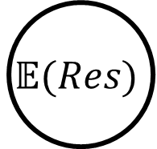
Prevention
Recovery
Nominal Scenario
$$\text{𝔼}(Res)$$
Nominal Performance
Hazard
Expected
Resilience:
Resilience over a set of hazardous scenarios
Recovery
Resilience
No Recovery
Faulty Performance
Fault Time
Yodo, N., & Wang, P. (2016).

Slide 2
Resilience means taking a dynamic understanding of risk/safety
Considering resilience is important when our system has dynamic attributes, e.g.:
The system state changes over time
(e.g., position, velocity, etc)
We can control this state
(e.g., operators, autopilot)
Because we can use it to determine how to control the system to a safe outcome in unsafe circumstances and what design/operational features we need to enable this control
Risk Outcomes
Safe Disruptions
Robustness Safety Threshold
Unsafe Disruptions
Recovery Time Safety Threshold

Slide 3
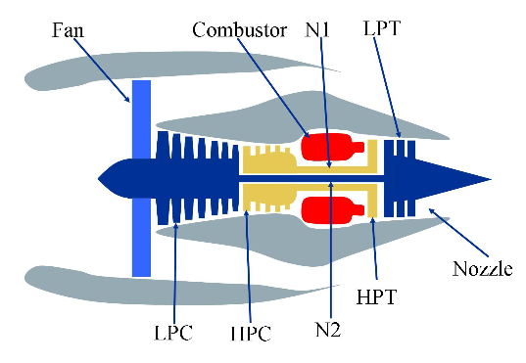
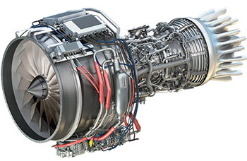
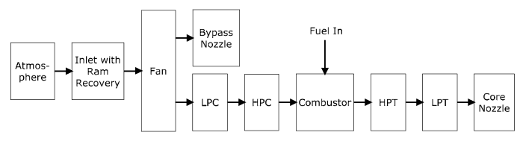
Idea: the system should be resilient-by-design
Concept Design
Embodiment Design
Implementation
Reactive
Design
Choose concept
Design system
Retrofit for resilience
?
?
?
?
Proactive
Design
Establish resilience approach
Integrate resilient features in design
Verify resilient function
?
?
✔
✔
S3
?
?
?
✔
S2
✔
S1
Image 1 & 2 Credit: User’s Guide for the Commercial Modular Aero-Propulsion System Simulation (C-MAPSS)
Image 3 Credit: https://en.wikipedia.org/wiki/File:General_Electric_Passport.jpg

Slide 4
System Model File: model.py
State Classes
Flow Classes
Function Classes
Mode Classes
Model Classes
Parameter Classes
etc…
Analysis Script: Script.py or Notebook.ipynb
Model instantiation (e.g. mdl = Model())
Simulation
result, history = propagate.one_fault(mdl, fault, t) …
Results processing and visualization
ModelGraph(mdl).draw()
plot.hist(history)
etc…
System
Model, FxnBlock, Flow, State…
SampleApproach, one_fault(), etc…
hist(), ModelGraph,
fmea(), etc…
Definition Packages
/define/block.py,
/define/state.py
/define/flow.py
/define/model.py
/define/mode.py, …
Simulation Modules
/sim/propagate.py
/sim/approach.py
/sim/search.py
Analysis Modules
/analyze/plot.py
/analyze/graph.py
/analyze/tabulate.py

Slide 5
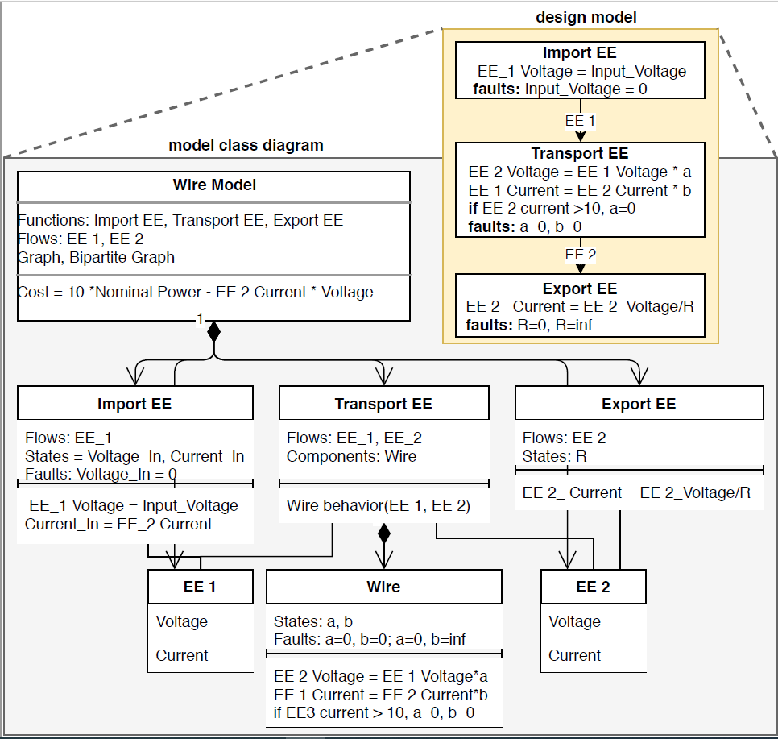
Model: Agglomeration of Functions, Flows, and Hazard Metrics
Function: Defines high-level system behaviors as well as failure modes and component architectures
Flow: Data Structures (inputs/outputs) that connect Functions
State: Entries that define Function/Flow state
Component: Sub-behavior internal to a Function with its own behaviors and properties, etc

Slide 6
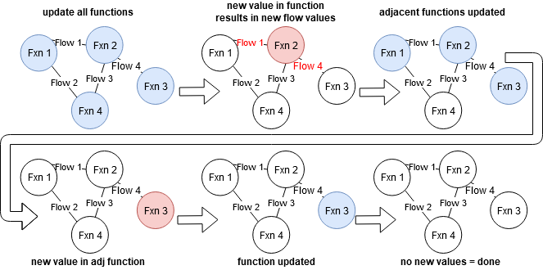
Static Fault Propagation
Behaviors defined in .behavior(), .static_behavior(), and .condfaults()
Stored in mdl.staticfxns

Slide 7
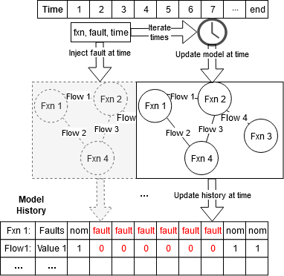
Dynamic Fault Propagation
Defined in .dynamic_behavior()
Runs once per timestep in a user-specified order.
Accessible in mdl.dynamicfxns
--------
Static/Dynamic propagation can be visualized using rd.graph.exec_order()

Slide 8
Activity: Open and instantiate pump model
Review code:
See pump code defining the Pump model class
See pump code defining MoveWater function class
Open tutorial notebook
Tutorial_unfilled.ipynb
Instantiate the model
mdl = Pump()
Explore
Try different parameters! Change things!
What does the model directory look like? dir(mdl)

Slide 9
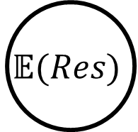
Goal: Quantify Resilience With Simulation
Prevention
Recovery
Nominal Scenario
$$\text{𝔼}(Res)$$
Nominal Performance
Hazard
Expected
Resilience:
Resilience over a set of hazardous scenarios
Recovery
Resilience
No Recovery
Faulty Performance
Fault Time
Yodo, N., & Wang, P. (2016).

Slide 10
Simulation—things to consider
What are we trying to model:
The nominal performance of a system?
The performance of a system over a set of operational paremeters
The performance in a fault scenario?
The performance over a set of fault scenarios?
What kind of set?

Slide 11
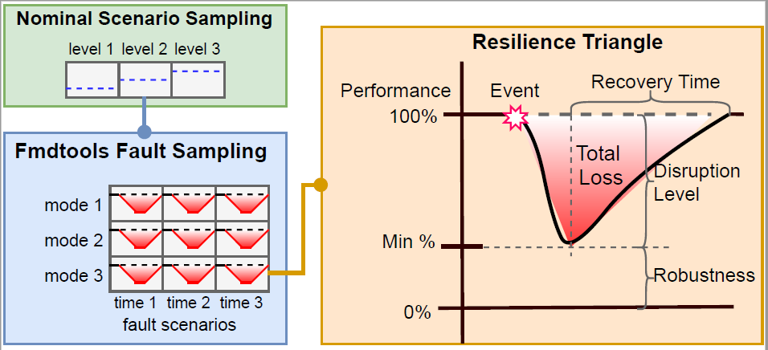
Simulation types
Nominal performance
Performance over a set of possible operational parameters
Resilience to a single fault or hazard
Resilience over a set of fault modes
Resilience to a set of fault modes over a set of operational parameters

Slide 12
Fault propagation aspects
Static/Dynamic propagation: How function states propagate to each other in a single time-step and multiple time-steps
Undirected graph representation—states can effect all other connected states, and vice versa, in any order
Stochastic Propagation: Whether and how stochastic states are instantiated over time
e.g. do we run with the “default” values of parameters, or do we sample from a random number generator?
Breadth of Scenarios: How hazards are represented as discrete scenarios to simulate
What set of joint faults do we use? How many times are sampled?
Operational scenarios and Joint operational/fault scenarios

Slide 13
Behavioral Simulation Methods
propagate.nominal(mdl)
Simulates system once with no fault—good for model setup
propagate.one_fault(mdl, function, fault, time=faulttime), .propagate.mult_fault(mdl, faultseq, disturbances)
Simulates system once with and without a fault
Good for verifying/visualizing model behavior under a given fault
propagate.single_faults(mdl)
Simulates the list of single fault modes
Only use for static (single time-step) models & to gauge fault severity
propagate.approach(mdl, app)
Simulates a set of fault modes over a set of times
Useful for expected resilience quantification
app defined in SampleApproach class
propagate.nominal_approach(mdl, nomapp), propagate.nested_approach(mdl,nomapp, **app_args)
Used for sampling the model over a range of parameters defined in a NominalApproach in nominal (nominal_approach) and faulty (nested_approach) scenarios.

Slide 14
Simulation types
Nominal performance
propagate.nominal()
Performance over a set of possible operational parameters
propagate.
nominal_approach()
Resilience to a single fault or hazard
propagate.one_fault()
propagate.mult_fault()
Resilience over a set of fault modes
propagate.approach()
Resilience to a set of fault modes over a set of operational parameters
propagate.nested_approach()

Slide 15
Definition of a fault sampling approach
app = SampleApproach(mdl,
faults = ‘all’/[list of faults]
phases = ‘all’/{fxn:phase:[s,e]}
modephases = {fxn:mode:{phases}}
jointfaults = {‘faults’:#,
‘jointfuncs’:True/False
‘pcond’: 0.##}
defaultsamp: = {‘samp’: ‘quad’/’fullint’/’evenspacing’…
‘numpts’: #
‘quad’: quadrature}
sampparams = {(fault, mode): sampparam}
(faults to include in the list)
(phases of each function to include (if model has phases))
(how function modes correlate to phases)
(Number of joint-fault modes to simulate (e.g. None, 2,3,..))
(Whether function modes are mutually exclusive)
(Conditional probability for joint faults (ind. by default))
(how to represent phases)
(Number of samples to take in each phase)
(If a quadrature is used, the quadpy object)
(If a different approach is to be used for each fault, sampparam follows the defaultsamp structure)

Slide 16
Definition of a nominal sampling approach
nomapp = NominalApproach()
nomapp.add_seed_replicates(raingeid, seeds)
nomapp.add_param_replicates(paramfunc, rangeid, replicates)
nomapp.add_param_ranges(paramfunc, rangeid, *args, **kwargs
nomapp.add_rand_params(paramfunc, rangid, *fixedargs, **randvars)
Instantiate approach
Construct approach as a set of random seeds to instantiate in the model
Construct approach as the output of parameters in a function over x replicates
Construct approach as the output of a parameter function a range of arguments *args, and **kwargs
which may either be fixed or varied as a tuple defining the range (start, end, step)
Construct approach as the output of a parameter function a range fixed arguments *fixedargs
and stochastic variables generated in **kwargs as (randfunc, funcparam1, funcparam2)

Slide 17
Activity: Propagate faults in the model
Run fault propagation methods:
Nominal
Fault(s)
Approach
What do the results look like?
endresults, resultshist, etc
Explore:
What happens when you change SampleApproach parameters?
What happens when you change model parameters?
How do these methods compare in terms of computational time?

Slide 18
Visualization, Quantification, Processing
Looking at a model
Looking at modelled quantities
Quantifying resilience
Saving/exporting results, etc

Slide 19



/resultdisp
process.py
Processing of simulation results into metrics/statistics
-hists(mdlhists)/hist(mdlhist): processes result history for fmea/visualization
-heatmaps(reshist), etc: creates heatmap of respective quantities over time/runs
-totalcost(endclasses): calculates total expected cost
-end/overall_diff(endclasses):
Difference between nominal and faulty scenarios
-percent/average/rate/…
Various statistics for endclasses
plot.py
Behavioral/Statistical Plotting
-mdlhists(mdlhist):
Plots behavior of given states over time in a set of scenarios
-metric_dist()/_from():
Histograms of modelled metrics
-samplecost(app, endclasses):
Cost and rates of a set of faults
-costovertime(endclasses,app):
Cost of fault modes over time
-phases(mdlphases)
Function modes over time.
-nominal_vals_1d/2d/3d():
Simulation metric(s) in terms of input parameters
-nom/res_factor_comparison()
Comparison of simulation statistics over given factors
graph.py
Visualization of simulation results on the model graph
-set_pos(graph):
Manually positions of functions/flows in graph
-show(mdl/graph):
Show graph at end-state
-exec_order(mdl/graph)
Show dynamic/static order
-history(graphhist):
Shows set of graphs over history
-result(s)_from(mdl, reshist, t)
Shows model state at a particular time(s)
-animation_from(mdl, reshist,t)
Animates model states over given times
tabulate.py
Display and export of simulation results as tables
-hist(mdlhist): Gives table of the history of model states.
-deghist(mdlhist, withstats): Gives table of all degraded functions and flows over time
-heatmaps(heatmap): Displays heatmap dictionary
-simple/phase/sum/fullfmea():
FMEA-like assessment with faults, probabilities, and costs.
-nominal/nested_stats():
Table of simulation statistics
-nom/res_factor_comparison()
Table of simulation statistics over given factors
plot.py
Behavioral/Statistical Plotting
-mdlhists(mdlhist):
Plots behavior of given states over time in a set of scenarios
-samplecost(app, endclasses):
Cost and rates of a set of faults
-costovertime(endclasses,app):
Cost of fault modes over time
-phases(mdlphases)
Function modes over time.
-nominal_vals_1d/2d/3d():
Simulation metric(s) in terms of input parameters
-nom/res_factor_comparison()
Comparison of simulation statistics over given factors
Netgraph

Slide 20
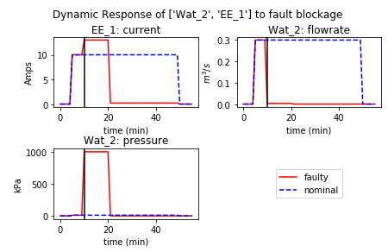
plot.py
plot.py
Behavioral/Statistical Plotting
-mdlhists(mdlhist):
Plots behavior of given states over time in a set of scenarios
-metric_dist()/_from():
Histograms of modelled metrics
-samplecost(app, endclasses):
Cost and rates of a set of faults
-costovertime(endclasses,app):
Cost of fault modes over time
-phases(mdlphases)
Function modes over time.
-nominal_vals_1d/2d/3d():
Simulation metric(s) in terms of input parameters
-nom/res_factor_comparison()
Comparison of simulation statistics over given factors
Example Syntax:
fig, ax = rd.plot.mdlhists(mdlhist, title=“Response to faultname”,
time_slice=faulttime,
fxnflowvals={‘Flow1':[‘val1', ‘val2'],’flow2’:’val1’},
cols=2, timelabel="time (min)")

Slide 21
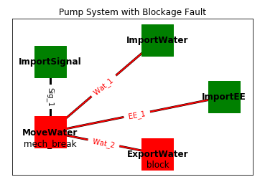
graph.py
plot.py
Behavioral/Statistical Plotting
-mdlhist/s/vals(mdlhist):
Plots behavior of given states over time in a set of scenarios
-samplemetric(app, endclasses):
Metric and rates of a set of faults
-metricovertime(endclasses,app):
Metric of fault modes over time
-phases(mdlphases)
Function modes over time.
-nominal_vals_1d/2d/3d():
Simulation metric(s) in terms of input parameters
-nom/res_factor_comparison()
Comparison of simulation statistics over given factors
Example Syntaxes:
fig, ax = rd.graph.show(mdl.graph)
fig, ax = rd.graph.show(resgraph)
fig, ax = rd.graph.result_from(mdl, reshist, time,
gtype = ‘normal’/'bipartite’,
scale=2, pos=pos)

Slide 22
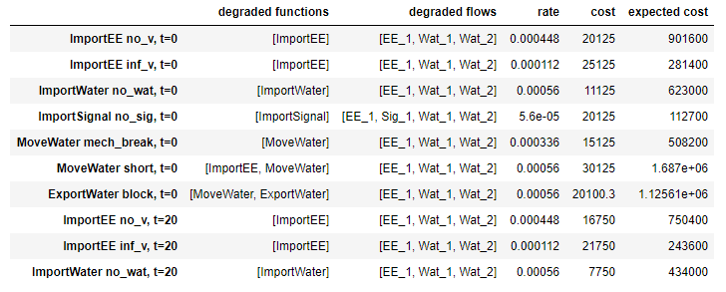
tabulate.py
tabulate.py
Display and export of simulation results as tables
-hist(mdlhist): Gives table of the history of model states.
-deghist(mdlhist, withstats): Gives table of all degraded functions and flows over time
-heatmaps(heatmap): Displays heatmap dictionary
-fmea():
FMEA-like assessment with faults, probabilities, and costs.
-nominal/nested_stats():
Table of simulation statistics
-nom/res_factor_comparison()
Table of simulation statistics over given factors
Example Syntaxes:
reshists, diffs, summaries = rd.process.hists(mdlhists)
fullfmea = rd.tabulate.fullfmea(endclasses, summaries)
phasefmea = rd.tabulate.phasefmea(endclasses, app)

Slide 23
Activity: Visualize the results
Visualize the results
Show model graph
Show nominal performances
Show performances in a nominal scenario
Make a scenario-based fmea
Explore
How can you show only the parameters you want? Or change the formatting?
What does the behavior under other faults look like?
What other analyses can you perform with these results?

Slide 24
Further Reading
Modelling/Simulation Basics
Scenario Sampling
Advanced/Specialized Model Setup
1. Model Definition
/docs/Model Structure Visualization Tutorial.ipynb
5. Fault Sampling Approaches
/docs/Approach Use-Cases.ipynb
9. Advanced Scenario Sampling
/example_rover/fault_sampling/Rover Mode Notebook.ipynb
/example_pump/AST_Sampling.ipynb
/example_rover/optimization/Search Comparison.ipynb
6. Simulation Parallelism
/example_pump/Parallelism Tutorial.ipynb
2. Model Simulation
/example_multirotor/Demonstration.ipynb
10. Optimization
/example_rover/optimization/Rover Response Optimization.ipynb
/example_multirotor/Multirotor Optimization.ipynb
/example_pump/Optimization.ipynb
/example_tank/Tank Optimization.ipynb
7. Nominal/Nested Approaches
/docs/Nominal Approach Use-Cases.ipynb
/example_rover/degradation_modelling/Degradation Modelling Notebook.ipynb
3. Plotting/Visualization
/example_pump/Pump Example Notebook.ipynb
4. Human Modelling
/example_rover/Rover Setup Notebook.ipynb
/example_rover/HFAC Analyses.ipynb
/example_rover/IDETC_Human_Paper_Analysis.ipynb
8. Stochastic Simulation
/example_pump/Stochastic Modelling.ipynb
11. Further Examples
/example_tank/Tank Analysis.ipynb
/example_eps/EPS Example Notebook.ipynb
D. Hulse, H. Walsh, A. Dong, C. Hoyle, I.Y. Tumer, C. Kulkarni, K. Goebel, “fmdtools: A Fault Propagation Toolkit for Resilience Assessment in Early Design“ IJPHM. Submitted
D. Hulse, C. Hoyle, I.Y. Tumer, K. Goebel, C. Kulkarni, “Temporal Fault Injection Considerations in Resilience Quantification.” ASME IDETC/CIE 2020, Design Automation Conference. IDETC2020-19287.
Hulse, D., & Irshad, L. (2022). Synthetic fault mode generation for resilience analysis and failure mechanism discovery. Journal of Mechanical Design, 145(3), 031707.
Hulse, D., & Irshad, L. (2022, September). Using Degradation Modeling to Identify Fragile Operational Conditions in Human-and Component-driven Resilience Assessment. In 2022 IEEE/AIAA 41st Digital Avionics Systems Conference (DASC) (pp. 1-10). IEEE.
Irshad, L., & Hulse, D. (2022, August). Resilience Modeling in Complex Engineered Systems With Human-Machine Interactions. In International Design Engineering Technical Conferences and Computers and Information in Engineering Conference (Vol. 86212, p. V002T02A024). American Society of Mechanical Engineers.

