Slide 1

Prevention
Recovery
Nominal Scenario
$$\text{𝔼}(Res)$$
Nominal Performance
Hazard
Expected
Resilience:
Resilience over a set of hazardous scenarios
Recovery
Resilience
No Recovery
Faulty Performance
Fault Time
Yodo, N., & Wang, P. (2016).

Slide 2
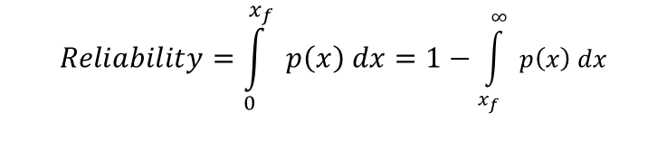

Likelihood
p(x)
Risk
Safety Constraint
0
Loss x
Failure
Threshold
Reliability
Risk: The effect of uncertainty on objectives (ISO 31073:2022)
Reliability: “the probability of an item performing its purpose adequately for the period of time intended under the operating and environmental conditions encountered” (KK Aggarwal, 1993)
Safety: “freedom from risk which is not tolerable” (ISO Guide 51)
$$Risk=\int{ p\left(x\right)∗x dx}$$
$$Reliability=\int_{0}^{x_{f}}{ p\left(x\right) dx}=1−\int_{x_{f}}^{∞}{ p\left(x\right) dx}$$

Slide 3
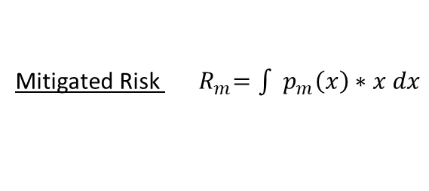
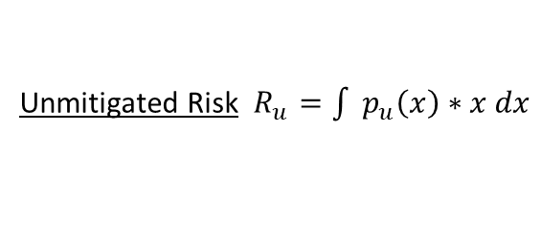

Likelihood
p(x)
Resilient Behavior
Mitigated Risk
Unmitigated Risk
Safety Constraint
0
Loss x
Failure
Threshold
Reliability
Resilience is a behavior the system performs to mitigate risk, e.g., recovering performance, switching to a redundant system, or reconfiguring the mission
One result of this is that risk mitigation is a good (but not the sole) measure of resilience:
Unmitigated Risk $R_{u}=\int{ p_{u}\left(x\right)∗x dx}$
Mitigated Risk ${ R}_{m}=\int{ p_{m}\left(x\right)∗x dx}$
Risk Mitigation$ΔR=R_{u}−R_{m}$

Slide 4


Scenario Setup
Resilience Simulation
Condition: Hazard blocks path
Outcome: Maze finished! ☺
Finish
Outcome: Crash ☹
Finish
Start
Start
Strategy: No Intrusion Detection
Strategy: Detect and re-plan!
Behavior: Locomotion and navigation through airspace

Slide 5
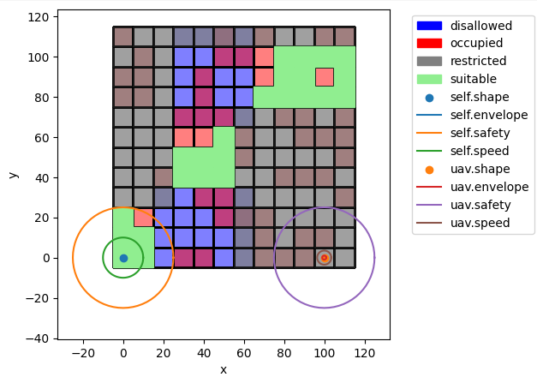
Restricted: airspace the aircraft isn’t allowed to fly in
End
Disallowed: Ground area where the aircraft isn’t allowed to land
Occupied: Ground area where it would be unsafe to land due to proximity to people
Suitable: Ground area where an allowed safe landing is possible
Self: Ownship aircraft, along with various envelopes for safety (distance deemed unsafe) speed (potential locations at next timestep), and envelope (physical boundary of aircraft)
Start
uav: Other aircraft(s) in the local airspace with given envelopes
Aspects of the map are randomly generated in this instance – but parameterizable such that we can change locations (start, end) and distributions (e.g., to match a real environment for a mission).

Slide 6
Resilience means taking a dynamic understanding of risk/safety
Considering resilience is important when our system has dynamic attributes, e.g.:
The system state changes over time
  (e.g., position, velocity, etc)
We can control this state
  (e.g., operators, autopilot)
Because we can use it to determine how to control the system to a safe outcome in unsafe circumstances and what design/operational features we need to enable this control
Risk Outcomes
Safe Disruptions
Robustness Safety Threshold
Unsafe Disruptions
Recovery Time Safety Threshold

Slide 7
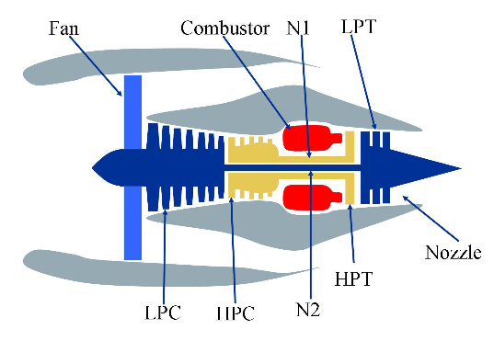
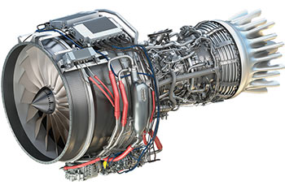
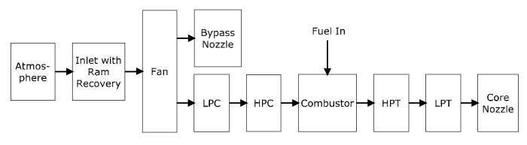
Idea: the system should be resilient-by-design
Concept Design
Embodiment Design
Implementation
Reactive
Design
Choose concept
Design system
Retrofit for resilience
?
?
?
?
Proactive
Design
Establish resilience approach
Integrate resilient features in design
Verify resilient function
?
?
✔
✔
S3
?
?
?
✔
S2
✔
S1
Image 1 & 2 Credit: User’s Guide for the Commercial Modular Aero-Propulsion System Simulation (C-MAPSS)
Image 3 Credit: https://en.wikipedia.org/wiki/File:General_Electric_Passport.jpg

Slide 8
System Model File: model.py
State Classes
Flow Classes
Function Classes
Mode Classes
Model Classes
Parameter Classes
etc…
Analysis Script: Script.py or Notebook.ipynb
Model instantiation (e.g. mdl = Model())
Simulation
  result, history = propagate.one_fault(mdl, fault, t) …
Results processing and visualization
  ModelGraph(mdl).draw()
  History.plot_line(‘value’)
  etc…
Model
Class
FunctionArchitecture, Function, Flow, State…
ParameterSample, one_fault(), etc…
PhaseMap,
fmea(), etc…
Definition Packages
/define/block/function.py,
/define/container/state.py
/define/flow/base.py
/define/architecture/function.py
/define/container/mode.py, …
Simulation Modules
/sim/propagate.py
/sim/sample.py
/sim/search.py
Analysis Modules
/analyze/phases.py
/analyze/tabulate.py
/analyze/phases.py …

Slide 9
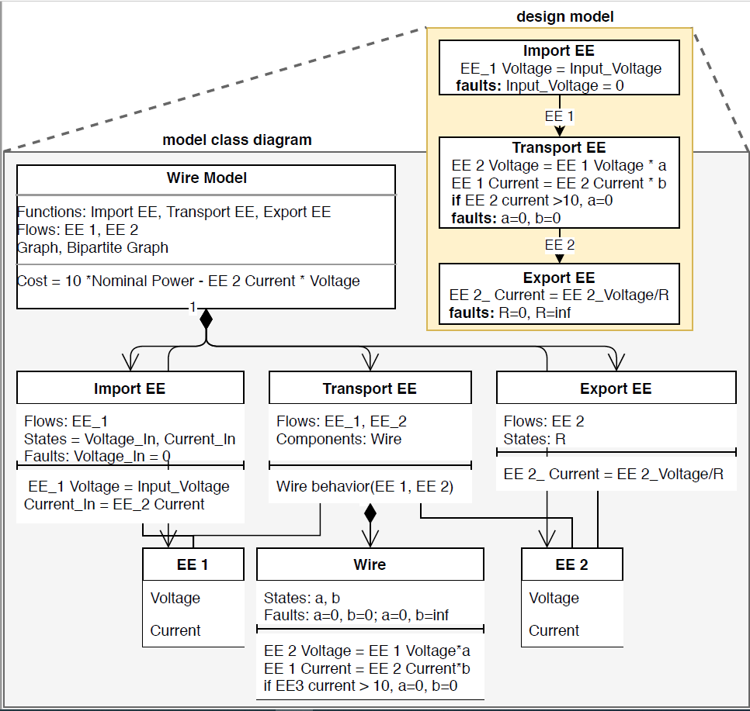
FunctionArchitecture: Agglomeration of Functions, Flows, and Hazard Metrics in overall graph structure
Function: Defines high-level system behaviors as well as failure modes and component architectures
State: Entries that define Function/Flow state
Flow: Data Structures (inputs/outputs) that connect Functions
Component: Sub-behavior internal to a Function with its own behaviors and properties, etc.

Slide 10
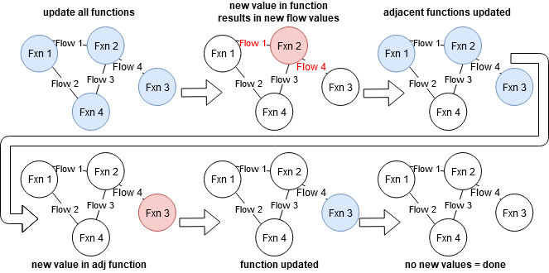
Static Fault Propagation
Behaviors defined in .behavior(), .static_behavior(), and .condfaults()
Stored in mdl.staticfxns

Slide 11
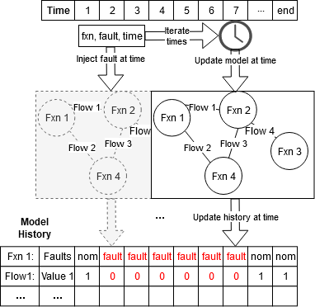
Dynamic Fault Propagation
Defined in .dynamic_behavior()
Runs once per timestep in a user-specified order.
Accessible in mdl.dynamicfxns
--------
Static/Dynamic propagation can be visualized using rd.graph.exec_order()

Slide 12
Activity: Open and instantiate pump model
Review code:
  See pump code defining the Pump model class
  See pump code defining MoveWater function class
Open tutorial notebook
  Tutorial_unfilled.ipynb
Instantiate the model
  mdl = Pump()
Explore
  Try different parameters! Change things!
  What does the model directory look like? dir(mdl)

Slide 13
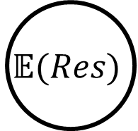
Goal: Quantify Resilience With Simulation
Prevention
Recovery
Nominal Scenario
$$\text{𝔼}(Res)$$
Nominal Performance
Hazard
Expected
Resilience:
Resilience over a set of hazardous scenarios
Recovery
Resilience
No Recovery
Faulty Performance
Fault Time
Yodo, N., & Wang, P. (2016).

Slide 14
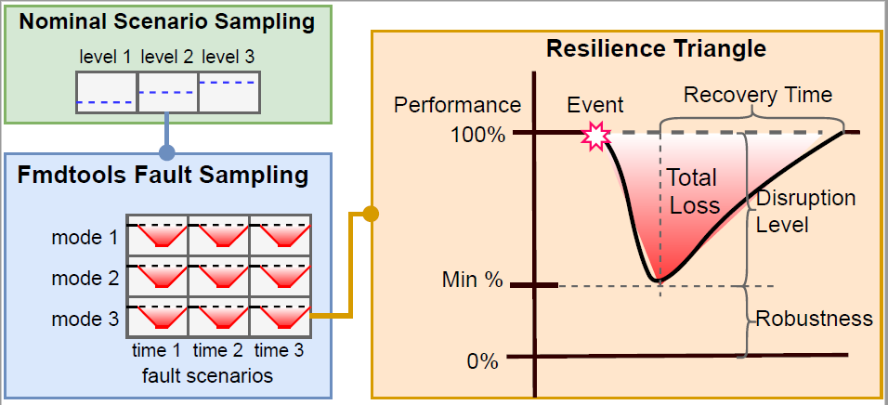
Nominal performance
propagate.nominal()
Performance over a set of possible operational parameters
propagate.
parameter_sample()
Resilience to a single fault or hazard
propagate.one_fault()
propagate.sequence()
Resilience over a set of fault modes
propagate.
fault_sample()
Resilience to a set of fault modes over a set of operational parameters propagate.nested_sample()

Slide 15




common.py
Basic analysis utilities (plotting, calculations, etc) used throughout.
result.py
Analysis and save/load of simulation results.
Result: Class for storing and analyzing results from a simulation specified in desired_result argument
tabulate.py
Construction of analyses based on samples.
FMEA: FMEA-like assessment with faults, probabilities, and costs.
Comparison: Class for comparing different metrics over different scenarios in a ParameterSample/Faultsample.
NominalEnvelope: Class for determining nominal envelope of system over a ParameterSample
phases.py
Analysis of phases of operation in the system
PhaseMap: Class for interacting with model phases of operation for sampling and analysis.
from_hist(): method for generating PhaseMaps from throughout a model.
/graph
Graph-based visualizations.
label.py
Defines graph labels.
style.py
Defines node and edge styles.
base.py
Generic graph-based visualizations.
Graph: Base class for displaying and interacting with graphs.
history.py
Logging, processing, and simulation histories.
History: Class for logging and analyzing results from a simulation specified by tracking options.
model.py
Graph visualizations for models
ModelGraph: Class to represent model constructs as graphs

Slide 16
State classes are used to represent variables (called fields) that change over time
Parameter classes are used to represent variables that don’t change over time, with similar syntax to States
class StateName(State):
varname1: float = 1.0
varname2: str = “default_value”
class ParameterName(Parameter):
varname1: float = 1.0
varname1_range = (0.0, 10.0)
varname2 : str = “default_value”
varname2_set = (“default_value”, “other_possible_value”)
varname1_range defines allowable range for the variable varname1
Field name
Field type or class
Default initial value
varname2_set defines allowable values for the field varname2
Mode classes are used to represent modes (faults and operational modes) that could occur in the system
class ModeName(Mode):
fault_faultname1 = (0.001, 200.0),
fault_faultname2 = (0.00001, 100.0, {‘on’: 1.0})
opermodes = (“off”, “on”)
mode: str = “off”
Dictionary of fault names and their optional properties (rate, repair cost, phases they could occur and their rates)
List of potential operational modes (if multiple)
Default mode (if multiple modes/not nominal)

Slide 17
class FlowName(Flow):
container_s = StateName
container_p = ParameterName
default_track = [‘s’,’m’]
def indicate_XXX(self):
Conditional statement (e.g., self.s.state>threshold) which is logged in the history and may be used to terminate simulations
Specifies which container classes play specific Flow roles (e.g., s corresponds to the state role, p corresponds to a parameter role, m corresponds to the mode role, etc)
Specifies what should be tracked in the FxnBlock history (fxnname.h) by default. May be a dict ({role:value}), list ([role1, role2]), or string (“all”,”none”, etc). Overwritten by track parameter at model instantiation.
These methods define Flow indicators and are called/tracked during simulation (in flow.i)

Slide 18
class FunctionName(Function):
container_s = FunctionState
container_m = FunctionMode
container_t = FunctionTime
flow_flowname1 = FlowClass1
flownames = {“outsideflowname”:”flowname1”}
default_sp = {‘end_time’: 100}
default_track = [‘s’,’m’]
def init_block(self, **kwargs):
<e.g., self.s.x = 2.0>
def static_behavior(self):
Runs only in static propagation steps
def dynamic_behavior(self):
Runs only in dynamic propagation steps
def indicate_XXX(self):
Conditional statement (e.g., self.s.state>threshold) which is logged in the history and may be used to terminate simulations
def classify(self, scen={}, hists={}, **kwargs):
Returns a Result dictionary (calculated at completion)
flow_XXX is used to append a flow of given type that is named XXX to the function class. If the flow(s) has a different name outside the function (optional), flownames matches the external name to the internal name
Specifies which classes play specific FxnBlock roles (e.g., s corresponds to the state role, m corresponds to the mode role, etc)
Default keyword arguments for SimParam. Only necessary when the functionblock will be simulated individually.
Specifies what should be tracked in the FxnBlock history (fxnname.h) by default. May be a dict ({role:value}), list ([role1, role2]), or string (“all”,”none”, etc). Overwritten by the track parameter during model instantiation.
Optional method to call to set up FxnBlock in ways not already defined by role initalization (e.g., attaching local MultiFlows or setting initial values for States from Parameter)
These methods define the behavior of the FxnBlock and thus simulate at each time-step of the simulation.
These methods define FxnBlock indicators and are called/tracked during simulation (in fxnname.i)
This method defines the Result to be returned when simulated individually

Slide 19
Default keyword arguments for SimParam. Defines max time of the simulation, along with phases, timestep, units, etc.
class ArchitectureName(FunctionArchitecture):
container_p= ModelParam
default_sp = {‘end_time’: 100}
default_track = [“fxns”, “flows]
def init_architecture(self, **kwargs):
self.add_flow(“flowname”, FlowClass)
…
self.add_fxn(“functionname”, FunctionClass, “flowname1”, “flowname2”)
…
def indicate_XXX(self):
Conditional statement
(e.g., self.fxns[“functionname”].s.state>threshold)
which is logged in the history and may be used to terminate simulations
def classify(self, scen={}, hists={}, **kwargs):
Returns a Result dictionary (calculated at completion)
Points to a Parameter representing immutable model characteristics instantiated at the start of the simulation
Specifies what should be tracked in the Model history by default. May be a dict ({role:value}), list ([role1, role2]), or string (“all”,”none”, etc). Overwritten by the track option in propagate.
Method to instantiate the model and define its structure:,
.add_flow is used to instantiate a flow
.add_fxn is used to instantiate a function and attach connected flows
These methods define Model indicators and are called/tracked during simulation (in modelname.i)
This method defines the Result to be returned by the model.

Slide 20
Flexible
Powerful
Efficient

