Slide 1
JEOD Overview
JEOD API
Model Documents
Model Reference Manuals

Slide 2
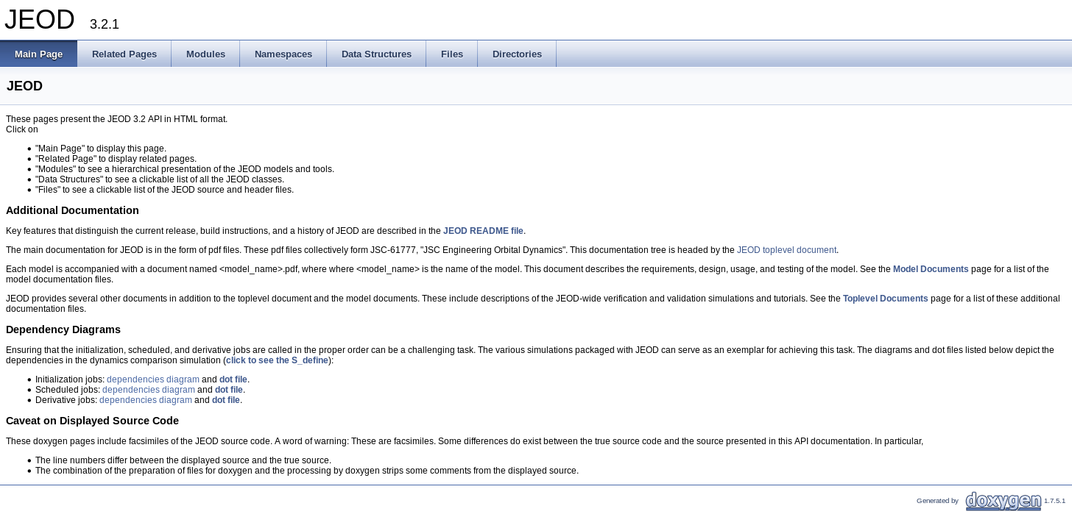
The JEOD API
At html/jeod/index.html
Front page:

Slide 3
Related Pages
README
Top level documents
Model documents

Slide 4
Documentation
(Uniform Presentation)
Main Document (<model>.pdf)
  Introduction
  Requirements
  Product Specification
    Conceptual Design
    Mathematical Formulations
    Detailed Design
    Inventory
  User Guide
    Simulation Users (inputs, outputs)
    Simulation Developers (instantiation, calling)
    Model Developers (extending)
  Inspection, Tests, Metrics
Reference Manual
(refman.pdf)
  Data Structure Index
  File Index
  Data Structrure Documentation
    Inheritance Diagram
  File Documentation

Slide 5
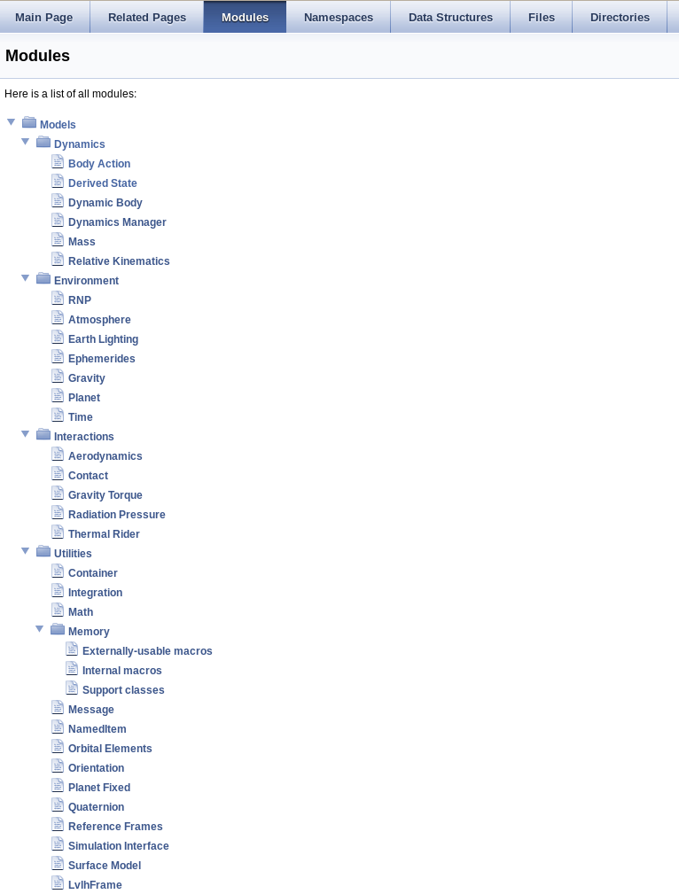
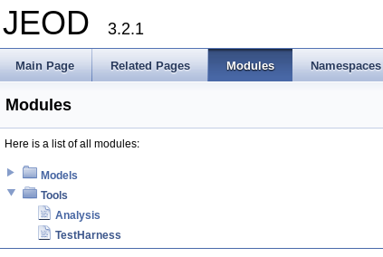
Modules
List of all models and tools
Link to each

Slide 6
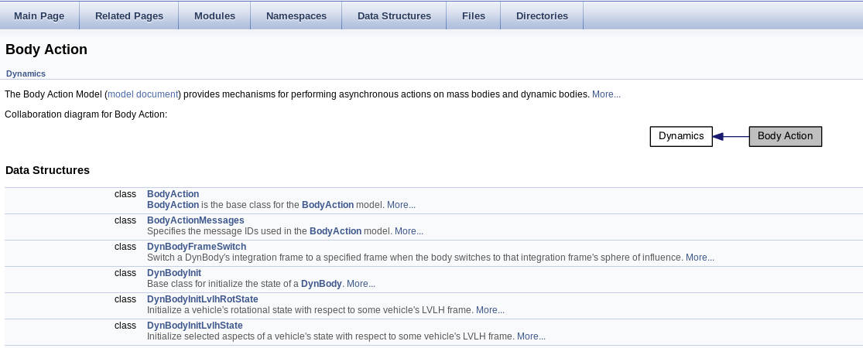
Models
Lists classes within each model
Brief description of each
Link to documentation

Slide 7
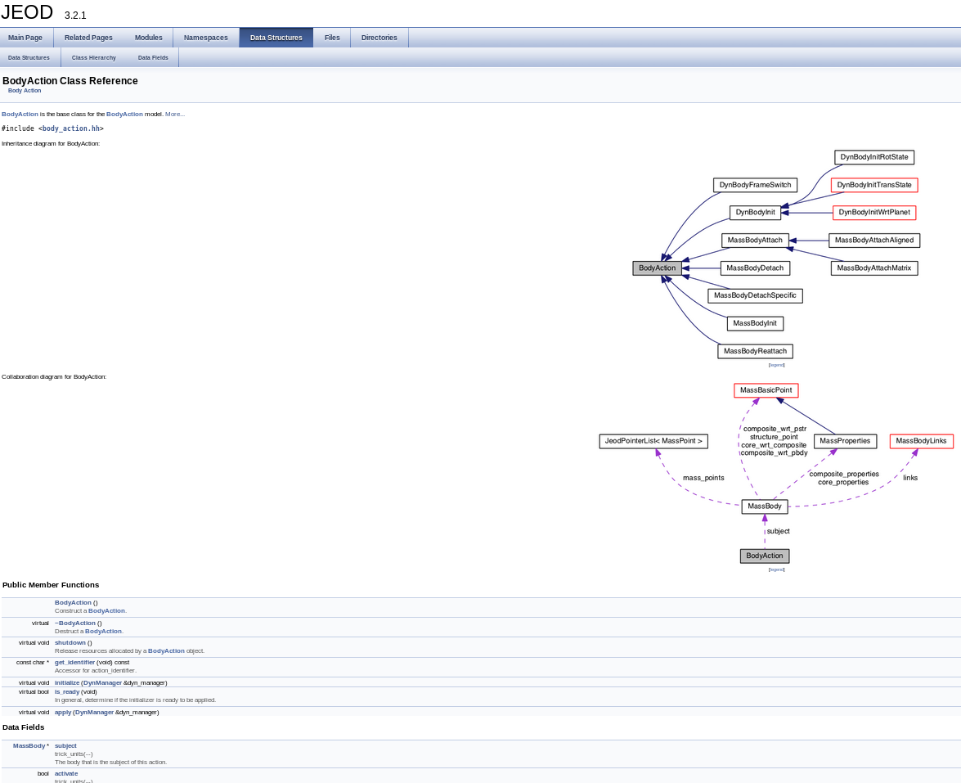
Data Structures / Classes
Inheritance
Collaboration
Fields
Clickable
Legend

Slide 8
Data Structures
Alphabetical list of structures / classes
Each goes to page seen on previous slide
Break - Exercises 2, 3

Slide 9
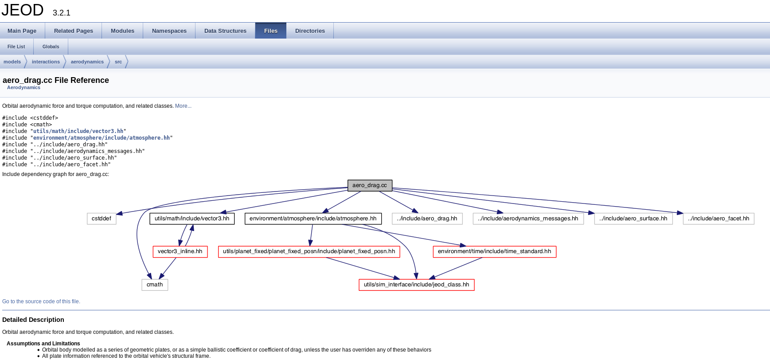
Files
Alphabetical list of files
Each has link to actual code content
Link to detailed description, including dependency graph.
  Note – code dependencies, not execution dependencies; difference in option-usage

Slide 10
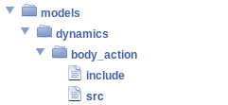
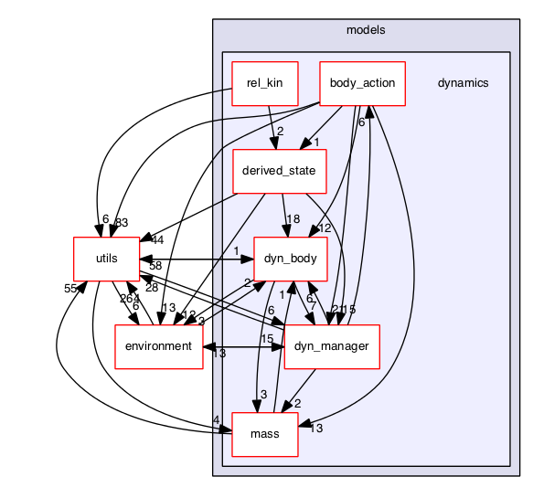
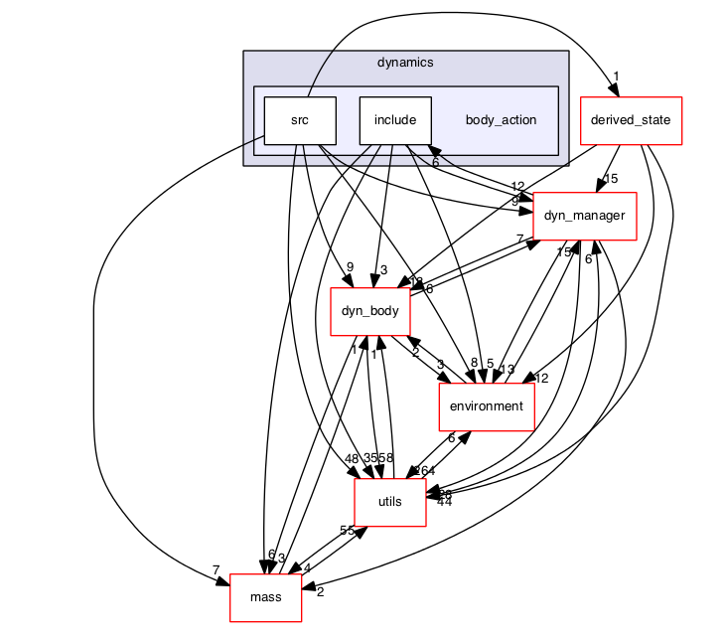
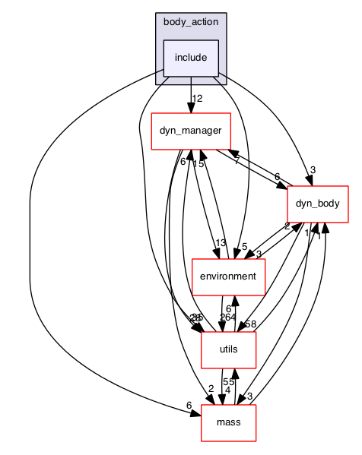
Directories
Directory index of files
Dependency graphs at all levels

