Slide 1
Core Flight System (CFS)
Checksum (CS)
Heritage Analysis
Nicholas Yanchik
01/14/2008

Slide 2
Heritage Analysis Overview
Study existing implementations of Checksum that represent previous solutions
Identify application features for each of the previous missions
Recommend features for the CFS Checksum that will be needed for future missions

Slide 3
Missions Targeted - SDO
CS checks contents of critical memory areas that should remain unchanged
  FSW images and tables
  Regions of RAM containing code
  Regions of RAM containing constant data tables
  All banks of nonvolatile memory

Slide 4
Missions Targeted - SWIFT/BAT
Main processor had only Memory Scrub
The Image Processor on the DSP had a Checksum
Ground could request checksum
Developed at Los Alamos

Slide 5
Missions Targeted - LRO
Only checks EEPROM
Big change from LRO CDR
  Feedback said they were doing too much by checksumming everything
Checksums at one Hertz

Slide 6
SDO Context Diagram

Slide 7
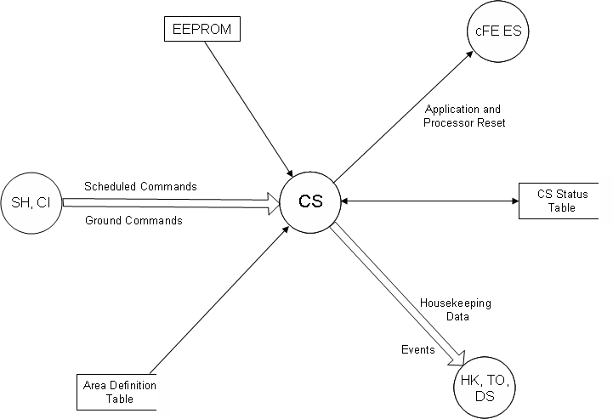
LRO Context Diagram

Slide 8
SWIFT/BAT Context Diagram
R6K
DSP
Memory
DSP
Command
Counter
Poll for
Requests
Send a
Request to
the DSP
Command
Packet
Science
Routine
Collect
DSP
Status
DSP Status
Executive
Routine
DSP
State Flags
Get CCSDS
Packet
Checksum
Process
Output
Data
Buffer
External interrupt

Slide 9
SDO CS
4 different calcuators check 7 memory types
Calculator | Memory Type
1) Table Checksum Calculator | 1) System Tables Memory Type
 | 2) Stored Command Processor Tables Memory Type
2) Code Checksum Calculator | 3) Code Segments Memory Type
 | 4) Expansion Segments Memory Type
3) EEPROM Calculator | 5) EEPROM 1 Segments Memory Type
 | 6) EEPROM 2 Segments Memory Type (SDNs only)
 | 6) BMC PROM Segments Memory type (MP only)
 | 7) PROM Segments Memory Type
4) Switch able EEPROM Calculator | -) None defined.

Slide 10
SDO CS 2
Segments
  Each checksummed table is one segment
  Each checksummed code segment is one segment
  EEPROM and PROM are divided up into 8192 byte segments
Checksums are stored in several different structures
  Table of segments to be verified
  Table of baseline checksums

Slide 11
LRO CS
Checks data in EEPROM
Computes baseline memory integrity value upon initialization (on processor or power on restart)
Splits EEPROM into separate 'regions' of 0x100 bytes in its Area Definition Table
Checksums are stored in a checksum status table

Slide 12
Swift/BAT CS
Used files only
Memory integrity in the RAD6000 (BAT main processor) is accomplished using Memory Scrub, not checksum
Physical memory is divided into logical segments
  EEPROM
  Code for each subsystem
  Static data for each subsystem
Segments are checksummed one block at a time
  One block is checksummed for each pass through the control loop
  The block size can be any number of works adjusted for the ~ 100Hz polling rate
All checksums are kept in a table
  Block size of each segment is kept in the table as well

Slide 13
Preserved on a Warm Reset
SDO
  Starts disabled
  Computed Checksums
  Segment Configurations
LRO
  Starts enabled
  Nothing
Swift/BAT
  Nothing
  Has no concept of warm restart

Slide 14
Feature Analysis
Task | SDO RAD 750 and Coldfire SDN | LRO | Swift/BAT
Algorithms | 8 bit add with carry | Cyclic Redundancy check (CRC) | Bytewise ANDing with accumulation value set initially to zero
Data Approach | Everything is a Table | Data can be either in Files or Tables | Everything is a File.
Initialization | Cold Reset, preserves nothing; checksums are regenerated for each segment and globally for each memory type; global CS enable/disable is set to enable Warm Reset: CS is disabled | Upon a Power-on or Processor Reset, the CS Software will enable the Memory Integrity Manager and compute the baseline unique memory integrity value for each enabled memory region specified in the Checksum Memory Definition table. | DE is enabled and CS, as a part of it, is available for use if a ground command requesting such a calculation is received. Since computer can be reset from ground, DE, and consequently CS would be restarted.

Slide 15
Feature Analysis 2
Task | SDO RAD 750 and Coldfire SDN | LRO | Swift/BAT
Software Modes | Capable of enabling/disabling checksumming and capable of enabling/disabling checksumming of a single calculator; supports sustaining engineering type activities including recomputing the checksum of a single segment of a single memory type | Capable of enabling/ disabling checksum for entire EEPROM or an area of EEPROM as defined in the Checksum Memory Definition Table. | CS can be enabled or disabled by ground command. Request for checksum calculation likewise come through ground commands.
Speed | CS task sends out housekeeping telemetry every 4 seconds in response to a request for telemetry. Each checksum control cycle is 500 milliseconds. | The Flight Software validates the EEPROM on a one Hertz schedule, or as commanded | On DSP: ~100 Hz or 10 ms polling rate; may be faster because there is no operating system; the DSP executive is only a control loop. In addition, operations are all logical commands; arithmetic commands normally take longer.

Slide 16
Command Analysis
Commands | SDO RAD 750 and Coldfire SDN | LRO | Swift/BAT
NOOP (No operation) | Present as described | Present as described | Present as described
RESET (Reset housekeeping counters to zero) | Resets CS Command execution and error counters | Present as described | DSP: software reset and hardware reset, MS: probably similar command. Not found
STATE (Enable / Disable checksumming) | Present as described | Present as described | Present for MS (Memory Scrub): enableMemScrub and enableEdac DSP: Enable/ disable memory segment checksum and also Restart Checksum

Slide 17
Command Analysis 2
Commands | SDO RAD 750 and Coldfire SDN | LRO | Swift/BAT
Enable /Disable Checksum Calculator (Two separate commands: Enable Checksum Calculator; Disable Checksum Calculator – each applies to a specific calculator) | Present as described | Not present | Not present
RECMEM Recompute Memory Type (Causes all checksums for a particular memory type to be recomputed) | Present as described | Not present - only one memory type | Not present
REGION (Enable/Disable checksumming for a region) | Enabling/ Disabling of a single Calculator | Not present | Not present

Slide 18
Command Analysis 3
Commands | SDO RAD 750 and Coldfire SDN | LRO | Swift/BAT
RECOMPUTE REGION (Recompute checksum for a region) | Recompute Memory Segment (Causes the checksum for a particular segment to be recomputed – for tables, the segment ID is the table ID) | Not present | Not present
FINDSEG Find segment for address (Searches for Memory segment that has a specified address. Result returned in an event message.) | Present as described | Not present | Not present

Slide 19
Command Analysis 4
Commands | SDO RAD 750 and Coldfire SDN | LRO | Swift/BAT
Oneshot Checksum Calculation (Given a memory address and range, perform a checksum of that range) | Present as Described | Not present | Not present
Cancel Oneshot Calculation (Cancels a one-shot checksum calculation while it is in progress) | Present as Described | Not present | Not present
Reset Memory Type (Resets all calculations for a particular memory type. The ranges of all segments for the memory type are recalculated as is done after a cold restart and the checksums are recomputed.) | Present as Described | Not present | Not present

Slide 20
Proposed Requirements

Slide 21
Considerable Requirements
Requirement | Rationale | Heritage
Memory Access Attempt | Key capability for fast onboard memory validation | Swift/BAT (though done through Memory Scrub)

Slide 22
Rejected Requirements
Requirement | Rationale | Heritage
Memory Scrub | Using this function to scrub memory after a read for Memory Integrity purposes does not seem logical as a part of Memory Integrity. Using it for locating specific data point upsets might be valuable, but the rationale for finding just those bits rather than determining a problem quickly and replacing the whole processor size record does not seem clear. | Swift/BAT on the RAD6000

Slide 23
Other Topics
How do we want to handle files?
  LRO doesn't check them
    EEPROM'd files are EDAC'd
  SDO doesn't have them
  SWIFT/BAT everything is a file
Algorithm
  ES uses the CRC-16-IBM polynomial, reflected
  LRO CDH uses CRC-16-CCITT, normal

