Slide 1
Core Flight Software System (CFS)
Limit Checker (LC)
Heritage Analysis Review
David Hardison
June 5, 2008

Slide 2
Application Overview
The Core Flight System Limit Checker (LC) is the system application responsible for monitoring telemetry data points
Data points are compared against predefined threshold limits
When a threshold condition is encountered, an event message is issued and a Relative Time Sequence (RTS) command script may be initiated to respond to the situation
Some missions (including SDO) have called this component the Telemetry and Statistics Monitor (TS)

Slide 3
Heritage Summary
The heritage missions examined for this analysis were:
  LRO
    LC design based on heritage from TRACE/WIRE with approximately 75% reuse (modifications primarily for cFE support).
  SDO
    TS design based upon code from WMAP with approximately 95% reuse
The following missions were investigated, but will not be discussed in detail:
  SWIFT/BAT
    Telemetry monitoring implemented in a STOL-based script controller that’s not envisioned for the CFS
    Instrument Health and Safety (IH) task used to monitor voltage and temperature values, but not intended for generic telemetry monitoring.
  ST-5
    Also based on WMAP so very similar to the SDO implementation
  GLAS
    Mission had no comparable telemetry monitoring capabiltiy
See document for more details on the development artifacts used

Slide 4
LRO LC Terminology
WATCHPOINT
  A piece of data, (either in telemetry or memory) whose value is to be compared against a predefined constant
TELEMETRY WATCHPOINT
  A watchpoint that is read from a telemetry packet
MEMORY WATCHPOINT
  A watchpoint that is read from a memory address or memory mapped I/O port
IMMEDIATE WATCHPOINT
  An alternate term used for MEMORY WATCHPOINT in the LRO LC documentation
WATCHPOINT DEFINITION TABLE
  The input table that holds the information necessary to define all LC watchpoints
WATCHPOINT RESULTS TABLE
  The output (dump-only) table that holds the results of watchpoint evaluations

Slide 5
LRO LC Terminology (cont.)
ACTIONPOINT
  A logical relationship between one or more watchpoint results, specified in Reverse Polish Notation
ACTIONPOINT DEFINITION TABLE
  The input table that holds the information necessary to define all LC actionpoints
ACTIONPOINT RESULTS TABLE
  The output (dump-only) table that holds the results of actionpoint evaluations
CUSTOM FUNCTION
  A mission specific function that can be used in place of a standard comparison operator in a watchpoint definition

Slide 6
SDO TS Terminology
MONITOR POINT
  A piece of data in telemetry whose value is to be compared against one or more predefined threshold values
THRESHOLD
  A predefined constant value that a monitor point is compared to
MONITOR LIMITS TABLE
  The input table that holds the information necessary to define all TS monitor points, thresholds, and responses for violations
STATISTICS TABLE
  The output (dump-only) table that stores statistics information on each monitor point
DERIVED FUNCTION
  A mission specific function that can be invoked to transform the data in a monitor point prior to the threshold comparisons
DERIVED FUNCTION POINTER TABLE
  Table that holds pointers to derived monitor functions

Slide 7
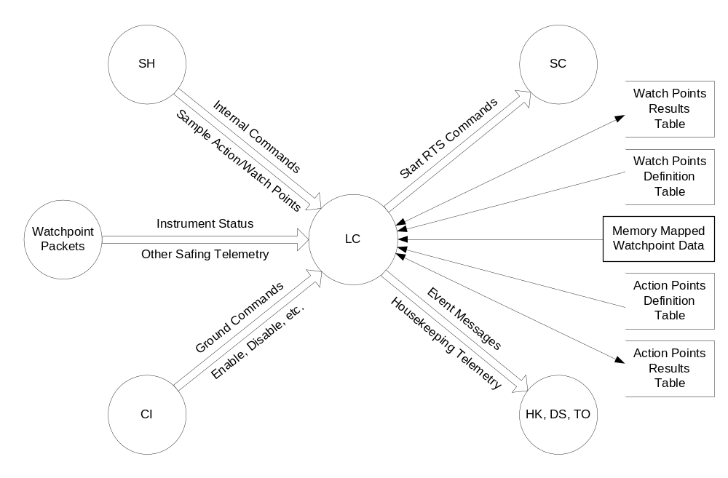
LRO LC Context Diagram

Slide 8
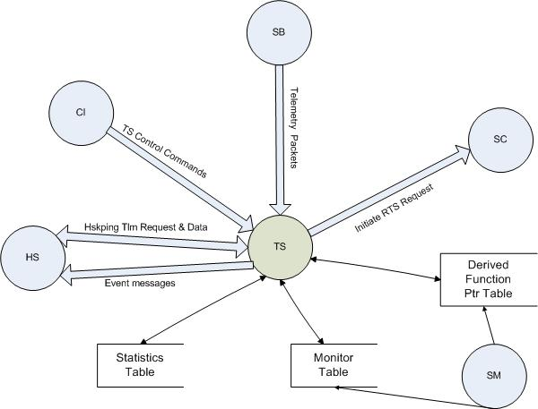
SDO TS Context Diagram

Slide 9
LRO LC Watchpoint Definition Table
Data Size
  int8, int16, int32, uint8, uint16, uint32, float
Operator ID
  Comparison type: <, <=, !=, =, >, >=, or custom
Stream ID
  Packet containing watchpoint data, or zero if direct memory address
Address Offset
  Packet offset or direct memory address
Bit Mask
  32 bit mask applied to data before comparison
Comparison Value
  Constant value to compare with watchpoint data value

Slide 10
LRO LC Actionpoint Definition Table
Default State
  unused, active, passive, disabled
RTS ID
  RTS to invoke if action is triggered
Event Text, Event Type, Event ID
  Event to generate if action is triggered
Consecutive Failure Count
  Number of consecutive failures required to trigger action
Max Event Count
  Maximum number of informational event messages that will be generated for this actionpoint
Polish Equation
  One (or more) watchpoint IDs combined with “and”, “or”, “not”, etc.
  Expression format is in Reverse Polish Notation

Slide 11
LRO LC Watchpoint Results Table
Most recent sample result for this watchpoint
  TRUE, FALSE, ERROR, Not Measured
Total sample count for this watchpoint
Number of times result transitioned from FALSE to TRUE
Number of consecutive TRUE results
  zero if currently FALSE
Total number of TRUE results
Most recent FALSE to TRUE transition
  Spacecraft time at transition
  Watchpoint data value at transition
Most recent TRUE to FALSE transition
  Spacecraft time at transition
  Watchpoint data value at transition

Slide 12
LRO LC Actionpoint Results Table
Most recent sample result for this actionpoint
  PASS, FAIL, ERROR, Not Measured
Current Actionpoint State
  unused, active, passive, disabled, permanently disabled
Total number of FAIL to PASS transitions
Total number of PASS to FAIL transitions
Number of consecutive FAIL results
  Zero if most recent result = PASS
Total number of FAIL results
Total number of RTS executions
Total number of result transition event messages sent

Slide 13
SDO TS Monitor Table
Monitor
Id
Monitor
Active
Data
Size
Derived
Function
Active
Stream Id
Monitor Point Name
Offset
Bit Mask
Derived
Function
Table Index
Event Message
Maximum
{
Derived Function Parameters (5)
threshold
active
continue
flag
Boolean Operation
(<, =, >, <>, >=, <=)
RTS
Active
Flag
RTS Number
Threshold 1
Threshold Limit
Failure Minimum
{
threshold
active
continue
flag
Boolean Operation
(<, =, >, <>, >=, <=)
RTS
Active
Flag
RTS Number
Threshold 4
Threshold Limit
Failure Minimum

Slide 14
SDO TS Statistics Table
Name | Size in Bytes | Data Type | Description
MONID | 2 | uint16 | ID Number of this monitor (Nominally its index)
MSGCNT | 1 | uint8 | Number of event messages sent for this monitor point
SPARE | 1 | uint8 | Spare
RTIME | 8 | TM_Sys | UTC of last monitor reset
SC (EXEC0 EXEC1 EXEC2 EXEC3 SPARE) | 2 | uint16 | Bit 15: Threshold 0 executed RTS Bit 14: Threshold 1 executed RTS Bit 13: Threshold 2 executed RTS Bit 12: Threshold 3 executed RTS Bit 0-11: Spare
CONSEC | 2 | uint16 | Samples that fall in the current threshold since entering the threshold
THRESHCNT[1] | 2 | uint16 | Number of samples received at Threshold 0
THRESHCNT[2] | 2 | uint16 | Number of samples received at Threshold 1
THRESHCNT[3] | 2 | uint16 | Number of samples received at Threshold 2
THRESHCNT[4] | 2 | uint16 | Number of samples received at Threshold 3
MONCNT | 4 | uint32 | Number of samples received for this monitor
AVGVAL | 4 | float | Average value of all samples
CURRENT.VL | 4 | variable | Value of Current sample in Data Type format
CURRENT.STIME | 4 | TM_Sys | Time of Current sample in System Time Format (TAI)
HIGH.VL | 4 | variable | Value of Highest sample in Data Type format
HIGH.STIME | 4 | TM_Sys | Time of Highest sample in System Time Format (TAI)
LOW.VL | 4 | variable | Value of Lowest sample in Data Type format
LOW.STIME | 4 | TM_Sys | Time of Lowest sample in System Time Format (TAI)

Slide 15
SDO TS Derived Function Pointer Table
Contains the addresses of derived functions
  A Derived Function is specified by table index in monitor definition records
64 entries:
  0-49 return the same format as the monitor point (unsigned, signed or float)
  50-63 always return a floating point value
Not a Software Manager table
  Must be changed as a software patch
  New functions can be added anywhere in system memory

Slide 16
LRO LC Modes of Operation
The LRO Limit Checker has three operating modes that can be set via the “Set LC Monitor State” ground command
ACTIVE
  Normal Operation Mode. Performs all limit tests defined in the watchpoint definition table and invokes stored command sequences as defined in the actionpoint definition table
PASSIVE
  Performs all limit tests, but no stored command sequences are invoked as the result of actionpoint triggers
DISABLED
  No watchpoint or actionpoint evalutions take place

Slide 17
SDO TS Modes of Operation
The SDO Telemetry and Statistics Monitor has two operating mode variables that can be set via the “Enable/Disable Monitoring” and Enable/Disable Watch Mode” ground commands
ACTIVE MODE
  If disabled, the TS task will not process any packets
  If enabled, packets are processed according to monitor setup table
WATCH MODE
  If disabled, the TS task will initiate RTS responses as defined in the monitor setup table
  If enabled, packets are processed but RTS responses defined in the monitor setup table will NOT be initiated

Slide 18
Scheduling
In the SDO TS task, monitor points are checked whenever a telemetry data packet is received from the software bus
In the LRO LC, scheduling is controlled by a combination of packet arrivals and sample commands
  Telemetry Watchpoints
    Evaluated whenever the packet containing them is received
  Memory Watchpoints
    Evaluated when the LC SAMPLE command is received with one or more memory watchpoint IDs specified in the command arguments
  Actionpoints
    Evaluated when the LC SAMPLE command is received with one or more actionpoint IDs specified in the command arguments
  The LC SAMPLE command may target none, one, or all watchpoints and/or actionpoints
  The LC SAMPLE command may be sent from the ground or onboard scheduler (SH) task. LC has two sets of command counters to distinguish between them

Slide 19
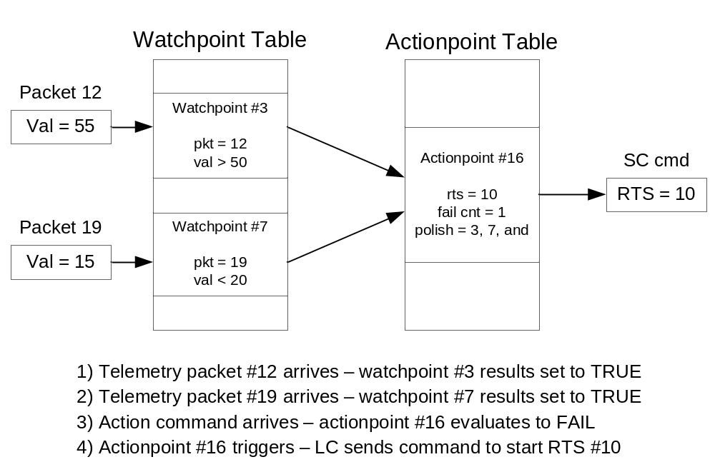
LRO LC Example Scenario

Slide 20
SDO TS Example Scenario
To setup a threshold for a continuous evaluation of a telemetry point that will start a RTS and issue an event when a telemetry point goes out of limits:
  The threshold would be configured as:
    Active Flag : TRUE
    Continue Flag : TRUE
    Operator : Greater Than
    RTS Active : TRUE
    RTS ID : User specified
    Limit : User specified
    Failure Count : 1

Slide 21
Limits
The LRO LC task has the following limits (in the current implementation):
  256 Watchpoints
  256 Actionpoints
  RPN evaluation expression limited to 20 combined operators and operands
The SDO TS task has the following limits:
  512 Monitor Points
  4 Thresholds per Monitor Point
  64 Derived Functions (50 return monitor point data type, 14 always return a float)
  5 16-bit Parameters per Derived Function

Slide 22
LRO LC Custom Functions
Can be used in place of a standard comparison operator in watchpoint definitions
If the comparison is designated “custom” (instead of <, <=, !=, =, >, or >=), the function stub LC_do_custom_function is called and passed the following parameters
  watch_id: The ID of the watchpoint for this call
  sized_data: Raw data read from packet, memory, or I/O
  pkt_ptr: Pointer to the entire packet (NULL if memory or I/O watch point)
LC_do_custom_function returns a TRUE or FALSE that is used as the result of the threshold comparison for the watchpoint that triggered the call
Custom functions are added by modifying the source for LC_do_custom_function, rebuilding the LC task, updating the flight system, and restarting the task.
LC can have as many custom functions as monitor points

Slide 23
SDO TS Derived Functions
Used for transforming the data contained in a monitor point
If enabled for a monitor point, the function is called once the packet is received and the value returned is used when comparing against thresholds instead of the original data
Each function can have up to 5 16-bit parameters passed into it
  Usually used to specify the numbers of other monitor points needed for the evaluation
  Should only pass monitor IDs LESS than the current monitor point so they have already been evaluated.
  Makes table ordering important
Derived functions are the only way to setup a response that depends on a combination of different monitor point values

Slide 24
CFS Limit Checker Primary Features
Primary Features are features that are core requirements implemented in more
than one of the heritage missions examined.
Requirement | Rationale | Heritage Reference
Noop Command Support | Common ground command | LRO, SDO
Reset Housekeeping Counters Command Support | Common ground command | LRO, SDO
Monitor telemetry data points against one or more threshold values | Core monitoring function | LRO, SDO
Compile statistics on threshold violations | Allows ground operators to monitor operation | LRO, SDO
Provide the capability to reset threshold violation statistics | Operators need to be able to clear statistics if an error condition is corrected or they want to discard prior monitoring data for some reason | LRO, SDO
Provide the capability to initiate RTS responses to threshold violations | Allows autonomous responses to spacecraft error conditions | LRO, SDO
Provide a mode that disables monitoring data points | Allows the application to be disabled if unexpected behavior occurs or configuration tables need to be updated | LRO, SDO
Provide a mode where monitoring data points is enabled, but RTS responses are disabled | Allows autonomous error responses to be turned off while still collecting data on threshold violations | LRO, SDO
Store monitoring and response configuration data in tables that can easily be updated by the ground operators | Provides in flight tuning of error conditions and responses | LRO, SDO
Support the use of Custom/Derived functions that can be updated by a software patch | Provides additional flexibility for complex data evaluations | LRO, SDO

Slide 25
To Be Considered
These features will require some additional investigation to determine how useful they may be. These are not critical capabilities and may be deferred to a later build of the CFS if the decision is made to incorporate any of them.
Requirement | Rationale | Heritage Reference
Support for Memory Address Monitoring | Allows monitoring of data that may not be accessible in telemetry packets. | LRO
Allow Symbol Name as Address Argument | May be useful in environments with dynamic loading. | None. Implemented in current CFS applications.
Allow Symbol Name With Optional Offset as Address Argument | Same rational as previous. | None. Implemented in current CFS applications.

Slide 26
Rejected
No features were identified that have been rejected

Slide 27
Proposed Approach
Based upon the heritage analysis it is recommended that the LRO LC design be used as the basis for the CFS Limit Checker for the following reasons:
  Using an existing design will speed development of the CFS version
  The TRACE/WIRE design of the LRO LC is more straight forward and flexible than the SDO approach taken from WMAP
  The LRO LC has already been made compatible with the cFE
  The CFS flight architecture will be using a table based scheduler application that can drive the actionpoint sampling approach of the LRO design

Slide 28
Proposed Context
SC
Watch Points
SH
Results
Table
Internal Commands
Start RTS Commands
Watch Points
Definition
Sample Action/Watch Points
Table
Watchpoint
Instrument Status
cFE
OSAL
Memory Mapped
Packets
LC
Watchpoint Data
Other Safing Telemetry
Ground Commands
Action Points
Event Messages
Definition
Enable, Disable, etc.
Housekeeping Tlm
Table
Action Points
Results
CI
Table
HK, TO

Slide 29
Backup Slides

Slide 30
LRO LC Command Set
No Operation - Increments the command counter
Reset - Resets housekeeping counters
Set State - Change the state of the LC task (Active, Passive, Disabled)
Action State - Changes the state of one or all Actionpoints (Active, Passive, Disabled)
Action Off - Changes individual Actionpoint state to permanent disable
Reset Action - Resets actionpoint statistics
Reset Watch - Resets watchpoint statistics
Sample - Examines actionpoints and memory watchpoints

Slide 31
SDO TS Command Set
No Operation - Increments the command counter
Reset - Resets housekeeping counters
Enable Monitoring - Sets the monitoring state to Enabled
Disable Monitoring - Sets the monitoring state to Disabled
Enable Watch Mode - Enables watch mode, preventing RTSes from being executed if a limit fails
Disable Watch Mode - Disables watch mode, allowing RTSes to be executed if a limit fails
Enable Monitor Point - Enables a single monitor point
Disable Monitor Point - Disables a single monitor point
Reset Monitor Point Stats - Resets the statistics for a single monitor point or all monitor points

Slide 32
Telemetry Monitoring: Characteristics to Keep and to Avoid
TRACE Limit Checker design is more straight forward and more flexible
The total number of monitor points value should be in the monitor definition table and should be reported in telemetry
Failure status of all monitors should be reported in telemetry
Telemetry should clearly indicate that enabling a monitor does not render it active if that is the case
Statistics that are collected are helpful
A table driven design is better for sustaining engineering
Commands that change monitor definitions would create havoc with sustaining engineering configuration management
Taken from: Telemetry & Statistics FSW Task, An Historical Analysis by Kris Naylor October 28, 2004

