Slide 1

ASME TURBO EXPO 2026 · GT2026-175147
Turbo-Design: Open-Source Radial Equilibrium Turbomachinery Solver
Part I — Turbines. A Python framework for radial equilibrium analysis with extensible loss models.
Dr. Paht Juangphanich, Dr. Arman Mirhashemi (NASA Glenn) · William Andress (Purdue) · June 2026
github.com/nasa/turbo-design

Slide 2
01 · MOTIVATION
Motivation
Legacy radial-equilibrium codes are poorly documented; commercial codes are closed-source; neither was built for machine-learning loss models.
NASA’s legacy radial-equilibrium tools — TD2, AXOD, and RTD — were written in Fortran 77 in the 1970s–90s. Their assumptions are poorly documented and difficult to extend. Commercial alternatives like AxSTREAM and AXIAL are proprietary, which makes it hard for academia and government to add custom physics or plug in machine-learning inference. Modern designs reduce losses through 3D optimization and advanced cooling, but legacy cascade-based loss models can’t capture those gains.
Open source, written in Python — easy to verify, modify, and extend
Modular loss-model interface — drop in custom correlations or trained ML inference models
Handles both axial and radial machines from a unified formulation
01 · Motivation
02

Slide 3
02 · OVERVIEW
Outline
03
Coordinate system and geometry
Meridional-velocity frame; smooth hub/shroud curves for accurate curvature
04
Governing equations
Radial-equilibrium derivation, retaining the meridional-curvature term
05
Solver modes
Pressure-balance and angle-matching, with the stability envelope
06
Turbine loss models
Legacy correlations as B-spline fits; ML-ready modular interface
02 · Overview
03

Slide 4
03 · GEOMETRY
Coordinate system and geometry
Built for radial flow paths
Angles are defined relative to the meridional velocity, not the axial.
Hub and shroud are defined as smooth curves rather than the jagged blade-row endpoints of legacy codes, giving accurate radius-of-curvature and inclination angles that drive the radial-equilibrium balance.
Velocity decomposition. The angle α is measured from V to the meridional Vₘ.
03 · Geometry
04

Slide 5
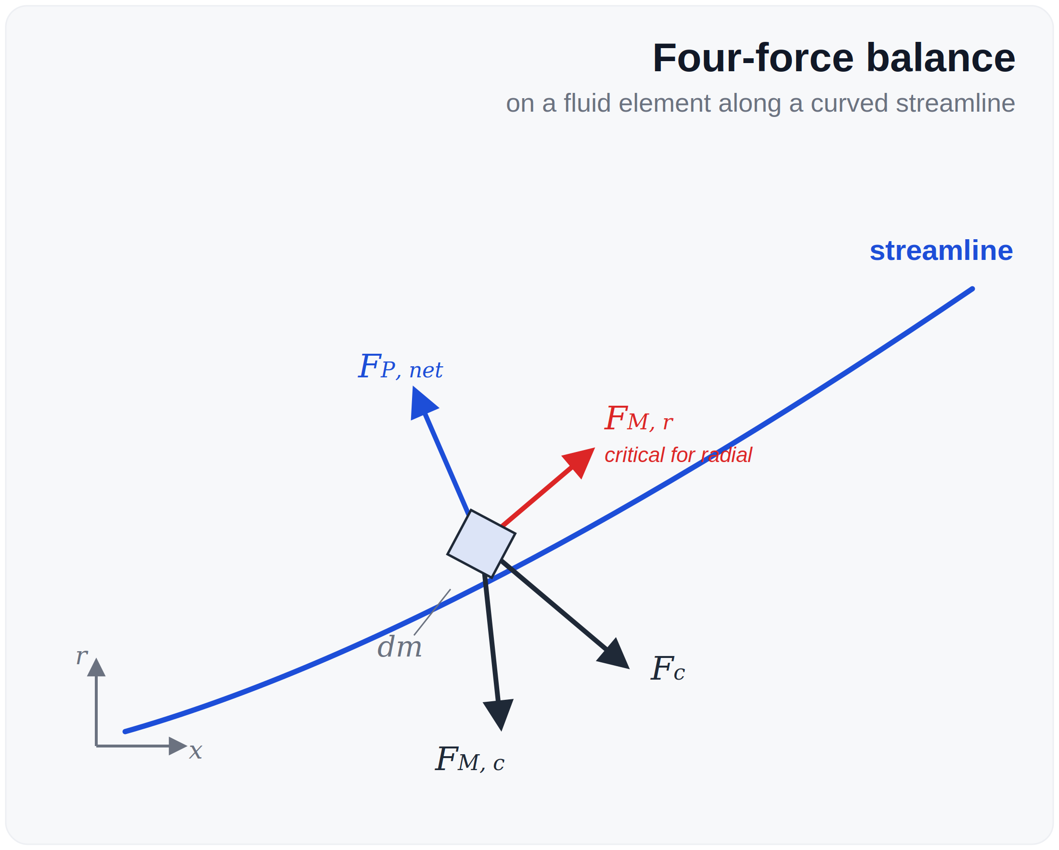

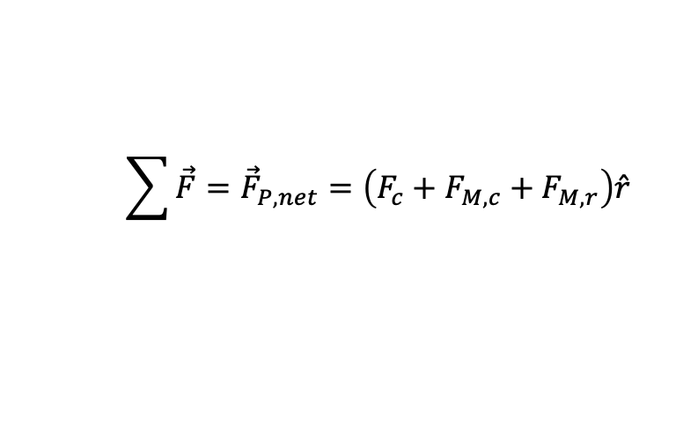
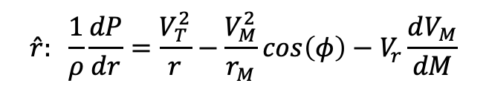
04 · GOVERNING EQUATION
Radial equilibrium
$$\sum{\vec{F}}={\vec{F}}_{P,net}=\left(F_{c}+F_{M,c}+F_{M,r}\right)\hat{r}$$
(5)
…
Full derivation in Appendix A
$$\hat{r}: \frac{1}{ρ}\frac{dP}{dr}=\frac{V_{T}^{2}}{r}−\frac{V_{M}^{2}}{r_{M}}\cos\left(φ\right)−V_{r}\frac{dV_{M}}{dM}$$
(15)
Derivation
OTAC Manual [10] and Cumpsty [11]
Most 1D analyses drop the last term. For axial machines that is fine — Vᵣ is small. For radial machines, where hub and shroud radii change significantly, dropping it introduces error in turning angles and streamline positions. Turbo-Design retains the term, computed as dM = (dx, dr) along the streamline.
Four-force balance on a fluid element. The radial pressure gradient must keep the element on its streamline.
04 · Radial Equilibrium
05

Slide 6
05 · SOLVER
Solver modes
Pressure Balance mode
Angle Matching mode
Blade angles are known. The solver balances pressure across all blade rows simultaneously using SciPy SLSQP, expressing pressures as fractional drops bounded between 0 and 1. This forces monotonic pressure decrease and improves convergence. Use for: design point analysis and off-design analysis when geometry is fixed.
Blade angles are unknown — the solver determines them
Target mass-flow distribution from hub to shroud sets the radial loading
Adjusting that distribution controls blade twist directly
Use for: design exploration before geometry is finalized
Derivation
Stability: the kinetic-energy parameter C (Appendix A) must remain below unity. As C approaches 1 the passage chokes; the solver detects this condition and reports it rather than returning NaN.
05 · Solver Modes
06

Slide 7
06 · LOSS MODELS
Loss models as a modular interface
Legacy correlations
Framework for ML-based loss
Four classical loss models are digitized from their original figures and fit as B-spline surfaces:
Ainley-Mathieson (1951)
Kacker-Okapuu (1982)
Craig-Cox (1970)
Traupel (1966)
CSV datasets are open in the repository so anyone can refit or audit them. Craig-Cox handles incidence — the others can be extended the same way.
Common base class receives upstream + current row properties
Any inference model (PyTorch, ONNX, scikit-learn) plugs in by inheriting it
Designed for interpolation within the training space — extrapolation needs care
Trained models on real engine data are deferred to a follow-up paper
Legacy correlations and machine-learning models share the same base-class interface; substituting one for the other requires no changes to the solver.
06 · Loss Models
07

Slide 8

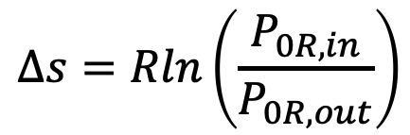
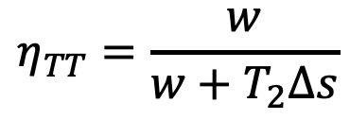
07 · EFFICIENCY
Entropy-based efficiency for radial turbines
The standard total-to-total formula misleads on radial machines — entropy gives a frame-independent answer.
For radial turbines, absolute total-pressure ratio is dominated by centrifugal frame-change rather than aerodynamic loss, so the standard formula reports near-unity efficiency even with significant irreversibilities. Recasting through entropy generation isolates real losses:
$$η_{TT}=\frac{w}{w+T_{2}Δs}$$
(27b)
where w = c_{P} (T₀₁ − T₀₂) and entropy generation reduces to:
$$Δs=Rln\left(\frac{P_{0R,in}}{P_{0R,out}}\right)$$
(27c)
P_{0R} is the relative total pressure — only irreversibilities reduce it.
07 · Entropy Efficiency
08

Slide 9
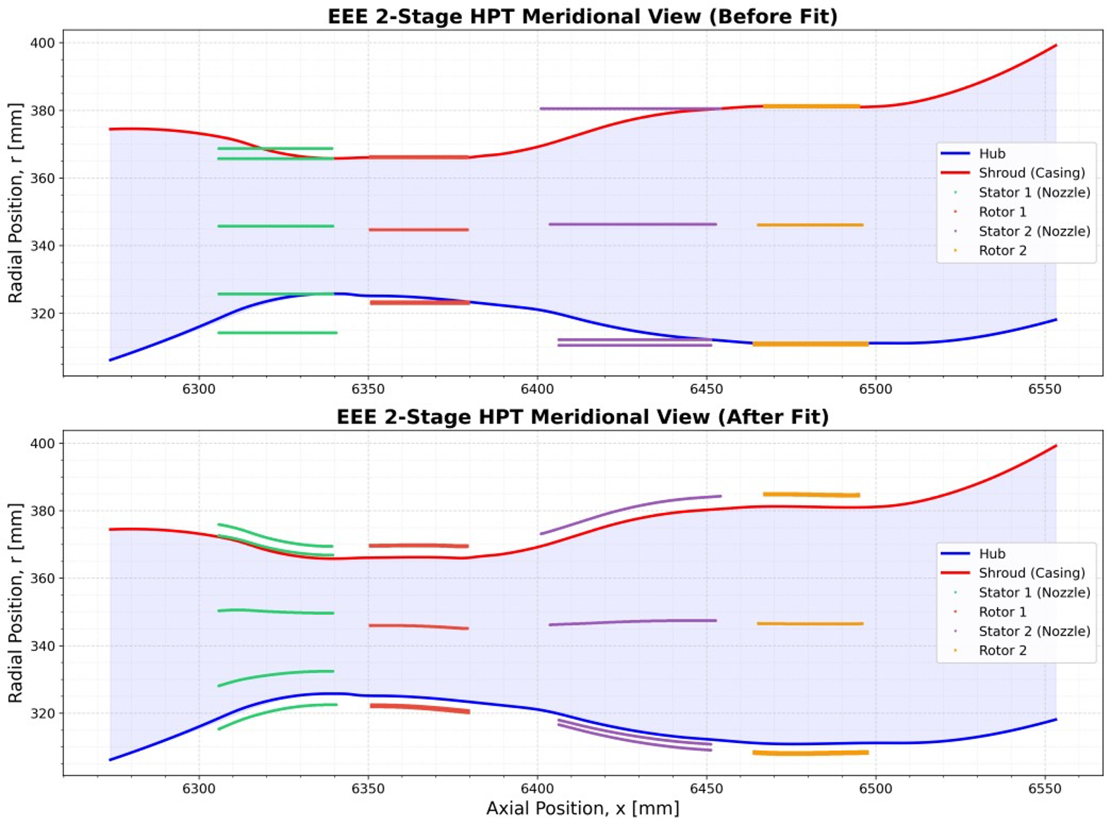

08 · VALIDATION 1
EEE 2-stage high-pressure turbine
Boundary conditions
Inlet: P₀ = 12.57 bar, T₀ = 1587 K, M = 0.2 Exit: Pₛ = 2.30 bar Rotors: 12400 RPM Fluid: air, variable cₚ and γ
CFD reference
ADS solver, Wilcox k–ω, y⁺ < 1, adiabatic walls, 30k iterations to convergence.
EEE Tutorial
NASA / GE Energy Efficient Engine 2-stage HPT — meridional view: hub, shroud and blade rows (paper Fig. 8). Full-scale warm-air test measured 90.0 % efficiency.
08 · Validation 1 — EEE
09

Slide 10
09 · EEE RESULTS
EEE — Turbo-Design vs CFD
Quantity | Source | Stage 1 | Stage 2
Efficiency η | CFD | 0.962 | 0.970
 | Turbo-Design | 0.955 | 0.986
 | Error | 0.7 % | 1.65 %
Stage loading ψ | CFD | 1.61 | 1.20
 | Turbo-Design | 1.56 | 1.26
 | Error | 3.1 % | 5.0 %
Mass flow [kg/s] | CFD | 29.46 (total)
 | Turbo-Design | 29.4 (total)
 | Error | 0.2 %
CFD-measured total-pressure loss prescribed per blade row (Eq. 22). Stage efficiency and mass flow agree within 2%.
09 · EEE Results
10

Slide 11
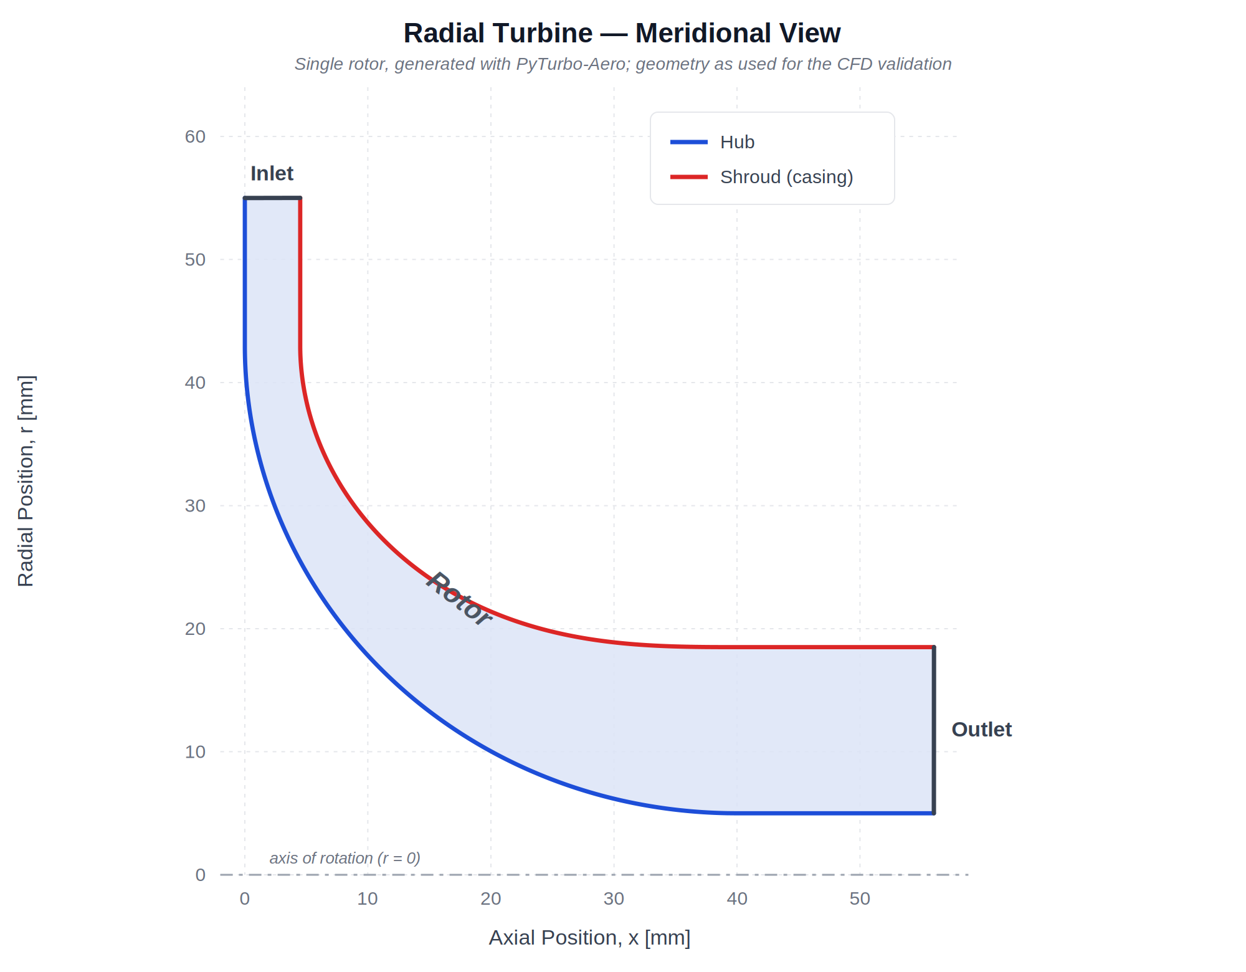
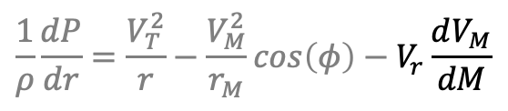
10 · VALIDATION 2
Radial turbine — where the curvature term matters
Test the Vᵣ · dVₘ/dM term
This is the case where dropping the curvature term in Eq 15 would matter most.
Inlet: P_{0R} = 50 bar, T_{0R} = 1200 K Exit: P_{static} = 25 bar Rotor: 50000 RPM, γ = 1.35 A zero-loss stator upstream of the rotor enforces α₁ = 0; α₂ is matched to the CFD rotor-inlet angle.
$$\frac{1}{ρ}\frac{dP}{dr}=\frac{V_{T}^{2}}{r}−\frac{V_{M}^{2}}{r_{M}}\cos\left(φ\right)−V_{r}\frac{dV_{M}}{dM}$$
Radial turbine generated with PyTurbo-Aero; geometry as used for the CFD validation.
10 · Validation 2 — Radial
11

Slide 12
11 · RADIAL RESULTS
Radial turbine — Turbo-Design vs CFD
Quantity | 1D model | CFD | Difference
P₀ loss (Yp) | 0.136 | 0.136 | prescribed
Total-total efficiency | 0.803 | 0.797 | +0.8 %
Total-static efficiency | 0.338 | 0.334 | +1.3 %
Total mass flow [kg/s] | 0.299 | 0.292 | +2.2 %
Enthalpy power [kW] | 23.23 | 22.45 | +3.5 %
Euler power [kW] | 23.23 | 22.46 | +3.5 %
T₀ inlet [K] | 1222.9 | 1222.9 | 0.0 %
T₀ exit mean [K] | 1152.6 | 1174.1 | −1.8 %
P₀ inlet [Pa] | 536,657 | 536,657 | 0.0 %
P₀ exit mean [Pa] | 427,458 | 428,240 | −0.2 %
β₁ avg [deg] | 0.01 | 0.12 | ~0 %
β₂ avg [deg] | 51.2 | 51.7 | −1.0 %
Single-rotor radial turbine, γ = 1.35. Pressure loss coefficient Yp = 0.136 prescribed from CFD.
11 · Radial Results
12

Slide 13
12 · CONCLUSIONS
Conclusions
Summary
Future work
Turbo-Design is an open-source Python radial equilibrium solver that replaces the legacy Fortran codes TD2 and AXOD2. The governing equations are derived from first principles, retaining the meridional curvature terms required for radial machines. Axial and radial turbines are handled with a unified formulation. The solver was validated against CFD for the NASA EEE two-stage HPT and an internally developed radial turbine, with agreement within 2% on mass flow and efficiency when supplied with CFD-measured loss coefficients.
Loss models tuned to specific turbomachinery stages
Machine-learning loss models trained on high-fidelity data
Compressor support, both axial and radial (Part II)
Continued validation against experimental datasets
Source code, tutorials, and CFD validation cases are available at
github.com/nasa/turbo-design
github.com/nasa/turbo-design
12 · Conclusions
13

Slide 14

NASA GLENN · PURDUE · ASME GT2026-175147
Thank you
paht.juangphanich@nasa.gov | github.com/nasa/turbo-design
Paht’s open-source projects

