Slide 1
Radix Sort Algorithm
Nasantogtokh Amarsaikhan CWEVXJ
Mussa Ebrahim
Nedal Eskaif

Slide 2
Radix Algorithm (LSD)
329
457
657
839
436
720
355
720
355
436
457
657
329
839
720
329
436
839
355
457
657
329
355
436
457
657
720
839

Slide 3
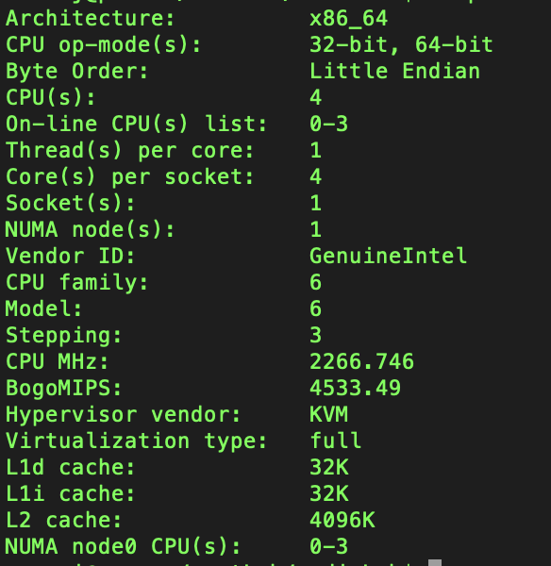
Used technology
System info:
Parallel solution
OpenMP
4 core – 4 thread
Shared memory arch

Slide 4
Array to be sorted
Random array
Generated randomly <= 10000
Time measurement excludes random array generation time

Slide 5
Time measurement

Slide 6
Conclusion
Did not gain much speed up, but it is something …
Tried bubble soring with OpenMP, but parallel version was slow.

