Slide 1

Hyatt hotels Reviews : Data Analysis
IST 687: Applied Data Science(M003)
Niti Saluja
Kathleen Flynn
Ananya Bhupathipalli

Slide 2

Business Questions
Our data
Interesting Analyses
Useful Models
Actionable Insights
Questions

Slide 3
Business Questions
What factors were considered while choosing the subset for analysis to achieve overall high NPS score?
On what factors do the ‘Likelihood to Recommend’ and ‘NPS Type’ have the highest dependency?
What is the effect of NPS on the Hotel Brand and Purpose of Visit?
What is the effect of age group on the NPS score
What are the recommendations you can provide to improve the NPS score of Hyatt?

Slide 4
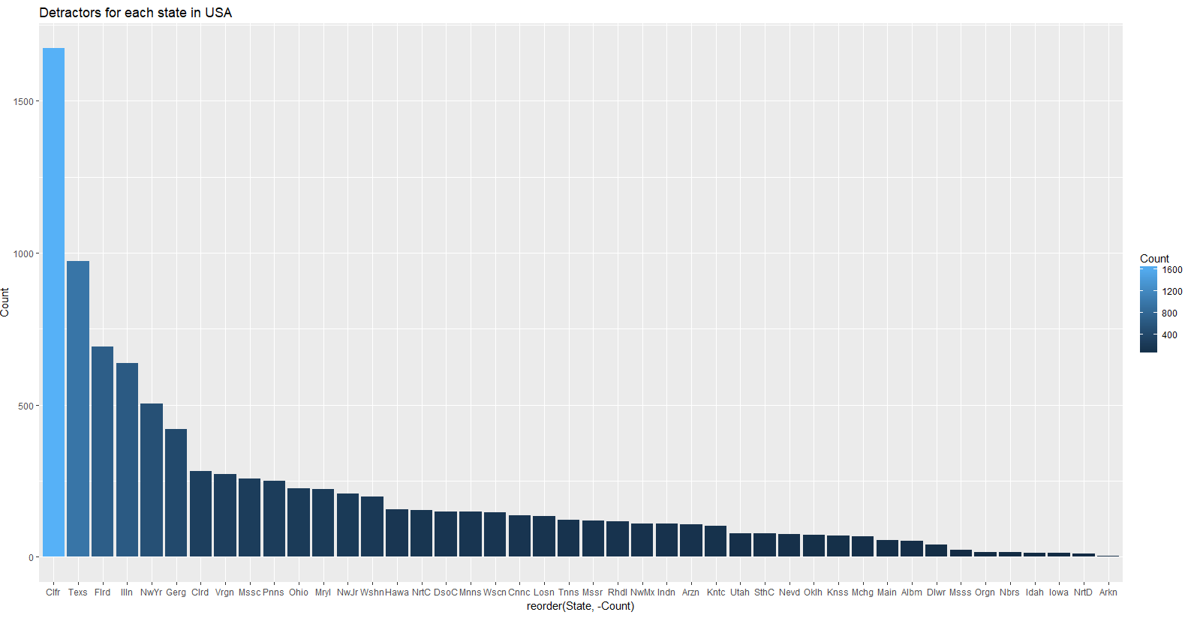
What factors should be considered while choosing the subset for analysis to achieve overall high NPS score?
Our subset: The State of California in the month of August, 2014.
Why?

Slide 5
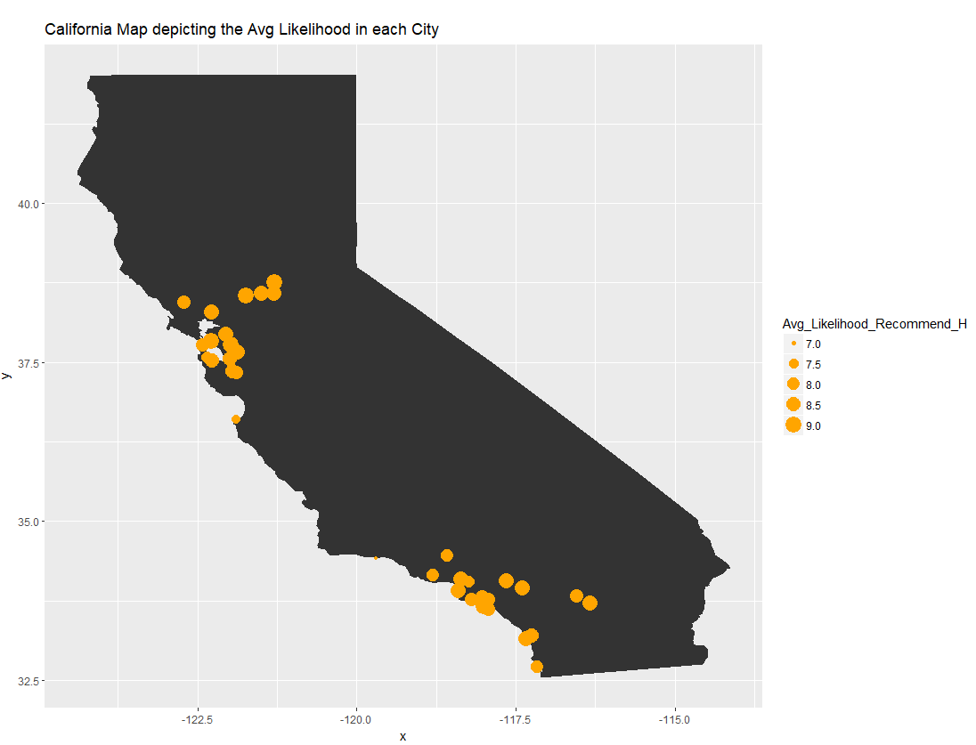
California state map
The map depicts the spread of Average Likelihood score across the different cities in California.
San Diego, San Francisco, Los Angeles have the highest LTR.
San Barbara, Monterey, Burlingame

Slide 6
On what factors do the ‘Likelihood to Recommend’ and ‘NPS Type’ have the highest dependency?
Highest dependency factors for NPS Type/Likelihood to Recommend:
Hotel Condition
Guest Room Condition
Customer Service Satisfaction
Tranquility
Age Range
Member Status
Hotel Brand
Fitness Center

Slide 7
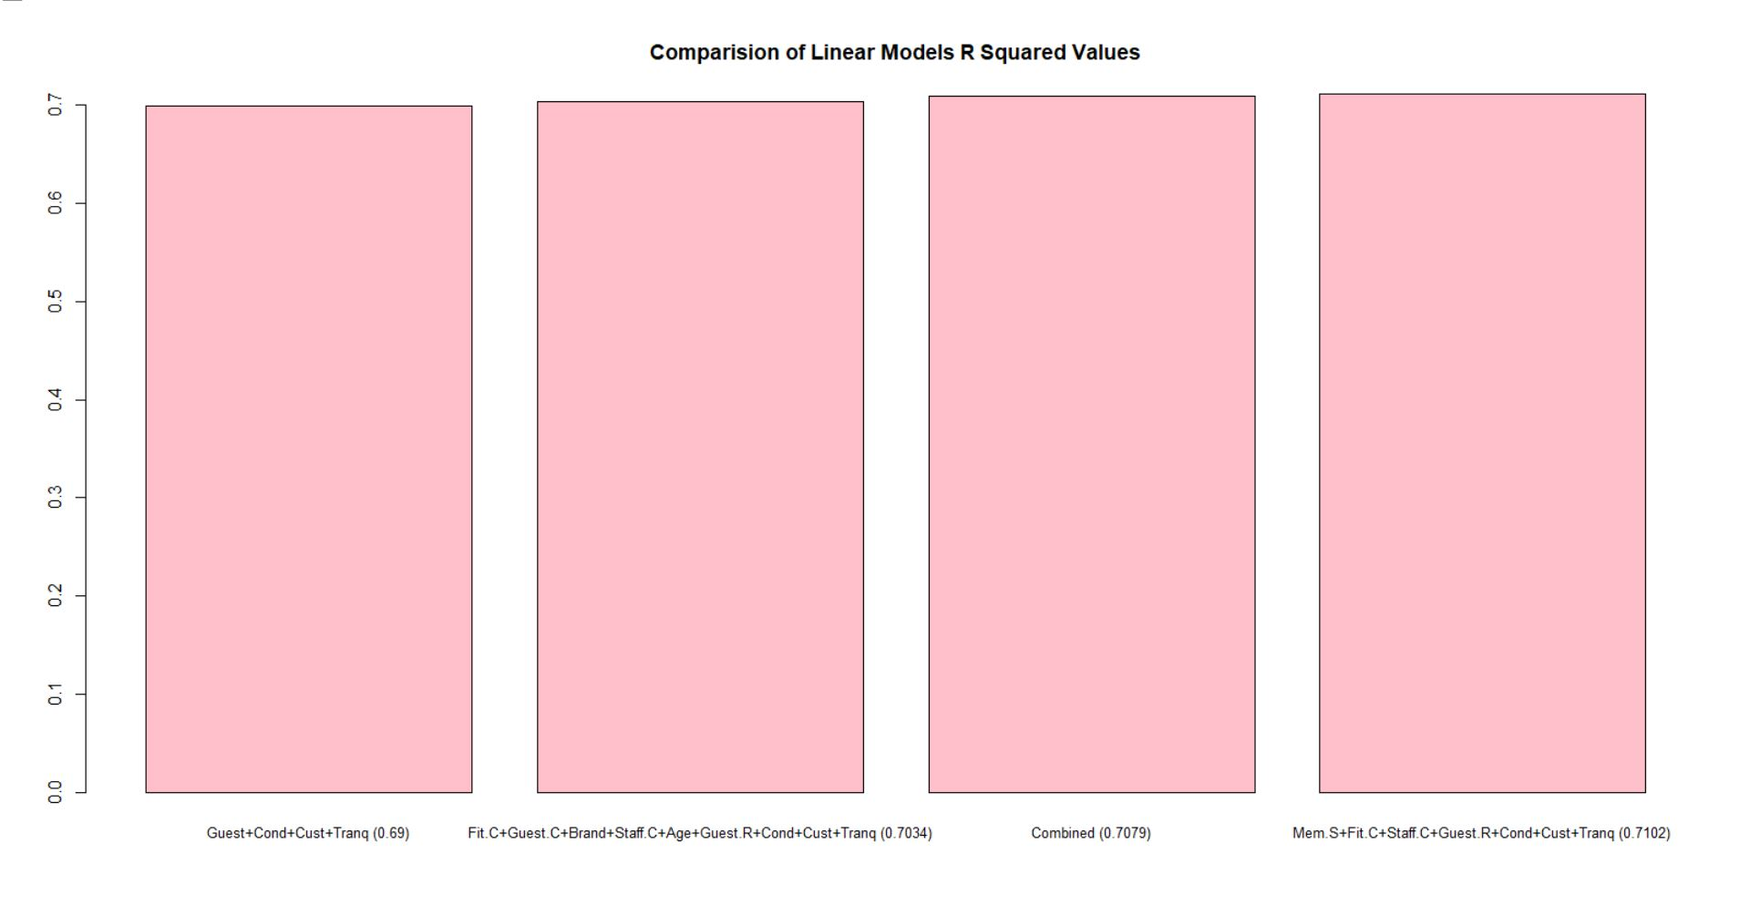
Comparison of R-Square Values of different models

Slide 8
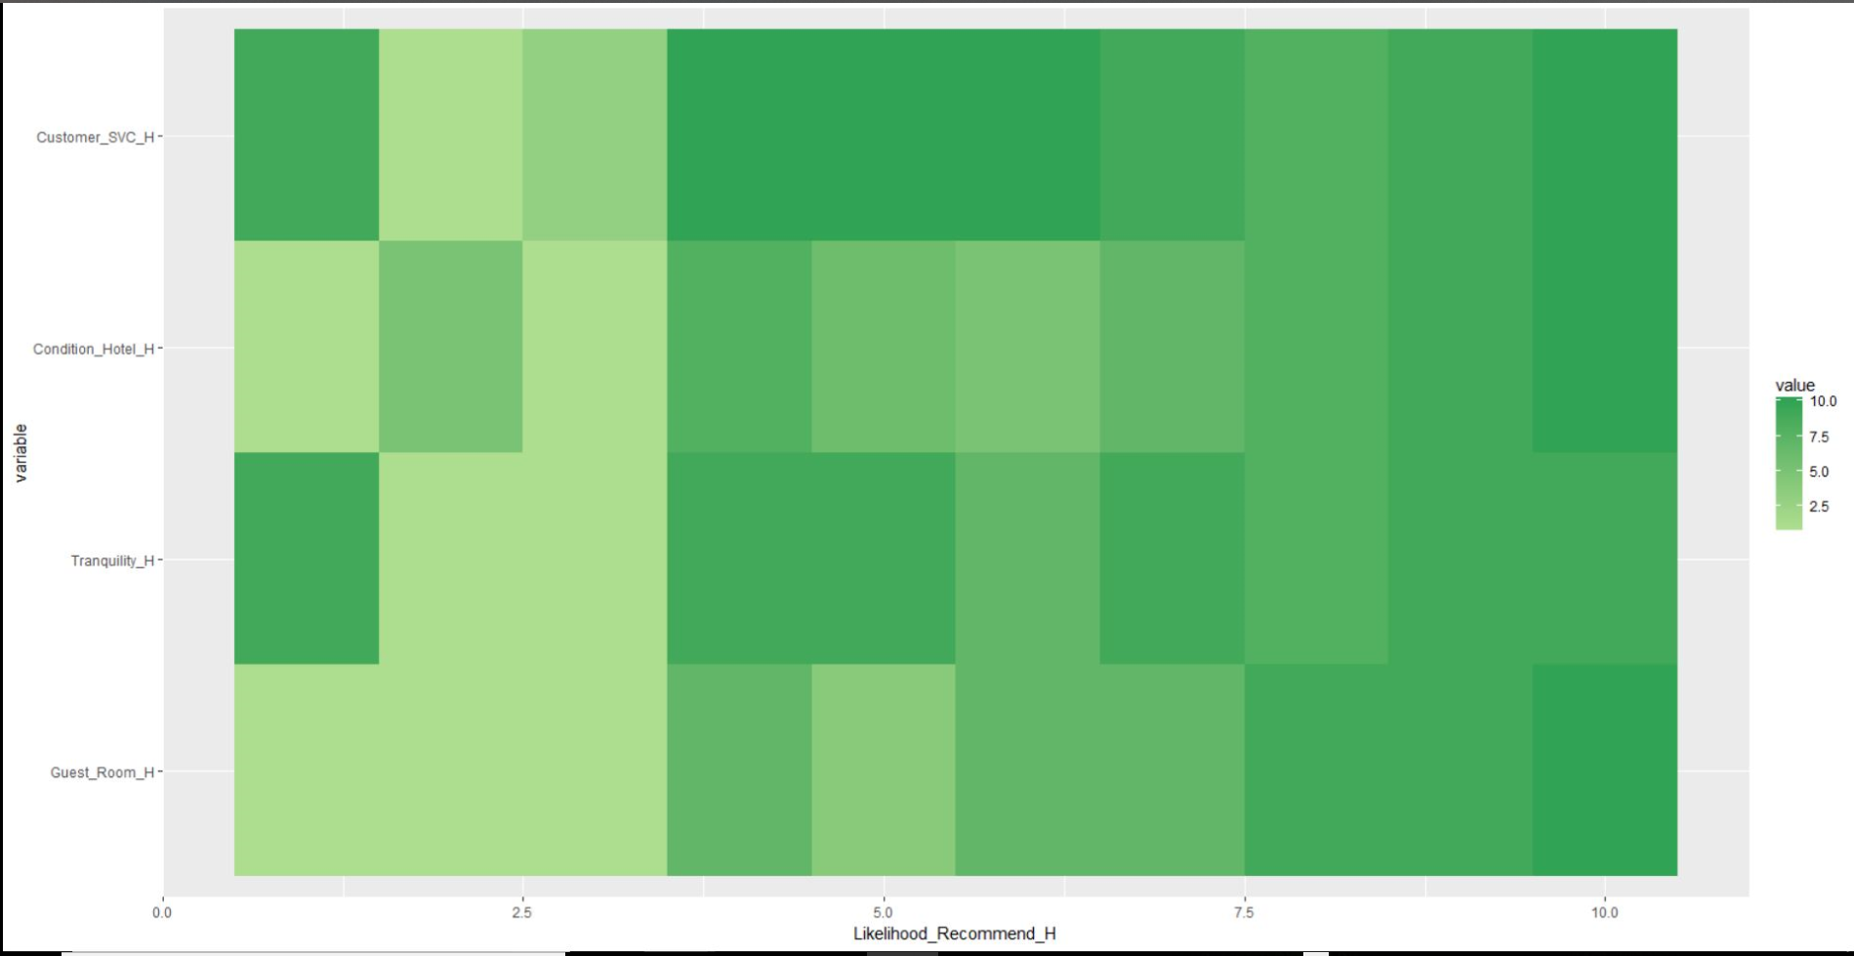
Results of the best Model

Slide 9
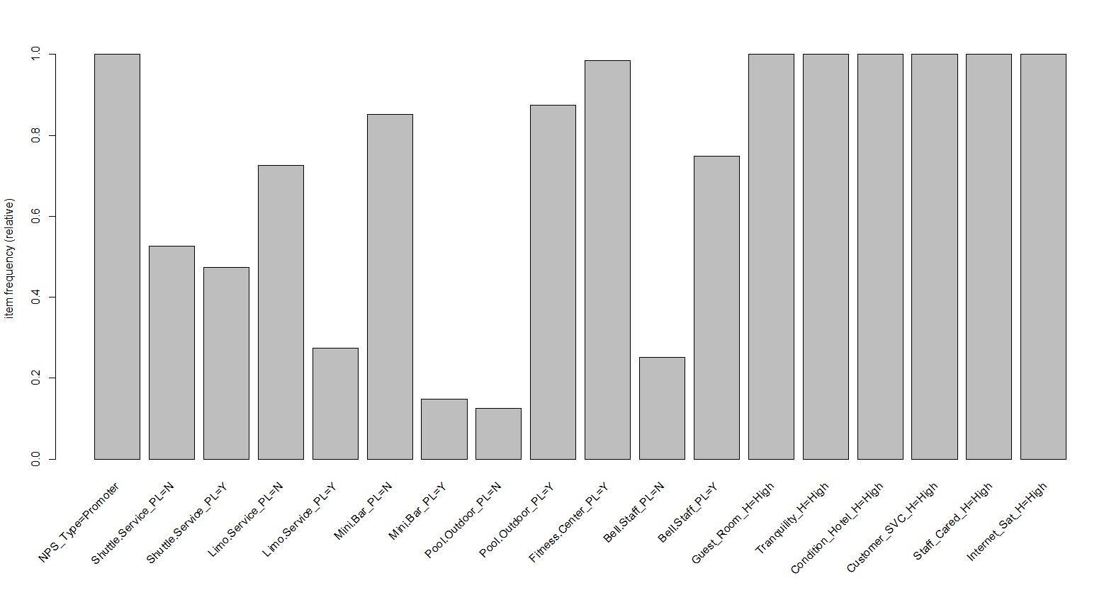
Factors contributing to high promoter score

Slide 10
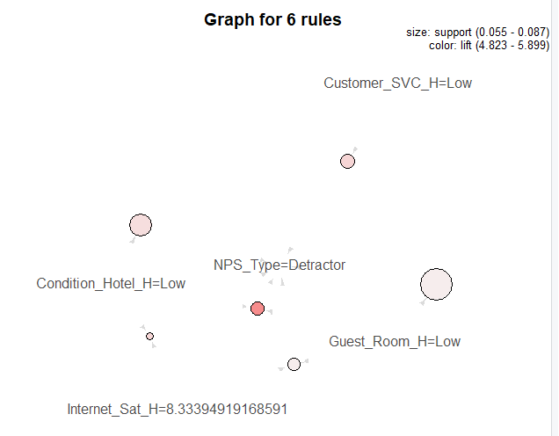
Factors contributing to high detractor score

Slide 11

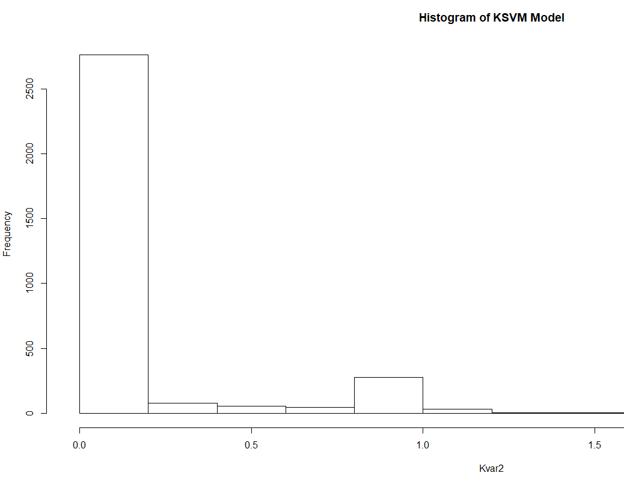
Prediction Model Accuracy
We performed Supervised Learning to train the machine to predict the NPS using the Amenities and Survey columns.
The accuracy of the model was calculated by comparing the predicted and the actual values.

Slide 12
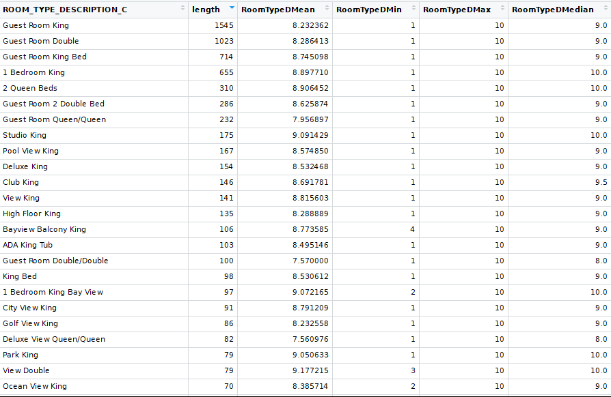
Descriptive Statistics : Analysis of Likelihood to recommend by room type.

Slide 13
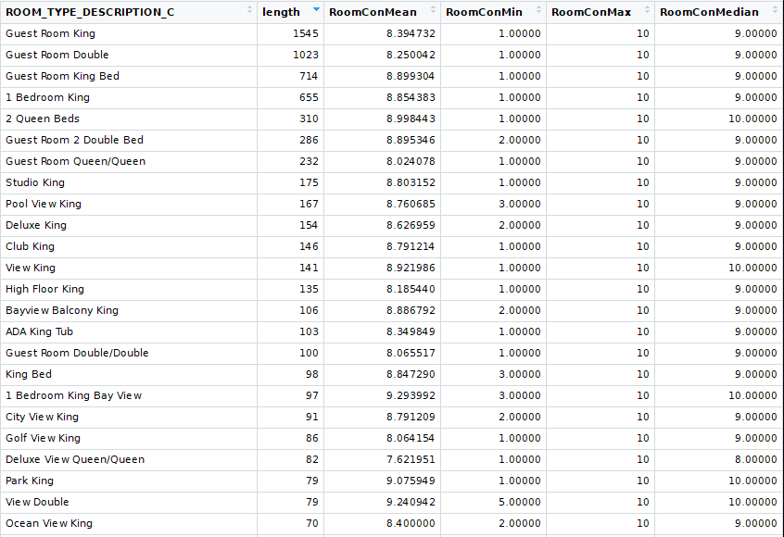
Guest room condition by room type.

Slide 14
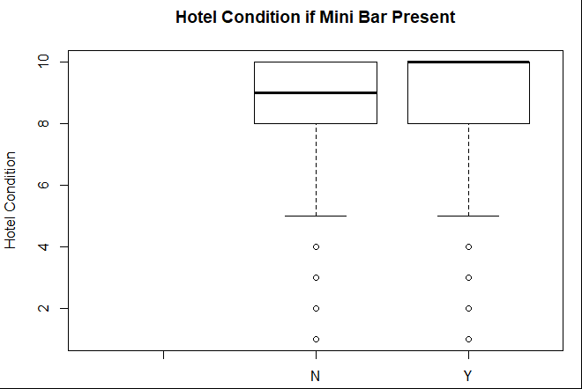
Analysis of Hotel condition and mini bar

Slide 15
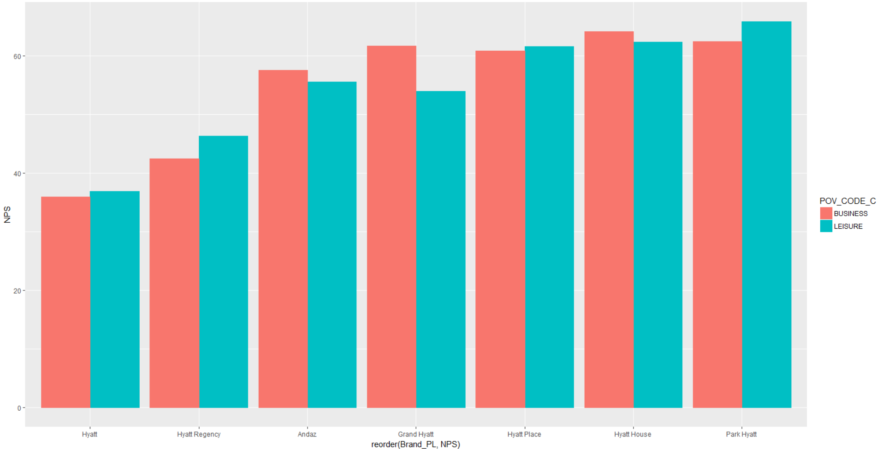
What is the effect of NPS on the Hotel Brand and Purpose of Visit?

Slide 16
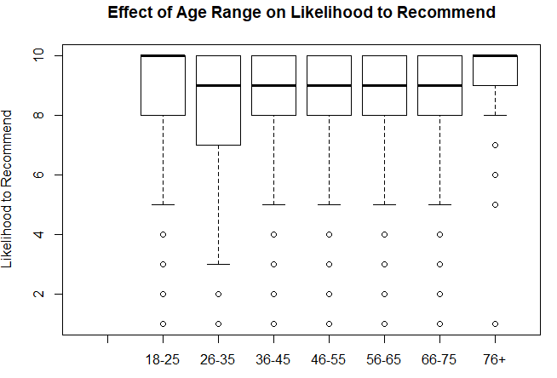
What is the effect of age group on the NPS score

Slide 17
What are the recommendations you can provide to improve the NPS of Hyatt?
Hyatt Hotel Chains should focus on :
Improving the Hotel Condition, Guest Room Condition and Customer Service as they directly impact the Net Promoter Score.
Improve the rooms ‘Guest Room King’ and ‘Guest Room Double,’ primarily in General Hyatt brand hotels.
Center the Hotel Promotional Activities towards the age groups of 26-35, 36-45, and 46-55 as the detractors seem to be concentrated in that group.
To improve the Hotel Condition, you can invest on improving facilities like Mini Bar, which will thereby have an impact on the NPS

Slide 18

Questions

