Slide 1
ONLINE MARBLE SHOPPING
NASARI K
ROLL NO:35
MCA

Slide 2
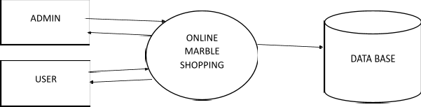



DATA FLOW DIAGRAM
LEVEL 0

Slide 3
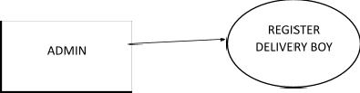





















LEVEL 1

Slide 4
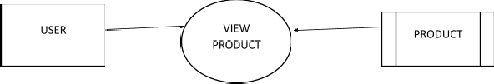















LEVEL 1.1

Slide 5
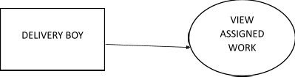




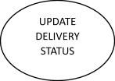
LEVEL 1.2
DATABASE DESIGN
LOGIN
FIELD NAME | DATA TYPE | CONSTRAINTS
LOGIN_ID | VARCHAR(10) | PRIMARY KEY
USER NAME | VARCHAR(15) | NOT NULL
PASSWORD | VARCHAR(20) | NOT NULL
TYPE | VARCHAR (15) | NOT NULL

Slide 6
DELIVERY BOY
FIELD NAME | DATA TYPE | CONSTRAINTS
D_ID | VARCHAR (10) | PRIMARY KEY
D_PLACE | VARCHAR(20) | NOT NULL
D_PHONE | INT | NOT NULL
D_EMAIL | VARCHAR(20) | NOT NULL
D_PROOF | VARCHAR(20) | NOT NULL
USER
FIELD NAME | DATA TYPE | CONSTRAINTS
U_ID | VARCHAR (15) | PRIMARY KEY
D_PLACE | VARCHAR(20) | NOT NULL
U_PHONE | INT | NOT NULL
U_EMAIL | VARCHAR(20) | NOT NULL
U_PROOF | VARCHAR(30) | NOT NULL

Slide 7
VEHICLE
FIELD NAME | DATA TYPE | CONSTRAINTS
V_ID | VARCHAR (20) | PRIMARY KEY
V_NAME | VARCHAR(20) | NOT NULL
V_NUMBER | VARCHAR(20) | NOT NULL
V_MODEL | VARCHAR(20) | NOT NULL
PRODUCT
FIELD NAME | DATA TYPE | CONSTRAINTS
P_ID | VARCHAR (20) | PRIMARY KEY
P_NAME | VARCHAR(20) | NOT NULL
P_PRICE | VARCHAR(20) | NOT NULL
P_IMAGE | VARCHAR(30) | NOT NULL

Slide 8
ORDER
FIELD NAME | DATA TYPE | CONSTRAINTS
O_ID | VARCHAR (20) | PRIMARY KEY
USER_ID | VARCHAR (20) | FOREIGN KEY
P_ID | VARCHAR (20) | FOREIGN KEY
DATE | DATE | NOT NULL
TIME | TIME | NOT NULL
QUALITY | VARCHAR(20) | NOT NULL
ASSIGN
FIELD NAME | DATA TYPE | CONSTRAINTS
A_ID | VARCHAR (20) | PRIMARY KEY
O_ID | VARCHAR (20) | FOREIGN KEY
D_ID | VARCHAR (20) | FOREIGN KEY
DATE | DATE | NOT NULL
TIME | TIME | NOT NULL
STATUS | VARCHAR(10) | NOT NULL

Slide 9
COMPLAINT
FIELD NAME | DATA TYPE | CONSTRAINTS
C_ID | VARCHAR (20) | PRIMARY KEY
U_ID | VARCHAR (20) | FOREIGN KEY
COMPLAINT | VARCHAR(20) | NOT NULL
REPLY | VARCHAR(20) | NOT NULL
DATE | DATE | NOT NULL
TIME | TIME | NOT NULL
PAYMENT
FIELD NAME | DATA TYPE | CONSTRAINTS
PAYMENT_ID | VARCHAR (20) | PRIMARY KEY
U_ID | VARCHAR (20) | FOREIGN KEY
O_ID | VARCHAR (20) | FOREIGN KEY
AMOUNT | FLOAT | NOT NULL
DATE | DATE | NOT NULL
TIME | TIME | NOT NULL

