Slide 1
Road Arc Attribute Editor
A QGIS Plugin for Standardized Road Network Attribute Management
under the Colombian Nomenclature
Nataly Alejandra Sarmiento Ospina | Geoinformatics Engineering | 2025–2026

Slide 2
Problem & Context
The Challenge
The VIAL Standard
Colombian standard requires 17 structured fields per road arc
Legacy GeoPackage/Shapefile datasets use inconsistent field names
Standard QGIS forms lack specific validation and controlled vocabularies
No built-in tool for propagating values across topologically contiguous segments
Defined by IGAC — Instituto Geográfico Agustín Codazzi
Encodes road identity: tipo_via + principal number + quadrant + generative road
Required for Colombia's Spatial Data Infrastructure (ICDE) compliance
Aligned with ISO 19157 geographic data quality standard

Slide 3
What the Plugin Does
① Field Mapping
② Inline Validation
③ Direction Normalization
GUI-guided import of legacy attributes into the VIAL schema via QComboBox dialog
Per-cell validators block invalid inputs; controlled vocabularies for tipo_via & quadrant fields
Canonical W→E / S→N polyline orientation enforced across all arcs automatically
④ Chain Detection
⑤ Generative Road Derivation
⑥ Audit Trail
Graph-based BFS grouping of co-linear contiguous segments by angular alignment (δ ≤ 15°)
Spatial index + perpendicularity ranking auto-fills num_generadora and related fields
Full JSON naming snapshots in historico_nom + UTC ISO 8601 timestamps on every write

Slide 4
System Architecture
__init__.py
plugin.py
QGIS entry point
classFactory(iface)
Lifecycle & Orchestration
initGui · run_attr_editor_flow · unload
attr_editor_core/
utils_common/
processing/
core.py · editor_dock.py
vial_reglas.py · mapping_dialog.py
Field schema, validation, UI dock
road_chain_merger.py
Chain detection & line dissolution
Geometric pipeline utilities
provider.py · alg_tool_two.py
QGIS Processing framework
Provider & algorithm stubs
Single Source of Truth (SSOT): all schema definitions live in core.py and vial_reglas.py. Every UI component — dock, delegate, suggestions engine — consumes these definitions rather than duplicating them, preventing schema drift.

Slide 5
Editing Session Workflow
1
2
3
4
5
Field
Mapping
Schema
Creation
Value
Transfer
Direction
Normalization
Labels
+ Dock
Map legacy fields to targets via
GUI dialog (line layers only)
Ensure all 17 VIAL fields exist;
migrate historico_nom to TEXT
apply_field_mapping() — single
changeAttributeValues() per feature
Orient polylines W→E
(S→N if same X coordinate)
Activate rule-based labels;
open AttrEditorDock
↩ Back-to-Mapping: dock rewinds the undo stack to the pre-mapping checkpoint and re-launches Step 1, preserving all other edits.

Slide 6
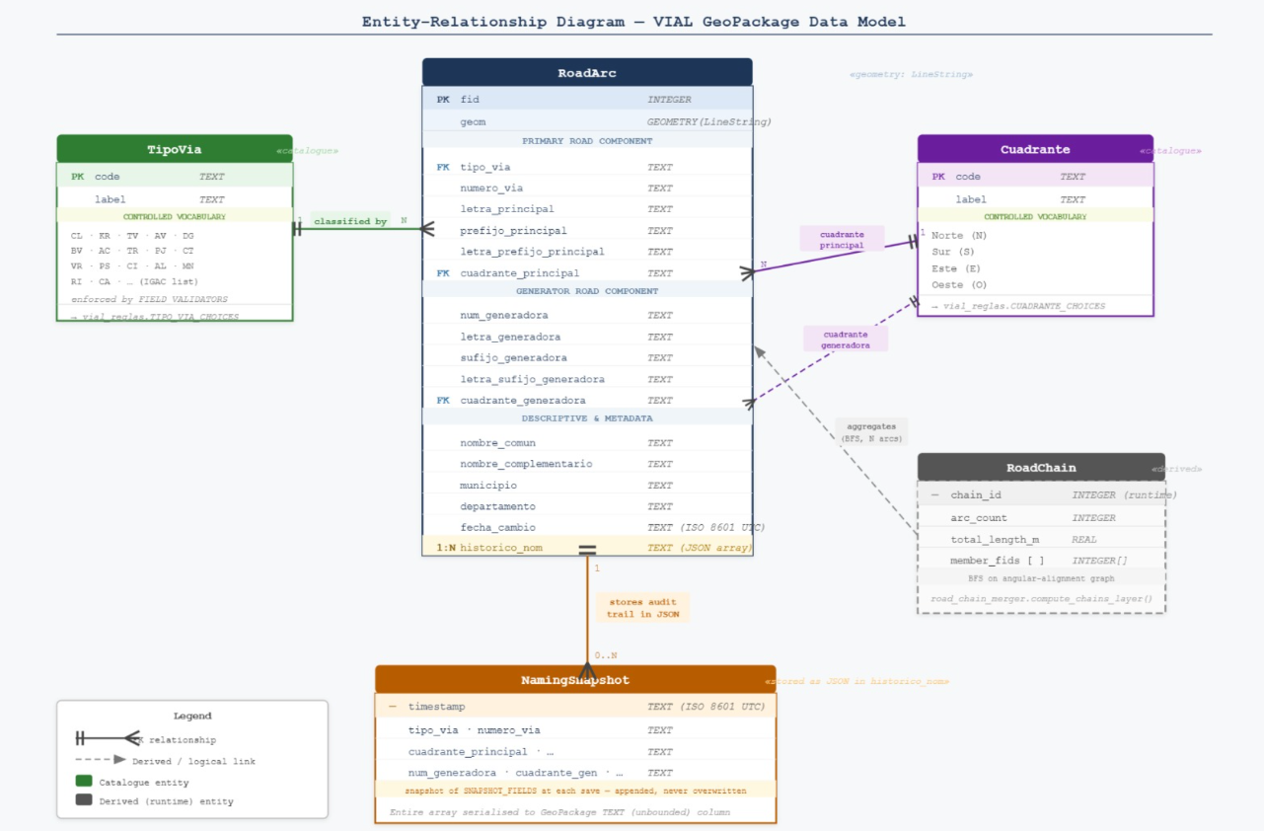
VIAL Field Schema — Key Fields
Field Name | Type | Description / Constraints
tipo_via | String | Road type — CL, KR, DG, TV, AV, AC, AK, CT, VT, TR
nombre_via | String | Official road name
numero_via | String | Principal road number (integer + optional suffix)
letra_principal | String | Letter A–Z, excluding {E, S, W, Ñ} (Bogotá grid)
prefijo_principal | String | Street prefix
cuadrante_principal | String | Directional quadrant: N, S, E, W
num_generadora | String | Generative road number
tipo_via_generadora | String | Generative road type (same vocabulary)
cuadrante_generadora | String | Generative road directional quadrant
acto_admin | String | Legal instrument — DECRETO, ACUERDO, etc.
historico_nom | TEXT | JSON array of prior naming snapshots (unbounded TEXT)
fecha_cambio | String | UTC ISO 8601 timestamp of last attribute write

Slide 7
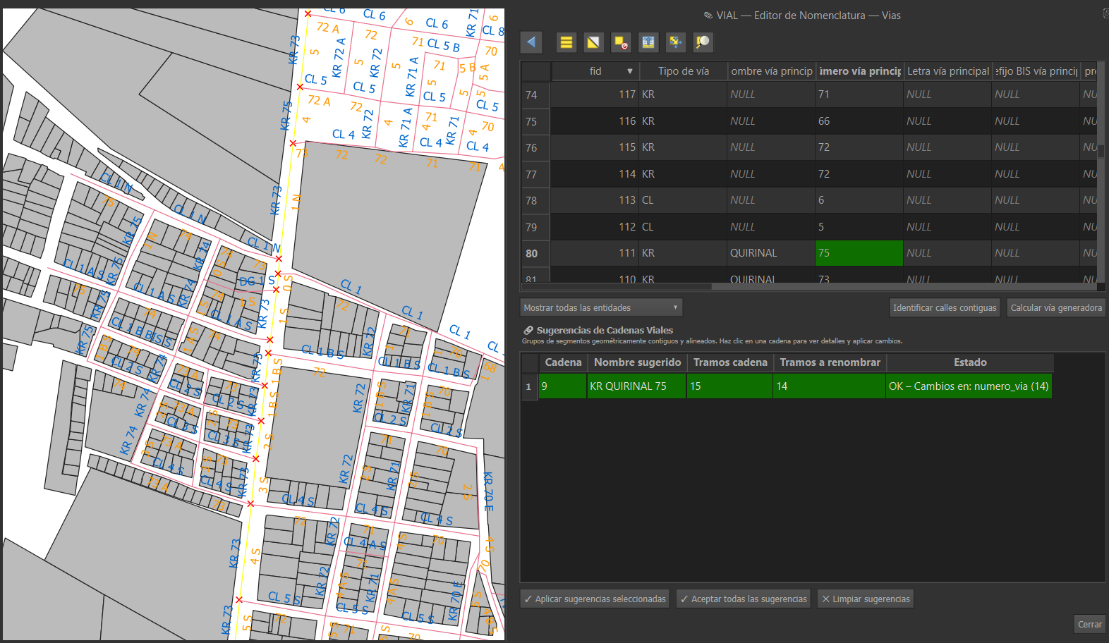
Chain Detection Algorithm
8-Step Pipeline (road_chain_merger.py)
1
Integer ID assignment — to_int($id) via fieldcalculator
2
Axis orientation — direction-invariant bearing [0°, 180°)
3
Vertex snapping — native:snapgeometries (tol = 0.5 m)
Key Formulas
4
Geometry repair — native:fixgeometries
5
Line intersections — native:lineintersections (id + axis_deg)
Axis Orientation (axis_deg):
Angular Difference (axis_diff):
α = (azimuth(start, end)
+ 360) mod 180
δ = |((αa - αb + 90)
mod 180) - 90|
6
Angular difference — axis_diff per intersection pair
7
Alignment filtering — axis_diff ≤ 15° AND a_id ≠ b_id
Alignment Condition:
δ <= θ (θ = 15°)
AND a_id != b_id
8
BFS connected components → chain_id assignment

Slide 8
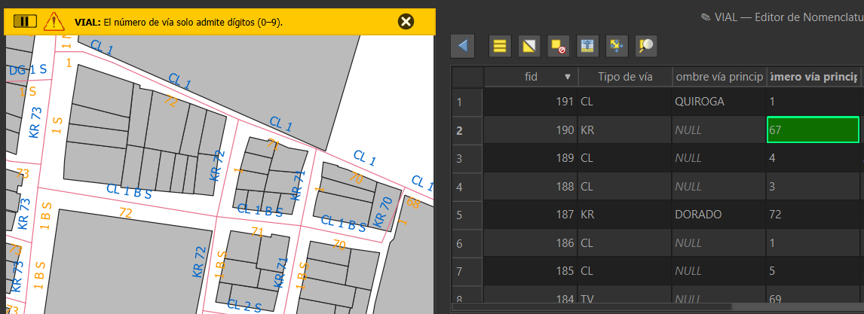
Validation System
VialAttributeDelegate
Key Validation Rules (vial_reglas.py)
tipo_via
Must be in {CL, KR, DG, TV, AV, AC, AK, CT, VT, TR}
letra_principal
Uppercase; cannot be E, S, W or Ñ (Bogotá grid)
numero_via
Integer string + optional suffix; 0S/0E allowed
Extends QgsAttributeTableDelegate
createEditor() → QComboBox for tipo_via & cuadrante fields; standard editor otherwise
setModelData() routes every edit through FIELD_VALIDATORS before persisting
Invalid values are blocked at write time — never reach the layer
Multi-row selection: validated value broadcast atomically to all selected features
cuadrante_*
Must be in {N, S, E, W}
acto_admin
Uppercase; Dcto → DECRETO, etc.
f : raw_value → (normalized, error | None)
nombre_via
Trimmed and normalized; null/blank treated as empty

Slide 9
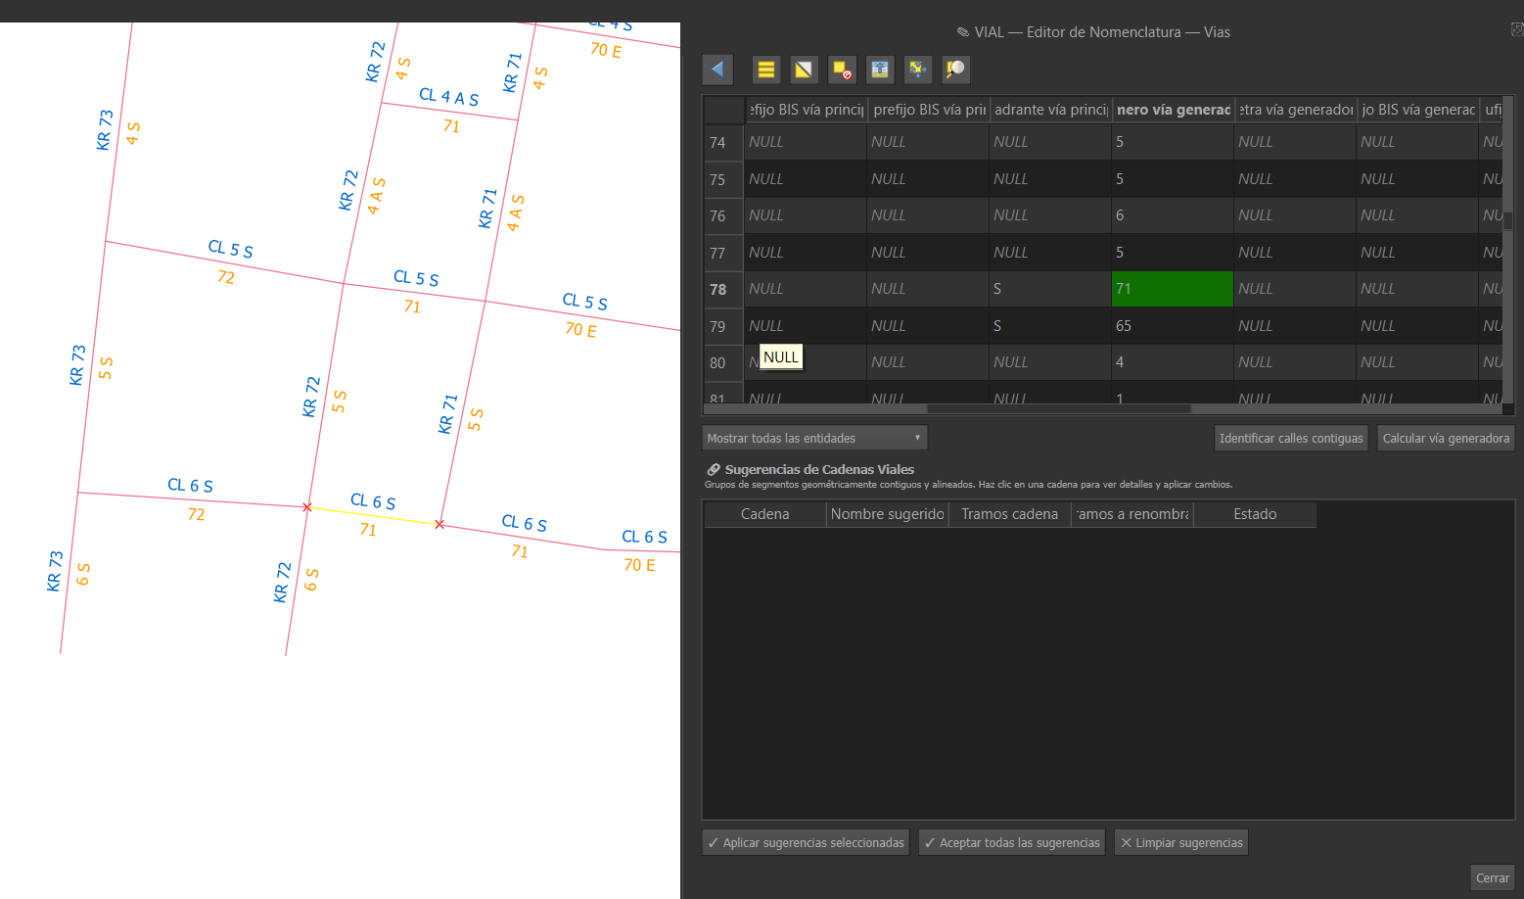
Generative Road Derivation
Generative Road Derivation
QgsSpatialIndex finds all arcs intersecting the target segment
Candidates ranked by perpendicularity (α ≈ target + 90°)
Majority-vote consensus on tipo_via + numero_via pair
Special DG / TV review panel for diagonal and transversal roads
User confirms or overrides suggestions before writing to layer
Special case: arcs at coordinates 0S / 0E require manual review per VIAL standard.

Slide 10
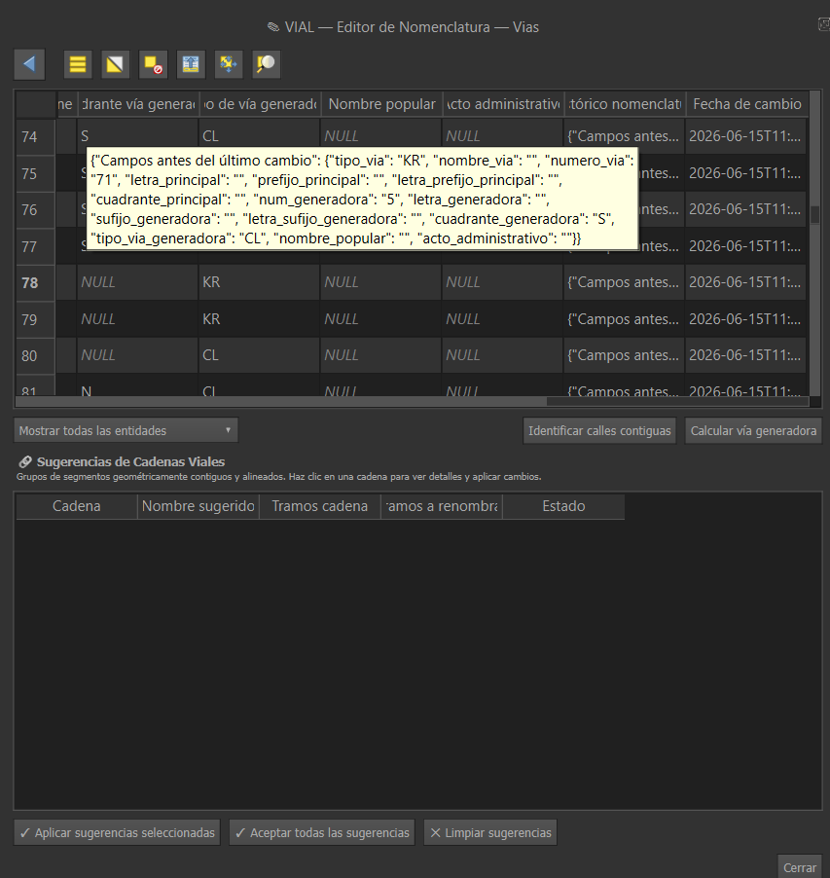
Audit Trail
Audit Trail
Every validated write triggers two operations:
historico_nom — 15 VIAL fields serialized as JSON object, prepended to array
fecha_cambio — current UTC timestamp in ISO 8601 format
Both wrapped in beginEditCommand / endEditCommand → one atomic undo step
historico_nom auto-migrated from VARCHAR(255) to TEXT for unbounded JSON
[{"tipo_via":"CL","num_via":"72",...,
"ts":"2026-06-10T14:32:00Z"}]

Slide 11
Strengths & Limitations
✓ Strengths
⚠ Limitations
Clean SSOT design — schema and validators centralized
No unit test suite — schema changes require code edits
Batch changeAttributeValues() minimizes undo stack overhead
Chain detection in-memory — may be slow for >100k segments
Spatial index for intersection queries — scalable performance
Stateless validators — cross-field consistency not enforced
Reactive Qt signal/slot validation prevents invalid data at edit time
historico_nom unbounded — no truncation / archiving policy
Full JSON audit history with UTC timestamps on every write
Scoped to Colombian VIAL — not generalized to other standards
ISO 19157 logical consistency and format correctness enforced
VialToolTwoAlg is a placeholder — Processing framework unused

Slide 12
Conclusion
Domain-Embedded Quality
Topology-Aware Automation
Extensible Architecture
VIAL business rules enforced at edit time — not post-process — ensuring ISO 19157 compliance continuously on every attribute write.
Graph-based chain detection and spatial-index derivation significantly reduce manual effort for contiguous segment batches and generative road fields.
SSOT design, modular packages, and the Processing framework stub provide a solid base for cross-field validation and future headless batch auditing.
Nataly Alejandra Sarmiento Ospina · Geoinformatics Engineering · Politecnico di Milano · 2025–2026

