Slide 1
Uganda Food Price Prediction Using Machine Learning
Predicting Food Prices Using Historical Market Data
Project Presented by: Nasasira Praise Dataset: World Food Programme (WFP) Uganda Food Prices Dataset Project: Machine Learning Predictive Modeling August 2026

Slide 2
PROJECT OVERVIEW,PROBLEM STATEMENT & OBJECTIVES
The main aim of this project was to determine whether machine learning could be used to predict food prices in Uganda based on historical market and commodity information
Problem Statement
Food prices in Uganda vary across commodities, locations and time, making accurate price estimation challenging.
This project investigates whether machine learning can predict food prices using historical food market data.
Objectives
Analyze historical food price patterns.
Identify factors associated with food prices.
Prepare the data for machine learning.
Develop and compare predictive models.
Identify the best-performing model.

Slide 3
DATASET
Dataset Description
Source: World Food Programme(WFP). Global Food Prices Database. Humanitarian Data Exchange(HDX) Link: https://data.humdata.org/dataset/wfp-food-prices Country: Uganda Observations:30933 Features: 16 Target: Food Price

Slide 4
Main Variables
Variable | Description
Date | Date of observation
Admin1 / Admin2 | Location
Market | Market information
Commodity | Food product
Category | Food category
Unit | Measurement unit
Pricetype | Retail / wholesale
Price | Target variable

Slide 5
DATA PREPARATION
Before modelling,the following steps were performed:
Checked data types and dataset structure
Checked for missing values and duplicates
Cleaned the dataset
Created year and month features from the date
Encoded categorical variables
Selected relevant prediction features
Split the data into training and testing sets

Slide 6
EDA & KEY FINDINGS

Slide 7
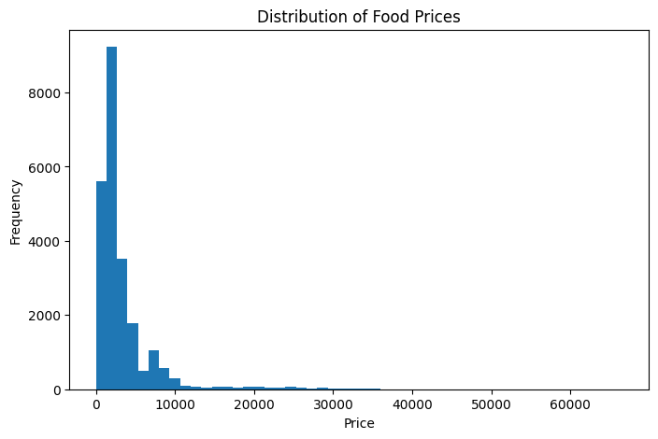
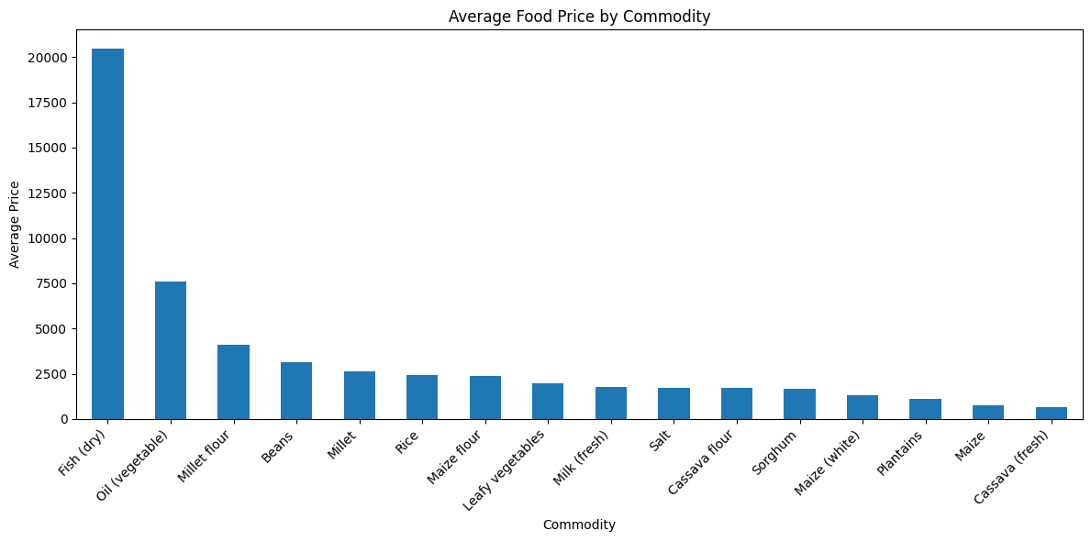
Price distribution histogram, Average price by commodity and Average Food Price Over Time

Slide 8
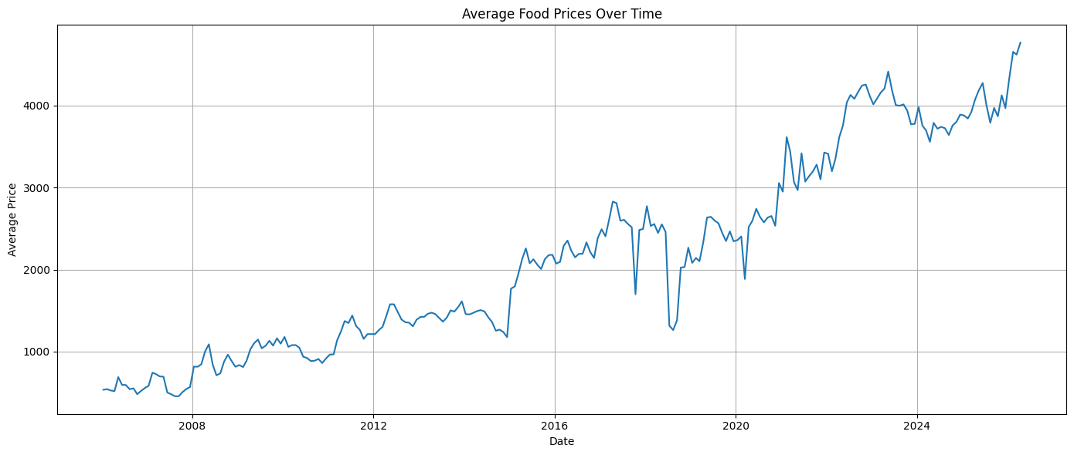

Slide 9
EDA Key Findings
Food prices were positively skewed.
Fish (dry) and vegetable oil were among the higher-priced commodities.
Cassava (fresh) was among the lower-priced commodities.
Average food prices generally increased over time.

Slide 10
The exploratory analysis showed that food prices were not evenly distributed. Some commodities had much higher prices than others, and prices generally showed an upward trend over time

Slide 11
MACHINE LEARNING
Machine Learning Approach
This was treated as a regression problem because the target variable, food price, is continuous.
I used two different approaches so that I could compare their predictive performance: Random Forest, which is a classical machine learning model, and a Neural Network
Random Forest Regressor
Classical machine learning model
Uses multiple decision trees
Captures nonlinear relationships
Neural Network
Deep learning model
Learns complex relationships between variables
Evaluation Metrics
MAE — Mean Absolute Error
RMSE — Root Mean Squared Error
R² — Coefficient of Determination

Slide 12
MODEL COMPARISON RESULTS
Random Forest
MAE: 335.20
RMSE: 1242.19
R²: 90.74%
Neural Network
MAE: 702.64
RMSE: 1513.58
R²: 86.25%

Slide 13
The Random Forest model performed better than the Neural Network. It achieved an MAE of 335.20, an RMSE of 1242.19 and an R-squared of 90.74%, compared with 86.25% for the Neural Network. Therefore, Random Forest was selected as the best-performing model

Slide 14
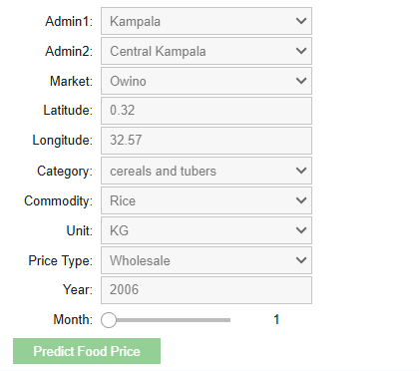
Food Price Prediction Demo
I also developed a working prediction interface where a user can provide information about a food commodity and market conditions and receive a predicted food price.
Administrative region
Market
Commodity
Category
Unit
Price type
Year
Month
Latitude and longitude
Output
Predicted Food Price

Slide 15
KEY FINDINGS & RECOMMENDATIONS
Key Findings
Food prices vary considerably between commodities.
Prices generally increased over the period analyzed.
Commodity type was an important factor in price prediction.
Random Forest provided the strongest predictive performance.
The model achieved 90.74% R² on the test data.
Recommendations
Use predictive analytics to support food security planning.
Support farmers and traders with better price information.
Use updated data to continuously improve the model.
Future models could include weather, inflation, fuel prices and seasonal production.

Slide 16
Conclusion
Machine learning can be used to predict food prices using historical Uganda food price data.
Best Model: Random Forest
R²: 90.74%
MAE: 335.20
RMSE: 1242.19
Future Improvement
However, integrating additional factors such as weather conditions, inflation, fuel prices, seasonal production and supply conditions could improve future food price prediction models.
Thank You

