Slide 1
Local LLM with RAG, Explained

Slide 2
Who this is for
You forked the repo and read the architecture, but it did not click yet
Goal: understand what happens, in what order, and why
We follow one question from the browser to the answer
Companion document: 01-detailed-guide.md (more depth, same order)

Slide 3
The problem
An LLM only knows what it saw in training
It does not know your PDFs and reports
Asked about them, it may invent an answer (hallucination)
We need a way to hand it the right passages at question time

Slide 4
The idea: RAG
Retrieval: find the passages of your documents that match the question
Augmented: put those passages into the prompt
Generation: the LLM writes the answer using them
Analogy: an open-book exam instead of an exam from memory

Slide 5
What is different here: agentic RAG
Classic RAG: always search once, then answer
Agentic RAG: the model decides whether, what and how often to search
Searching is a tool the model can call, like opening a drawer
Everything runs locally: Ollama + Pydantic AI, no cloud keys

Slide 6
Words you will meet
Embedding: numbers that capture the meaning of a text; similar meaning, nearby numbers
Chunk: a 1000-character piece of a document
Vector store: a database that finds the nearest vectors (LanceDB)
Tool calling: the model asks our code to run a function
Agent: LLM + tools + a loop (think, act, read, repeat)

Slide 7
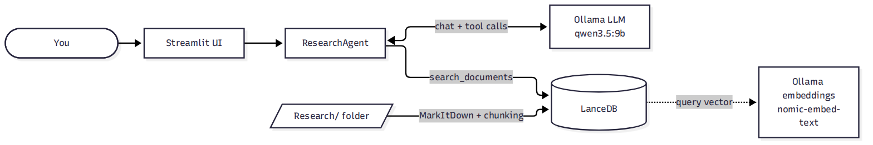
The big picture
diagram 1

Slide 8
Two life cycles
Indexing: happens once per folder, before any question
  read files, cut into chunks, embed, store
Answering: happens for every question
  the agent searches the store, reads results, writes the answer
Keeping these two apart is the key to reading the code

Slide 9
Indexing step 1: find and convert
load_documents walks the folder recursively
Supported: .pdf .docx .pptx .xlsx .md .html .csv .json
MarkItDown converts each file to Markdown text
A file that fails is skipped with a warning; indexing continues

Slide 10
Indexing step 2: chunking
Window of 1000 characters, moving forward 900 each time
The 100-character overlap keeps boundary sentences whole
Each chunk becomes {text, source, page}
Why small chunks? Search can then return only the relevant part

Slide 11
Indexing step 3: embed and store
The Document model marks text as the source of the vector
table.add(...) makes LanceDB call Ollama nomic-embed-text automatically
Each chunk gets a 768-number vector
Data lives in storage/lancedb (gitignored)
reload=False reuses the table, so switching models is fast

Slide 12
A known limitation
page is always 1: MarkItDown returns the whole file as one text
Citations [Source: file, Page: N] are trustworthy for the file, not the page
Planned fix: plan 001 (cite exact files and lines)

Slide 13
The agent
OpenAIChatModel + OllamaProvider at localhost:11434/v1
Ollama speaks the OpenAI-compatible API, so Pydantic AI reuses its client
AgentDeps hands the vector store to the tool (dependency injection)
The system prompt defines the behaviour

Slide 14
The system prompt says
ALWAYS use search_documents for document questions; never use own knowledge
Write complete, self-contained queries (no pronouns)
Split compound questions into several focused searches
Stop after about 2-3 searches
Say so if the documents do not contain the answer
Cite as [Source: ..., Page: ...]

Slide 15
The tool: search_documents
@self.agent.tool
async def search_documents(ctx, query: str) -> str:
vec = embedding_func.compute_query_embeddings(query)[0]
results = ctx.deps.vector_store.search(vec).limit(10).to_list()
Embed the query with the same model used at indexing
Return the 10 nearest chunks as text with source and page
The docstring and type hints become the tool description the model sees

Slide 16
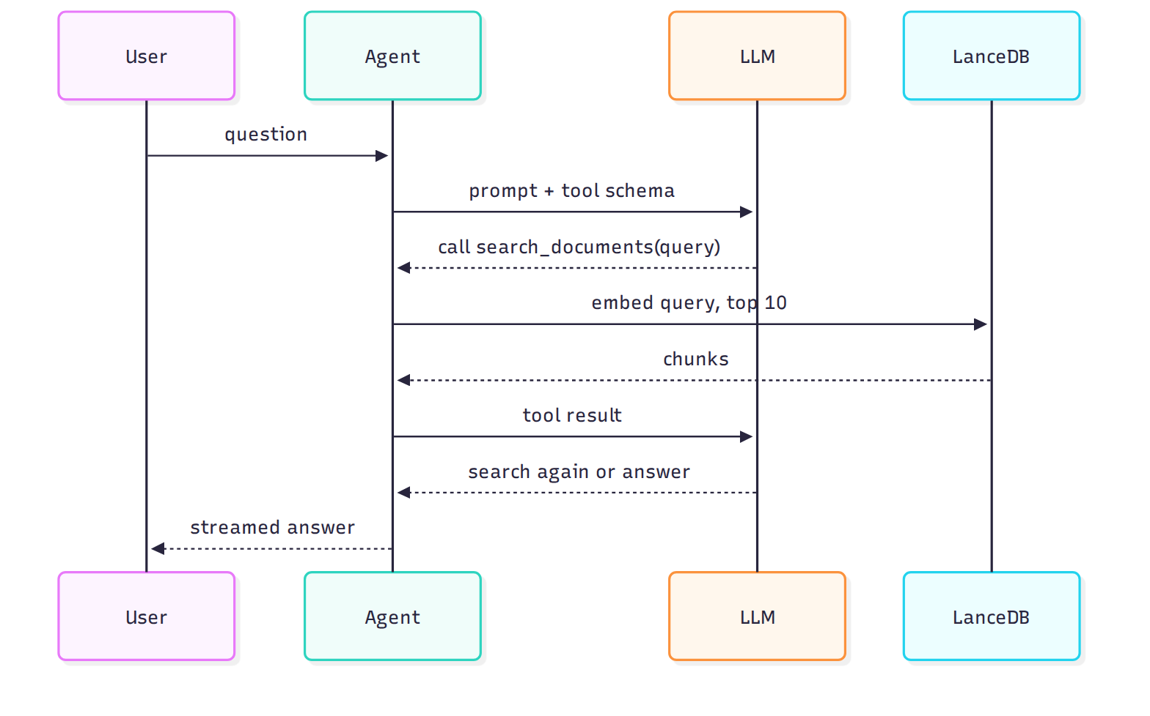
One question, step by step
diagram 2

Slide 17
Why this is "agentic"
The arrow "LLM asks for a search" can happen 0, 1 or several times
Zero: the model answers directly (small talk)
Several: it splits a compound question into focused searches
The loop ends when the model stops calling tools and writes the answer

Slide 18
Streaming
run_stream_sync starts the run; stream_text() yields the cumulative text
The code keeps last_text and yields only the new part
With tool events on, the UI first learns which queries were searched
Result: "Searching: ..." lines, then the answer appearing live

Slide 19
Safety valves
UsageLimits(tool_calls_limit=4) in the app: no endless search loops
enable_thinking: False for qwen3: avoids very long hidden reasoning
Models are filtered by the tools capability in core/models.py
Missing models are pulled automatically from Ollama

Slide 20
The Streamlit app
Streamlit re-runs the whole script on every click, so state lives in st.session_state
Sidebar: New Chat, model, documents folder, Re-index, chunk count
Agent rebuilt when model or folder changes; only a folder change re-indexes
Chat history is converted to Pydantic AI messages so the model remembers

Slide 21
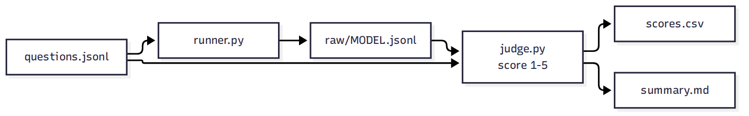
The benchmark: which model is best?
diagram 3

Slide 22
How the judge scores
Each question has a golden answer and a list of key facts
A larger model compares the candidate answer against them
5 = all facts, no hallucination, cites sources; 1 = wrong or empty
Also captured: search count, total time, time to first text
Use it as a baseline before changing prompts, tools or backend

Slide 23
Repository map
core/ agent, document loader, model helpers
interfaces/ Streamlit app
bench/ evaluation harness
Research/ sample PDFs; storage/ generated vector data
docs/ architecture, ADRs (decisions), plans (future work)

Slide 24
Where it is heading
Plan 001, precision search: filesystem tools (find, grep, read line ranges), an iterative loop, hybrid retrieval, exact file and line citations
Plan 002, hybrid backend: llama.cpp on the GPU for the chat LLM, Ollama on the CPU for embeddings
Both are proposals; nothing is implemented yet

Slide 25
Hands-on path
Run the app and ask about the PDFs in Research/; watch the search lines
Ask something off-topic: does it search? does it admit it does not know?
Inspect a few stored chunks in a Python shell
Change one knob (chunk size, limit(10), a prompt line), re-index, run python -m bench --limit 2 -v
Read docs/plans/ to see the intended direction

Slide 26
Summary
Documents become chunks, chunks become vectors, vectors live in LanceDB
A local LLM, as an agent, decides when to call search_documents
The tool returns the 10 nearest chunks; the model answers with citations
A benchmark with an LLM judge compares models objectively
Next steps: more precise search and a faster inference backend

