Slide 1
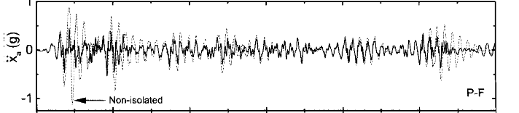
091- Reference Journal
Unidirectional: Cent_acc_00.txt
Ts=0.5, NST=5, U=0.1, rmbm=1, es=0.05, ndt=985, dtn=0.02, ndiv=50

Slide 2
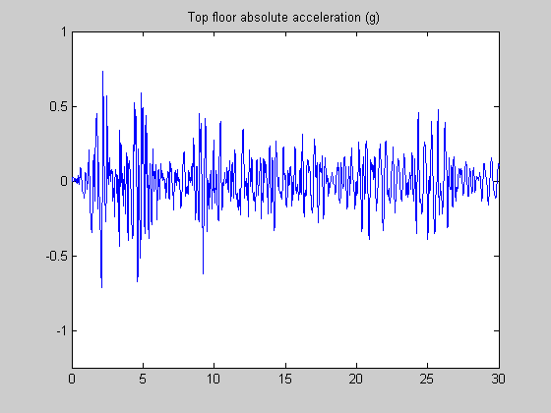

Slide 4
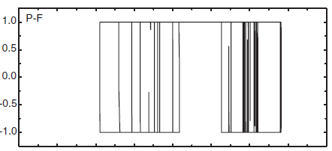

Slide 5
