Slide 1
Classification of Authors by Functional Words

Slide 2
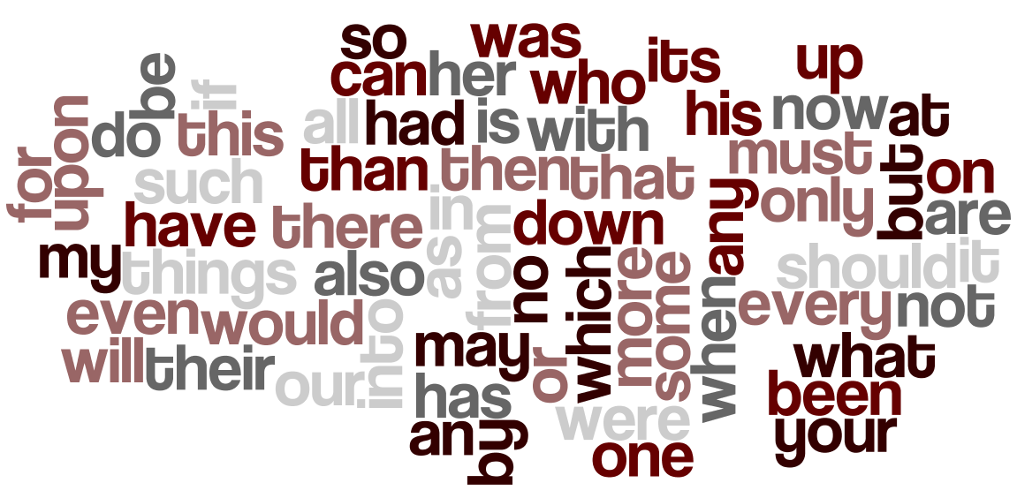
Introduction
Functional words: common prepositions, pronouns, adverbs, etc.

Slide 3
Goals/Motivation
Motivation
Every writer has his own writing style
Be able to match authors to anonymous books written in different periods
Goals
Classify authors on the basis of functional words
Reduce the number of functional words required for the classification problem

Slide 4
About the Dataset
65 variables and 841 Observations
Authors: William Shakespeare, John Milton, Jack London, Jane Austen
69 Function Words (Predictor Variables)
Removed words: a, and, of, the, to
Notes:
Raw data
But problem with raw data :: noisy. Too many.
eg) words such as ‘and, a, the, of’ definitely going to be used a lot. Thus excluded them to not affect the clear classification.
We reduced to 14 variables base on loadings of PCA.

Slide 5
Assumptions
While analyzing the frequencies, we have the following assumptions:
The style of the author remains the same.
Occurrences of successive functional words are independent.
Blocks of 1700 words chosen because there’s an offset between maintaining the style, and the dependence of the variables.
Notes:
Raw data
But problem with raw data :: noisy. Too many.
eg) words such as ‘and, a, the, of’ definitely going to be used a lot. Thus excluded them to not affect the clear classification.
We reduced to 14 variables base on loadings of PCA.

Slide 6
About the Authors
William Shakespeare (1564 – 1616)
Playwright: 13 of his plays are included in the dataset.
Various kinds of plays ranging from comedies to tragedies.
John Milton (1608 – 1674)
Poet: Known for his epic poem Paradise Lost, included in the data set.
Wrote at a time of political change, and his ideas reflect freedom and urgent issues of his day.

Slide 7
About the Authors
Jane Austen (1775 – 1817)
Novelist: 5 of her works are included in the data set.
Romantic fiction, with strong realism and social commentary.
Jack London (1876 – 1916)
Author and social activist: 6 of his works are included in the data set.
Pioneer of magazine commercial fiction. Advocate of socialism and worker rights.

Slide 8
Exploratory Analysis
Notes:
We started off the analysis by dividing our dataset by classes. Then for each class (each author), we created a bar plot of the frequency of each variable.

Slide 9
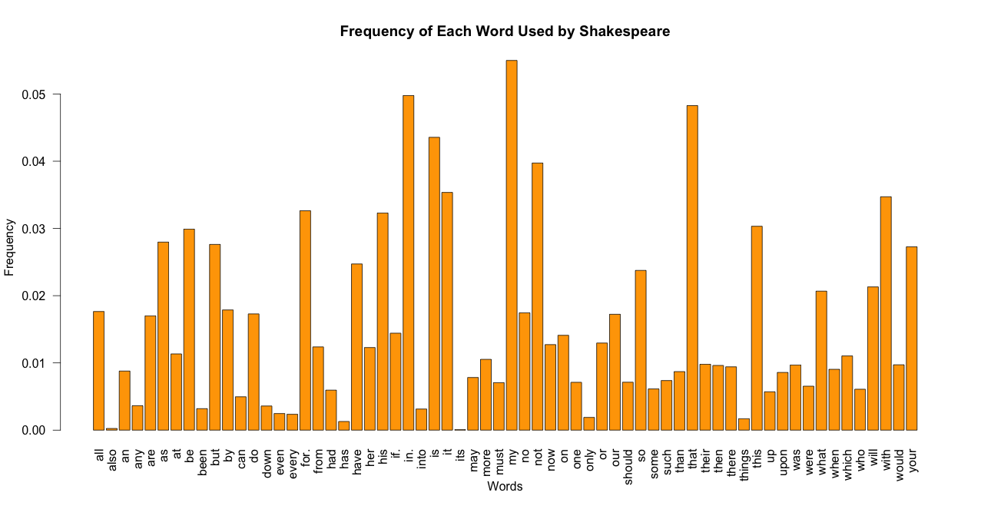
Shakespeare
Most Frequent Words: My, In, That, Is, Not
Notes:
The x-axis was the words (each of the 64 variables), and the y-axis was the frequency: the number of times the word was used divided by the total number of words used by that author.
As we can see from Shakespeare’s frequency plot, the most frequent words used by him were My, In, That, Is, and Not.

Slide 10
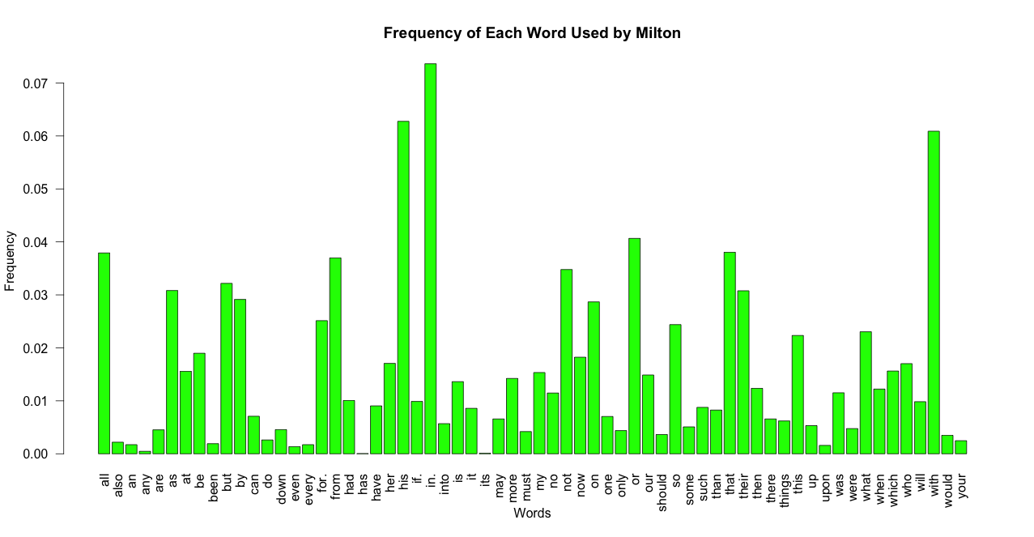
Milton
Most Frequent Words: In, His, With, Or, All
Notes:
Milton’s most frequent words were: In, His, With, Or, All

Slide 11
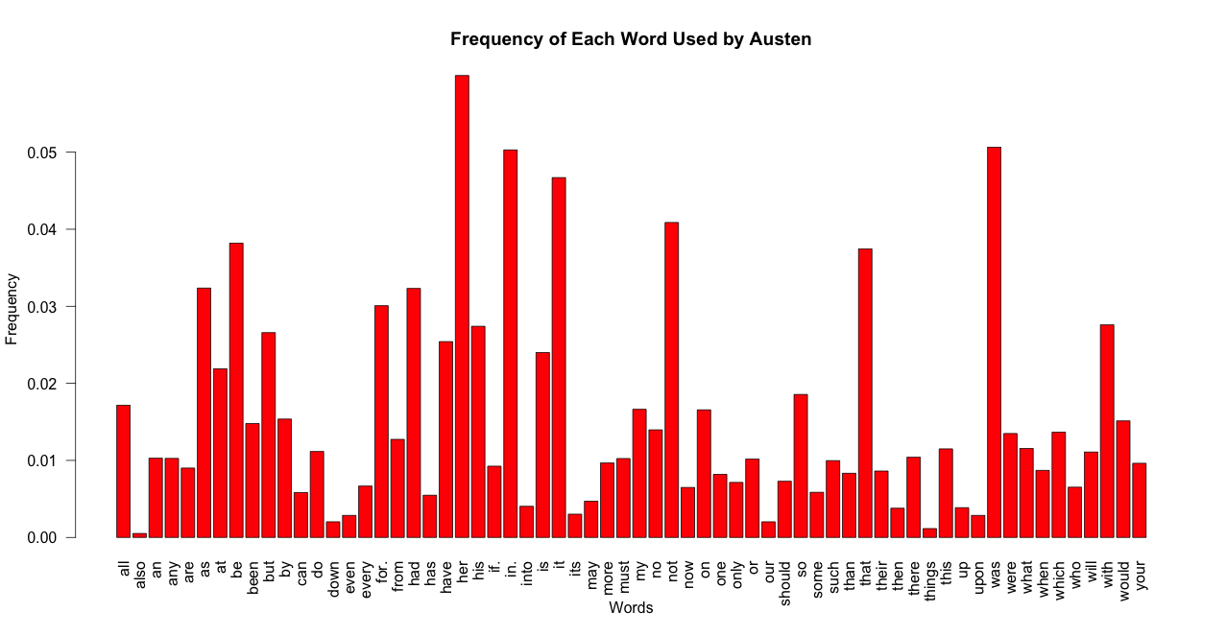
Austen
Most Frequent Words: Her, Was, In, It, Not
Notes:
Austen’s most frequently used words were Her, Was, In, It, and Not.

Slide 12
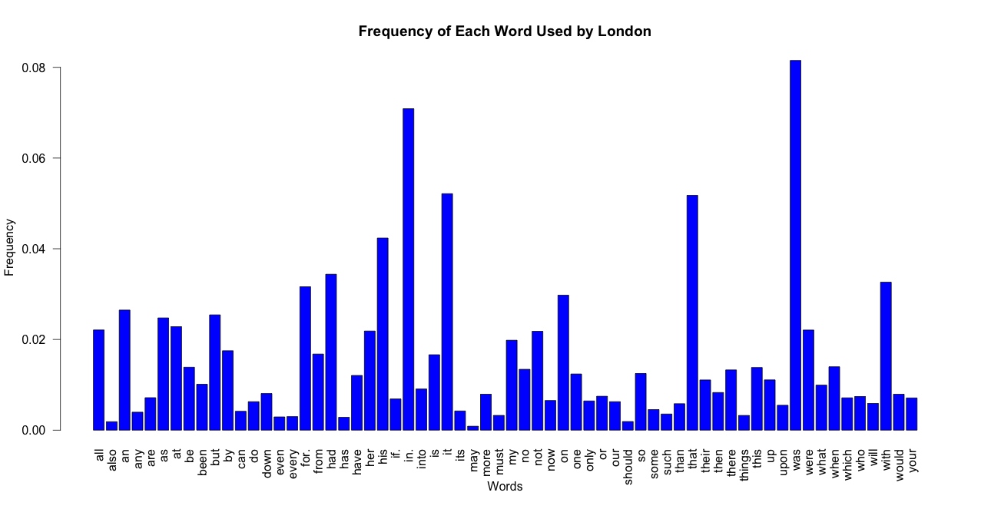
London
Most Frequent Words: Was, In, It, That, His
Notes:
And London’s most frequently used words were: Was, In, It, That, His

Slide 13
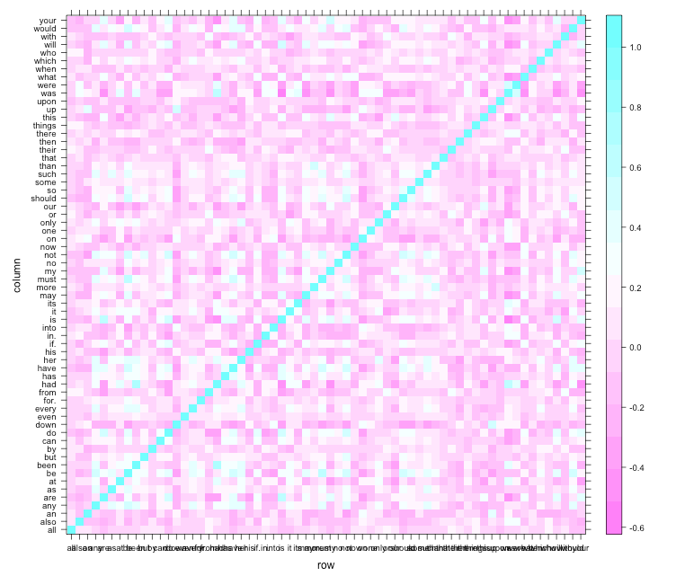
Heatmap
Notes:
We also checked the correlations between the variables, and as can be seen by the heatmap, majority of the variables were really highly uncorrelated, or negatively correlated.

Slide 14
Methods Used in the Analysis
Dimension Reduction Techniques Used
Principal Components Analysis (PCA)
Classification Methods Used
Linear Discriminant Analysis (LDA)
Quadratic Discriminant Analysis (QDA)
Logistic Regression (LR)
Nearest Neighbors (k-NN)
Support Vector machines (SVM)
Classification Trees
Random Forest (RF)
Notes:
The methods used in our analysis were: PCA, LDA, Logistic Regression, k-Nearest Neighbors, SVM, Classification Trees, and Random forest.

Slide 15
Dimension Reduction Techniques
Notes:
For the sole purpose of dimension reduction, we performed the Principal Components Analysis.
Although the analysis gave us 64 principal components, we decided to mainly focus on the first three, the first three PCs explained over 50 percent of the variance.

Slide 16
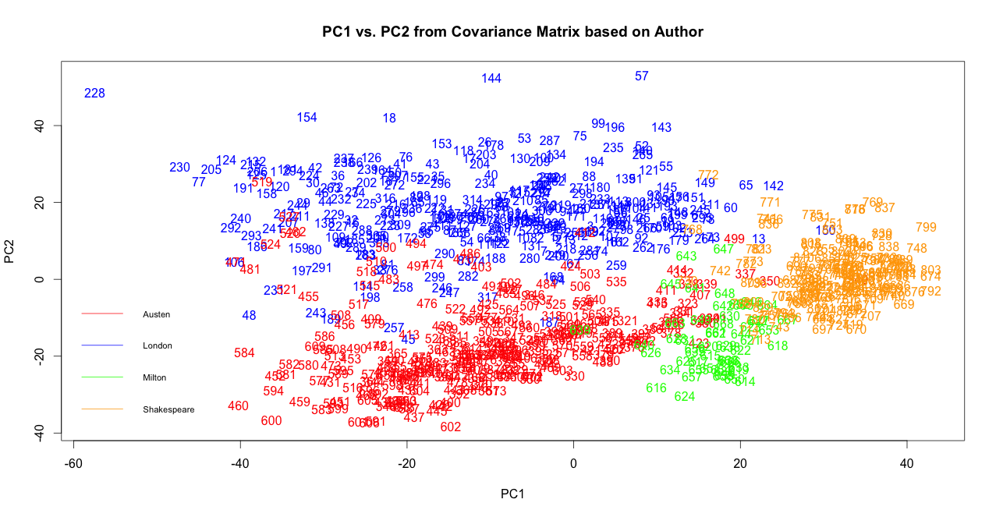
PC1 and PC2
Notes:
This is the PC1 vs. PC2 plot….(the four colors are the different Authors: Blue = Austen, Red = London, Green = Milton, and Orange = Shakespeare)

Slide 17
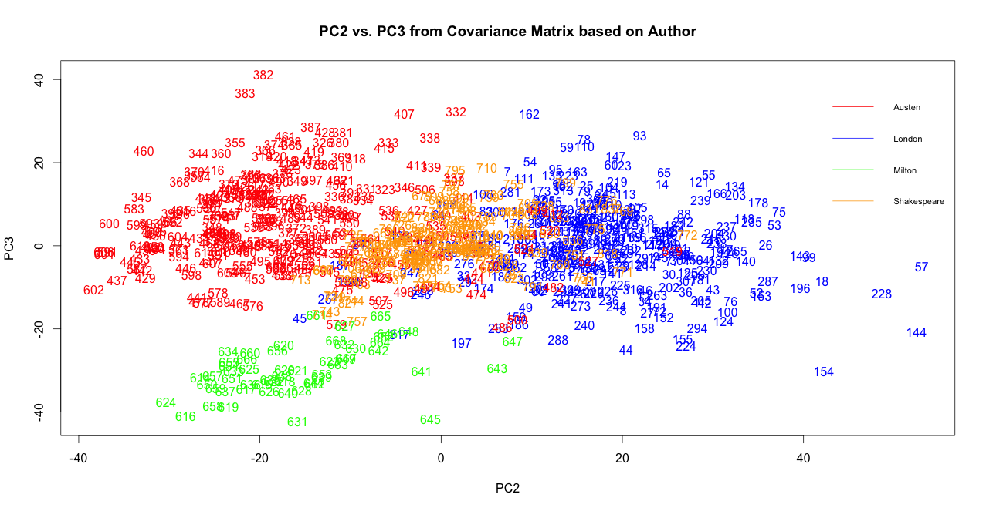
PC2 and PC3
Notes:
….and this is the PC2 vs. PC3 plot.
Both of just three PCs, we can see that there is a significant difference between the four classes. The loadings itself were not very interpretable, however, we decided to plot the first three PC loadings and bar plot.

Slide 18
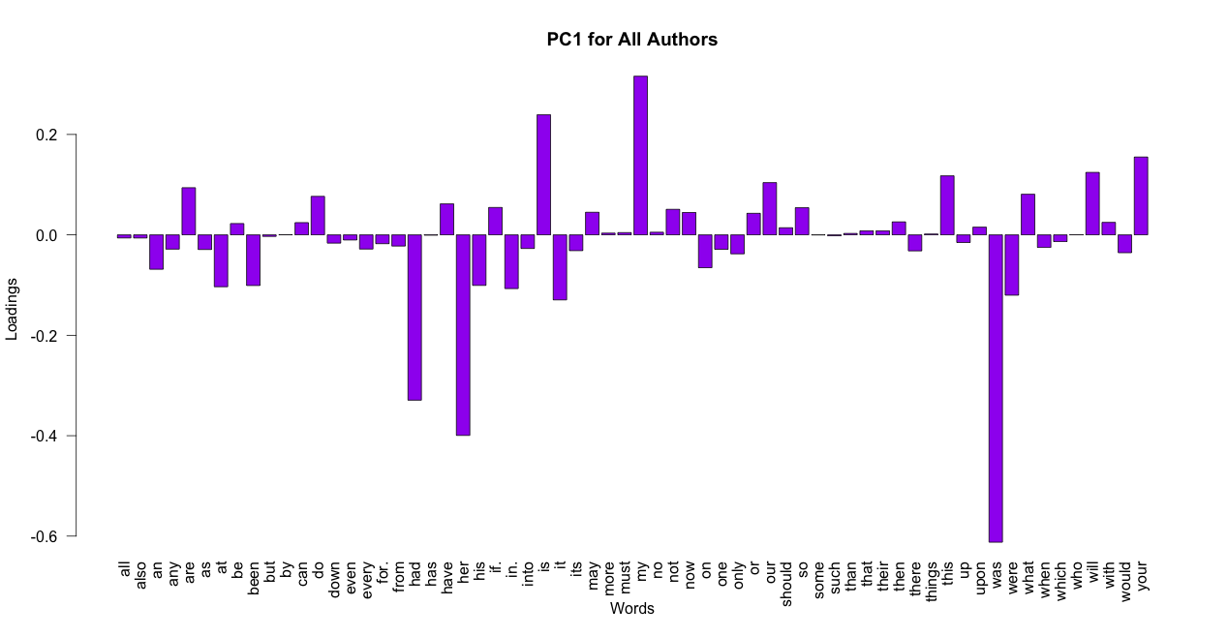
PC1 Loadings
Notes:
To reduce the dimensions of our dataset, we chose variables that seemed to have the highest loadings based on the bar plots of the first three PCs. We chose words like was…

Slide 19
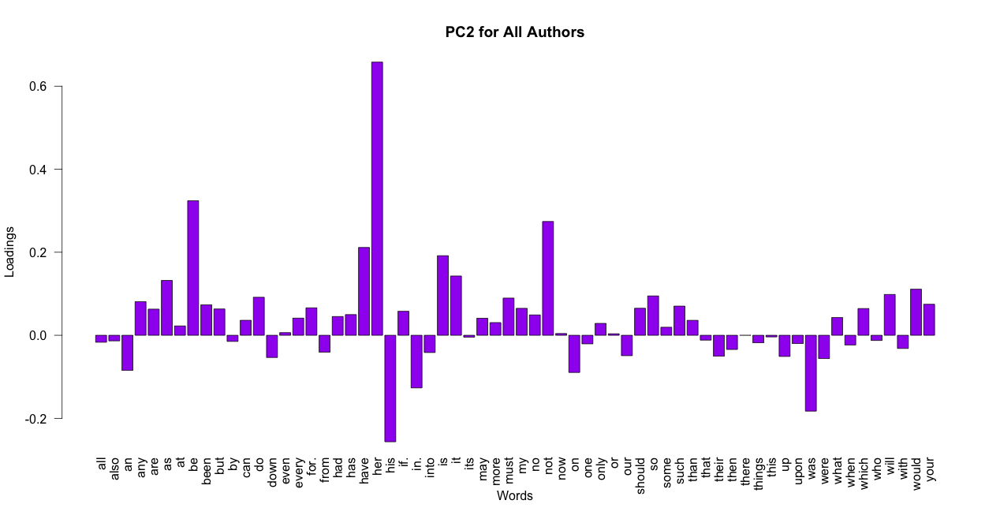
PC2 Loadings
Notes:
…. Her, his, …

Slide 20
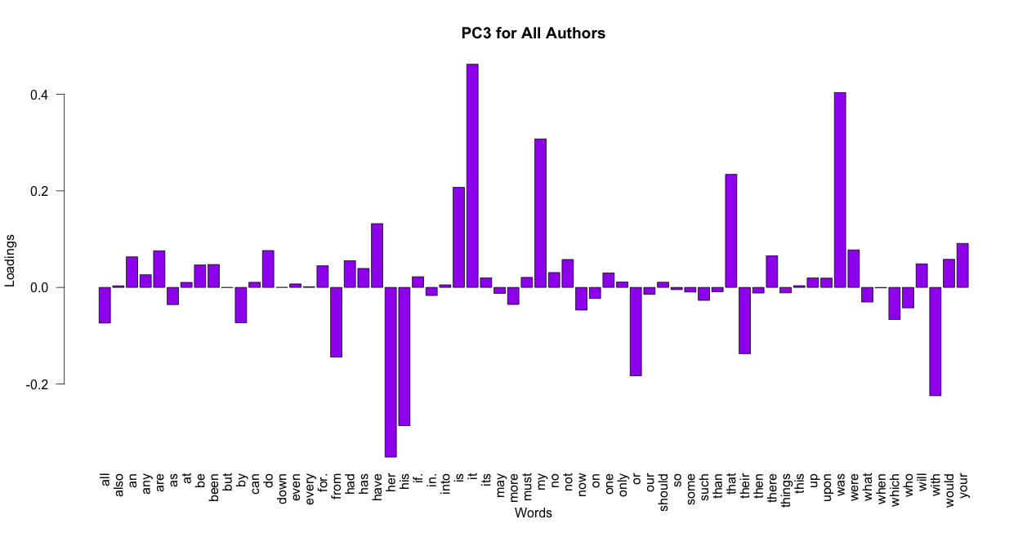
PC3 Loadings
Notes:
… my, etc.

Slide 21
Dimension Reduction
15 variables and 841 Observations
Authors: William Shakespeare, John Milton, Jack London, Jane Austen
14 Function Words (Predictor Variables): Was, Her, Had, Is, My, That, His, Their, Be, Not, It, Or, With, Any
Notes:
In the end we, we had 15 variables in total and 841 variables. The 14 variables we reduced to were: Was, Her, Had, Is, My, That, His, Their, Be, Not, It, Or, With, and Any.

Slide 22
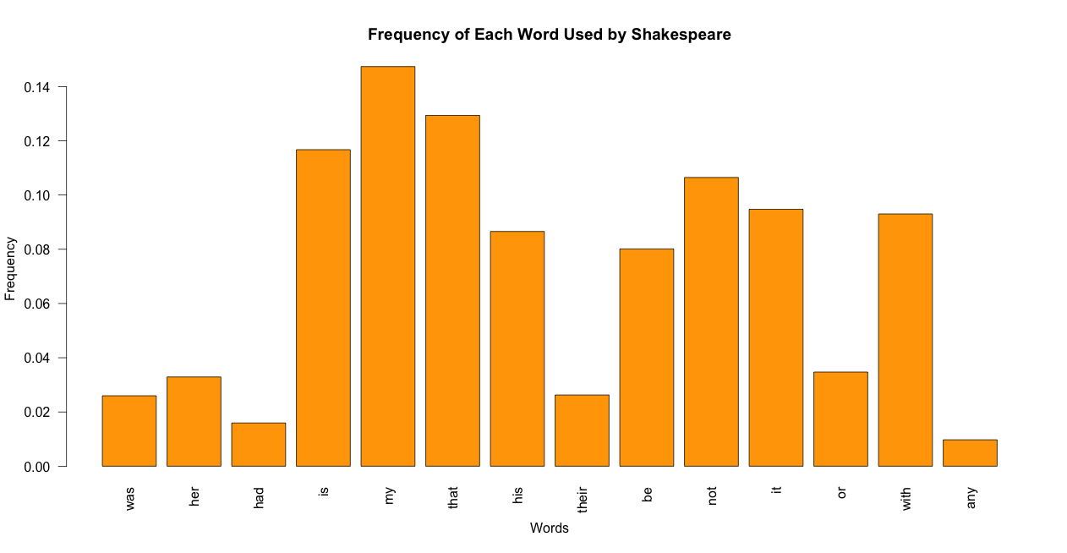
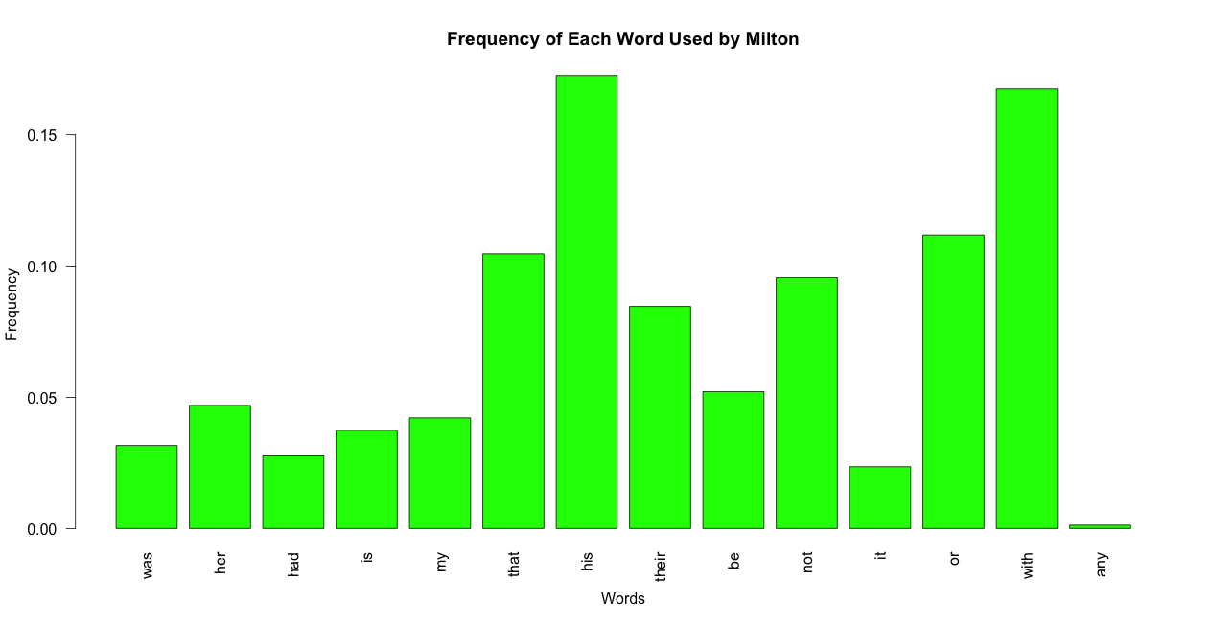
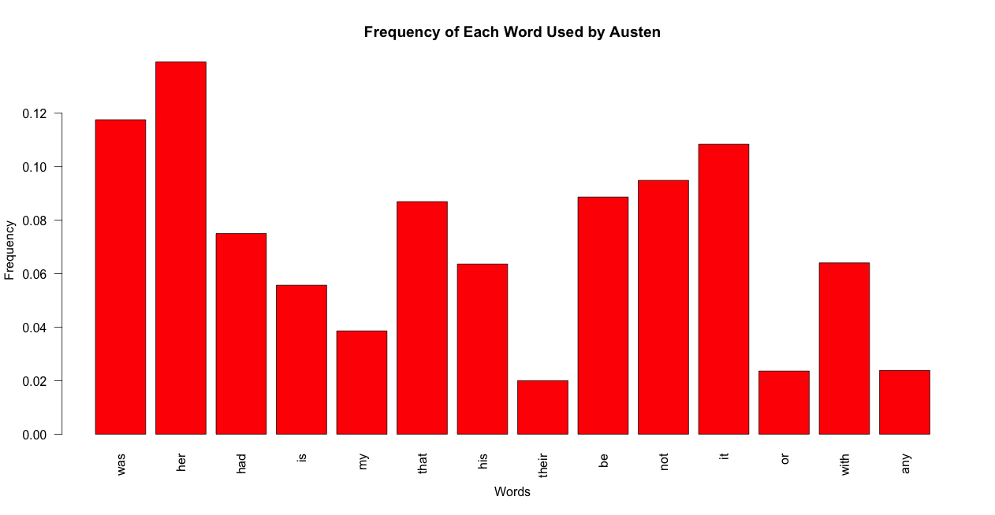
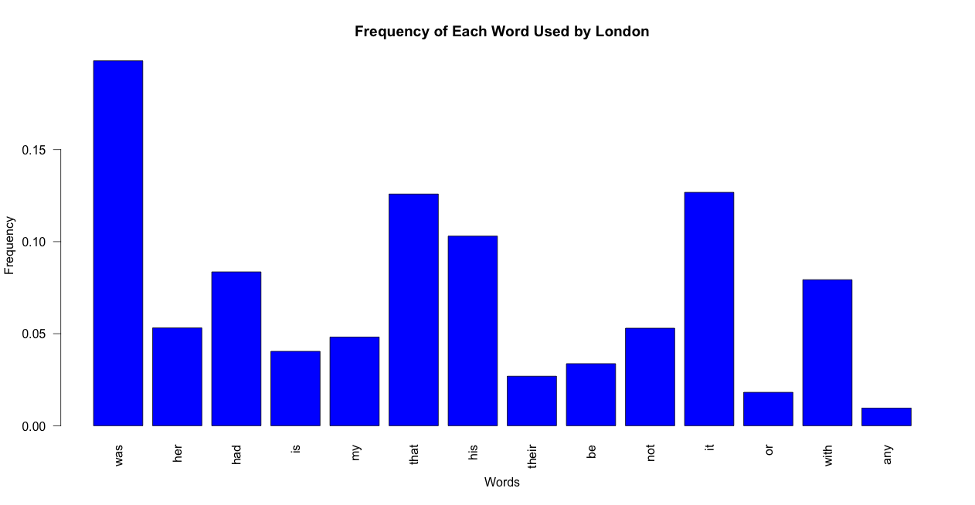
Frequency Plots
(14 Variables)
Notes:
Here, are the frequency plots of the 14 variables for each author. Some of the most frequent words we saw in the earlier plots are still seen in this plot.
Such as:
Shakespeare: My, That, Not
Milton: His, With, Or
London: Her, Was, Not
Austen: Was, That, His

Slide 23
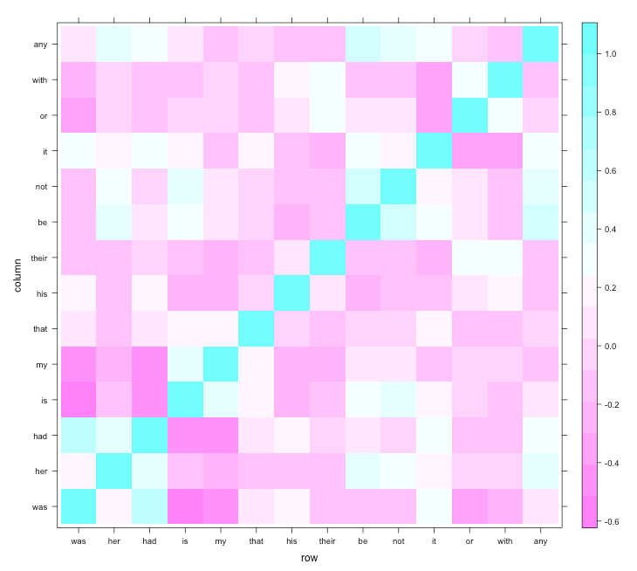
Heatmap
(14 Variables)
Notes:
The updated heatmap still shows little to no correlation

Slide 24
Classification Techniques
Notes:
As part of the analysis, we performed different classification techniques using all of the 64 variables and calculated the test and training errors.

Slide 25
Training and Test Errors (All Variables)
 | Training Errors | Test Errors
 | (in Percentages)
LDA | 0 | 0.775
LR | 0 | 0.775
KNN | 0 | 1.1628
SVM | 0 | 0.775
Trees | 5.317 | 6.977
Pruned Tree | 7.547 | 8.527
RF | 0 | 1.550
**QDA does not work because observations (55) for Milton is less than the
number of predictor variables (64)
Notes:
Based on the test errors, LDA, Logistic regression, and SVM worked the best. We were not able to perform QDA because our observations for Milton was less than the number of predictor variables in our dataset.

Slide 26
Training and Test Errors (14 Variables)
 | Training Errors | Test Errors
 | (in Percentages)
LDA | 3.602 | 1.550
QDA | 2.058 | 1.550
LR | 3.087 | 2.713
KNN | 0 | 3.101
SVM | 1.887 | 1.550
Trees | 6.003 | 6.202
Pruned Tree | 7.547 | 8.527
RF | 0 | 2.326
Notes:
Even with 14 variables, we can see similar conclusions. Here, LDA, QDA, and SVM gave us gave us the lowest test errors.
Why would this be the case?

Slide 27
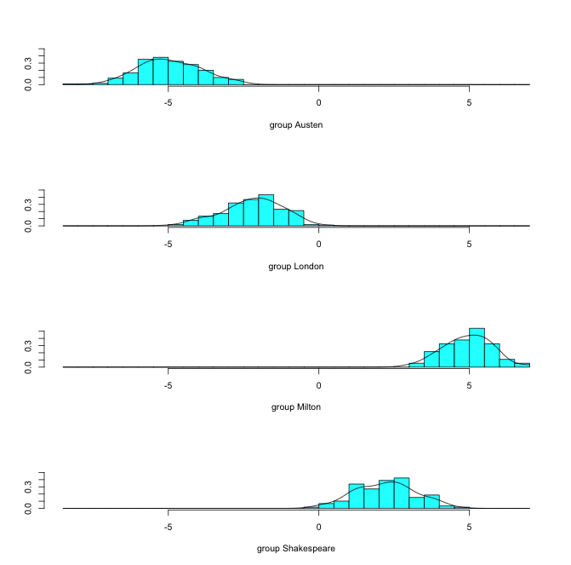
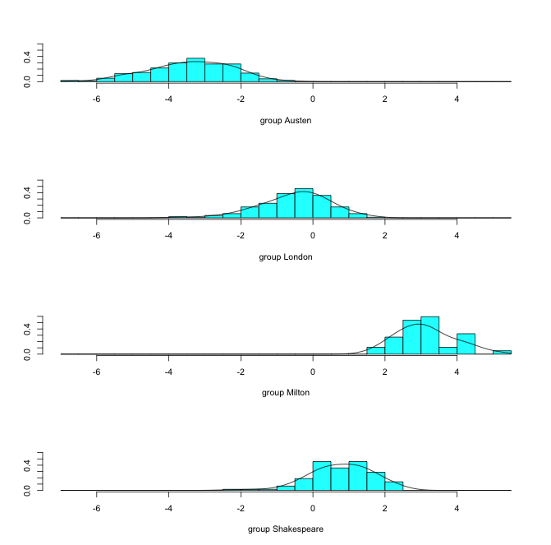
Class Density Plots
All Variables
14 Variables
Distributions of Classes are Approximately Normal
Distributions of Classes are Slightly
Skewed
Notes:
Looking at the class density plots, we can see that the distributions of classes are approximately normal for the case with all variables included. Even with only 14 variables, the distribution of classes was only slightly skewed (slightly less normal).

Slide 28
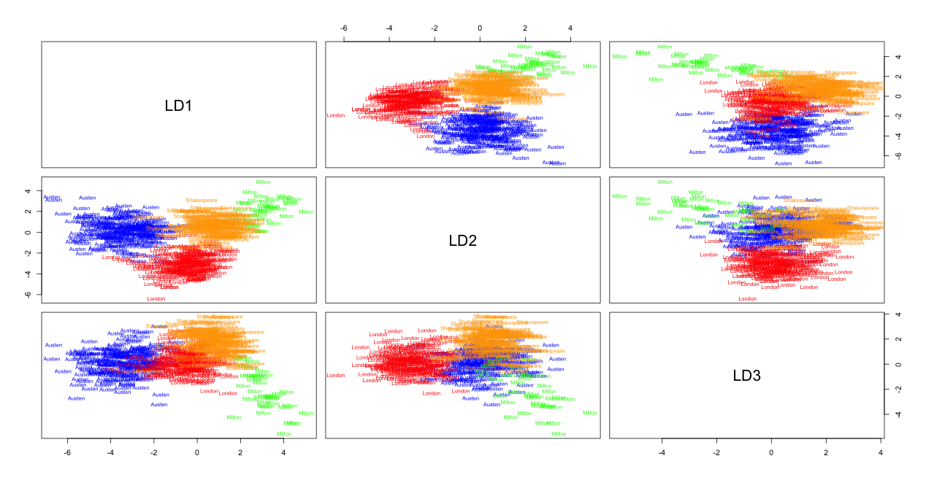
Linear Discriminants Plots
(14 Variables)
Red = Austen, Blue = London, Green = Milton, Orange = Shakespeare
Notes:
The LDA gave us 3 LDs and as can be seen from the plot of the pairs of LDs, there is clear classification between the authors.

Slide 29
Linear Discriminant Analysis
Since normality assumption is satisfied, LDA works better than LR
Since LDA is a simpler model than SVM, and they both have same test error, we prefer LDA over SVM.
Since QDA and LDA have same test error, it is reasonable to assume equal variances for each class
Therefore, LDA is best
Notes:
We decided to choose LDA over SVM and QDA because even though SVM does not need any assumptions to be satisfied, the main advantage of SVM is in higher dimensions.
If the classes are linearly separable in the first dimension, then it doesn’t have any distinct advantage over LDA and therefore for simplicity, we thought LDA was a better choice.
Next, we saw that QDA and LDA had the same test error. LDA and QDA both require the normality assumption to be satisfied, and as seen earlier, our classes were approximately equal.
However, since we didn’t know the exact variances for each class, based on these test errors, we can assume that the variances are approximately equal for all classes and therefore, again, LDA was the better choice.
Therefore, LDA worked best for our model.

Slide 30
Robustness Check

Slide 31
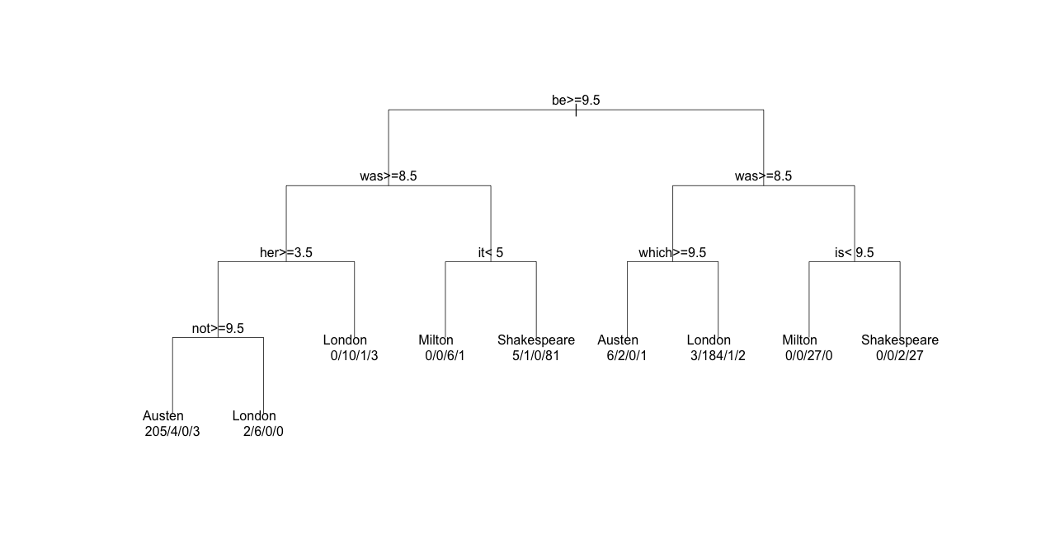
Unpruned Classification Tree
(All Variables)

Slide 32
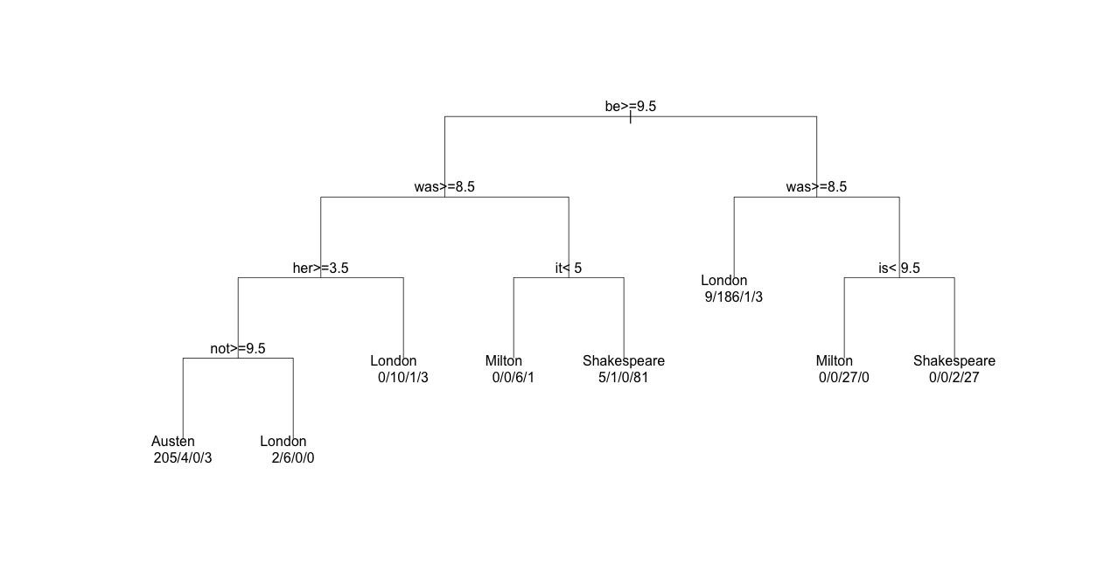
Unpruned Classification Tree
(14 Variables)
Notes:
It is true that be, was, her, was distinctively used by Austen. However, we all know that these words are not used by mainly this one author. Every author uses these words in every book, with different frequencies. For example: one book of Shakespeare might contain more number of the word “be” than one book of Austen. However, another book of Austen may have more number of “be” in another book than Shakespeare. In this case, if we classify the more “be’s” as Shakespeare then Austin will be misclassified. Classifying based on how many times an author used the word ‘be’, is too general.This is why classification tree is causing more error than the other methods. Later on, this limitation is compensated by Random Forest.
As seen earlier, the error for random forest decreases compared to the trees because it is generating many different classification trees with a random set of words used by authors in each split. Because the subset of words is coming from the same population, the bias does not change compared to classification trees. However, since random forest is making 5000 classification trees in our case, it is reducing the error by choosing on the basis of majority vote.

Slide 33
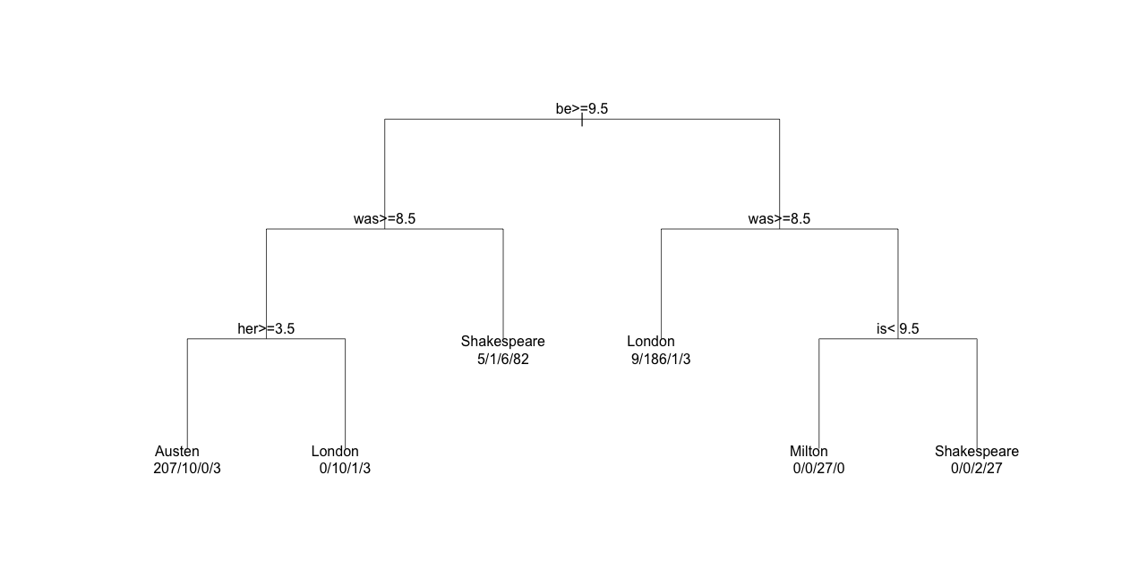
Pruned Tree with CP = 0.027624
(All Variables)

Slide 34
Pruned Tree with CP = 0.027624
(14 Variables)

Slide 35
Variable Importance

Slide 36
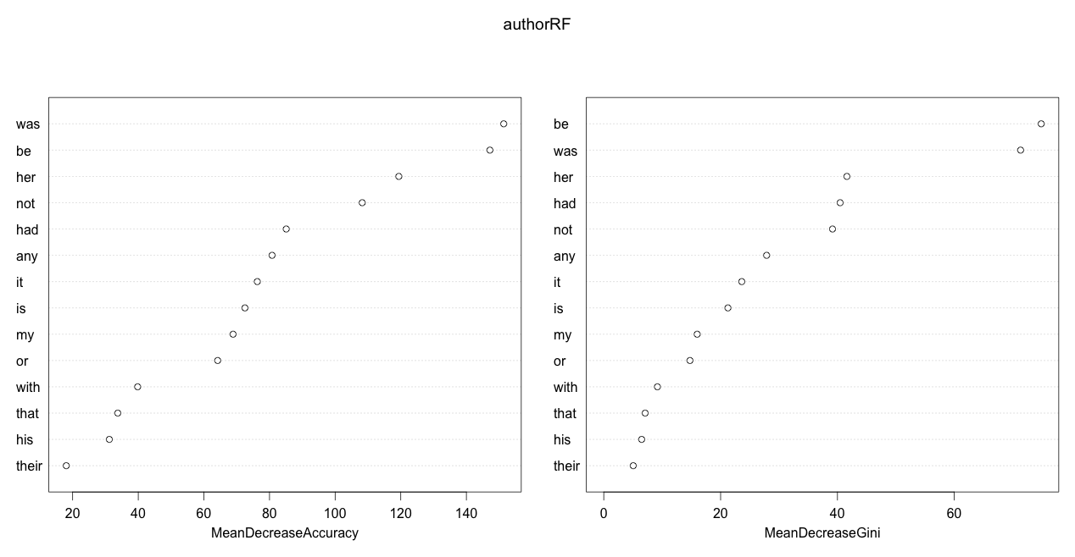
All Four Classes
Most Important Variables: Be, Was, Her, Had, Not

Slide 37
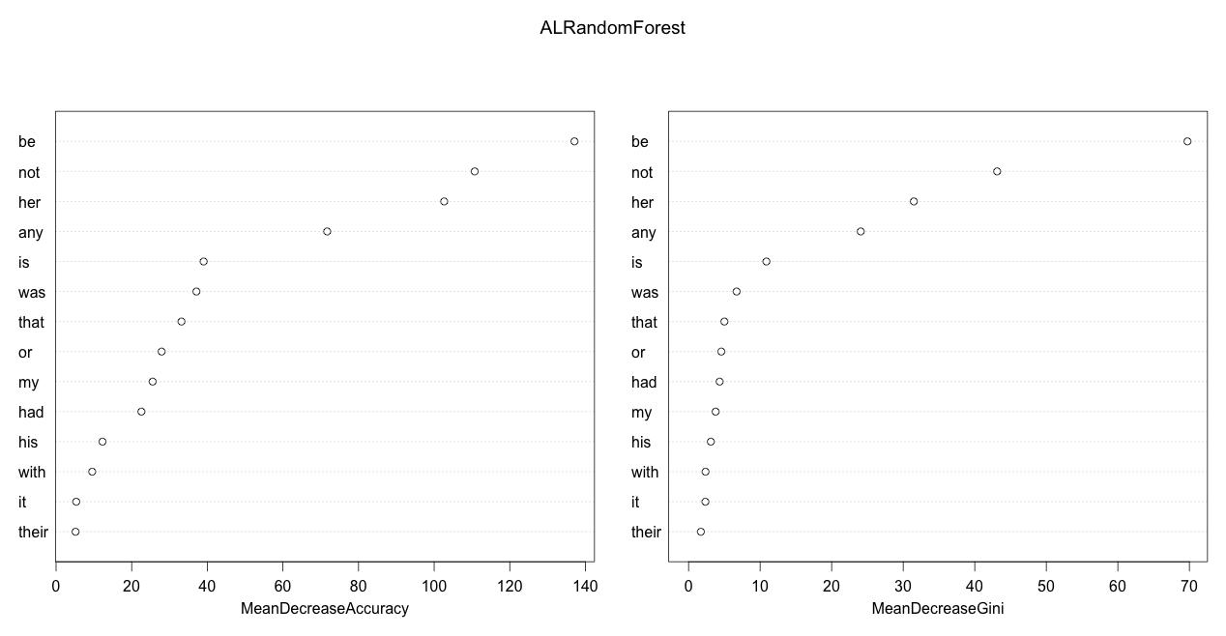
Austen and London
Most Important Variables: Be, Not, Her, Any, Is
Notes:
Previous slide looked at importance of words for every classes
However, the importance of words will be not the same for every author
So we grouped authors into two and compared the importance of words.

Slide 38
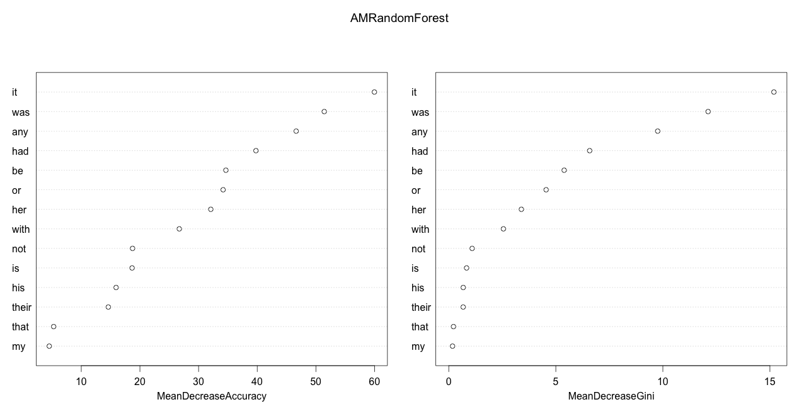
Austen and Milton
Most Important Variables: It, Was, Any, Had, Be

Slide 39

Austen and Shakespeare
Most Important Variables: Was, Had, Her, Any, My

Slide 40
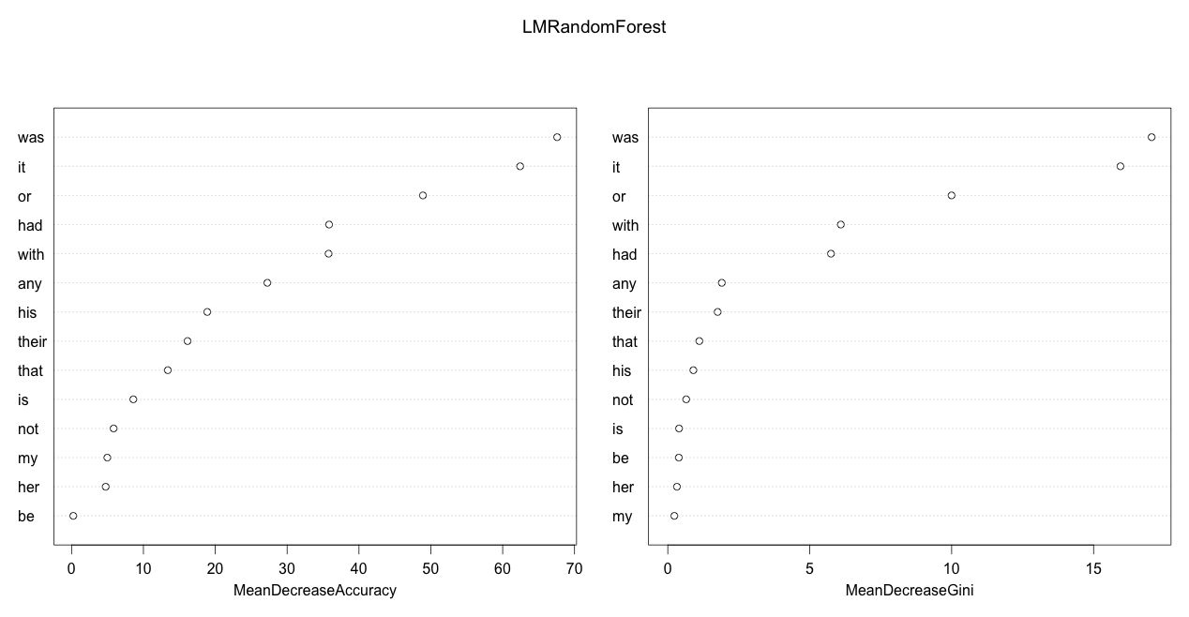
London and Milton
Most Important Variables: Was, It, Or, With, Had

Slide 41
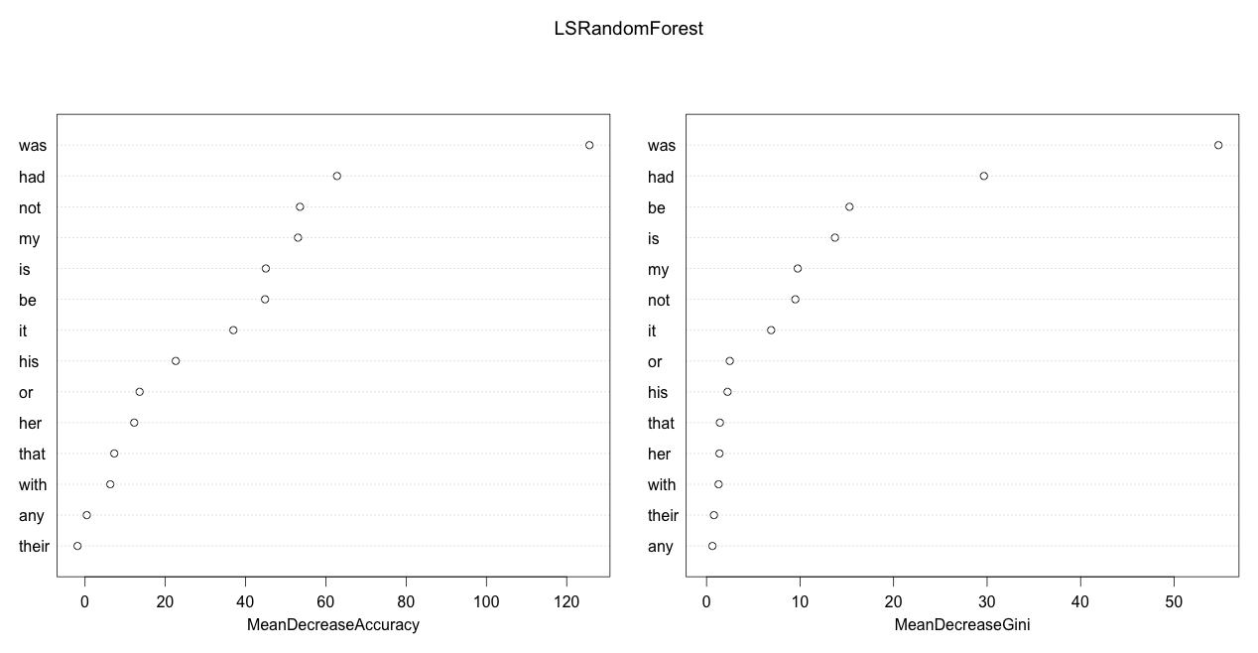
London and Shakespeare
Most Important Variables: Was, Had, Be, Is, My

Slide 42

Milton and Shakespeare
Most Important Variables: It, Is, Or, My, With

Slide 43
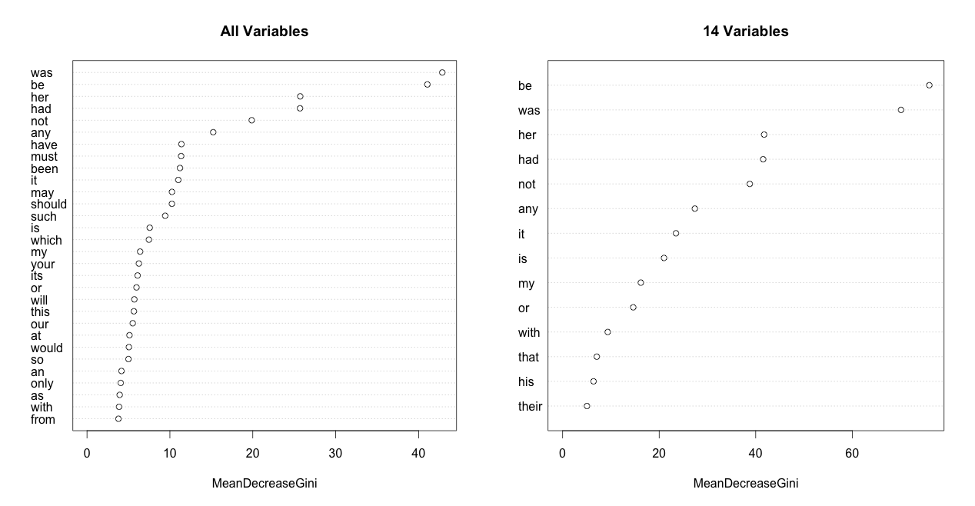
Robustness Checking
Most Important Variables: Be, Was, Her, Had, Not
Notes:
Noise does not affect much in classification.
Variables(words) used by almost all authors, is not used as a classification word.

Slide 44
Conclusion

Slide 45
Summary
LDA works best for our dataset
Reduced the number of variables based on PC loadings, for simplicity
Used RF to determine the most important variables
Reducing the dimension did not affect the most important variables and still resulted in good classification
Notes:
Saw PCA loadings,

Slide 46
Summary
Our analysis is based on authors from different eras, therefore, this quantitative method works well for us
However, this method may not work as well in all cases if we classified
Authors from same eras
Authors with similar writing styles
Authors and similar genres
Notes:
Saw PCA loadings,

