Slide 1
PEOPLE ANALYTICS & WORKFORCE INTELLIGENCE
HR Workforce Analytics Report
Data Cleaning, Key Organizational Measures, Exploratory Findings & Strategic Action Plan
Prepared by: People Analytics Team | Dataset: 19,600 Workforce Records (EGP 7.2B Payroll)

Slide 2
EXECUTIVE CONTEXT
Project Overview & Analytical Methodology
Understanding our multi-regional workforce structure and analysis roadmap
1. Dataset & Context
2. Data Quality & Cleansing
3. Strategic Objectives
• Analyzed 19,600 employee profiles across 10 operational departments.
• Regional coverage across Egypt (Cairo, Alex, Giza, Mansoura), KSA, UAE, & Remote.
• Total annual payroll footprint of EGP 7.20 Billion.
• Resolved non-numeric ID anomalies, standardized casing and name artifacts.
• Harmonized dates, categories, job titles, and standardized 1-10 satisfaction scores.
• Imputed missing features using robust department-level median benchmarks.
• Evaluate compensation equity and payroll concentration across seniority tiers.
• Diagnose critical turnover drivers and identify departmental retention risks.
• Deliver a data-backed 4-Pillar Action Plan for executive leadership.

Slide 3
EXECUTIVE DIRECT MEASURES
Core Workforce Key Performance Indicators (KPIs)
Five foundational baseline figures defining our organizational scale and health
19,600
Total Workforce Headcount
Distributed across 4 regional hubs + 14.5% Remote footprint
7.20B EGP
Total Annual Payroll
Annual human capital compensation budget
367,250 EGP
Average Annual Salary
Median salary: 256,800 EGP (Right-skewed by Senior/Exec roles)
12.2%
Resignation Turnover Rate
Voluntary exits (Overall combined attrition stands at 16.1%)
2.86 Years
Average Resignation Tenure
Critical departure window compared to 5.78 yrs active tenure

Slide 4
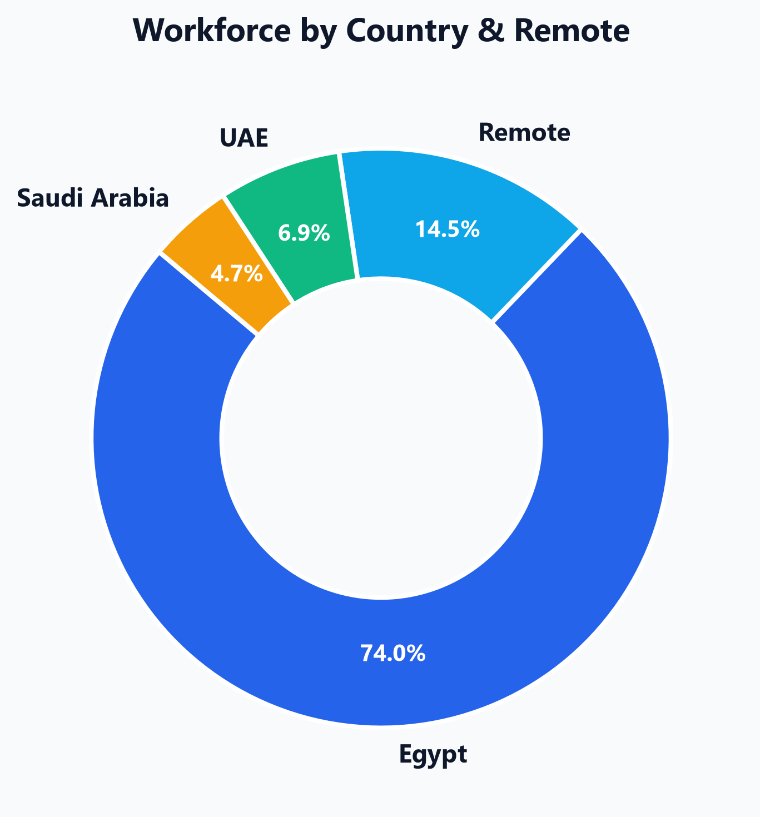
WORKFORCE DEMOGRAPHICS
Chart 1: Regional Workforce Distribution & Remote Footprint
Analysis of employee geographic concentration across national and distributed hubs
Geographic Distribution Analysis
• Egypt represents the anchor operational market, hosting the vast majority of our multi-city staff (Cairo, Alexandria, Giza, Mansoura).
• A healthy 14.5% remote workforce indicates strong adoption of distributed talent models.
• Regional hubs in Saudi Arabia (Riyadh) and UAE (Dubai) provide strategic expansion bases in high-growth GCC markets.
📌 Key Executive Takeaway:
Scaling remote talent from 14.5% toward 25% will allow access to broader MENA talent pools while optimizing physical real-estate overhead.

Slide 5
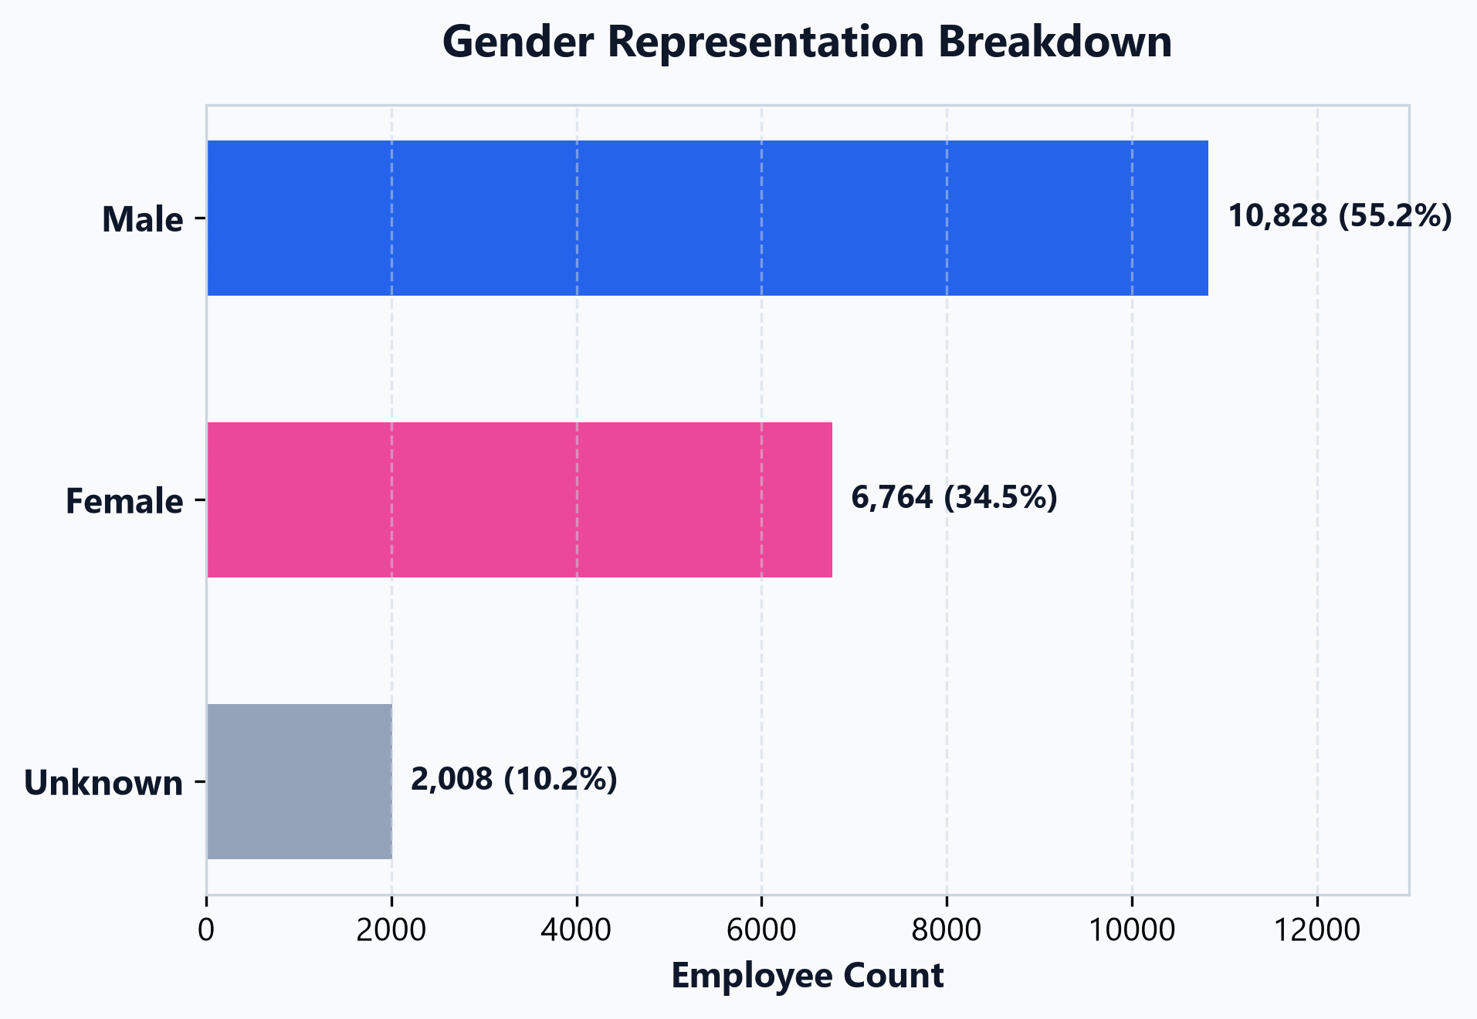
DIVERSITY & INCLUSION
Chart 2: Workforce Gender Representation & Leadership Equity
Evaluating gender balance and female leadership participation across the organization
Diversity & Representation Findings
• Overall workforce composition stands at ~55% Male, ~34% Female, and ~11% Unspecified.
• Female representation in leadership roles (34.2%) mirrors overall female workforce participation (34.5%).
• Demonstrates healthy organic progression without systemic glass ceilings in promotion pipelines.
📌 Key Executive Takeaway:
Female leadership participation matches general workforce share perfectly (34.2% vs 34.5%), reflecting merit-based leadership pathways.

Slide 6
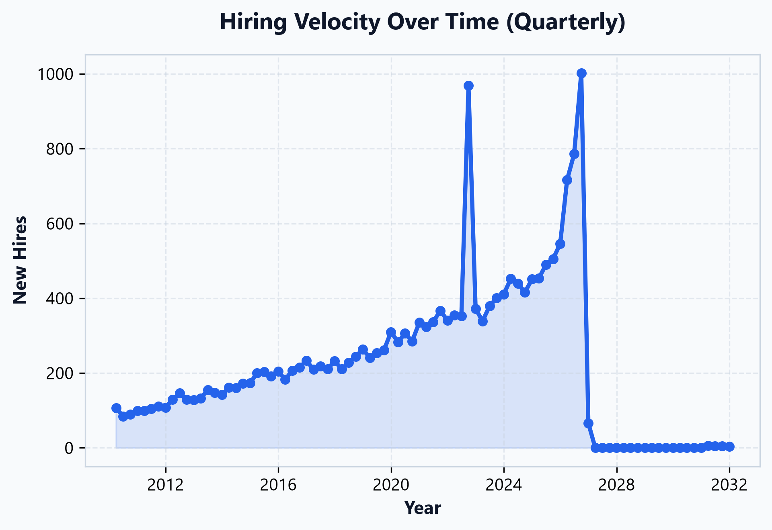
RECRUITMENT & GROWTH
Chart 3: Longitudinal Hiring Trends & Momentum
Quarterly recruitment volume tracking organizational scaling patterns over time
Talent Acquisition Trends
• Continuous hiring momentum reflects steady organizational expansion across technical and operational domains.
• Recruitment peaks correspond with major regional market entries and departmental expansions.
• Highlights the necessity for scalable, automated onboarding pipelines to maintain high new-hire satisfaction.
📌 Key Executive Takeaway:
Establishing standardized onboarding cohorts during peak quarters will shorten time-to-productivity for new hires.

Slide 7
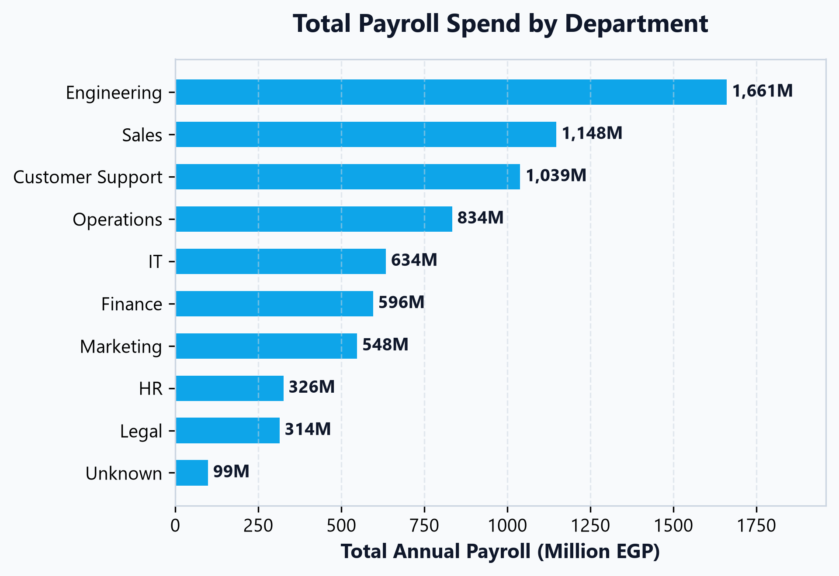
FINANCIAL & PAYROLL ALLOCATION
Chart 4: Total Annual Payroll Spend by Department
Evaluating budget concentration across core business functions (Million EGP)
Payroll Allocation Insights
• Engineering (1.66B EGP) and Operations (834M EGP) represent the largest payroll budget commitments.
• Customer Support maintains a large headcount (3,650 employees) but lower aggregate spend (1.04B EGP) due to entry-level wage bands.
• IT and Finance demonstrate high compensation density per employee.
📌 Key Executive Takeaway:
Engineering and IT account for over 30% of total payroll; protecting technical talent through retention packages is vital.

Slide 8
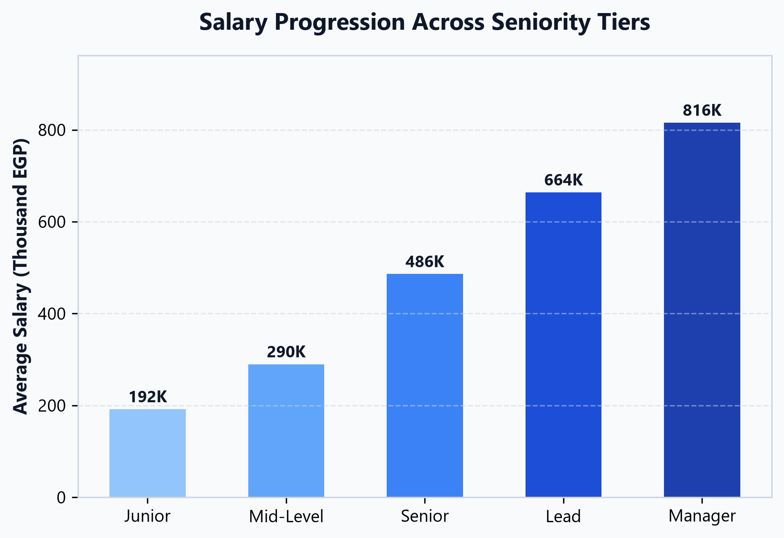
COMPENSATION & SENIORITY
Chart 5: Compensation Progression Across Seniority Tiers
Analyzing salary scaling from Junior contributors to Executive Managers
Career Tier Compensation Structure
• Junior average compensation starts at ~190K EGP, progressing to ~290K for Mid-Level and ~485K for Senior professionals.
• Substantial compensation inflection at Lead (~665K) and Manager (~800K) levels.
• Reflects structured pay bands that reward strategic leadership responsibility and tenure.
📌 Key Executive Takeaway:
The 67% jump from Mid-Level to Senior is a key motivator; formalizing mid-career promotion milestones prevents premature departures.

Slide 9
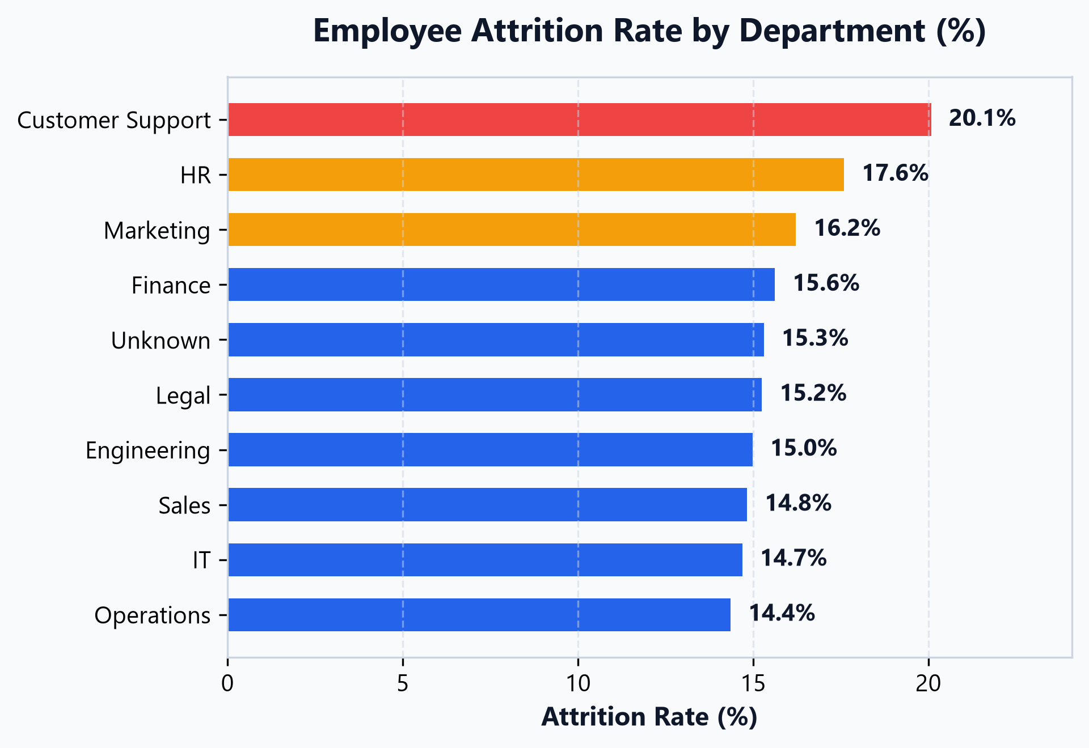
RETENTION & TURNOVER
Chart 6: Employee Attrition Rate by Department (%)
Identifying high-turnover hotspots and retention vulnerability areas
Departmental Turnover Diagnosis
• Customer Support exhibits the highest attrition rate at 20.1%, significantly outpacing the corporate average (16.1%).
• HR (17.6%) and Marketing (16.2%) represent secondary retention risk centers.
• Engineering (15.0%) and Operations (14.4%) demonstrate the strongest retention resilience.
📌 Key Executive Takeaway:
Customer Support's 20.1% attrition is directly linked to lower pay bands (284K avg); adjusting entry compensation will curb recruitment churn.

Slide 10
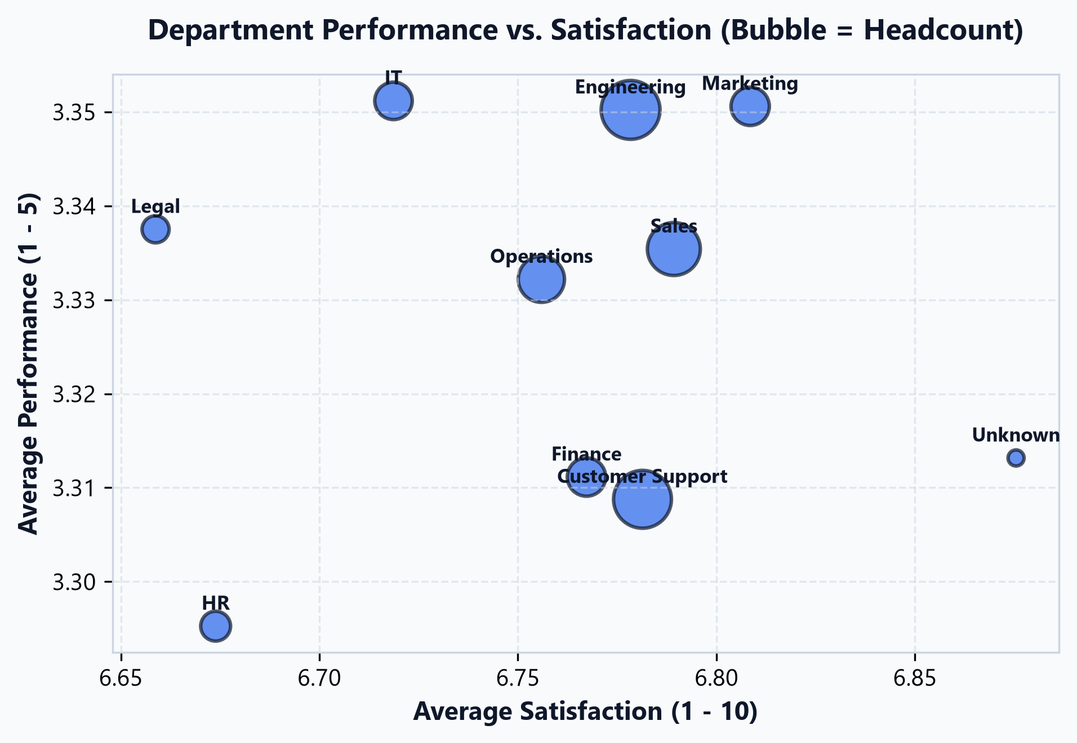
ORGANIZATIONAL HEALTH
Chart 7: Department Performance vs. Satisfaction Quadrant
Mapping workforce morale against performance ratings (Bubble size = Headcount)
Departmental Health Matrix
• Employee performance is exceptionally stable across all business units (averaging 3.30 to 3.35 out of 5).
• Marketing (6.81) and Sales (6.79) lead the organization in overall employee sentiment and morale.
• Legal (6.66) and HR (6.67) record lower satisfaction, indicating high administrative workload and burnout risks.
📌 Key Executive Takeaway:
Deploying workload rebalancing and pulse surveys in HR and Legal can raise satisfaction scores toward top-performing benchmarks.

Slide 11
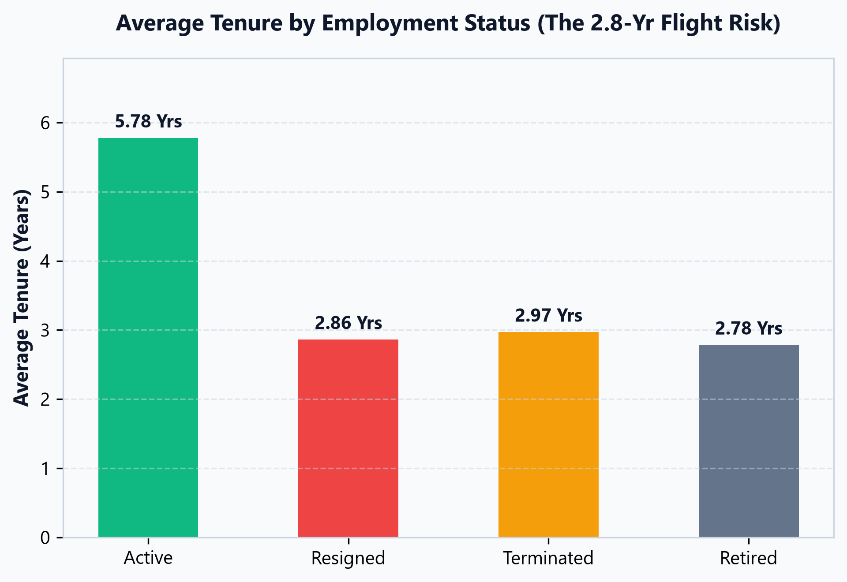
TENURE & FLIGHT RISK
Chart 8: Average Tenure Analysis: The 2.86-Year Flight Risk
Comparing years of service across employment statuses to identify departure windows
Critical Flight-Risk Window
• Departing employees (Resigned) average 2.86 years of service, compared to 5.78 years for active retained staff.
• Identifies the 'Year 3 Cliff': employees who reach 2.5–3 years without clear promotion pathways seek external opportunities.
• Retaining employees past year 3 significantly boosts long-term organizational tenure.
📌 Key Executive Takeaway:
Intervening at the 24-month mark with career reviews and salary adjustments can capture high-flight-risk talent before the 3-year threshold.

Slide 12
STRATEGIC ROADMAP
Executive Outro: 4-Pillar HR Action Plan
Actionable initiatives to optimize retention, pay equity, and organizational performance
Pillar 1: Targeted Compensation Restructure
• Benchmark Customer Support compensation against industry standards.
• Uplift entry/mid support pay bands to curb the 20.1% attrition rate.
• Reduce high onboarding and replacement recruitment costs.
Pillar 2: Mitigate the 'Year 3 Cliff'
• Institute mandatory 24-month career progression & promotion reviews.
• Create structured lateral and technical growth tracks.
• Proactively re-engage high-performing talent before the 2.8-year departure threshold.
Pillar 3: Scale Distributed Remote Model
• Expand remote talent share from 14.5% toward 25%.
• Access top-tier regional talent across MENA without physical office overhead.
• Implement unified digital collaboration & performance frameworks.
Pillar 4: Retention & Wellbeing Audits
• Deploy quarterly pulse surveys in lower-satisfaction departments (Legal, HR).
• Implement workload rebalancing and automation to reduce burnout.
• Protect high-value engineering knowledge through structured retention incentives.

Slide 13
Thank You
Questions & Executive Discussion
HR Workforce Analytics & Strategic Recommendations | People Analytics Team

