Slide 1
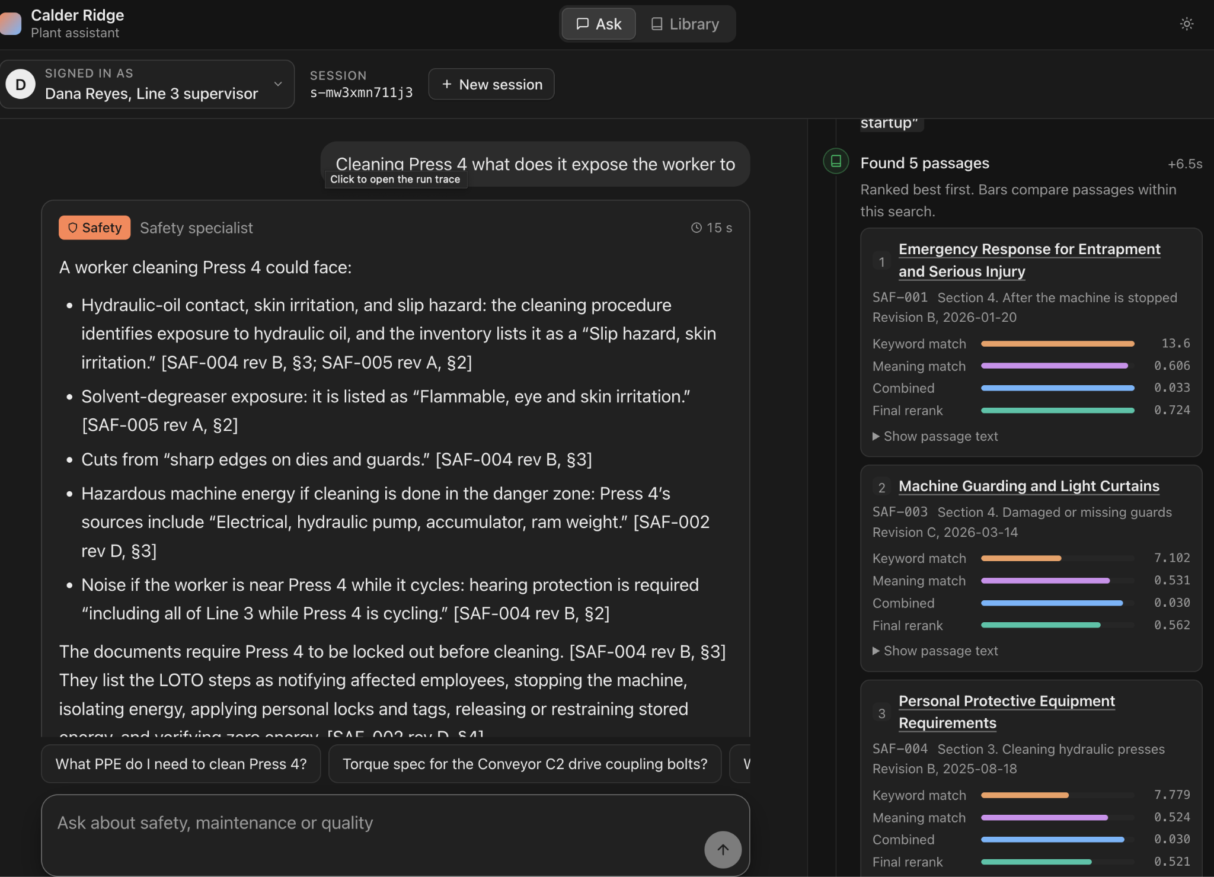
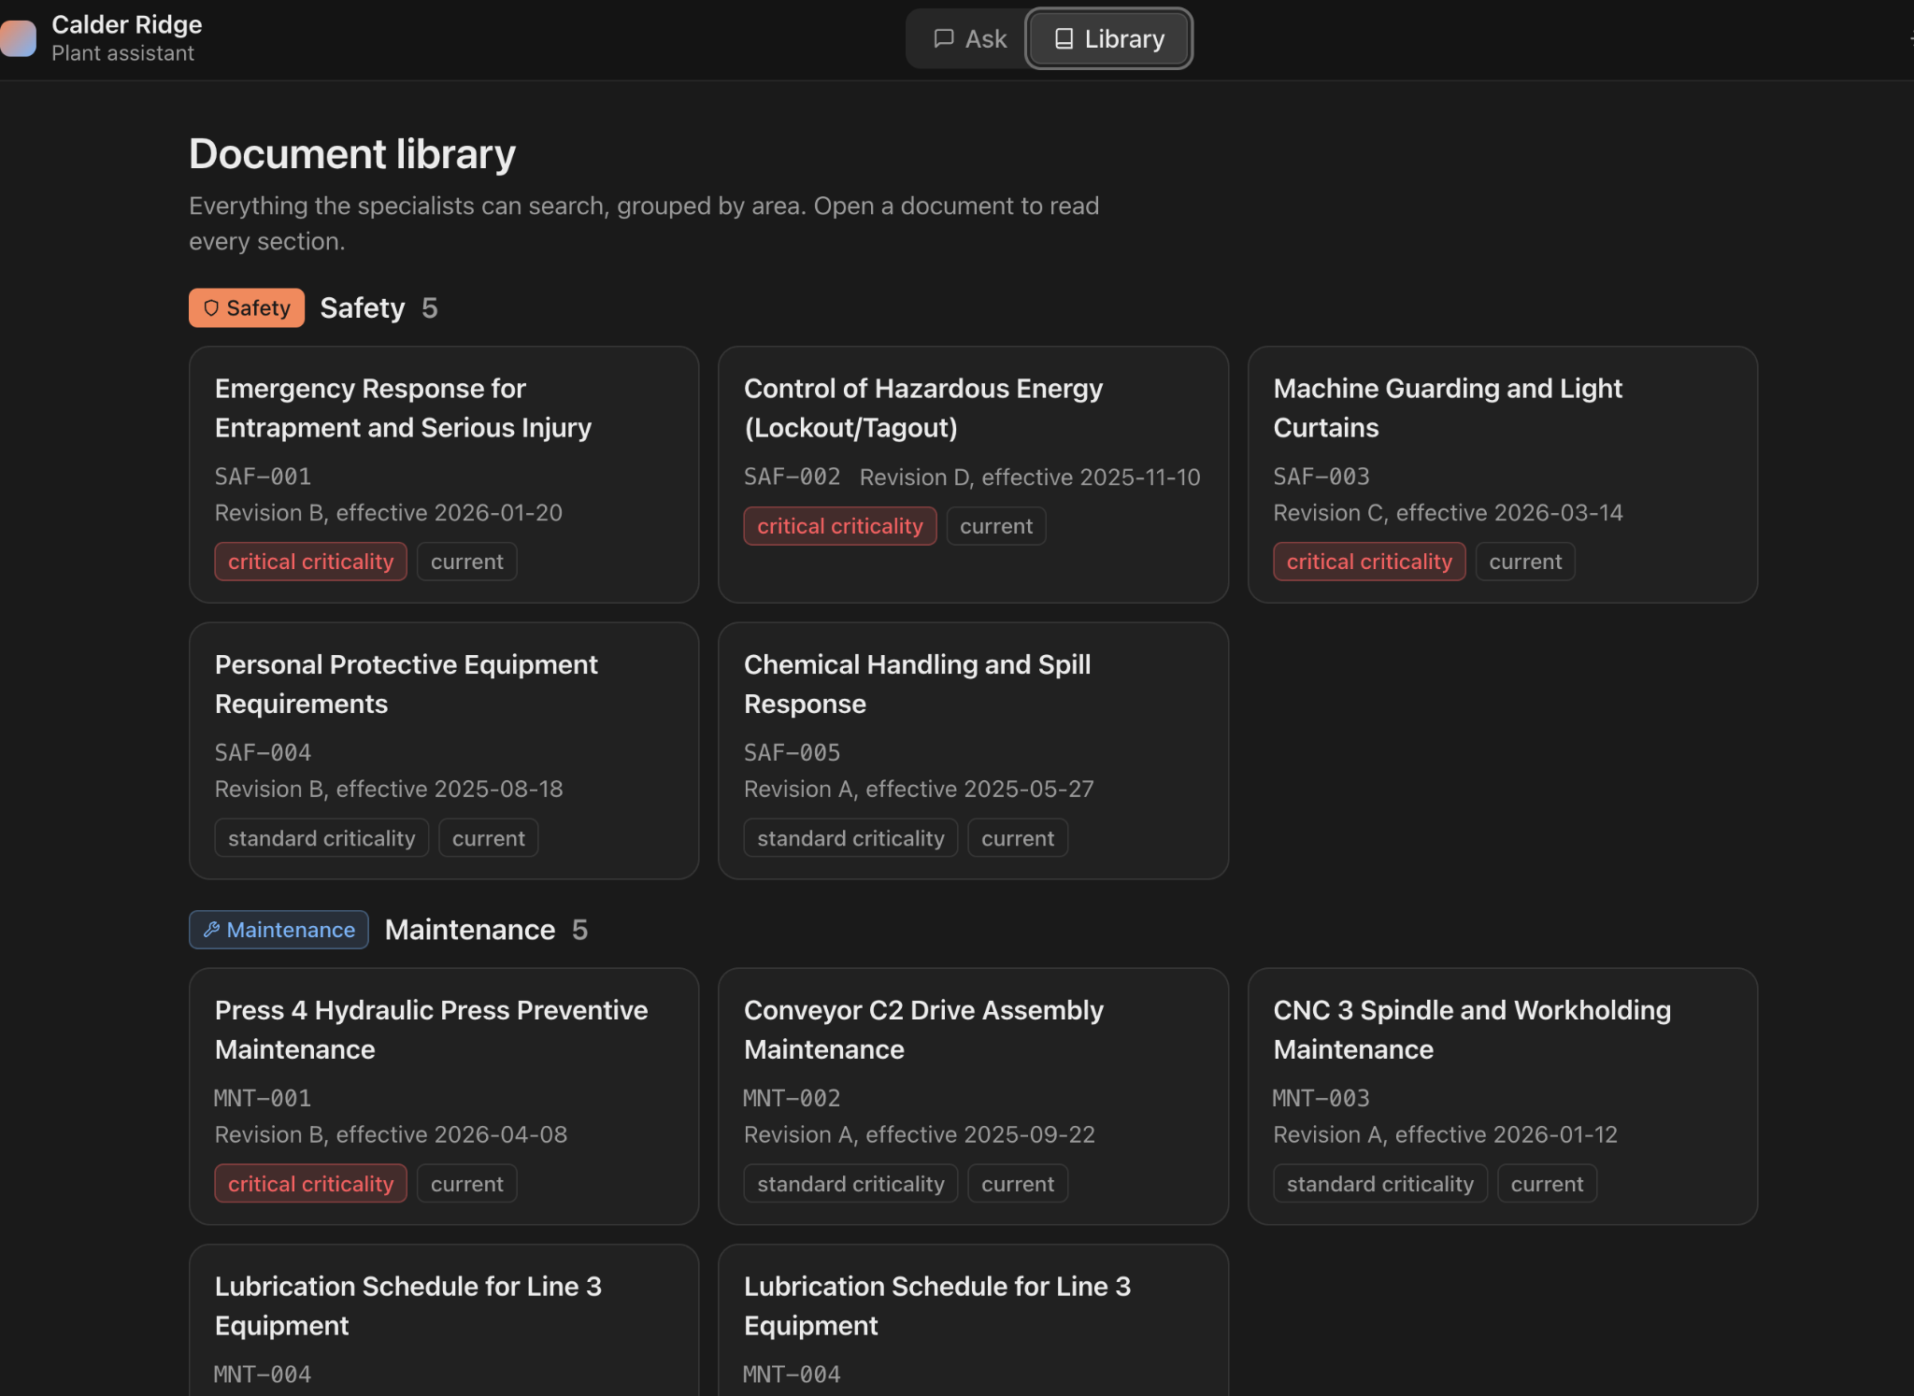
Plant Assistant
Ask any question about safety, maintenance or quality.
Get a short answer quoted from the plant's own documents, with the source.
If the documents don't cover it, it tells you instead of guessing.
In an emergency, it shows you who to call first.

