Slide 1
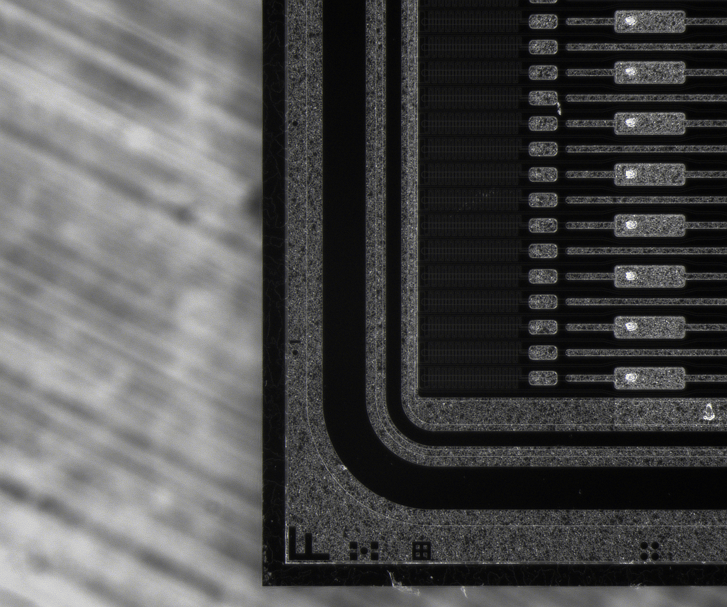
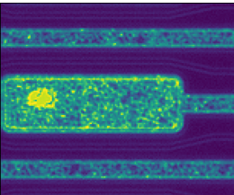
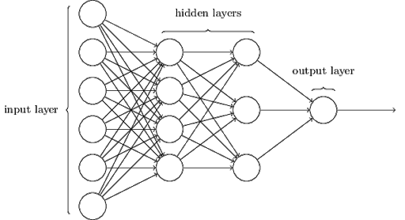
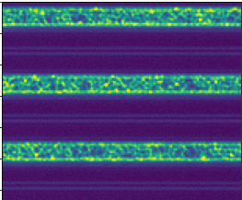
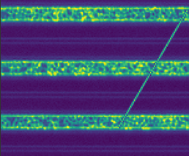
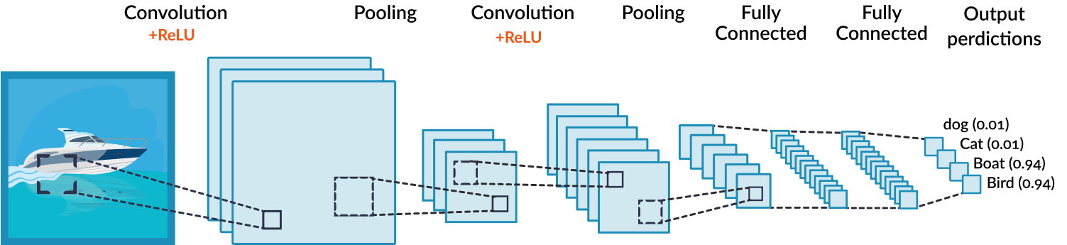
Using Computer Vision and Machine Learning to Detect Damage On Silicon Semiconductor Strip Sensors Nashad Rahman
Motivation
The ATLAS Detector at the Large Hadron Collider (LHC) in Geneva, Switzerland has many different methods of detecting particles, one of which is the use of silicon strip semiconductor detectors
These detectors will consist of a 10x10x Silicon semiconductor sensor, attached to readout electronics . Each sensor is made up of 75um wide columns, each acting as readout channel. [1]
On delivery from the vendor, sites must test all sensors for mechanical & electrical properties to verify they match strict quality control standards.
Physically damaged sensors will lead to dead channels, so any damage must be detected accurately - and with a total of 17k strip sensors - as fast as possible
We seek to use machine learning to efficiently detect damage on silicon strip detectors
Methods
Splitting Images
Over 3,000 images available in the dataset and had a resolution of 1224 × 1024
These were then split into 8x8 pieces, creating 64 smaller images of resolution 153 x 128
Adding “Damage” to Sensors
Damaged sensors from the vendor are rather rare, so the dataset did not have any damaged sensor images
Artificial damage had to be added in the form of lines drawn over the images. These lines spanned across two random points in the images. The introduced damage was of the scale of commonly found issues (eg. tweezer marks)
Results
The full dataset was 3,003 images and created 192,192 smaller images, each of which had a duplicated “damaged” version, leading to a total of 384,384 images which trained the network
Resources used:
One Node, 40 Processors
CPU Time = 84:55:20
Wall Time = 06:27:01
Memory = 36.095GB
Final Results:
Training Loss: 0.0276
Training Accuracy: 0.9942
Validation Loss: 0.0328
Validation Accuracy: 0.9932
Analysis
The accuracy being over 99% is rather promising.
The Network seems to have confusion with images where the “Damage” lines are parallel to the sensor strips – this is difficult for a human to see too!
The Network was trained with 384,384 input images, so it may be over fitted, but it is still able to analyze images it has not seen before.
Background
Convolutional Neural Networks (CNN’s)
Images behave as matrices
Various layers of the neural network take an input from a matrix and output another matrix. These are called hidden layers.
The various hidden layers end with a final output layer, which has values correlating to the likeliness of given category
The parameters within the hidden layers are altered to best increase the prediction accuracy
In CNN’s, Images are firsts “convolved” to detect features. The relationship between nearby pixels is used to convolve the images through various filters
Acknowledgements
Thank you to Dr. Trevor Vickey (Uni of Sheffield), Dr. Andrew Blue (Uni of Glasgow), and Dr. Paul Miyagawa (QMU London) for the dataset of sensor images and insightful conversations
Thank you to Dr. Richard Hughes for guidance throughout this project
Training and processing was done on the Ohio Super Computer
Building the network
Model: "sequential"
_________________________________________________________________
Layer (type) Output Shape Param #
=================================================================
conv2d (Conv2D) (None, 124, 149, 30) 780
_________________________________________________________________
max_pooling2d (MaxPooling2D) (None, 62, 74, 30) 0
_________________________________________________________________
conv2d_1 (Conv2D) (None, 58, 70, 25) 18775
_________________________________________________________________
max_pooling2d_1 (MaxPooling2 (None, 29, 35, 25) 0
_________________________________________________________________
flatten (Flatten) (None, 25375) 0
_________________________________________________________________
dense (Dense) (None, 64) 1624064
_________________________________________________________________
dense_1 (Dense) (None, 2) 130
=================================================================
Total params: 1,643,749
Trainable params: 1,643,749
Non-trainable params: 0
_________________________________________________________________
References
Cite{Ahmad_etal_2007}
Cite{https://images.app.goo.gl/kWH4r6aXkHwkzH4YA}
Cite{https://images.app.goo.gl/MoRAadKM1QW7stib9}

