Slide 1
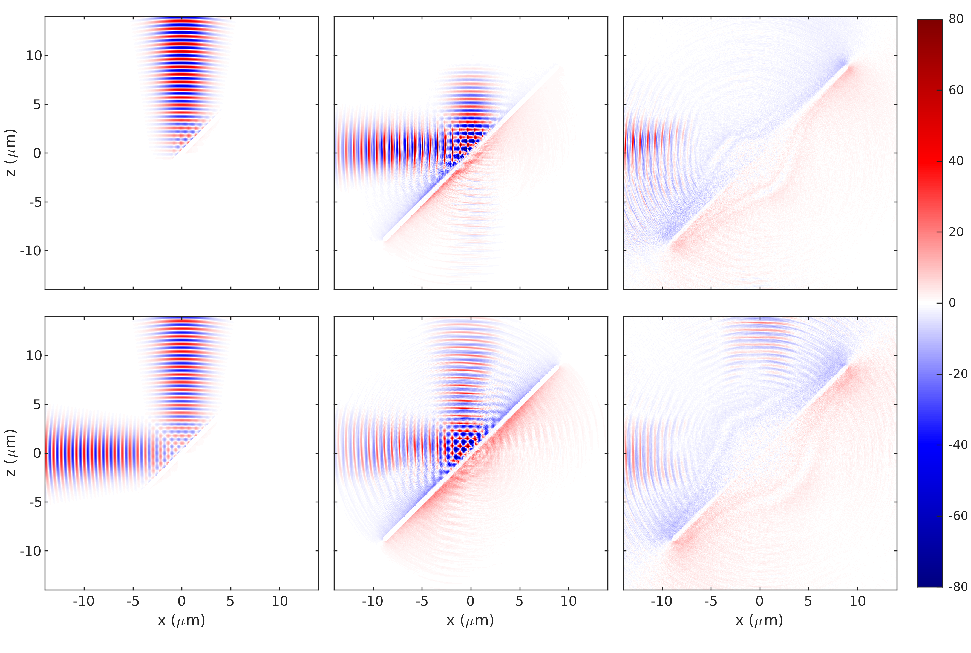
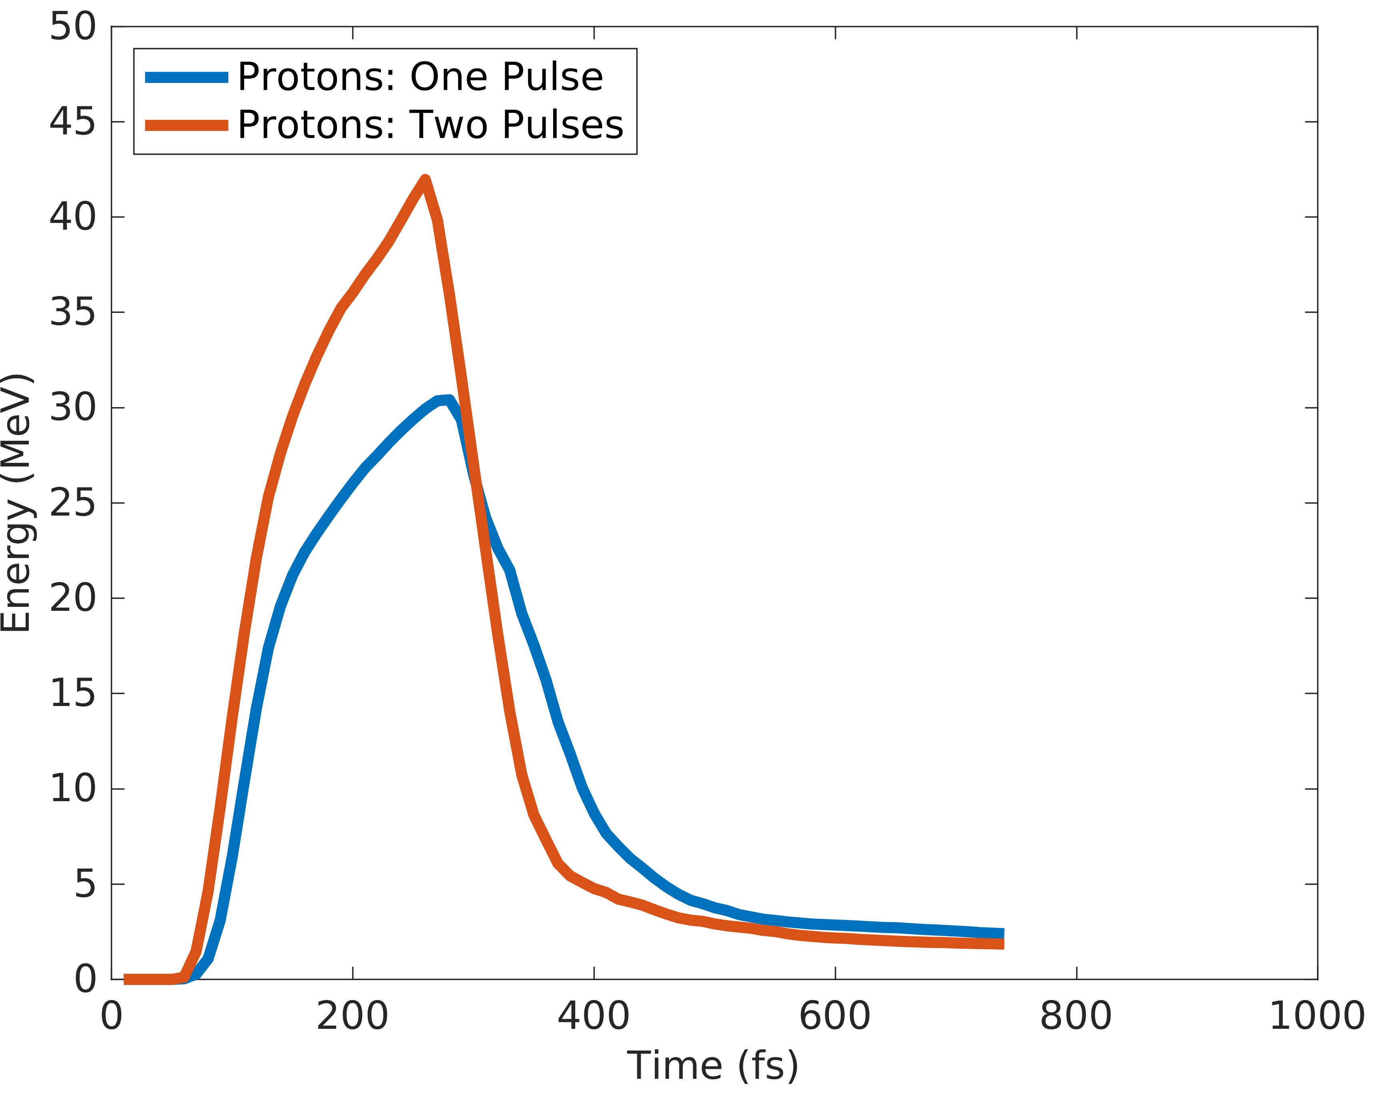
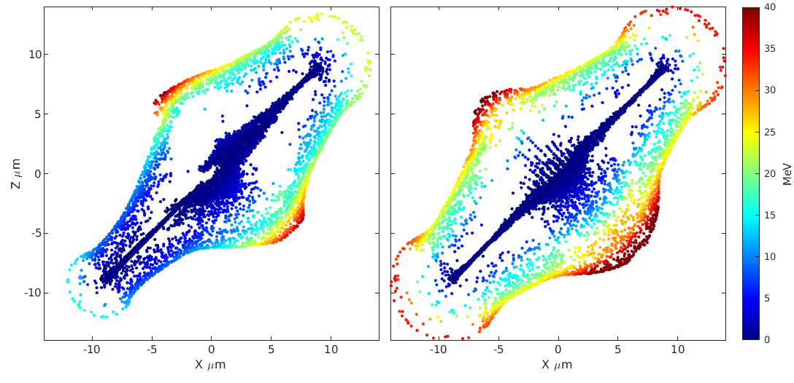
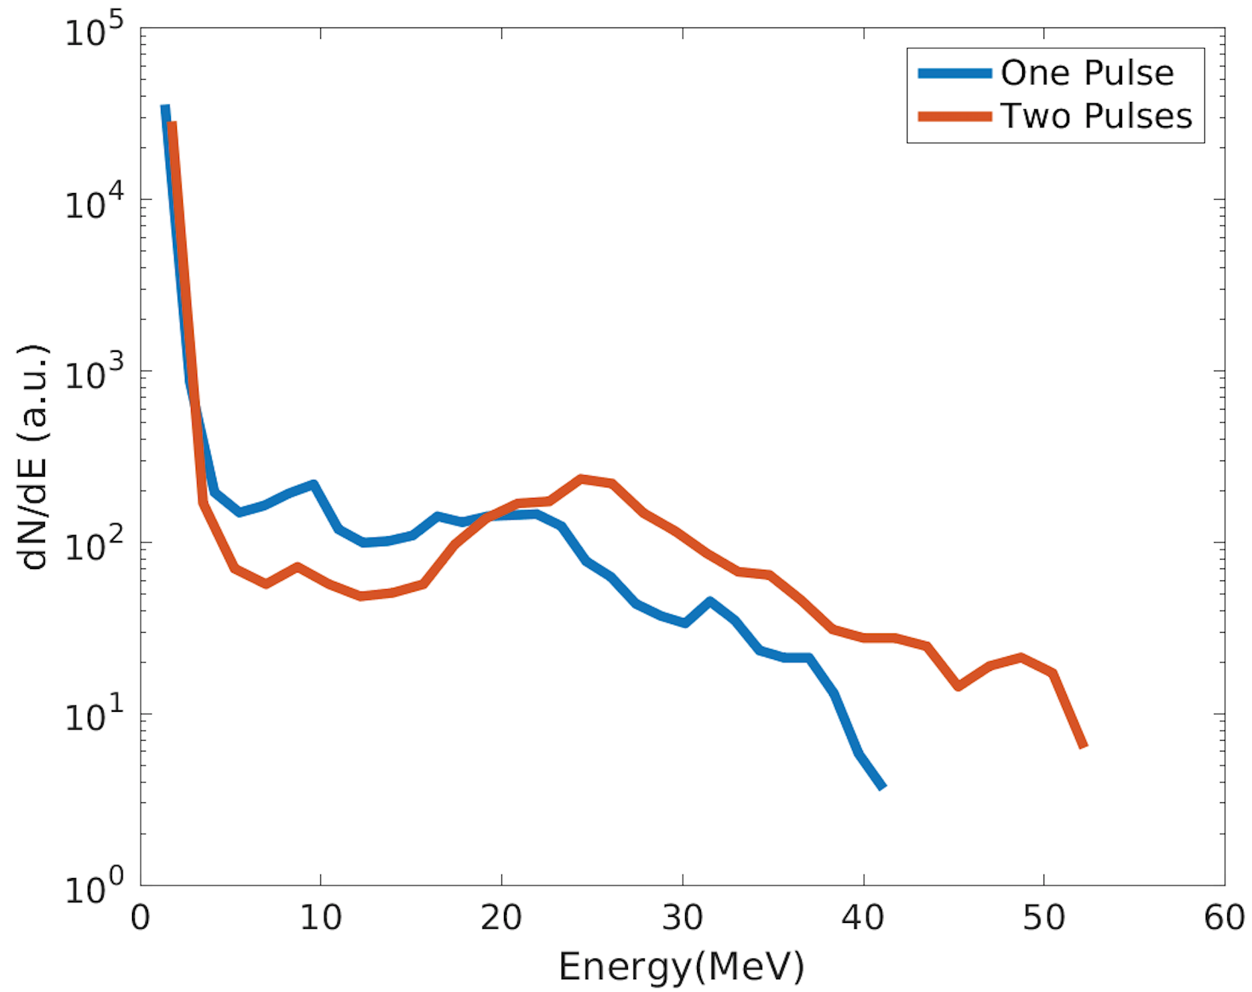
Using Computer Vision and Machine Learning to Detect Damage On Silicon Strip Sensors Nashad Rahman
Motivation
The Large Hadron Collider (LHC) in Geneva, Switzerland has many different methods of collecting data, one of which is silicon strip detectors
Silicon strip detectors, among others, can become damaged after having very high energy particles and radiation being emitted through them
Damaged sensors can give false information, so they must be detected easily
With over 17,000 strip sensors alone, manually inspecting the sensors can be challenging [1]
We seek to use machine learning to efficiently detect damage on silicon strip detectors
Results
Analysis
We see an increase of 1.35x increase in the peak proton energies. This dramatic increase in energy is seen not only in the most energetic protons, but throughout the entire spectra.
We see a faster increase in peak ion energy along with greater peak ion energy
Electric field component Normal to the Target
Average Energy of top 1000 macroparticles
50 fs
100 fs
150 fs
Background
The Particle-In-Cell Technique (PIC)
Fields are solved on a discretized grid, Maxwell’s equations are solved by a set of difference equations.
Single Pulse
Proton Energies at 250 fs into the simulation
Double Pulse
Particles are modeled by macroparticles which represent many ions or electrons.
Particles are pushed by the fields on the grid, and the resulting fields are then calculated.
Proton Spectra at 200fs
Target Normal Sheath Acceleration (TNSA)
This is the method by which lasers are able to accelerate ions.
Laser light interacts with electrons which absorbs some energy. These electrons then transfer some energy to heavier ions
Why does this happen?
More of the laser pulse is absorbed
More laser energy is transferred to electron energy
More electron energy converted to proton energy
Still figuring out why, we suspect something to do with B fields
Laser Parameters
Peak intensity of 10²¹ W*cm⁻²
Spot size of 1.86 μm (beam waist)
Pulse width of 42 fs (FWHM)
Target Parameters
0.46 μm Ethylene Glycol Target
36 particles per cell (9 particles per species for 4 species)
No preplasma
1 eV starting temperature
Methods
Set Up
We use a method similar to that described in Ferri et al. 2019 where two laser pulses of half energy irradiate a target at an angle and compare it to using one pulse at full energy.
Ferri et al. 2019 found that an angle of incidence of 45˚ to normal yielded the highest energy ions
We used the Large Scale Plasma (LSP) code, whereas Ferri et al. 2019 used EPOCH
We ran our simulation to 1 ps with 20 as timesteps on a 14 by 14 μm grid and 2800 by 2800 cells
Acknowledgements
Simulations were performed on the ASC Unity cluster at Ohio State University.
BIBLIOGRAPHY
Cite{Ahmad_etal_2007}

