Slide 1
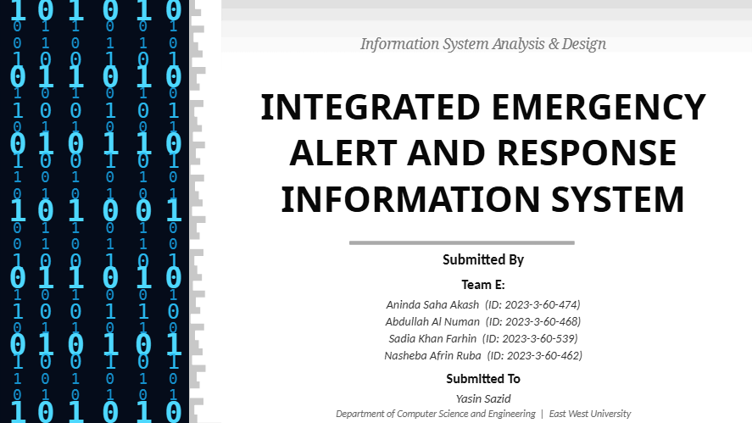
Integrated Emergency Alert
& Response Information System
Emergency Alert & Response Information System

Slide 2
INTRODUCTION
🌐
Integrated Emergency Alert
& Response Information System
KEY POINTS
01
Early disaster alerts
About: A unified platform for disaster alerting, rescue coordination, volunteer management, relief distribution, and shelter support.
02
Emergency request management
Purpose: Purpose: Improve preparedness, communication, coordination, and response speed during emergencies. It also supports timely alerts, effective rescue operations, volunteer coordination, and proper relief and shelter management to protect communities and save lives.
03
Rescue & volunteer coordination
04
Shelter & relief management
Emergency Alert & Response Information System

Slide 3
PROJECT OVERVIEW
Project Introduction
🚨
Unified Platform
Disaster alerting, emergency response, rescue coordination, volunteer management, and relief distribution in one system.
🔗
Connected Stakeholders
Connects citizens, admin, rescue teams, volunteers, police, medical teams, and fire service.
📡
Real-Time Communication
Live alerts, status tracking, and emergency notifications across all user roles.
🎯
Core Goal
Improve preparedness, communication, coordination, and response speed during emergencies.
02
Emergency Alert & Response Information System

Slide 4
PROBLEM STATEMENT
Problem We
Are Solving
Emergency services are often fragmented
P1
P2
Victims don't get fast alerts or coordinated help
P3
Rescue, relief & shelter info are hard to track
IMPACT: Delayed or failed emergency response leads to preventable loss of life and property.
P4
No single platform for all emergency stakeholders
Reason 1: Lack of a Unified Emergency Platform
Emergency services are fragmented. Victims don't get fast alerts. Rescue, relief, and shelter data are scattered across disconnected systems.
Need for real-time emergency communication
P5
03
Emergency Alert & Response Information System

Slide 5
OBJECTIVES
Project Objectives
01
Provide early disaster alerts
02
Allow users to request emergency support instantly
03
Coordinate rescue teams and volunteers
04
Manage shelters and relief distribution
05
Track status of requests and operations
06
Improve administrative monitoring and control
04
Emergency Alert & Response Information System

Slide 6
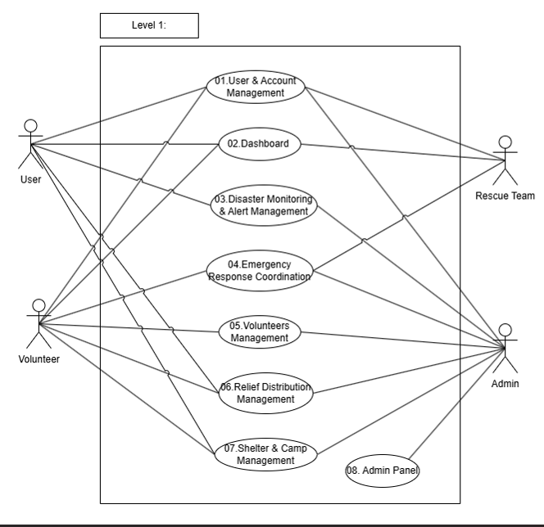
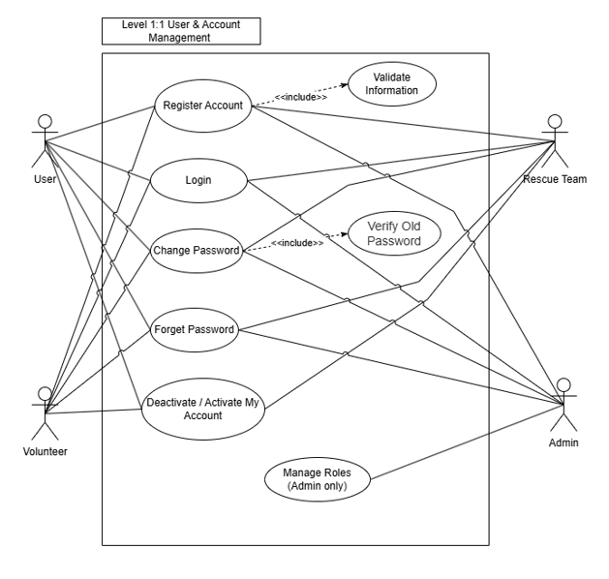
SCENARIO BASED MODELING
Use Case Diagram
Actors: User | Admin | Volunteer | Rescue Team
06
Emergency Alert & Response Information System

Slide 7
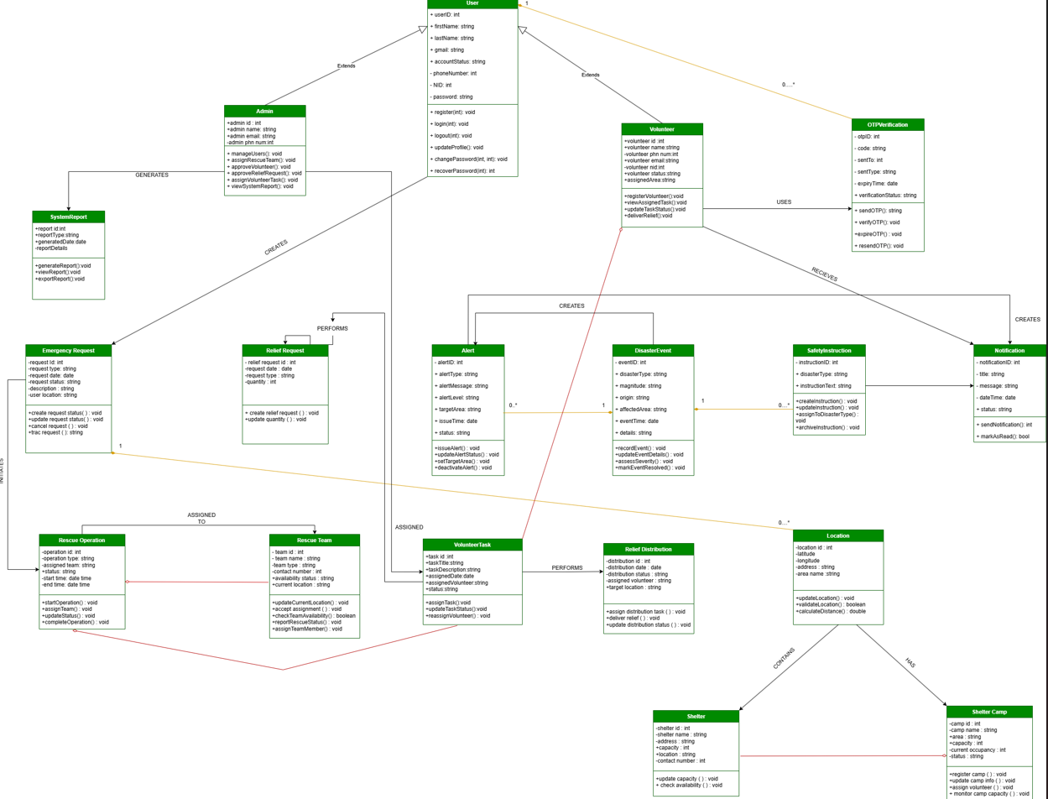
CLASS BASED MODELING
Class Diagram
[Insert Diagram Here]
Link : https://app.diagrams.net/#
17
Emergency Alert & Response Information System

Slide 8
BEHAVIORAL MODELING
Chapter 4 — Behavioral Modeling
Behavioral modeling explains how the system behaves over time through events, state changes, and actor interactions.
🔄
State Diagram
Shows lifecycle of key system objects — how they transition between states based on events and conditions.
↔️
Sequence Diagram
Illustrates interactions between actors and system modules over time, showing message flows and operations.
⚡
Focus Area
Event flow, system reactions, and interaction among actors and modules in real emergency scenarios.
21
Emergency Alert & Response Information System

Slide 9
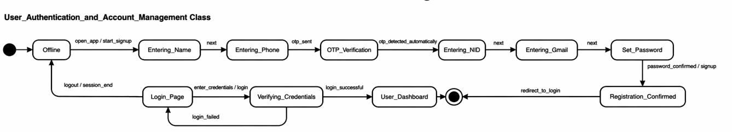
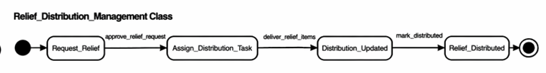
BEHAVIORAL MODELING
State Diagram
22
Emergency Alert & Response Information System

Slide 10
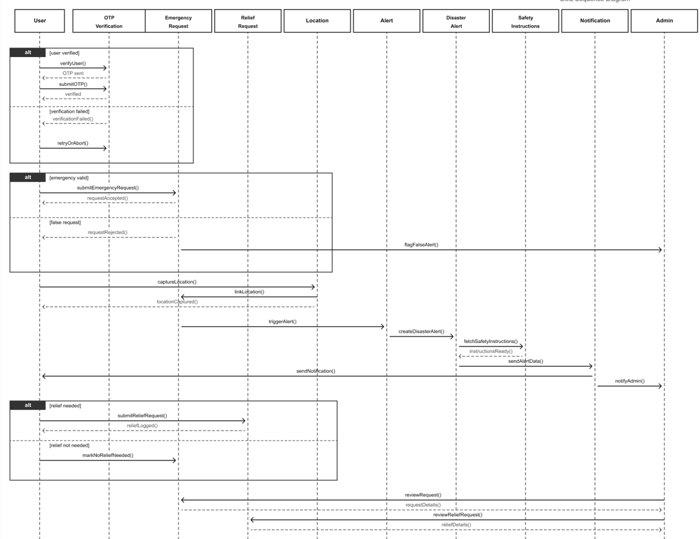
BEHAVIORAL MODELING
Sequence Diagram
1/5
[Insert Diagram Here]
27
Emergency Alert & Response Information System

Slide 11
SYSTEM MODULES
Major Functional Modules
🔐
User Authentication
& Account Mgmt
📊
Dashboard &
Profile Management
🚨
Disaster Alert
Management
📞
Emergency Service
Communication
⛑️
Rescue
Coordination
🤝
Volunteer
Management
📦
Relief
Distribution
🏕️
Shelter & Camp
Management
⚙️
Admin Control
Panel & Reporting
32
Emergency Alert & Response Information System

Slide 12
REQUIREMENT ELICITATION
Requirement
Elicitation Plan
🎯 Target Users
• Residents in high-risk areas
• Students and office workers
• Elderly / disabled / special-needs users
Method: Semi-structured interview — direct interaction to understand real emergency problems and identify key features.
⚠️ Challenges
Why This Method?
• Limited user participation
→ Direct user interaction
• Users may not explain experiences clearly
→ Understand real emergency problems
→ Identify key features & expectations
• Time and resource limitations
33
Emergency Alert & Response Information System

Slide 13
CONCLUSION
Conclusion
🌐
More than just an alert app — a complete emergency information, response, coordination, relief, and shelter management platform.
⚡
Improves safety, response speed, and operational transparency across all emergency stages.
🔁
Supports both preparedness and post-disaster coordination for all stakeholders.
🛡️
Built for real impact — connecting citizens, rescue teams, volunteers, and authorities in one unified system.
Thank You Everyone
34
Emergency Alert & Response Information System

