Slide 1
Teamline
CPSC 547 Project
Peer Review 1
Nick Bradley + Felix Grund

Slide 2
Domain
Both authors are TAs in CPSC310
Term-long coding project in 5 sprints
Code management on Github
AutoTest
Tool that runs a test suite on students’ code base on push
Determines a grade for the current sprint based on passed tests rate
Retrospective after each sprint
TAs meet with assigned teams and may “downgrade”
Was work equitably distributed?

Slide 3
Problem & Approach
Problem: how to judge whether work was equitably distributed?
Commit history? – may not reflect actual distribution
Talking to students? – some are good at cheating
Approach: visualizing contribution
Derived quantitative attribute commitContribution
Graph showing commits associated grade improvement
Show overall team performance
Show individual performance

Slide 4
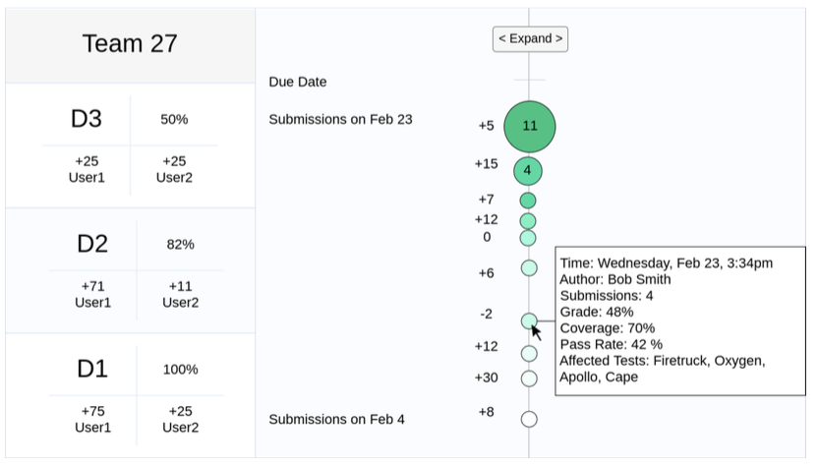
Draft (Team View)
Proposal Fig 1

Slide 5
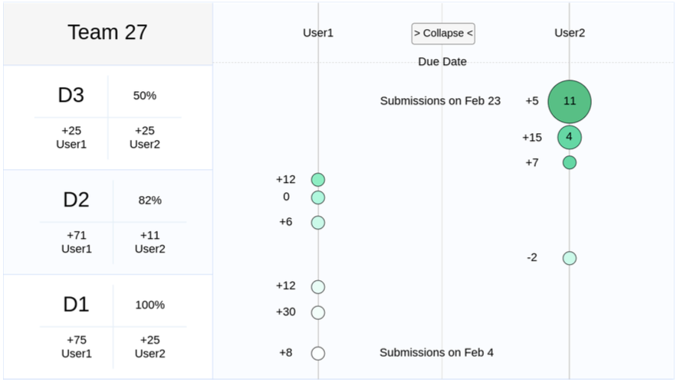
Draft (Student View)
Proposal Fig 2

Slide 6
What/Why/How
What: Table of graded submission records with the attributes
Why:
Compare contributions of team members
Derive a retrospective grade
How:
Align submissions on parallel axis by timestamp
Area marks for submissions
Overlapping submissions => bigger area marks that can be expanded/collapsed
Saturation of area marks reflecting overall grade
Interaction
Hover over area marks => details on submission
Click on area mark => open commit on Github
Hover over group mark => show expand grouped submissions
Click on button => switch between team view and student view

