Slide 1
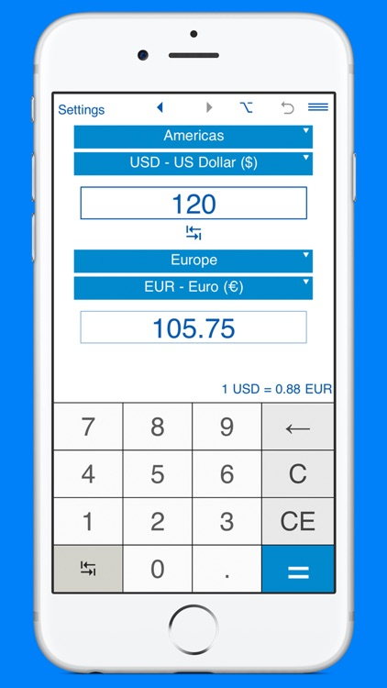

Currency Converter
Have you ever been in a different country and didn’t know the exchange rate there? Well, this converter is just for you!
https://github.com/heyarviind/currency-converter
https://github.com/1998chaitu/CurrencyConverter
https://github.com/charleslarnold/currency_converter
By: Nashika Auguste

