Slide 1
CONTOUR SEGMENT GROUPING FOR OVERLAPPING CONVEX OBJECT SEGMENTATION
Author:
Nikita Ashikhmin
Examiners:
Professor Heikki KälviäinenAssociate
Professor, Cand. Sci Gleb Radchenko

Slide 2
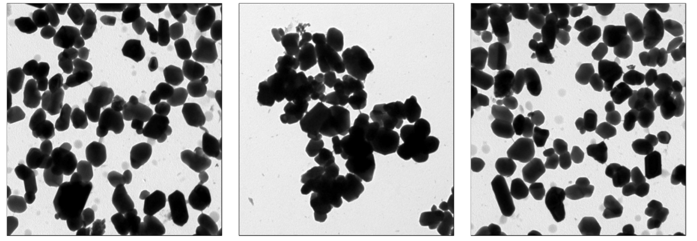

Background
Examples of real images
Notes:
The problem of segmentation of overlapping objects has a many practical use in industry and . It may be the images of molecular or cellular objects. In this task the reasercher should to calculate the amount of nanoparticles and estimate their countor. As an real example I can tell about situation in Russian Academy Of Science several years ago. During the process of the developing of submarine coating to reduce acustic profile the science should calculate the count of particles on the images of the coating. Usually for one experiment there are about one hundred photos. Previously research assistants calculate these particles manually. It was awful. But now they can use the machine learning algorithms and it allow them to concentrate on the real problems

Slide 3
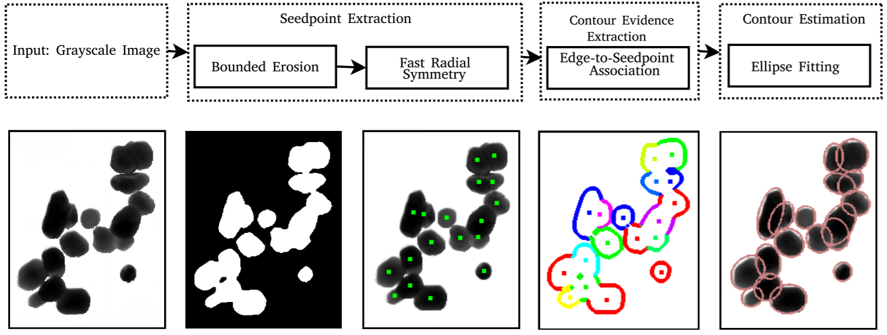
Seed points methods
Notes:
There are two common ways to solve the task.
First method is so call seed point based method. The visualization of the method steps you see on the screen.
Firstly we apply to binarization to the image. It can be simple Otsu method. Next we extract the seed points, centers of overlapped particles. Futhermore the contour evidene estimation step where weassociate edges to seed points. And the last step is estimate of contours of particles. Lets look more detailed to every step

Slide 4
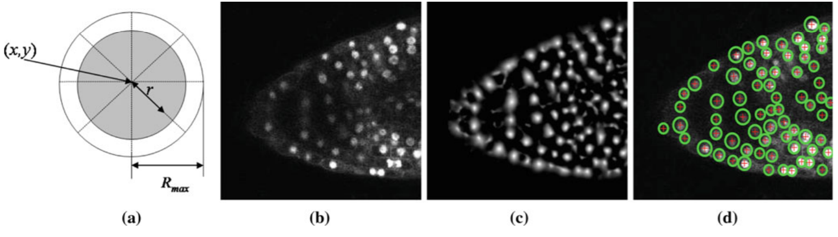
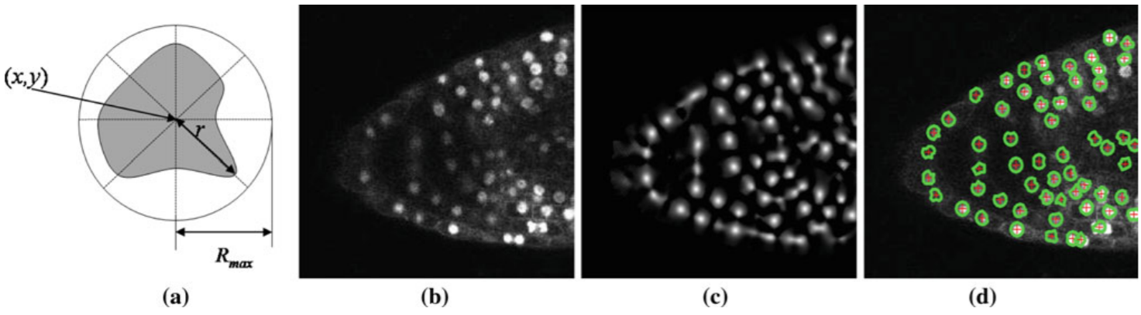
Local Convergence Filters
Coin filter
has the support region in
this method is defined by a circular shape
IRIS filter
differs from the previous one in that the radius of a support region for each of the N directions changing independently.
Original image b) Filter response c) Detection overlayed on the input image
Notes:
There are several methods for seed point extraction. The most used methods are Local coverage filters. These filters based on evaluating the degree of converegence of of the gradient vector within a local area around of pixel of the interest. region for each of the N directions changing independently, maximizing convergence for
each radial direction.

Slide 5
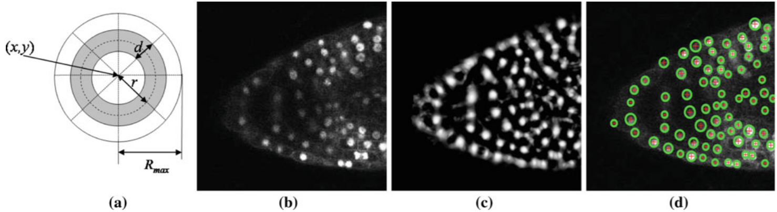
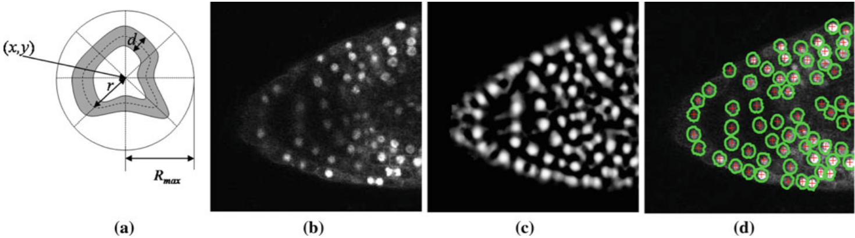
Local Convergence Filters
Adaptive ring filter
differs from the previous filters by defining a ring-shaped convergence region
Sliding Band Filter filter
combines both the shape flexibility of the IF with the limited band search of the ARF.
Original image b) Filter response c) Detection overlayed on the input image

Slide 6
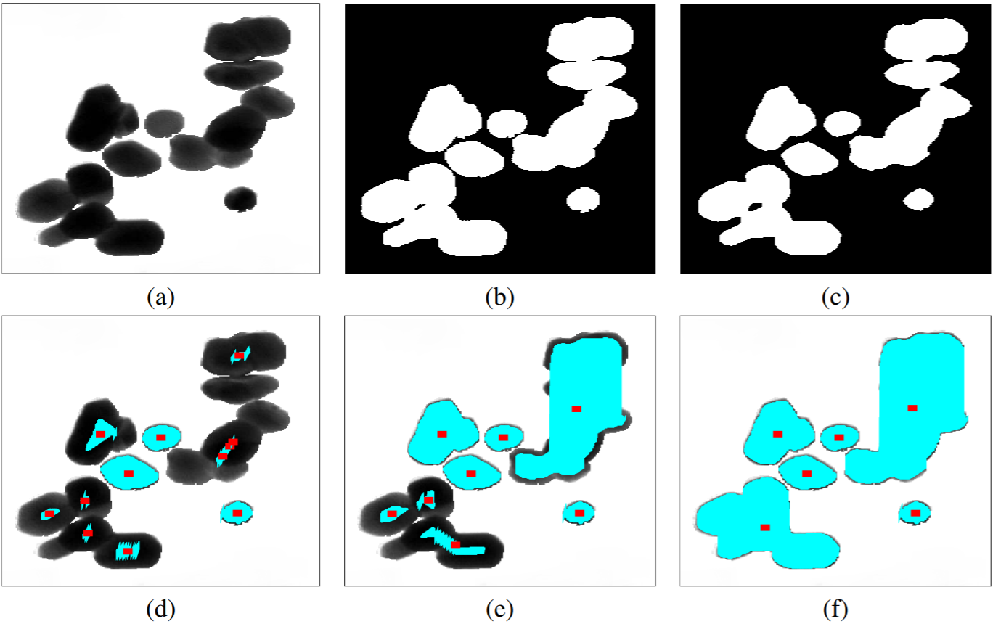
Ultimate Erosion for Convex Sets
Ultimate Erosion for Convex Sets (UECS) is an iterative morphological algorithm that extracts the seed regions from overlapping object. UECS is an extension of the Ultimate Erosion (UE) method with a modified stopping criteria.
Original grayscale image; (b) Binary image; (c) After morphological opening;
(d) UECS (threshold 0.1); (e) UECS (threshold 0.2); (f) UECS (threshold 0.3);
Notes:
Ultimate Erosion for Convex Sets (UECS) [9] is an iterative morphological algorithm that extracts the seed regions from overlapping object. UECS is an extension of the Ultimate Erosion (UE) method with a modified stopping criteria [9]. The algorithms consist of two stages. On the first stage, the image is decomposed into disjoint convex sets. This stage is based on the Ultimate Erosion algorithm with medicated stooping criteria that make possible to avoid over-segmentation. The result of this stage is set of disconnected objects.

Slide 7
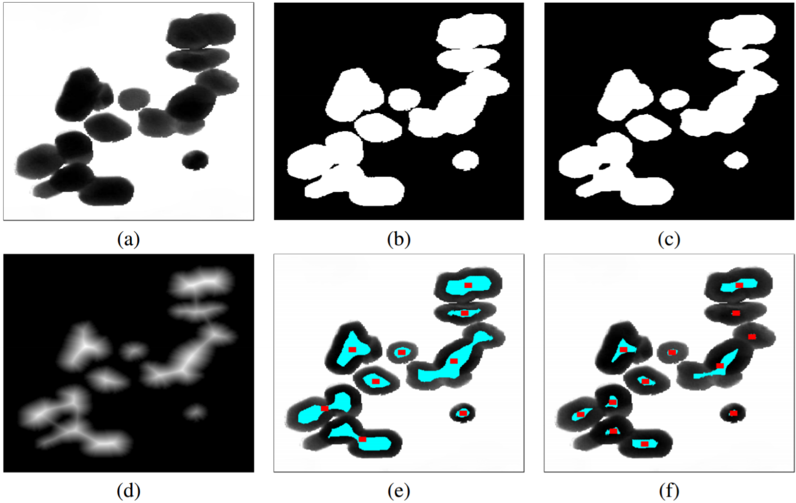
Distance Transform
The Distance Transform (DT) is a simple operator that is usually applied to image
segmentation. The DT transform each pixel in its small region of the interest.
(a) Original image; (b) Binary image; (c) Binary image after morphological opening;(d) Result of DT; (e) Seed points/regions identified by DT (thershold 0.5); (f) Seed points/regions identified by DT (thershold 0.7)
Notes:
Ultimate Erosion for Convex Sets (UECS) [9] is an iterative morphological algorithm that extracts the seed regions from overlapping object. UECS is an extension of the Ultimate Erosion (UE) method with a modified stopping criteria [9]. The algorithms consist of two stages. On the first stage, the image is decomposed into disjoint convex sets. This stage is based on the Ultimate Erosion algorithm with medicated stooping criteria that make possible to avoid over-segmentation. The result of this stage is set of disconnected objects.

Slide 8
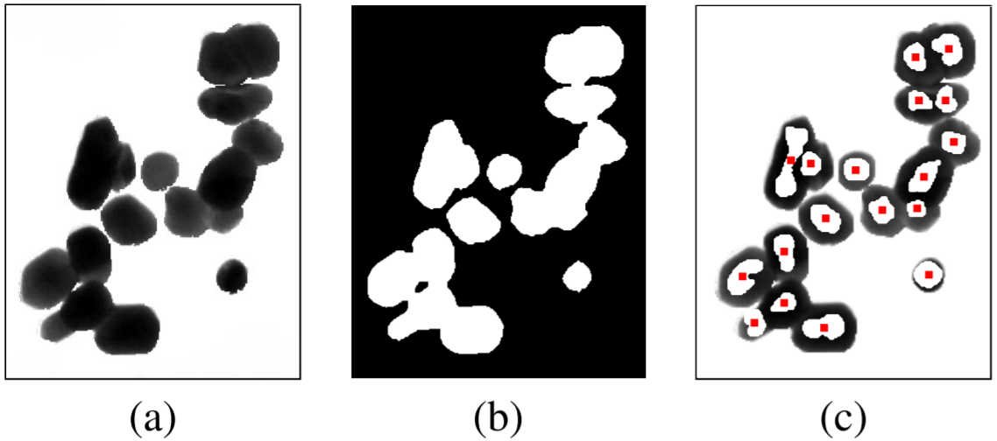
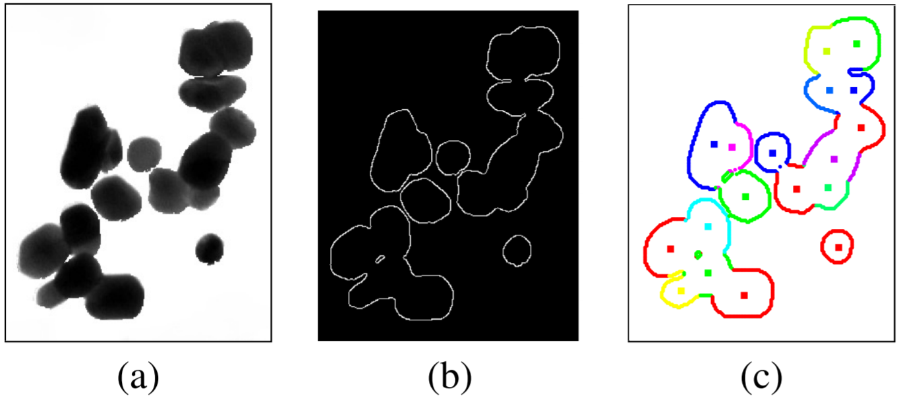
Fast Radial Symmetry Transform
Seedpoint extraction by BE-FRS:
(a) Original grayscale image; (b) Binary image after morphological erosion; (C) Seedpoints identified by FRS.
Contour evidence extraction performed by edge-to-seedpoint association:
(a) Original grayscale image; (b) Gradient image; (c) Edge-to-seedpoint association (the colors are used only for illustrative purpose to visualize the edge-to-seedpoint association).

Slide 9
Fast Radial Symmetry method
Notes:
There are two common ways to solve the task.
First method is so call seed point based method. The visualization of the method steps you see on the screen.
Firstly we apply to binarization to the image. It can be simple Otsu method. Next we extract the seed points, centers of overlapped particles. Futhermore the contour evidene estimation step where weassociate edges to seed points. And the last step is estimate of contours of particles. Lets look more detailed to every step

Slide 10
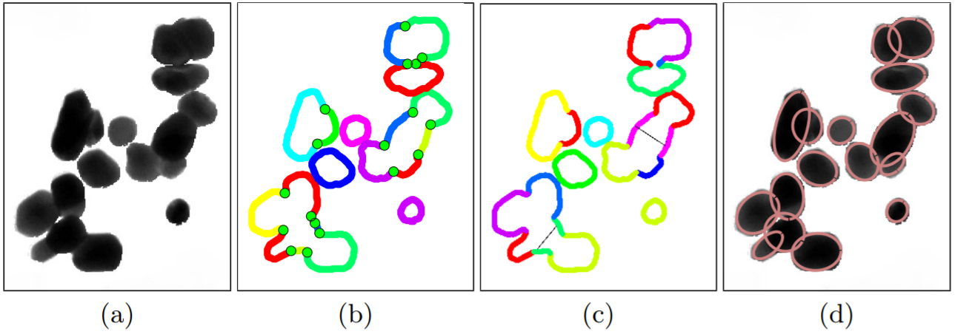
Concave point based method
(a) Original image; (b) Contour segmentation; (c) Segment grouping (the thin gray lines are added to illustrate the grouping of non-adjacent segments); (d) Contour estimation.
Notes:
Another approach for segmentation of overlapping objects is the concave point-based
method. That method was well-described in [15]. The idea of this methods is dividing the
contour of the group of overlapping objects to set of segments separated by special points,
so-called concave points. The main steps of the methods are shown in Algorithm 1. The
visualization of the method is shown in Figure 6.

Slide 11
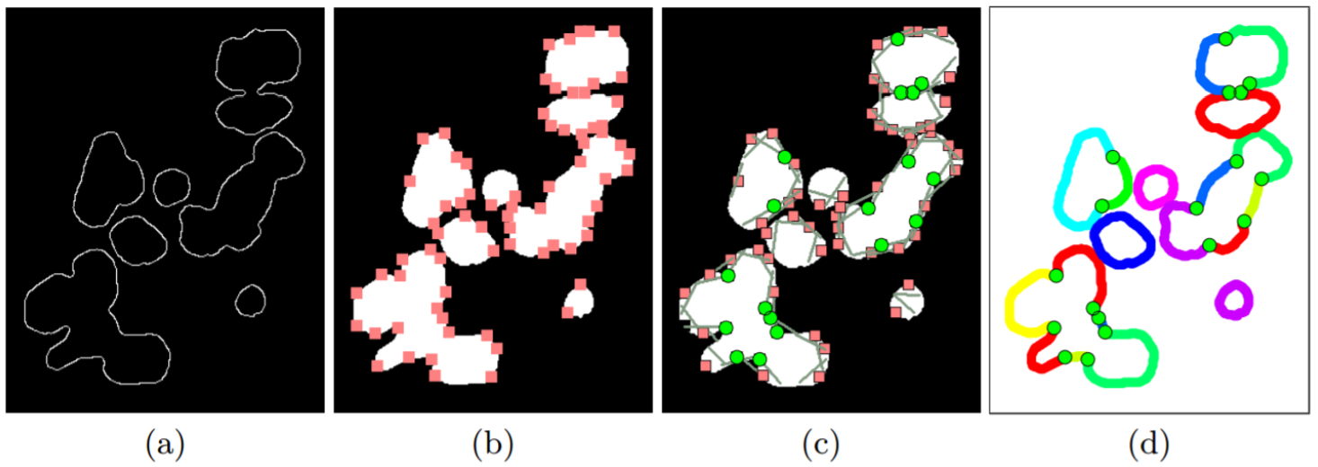
Contour segmentation
(a) Edge map; (b) Corner detection; (c) Concavity test to extract concave corners (green circle) and removed convex corners (pink sqaure); (d) Contour segmentation by concave points (the colors are used only for illustrative purpose to visualize the segmented contour by concave points)
Notes:
Another approach for segmentation of overlapping objects is the concave point-based
method. That method was well-described in [15]. The idea of this methods is dividing the
contour of the group of overlapping objects to set of segments separated by special points,
so-called concave points. The main steps of the methods are shown in Algorithm 1. The
visualization of the method is shown in Figure 6.

Slide 12
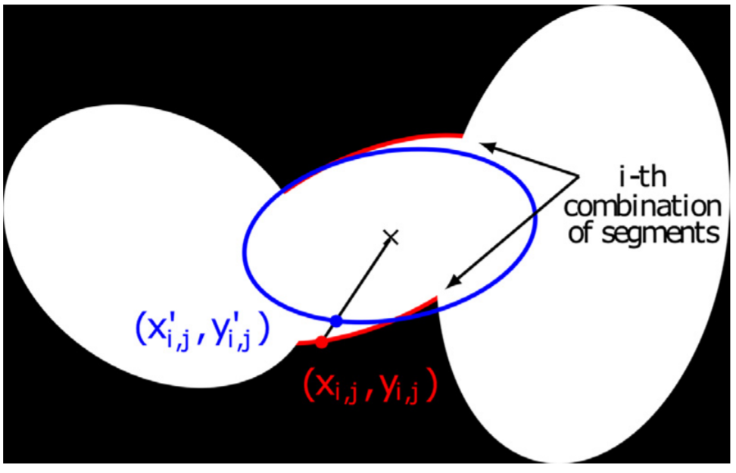
Segment grouping
The i-th combination (in red) is matched with an ellipse (in blue). For each point j of the ith combination the distance to the corresponding point of the fitted ellipse is calculated.
Notes:
Another approach for segmentation of overlapping objects is the concave point-based
method. That method was well-described in [15]. The idea of this methods is dividing the
contour of the group of overlapping objects to set of segments separated by special points,
so-called concave points. The main steps of the methods are shown in Algorithm 1. The
visualization of the method is shown in Figure 6.

Slide 13
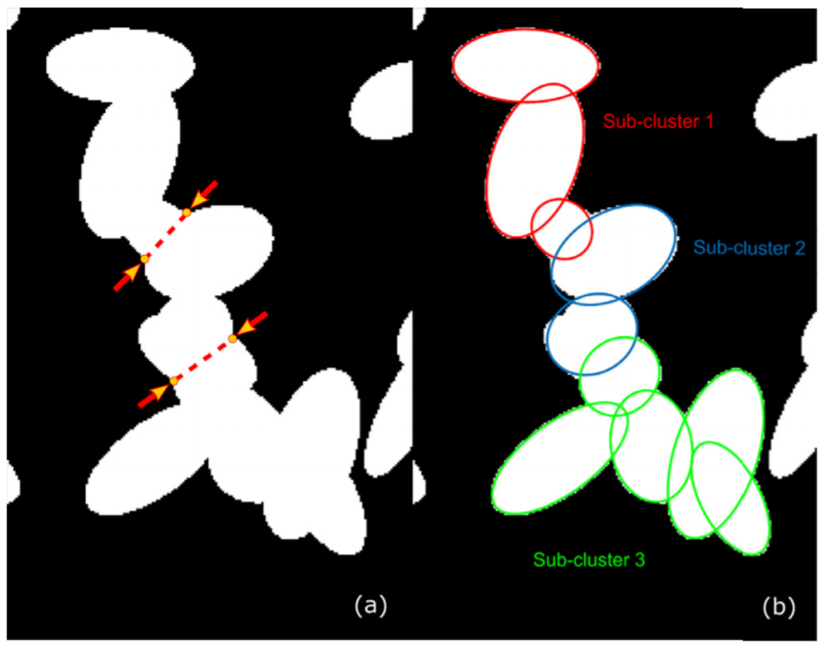
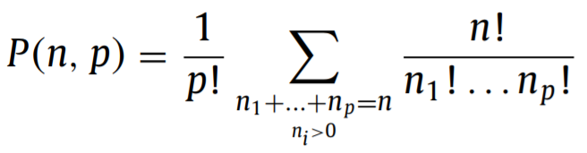
Cluster decomposition
Stirling numbers:
Illustration of cluster decomposition and ellipse fitting in the case of a cluster involving 17 segments:
Initial cluster and detected split
resulting subclusters and ellipse fitting.
Notes:
The next step addresses segment combination and ellipse fitting. As discussed in introduction, several grouping methods have been evaluated in the literature [15–17,20]. They generally suffer either from bad recognition, as in the case of large cluster of particles, or from robustness issues, as in the case of highly noisy images or from relatively high computing time requirements. The proposed method, called Global Segments Combinations (GSC), is based on an exhaustive enumeration of all possible combinations of segments, followed by a selection of the best combination thanks to a merit function, and is aimed at addressing these weaknesses. The Stirling partition numbers (also called Stirling number of the second kind) are particularly convenient to perform this enumeration task. Indeed, in combinatorics, the Stirling partition number P(n, p) designates the number of possible ways to partition a set of n objects into p non-empty subsets.

