Slide 1
Introduction to Computing Using Python
Graphical User Interfaces
Basic tkinter Widgets
Event-Based tkinter Widgets
Designing GUIs
OOP for GUIs

Slide 2
Graphical user interfaces (GUIs)
Introduction to Computing Using Python
Almost all computer apps have a GUI
A GUI gives a better overview of what an application does
A GUI makes it easier to use the application.
A graphical user interface (GUI) consists of basic visual building blocks,
called widgets, packed inside a standard window.
widgets include buttons, labels, text entry forms, menus, check boxes, scroll bars, …
In order to develop GUIs, we need a module that makes widgets available; we will use module tkinter that is included in the Standard Library.

Slide 3
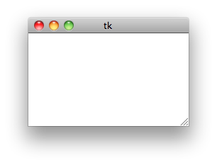
Widget Tk
Introduction to Computing Using Python
We introduce some of the commonly used tkinter widgets
Widget Tk represents the GUI window
>>> from tkinter import Tk
>>> root = Tk()
>>>
>>> from tkinter import Tk
>>> root = Tk()
>>> root.mainloop()
As usual, the constructor creates the widget (i.e., GUI object) …
As usual, the constructor creates the widget (i.e., GUI object) …
… but method mainloop() really starts the GUI
The window is currently empty; normally it contains other widgets

Slide 4
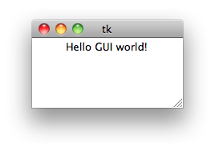
Widget Label (for displaying text)
Introduction to Computing Using Python
Option | Description
master | The master of the widget
text | Text to display on the widget
Option | Description
master | The master of the widget
text | Text to display on the widget
image | Image to display
width | Width of widget (in pixels or characters)
height | Height of widget (in pixels or characters)
relief | Border style (FLAT, RAISED, RIDGE, …)
borderwidth | Width of border (no border is 0)
background | Background color (e.g., string “white”)
foreground | Foreground color
font | Font descriptor (as a tuple
padx, pady | Padding added along the x- or y- axis
The widget Label can be used to display text inside a window.
Method pack() specifies the placement of the widget within its master
>>> from tkinter import Tk, Label
>>> root = Tk()
>>> hello = Label(master = root, text = 'Hello GUI world!')
>>> hello.pack() # widget placed against top boundary of master (default)
>>>
>>> from tkinter import Tk, Label
>>> root = Tk()
>>> hello = Label(master = root, text = 'Hello GUI world!')
>>>
>>> from tkinter import Tk, Label
>>> root = Tk()
>>> hello = Label(master = root, text = 'Hello GUI world!')
>>> hello.pack() # widget placed against top boundary of master (default)
>>> root.mainloop()
The widget constructor has many options

Slide 5
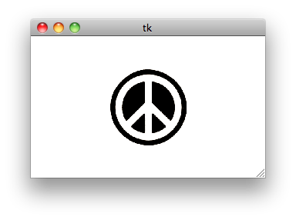
Widget Label (for displaying images)
Introduction to Computing Using Python
Option | Description
master | The master of the widget
text | Text to display
image | Image to display
width | Width of widget (in pixels or characters)
height | Height of widget (in pixels or characters)
relief | Border style (FLAT, RAISED, RIDGE, …)
borderwidth | Width of border (no border is 0)
background | Background color (e.g., string “white”)
foreground | Foreground color
font | Font descriptor (as a tuple
padx, pady | Padding added along the x- or y- axis
The widget Label can be used to display images too
Option image must refer to an image in a format that tkinter can display. The PhotoImage class, defined in module tkinter, is used to transform a GIF image into an object with such a format.
from tkinter import Tk, Label, PhotoImage
root = Tk()
# transform GIF image to a format tkinter can display
photo = PhotoImage(file='peace.gif')
peace = Label(master=root,
image=photo,
width=300, # width of label, in pixels
height=180) # height of label, in pixels
peace.pack()
root.mainloop()
peace.py

Slide 6
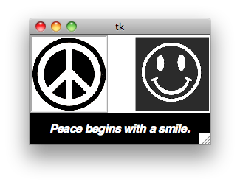
Packing widgets
Introduction to Computing Using Python
from tkinter import Tk, Label, PhotoImage, BOTTOM, LEFT, RIGHT, RIDGE
root = Tk()
text = Label(root,
font=('Helvetica', 16, 'bold italic'),
foreground='white',
background='black',
pady=10,
text='Peace begins with a smile.')
text.pack(side=BOTTOM)
peace = PhotoImage(file='peace.gif')
peaceLabel = Label(root,
borderwidth=3,
relief=RIDGE,
image=peace)
peaceLabel.pack(side=LEFT)
smiley = PhotoImage(file='smiley.gif')
smileyLabel = Label(root,
image=smiley)
smileyLabel.pack(side=RIGHT)
root.mainloop()
Method pack() specifies the placement of the widget within its master
Option | Description
side | LEFT, RIGHT, TOP, BOTTOM,
fill | 'both', 'x', 'y', or 'none'
expand | True or False
smileyPeace.py

Slide 7
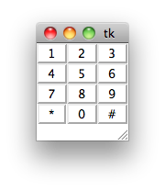
Arranging widgets into a grid
Introduction to Computing Using Python
Method grid() is used to place widgets in a grid format
pack() and grid() use different algorithms to place widgets within a master; You must use one or the other for all widgets with the same master.
from tkinter import Tk, Label, RAISED
root = Tk()
labels = [['1', '2', '3'],
['4', '5', '6'],
['7', '8', '9'],
['*', '0', '#']]
for r in range(4):
for c in range(3):
# create label for row r and column c
label = Label(root,
relief=RAISED,
padx=10,
text=labels[r][c])
# place label in row r and column c
label.grid(row=r, column=c)
root.mainloop()
Options
column
columnspan
row
rowspan
phone.py

Slide 8
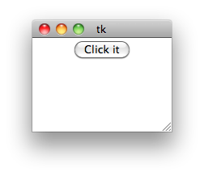
Widget Button
Introduction to Computing Using Python
>>> === RESTART ===
>>>
>>> === RESTART ===
>>>
Day: 13 Apr 2012
Time: 15:50:05 PM
>>> === RESTART ===
>>>
Day: 13 Apr 2012
Time: 15:50:05 PM
Day: 13 Apr 2012
Time: 15:50:07 PM
Day: 13 Apr 2012
Time: 15:50:11 PM
>>> === RESTART ===
>>>
Day: 13 Apr 2012
Time: 15:50:05 PM
Day: 13 Apr 2012
Time: 15:50:07 PM
Click the button…
…and clicked() gets executed
Widget Button represents the standard clickable GUI button
Option command
specifies the function that is executed every time the button is clicked
This function is called an event handler: it handles the event
of clicking this particular button
from tkinter import Tk, Button
from time import strftime, localtime
def clicked():
'prints day and time info'
time = strftime('Day: %d %b %Y\nTime: %H:%M:%S %p\n',
localtime())
print(time)
root = Tk()
button = Button(root,
text='Click it',
command=clicked)
button.pack()
root.mainloop()
clickit.py

Slide 9
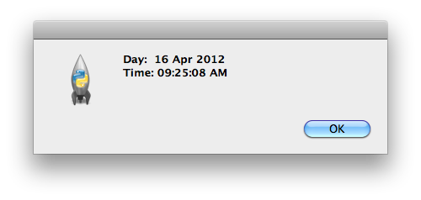
Widget Button
Introduction to Computing Using Python
>>> === RESTART ===
>>>
Day: 13 Apr 2012
Time: 15:50:05 PM
Day: 13 Apr 2012
Time: 15:50:07 PM
Day: 13 Apr 2012
Time: 15:50:07 PM
from tkinter import Tk, Button
from time import strftime, localtime
from tkinter.messagebox import showinfo
def clicked():
'prints day and time info'
time = strftime('Day: %d %b %Y\nTime: %H:%M:%S %p\n',
localtime())
showinfo(message = time)
root = Tk()
button = Button(root,
text='Click it',
command=clicked)
button.pack()
root.mainloop()
Suppose we want the date and time to be printed in a window, rather than in the shell
from tkinter import Tk, Button
from time import strftime, localtime
def clicked():
'prints day and time info'
time = strftime('Day: %d %b %Y\nTime: %H:%M:%S %p\n',
localtime())
print(time)
root = Tk()
button = Button(root,
text='Click it',
command=clicked)
button.pack()
root.mainloop()
clickit.py

Slide 10
Event-driven programming
Introduction to Computing Using Python
When a GUI is started with the mainloop() method call, Python starts an infinite loop called an event loop
while True:
1. wait for an event to occur
2. run the associated event handler
Event-driven programming is the programming approach used to build applications whose execution flow is determined by events and described using an event loop

Slide 11
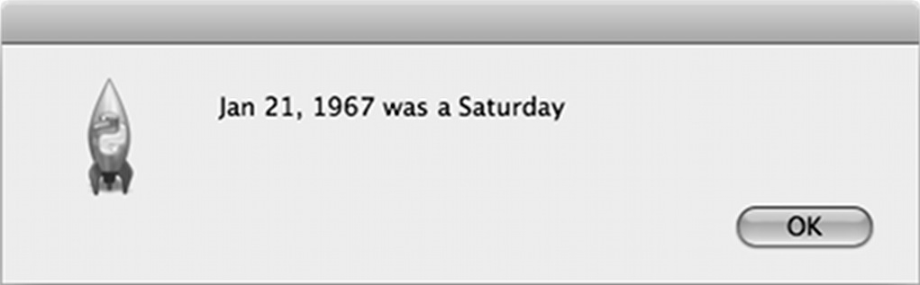
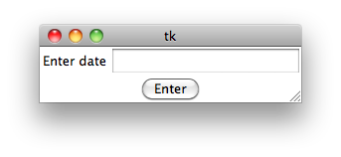
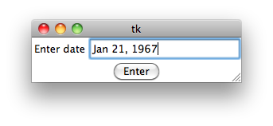
Widget Entry
Introduction to Computing Using Python
from tkinter import Tk, Button, Entry, Label, END
from time import strptime, strftime
from tkinter.messagebox import showinfo
def compute():
global dateEnt # dateEnt is a global variable
date = dateEnt.get()
weekday = strftime('%A', strptime(date, '%b %d, %Y'))
showinfo(message = '{} was a {}'.format(date, weekday))
dateEnt.delete(0, END)
root = Tk()
label = Label(root, text='Enter date')
label.grid(row=0, column=0)
dateEnt = Entry(root)
dateEnt.grid(row=0, column=1)
button = Button(root, text='Enter', command=compute)
button.grid(row=1, column=0, columnspan=2)
root.mainloop()
Widget Entry represents the single-line text entry/display form
Event handler compute() should:
Read the date from entry dateEnt
Compute the weekday corresponding to the date
Display the weekday message in a pop-up window
Erase the date from entry dateEnt (to make it easier to enter another date)
def compute():
# implement this
root = Tk()
label = Label(root, text='Enter date')
label.grid(row=0, column=0)
dateEnt = Entry(root)
dateEnt.grid(row=0, column=1)
button = Button(root, text='Enter', command=compute)
button.grid(row=1, column=0, columnspan=2)
root.mainloop()
To illustrate it, let’s build an app that takes a date and prints the day of the week corresponding to the date
day.py

Slide 12
Widget Entry
Introduction to Computing Using Python
from tkinter import Tk, Button, Entry, Label, END
from time import strptime, strftime
from tkinter.messagebox import showinfo
def compute():
global dateEnt # dateEnt is a global variable
date = dateEnt.get()
weekday = strftime('%A', strptime(date, '%b %d, %Y'))
showinfo(message = '{} was a {}'.format(date, weekday))
dateEnt.delete(0, END)
...
dateEnt = Entry(root)
dateEnt.grid(row=0, column=1)
...
Method | Description
e.get() | return string in entry e
e.insert(idx, text) | insert text into entry e starting at index idx
e.delete(from, to) | delete text from index from to index to inside entry e

Slide 13
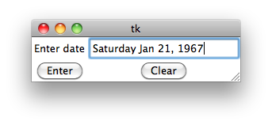
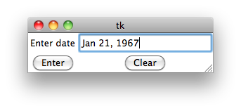
Exercise
Introduction to Computing Using Python
from tkinter import Tk, Button, Entry, Label, END
from time import strptime, strftime
from tkinter.messagebox import showinfo
def compute():
global dateEnt # dateEnt is a global variable
date = dateEnt.get()
weekday = strftime('%A', strptime(date, '%b %d, %Y'))
dateEnt.insert(0, weekday + ' ')
def clear():
global dateEnt # dateEnt is a global variable
dateEnt.delete(0, END)
root = Tk()
label = Label(root, text='Enter date')
label.grid(row=0, column=0)
dateEnt = Entry(root)
dateEnt.grid(row=0, column=1)
button = Button(root, text='Enter', command=compute)
button.grid(row=1, column=0)
button = Button(root, text='Clear', command=clear)
button.grid(row=1, column=1)
root.mainloop()
Modify the app so that instead of displaying the weekday message in a separate pop-up window,
Modify the app so that instead of displaying the weekday message in a separate pop-up window, insert it in front of the date in the entry box.
Also add a button labeled “Clear” that erases the entry box.

Slide 14
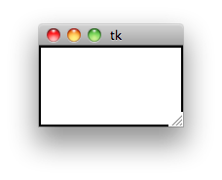
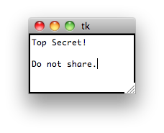
Widget Text
Introduction to Computing Using Python
>>>
char = T
char = o
char = p
char = space
char = S
char = e
char = c
char = r
char = e
char = t
char = exclam
char = Return
char = Return
char = D
char = o
char = space
char = n
char = o
char = t
char = space
char = s
char = h
char = a
char = r
char = e
char = period
We use a Text widget to develop an application that looks like a text editor, but “secretly” records and prints every keystroke the user types
Widget Text represents the multi-line text entry/display form
Like widget Entry, it supports methods get(), insert(), delete()
except that the index has the format row.column
Method | Description
t.get(from, to) | return text from index from to index to in text entry t
t.insert(idx, text) | insert text into text entry t starting at index idx
t.delete(from, to) | delete text from index from to index to inside text entry t

Slide 15
Widget Text
Introduction to Computing Using Python
>>>
char = T
char = o
char = p
char = space
char = S
char = e
char = c
char = r
char = e
char = t
char = exclam
char = Return
char = Return
char = D
char = o
char = space
char = n
char = o
char = t
char = space
char = s
char = h
char = a
char = r
char = e
char = period
We use a Text widget to develop an application that looks like a text editor, but “secretly” records and prints every keystroke the user types
In order to record every keystroke, we need to associate an event-handling function with keystrokes
Widget method bind() method “binds” (i.e., associates) an event type to an event handler. For example
text.bind('<KeyPress>', record)
binds a keystroke, described with string '<KeyPress>', within widget text to event handler record()

Slide 16
Widget Text
Introduction to Computing Using Python
Event-handling function record() takes as input an object of type Event; this object is created by Python when an event occurs
from tkinter import Tk, Text, BOTH
def record(event):
'''event handling function for key press events;
input event is of type tkinter.Event'''
print('char = {}'.format(event.keysym)) # print key symbol
root = Tk()
text = Text(root,
width=20, # set width to 20 characters
height=5) # set height to 5 rows of characters
# Bind a key press event with the event handling function record()
text.bind('<KeyPress>', record)
# widget expands if the master does
text.pack(expand=True, fill=BOTH)
root.mainloop()
An Event object contains information about the event, such as the symbol of the pressed key
Keystroke events are bound to event handling function record()

Slide 17
Event pattern and tkinter class Event
Introduction to Computing Using Python
Type | Description
Button | Mouse button
Return | Enter/Return key
KeyPress | Press of a keyboard key
KeyRelease | Release of a keyboard key
Motion | Mouse motion
The first argument of method bind() is the type of event we want to bind
The type of event is described by a string that is the concatenation of one or more event patterns
An event pattern has the form
Modifier | Description
Control | Ctrl key
Button1 | Left mouse button
Button3 | Right mouse button
Shift | Shift key
<modifier-modifier-type-detail>
<Control-Button-1>:
<Control-Button-1>: Hitting Ctrl and the left mouse button simultaneously
<Button-1><Button-3>:
<Control-Button-1>: Hitting Ctrl and the left mouse button simultaneously
<Button-1><Button-3>: Clicking the left mouse button and then the right one
<KeyPress-D><Return>:
<Control-Button-1>: Hitting Ctrl and the left mouse button simultaneously
<Button-1><Button-3>: Clicking the left mouse button and then the right one
<KeyPress-D><Return>: Hitting the keyboard key and then Return
<Buttons1-Motion>:
<Control-Button-1>: Hitting Ctrl and the left mouse button simultaneously
<Button-1><Button-3>: Clicking the left mouse button and then the right one
<KeyPress-D><Return>: Hitting the keyboard key and then Return
<Buttons1-Motion>: Mouse motion while holding left mouse button
Detail | Description
<button number> | 1,2, or 3 for left, middle, and right buttons
<key symbol> | Key letter symbol

Slide 18
Event pattern and tkinter class Event
Introduction to Computing Using Python
The second argument of method bind() is the event handling function
The event handling function must be defined to take exactly one argument, an object of type Event, a class defined in tkinter
When an event occurs, Python will create an object of type Event associated with the event and then call the event-handling function with the Event object passed as the single argument
An Event object has many attributes that store information about the event
Attribute | Event Type | Description
num | ButtonPress, ButtonRelease | Mouse button pressed
time | all | Time of event
x | all | x-coordinate of mouse
y | all | x-coordinate of mouse
keysum | KeyPress, KeyRelease | Key pressed as string
keysum_num | KeyPress, KeyRelease | Key pressed as Unicode number

Slide 19
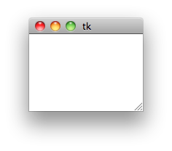
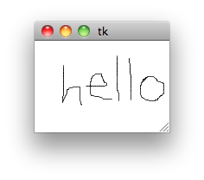
Widget Canvas
Introduction to Computing Using Python
Widget Canvas represents a drawing board in which lines and other geometrical objects can be drawn
We illustrate widget Canvas by developing a pen drawing app
the user starts the drawing of the curve by pressing the left mouse button
the user then draws the curve by moving the mouse, while still pressing the left mouse button

Slide 20
Widget Canvas
Introduction to Computing Using Python
Every time the mouse is moved while pressing the left mouse button, the handler draw() is called with an Event object storing the new mouse position.
To continue drawing the curve, we need to connect this new mouse position to the previous one with a straight line.
from tkinter import Tk, Canvas
# event handlers begin() and draw() to be defined
root = Tk()
canvas = Canvas(root, height=100, width=150)
# bind left mouse button click event to function begin()
canvas.bind("<Button-1>", begin)
# bind mouse motion while pressing left button event
canvas.bind("<Button1-Motion>", draw)
canvas.pack()
root.mainloop()
We illustrate widget Canvas by developing a pen drawing app
the user starts the drawing of the curve by pressing the left mouse button
the user then draws the curve by moving the mouse, while still pressing the left mouse button

Slide 21
Widget Canvas
Introduction to Computing Using Python
from tkinter import Tk, Canvas
# event handlers begin() and draw() to be defined
root = Tk()
canvas = Canvas(root, height=100, width=150)
# bind left mouse button click event to function begin()
canvas.bind("<Button-1>", begin)
# bind mouse motion while pressing left button event
canvas.bind("<Button1-Motion>", draw)
canvas.pack()
root.mainloop()
from tkinter import Tk, Canvas
# event handlers begin() and draw() to be defined
root = Tk()
x, y = 0, 0 # mouse coordinates (global variables)
canvas = Canvas(root, height=100, width=150)
# bind left mouse button click event to function begin()
canvas.bind("<Button-1>", begin)
# bind mouse motion while pressing left button event
canvas.bind("<Button1-Motion>", draw)
canvas.pack()
root.mainloop()
from tkinter import Tk, Canvas
def begin(event):
global x, y
x, y = event.x, event.y
def draw(event):
global x, y, canvas
newx, newy = event.x, event.y
# connect previous mouse position to current one
canvas.create_line(x, y, newx, newy)
# new position becomes previous
x, y = newx, newy
root = Tk()
x, y = 0, 0 # mouse coordinates (global variables)
canvas = Canvas(root, height=100, width=150)
# bind left mouse button click event to function begin()
canvas.bind("<Button-1>", begin)
# bind mouse motion while pressing left button event
canvas.bind("<Button1-Motion>", draw)
canvas.pack()
root.mainloop()
Therefore the previous mouse position must be stored
But where?
Therefore the previous mouse position must be stored
But where?
In global variables x and y
Handler begin() sets the initial values of x and y
We illustrate widget Canvas by developing a pen drawing app
the user starts the drawing of the curve by pressing the left mouse button
the user then draws the curve by moving the mouse, while still pressing the left mouse button
Method create_line() creates a line segment between (x, y) and (newx, newy)

Slide 22
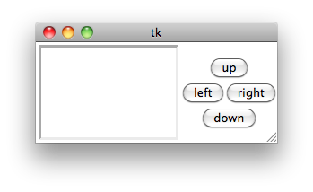
Widget Frame
Introduction to Computing Using Python
Frame
Widget Frame is a key widget whose primary purpose is to serve as the master of other widgets and help define a hierarchical structure of the GUI and its geometry
We illustrate widget Frame by developing an Etch-A-Sketch drawing app
Pressing a button moves the pen 10 pixels in the indicated direction
To facilitate the specification of the geometry of the GUI widgets, we use
a Frame widget to be the master of the 4 buttons

Slide 23
Widget Frame
Introduction to Computing Using Python
from tkinter import Tk, Canvas, Frame, Button,
SUNKEN, LEFT, RIGHT
# event handlers to be defined here
root = Tk()
canvas = Canvas(root, height=100, width=150,
relief=SUNKEN, borderwidth=3)
canvas.pack(side=LEFT)
box = Frame(root) # frame to hold the 4 buttons
box.pack(side=RIGHT)
# buttons have Frame widget as their master
button = Button(box, text='up', command=up)
button.grid(row=0, column=0, columnspan=2)
button = Button(box, text='left', command=left)
button.grid(row=1, column=0)
button = Button(box, text='right', command=right)
button.grid(row=1, column=1)
button = Button(box, text='down', command=down)
button.grid(row=2, column=0, columnspan=2)
x, y = 50, 75 # initial pen position
root.mainloop()
Frame

Slide 24
Exercise
Introduction to Computing Using Python
from tkinter import Tk, Canvas, Frame, Button,
SUNKEN, LEFT, RIGHT
# event handlers to be defined here
root = Tk()
canvas = Canvas(root, height=100, width=150,
relief=SUNKEN, borderwidth=3)
canvas.pack(side=LEFT)
box = Frame(root) # frame to hold the 4 buttons
box.pack(side=RIGHT)
# buttons have Frame widget as their master
button = Button(box, text='up', command=up)
button.grid(row=0, column=0, columnspan=2)
button = Button(box, text='left',command=left)
button.grid(row=1, column=0)
button = Button(box, text='right', command=right)
button.grid(row=1, column=1)
button = Button(box, text='down', command=down)
button.grid(row=2, column=0, columnspan=2)
x, y = 50, 75 # initial pen position
root.mainloop()
def up():
'move pen up 10 pixels'
global y, canvas
canvas.create_line(x, y, x, y-10)
y -= 10
def up():
'move pen up 10 pixels'
global y, canvas
canvas.create_line(x, y, x, y-10)
y -= 10
def down():
'move pen down 10 pixels'
global y, canvas
canvas.create_line(x, y, x, y+10)
y += 10
def left():
'move pen left 10 pixels'
global x, canvas
canvas.create_line(x, y, x-10, y)
x -= 10
def right():
'move pen right 10 pixels'
global x, canvas
canvas.create_line(x, y, x+10, y)
x += 10
Implement the 4 event
handlers
Note: the x coordinates increase from left to right, while the y coordinates increase from top to bottom

Slide 25
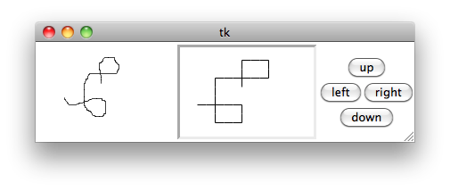
OOP for GUIs
Introduction to Computing Using Python
Suppose we want to build a new GUI that incorporates GUIs we have already developed
For example, GUIs draw and Etch-A-Sketch
Ideally, we would like to reuse the code we have already developed

Slide 26
OOP for GUIs
Introduction to Computing Using Python
from tkinter import Tk, Canvas
def begin(event):
global x, y
x, y = event.x, event.y
def draw(event):
global x, y, canvas
newx, newy = event.x, event.y
# connect previous mouse position to current one
canvas.create_line(x, y, newx, newy)
# new position becomes previous
x, y = newx, newy
root = Tk()
x, y = 0, 0 # mouse coordinates (global variables)
canvas = Canvas(root, height=100, width=150)
# bind left mouse button click event to function begin()
canvas.bind("<Button-1>", begin)
# bind mouse motion while pressing left button event
canvas.bind("<Button1-Motion>", draw)
canvas.pack()
root.mainloop()
from tkinter import Tk, Canvas
def begin(event):
global x, y
x, y = event.x, event.y
def draw(event):
global x, y, canvas
newx, newy = event.x, event.y
# connect previous mouse position to current one
canvas.create_line(x, y, newx, newy)
# new position becomes previous
x, y = newx, newy
root = Tk()
x, y = 0, 0 # mouse coordinates (global variables)
canvas = Canvas(root, height=100, width=150)
# bind left mouse button click event to function begin()
canvas.bind("<Button-1>", begin)
# bind mouse motion while pressing left button event
canvas.bind("<Button1-Motion>", draw)
canvas.pack()
root.mainloop()
from tkinter import Tk, Canvas, Frame, Button,
SUNKEN, LEFT, RIGHT
# event handlers to be defined here
root = Tk()
canvas = Canvas(root, height=100, width=150,
relief=SUNKEN, borderwidth=3)
canvas.pack(side=LEFT)
box = Frame(root) # frame to hold the 4 buttons
box.pack(side=RIGHT)
# buttons have Frame widget as their master
button = Button(box, text='up', command=up)
button.grid(row=0, column=0, columnspan=2)
button = Button(box, text='left', command=left)
button.grid(row=1, column=0)
button = Button(box, text='right', command=right)
button.grid(row=1, column=1)
button = Button(box, text='down', command=down)
button.grid(row=2, column=0, columnspan=2)
x, y = 50, 75 # initial pen position
root.mainloop()
Need to rename x and y

Slide 27
OOP for GUIs
Introduction to Computing Using Python
Our GUI programs do not encapsulate the implementation, making code reuse problematic
We now redevelop our GUIs as classes using OOP, so that they are easily reusable
Let’s start simple, with the ClickIt app
from tkinter import Tk, Button
from time import strftime, localtime
from tkinter.messagebox import showinfo
def clicked():
time = strftime('Day: %d %b %Y\nTime: %H:%M:%S %p\n’, localtime())
showinfo(message = time)
root = Tk()
button = Button(root, text='Click it', command=clicked)
button.pack()
root.mainloop()

Slide 28
Class ClickIt
Introduction to Computing Using Python
Main idea: incorporating a widget into a GUI is easy, so develop the user-defined GUI so it is a widget
How? By developing the user-defined GUI as a subclass of a built-in widget class
Class Frame, for example
>>> from tkinter import Tk
>>> root = Tk()
>>> clickit = ClickIt(root)
>>> clickit.pack()
>>> root.mainloop()
Usage
class ClickIt(Frame):
# class methods to be defined
ClickIt constructor takes as input the master widget
from tkinter import Tk, Button
from time import strftime, localtime
from tkinter.messagebox import showinfo
def clicked():
time = strftime('Day: %d %b %Y\nTime: %H:%M:%S %p\n’, localtime())
showinfo(message = time)
root = Tk()
button = Button(root, text='Click it', command=clicked)
button.pack()
root.mainloop()

Slide 29
Class ClickIt
Introduction to Computing Using Python
# from ...
class ClickIt(Frame):
def __init__(self, master):
Frame.__init__(self, master)
button = Button(self, text='Click it', command=self.clicked)
button.pack()
def clicked(self):
time = strftime('Day: %d %b %Y\nTime: %H:%M:%S %p\n’, localtime())
showinfo(message=time)
# from ...
class ClickIt(Frame):
def __init__(self, master):
Frame.__init__(self, master)
button = Button(self, text='Click it', command=self.clicked)
button.pack()
constructor input argument: the master widget
ClickIt should be initialized just like Frame
event handler is a class method (for encapsulation)
ClickIt widget self contains a Button widget that packs itself inside its master (self)
from tkinter import Tk, Button
from time import strftime, localtime
from tkinter.messagebox import showinfo
def clicked():
time = strftime('Day: %d %b %Y\nTime: %H:%M:%S %p\n’, localtime())
showinfo(message = time)
root = Tk()
button = Button(root, text='Click it', command=clicked)
button.pack()
root.mainloop()

Slide 30
Instance variables for shared widgets
Introduction to Computing Using Python
from tkinter import Tk, Button, Entry, Label, END
from time import strptime, strftime
from tkinter.messagebox import showinfo
def compute():
global dateEnt # dateEnt is a global variable
date = dateEnt.get()
weekday = strftime('%A', strptime(date, '%b %d, %Y'))
showinfo(message = '{} was a {}'.format(date, weekday))
dateEnt.delete(0, END)
root = Tk()
label = Label(root, text='Enter date')
label.grid(row=0, column=0)
dateEnt = Entry(root)
dateEnt.grid(row=0, column=1)
button = Button(root, text='Enter', command=compute)
button.grid(row=1, column=0, columnspan=2)
root.mainloop()
class Day(Frame):
def __init__(self, master):
Frame.__init__(self, master)
label = Label(self, text='Enter date')
label.grid(row=0, column=0)
self.dateEnt = Entry(self) # instance variable
self.dateEnt.grid(row=0, column=1)
button = Button(self, text='Enter', command=self.compute)
button.grid(row=1, column=0, columnspan=2)
def compute(self):
date = self.dateEnt.get()
weekday = strftime('%A', strptime(date, '%b %d, %Y'))
showinfo(message = '{} was a {}'.format(date, weekday))
self.dateEnt.delete(0, END)
Entry widget is assigned to an instance variable …
We redevelop next the birthday app
Note that Entry widget is accessed
by the event handling function …
… while the Label and Button widgets are not
… so it is accessible by the event handler without global variables
day.py

Slide 31
Instance variables for shared data
Introduction to Computing Using Python
from tkinter import Tk, Canvas
def begin(event):
global x, y
x, y = event.x, event.y
def draw(event):
global x, y, canvas
newx, newy = event.x, event.y
# connect previous mouse position to current one
canvas.create_line(x, y, newx, newy)
# new position becomes previous
x, y = newx, newy
root = Tk()
x, y = 0, 0 # mouse coordinates (global variables)
canvas = Canvas(root, height=100, width=150)
# bind left mouse button click event to function begin()
canvas.bind("<Button-1>", begin)
# bind mouse motion while pressing left button event
canvas.bind("<Button1-Motion>", draw)
canvas.pack()
root.mainloop()
In addition to the Canvas widget, variables x and y are accessed by event handlers
from tkinter import Canvas, Frame, BOTH
class Draw(Frame):
def __init__(self, parent):
Frame.__init__(self, parent)
# mouse coordinates are instance variables
self.oldx, self.oldy = 0, 0
# create canvas and bind mouse events to handlers
self.canvas = Canvas(self, height=100, width=150)
self.canvas.bind("<Button-1>", self.begin)
self.canvas.bind("<Button1-Motion>", self.draw)
self.canvas.pack(expand=True, fill=BOTH)
def begin(self, event):
self.oldx, self.oldy = event.x, event.y
def draw(self, event):
newx, newy = event.x, event.y
self.canvas.create_line(self.oldx, self.oldy, newx, newy)
self.oldx, self.oldy = newx, newy
We redevelop next the drawing app
day.py

Slide 32
Exercise
Introduction to Computing Using Python
from tkinter import Tk, Canvas, Frame, Button,
SUNKEN, LEFT, RIGHT
def up():
'move pen up 10 pixels'
global y, canvas
canvas.create_line(x, y, x, y-10)
y -= 10
# remaining event handlers omitted
root = Tk()
canvas = Canvas(root, height=100, width=150,
relief=SUNKEN, borderwidth=3)
canvas.pack(side=LEFT)
box = Frame(root) # frame to hold the 4 buttons
box.pack(side=RIGHT)
button = Button(box, text='up', command=up)
button.grid(row=0, column=0, columnspan=2)
button = Button(box, text='left', command=left)
button.grid(row=1, column=0)
button = Button(box, text='right', command=right)
button.grid(row=1, column=1)
button = Button(box, text='down', command=down)
button.grid(row=2, column=0, columnspan=2)
x, y = 50, 75 # initial pen position
root.mainloop()
from tkinter import Tk, Canvas, Frame, Button, SUNKEN, LEFT, RIGHT
class Plotter(Frame):
def __init__(self, parent=None):
Frame.__init__(self, parent)
self.x, self.y = 75, 50
self.canvas = Canvas(self, height=100, width=150,
relief=SUNKEN, borderwidth=3)
self.canvas.pack(side=LEFT)
buttons = Frame(self)
buttons.pack(side=RIGHT)
b = Button(buttons, text='up', command=self.up)
b.grid(row=0, column=0, columnspan=2)
b = Button(buttons, text='left', command=self.left)
b.grid(row=1, column=0)
b = Button(buttons, text='right', command=self.right)
b.grid(row=1, column=1)
b = Button(buttons, text='down', command=self.down)
b.grid(row=2, column=0, columnspan=2)
def up(self):
self.canvas.create_line(self.x, self.y, self.x, self.y-10)
self.y -= 10
# remaining event handlers omitted
Redevelop the Etch-A-Sketch app as a class

Slide 33
OOP for GUIs
Introduction to Computing Using Python
Let’s now develop the GUI combining our draw and Etch-A-Sketch apps
class App(Frame):
def __init__(self, master):
Frame.__init__(self, master)
draw = Draw(self)
draw.pack(side=LEFT)
plotter = Plotter(self)
plotter.pack(side=RIGHT)
To get it started:
>>> from tkinter import Tk
>>> root = Tk()
>>> app = App(root)
>>> app.pack()
>>> root.mainloop()
Yes, that’s it!
The encapsulation and abstraction resulting from implementing our GUIs as classes
makes code reuse easy

