Slide 1
World Wide Web (WWW)
Introduction to Computing Using Python
The Internet is a global network that connects computers around the world
It allows two programs running on two computers to communicate
The programs typically communicate using a client/server protocol: one program (the client) requests a resource from another (the server)
The computer hosting the server program is often referred to as a server too
The World Wide Web (WWW or, simply, the web) is a distributed system of resources linked through hyperlinks and hosted on servers across the Internet
Resources can be web pages, documents, multimedia, etc.
Web pages are a critical resource as they contain hyperlinks to other resources
Servers hosting WWW resources are called web servers
A program that requests a resource from a web server is called a web client

Slide 2
WWW plumbing
Introduction to Computing Using Python
When you click a hyperlink in a browser:
The browser (the web client in this case) parses the hyperlink to obtain
the name and location of the web server hosting the associated resource
the pathname of the resource on the server
The browser connects to the web server and sends it a message requesting the resource
The web server replies back with a message that includes the requested resource (if the server has it)
The technology required to do the above includes:
Uniform Resource Locator (URL)
HyperText Transfer Protocol (HTTP)
HyperText Markup Language (HTML)
The technology required to do the above includes:
A naming and locator scheme that uniquely identifies, and locates, resources
A communication protocol that specifies precisely the order in which messages are sent as well as the message format
A document formatting language for developing web pages that supports hyperlink definitions

Slide 3
Naming scheme: URL
Introduction to Computing Using Python
The Uniform Resource Locator (URL) is a naming and locator scheme that uniquely identifies, and locates, resources on the web
http://www.w3.org/Consortium/mission.html
scheme
host
pathname
Other examples:
https://webmail.cdm.depaul.edu/
ftp://ftp.server.net/
mailto:lperkovic@cs.depaul.edu
file:///Users/lperkovic/

Slide 4
Communication protocol: HTTP
Introduction to Computing Using Python
The HyperText Transfer Protocol (HTTP) specifies the format of the web client’s request message and the web server’s reply message
Suppose the web client wants http://www.w3.org/Consortium/mission.html
After the client makes a network
connection to internet host www.w3.org, it send a request
message
request line
GET /Consortium/mission.html HTTP/1.1
Host: www.w3.org
User-Agent: Mozilla/5.0 ...
Accept: text/html,application/xhtml+xml...
Accept-Language: en-us,en;q=0.5 ...
...
request headers
After processing the request,
the server sends back a reply that includes the requested resource (file mission.html)
reply line
HTTP/1.1 200 OK
Date: Sat, 21 Apr 2012 16:11:26 GMT
Server: Apache/2
Last-Modified: Mon, 02 Jan 2012 17:56:24 GMT
...
Content-Type: text/html; charset=utf-8
<html>
...
</html>
reply headers
requested resource

Slide 5
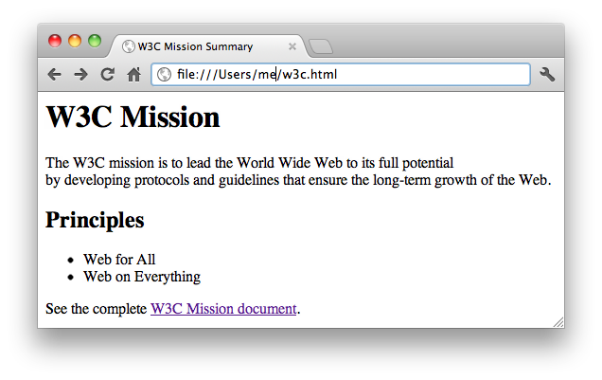
HyperText Markup Language: HTML
Introduction to Computing Using Python
An HTML file is a text file written in HTML and is referred to as the source file
An HTML file is a text file written in HTML and is referred to as the source file
The browser interprets the HTML source file and displays the web page
<html>
<head>
<title>W3C Mission Summary</title>
</head>
<body>
<h1>W3C Mission</h1>
<p>
The W3C mission is to lead the World Wide Web to its full potential<br>
by developing protocols and guidelines that ensure the long-term growth of the Web.
</p>
<h2>Principles</h2>
<ul>
<li>Web for All</li>
<li>Web on Everything</li>
</ul>
See the complete <a href="http://www.w3.org/Consortium/mission.html">W3C Mission document</a>.
</body>
</html>
w3c.html

Slide 6
HyperText Markup Language: HTML
Introduction to Computing Using Python
An HTML source file is composed of HTML elements
Each element defines a component of the associated web page
In the source file, an HTML element is described using:
A pair of tags, the start tag and the end tag
Optional attributes within the start tag
Other elements or data between the start and end tag
In the source file, an HTML element is described using:
A pair of tags, the start tag and the end tag
Optional attributes within the start tag
In the source file, an HTML element is described using:
In the source file, an HTML element is described using:
A pair of tags, the start tag and the end tag
heading h1
line break br
data
paragraph
heading h2
<h2>Principles</h2>
<h2> </h2>
list ul
anchor a

Slide 7
HyperText Markup Language: HTML
Introduction to Computing Using Python
<html>
<head>
<title>W3C Mission Summary</title>
</head>
<body>
<h1>W3C Mission</h1>
<p>
The W3C mission is to lead the World Wide Web to its full potential<br>
by developing protocols and guidelines that ensure the long-term growth of the Web.
</p>
</body>
</html>
<html>
<head>
</head>
<body>
</body>
</html>
<html>
<head>
<title>W3C Mission Summary</title>
</head>
<body>
</body>
</html>
<html>
</html>
<html>
<head>
<title>W3C Mission Summary</title>
</head>
<body>
<h1>W3C Mission</h1>
</body>
</html>
<html>
<head>
<title>W3C Mission Summary</title>
</head>
<body>
<h1>W3C Mission</h1>
<p>
The W3C mission is to lead the World Wide Web to its full potential<br>
by developing protocols and guidelines that ensure the long-term growth of the Web.
</p>
<h2>Principles</h2>
</body>
</html>
<html>
<head>
<title>W3C Mission Summary</title>
</head>
<body>
<h1>W3C Mission</h1>
<p>
The W3C mission is to lead the World Wide Web to its full potential<br>
by developing protocols and guidelines that ensure the long-term growth of the Web.
</p>
<h2>Principles</h2>
<ul>
</ul>
</body>
</html>
<html>
<head>
<title>W3C Mission Summary</title>
</head>
<body>
<h1>W3C Mission</h1>
<p>
The W3C mission is to lead the World Wide Web to its full potential<br>
by developing protocols and guidelines that ensure the long-term growth of the Web.
</p>
<h2>Principles</h2>
<ul>
<li>Web for All</li>
<li>Web on Everything</li>
</ul>
</body>
</html>
<html>
<head>
<title>W3C Mission Summary</title>
</head>
<body>
<h1>W3C Mission</h1>
<p>
The W3C mission is to lead the World Wide Web to its full potential<br>
by developing protocols and guidelines that ensure the long-term growth of the Web.
</p>
<h2>Principles</h2>
<ul>
<li>Web for All</li>
<li>Web on Everything</li>
</ul>
See the complete
.
</body>
</html>
<html>
<head>
<title>W3C Mission Summary</title>
</head>
<body>
<h1>W3C Mission</h1>
<p>
The W3C mission is to lead the World Wide Web to its full potential<br>
by developing protocols and guidelines that ensure the long-term growth of the Web.
</p>
<h2>Principles</h2>
<ul>
<li>Web for All</li>
<li>Web on Everything</li>
</ul>
See the complete <a href="http://www.w3.org/Consortium/mission.html">W3C Mission document</a>.
</body>
</html>
document metadata
document content
text data

Slide 8
Hyperlinks
Introduction to Computing Using Python
HTML anchor element (a) defines a hyperlink
<a href="http://www.w3.org/Consortium/mission.html">W3C Mission document</a>.
attribute
attribute value
hyperlink text
The anchor start tag must have attribute href whose value is a URL
The URL can be relative or absolute
...
<a href="/Consortium/facts.html"
...
<a href="http://twitter.com/W3C"
...
...
<a href="/facts.html"
...
<a href="http://twitter.com/W3C"
...
http://www.w3.org/Consortium/mission.html
relative URL that corresponds to absolute URL http://www.w3.org/Consortium/facts.html

