Slide 1
Setting Up Your Computer
This Presentation covers how to download then install the Visual Studio 2012 Compiler, then
Write your first code sample

Slide 2

Downloading VS Compiler
Caution: Microsoft has many tools named visual studio, ensure you get the compiler through the Imagine website.
Once inside Imagine, choose Developer Tools from left menu, then choose Visual Studio 2012 towards the bottom.

Slide 3
Mac Users Need Windows
Visual Studio 2012 requires Windows OS
Mac users need to emulate Windows – choose whatever route for this. I personally use Parallels; available for purchase from the App Store
Once Parallels is installed choose Windows
Imagine site has Free Windows O.S. downloads

Slide 4
Other C compilers Not Accepted
Your programming assignments must be completed using Microsoft Visual Studio 2012
Other versions of the compiler have minor differences
Your code, if done using other compilers may not compile or work well under Microsoft VS 2012
Code that does not compile may not receive any credit

Slide 5
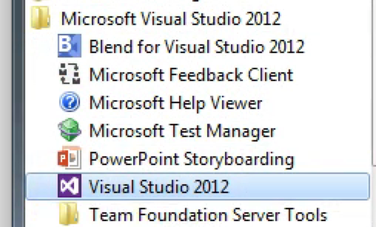
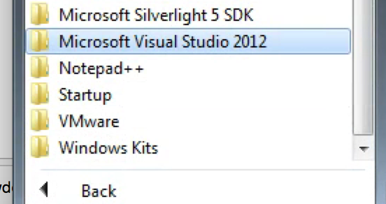
Setup Your Machine
Once VS 2012 is setup, Click Start button then choose Visual Studio 2012

Slide 6
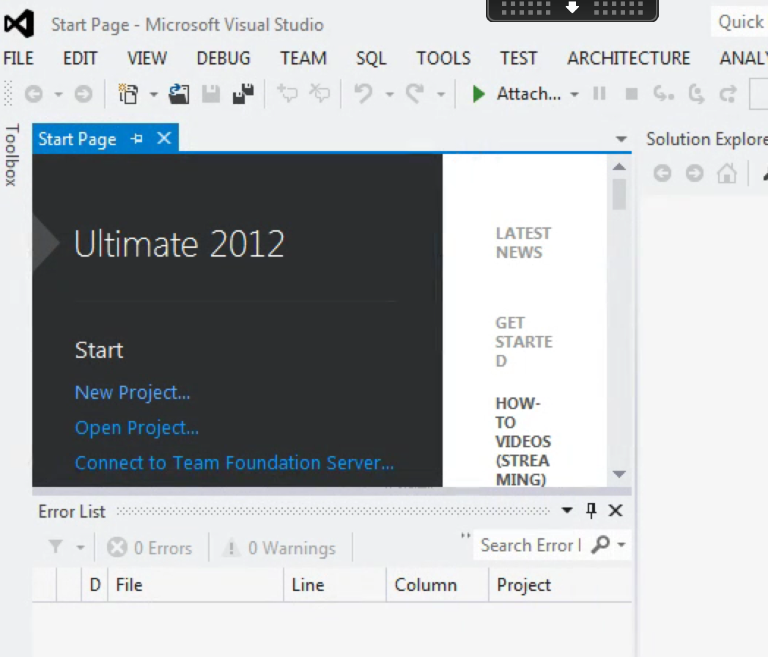
Ready, Set, Go!
If you get to the screen shot below, you’re all set.

