Slide 1
SYSTEM ANALYSIS · PRODUCT WALKTHROUGH
UniformDesk
Supplier supply · School issue · Proof for every student
Comprehensive system presentation with live application screenshots and end-to-end operational flows.
Prepared as a System Analyst briefing | Local demo environment

Slide 2
01 AGENDA
What this briefing covers
Context
System design
Live product tour
Readiness
• Business problem
• Stakeholders & roles
• Solution positioning
• Architecture
• Tenancy & RBAC
• End-to-end spine flow
• School desk screens
• Supplier portal screens
• Trust & offline
• What is solid today
• Pre-production gaps
• Recommended next steps
UniformDesk System Overview | Confidential
2 / 46

Slide 3
02 PROBLEM
Why schools and suppliers need UniformDesk
No proof of issue
Uniforms leave the store without a signed, shareable record.
Stock without a ledger
Counts drift; shortages are informal or hidden.
Broken supply chain
Orders, deliveries, and invoices live in chat/spreadsheets.
Weak audit trail
Auditors cannot correlate student, slip, DN, and payment.
UniformDesk System Overview | Confidential
3 / 46

Slide 4
03 SOLUTION
One modular monolith, two portals, one truth
School Desk
Supplier Portal
• Issue with mandatory signature
• Stock balances + ledger
• Receive against supplier DN
• Student history & reports
• Public proof link for guardians
• Multi-school portfolio
• Orders → pack → dispatch
• Invoices + payment confirmation
• White-label branding
• Activity & notifications
UniformDesk System Overview | Confidential
4 / 46

Slide 5
04 STAKEHOLDERS
Roles and responsibilities
Storekeeper
School Admin
Auditor
Issue, receive, stock ops
Catalog, kits, users, integrations
Reports & audit export
Supplier Admin
Supplier Staff
Guardian
Catalog, branding, portfolio
Pack, dispatch, collect
View public proof (no login)
UniformDesk System Overview | Confidential
5 / 46

Slide 6
05 ARCHITECTURE
Modular monolith — Next.js + Prisma
Presentation
School desk UI · Supplier portal · Public proof · PWA shell
Application
Server Actions · REST (/api/v1) · Edge middleware (JWT)
Domain modules
issue · inventory · supply · payments · reports · integrations
Data
Prisma ORM · SQLite (local/CI) · Postgres path for production
UniformDesk System Overview | Confidential
6 / 46

Slide 7
06 SYSTEM FLOW
End-to-end operational spine
1
2
3
4
5
6
Catalog align SKUs
Order (PO)
Pack & Dispatch DN
School Receive
Issue + Signature
Proof + Invoice/Pay
→
→
→
→
→
• SKU matching is mandatory: supplier product SKU → school catalog SKU.
• Stock only moves with ledger entries (receive / issue / void / adjust).
• No issue without signature; guardians verify via public /v/[token].
• Payments are settlement confirmation (cash/bank/sandbox), not a PSP product.
UniformDesk System Overview | Confidential
7 / 46

Slide 8
07 FLOW DETAIL
Who does what across the loop
SUPPLIER
Create/fulfill order → Pack DN → Dispatch → Invoice → Confirm payment
SCHOOL
Receive DN into stock → Issue kit with signature → Share proof → Review invoices
GUARDIAN
Open /v/[token] — verify student, items, date — no UniformDesk account required
UniformDesk System Overview | Confidential
8 / 46

Slide 9
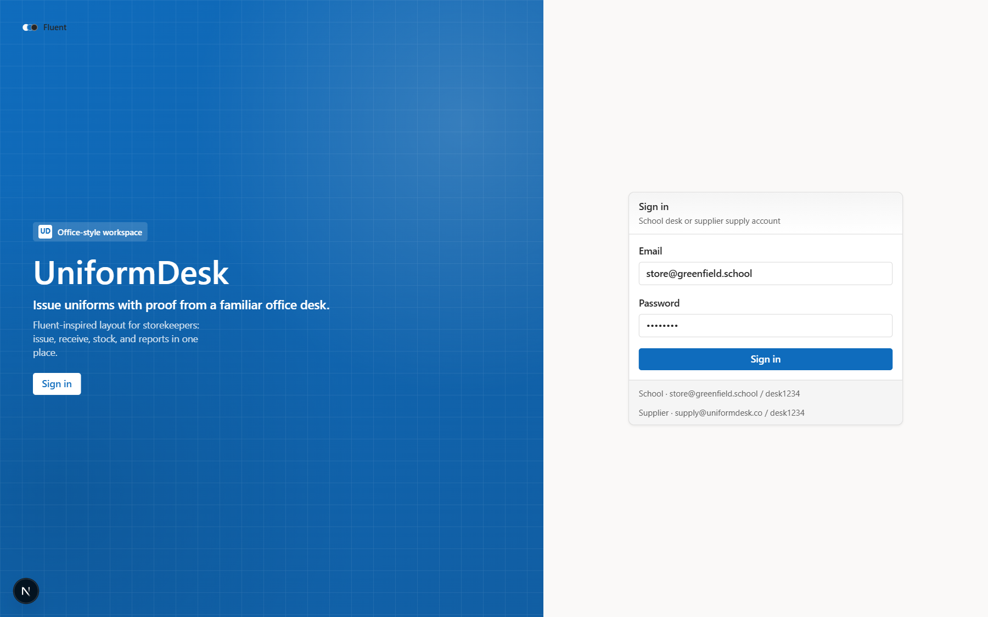
08 LIVE UI
Login
Entry point for school and supplier tenants.
Analyst notes
• JWT session cookie
• Demo seed accounts
• Edge middleware gate
UniformDesk System Overview | Confidential
UniformDesk System Overview | Confidential
0 / 0
9 / 46

Slide 10
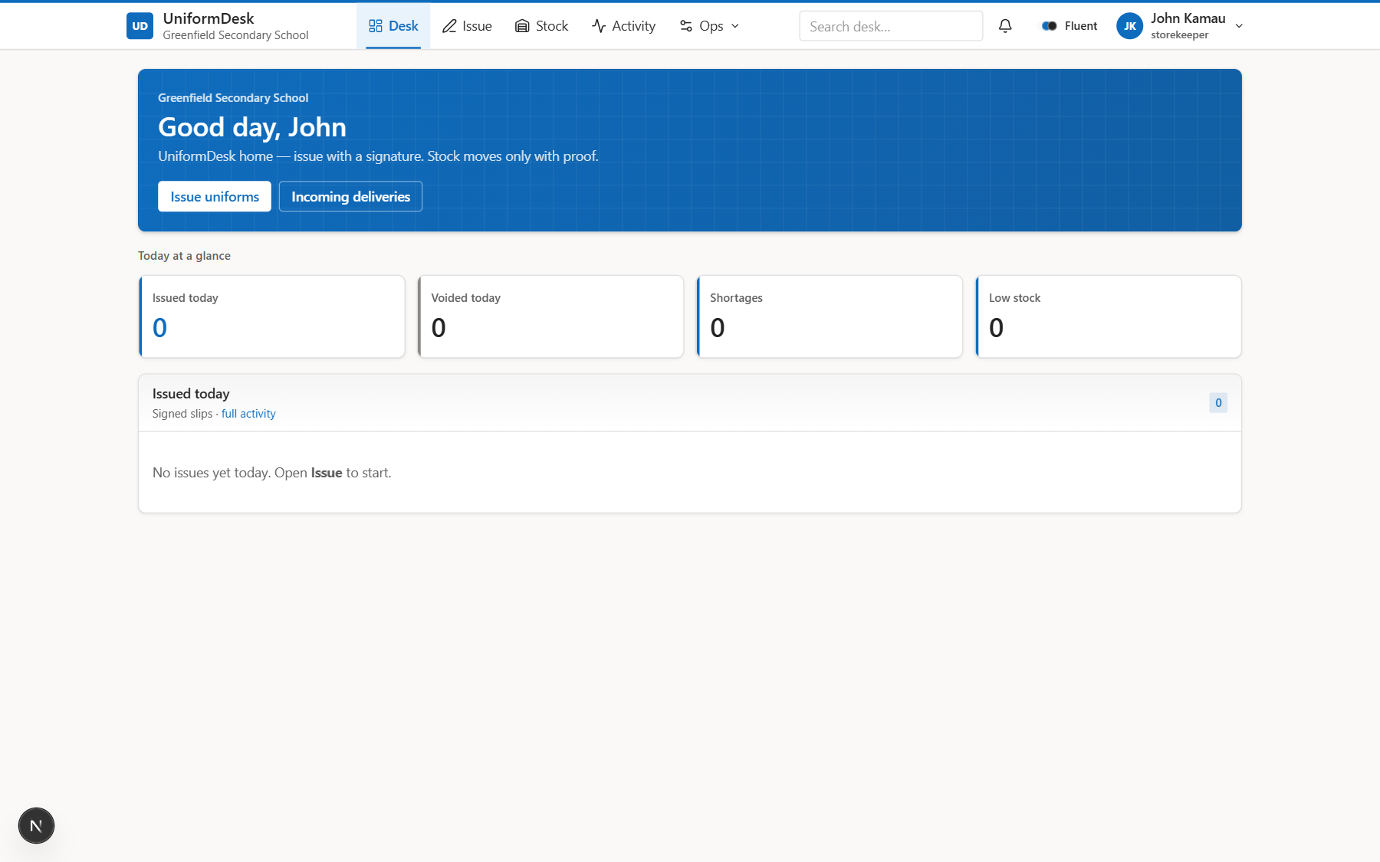
09 SCHOOL DESK
Home / Desk overview
Daily operational command center.
Analyst notes
• Today stats
• Needs attention
• Issue CTA
UniformDesk System Overview | Confidential
UniformDesk System Overview | Confidential
0 / 0
10 / 46

Slide 11
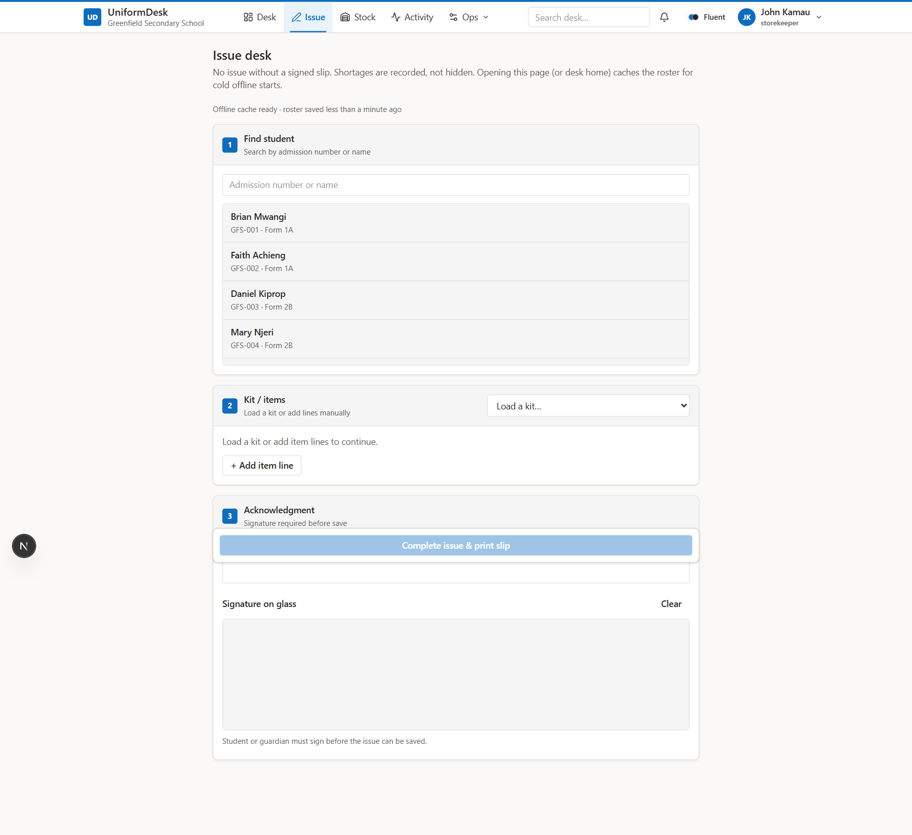
10 SCHOOL DESK
Issue desk
Signature-gated kit issue workflow.
Analyst notes
• Student search
• Kit / lines
• Offline queue ready
UniformDesk System Overview | Confidential
UniformDesk System Overview | Confidential
0 / 0
11 / 46

Slide 12
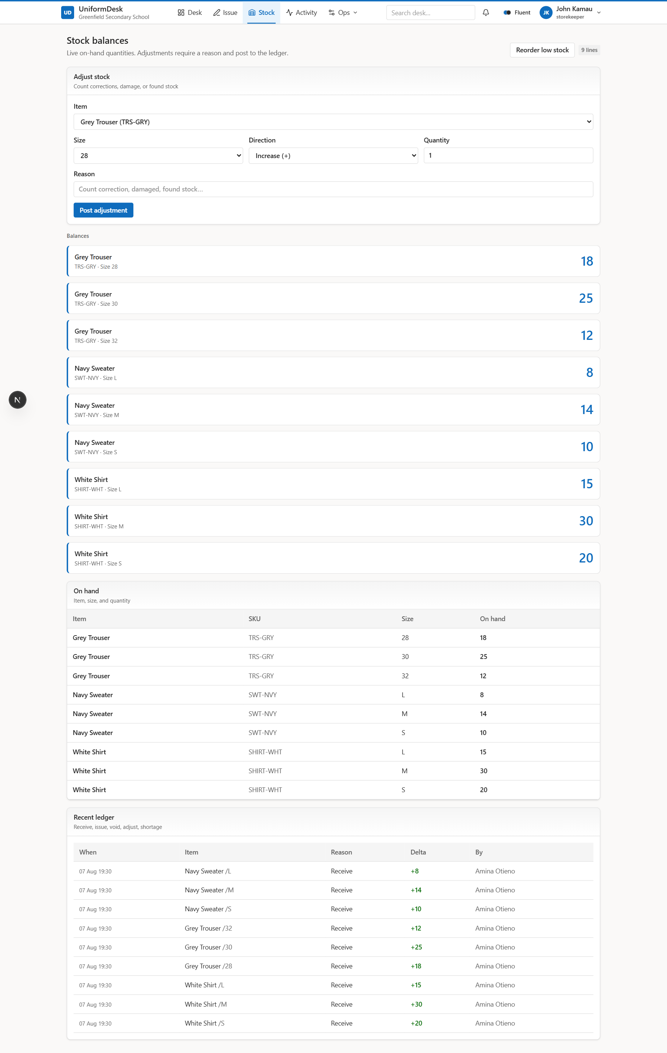
11 SCHOOL DESK
Stock balances
On-hand by item and size.
Analyst notes
• Ledger-backed
• Adjust with reason
• Reorder CTA
UniformDesk System Overview | Confidential
UniformDesk System Overview | Confidential
0 / 0
12 / 46

Slide 13
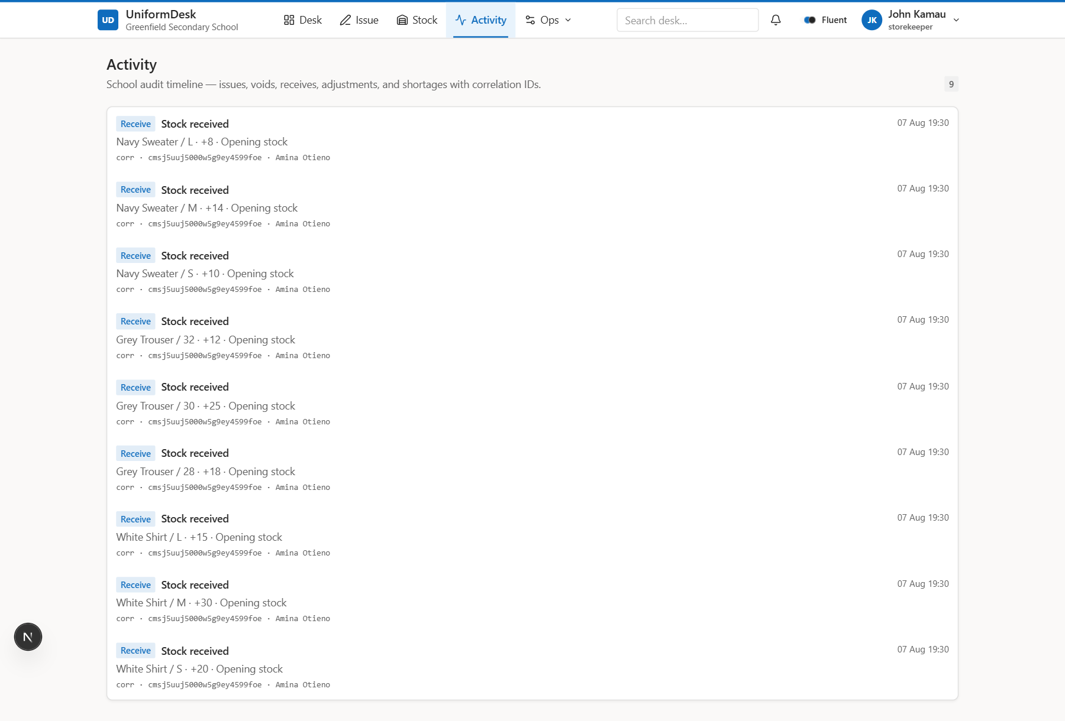
12 SCHOOL DESK
Activity timeline
Audit trail with correlation IDs.
Analyst notes
• Issue / void / receive
• Support-friendly refs
UniformDesk System Overview | Confidential
UniformDesk System Overview | Confidential
0 / 0
13 / 46

Slide 14
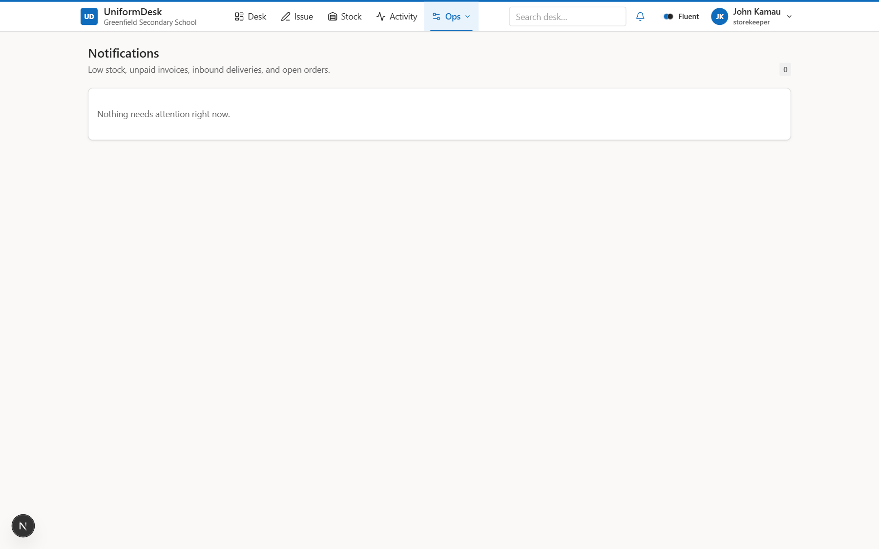
13 SCHOOL DESK
Notifications
Actionable attention feed.
Analyst notes
• Low stock
• Unpaid invoices
• Inbound DNs
UniformDesk System Overview | Confidential
UniformDesk System Overview | Confidential
0 / 0
14 / 46

Slide 15
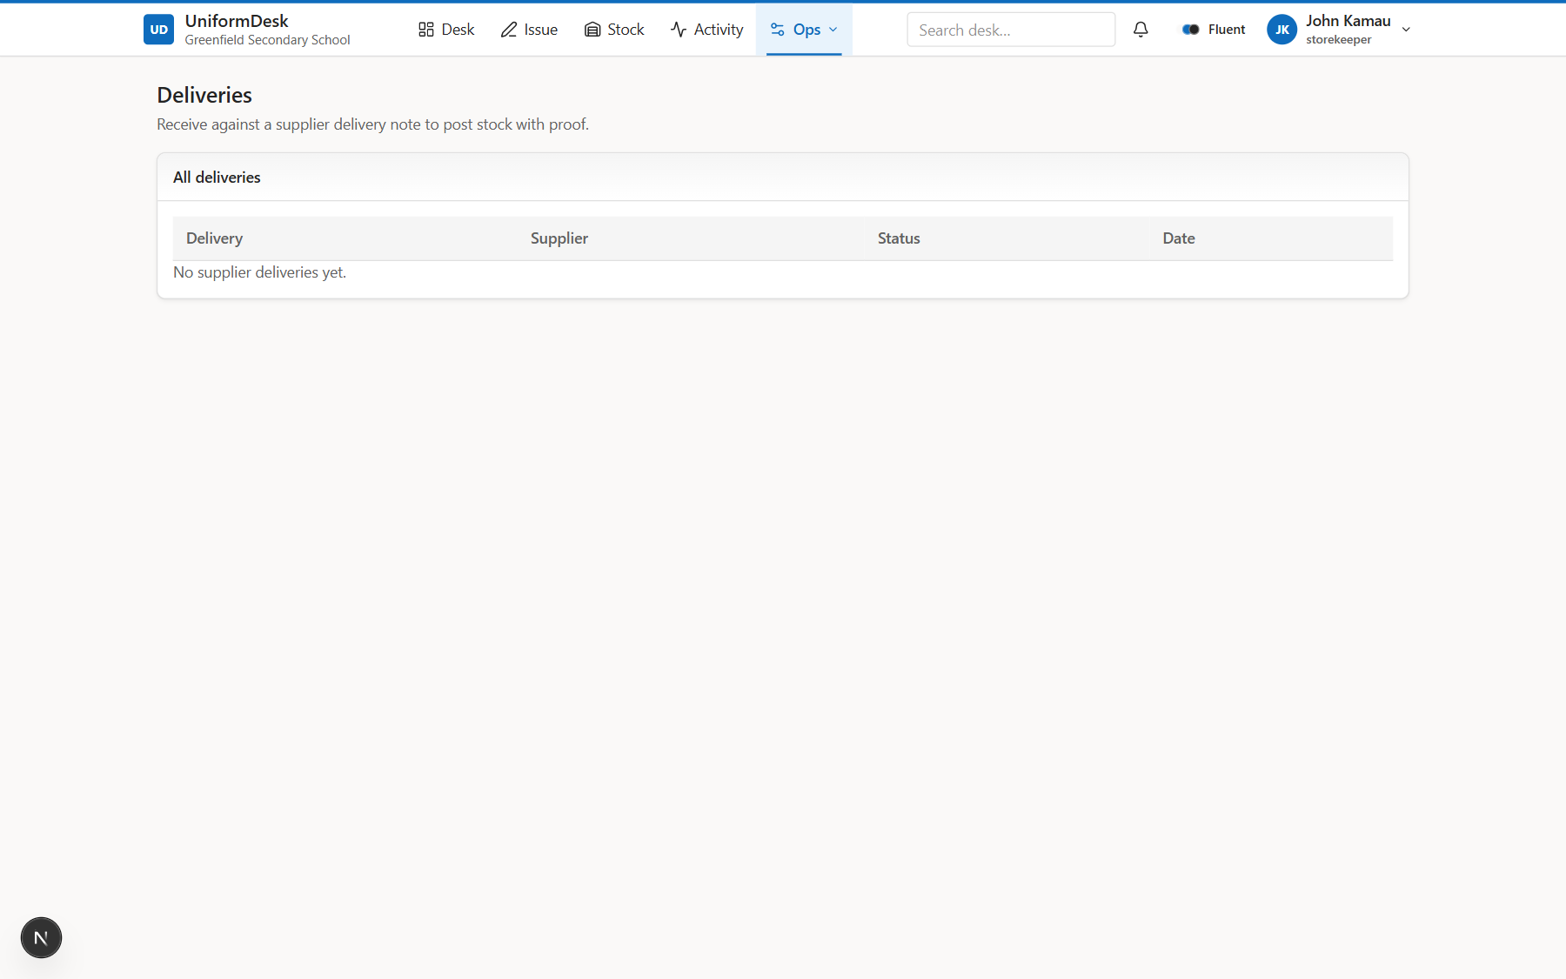
14 SCHOOL DESK
Deliveries
Receive against supplier DN.
Analyst notes
• SKU match check
• Posts stock + ledger
UniformDesk System Overview | Confidential
UniformDesk System Overview | Confidential
0 / 0
15 / 46

Slide 16
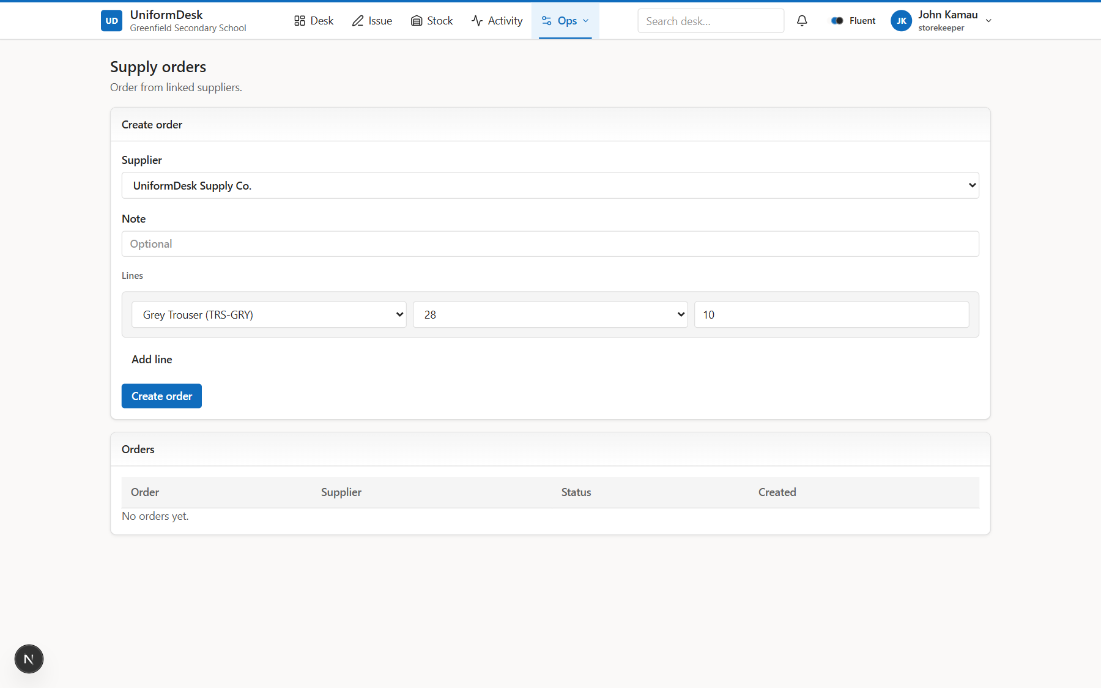
15 SCHOOL DESK
Orders
School purchase orders to supplier.
Analyst notes
• Status tracking
• Links to DNs
UniformDesk System Overview | Confidential
UniformDesk System Overview | Confidential
0 / 0
16 / 46

Slide 17
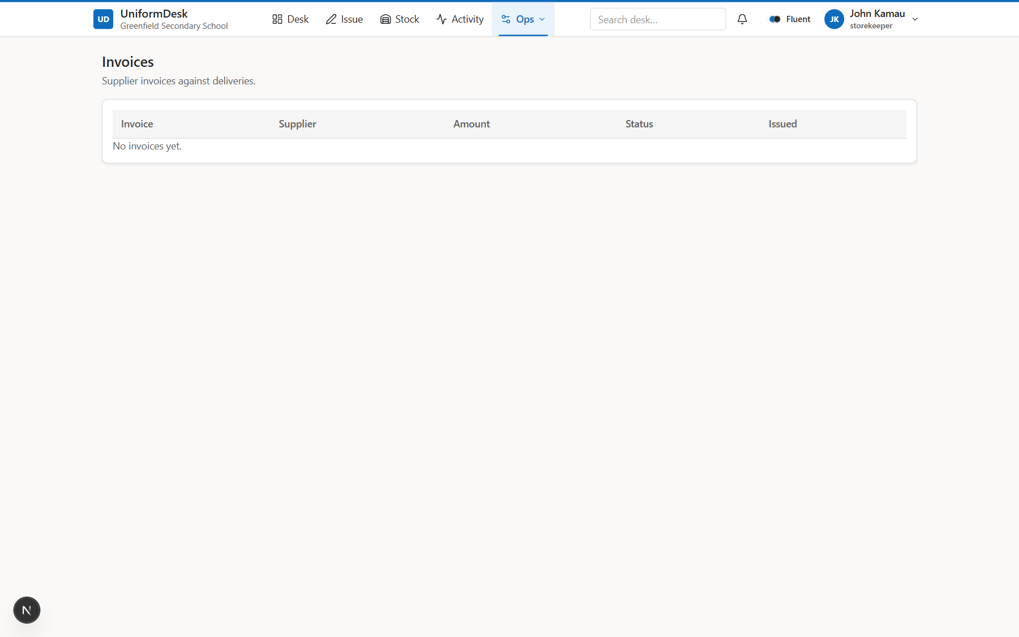
16 SCHOOL DESK
Invoices
Supplier bills visible to school.
Analyst notes
• Settlement status
• Printable sheet
UniformDesk System Overview | Confidential
UniformDesk System Overview | Confidential
0 / 0
17 / 46

Slide 18
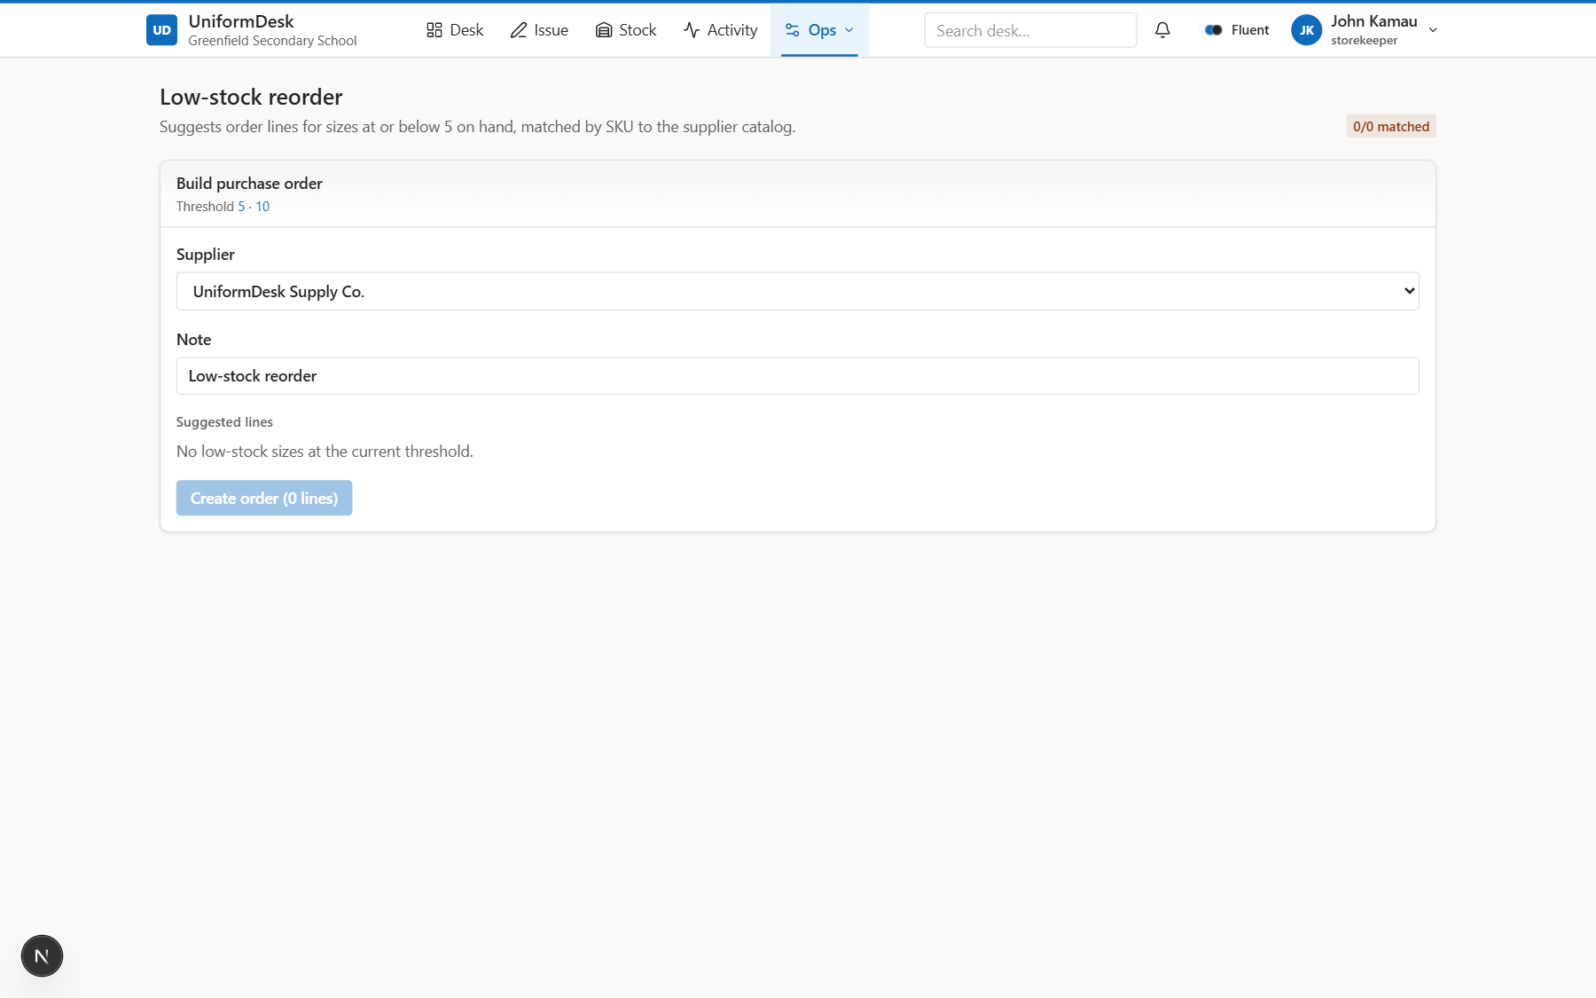
17 SCHOOL DESK
Low-stock reorder
Suggest PO lines from thresholds.
Analyst notes
• SKU → supplier product
• Unmatched listed
UniformDesk System Overview | Confidential
UniformDesk System Overview | Confidential
0 / 0
18 / 46

Slide 19
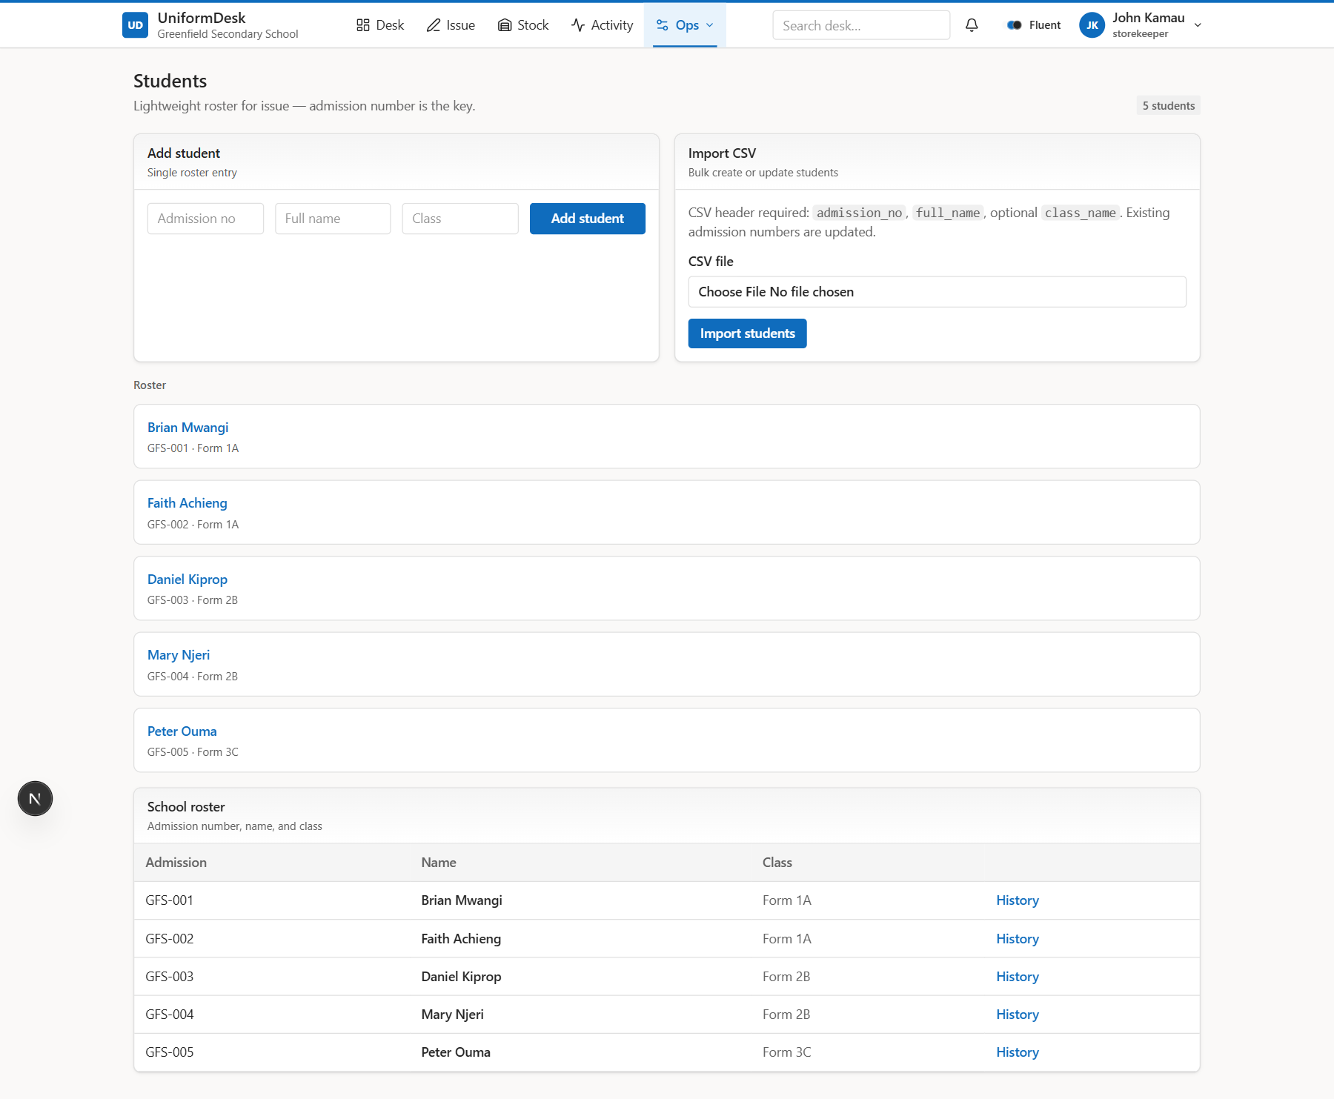
18 SCHOOL DESK
Students roster
Admission-based student master.
Analyst notes
• CSV import
• History per student
UniformDesk System Overview | Confidential
UniformDesk System Overview | Confidential
0 / 0
19 / 46

Slide 20
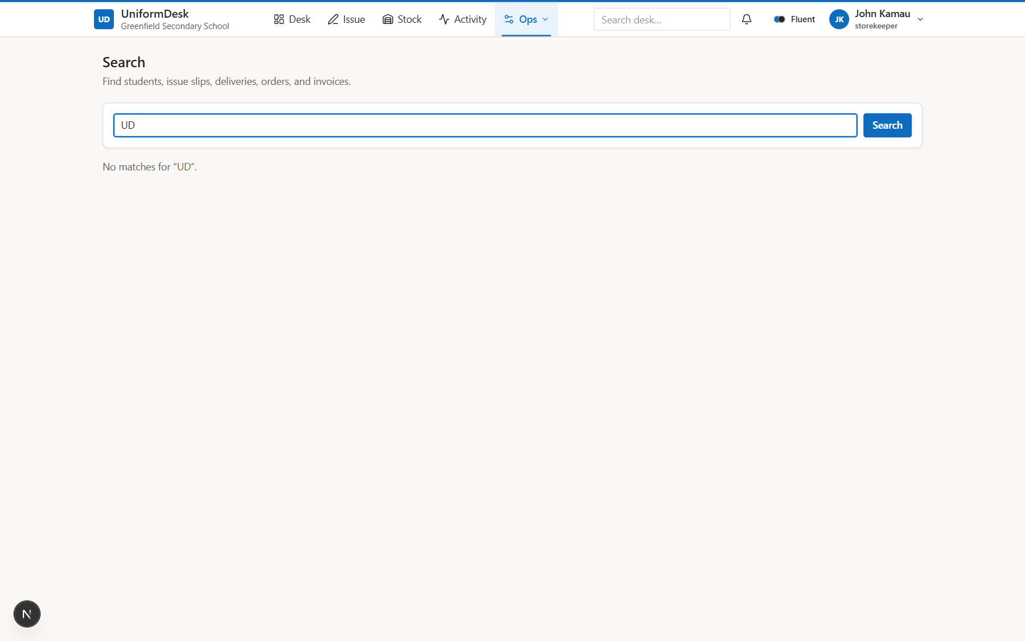
19 SCHOOL DESK
Desk search
Cross-entity findability.
Analyst notes
• Students, slips, supply docs
UniformDesk System Overview | Confidential
UniformDesk System Overview | Confidential
0 / 0
20 / 46

Slide 21
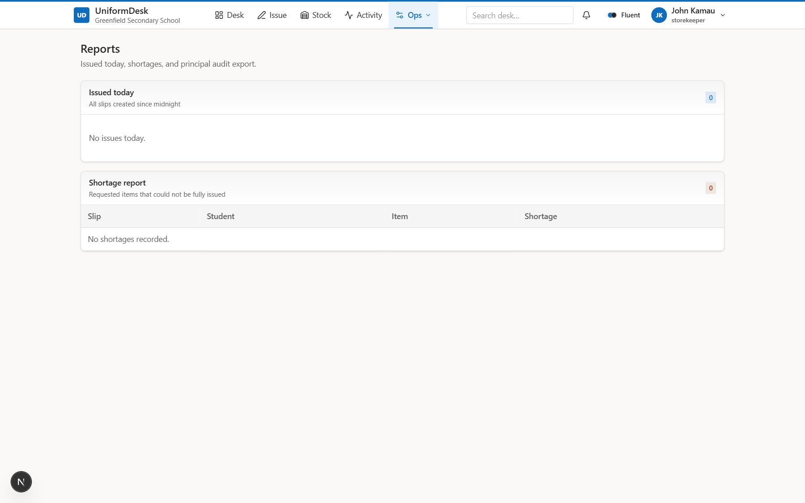
20 SCHOOL DESK
Reports
Issued today & shortages.
Analyst notes
• Audit CSV export
UniformDesk System Overview | Confidential
UniformDesk System Overview | Confidential
0 / 0
21 / 46

Slide 22
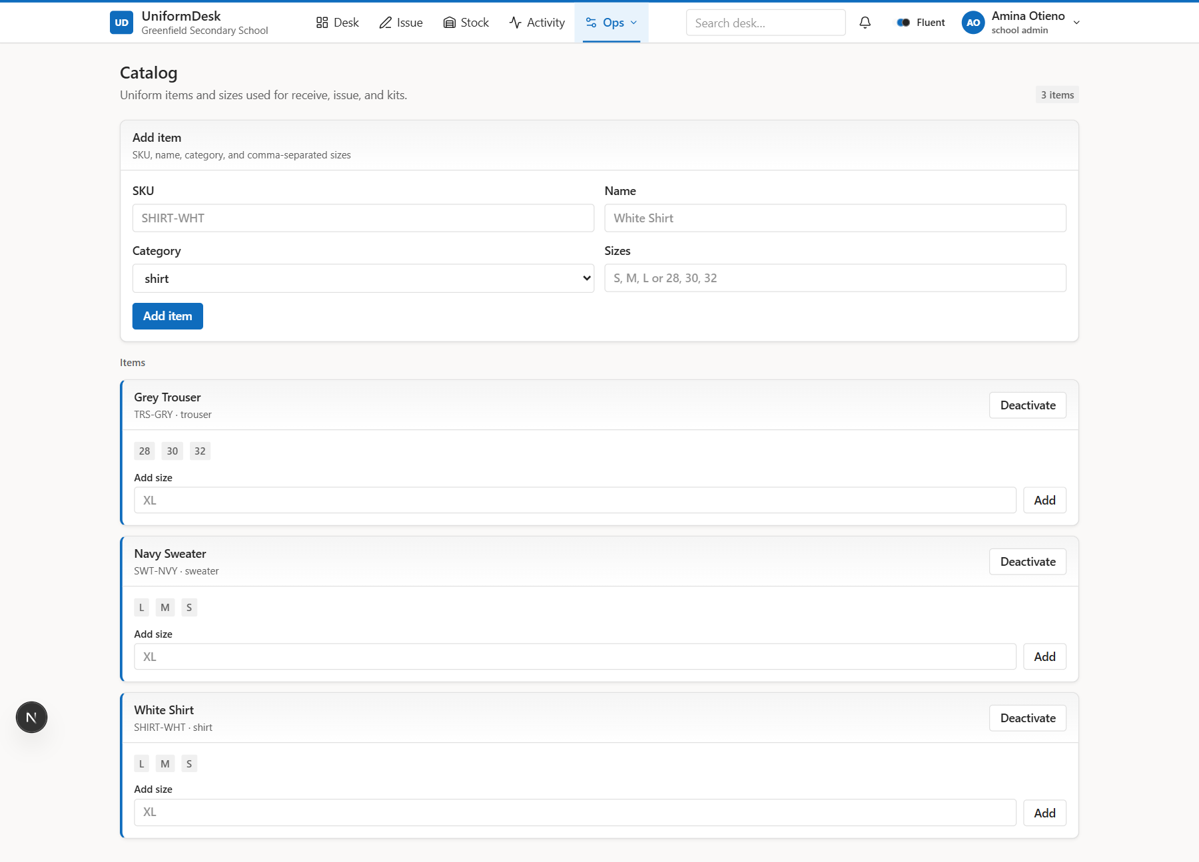
21 SCHOOL ADMIN
Catalog
Items and sizes (admin).
Analyst notes
• SKU is receive key
UniformDesk System Overview | Confidential
UniformDesk System Overview | Confidential
0 / 0
22 / 46

Slide 23
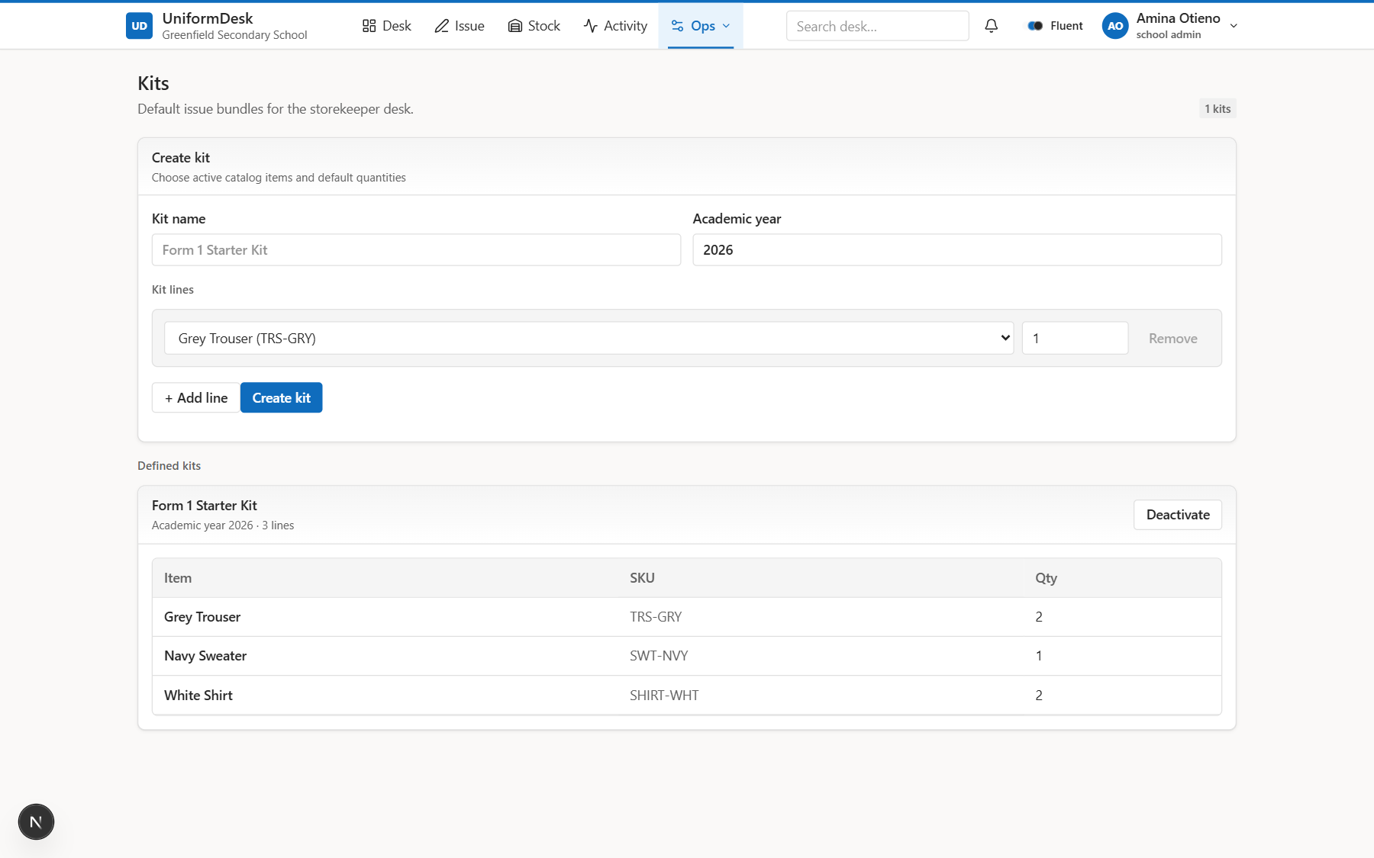
22 SCHOOL ADMIN
Kits
Issue bundles for speed.
Analyst notes
• Default qtys per item
UniformDesk System Overview | Confidential
UniformDesk System Overview | Confidential
0 / 0
23 / 46

Slide 24
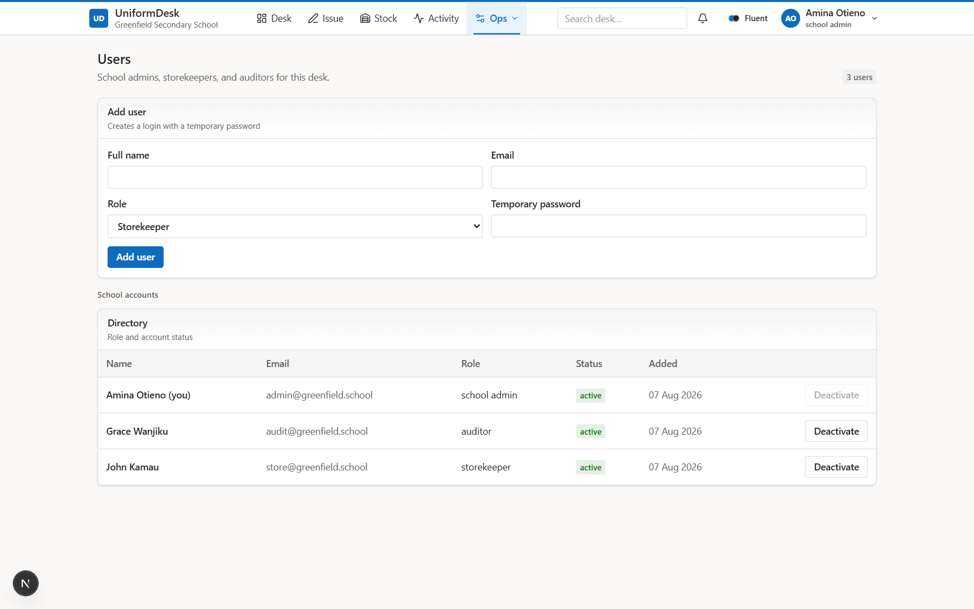
23 SCHOOL ADMIN
Users & roles
Desk accounts and RBAC.
Analyst notes
• Admin / storekeeper / auditor
UniformDesk System Overview | Confidential
UniformDesk System Overview | Confidential
0 / 0
24 / 46

Slide 25
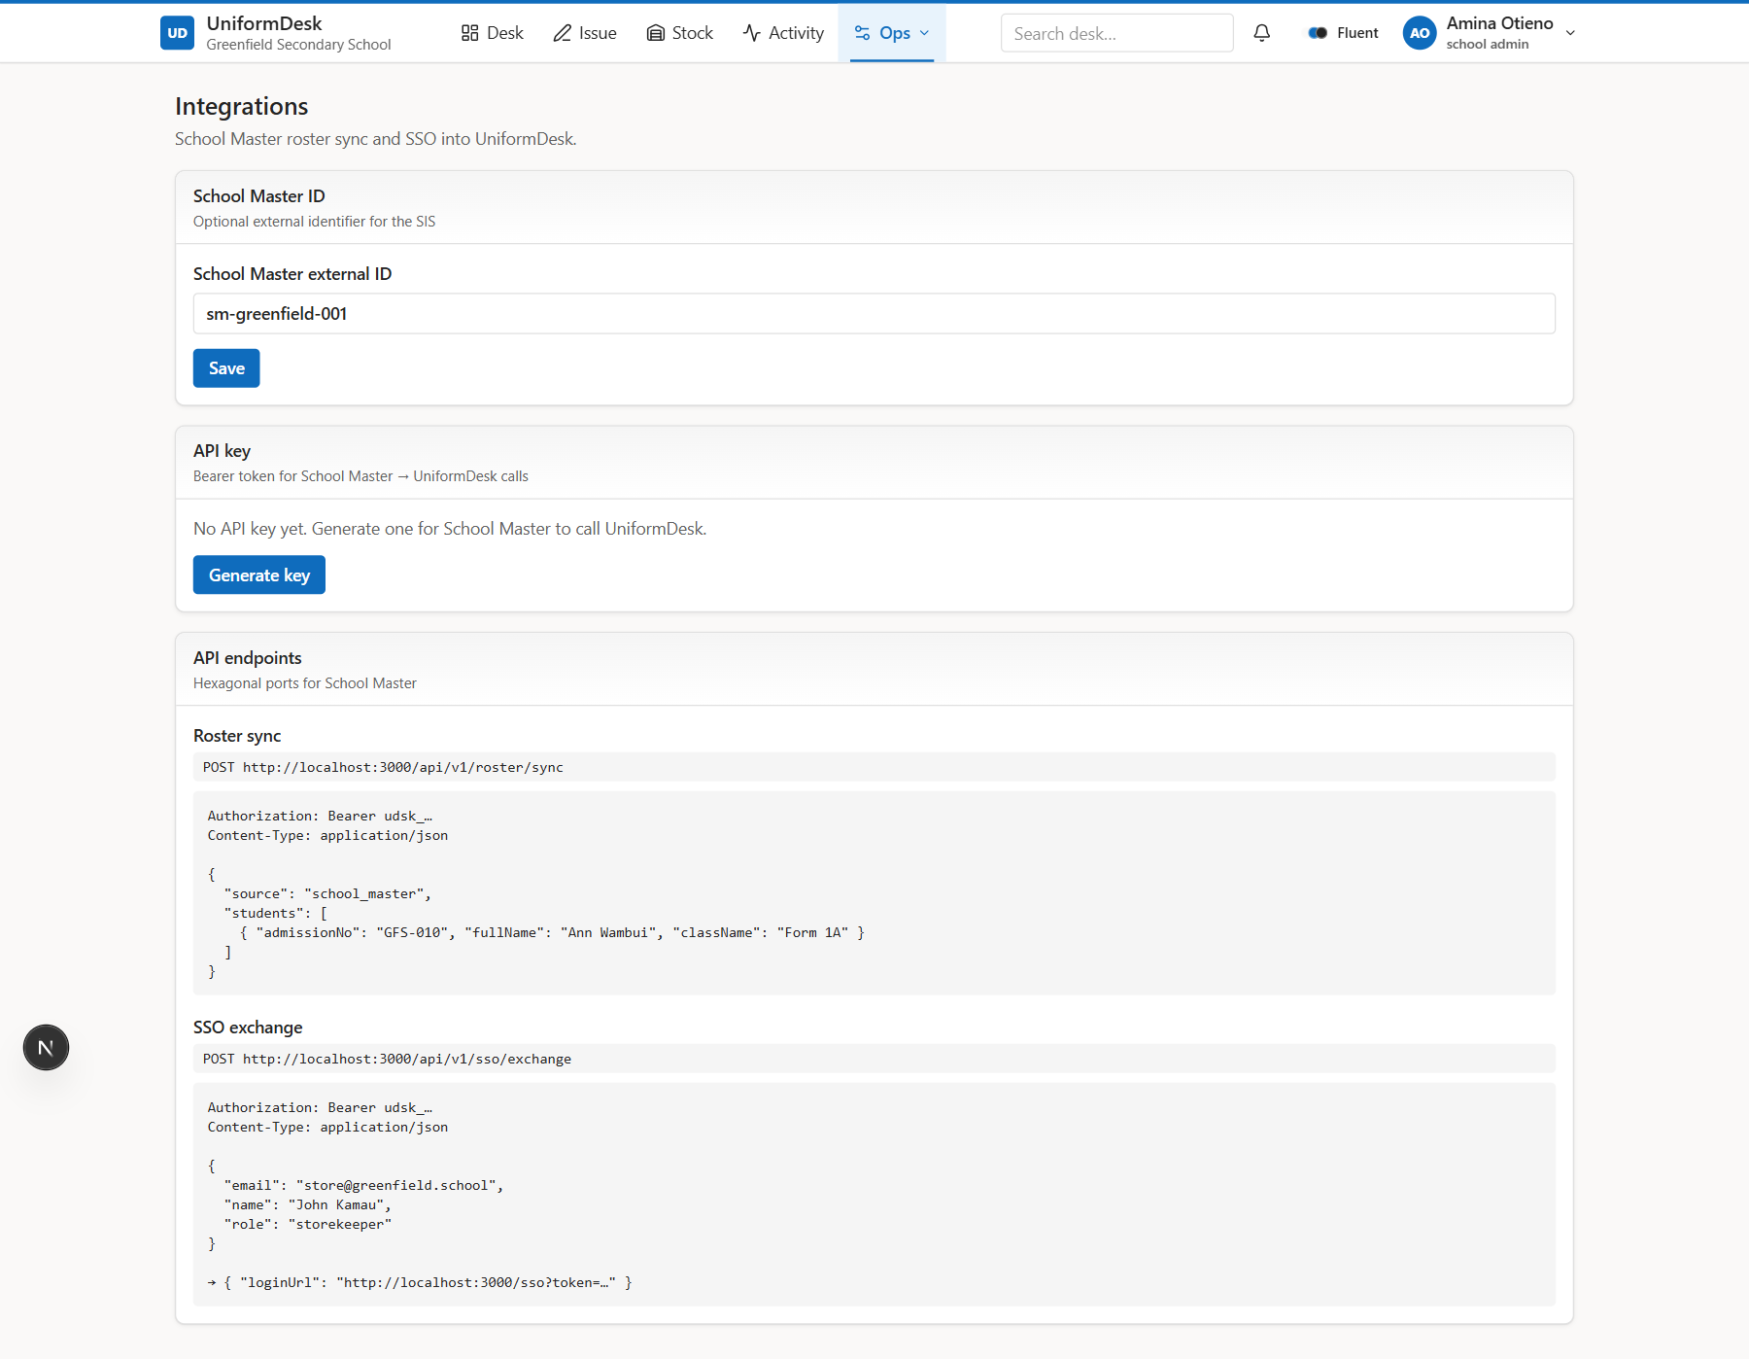
24 SCHOOL ADMIN
Integrations
School Master API + SSO.
Analyst notes
• Roster sync
• API keys
UniformDesk System Overview | Confidential
UniformDesk System Overview | Confidential
0 / 0
25 / 46

Slide 26
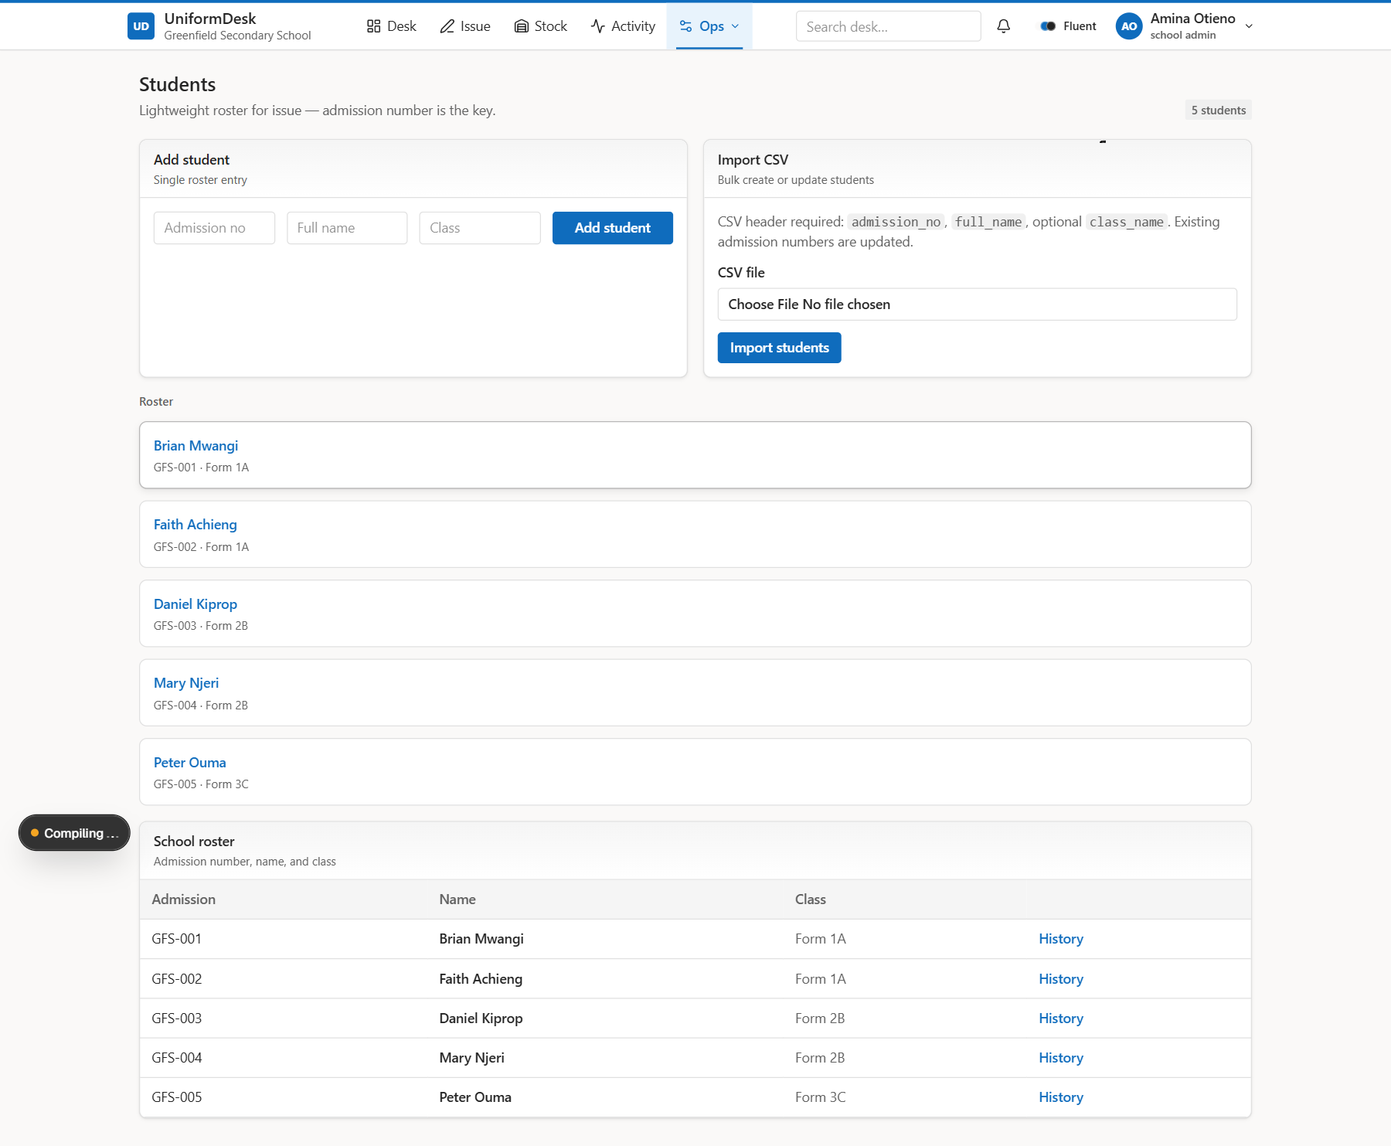
25 SCHOOL DESK
Student history
Per-student issue trail.
Analyst notes
• Slips, shortages, voids
UniformDesk System Overview | Confidential
UniformDesk System Overview | Confidential
0 / 0
26 / 46

Slide 27
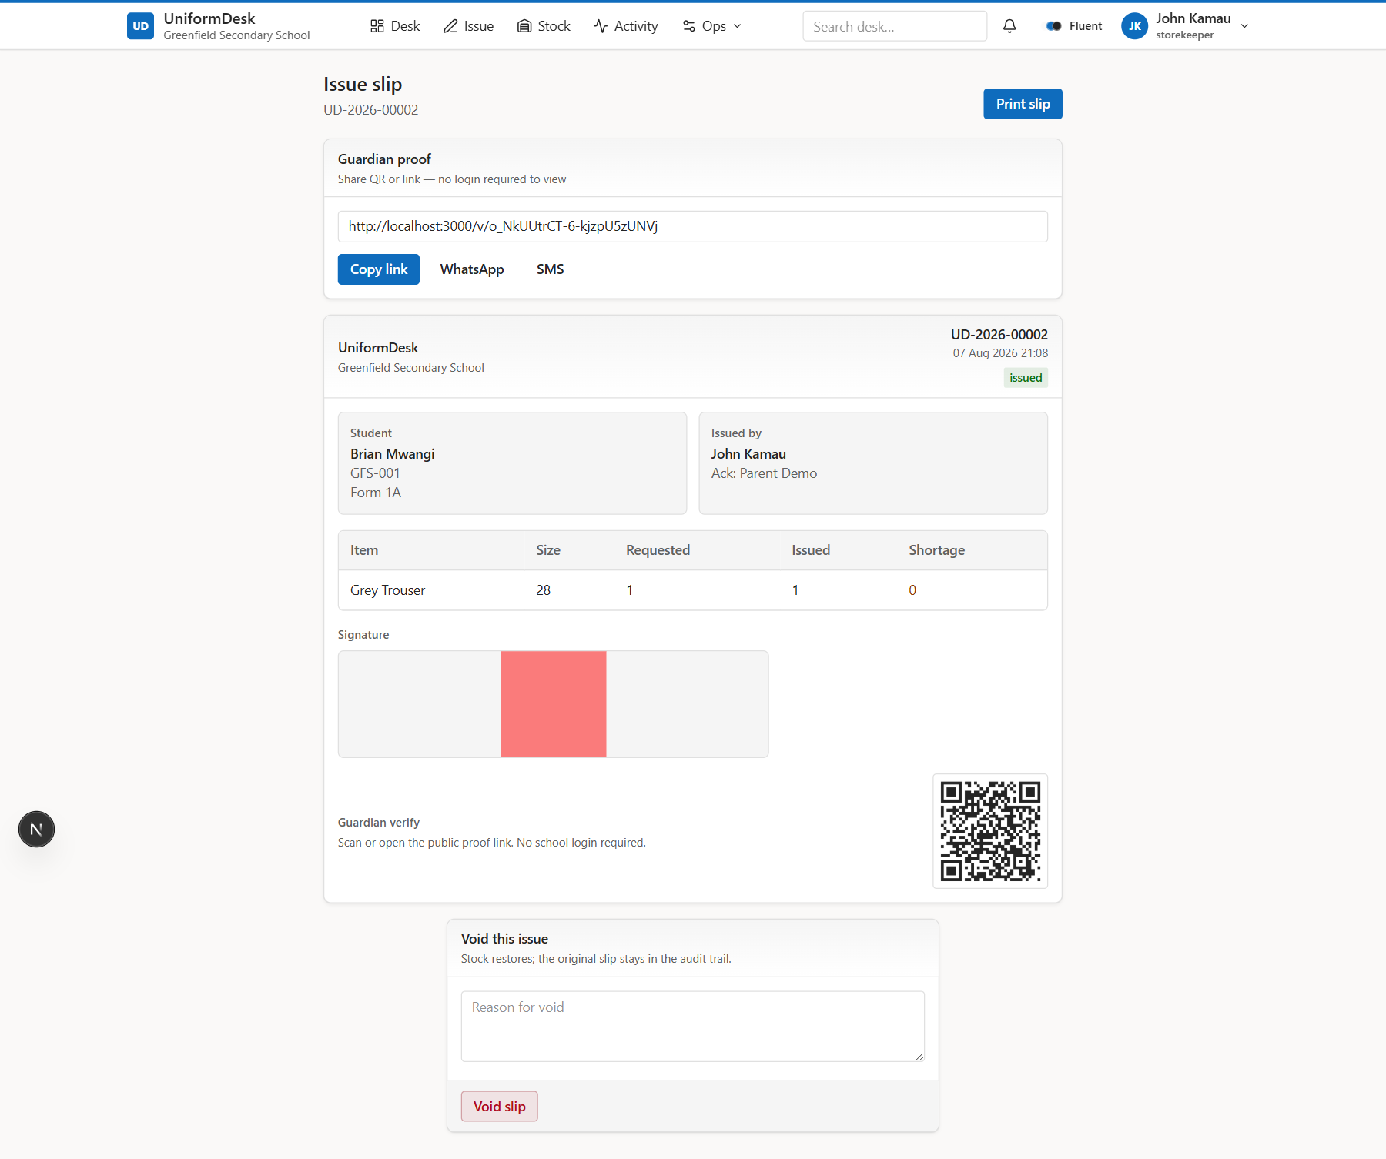
26 TRUST
Issue slip (printable proof)
Signed record with QR and share actions.
Analyst notes
• Slip number
• Signature captured
• Share / print
UniformDesk System Overview | Confidential
UniformDesk System Overview | Confidential
0 / 0
27 / 46

Slide 28
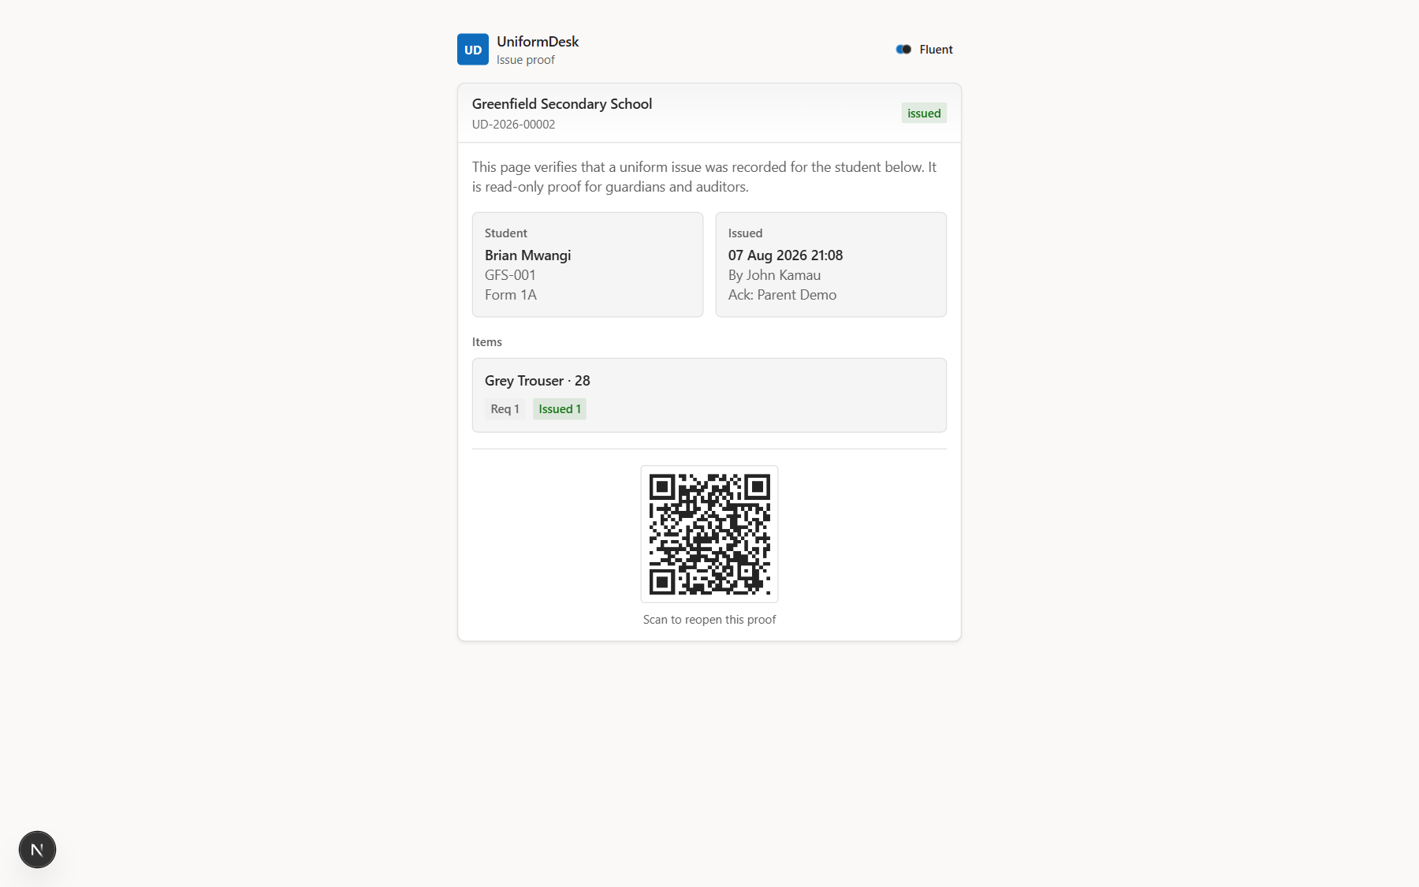
27 TRUST
Public guardian proof
No login — tokenized verification page.
Analyst notes
• /v/[token]
• QR from slip
• Parent-friendly
UniformDesk System Overview | Confidential
UniformDesk System Overview | Confidential
0 / 0
28 / 46

Slide 29
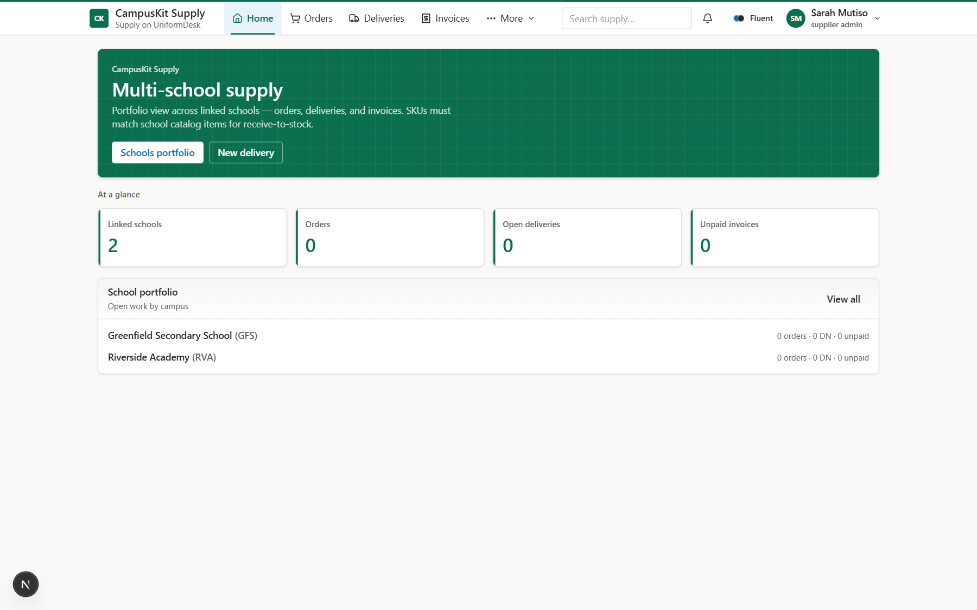
28 SUPPLIER
Supply home
Multi-school portfolio overview.
Analyst notes
• Open deliveries
• Unpaid invoices
• Attention strip
UniformDesk System Overview | Confidential
UniformDesk System Overview | Confidential
0 / 0
29 / 46

Slide 30
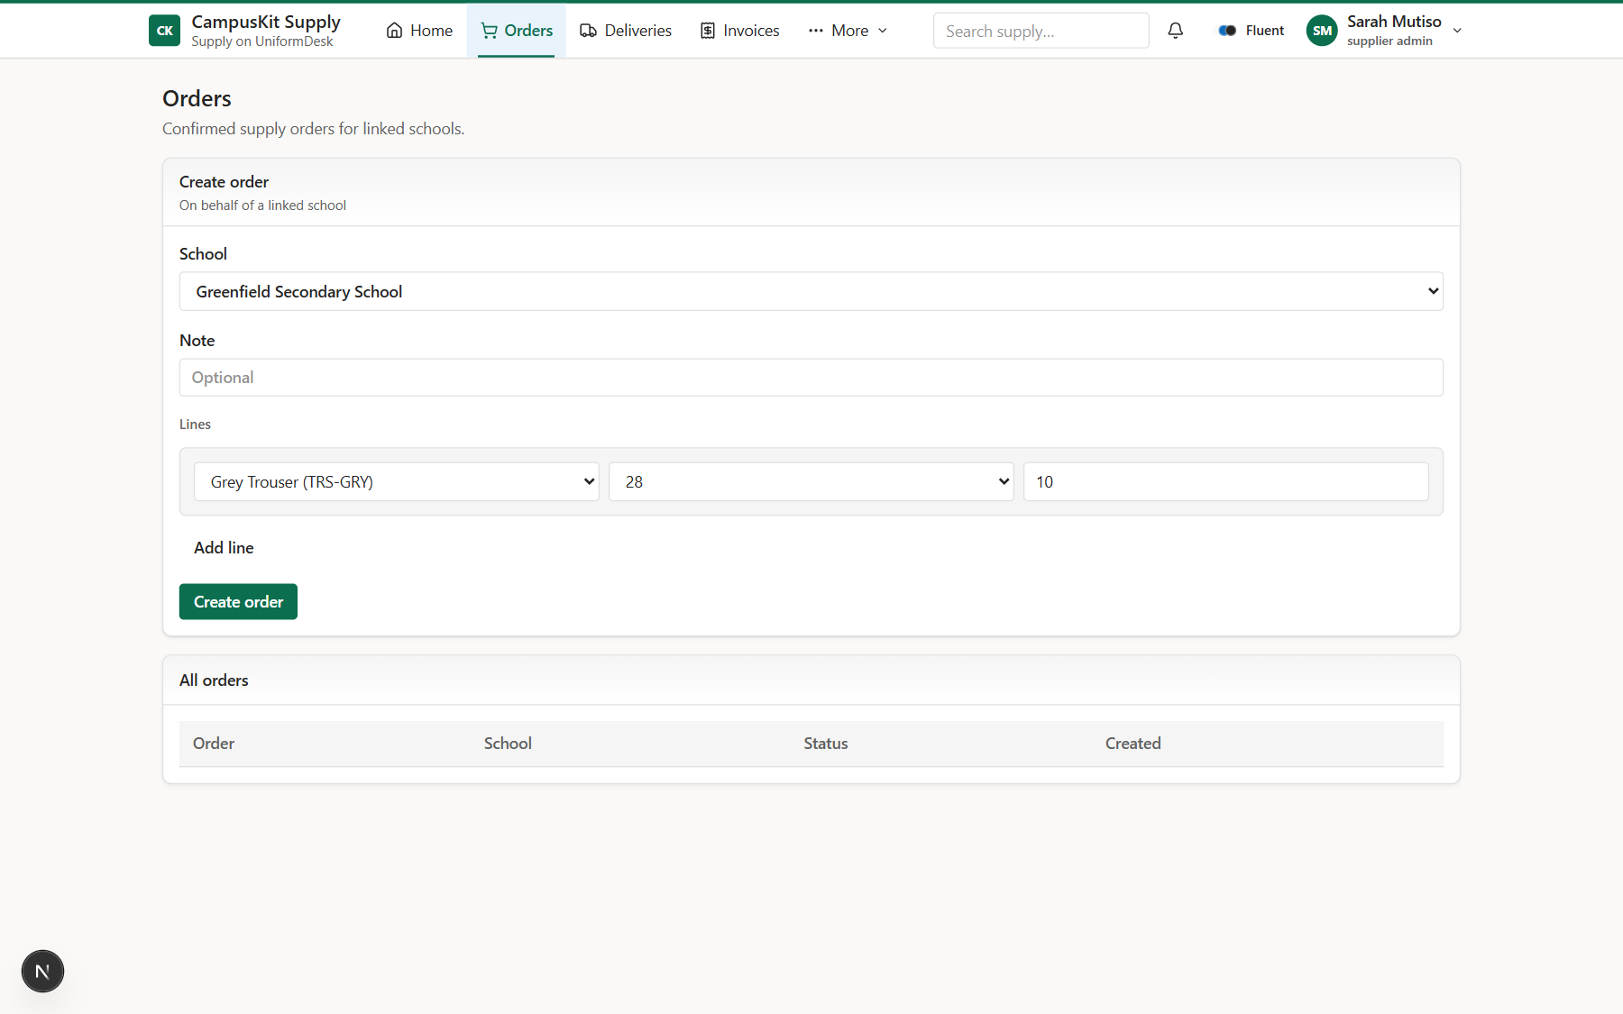
29 SUPPLIER
Orders
Inbound school POs.
Analyst notes
• Confirm / fulfill path
UniformDesk System Overview | Confidential
UniformDesk System Overview | Confidential
0 / 0
30 / 46

Slide 31
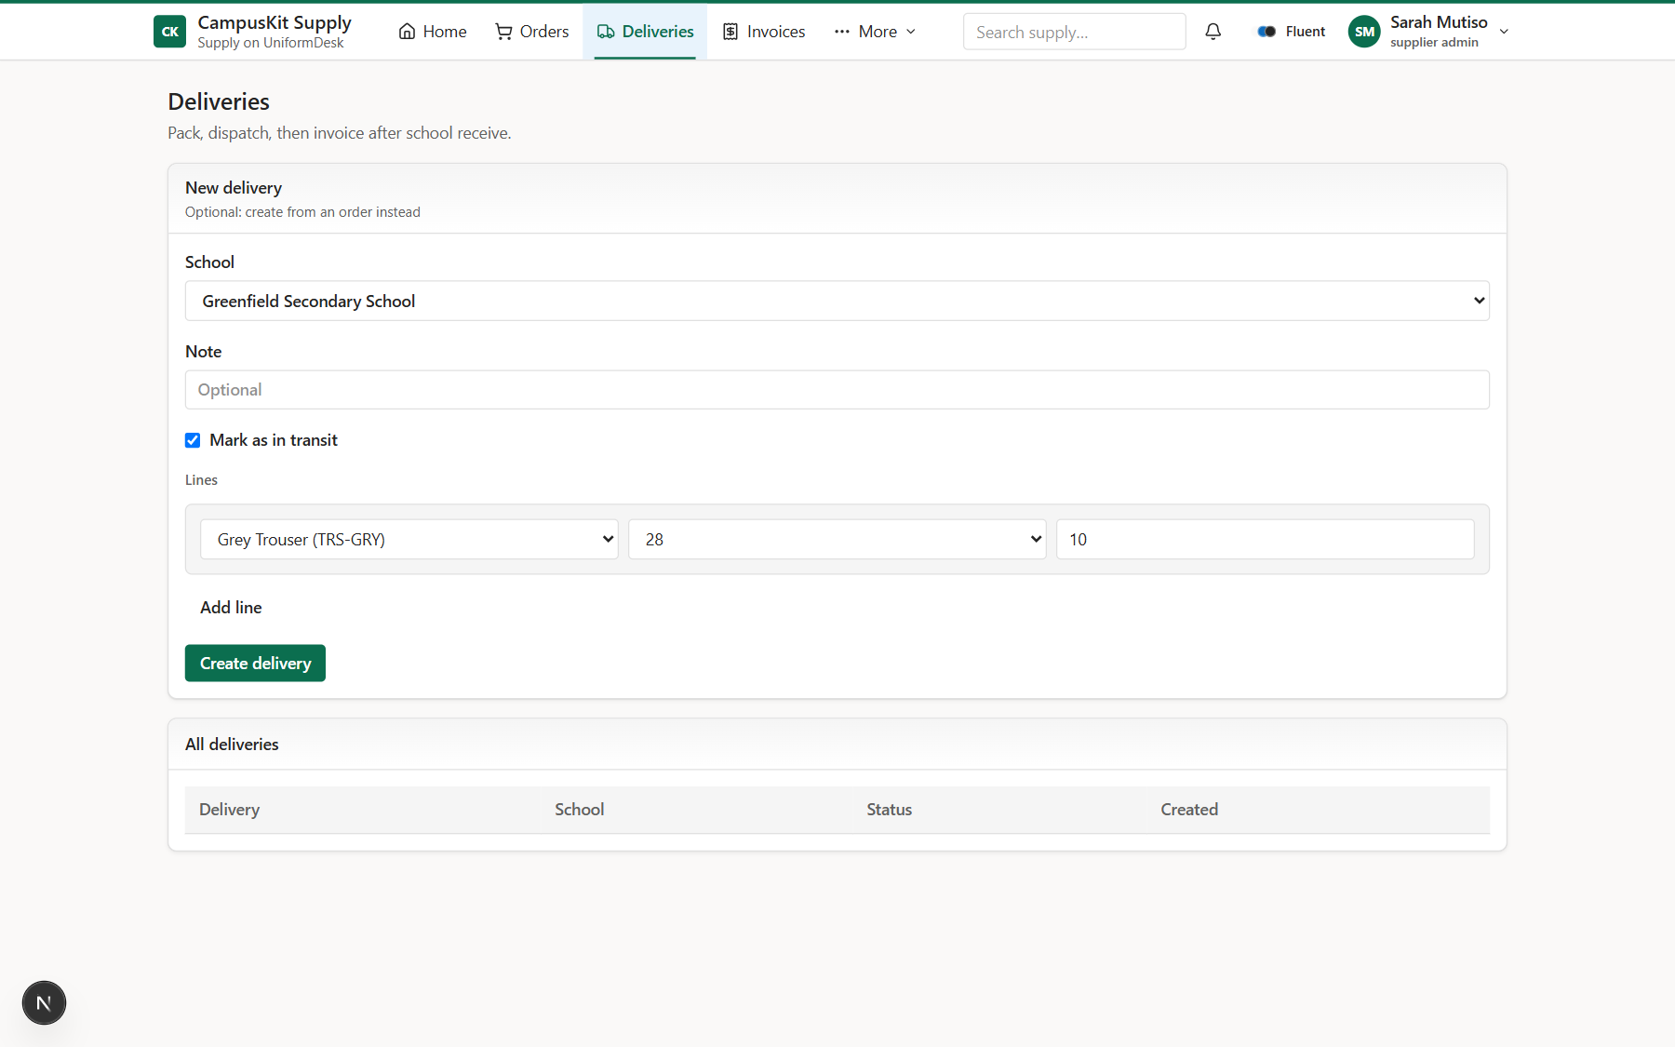
30 SUPPLIER
Deliveries
Pack and dispatch queue.
Analyst notes
• DN numbers
• Status pipeline
UniformDesk System Overview | Confidential
UniformDesk System Overview | Confidential
0 / 0
31 / 46

Slide 32
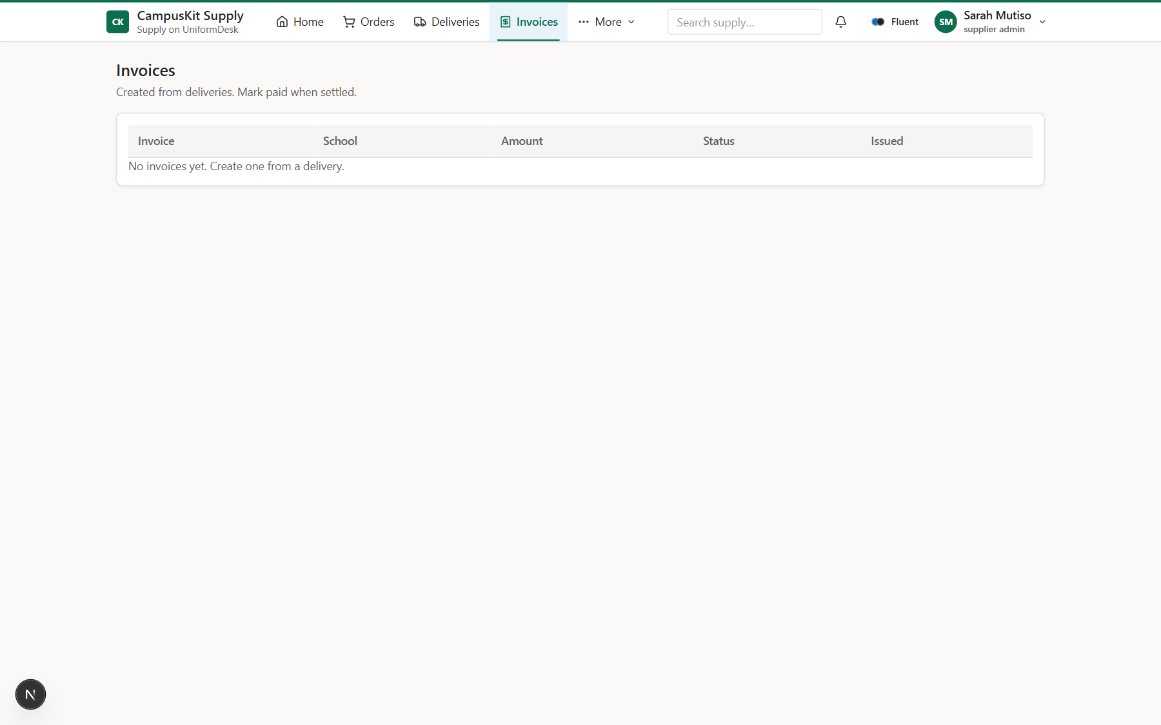
31 SUPPLIER
Invoices
Billing and collection.
Analyst notes
• Payment confirmation
UniformDesk System Overview | Confidential
UniformDesk System Overview | Confidential
0 / 0
32 / 46

Slide 33
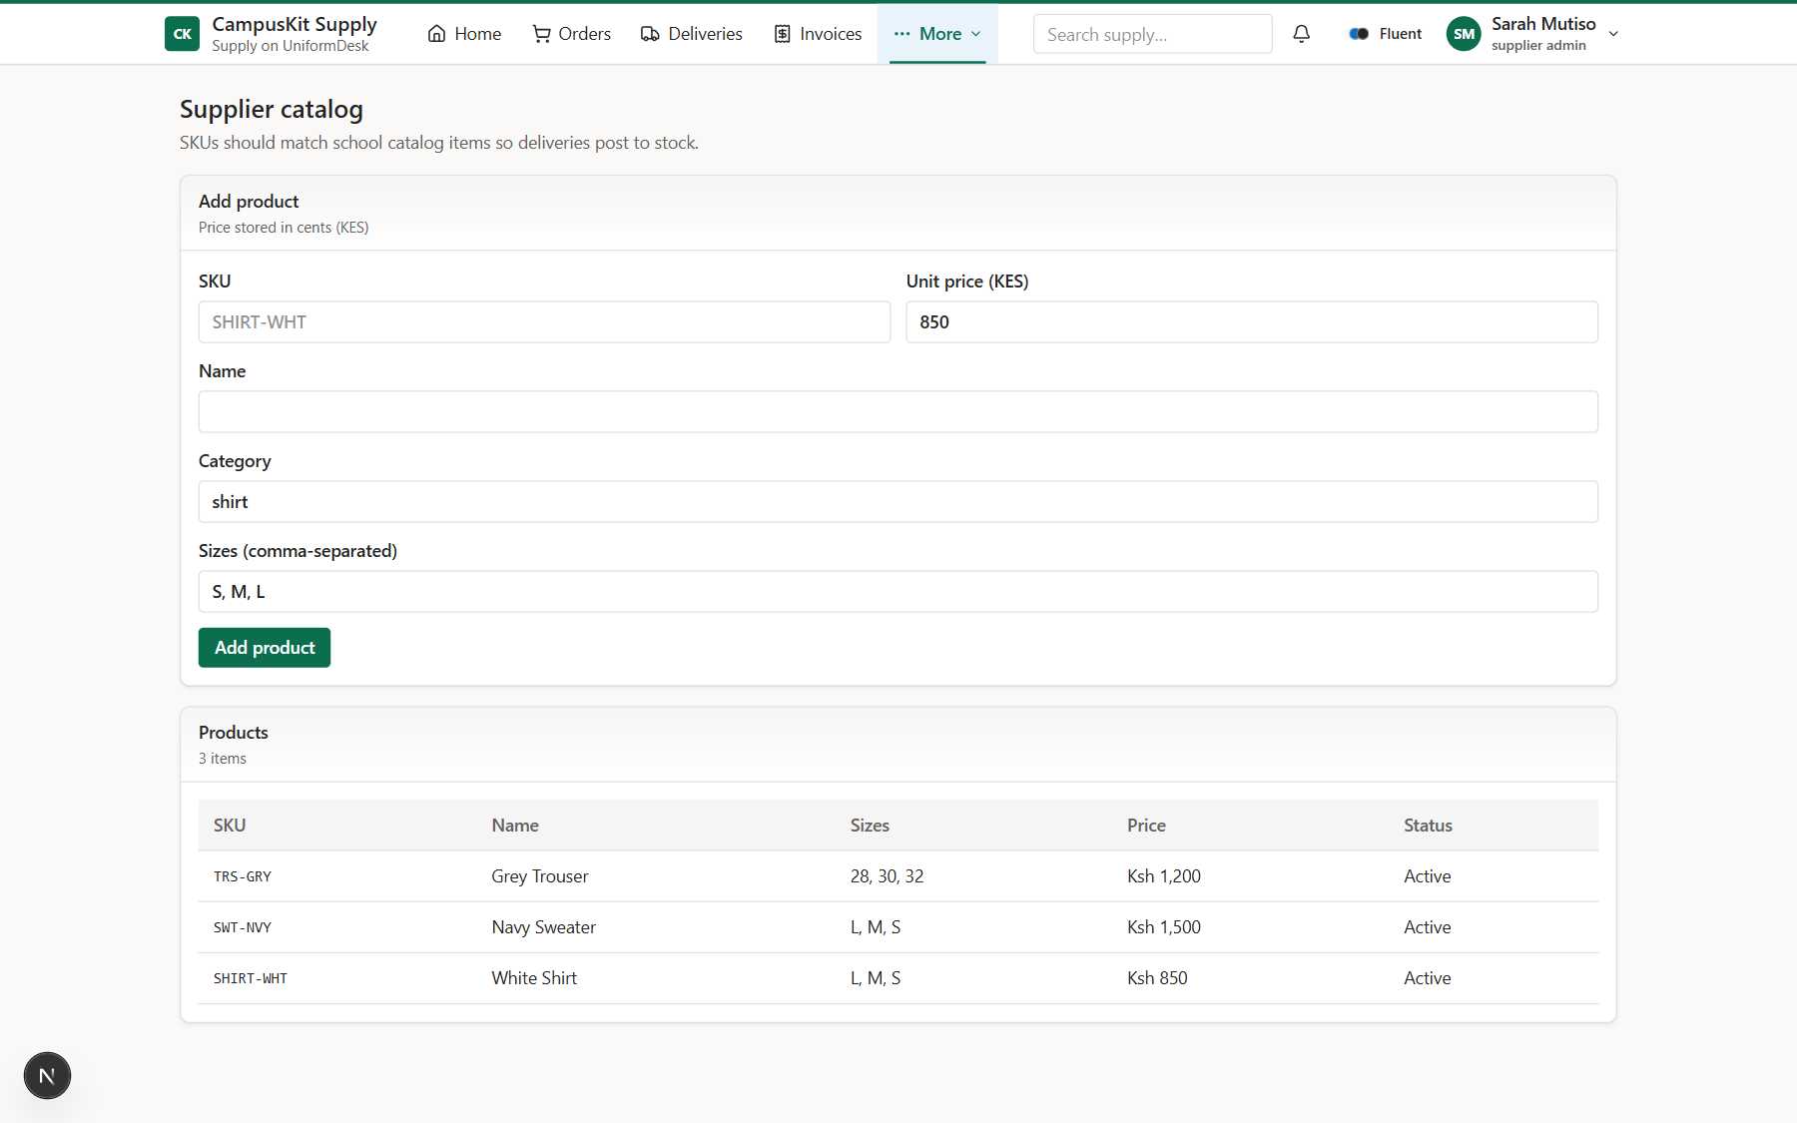
32 SUPPLIER
Catalog
Products & SKUs.
Analyst notes
• Must match school SKUs
UniformDesk System Overview | Confidential
UniformDesk System Overview | Confidential
0 / 0
33 / 46

Slide 34
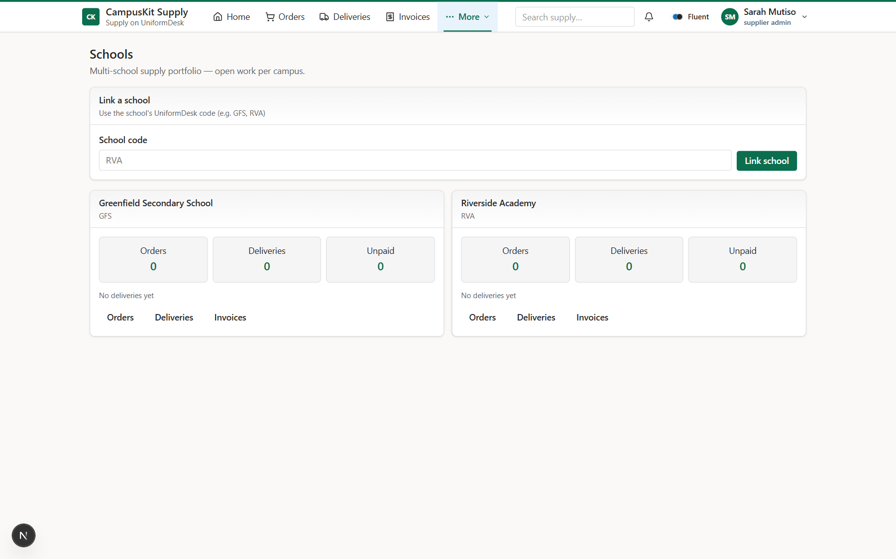
33 SUPPLIER
Schools portfolio
Linked campuses.
Analyst notes
• Filter by school
UniformDesk System Overview | Confidential
UniformDesk System Overview | Confidential
0 / 0
34 / 46

Slide 35

34 SUPPLIER
Activity
Supply timeline.
Analyst notes
• DN / INV / PAY corr IDs
UniformDesk System Overview | Confidential
UniformDesk System Overview | Confidential
0 / 0
35 / 46

Slide 36

35 SUPPLIER
Notifications
Dispatch & collect prompts.
Analyst notes
• Packed DNs
• Open invoices
UniformDesk System Overview | Confidential
UniformDesk System Overview | Confidential
0 / 0
36 / 46

Slide 37
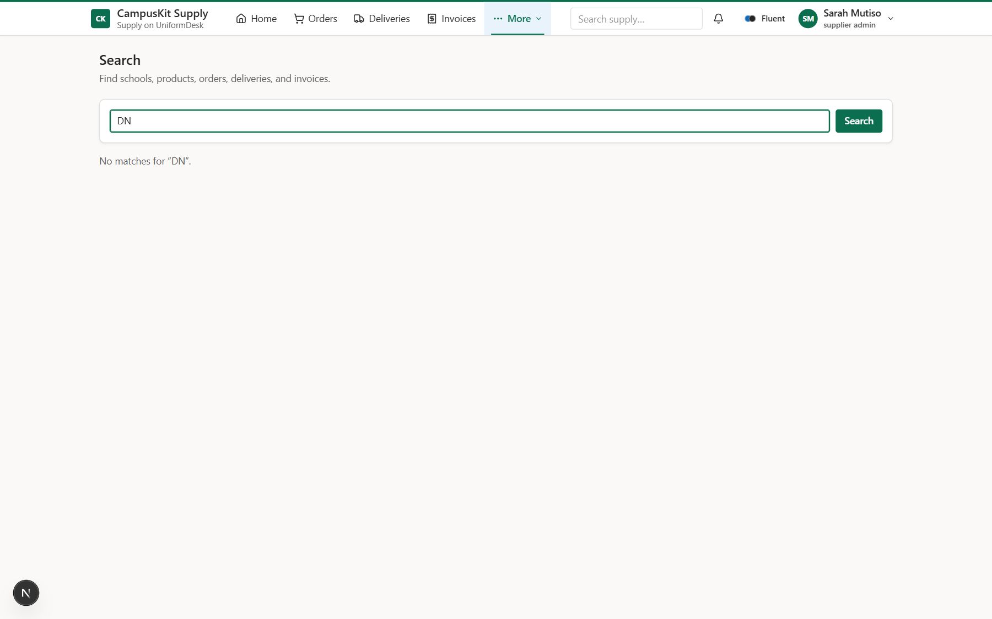
36 SUPPLIER
Search
Find schools, SKUs, docs.
Analyst notes
• Top-bar search
UniformDesk System Overview | Confidential
UniformDesk System Overview | Confidential
0 / 0
37 / 46

Slide 38
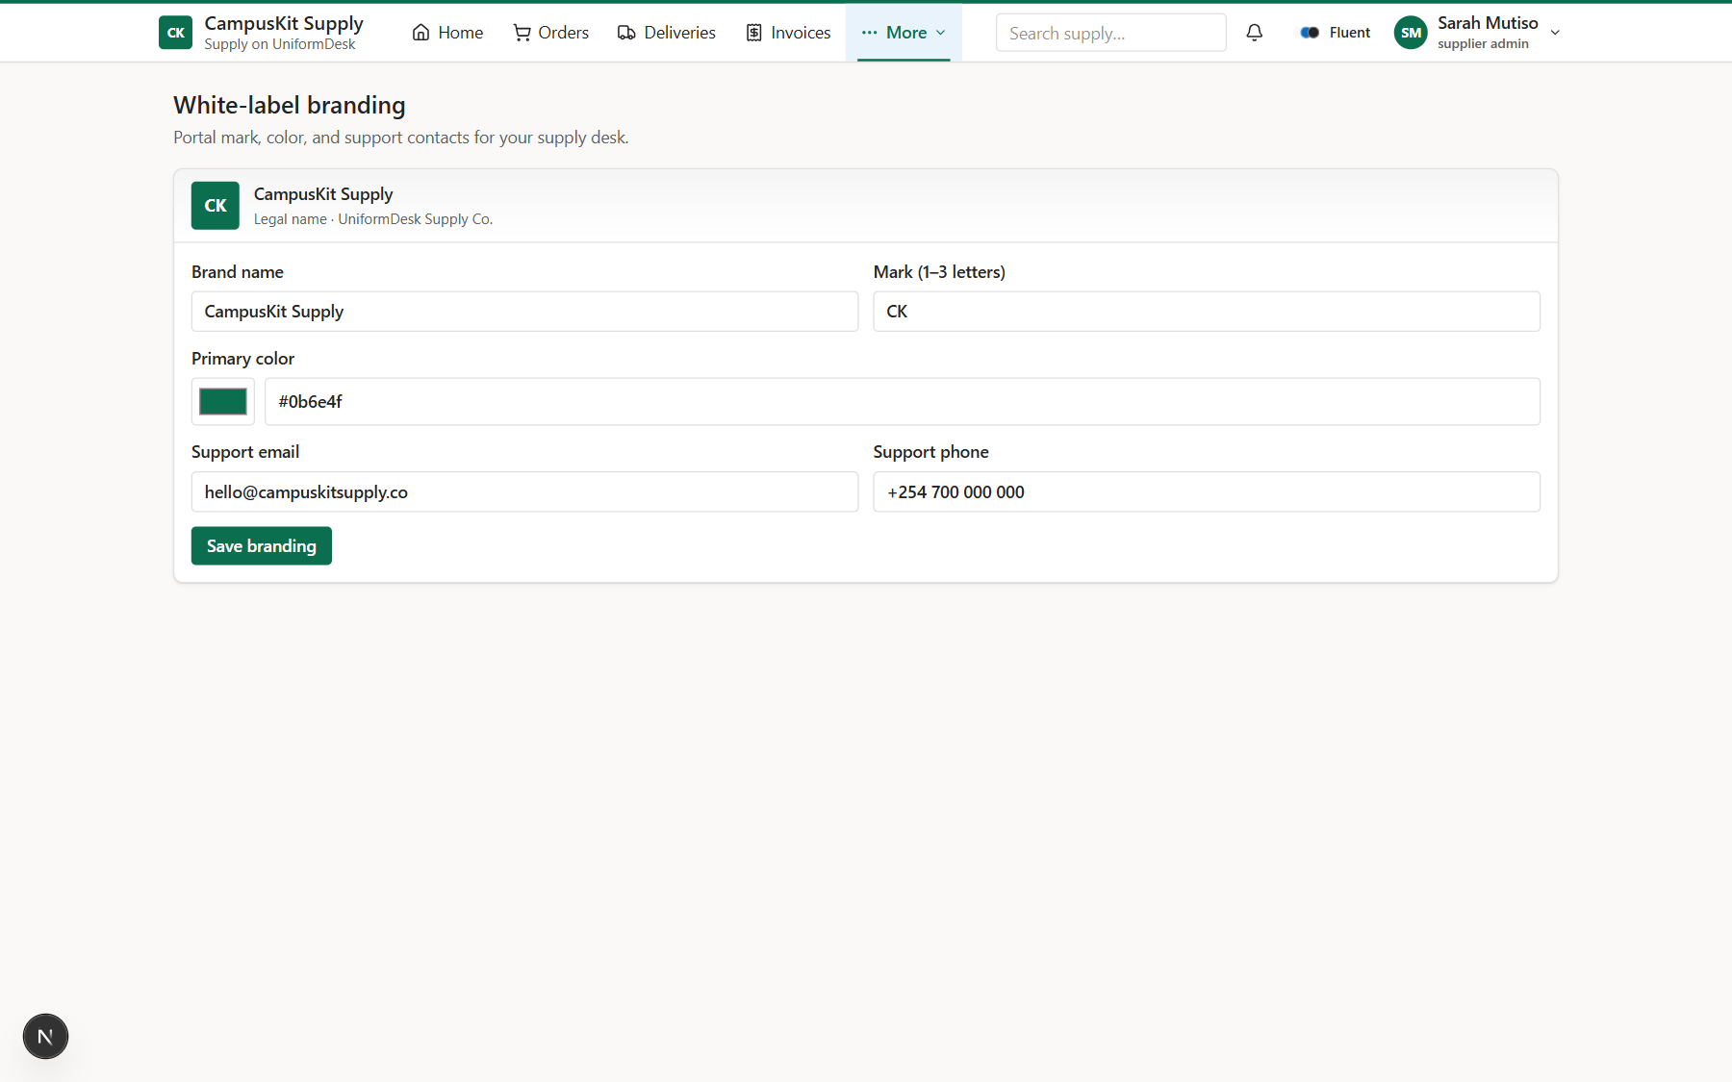
37 SUPPLIER
Branding
White-label portal look.
Analyst notes
• Mark, color, contacts
UniformDesk System Overview | Confidential
UniformDesk System Overview | Confidential
0 / 0
38 / 46

Slide 39
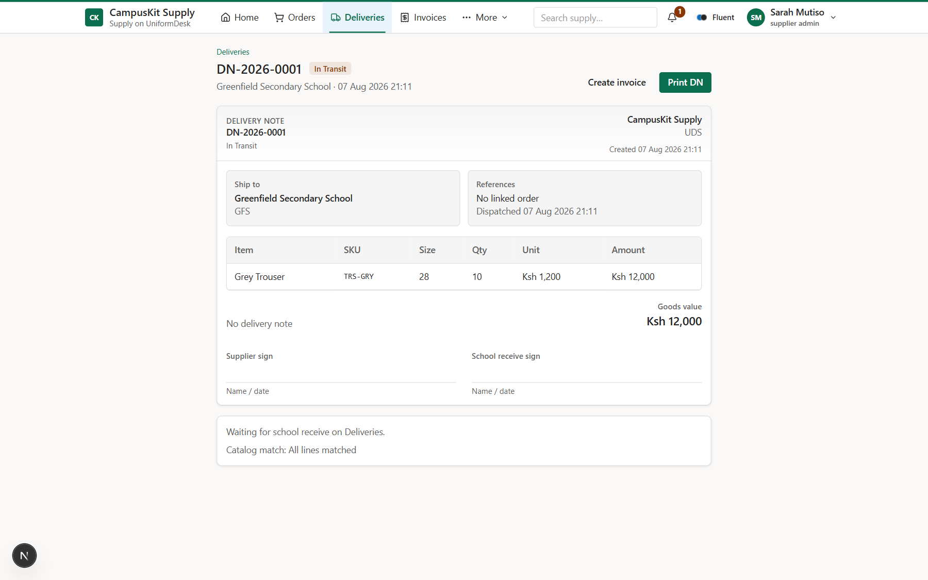
38 SUPPLIER
Delivery note detail (printable)
Operational DN with print pack.
Analyst notes
• Lines + sign-off
• Dispatch / invoice actions
UniformDesk System Overview | Confidential
UniformDesk System Overview | Confidential
0 / 0
39 / 46

Slide 40
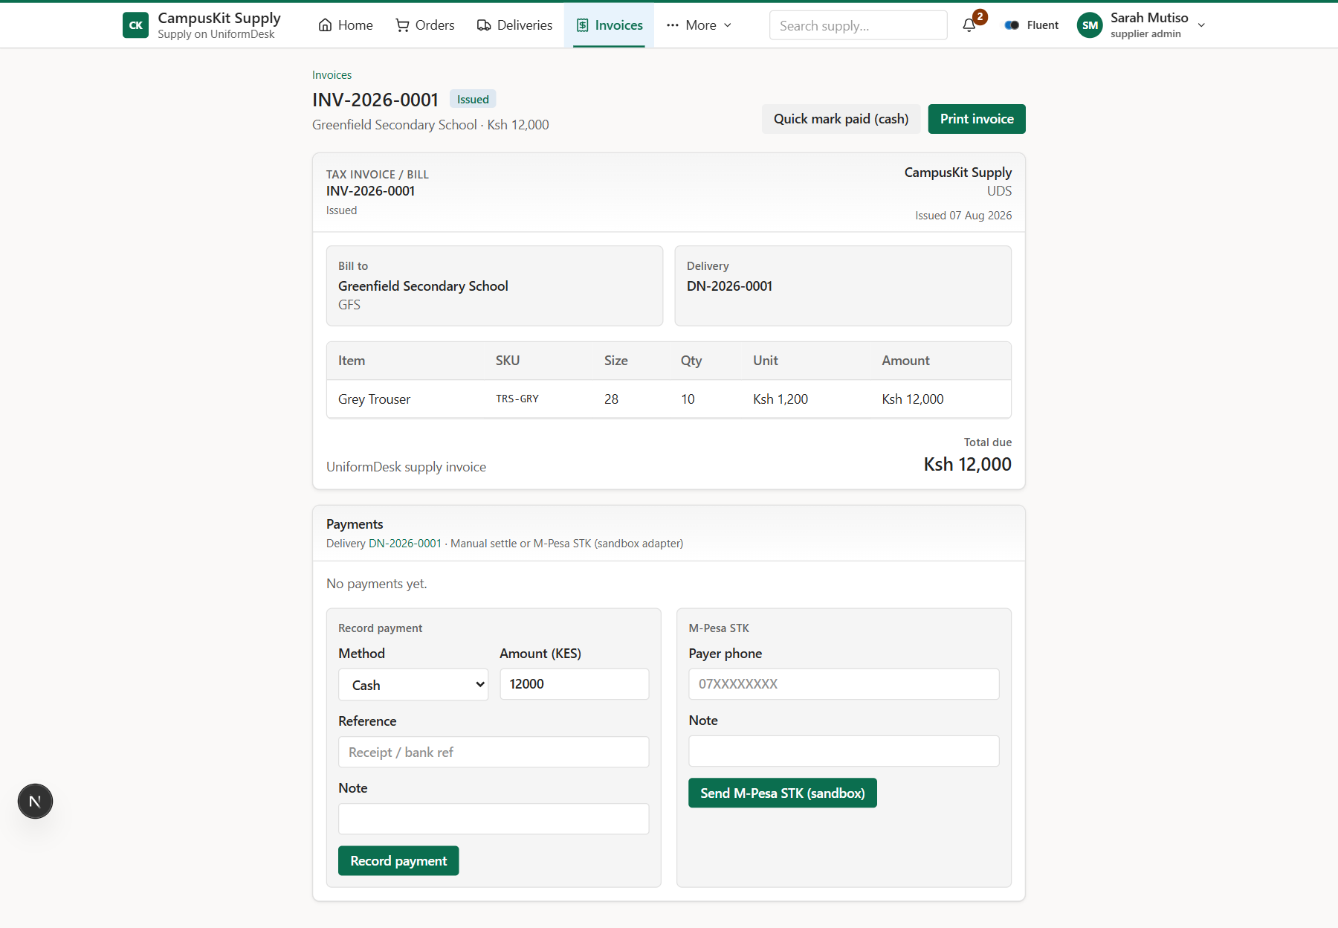
39 SUPPLIER
Invoice detail + payment confirmation
Record cash/bank or sandbox STK.
Analyst notes
• Not a payment rails product
• Marks paid when covered
UniformDesk System Overview | Confidential
UniformDesk System Overview | Confidential
0 / 0
40 / 46

Slide 41
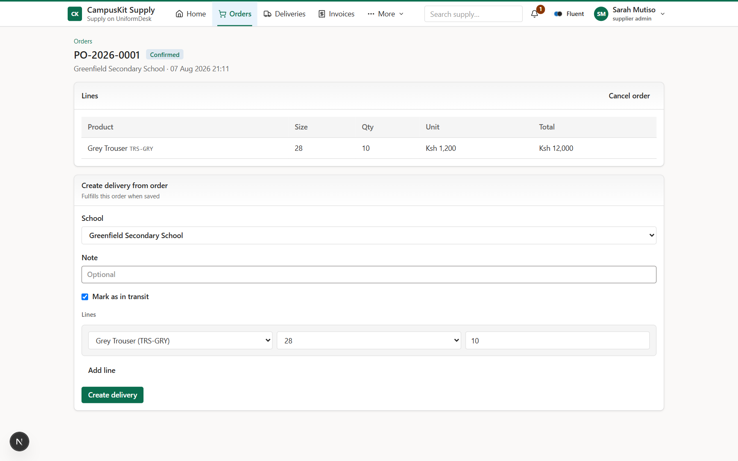
39b SUPPLIER
Order detail
Confirmed school PO with line items.
Analyst notes
• Create DN from order
• Cancel when needed
• School linkage
UniformDesk System Overview | Confidential
UniformDesk System Overview | Confidential
0 / 0
41 / 46

Slide 42
40 DATA & TRUST
What makes UniformDesk auditable
• StockBalance + StockLedgerEntry — every movement is explainable.
• IssueSlip requires signature image; void requires reason and restores stock.
• publicToken enables guardian verification without exposing the desk.
• Correlation IDs (slip / DN / INV / PAY) appear in activity feeds for support.
• Tenant isolation: schoolId / supplierId enforced in session and queries.
• RBAC separates storekeeper write paths from auditor read paths.
UniformDesk System Overview | Confidential
42 / 46

Slide 43
41 OFFLINE / PWA
Issue continuity on flaky school networks
• Service worker caches app shell (production).
• Desk home / issue page warm an IndexedDB roster snapshot.
• /issue-offline runs from cache when the server is unreachable.
• Queued issues sync via POST /api/v1/issue when back online.
• Local on-hand adjusts while offline so successive issues stay realistic.
• Scope is intentional: issue-only offline — receive/admin still need network.
UniformDesk System Overview | Confidential
43 / 46

Slide 44
42 READINESS
Analyst assessment
Strong today
Before live production
• Clear domain model & dual portals
• Ledger + signature invariants (tested)
• Supply loop to payment confirmation
• CI on GitHub + middleware gate
• Pilot-ready UX (search, notices, print)
• Postgres (leave SQLite)
• Staging + backup/restore drill
• Secrets rotation / no demo passwords
• Observability (logs / uptime)
• Limited pilot: 1 school + 1 supplier
UniformDesk System Overview | Confidential
44 / 46

Slide 45
43 DEMO SCRIPT
10-minute live walkthrough
• 1) Login as store@greenfield.school / desk1234 — show desk home.
• 2) Issue a kit with signature — open slip, show QR/share.
• 3) Open public proof in a private window.
• 4) Login as supply@uniformdesk.co — show deliveries & dispatch.
• 5) School receive DN — stock rises; show activity correlation.
• 6) Supplier invoice + mark paid (confirmation).
• 7) Close with notifications / reorder / print packs if time.
UniformDesk System Overview | Confidential
45 / 46

Slide 46
UniformDesk
One spine: supply → stock → signed issue → proof → settlement confirmation.
Questions & discussion

