Slide 1
CSE710: Advanced Artificial Intelligence
Interpretable Cardiac Risk Prediction
A Deep Learning Approach with SHAP-based Clinical Explanations
Project Team
[Person 1 Name]
[Person 2 Name]
[Person 3 Name]
May 2026

Slide 2
Presentation Outline
● Problem Statement & Motivation
● Training & Optimization
● Dataset Overview
● Model Evaluation
● Data Preprocessing
● Explainable AI — SHAP
● Exploratory Data Analysis
● Key Findings & Limitations
● MLP Architecture
● References

Slide 3
Problem Statement & Motivation
Why Cardiac Risk Prediction Matters
Our Solution
● Cardiovascular disease is the #1 cause of death globally (WHO, 2023)
● Early detection dramatically reduces mortality and healthcare costs
● Routine clinical data (ECG, cholesterol, blood pressure) already holds predictive power
● MLP deep learning model
● SHAP for per-prediction explanations
● UCI Heart Disease dataset
● 302 patients · 13 clinical features
● Binary target: Cardiac Risk / No Risk
The "Black Box" Problem in Clinical AI
● Deep learning is powerful but opaque — clinicians cannot trust what they cannot understand
● Regulatory frameworks (FDA, EU AI Act) increasingly require explainability for medical AI
● Without interpretability, accurate predictions may still be rejected in clinical practice
Goal: an accurate AND interpretable model that clinicians can act on.
1/12

Slide 4
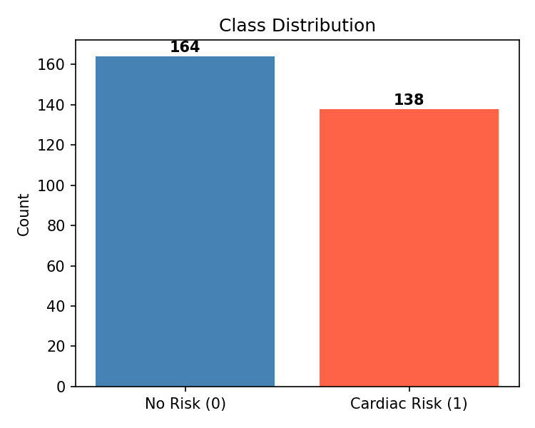
Dataset Overview — UCI Heart Disease (Cleveland)
Dataset at a Glance
Class Distribution
● Source: UCI Machine Learning Repository — Cleveland subset
● Curated on Kaggle by mragpavank
● 303 records → 302 after removing 1 duplicate
● Classes: 164 Cardiac Risk (54%) · 138 No Risk (46%)
Selected Features (13 total)
Age
Age in years
ChestPainType
0 = asymptomatic … 3 = typical angina
RestingBP
Resting blood pressure (mm Hg)
Cholesterol
Serum cholesterol (mg/dl)
MaxHR
Maximum heart rate achieved
Oldpeak
ST depression induced by exercise
Thalassemia
Thalassemia type (0–3)
2/12

Slide 5
Data Preprocessing Pipeline
Step 1 — Missing Values
No missing values found across all 303 records and 14 columns.
Step 2 — Deduplication
1 exact duplicate row removed → 302 clean samples retained.
Step 3 — Feature / Target Split
X = 13 clinical features. y = binary target (1 = Cardiac Risk, 0 = No Risk).
Step 4 — Train-Test Split
80% Training (241 samples) · 20% Testing (61 samples) · Stratified by class label.
Step 5 — Standardization
StandardScaler fitted on training data only; applied to both train and test sets.
Stratification ensures class proportions are preserved; fitting the scaler only on training data prevents data leakage.
3/12

Slide 6
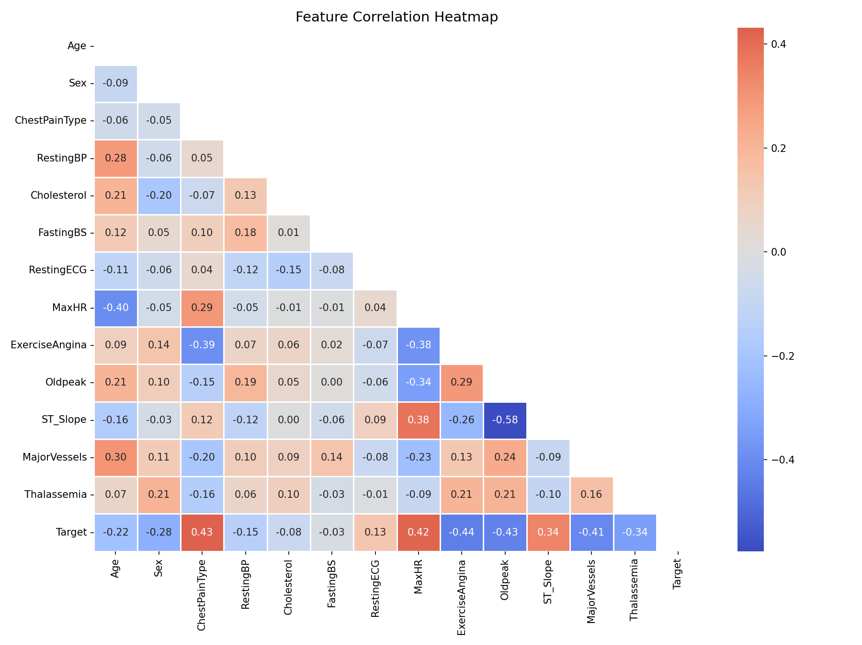
Exploratory Data Analysis
Correlation Heatmap
Class Distribution by Feature
Key: MaxHR negatively correlated with risk · Oldpeak strongly positive · Thalassemia and ChestPainType show high discriminative power.
4/12

Slide 7
MLP Architecture
Network Design
Training Configuration
Input Layer
● Optimizer: Adam (adaptive learning rate)
● Loss Function: Binary Cross-Entropy
● Batch Size: 16 · Max Epochs: 200
● Validation Split: 15% of training set
● Early Stopping: patience = 15 on val_loss
● Best weights automatically restored on stop
13 features (standardized)
Dense 64 + ReLU
First hidden layer + Dropout(0.3)
Dense 32 + ReLU
Second hidden layer + Dropout(0.3)
Dense 16 + ReLU
Third hidden layer
Why Dropout? With only 302 samples, the model easily memorises the training set. Randomly zeroing 30% of neurons each step forces the network to learn redundant representations — acting as an ensemble of many sub-networks.
Output — Sigmoid
P(Cardiac Risk) ∈ [0, 1]
Total Parameters: 3,521 (13.75 KB)
5/12

Slide 8
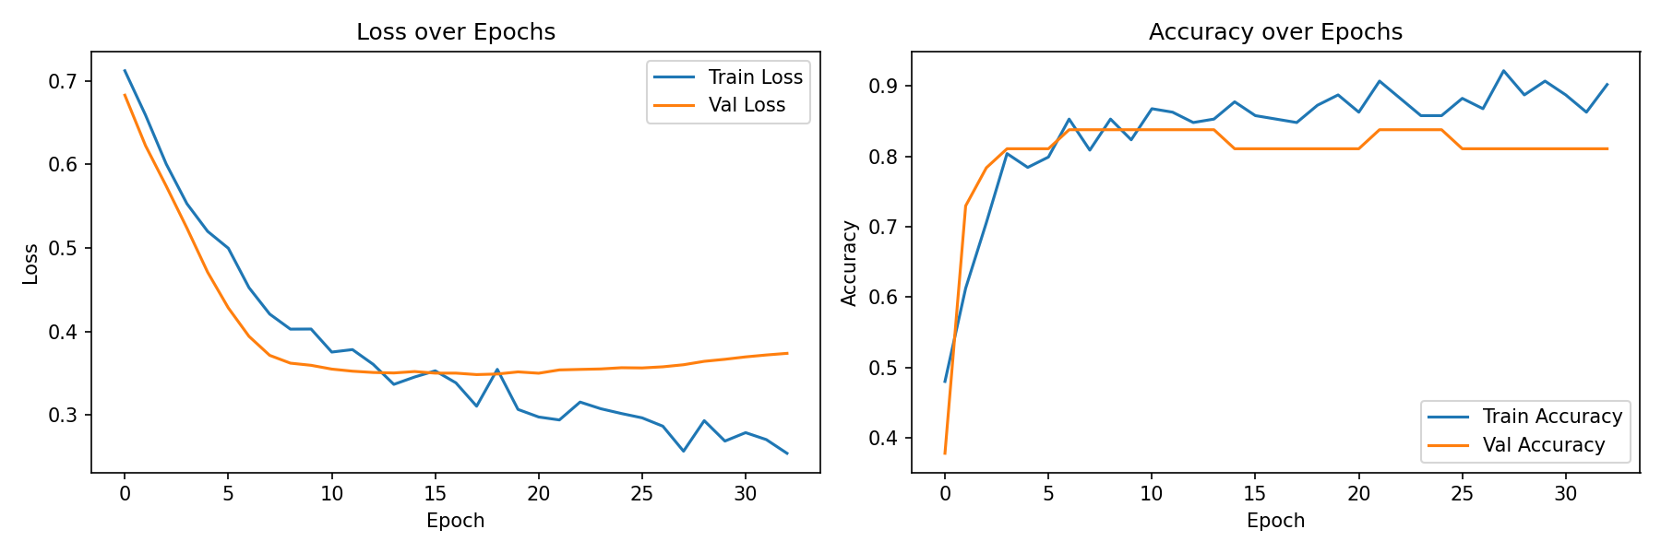
Training & Optimization
Training History
Observations
● Stopped at epoch ~33 via early stopping
● val_loss plateaued after epoch ~14
● No significant overfitting observed
● Best weights from epoch ~14 restored
– Small train/val accuracy gap expected at n=302
Early stopping is essential here — without it, 200 epochs on 241 samples would cause severe overfitting. The model converged in ~33 epochs, saving compute and preserving generalisation.
6/12

Slide 9
Model Evaluation — Performance Metrics
Accuracy
Precision
Recall
F1-Score
ROC-AUC
80.33%
76.92%
90.91%
83.33%
86.90%
Overall correct predictions
Of predicted Risk: truly Risk
Of true Risk cases: caught
Harmonic mean of Prec & Recall
Area under the ROC curve
Clinical interpretation: Recall (90.91%) is the most critical metric in cardiac screening. A false negative — missing a real cardiac risk patient — is far more dangerous than a false alarm. The model correctly catches 30 of 33 true risk cases in the test set (only 3 missed).
Confusion Matrix Detail: TP = 30 · TN = 19 · FP = 9 · FN = 3
7/12

Slide 10
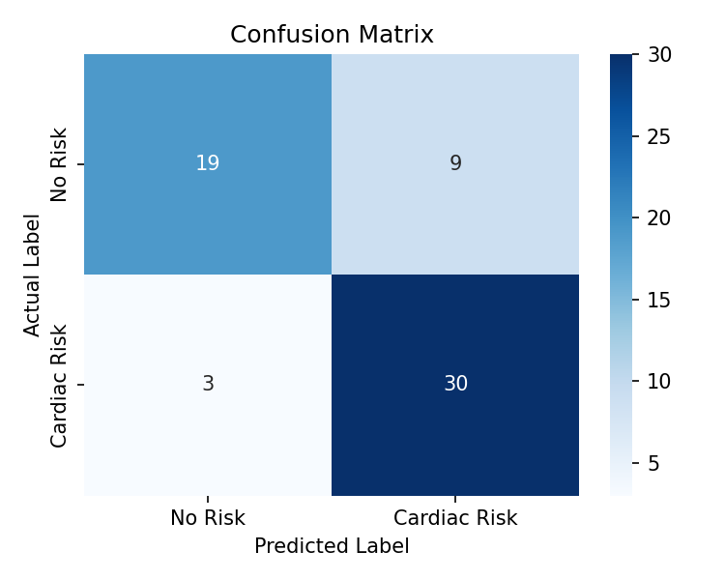
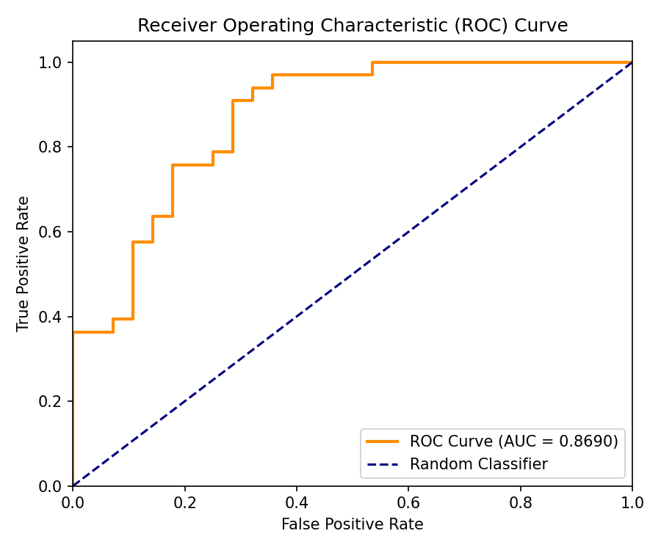
Model Evaluation — Confusion Matrix & ROC Curve
Confusion Matrix
ROC Curve (AUC = 0.8690)
8/12

Slide 11
Explainable AI — What is SHAP?
SHAP — SHapley Additive exPlanations
Rooted in cooperative game theory (Shapley, 1953) · Adapted for ML by Lundberg & Lee (NeurIPS 2017)
Local Accuracy
For any prediction, the SHAP values sum exactly to the model output minus a baseline. Explanation and model always agree.
Missingness
Features that are absent from the input have zero SHAP contribution — no phantom effects.
Consistency
If a feature's contribution increases across all coalition subsets, its SHAP value can only increase — a monotonicity guarantee.
Why KernelExplainer?
● Model-agnostic — works with any black-box, including TensorFlow/Keras MLP
● Samples feature perturbations to estimate Shapley values without model-specific access
● Setup: 100 background samples · 50 test samples · nsamples=100 per explanation
9/12

Slide 12
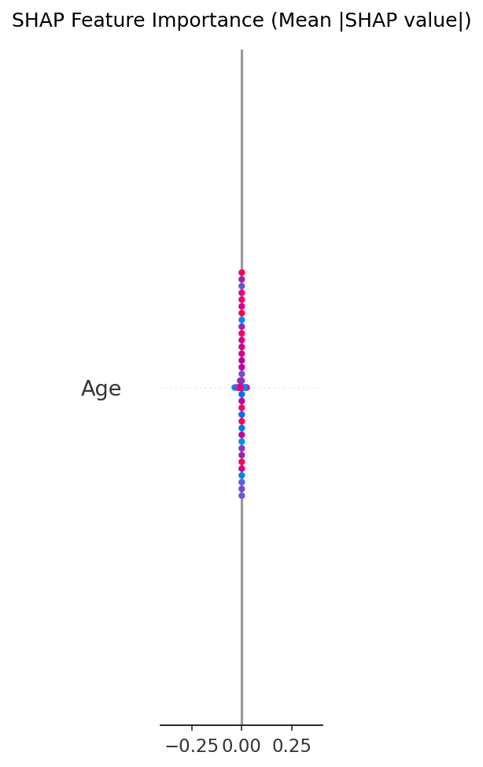
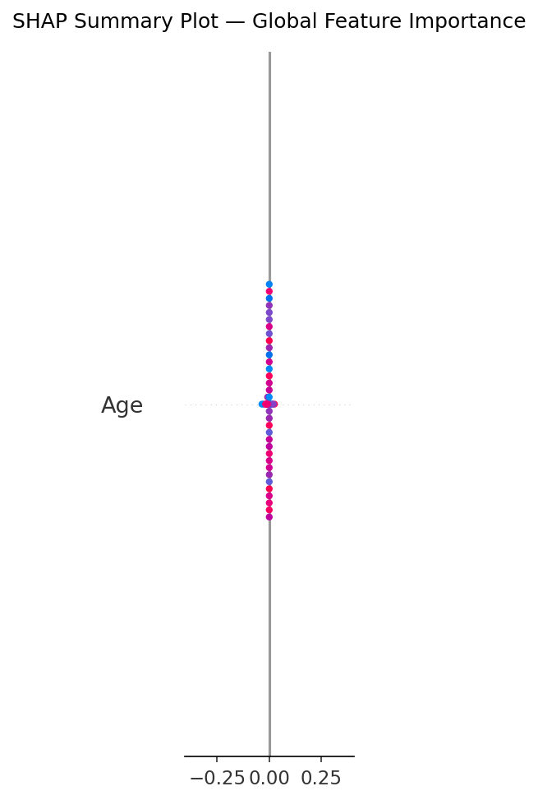
SHAP — Global Feature Importance
Mean |SHAP| — Feature Importance Bar
Beeswarm — Direction & Magnitude
Top global drivers: Thalassemia · ChestPainType · MaxHR · Oldpeak · MajorVessels
10/12

Slide 13
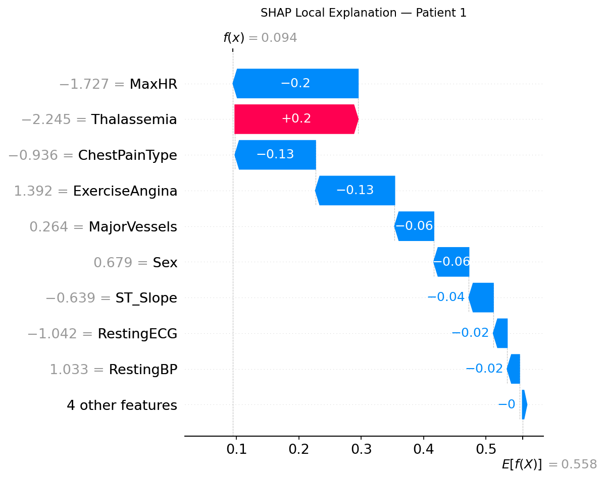
SHAP — Local Explanation (Patient-Level)
Waterfall Plot — Patient 1
Reading the Waterfall
● Patient 1: Actual = No Risk · Predicted = No Risk (P = 0.094) ✓
● MaxHR drives prediction strongly toward No Risk (large negative SHAP)
● Thalassemia also reduces predicted risk for this patient
● ChestPainType adds minor push toward risk
– Each bar moves the output from the baseline expected value (~0.54)
Unlike global rankings, SHAP local explanations let a clinician see exactly why the model flagged a specific patient — enabling audit, override, and trust-building in practice.
11/12

Slide 14
Key Findings & Limitations
Key Findings
Limitations
● MLP achieves 80.33% accuracy and 90.91% recall on 302 samples
● High recall minimises false negatives — the most critical error in cardiac screening
● Thalassemia and ChestPainType are the strongest global predictors
● MaxHR is protective — higher max heart rate lowers predicted risk
● Local SHAP explanations make individual predictions auditable
● Small dataset (302 samples) limits generalisation
● Cleveland subset only — may not reflect diverse populations
● KernelExplainer is slow for large test sets (sampling-based)
● Binary target collapses 5 original severity levels into 2
Future Work
● Larger, multi-centre datasets for better generalisation
● TreeSHAP or GradientSHAP for faster local explanations
● Extend to multi-class severity prediction
● Real-time clinical decision-support integration
12/12

Slide 15
References
[1] Detrano, R., et al. (1989). International application of a new probability algorithm for the diagnosis of coronary artery disease. American Journal of Cardiology, 64(5), 304–310.
[2] Dua, D. & Graff, C. (2019). UCI Machine Learning Repository. University of California, Irvine.
[3] mragpavank. (2020). Heart Disease UCI. Kaggle. kaggle.com/code/mragpavank/heart-disease-uci
[4] Lundberg, S. M. & Lee, S.-I. (2017). A unified approach to interpreting model predictions. Advances in Neural Information Processing Systems (NeurIPS), 30.
[5] Shapley, L. S. (1953). A value for n-person games. Contributions to the Theory of Games, 2, 307–317.
[6] Abadi, M., et al. (2015). TensorFlow: Large-scale machine learning on heterogeneous distributed systems. arXiv:1603.04467.
[7] Chollet, F., et al. (2015). Keras. GitHub: github.com/keras-team/keras
[8] World Health Organization. (2023). Cardiovascular diseases fact sheet. WHO.

Slide 16
Thank You
Any Questions?
CSE710: Advanced Artificial Intelligence
[Person 1 Name] · [Person 2 Name] · [Person 3 Name]
Dataset: UCI Heart Disease (Cleveland) · Model: MLP · XAI: SHAP

