Slide 1
Linux

Slide 2
Table of Content
Module | Topic
Module 1: | Linux History
Module 2: | Linux Architecture
Module 3: | Linux file system
Module 4: | BASH commands
Module 5: | File permission

Slide 3

Module 1: History of Linux
Linus Torvalds developed Linux kernel in 1991.
The motive behind developing Linux was to release free academic version of Unix.
Linux was released under GPL (General Public License)
Notes:
Linux Torvalds pursuing master's degree in computer science at University of Helsinki. He purchased book on "Operating Systems: Design and Implementation" in which the author Andrew has described MINIX (Mini UNIX) an educational version of UNIX. The book changed Torvalds' life: he was fascinated by the clear structure of the Unix and its underlying philosophy. Since MINIX was not free OS, he decided to develop a free UNIX based OS for academic purpose. He developed Linux kernel & released first version of Linux under GPL license in 1991. Once penguin took bite of Linus Torvalds in National Zoo, Australia. He liked that penguin & hence decided to keep Linux logo as Penguin. Later on that Penguin was named as Tux stands for "Torvalds UNIX".
Refer: https://en.wikipedia.org/wiki/History_of_Linux and https://en.wikipedia.org/wiki/Linus_Torvalds

Slide 4

Linux logo
TUX (Torvalds Unix)

Slide 5
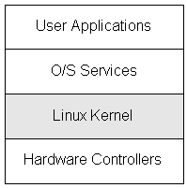
Linux Architecture

Slide 6
Linux Architecture
Hardware Controllers
Hardware controllers comprises all physical devices like CPU, hard disk, RAM, network hardware etc.
Linux Kernel
Linux Kernel mediates access to the hardware resources. Kernel is a heart of every OS.
O/S Services
OS Services is a programming interface to the kernel. It includes compiler tool, libraries, shell etc.
User Applications
User applications include the applications used by end user. For example editors, word processors, web browsers etc.

Slide 7
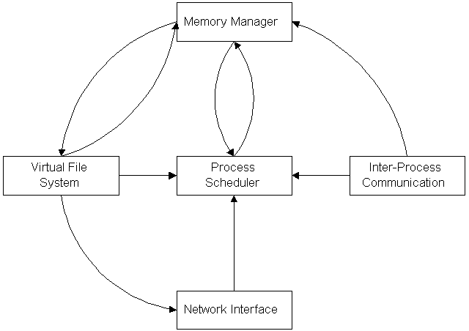
Linux Kernel Architecture

Slide 8
Linux Kernel Architecture
Process Scheduler
Process Scheduler controls the process access to the CPU & ensures that every process will have access to the CPU.
Memory Manager
Memory manager permits multiple processes to securely share the machine’s main memory system.
Virtual File System (VFS)
VFS is an abstraction layer on top of a more concrete file system. VFS allows client application to access different types of files in uniform way. For example local file & network file.

Slide 9
Linux Kernel Architecture
Network Interface
Network Interface provides us access to variety of network protocols & different network hardware.
Inter-process Communication (IPC)
IPC establishes communication among several processes on a Linux system.

Slide 10
Unix vs Linux
Sr. No. | Unix | Linux
1. | Unix is paid operating system. Depending upon Unix flavor, the cost structure changes. | Linux can be freely distributed, freely copied, freely downloaded.
2. | Unix is developed for mainframes users and server side users. | Linux is used by home users, server side users etc.
3. | Unix is mainly developed by AT&T, few commercial vendors and NGOs. | Linux is developed by open source community. Thus it is a community work.
4. | Unix support Bourne shell as text mode interface. Now it also supports BASH, Korn & C. | Linux default shell is BASH (Bourne Again SHell).
5. | Unix is shipped with GUI called CDE(Common Desktop Environment). Presently Unix also supports Gnome. | Linux has 2 primary GUIs KDE & Gnome. Apart from this, there are many other GUIs have been developed like Xfce, LXDE, Unity etc.

Slide 11
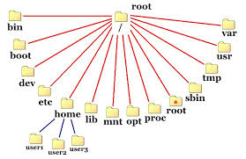
Linux File System
In Linux, everything is a file. Even directory is also a file.
Linux mainly supports file formats Ext3 & Ext4. Apart from this, it also has support for JFS, NFS, FAT32 etc.

Slide 12
Linux File System
PATH | CONTENTS
/bin | Essential user command binaries. For example cp, pwd, rm etc.
/boot | Static files of boot loader.
/dev | Device files like CD-ROM, hard disk, CPU etc.
/etc | System related configuration files. For example host.conf, httpd.conf.
/home | User home directories like /home/anand, /home/guest etc
/lib | Essential shared libraries & kernel modules.
/media | Mount point for removable media like /media/cdrom. The removable media is automatically mounted in /media.
/mnt | Mount point for temporarily mounted file systems. /mnt is used to manually mount the devices using ‘mount’ command.
/opt | Contains third party softwares like Java etc.
/proc | Contains the information about running process with a particular processId.

Slide 13
Linux File System continued..
PATH | CONTENTS
/root | Home directory of root user.
/run | Run-time variable data i.e. information about the running system since last boot, e.g., currently logged-in users etc.
/sbin | Contains binary executable programs required by System Administrator. For example reboot, iptables, ifconfig etc.
/srv | Contains server specific and service related files.
/sys | /sys stores & allows modification of the devices connected to the system.
/tmp | /tmp stores the temporary files of the user & system till next boot.
/usr | Contains executable binaries, documentation, source code, libraries for second level program. For example /usr/bin, /usr/lib, /usr/src etc.
/var | /var contains the files that are expected to grow i.e. logs, mails etc.

Slide 14




Linux GUI

Slide 15




Linux Distributions

Slide 16
BASH commands
Bash is a Unix shell and command language written by Brian Fox released in 1989.
The Bash command syntax is a superset of the Bourne shell command syntax.
Bash commands are widely used in Linux environment.

Slide 17
File operation related BASH commands
Sr. No. | Command | Description
1. | cat | Concatenate and print (display) the content of files.
2. | cd | Change Directory.
3. | cmp | Compare two files
4. | cp | Copy one or more files to another location
5. | cut | Divide a file into several parts.
6. | dd | Convert and copy a file, write disk headers, boot record.
7. | diff | Display the differences between two files.
8. | find | Search for files that meet a desired criteria.
9. | grep | Search file(s) for lines that match a given pattern.
10. | locate | Find files.
11. | ls | List information about file(s).
12. | mkdir | Create new folder(s).

Slide 18
File operation related BASH commands
Sr. No. | Command | Description
13. | gzip | Compress or decompress named file(s).
14. | rar | Archive files with compression.
15. | zip | Package and compress (archive) files.
16. | mv | Move or rename files or directories.
17. | pwd | Print Working Directory.
18. | rcp | Copy files between two machines.
19. | rename | Rename files.
20. | rm | Remove files.
21. | rmdir | Remove folder(s).
22. | slocate | Find files.
23. | Tail | Otutput the last part of file.
24. | wc | Print byte, word, and line counts.

Slide 19
System operations related BASH commands
Sr. No. | Command | Description
1. | df | Display free disk space
2. | Free | Display memory usage
3. | Hostname | Print or set system name
4. | ifconfig | Configure a network interface
5. | kill | Kill a process by specifying its PID
6. | logname | Print current login name
7. | logout | Exit a login shell
8. | mount | Mount a file system
9. | netstat | Networking information
10. | passwd | Modify a user password

Slide 20
System operations related BASH commands
Sr. No. | Command | Description
11. | ping | Test a network connection.
12. | pkill | Kill processes by a full or partial name.
13. | ps | Process status.
14. | reboot | Reboot the system.
15. | shutdown | Shutdown or restart linux.
16. | sleep | Delay for a specified time.
17. | su | Substitute user identity.
18. | sudo | Execute a command as another user.
19. | umount | Unmount a device.
20. | vmstat | Report virtual memory statistics.

Slide 21
Miscellaneous BASH commands
Sr. No. | Command | Description
1. | cal | Display a calendar.
2. | clear | Clear terminal screen.
3. | date | Display or change the date & time.
4. | echo | Display message on screen.
5. | env | Environment variables.
6. | exec | Execute a command.
7. | exit | Exit the shell.
8. | export | Set an environment variable.
9. | expr | Evaluate expressions.
10. | help | Display help for a built-in command.

Slide 22
Miscellaneous BASH commands
Sr. No. | Command | Description
11. | less | Display output one screen at a time.
12. | man | Help manual.
13. | more | Display output one screen at a time.
14. | vi | Text Editor

Slide 23
File Permissions
You can see the following output after running command ‘ll’ on console:
-rw-r--r-- 1 anand developers 1892 Jul 10 18:30 info.txt
-rw-r--r: File permission
anand: User name
developers: Group name

Slide 24
File Permissions continued…
r – User can read the file contents.
w – User can write into the file or directory.
x – User can execute the file or directory.
r = (100)₂ = 4
w = (010)₂ = 2
x = (001)₂ = 1

Slide 25
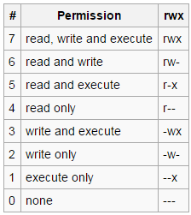
File Permissions continued…

Slide 26
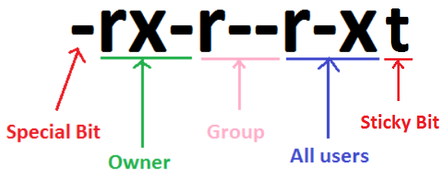
Special bits
File permissions are described with a string having 10 bits:
Special Bit:
_ No special permission
d Directory
l Symbolic Link
Sticky Bit:
t – File or directory having sticky
bit can be deleted only by owner
or by root.

Slide 27
Changing file permission
File permissions can be changed using three basic BASH commands:
chmod
This allows you to change the "access rights" to the file or directory.
chgrp
This allows you to change "Group Ownership" of a file or directory.
chown
This will change the ownership of the file/directory (need to be root to use)

Slide 28
‘chmod’
$ chmod u+x filename
[Adds single permission to file/directory]
$ chmod u+r,g+x filename
[Adds multiple permissions to file/directory]
$ chmod u-rx filename
[Remove permission from a file/directory]
$ chmod a+x filename
[Change permission for all roles on a file/directory]

Slide 29
‘chmod’
$ chmod --reference=file1 file2
[Make permission for a file same as another file]
$ chmod -R 755 directory-name/
[Apply the permission to all the files under a directory recursively]
$ chmod u+X *
[Change execute permission only on the directories (files are ignored).]
$ chmod +t filename
[Adds sticky bit to the file or folder]

Slide 30
‘chgrp’
$ chgrp sysadmin readme.txt
[Changes the group ownership of the file to ‘sysadmin’]
$ chgrp sysadmin mydir
[Changes the group ownership of the directory to ‘sysadmin’]
$ chgrp –R sysadmin mydir
[Changes the group ownership recursively of the directory to ‘sysadmin’ including its sub-directories]

Slide 31
‘chown’
$ chown anand readme.txt
[Changes file ownership to ‘anand’]
$ chown anand:developers readme.txt
[Changes file ownership to user ‘anand’ & group ‘developers’]
$ chown :sysadmins readme.txt
[Changes file ownership to the group ‘sysadmins’]

Slide 32
‘chown’
$ chown root:developers mydir
[Changes directory ownership to ‘root’ user & ‘developers’ group]
$ chown –R root mydir
[Recursively changes file ownership to the directory ‘mydir’ including all sub directories.]

