Slide 1
Log-Based CDC
Presenter: Bao Nguyen
May 2023

Slide 2
Agenda
Concepts: Log-Based CDC
Concepts: Apache Kafka
Concepts: Debezium
Concepts: KSQL
Context 1: Only CDC
Context 2: CDC + Transform
Model 1: Only CDC
Model 2: CDC + Transform

Slide 3
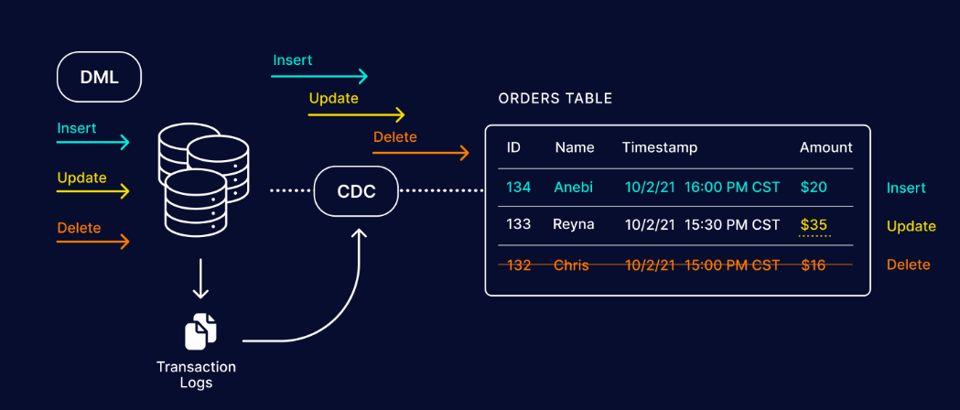
Concepts: Log-Based CDC

Slide 4
Concepts: Log-Based CDC
Log-Based Change Data Capture
Databases contain transaction logs (also called redo logs) that store all database events allowing for the database to be recovered in the event of a crash. With log-based change data capture, new database transactions – including inserts, updates, and deletes – are read from source databases’ native transaction logs.
References:
https://www.striim.com/blog/change-data-capture-cdc-what-it-is-and-how-it-works

Slide 5
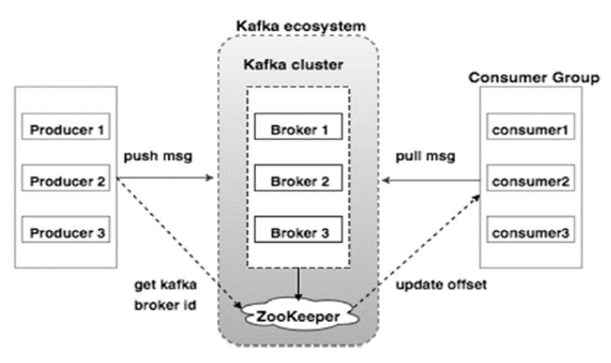
Concepts: Apache Kafka

Slide 6
Concepts: Apache Kafka
Apache Kafka
Apache Kafka is an open-source distributed event streaming platform used by thousands of companies for high-performance data pipelines, streaming analytics, data integration, and mission-critical applications.
References:
https://kafka.apache.org/
https://kafka.apache.org/intro

Slide 7
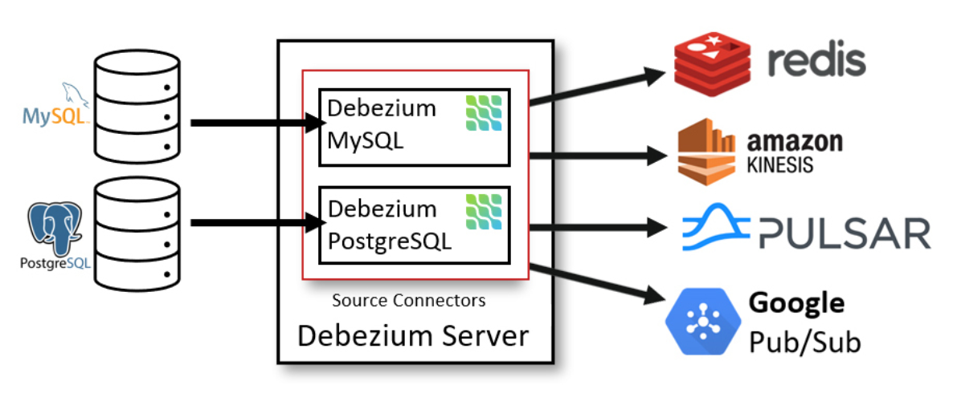
Concepts: Debezium

Slide 8
Concepts: Debezium
Debezium
Debezium is an open-source tool for CDC that is based on Apache Kafka. It can capture row-level changes using transactional logs. The order of events recorded by Debezium is the same as how changes were made to the database. These events become topics published to Apache Kafka.
References:
https://www.arcion.io/blog/cdc-tools
https://debezium.io/documentation/reference/stable/connectors/postgresql.html
https://debezium.io/documentation/reference/stable/architecture.html

Slide 9
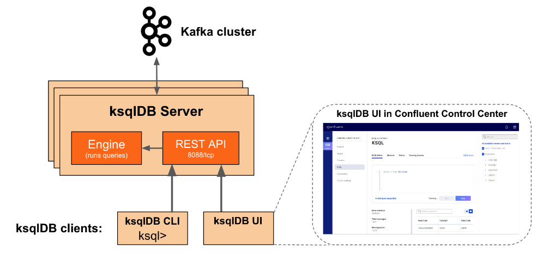
Concepts: KSQL

Slide 10
Concepts: KSQL
KSQL
KSQL is an open source streaming SQL engine for Apache Kafka. It provides a simple and completely interactive SQL interface for stream processing on Kafka; no need to write code in a programming language such as Java or Python. KSQL is open-source (Apache 2.0 licensed), distributed, scalable, reliable, and real-time.
References:
https://stackshare.io/ksql
https://docs.ksqldb.io/en/latest/concepts/streams/
https://docs.ksqldb.io/en/latest/concepts/queries/

Slide 11
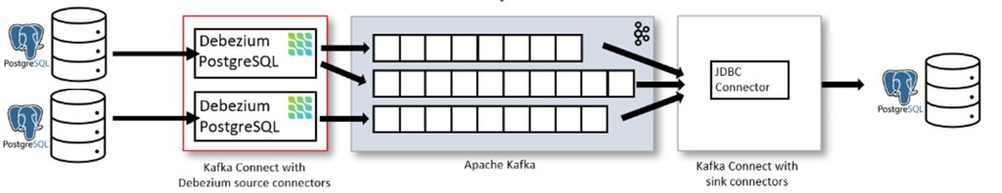
Model 1: Only CDC

Slide 12
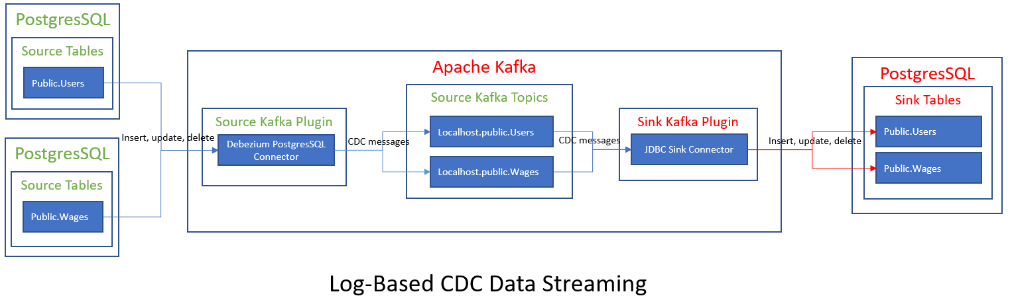
Model 1: Only CDC

Slide 13
Context 1: Only CDC
Description:
- We have a Users table (fields: user_id, first_name, last_name) in a source PostgreSQL database.
- We have a Wages table (fields: user_id, wage) in another soure PostgreSQL database.
- We have a Users table (fields: user_id, first_name, last_name) in a sink PostgreSQL database.
- We have a Wages table (fields: user_id, wage) in a sink PostgreSQL database.
- We want to synchronize the Change Data Capture (CDC) to the tables Users and Wages in a sink PostgreSQL database when the tables Users and Wages are inserted, updated, or deleted in the source PostgreSQL database.
- We expect this synchonization happenning in near-real-time.

Slide 14
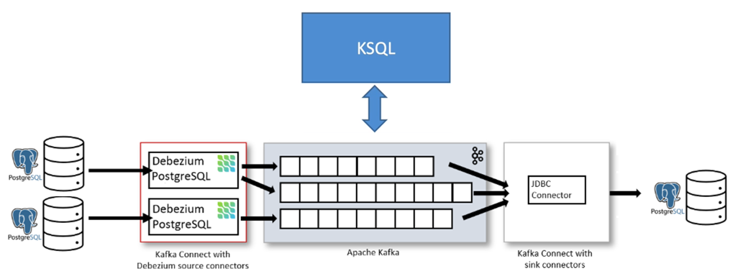
Model 2: CDC + Transform

Slide 15
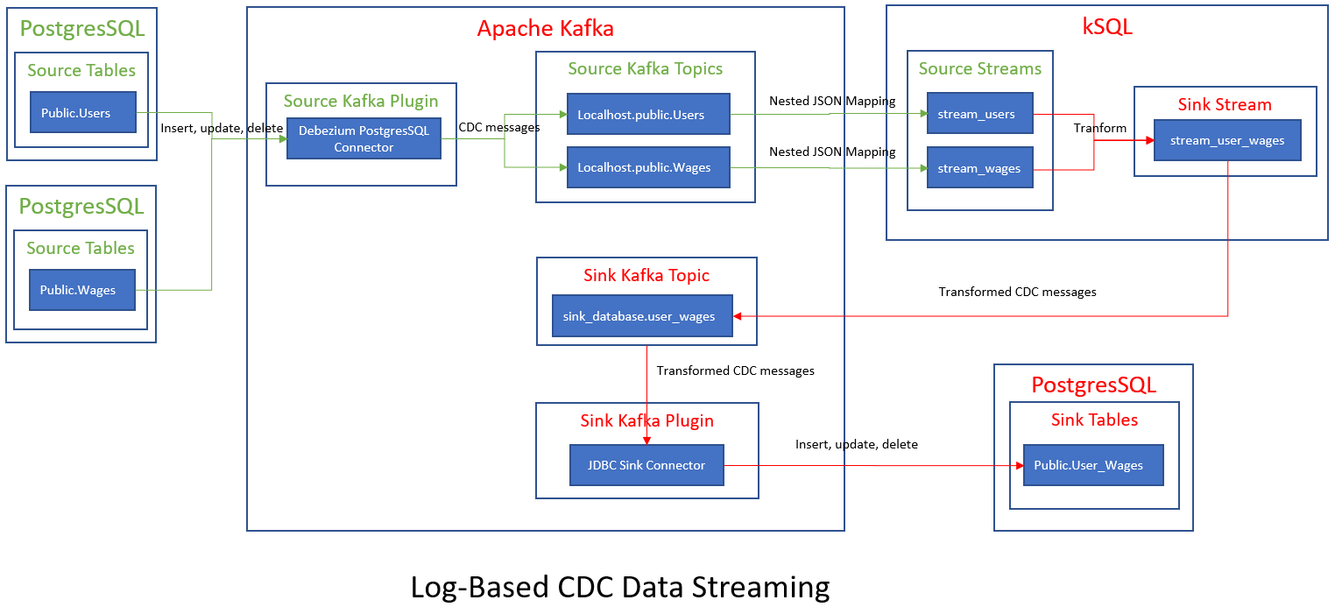
Model 2: CDC + Transform

Slide 16
Context 2: CDC + Transform
Description:
- We have a Users table (fields: user_id, first_name, last_name) in a source PostgreSQL database.
- We have a Wages table (fields: user_id, wage) in another soure PostgreSQL database.
- We have a User_Wages table (fields: user_id, full_name, wage) in a sink PostgreSQL database.
- We want to synchronize the Change Data Capture (CDC) to the table User_Wages in a sink PostgreSQL database when the tables Users and Wages are inserted, updated, or deleted in the source PostgreSQL database.
- This synchonization includes the data tranforming as following:
+ User_Wages.user_id = Users.user_id
+ User_Wages.full_name = Users.first_name + ' ' + Users.last_name
+ User_Wages.wage = Wages.wage
- We expect this synchonization happenning in near-real-time.

