Slide 1
NestJS Fundamental
May 2023

Slide 2
Introduce NestJS
What is NestJS?
NestJS Architecture
NestJS CLI
Workspaces and project file structure
NestJS Overview
Decorators
Dependency Injection
Controllers, Routers
Modules, Providers
Pipe, Class transform, Validator
Configurations, Loging, Errors
Data Serialization
Databases
Auth, JWT
OpenAPI
Pros & Cons
Demo

Slide 3
01
Introduce NestJS

Slide 4

What is NestJS?
NestJS is a framework for building efficient, scalable Node.js server-side applications.
It uses progressive JS, is built with and fully supports TS.
It combines elements of OOP (Object Oriented Programming), FP (Functional Programming), FRP (Functional Reactive Programming).

Slide 5
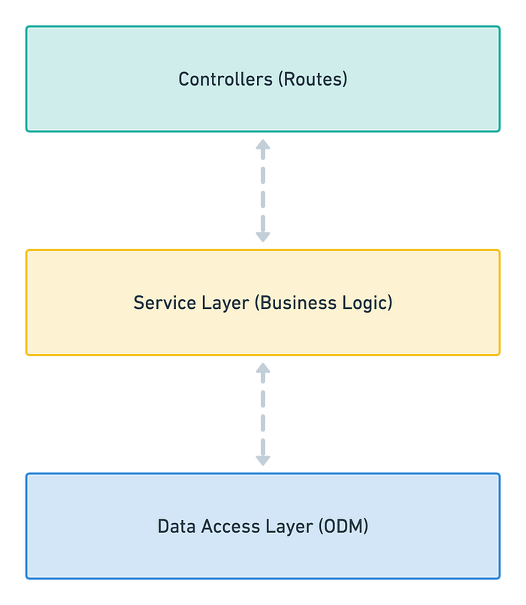
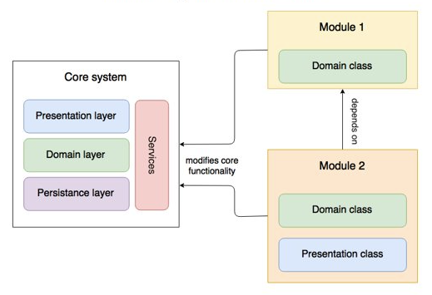
NestJS Architecture
NestJS follows a modular and layered approach, combining concepts from both 3-tier architecture and the modular architecture pattern
It's promotes separation of concerns, modularity, reusability, and testability
3-tier architecture
Modular system architecture

Slide 6
NestJS CLI
The Nest CLI is a command-line interface tool that helps you to initialize, develop, and maintain your Nest application
npm install -g @nestjs/cli – Install the CLI global
nest --help – See the available nest commands
To create a new basic Nest project run the follow command:
nest new my-nest-project
Other commands:
nest generate <schematic> <name> [options]
nest build <name> [options]
nest start <name> [options]
nest add <name> [options]

Slide 7
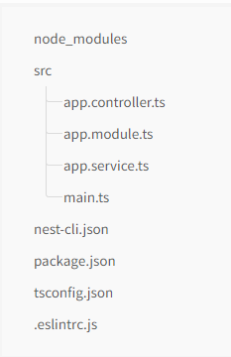
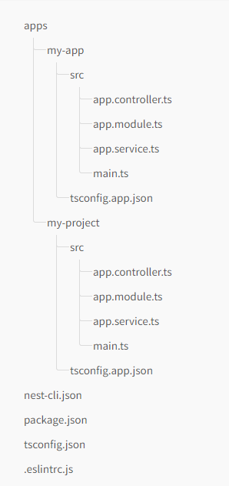
Workspaces and Project file structure
Standard Mode
Useful for building individual project-focused applications that have their own dependencies and settings, and don't need to optimize for sharing modules, or optimizing complex builds.
Monorepo mode
Treats code artifacts as part of a lightweight monorepo, and may be more appropriate for teams of developers and/or multi-project environments.

Slide 8
02
NestJS Overview

Slide 9

Decorators
Decorator is a structural design pattern that lets you attach new behaviors to objects by placing these objects inside special wrapper objects that contain the behaviors.

Slide 10
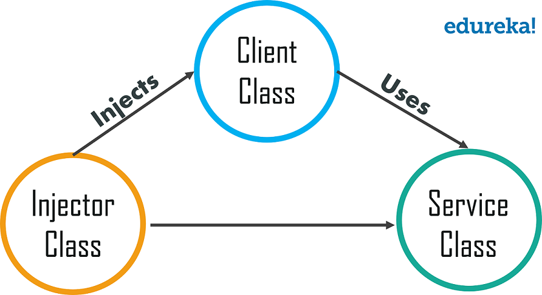
Dependency Injection - DI
Dependency injection is a programming technique that makes a class independent of its dependencies.
To implement dependency injection:
The service you want to use.
The client that use the service.
The injector which creates a service instance and injects it into the client

Slide 11
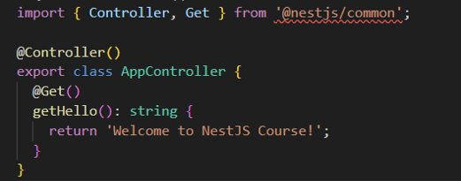
Controller & Router
Controllers are responsible for handling incoming requests and returning responses to the client.
Routing mechanism controls which controller receives which request.
NestJS use classes and decorators.
NestJS provide decorators for all HTTP methods: @Get(), @Post(), @Put(), Delete(),...

Slide 12
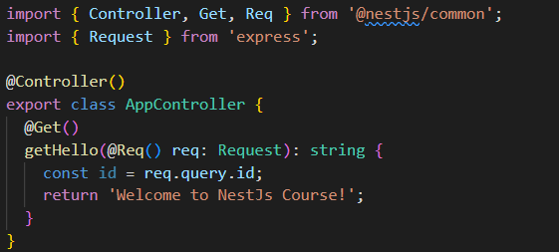
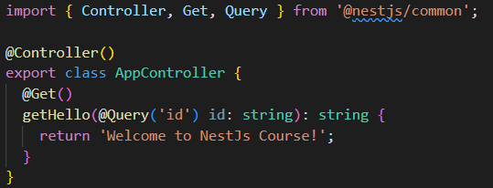
Controller & Router
Nest provides access to request object of underlying platform
Decorator | Represent
@Request(), @Req() | req
@Response(), @Res() | res
@Next() | next
@Session() | req.session
@Param(key?: string) | req.params / req.params[key]
@Body(key?: string) | req.body / req.body[key]
@Query(key?: string) | req.query / req.query[key]
@Headers(name?: string) | req.headers / req.headers[name]
@Ip() | req.ip
@HostParam() | req.hosts

Slide 13
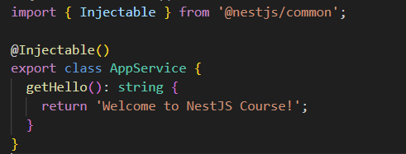
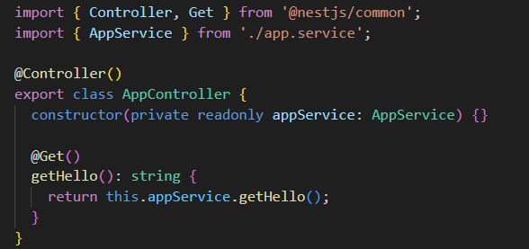
Providers
Many of NestJS classes may be treated as a provider : services, repositories, factories,…
Main idea of a provider is that it can be injected as a dependency.

Slide 14
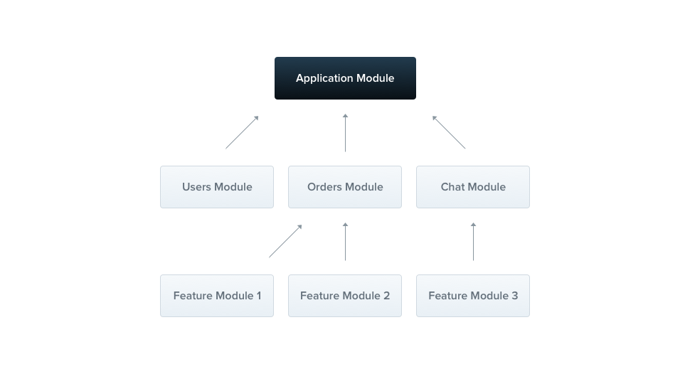
Modules
The @Module() decorator provides metadata that Nest makes use of to organize the application structure.
Each application has as least one module, a root module.

Slide 15
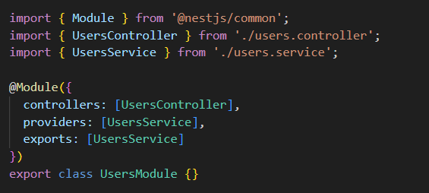
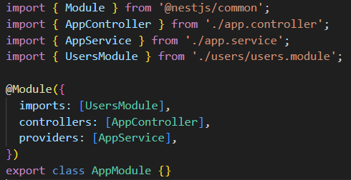
Modules
The @Module() decorator takes a single object whose properties describe the module
providers | The providers that will be instantiated by the Nest injector and that may be shared at least across this module
controllers | The set of controllers defined in this module which have to be instantiated
imports | The list of imported modules that export the providers which are required in this module
exports | The subset of providers that are provided by this module and should be available in other modules which import this module. You can use either the provider itself or just its token (provide value)

Slide 16
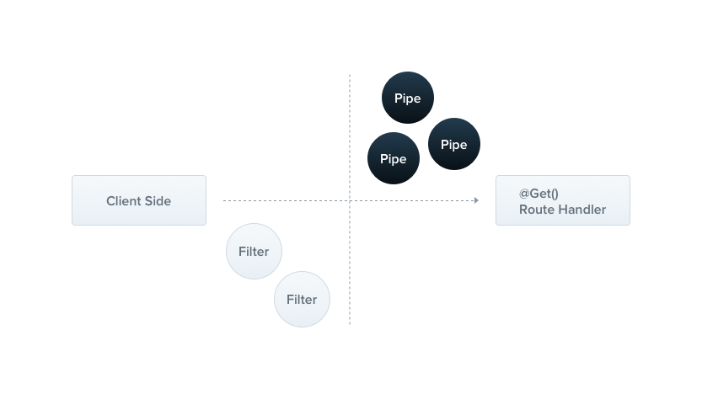
Pipes
A pipe is a class annotated with the @Injectable() decorator, which implements the PipeTransform interface.
Pipes have two typical use cases:
transformation
validation
In both case, pipes operate on the arguments being processed by a controller route handler

Slide 17
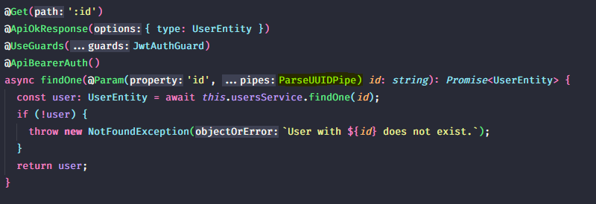
Build-in pipes
Nest comes with 9 pipes available out-of-the-box:
ValidationPipe
ParseIntPipe
ParseFloatPipe
ParseBoolPipe
ParseArrayPipe
ParseUUIDPipe
ParseEnumPipe
DefaultValuePipe
ParseFilePipe

Slide 18
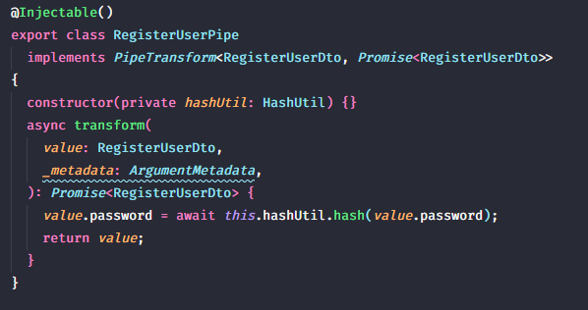
Custom pipes
Pipes implement the PipeTransform generic interface => every pipe must have a transform() method. This method will be called by NestJS to process the arguments.
The transform() method accepts two parameters :
value: the value of the processed argument.
metadata (optional): an object containing metadata about the argument.
Whatever is returned from the transform() method will be passed on to the route handler. Exceptions will be sent back to the client.

Slide 19
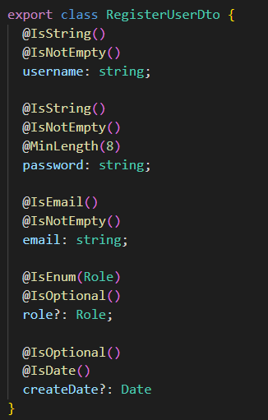
class-validator
Nest works well with the class-validator library.
This powerful library allows you to use decorator-based validation
Decorator-based validation is more powerful when combined with Nest's Pipe capabilities since we have access to the metatype of the processed property
Some validation decorators that Nest provide:
IsEnum
IsEmail
IsDate
MinLength
MaxLength

Slide 20
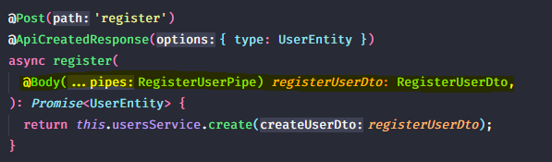
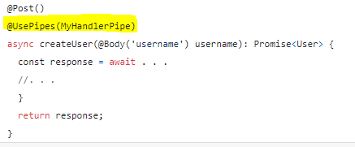
Validation Pipe Scope
Parameter-scope:
Defined at the parameter level
Only the specific parameter for which the pipe has been specified will be processed
Useful when the validation logic concerns only one specified parameter
Method/Controller-scope:
Defined at the handler level (in a controller)
Via the @UsePipes() decorator
Such pipe will process all parameters for the incoming requests.
Global-scope:
Defined at the application level
Applied to any incoming request

Slide 21
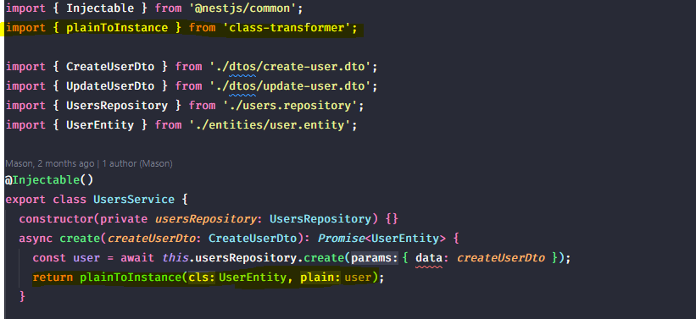
class-transformer
Allows us to make some cool data transformations of our data
It can translate a plain request object to some instance of class and versa
It allows serializing/deserializing object based on criteria
Notes:
NestJS REST API: class-validator & class-transformer | by Panos Zafeiropoulos | Medium

Slide 22
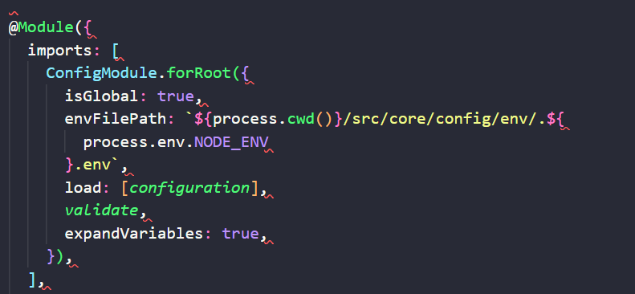
Configurations
Applications often run in different environments. Depending on the environment, different configuration settings should be used.
Externally defined environment variables are visible inside Node.js through the process.env global.
NestJS/config could solve the problem of multiple environments by setting the environment variables separately in each environment.
envFilePath: To set another path for the .env
load: To load the custom configurations file
expandVariables: allow to create nested environment variables

Slide 23
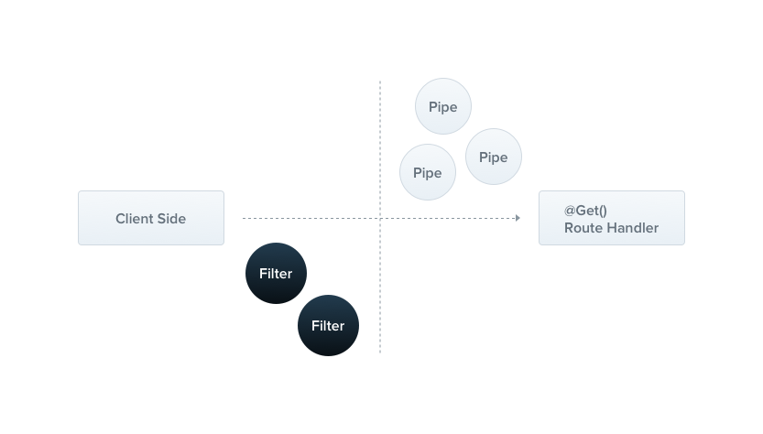
Exception Filter
Nest comes with a built-in exceptions layer which is responsible for processing all unhandled exceptions across an application.
When an exception is not handled by your application code, it is caught by this layer, which then automatically sends an appropriate user-friendly response

Slide 24
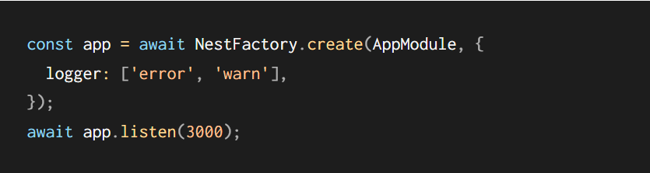
Logger
Nest comes with a built-in text-based logger which is used during application bootstrapping and several other circumstances such as displaying caught exceptions (i.e., system logging).
This functionality is provided via the Logger class in the @nestjs/common package. You can fully control the behavior of the logging system:
Disable logging entirely.
Specify the log level of detail (e.g., display errors, warnings, debug information, etc.).
Override timestamp in the default logger (e.g., use ISO8601 standard as date format).
Completely override the default logger.
Customize the default logger by extending it.
Make use of dependency injection to simplify composing and testing your application.

Slide 25
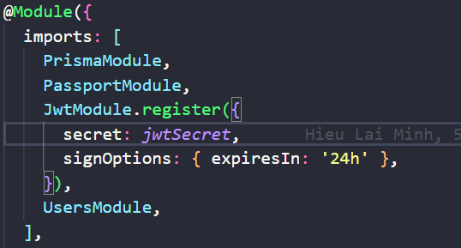
Authenticate
Authentication is an essential part of most applications. There are many different approaches and strategies to handle authentication. The approach taken for any project depends on its particular application requirements.
NestJS have provide several approaches to authentication that can be adapted to a variety of different requirements.
Example for JWT:
secret: is secret key for extract or generate jwt token
signOptions: to provide optional properties for jwt token : (expiresIn, notBefore, audience, subject, issues,...). For more

Slide 26
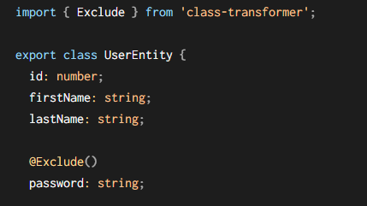
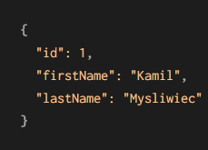
Serialization
Serialization is a process that happens before objects are returned in a network response. This is an appropriate place to provide rules for transforming and sanitizing the data to be returned to the client. For example, sensitive data like passwords should always be excluded from the response. Or, certain properties might require additional transformation, such as sending only a subset of properties of an entity.

Slide 27



Database
Nest support methods for integrating with database. Such as MikoORM, Sequelize, Knex.js, TypeORM, Prisma, Mongoose.

Slide 28
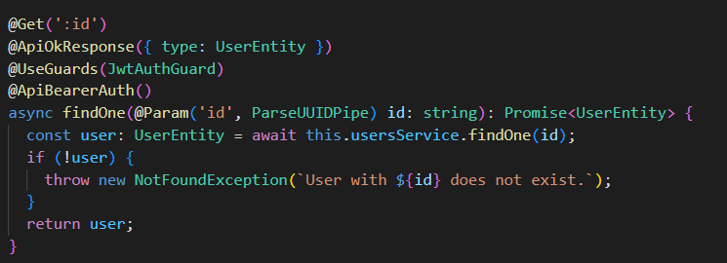
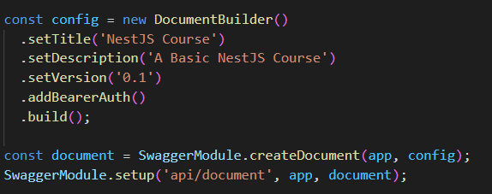
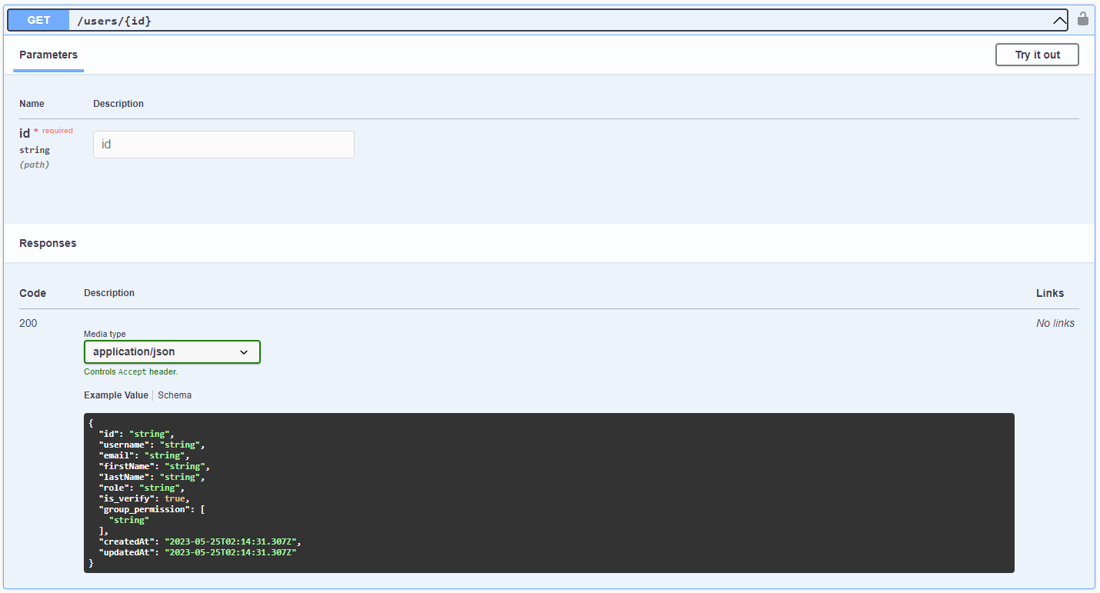
OpenAPI
NestJS provide @nestjs/swagger to generate api document

Slide 29
03
Pros & Cons

Slide 30
Pros & Cons
Pros
Cons
Powerful
Easy to understand
Good architecture
Easy to integrates with other extensions
Circular Dependency

Slide 31
Why should we use NestJS?
NestJS uses a modular architecture, which makes it easier to organize your code and reuse code across different parts of your application.
NestJS uses TypeScript, which provides optional static typing and improved code readability.
NestJS uses dependency injection, which makes it easier to manage dependencies and ensure that your application is modular and scalable.
NestJS provides built-in support for a variety of features, such as WebSockets and GraphQL, which can be especially useful for certain types of applications.

Slide 32
04
Demo

