Slide 1
Artillery

Slide 2
What is load testing?
Artillery
Comparison
Advantages & disadvantages
Examples
References

Slide 3
01
What is load testing?

Slide 4
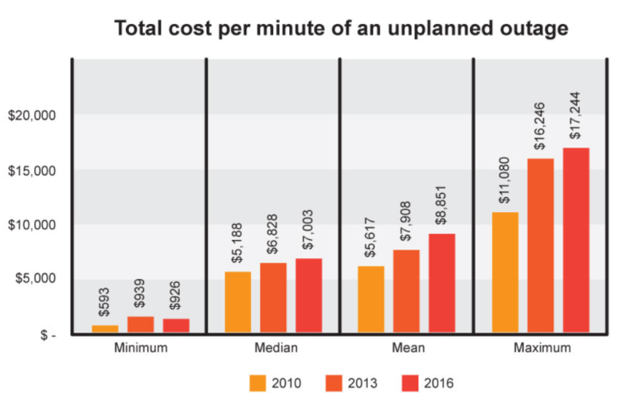
Real world scenarios
Toysrus.com could not handle the increased traffic generated by their advertising campaign resulting in loss of sales.
An Airline website was not able to handle 10000+ users during a festival offer.
Encyclopedia Britannica were not able to keep up with the onslaught of traffic for weeks after declaring free access to their online database as a promotional offer.

Slide 5

Consequences
Most users click away after 8 seconds’ delay in loading a page
$4.4 Billion lost annually due to poor performance

Slide 6
What is load testing?
Load testing is a type of performance testing that simulates a real-world load on a system or application to see how it performs under stress.
Some extremely popular sites have suffered serious downtimes when they get massive traffic volumes.
E-commerce websites invest heavily in advertising campaigns, but not in load testing to ensure optimal system performance, when that marketing brings in traffic.

Slide 7
Why load testing?
Gives confidence in the system & its reliability and performance.
Helps identify the bottlenecks in the system under heavy user stress scenarios.
Gives excellent protection against poor performance.
Accommodates complementary strategies for performance management and monitoring of a production environment.

Slide 8
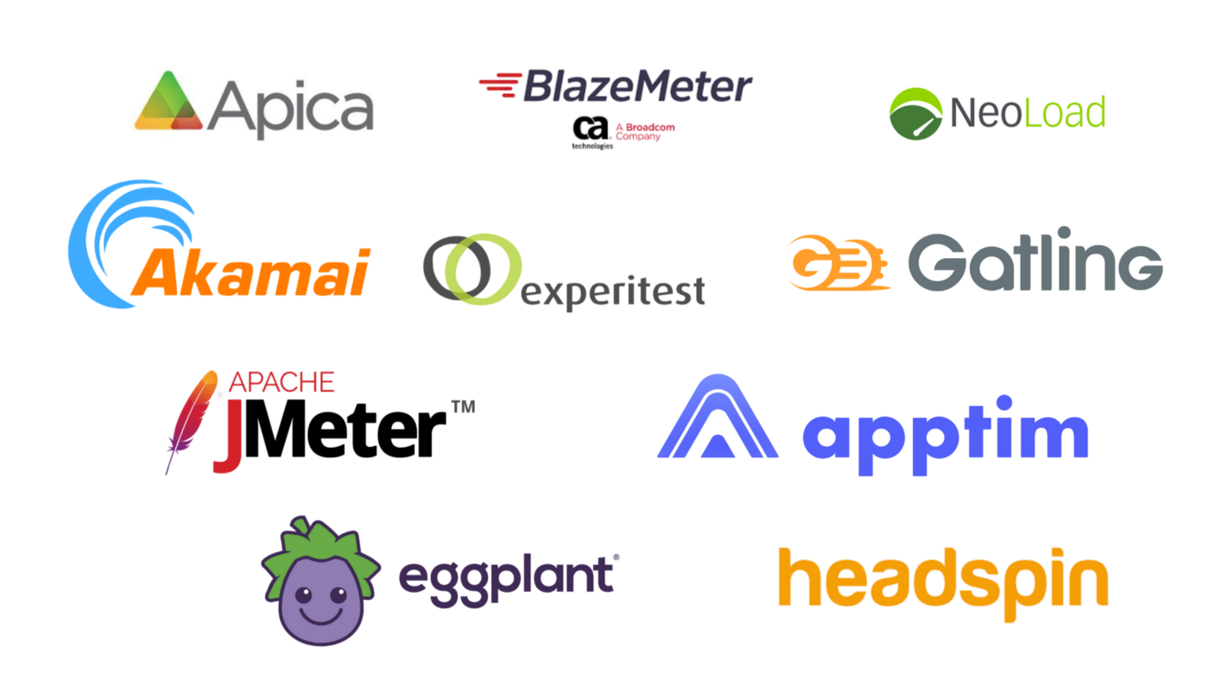
Popular load testing tools

Slide 9
02
Artillery

Slide 10

Artillery
Command-line tool purpose-built for load testing and smoke testing web applications.
Written in JavaScript.
Supports testing HTTP, Socket.io, and WebSockets APIs.

Slide 11
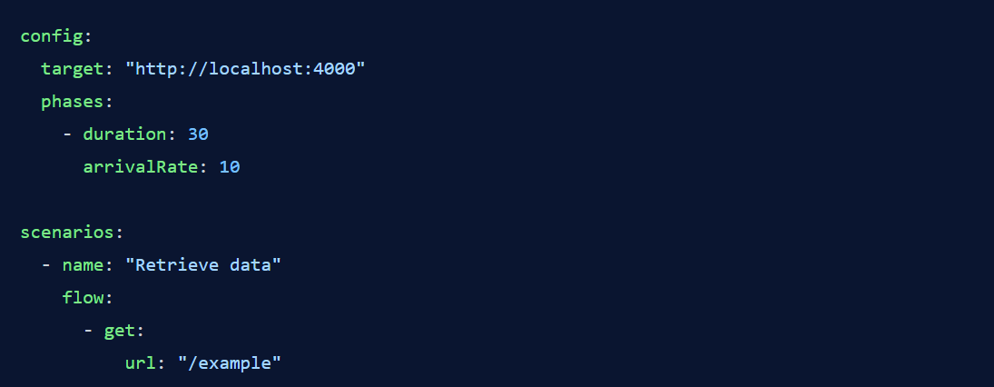
Artillery
Basic Artillery test script:

Slide 12
Artillery
target: defines the base URL for the application
phases: set up the number of virtual users generated in a period of time and how frequently these users are sent to specified endpoints
duration: determines much time virtual users will be generated for
arrivalRate: determines the number of virtual users sent to the endpoints per second
scenarios: defines the various operations that a virtual user should perform
flow: specifies the exact steps that should be executed in order

Slide 13
03
Advantages &
Disadvantages

Slide 14
References
Artillery Docs | Artillery

