Slide 1
Artillery

Slide 2
What is load testing?
Artillery
Comparison
Advantages & Disadvantages
Artillery Usage
Artillery in a CI/CD environment
References

Slide 3
01
What is load testing?

Slide 4
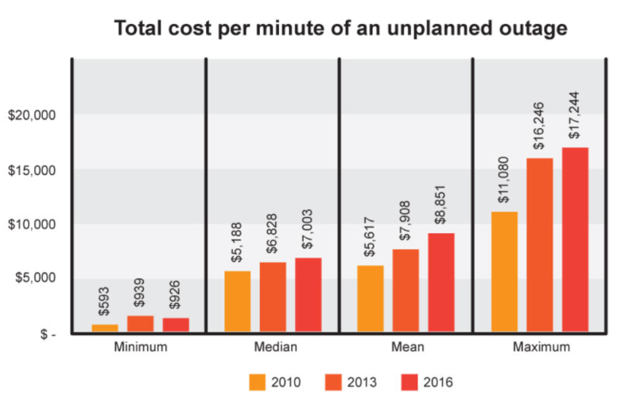
Real world scenarios
Toysrus.com could not handle the increased traffic generated by their advertising campaign resulting in loss of sales.
An Airline website was not able to handle 10000+ users during a festival offer.
Encyclopedia Britannica were not able to keep up with the onslaught of traffic for weeks after declaring free access to their online database as a promotional offer.

Slide 5

Consequences
Most users click away after 8 seconds’ delay in loading a page
$4.4 Billion lost annually due to poor performance

Slide 6
What is load testing?
Load testing is a type of performance testing that simulates a real-world load on a system or application to see how it performs under stress.
Some extremely popular sites have suffered serious downtimes when they get massive traffic volumes.
E-commerce websites invest heavily in advertising campaigns, but not in load testing to ensure optimal system performance, when that marketing brings in traffic.

Slide 7
Why load testing?
Gives confidence in the system & its reliability and performance.
Helps identify the bottlenecks in the system under heavy user stress scenarios.
Gives excellent protection against poor performance.
Accommodates complementary strategies for performance management and monitoring of a production environment.

Slide 8

Popular load testing tools

Slide 9
02
Artillery

Slide 10

Artillery
Command-line tool purpose-built for load testing and smoke testing web applications.
Written in JavaScript.
Supports testing HTTP, Socket.io, and WebSockets APIs.

Slide 11
03
Comparison

Slide 12
04
Advantages &
Disadvantages

Slide 13
05
Artillery Usage

Slide 14

Artillery Usage
Running a load test in Artillery

Slide 15
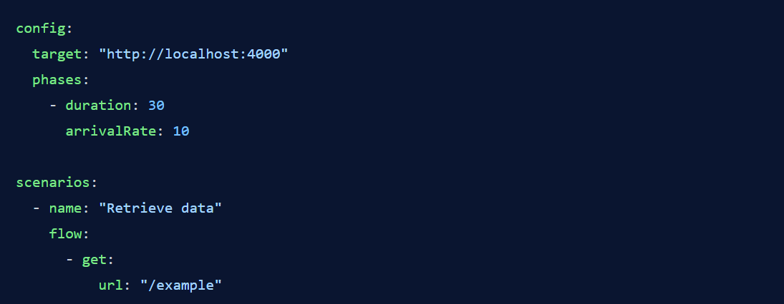
Artillery Usage
Basic Artillery test script:

Slide 16
Artillery Usage
target: defines the base URL for the application
phases: set up the number of virtual users generated in a period of time and how frequently these users are sent to specified endpoints
duration: determines much time virtual users will be generated for
arrivalRate: determines the number of virtual users sent to the endpoints per second
scenarios: defines the various operations that a virtual user should perform
flow: specifies the exact steps that should be executed in order

Slide 17
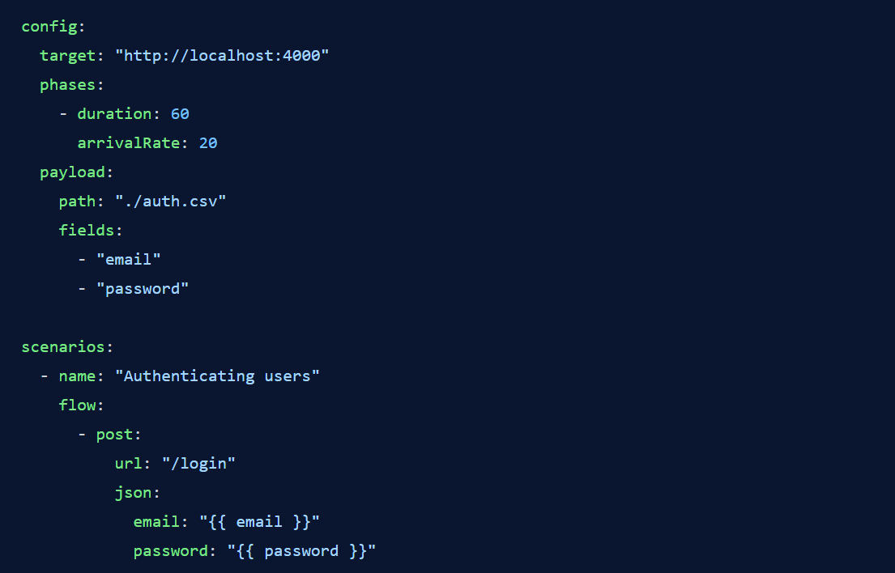
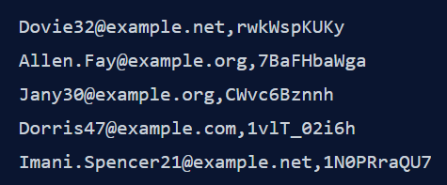
Artillery Usage
Injecting data from a payload file (CSV, plaintext file):
auth.csv

Slide 18
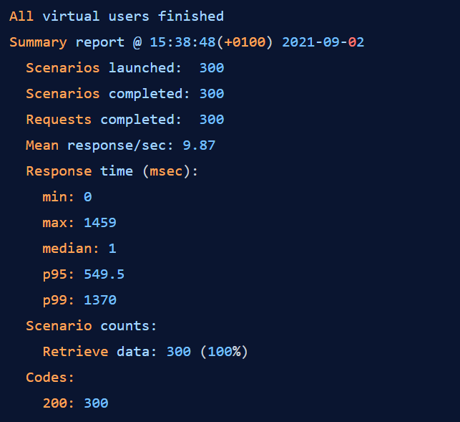
Artillery Usage
Result:

Slide 19
Artillery Usage
min: the minimum response times
max: maximum response times
median: median response times

Slide 20


Artillery Usage
Generating status reports in Artillery:
Report is placed in a test.json file in the current working directory
This JSON file can be visualized through Artillery's online report viewer or converted into an HTML report through the report subcommand:

Slide 21
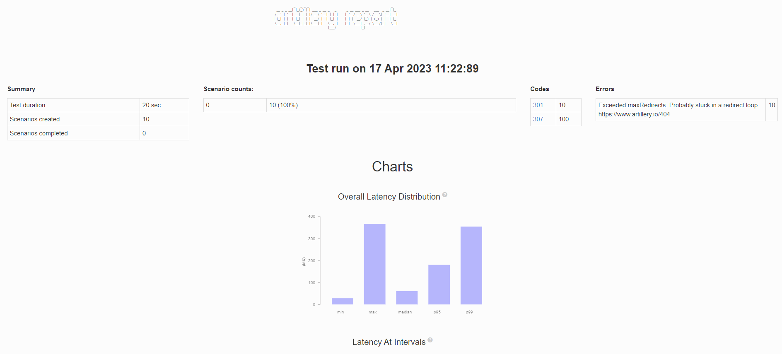
Artillery Usage
Artillery report:

Slide 22
05
Artillery in a
CI/CD environment

Slide 23
Artillery in a CI/CD environment
Set failure conditions that cause the program to exit
Abort if performance objectives are not met

Slide 24
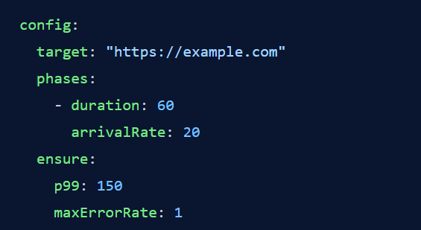
Artillery in a CI/CD environment
Artillery provides support for this use case through its config.ensure property
The setting to assert that 99% of all requests have an aggregate response time of 150 milliseconds or less and that 1% or less of all requests are allowed to fail

Slide 25
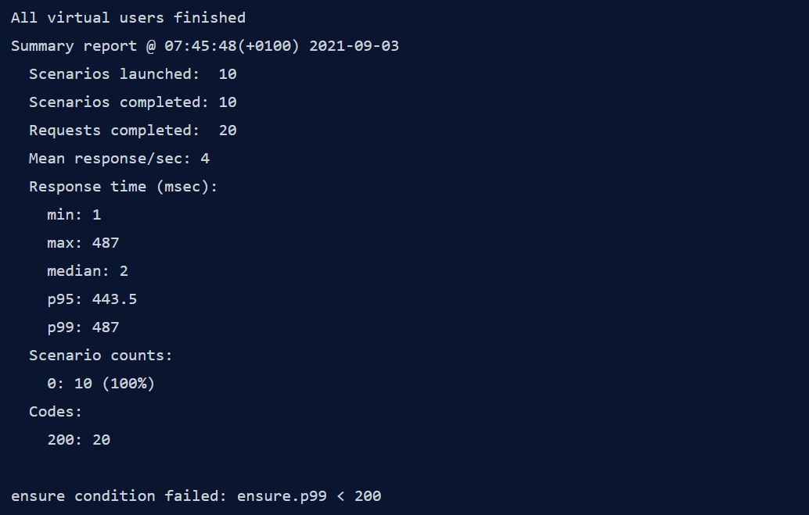
Artillery in a CI/CD environment
It will continue as before, except that assertions are verified at the end of the test and cause the program to exit

Slide 26
References
Artillery Docs | Artillery

