Slide 1
Vite.js

Slide 2
What is a module bundler?
Vite.js
Advantages & disadvantages
Creating a Vite project
References

Slide 3
01
What is a module bundler?

Slide 4
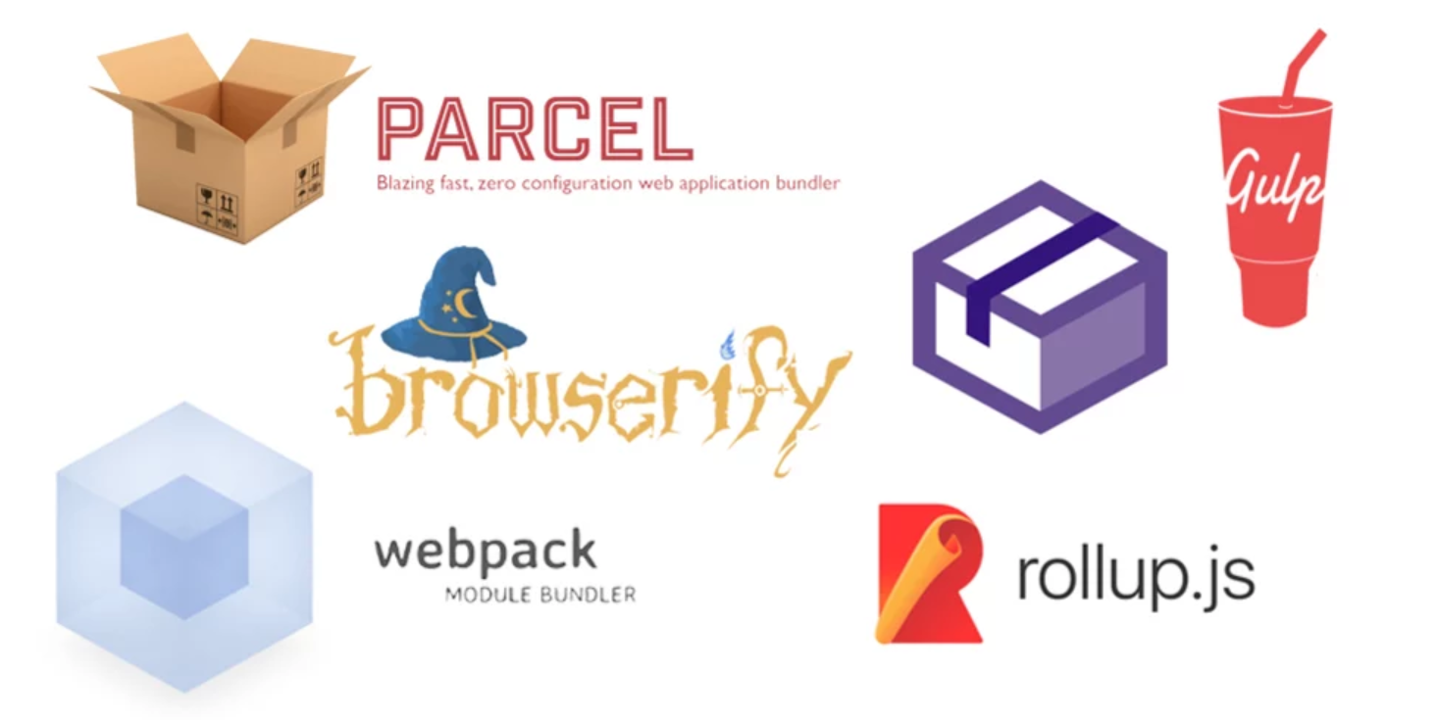
What is a module bundler?
A bundler is a development tool that combines many JavaScript code files into a single one that is production-ready loadable in the browser.

Slide 5
What is a module bundler?
Keeps track dependencies
Modular code
Easy to maintain

Slide 6
02
Vite.js

Slide 7

Vite.js
Vite (French: [vit], like "veet")
Written by Evan You (2020)
Used by default in Vue project templates
TypeScript & TSX support
Support for Hot Module Replacement (HMR)
Link: github.com/vitejs/vite

Slide 8
Vite.js
Application divided into 2 parts:
Dependencies: plain JavaScript that will not change much during development
Source code: JSX, CSS, Vue/React and other components that require conversion

Slide 9
Vite.js
Dependencies:
Pre-bundling: code to be split into dependencies is converted from CommonJS or UMD to ESM
Pre-bundling uses esbuild (10 to 100 times faster than JavaScript-based bundling)

Slide 10
Vite.js
Source code:
Vite will only convert source code and serve it using native ESMs upon browser request.

Slide 11
Vite.js
Hot Module Replacement (HMR):
Replacing only the modules that have changed, rather than reloading the entire application

Slide 12
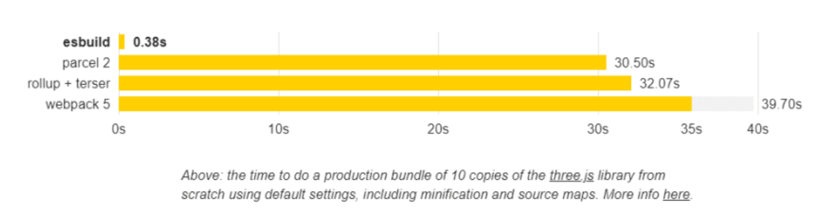
Vite.js
Bundles dependencies 10-100x faster than other JavaScript-based bundlers
Vishnu Sivan (dev.to)

Slide 13
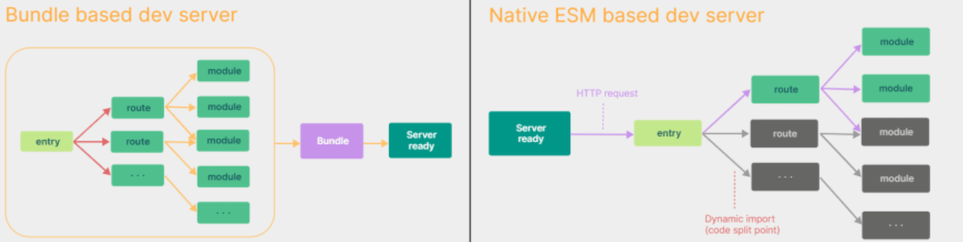
Vite.js
Native ES modules
Webpack bundles the entire project
Vite only bundles needed pages
Vishnu Sivan (dev.to)

Slide 14
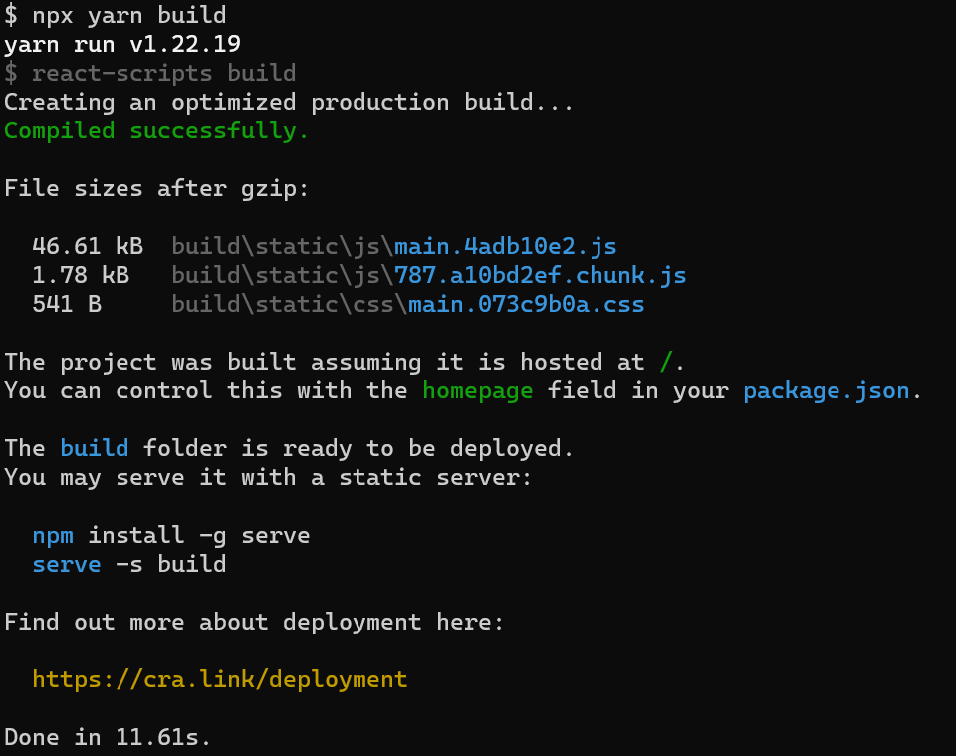
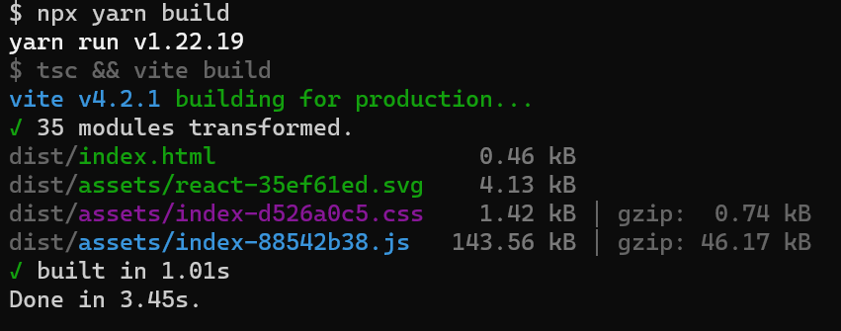
Vite.js
Performance comparison
Create React App (11.61s)
Vite (3.45s)

Slide 15
03
Advantages &
Disadvantages

Slide 16
Advantages
Provides lightning-fast start-ups
Sass, Less and Stylus support
Multi-page support
Offers templates for React, Vue, Svelte, Lit and Vanilla

Slide 17
Disadvantages
Limited browser compatibility
Small community
Using different bundlers for the dev and prod environment could result in bugs
Lack of Jest support

Slide 18
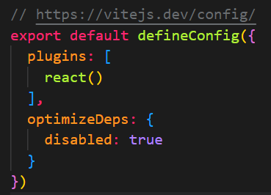
Disadvantages
By default, esbuild is used for the development, while the production bundle is built using Rollup
Solution:
Disable dependencies optimizations

Slide 19
02
Create a Vite project

Slide 20
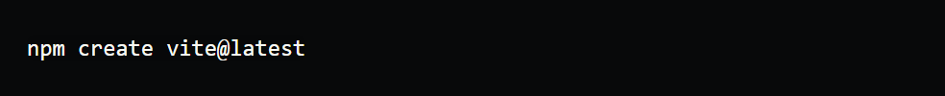
Create a Vite project
Requirements:
Node.js 12.2+
npm or yarn
Run the following command:

Slide 21

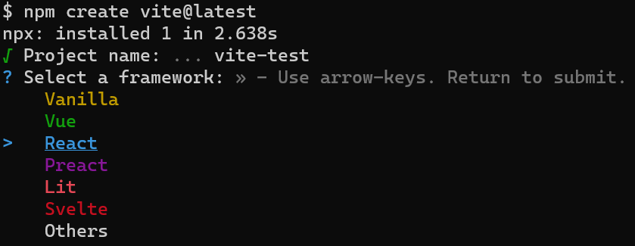
Create a Vite project
Enter your project name:
Choose a framework:

Slide 22
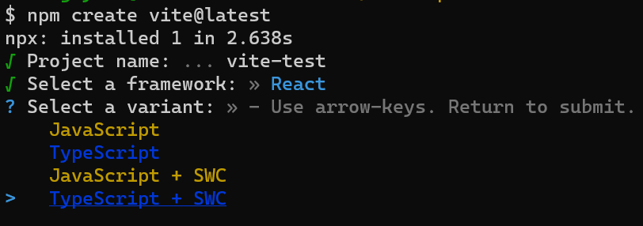
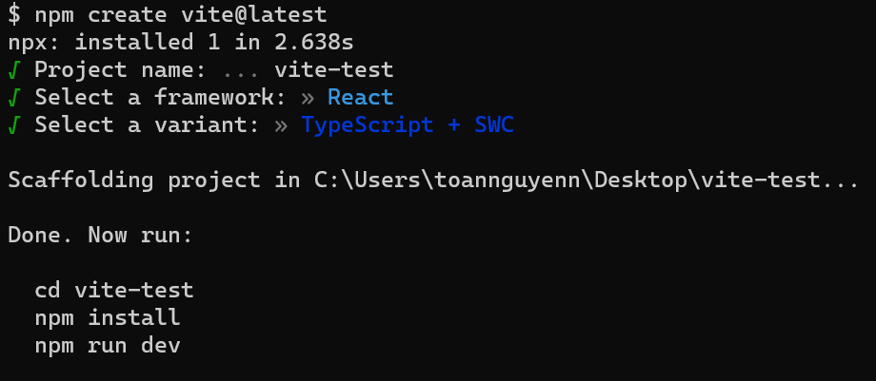
Create a Vite project
Choose a variant (SWC stands for Speedy Web Compiler, a Rust-based bundler):
Run the following command:

Slide 23
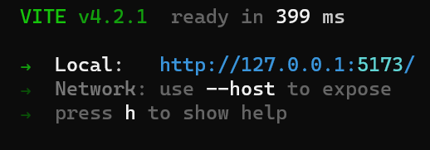
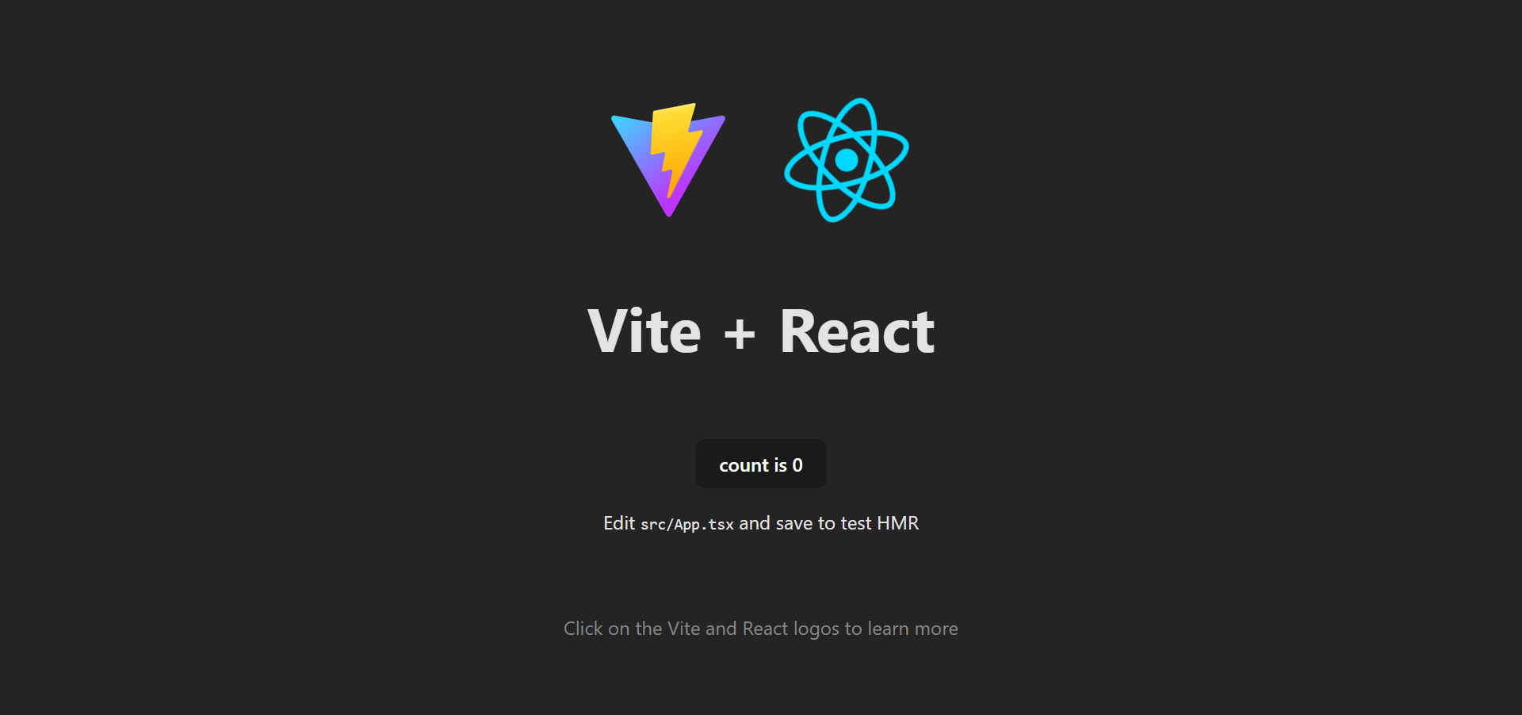
Create a Vite project
The project is ready in 399ms

Slide 24
References
Vite | Next Generation Frontend Tooling (vitejs.dev)
Learn Vite with Evan You - YouTube

