Slide 1
Vite.js

Slide 2
What is a module bundler?
Vite.js
Advantages & disadvantages
Creating a Vite project
Refereces

Slide 3
01
What is a module bundler?

Slide 4

What is a module bundler?
A bundler is a development tool that combines many JavaScript code files into a single one that is production-ready loadable in the browser.

Slide 5
What is a module bundler?
Keeps track dependencies
Modular code
Easy to maintain

Slide 6
02
Vite.js

Slide 7

Vite.js
Vite (French: [vit], like "veet")
Written by Evan You (2020)
Used by default in Vue project templates
TypeScript & TSX support
Link: github.com/vitejs/vite

Slide 8
Vite.js
Support for Hot Module Replacement (HMR)
Vite 4.0 now uses Rollup 3.0 at build time
Vite 4.0: adds support for SWC, a Rust-based bundler that claims speed improvement over Babel

Slide 9
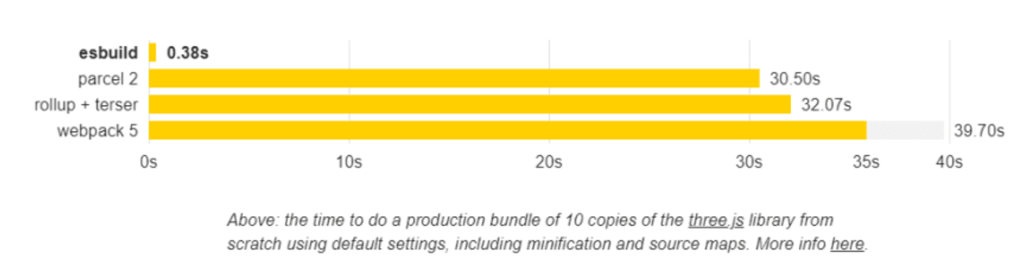
Vite.js
Bundles dependencies 10-100x faster than other JavaScript-based bundlers
Vishnu Sivan (dev.to)

Slide 10
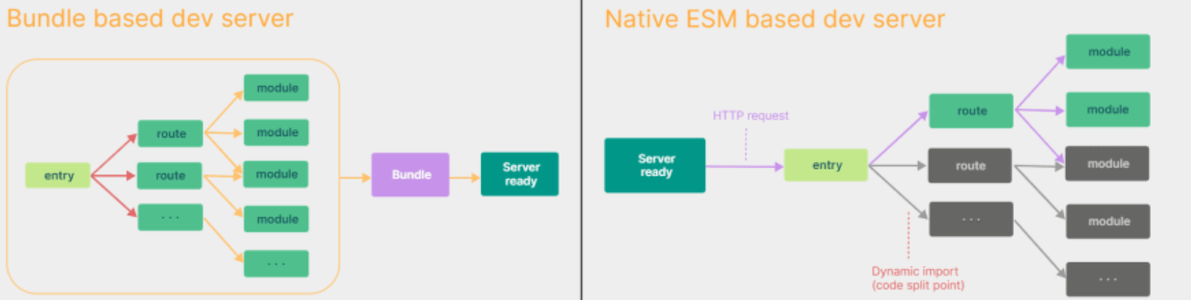
Vite.js
Native ES modules
Webpack bundles the entire project
Vite only bundles needed pages
Vishnu Sivan (dev.to)

Slide 11
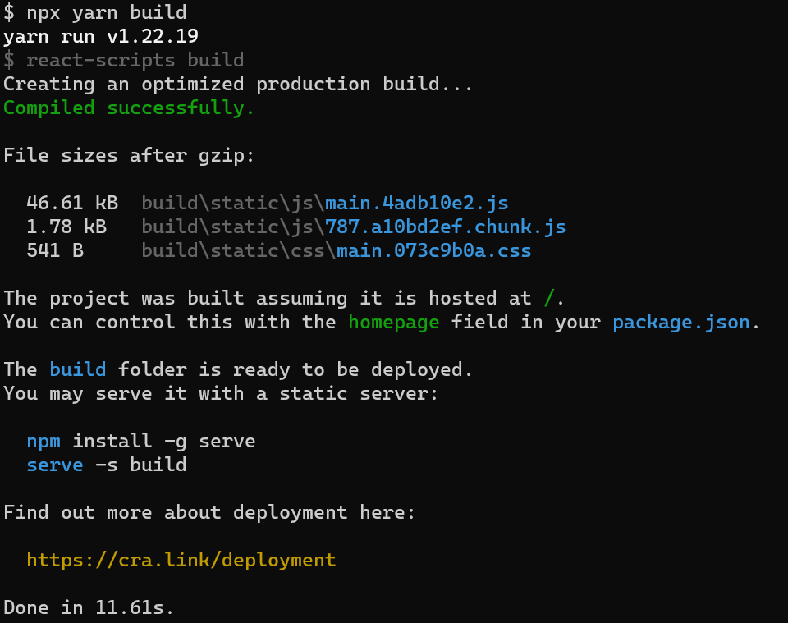
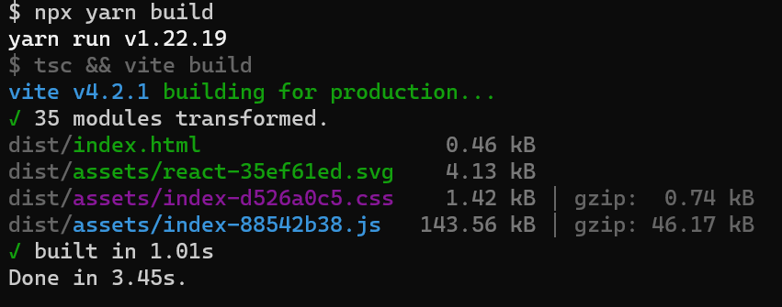
Vite.js
Performance comparison
Create React App (11.61s)
Vite (3.45s)

Slide 12
03
Advantages &
Disadvantages

Slide 13
Advantages
Provides lightning-fast start-ups
Sass, Less and Stylus support
Multi-page support
Offers templates for React, Vue, Svelte, Lit and Vanilla

Slide 14
Disadvantages
Limited browser compatibility
Small community
Using different bundlers for the dev and prod environment could result in bugs
Lack of Jest support

Slide 15
02
Create a Vite project

Slide 16
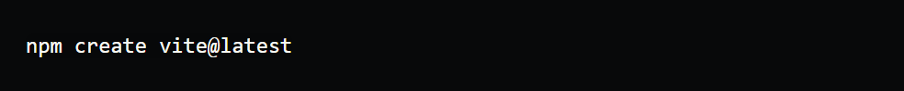
Create a Vite project
Requirements:
Node.js 12.2+
npm or yarn
Run the following command:

Slide 17

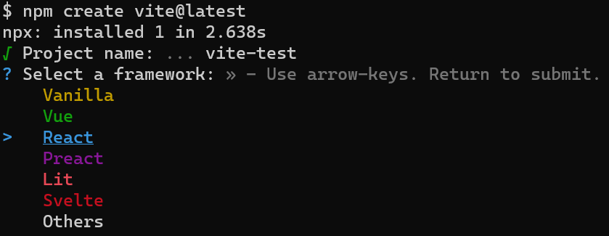
Create a Vite project
Enter your project name:
Choose a framework:

Slide 18
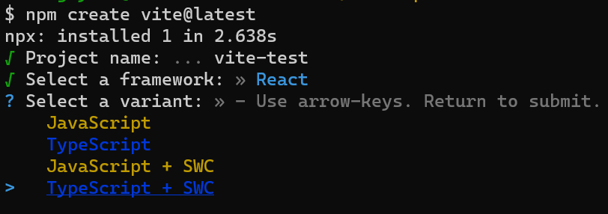
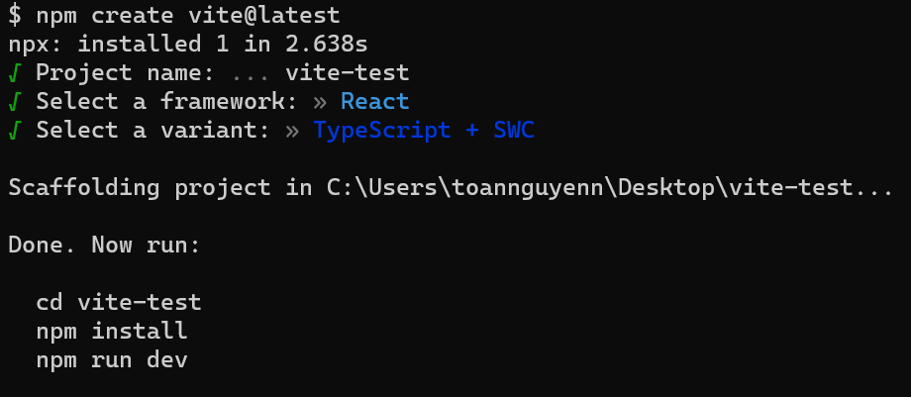
Create a Vite project
Choose a variant (SWC stands for Speedy Web Compiler, a Rust-based bundler):
Run the following command:

Slide 19
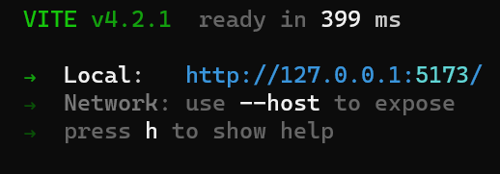

Create a Vite project
The project is ready in 399ms

Slide 20
References
Vite | Next Generation Frontend Tooling (vitejs.dev)
Learn Vite with Evan You - YouTube

