Slide 1
AWS App Runner
Deploy containerized web applications and APIs at scale
NashTech
Jul 2023

Slide 2
Why AWS App Runner?
What is AWS App Runner?
AWS App Runner Pricing

Slide 3
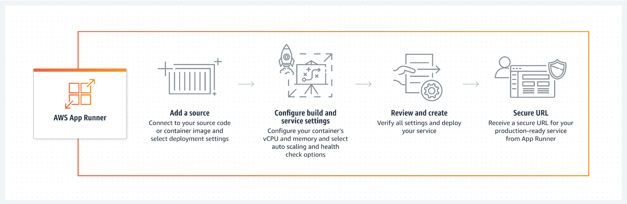
Why AWS App Runner?
AWS App Runner is a fully managed container application service
Build and run secure web applications at scale without prior container or infrastructure experience.
Scale your applications cost-effectively, with high availability and low latency.
Meet your infrastructure and compliance requirements while staying focused on your application.
Connect to AWS database, cache, and message queue services that support your applications.

Slide 4
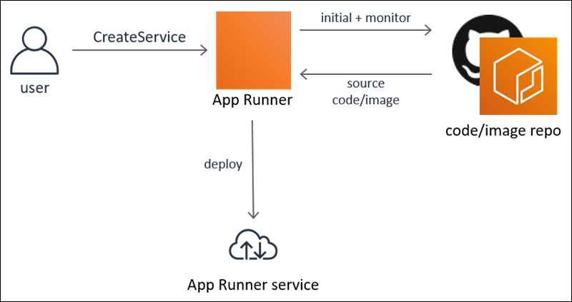
What is AWS App Runner?
AWS App Runner is an AWS service that provides a fast, simple, and cost-effective way to directly deploy from source code or a container image to a scalable and secure web application.
You don't need to learn new technologies, decide which compute service to use, or know how to provision and configure AWS resources.
App Runner connects directly to your code or image repository.
It provides an automatic integration and delivery pipeline with fully managed operations, high performance, scalability, and security.

Slide 5
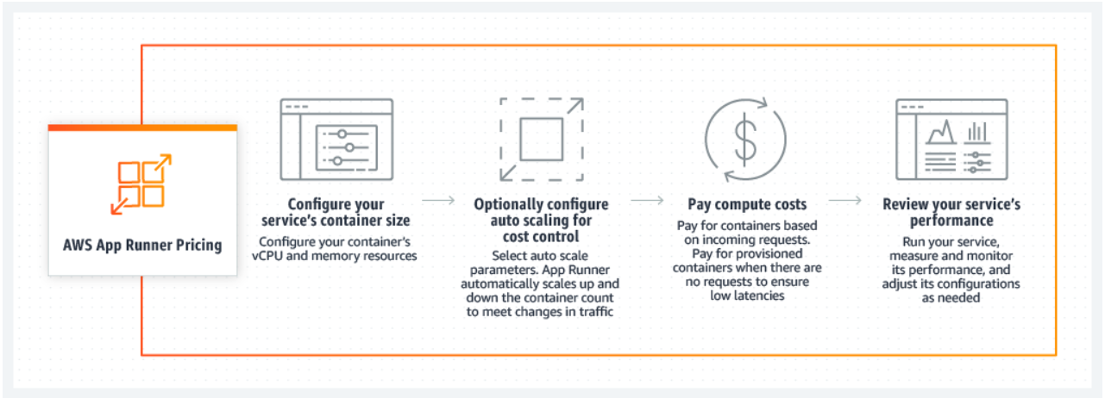
AWS App Runner Pricing

Slide 6
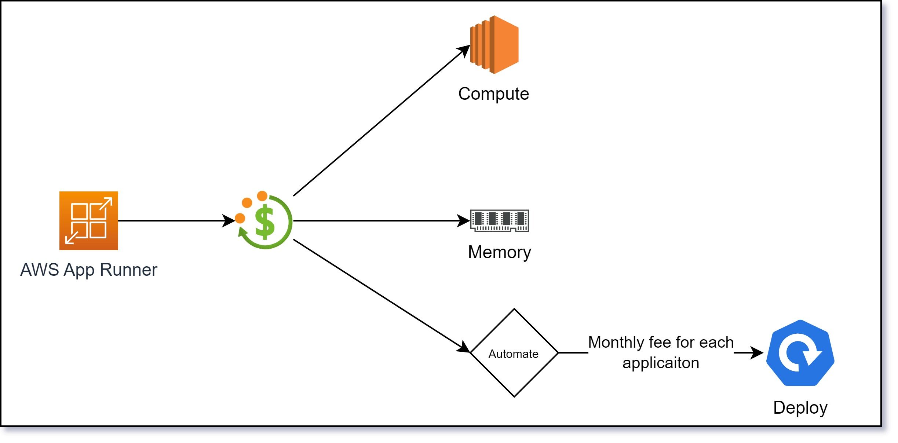
AWS App Runner Pricing (2)
You are charged for the compute and memory resources used by your application
if you automate your deployments, you will pay a monthly fee for each application that covers all automated deployments for that month.
If you opt to deploy from the source code, you will pay a build fee for the time it takes App Runner to build a container from your source code.

Slide 7
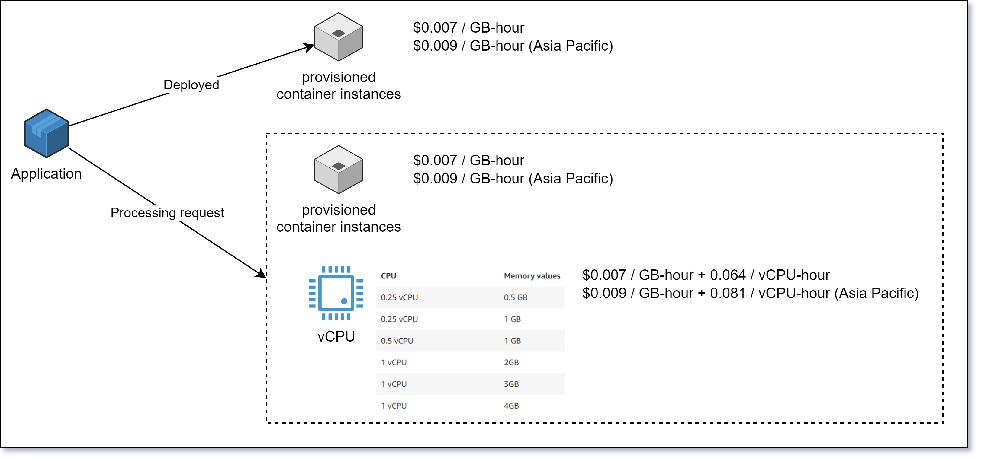
AWS App Runner Pricing (3)

Slide 8
Comparing Deployment by EC2 and App Runner
AWS App Runner
EC2
Don’t need to know about Docker, Auto Scaling, Security, Networking, Observability.
Easy to configure service to run and build step by step.
Easy to target CPU and Memory to run.
Need to know about Docker. Manually configure Auto Scaling, Security, Networking, and Observability.
Need to have CI/CD process to build and run. We need to know how to deploy to EC2.
Must have knowledge and script to choose correctly which needed EC2.

