Slide 1
Monitoring with Prometheus and Grafana – Hands On
Ninh.Nguyen
2nd Aug 2023

Slide 2
Prometheus and Grafana Intro
Prometheus Operator
Installation with Helm
Prometheus Scrape Configuration
ScrapeConfig vs ServiceMonitor
ServiceMonitor setup
Grafana Dashboard
Visualize metric on dashboard
Connect Grafana with Cloudwatch
AlertManager vs Grafana Alerts
Slack Notification with AlertManager
Slack Notification with Grafana Alerts
Prometheus Adapter
Setup custom rule for Prometheus Adapter
HPA Scale based on custom-metric

Slide 3
Prometheus and Grafana Intro

Slide 4
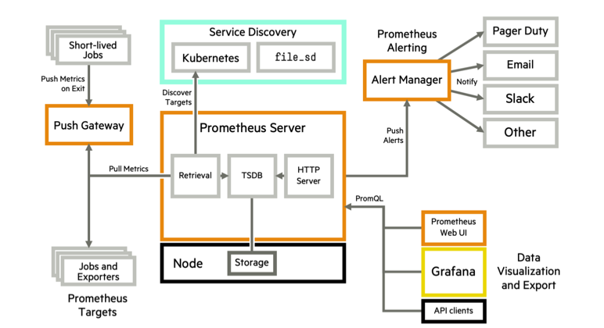
Prometheus and Grafana Intro
Prometheus and Grafana Overview
Notes:
Prometheus is an open-source systems monitoring and alerting toolkit originally built at SoundCloud. Prometheus joined the Cloud Native Computing Foundation in 2016 as the second hosted project.
Grafana is open source visualization and analytics software. It allows you to query, visualize, alert on, and explore your metrics no matter where they are stored.
Prometheus and Grafana Use Cases: Microservices and Kubernetes
Alternatives for Prometheus and Grafana: InfluxDB & Graphite
The Prometheus servers need as much target auto discovery as possible. There are several options to achieve this:
Prometheus Kubernetes SD (service discovery)
The Prometheus operator and its Custom Resource Definitions
Consul SD
Azure SD for Azure VM
GCE SD for GCP instances
EC2 SD for AWS VM
File SD
Apart from application metrics, we want Prometheus to collect metrics related to the Kubernetes services, nodes, and orchestration status.
Node exporter for the classical host-related metrics: cpu, mem, network, etc.
Kube-state-metrics for orchestration and cluster level metrics: deployments, pod metrics, resource reservation, etc.
Kubernetes control plane metrics: kubelet, etcd, dns, scheduler, etc.
Prometheus can configure rules to trigger alerts using PromQL. alertmanager will be in charge of managing alert notification, grouping, inhibition, etc.
The AlertManager component configures the receivers and gateways to deliver alert notifications.
Grafana can pull metrics from any number of Prometheus servers and display panels and Dashboards.

Slide 5
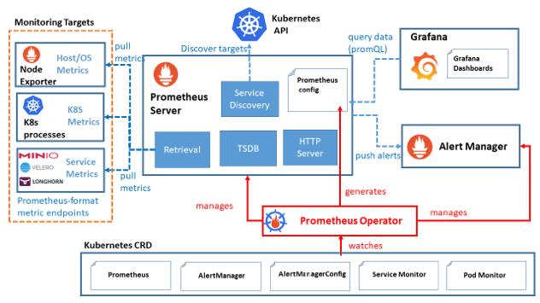
Prometheus and Grafana Intro
Prometheus Operator
Notes:
Custom Resource Definition (CRD) resource is a way to define your own resource kind like Deployment, StatefulSet etc. CRDs define the structure and validation of the custom kind.
Custom Resource (CR) are the resources that are created by following the structure from a Custom Resource Definition (CRD).
Custom Controller makes sure that our Kubernetes cluster or application always matches its current state with the desired state that we expect it to.
So, Operator is a set of Kubernetes custom controllers that we deploy in the cluster. These listen for changes in the custom resources owned by them (those which we have created using CRDs), and perform certain actions like creating, modifying, deleting Kubernetes resources.
Prometheus Operator is a fully automated way of deploying (like any other standard Kubernetes Deployment object) Prometheus server, Alertmanager and all the related secrets, configmap etc…

Slide 6
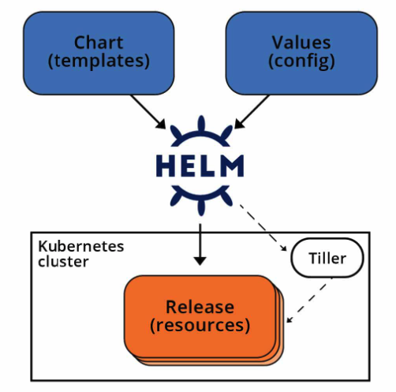
Prometheus and Grafana Intro
Install with Helm
Helm is an open-source graduated CNCF project originally created by DeisLabs as a third-party utility, now known as the package manager for Kubernetes.
A Helm chart is a set of YAML manifests and templates that describes Kubernetes resources (Deployments, Secrets, CRDs, etc.) and defined configurations needed for the Kubernetes application
Notes:
Helm is a tool that automates the creation, packaging, configuration, and deployment of Kubernetes applications by combining your configuration files into a single reusable package.

Slide 7
Prometheus and Grafana Intro
helm repo add prometheus-community https://prometheus-community.github.io/helm-charts
helm repo add stable https://charts.helm.sh/stable
helm repo update
helm search repo prometheus |egrep "stack|CHART"
###NAME CHART VERSION APP VERSION DESCRIPTION
###prometheus-community/kube-prometheus-stack 48.1.1 v0.66.0 kube-prometheus-stack collects Kubernetes manif...
###prometheus-community/prometheus-stackdriver-exp... 4.3.0 0.13.0 Stackdriver exporter for Prometheus
###grafana/loki-stack 2.9.10 v2.6.1 Loki: like Prometheus, but for logs.
helm pull prometheus-community/kube-prometheus-stack --version 48.1.1
tar -xzf kube-prometheus-stack-48.1.1.tgz
cp kube-prometheus-stack/values.yaml ./kube-prometheus-stack-values.yaml
Install with Helm
Notes:
Helm is a tool that automates the creation, packaging, configuration, and deployment of Kubernetes applications by combining your configuration files into a single reusable package.

Slide 8
Prometheus and Grafana Intro
Set following parameters in ./kube-prometheus-stack-values.yaml:
prometheus:
prometheusSpec:
podMonitorSelectorNilUsesHelmValues: false
serviceMonitorSelectorNilUsesHelmValues: false
ruleSelectorNilUsesHelmValues: false
###the known issue: https://github.com/helm/charts/issues/11310
###Install with following command:
helm -n monitoring upgrade prometheus-grafana-stack --install -f kube-prometheus-stack-values.yaml kube-prometheus-stack
###For the next time update the configuration:
helm -n monitoring upgrade prometheus-grafana-stack -f kube-prometheus-stack-values.yaml kube-prometheus-stack
Install with Helm
Notes:
Helm is a tool that automates the creation, packaging, configuration, and deployment of Kubernetes applications by combining your configuration files into a single reusable package.
Share screen to show up the demo terminal….

Slide 9
Prometheus and Grafana Intro
Install with Helm
Notes:
Helm is a tool that automates the creation, packaging, configuration, and deployment of Kubernetes applications by combining your configuration files into a single reusable package.
Share screen to show up the demo terminal….

Slide 10
Prometheus Scrape Config
Notes:
The Prometheus servers need as much target auto discovery as possible. There are several options to achieve this:
Prometheus Kubernetes SD (service discovery)
The Prometheus operator and its Custom Resource Definitions
Consul SD
Azure SD for Azure VM
GCE SD for GCP instances
EC2 SD for AWS VM
File SD
Apart from application metrics, we want Prometheus to collect metrics related to the Kubernetes services, nodes, and orchestration status.
Node exporter for the classical host-related metrics: cpu, mem, network, etc.
Kube-state-metrics for orchestration and cluster level metrics: deployments, pod metrics, resource reservation, etc.
Kubernetes control plane metrics: kubelet, etcd, dns, scheduler, etc.
Prometheus can configure rules to trigger alerts using PromQL. alertmanager will be in charge of managing alert notification, grouping, inhibition, etc.
The AlertManager component configures the receivers and gateways to deliver alert notifications.
Grafana can pull metrics from any number of Prometheus servers and display panels and Dashboards.
https://sysdig.com/blog/kubernetes-monitoring-prometheus/

Slide 11
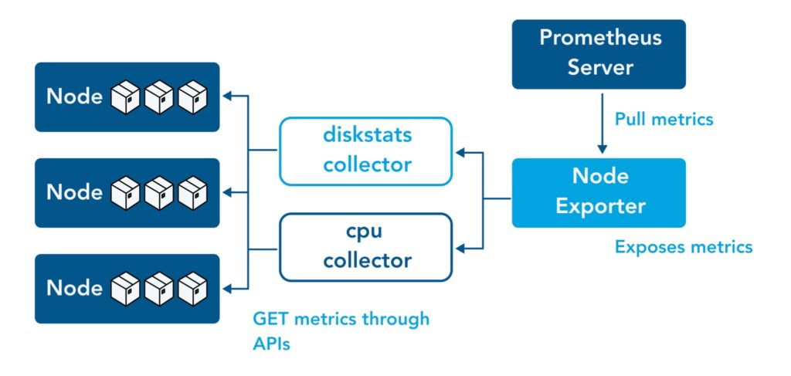
Prometheus Scrape Config
Prometheus Exporter
A Prometheus Exporter can fetch statistics from an application in the format used by that system (i.e. XML), convert those statistics into metrics that Prometheus can utilize, and then expose them on a Prometheus-friendly URL. There is a vast library of applications that can export metrics from third parties and transform them into Prometheus metrics
Notes:
Share screen to show up the demo terminal….
https://prometheus.io/docs/instrumenting/exporters/#http
The Prometheus servers need as much target auto discovery as possible. There are several options to achieve this:
Prometheus Kubernetes SD (service discovery)
The Prometheus operator and its Custom Resource Definitions
Consul SD
Azure SD for Azure VM
GCE SD for GCP instances
EC2 SD for AWS VM
File SD
Apart from application metrics, we want Prometheus to collect metrics related to the Kubernetes services, nodes, and orchestration status.
Node exporter for the classical host-related metrics: cpu, mem, network, etc.
Kube-state-metrics for orchestration and cluster level metrics: deployments, pod metrics, resource reservation, etc.
Kubernetes control plane metrics: kubelet, etcd, dns, scheduler, etc.
Prometheus can configure rules to trigger alerts using PromQL. alertmanager will be in charge of managing alert notification, grouping, inhibition, etc.
The AlertManager component configures the receivers and gateways to deliver alert notifications.
Grafana can pull metrics from any number of Prometheus servers and display panels and Dashboards.
https://sysdig.com/blog/kubernetes-monitoring-prometheus/

Slide 12
Prometheus Scrape Config
scrapeConfig vs ServiceMonitor
A scrape_config specifies a set of targets and configuration parameters describing how to scrape them. In this case, for each target; one scrape configuration block needs to be
A ServiceMonitor lets us create a job entry in scrape_config in an easier Kubernetes-native way. Internally Prometheus Operator translates the configuration from each ServiceMonitor resource to prometheus.yaml’s scrape_config section.
ServiceMonitor is suitable if you already have a Service for your pods. However, if in a certain scenario, you don’t have it, then PodMonitor is the right choice
Notes:
Share screen to show up the demo terminal….

Slide 13
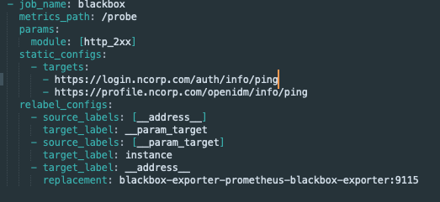
Prometheus Scrape Config
scrapConfig setup
Notes:
Share screen to show up the demo terminal….
Blackbox Exporter is a probing exporter that allows monitoring network endpoints using HTTP, HTTPS, DNS, ICMP, or TCP protocols. It generates multiple metrics on your configured targets, like general endpoint status, response time, redirect information, or certificate expiration dates.

Slide 14
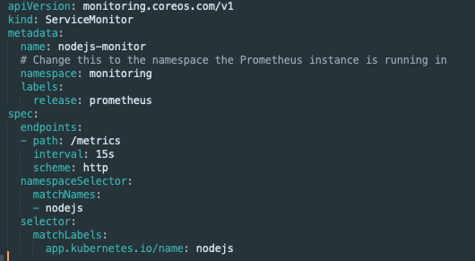
Prometheus Scrape Config
serviceMonitor setup
Notes:
Share screen to show up the demo terminal….

Slide 15
Grafana Dashboard

Slide 16
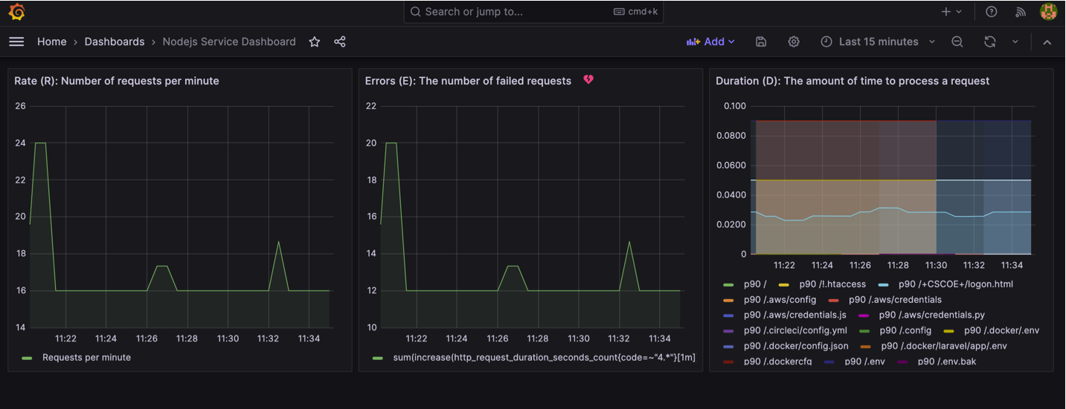
Grafana Dashboard
Dashboard setup
Notes:
Helm is a tool that automates the creation, packaging, configuration, and deployment of Kubernetes applications by combining your configuration files into a single reusable package.
Share screen to show up the demo terminal….

Slide 17
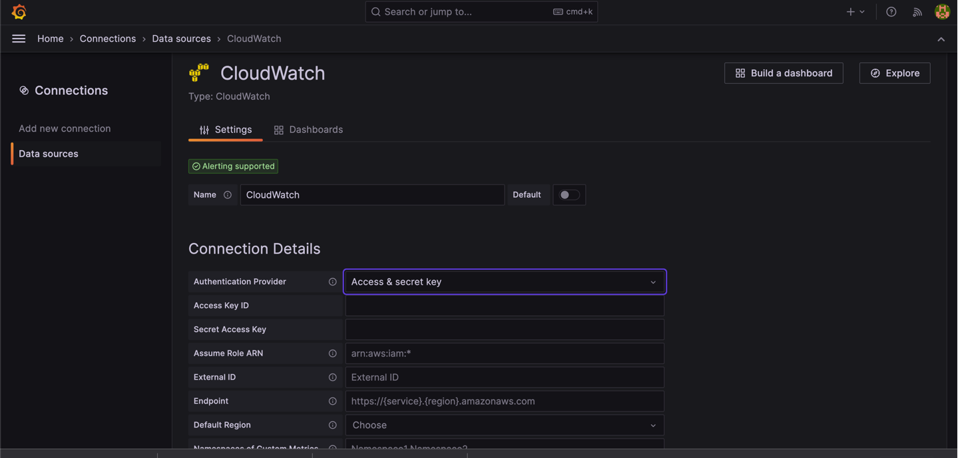
Grafana Dashboard
Cloudwatch - Data Source setup
Notes:
To Retrive all metrics on AWS Cloudwatch we can use 02 option:
YACE exporter → PrometheUS
https://aws.amazon.com/blogs/opensource/monitor-aws-services-used-by-kubernetes-with-prometheus-and-promcat/
Cloudwatch datasource → Grafana
Share screen to show up the demo terminal….

Slide 18
AlertManager vs Grafana Alerts

Slide 19
AlertManager vs Grafana Alerts
Slack Notification with AlertManager
Setup Webhook URL
Update Alertmanger config
Update Prometheus Rules to fire an alert
Notes:
Helm is a tool that automates the creation, packaging, configuration, and deployment of Kubernetes applications by combining your configuration files into a single reusable package.
Share screen to show up the demo terminal….

Slide 20
AlertManager vs Grafana Alerts
Slack Notification with Grafana Alert
Setup alert rules
Set Notification policy
Notes:
Helm is a tool that automates the creation, packaging, configuration, and deployment of Kubernetes applications by combining your configuration files into a single reusable package.
Share screen to show up the demo terminal….

Slide 21
Prometheus Adapter

Slide 22
Prometheus Adapter
Setup custom rule for Prometheus Adapter
Metric server in Kubernetes: 03 types
Setup custom rule to monitor custom_metric from Application
Notes:
Share screen to show up the demo terminal….
###show all kind of metric servers:
kubectl -n monitoring get apiservice

Slide 23
Prometheus Adapter
HPA Scale based on custom-metric
Setup HPA with custom_metric
Trigger load test to demonstrate the Pod scaling
Notes:
Helm is a tool that automates the creation, packaging, configuration, and deployment of Kubernetes applications by combining your configuration files into a single reusable package.
Share screen to show up the demo terminal….

Slide 24
Any Questions…?

