Slide 1
Software Testing Recap in Java and Python for Software Testing
Prepared by Chala Urgessa

Slide 2
Overall Marking Schema
Attendance | Assignment 1 | Assignment 2 | Final Project
10% | 20% | 20% | 50%
Bonus for the Class Participation
upto 20%

Slide 3
Introduction to Java for Testing
1. Java Syntax and Structure
Basic syntax, variables, data types, and operators.
Control structures: if-else, switch-case, loops (for, while, do-while).
2. Java Methods and Functions
Understanding methods, parameters, return types.
Method overloading and recursive methods.

Slide 4
Class Quiz
Question 3: What is the correct way to start a while loop that runs as long as i is less than 5?
A) while (i < 5) {} B) while i < 5 {}
C) while (i < 5); D) while i < 5;
Question 4: Which feature allows a method in Java to have the same name but different parameters?
A) Method overloading B) Method overriding
C) Polymorphism D) Inheritance
Question 5: Which of the following is true about recursive methods in Java?
A) A recursive method cannot call itself.
B) A recursive method must have a condition that leads to it not calling itself, to avoid infinite recursion.
C) All methods in Java are recursive by default.
D) Recursive methods are slower than non-recursive methods for all cases.
Question 1: Which of the following data types is used to store a true or false value in Java?
A) int B) boolean C) string D) double
Question 2: Which of the following control structures is used to execute a block of code several times?
A) if-else B) for loop C) switch-case
D) try-catch
Notes:
Answer: B) boolean
Answer: B) for loop
Answer: A) while (i < 5) {}
Answer: A) Method overloading
Answer: B) A recursive method must have a condition that leads to it not calling itself, to avoid infinite recursion.

Slide 5
Java - Basic Concepts & OOP
// Java program to illustrate simple functions
public class Main {
// Function to add two numbers
static int add(int num1, int num2) {
return num1 + num2;
}
public static void main(String args[]) {
int sum = add(10, 20);
System.out.println("The sum is: " + sum);
}
}

Slide 6
Object-Oriented Programming in Java
1. Classes and Objects
Understanding classes, objects, constructors, and instantiation.
2. Core OOP Concepts
Encapsulation: Access modifiers, getters and setters.
Inheritance: Extending classes, method overriding.
Polymorphism: Compile-time and runtime polymorphism.
Abstraction: Abstract classes and interfaces.
3. Exception Handling
Try-catch blocks, finally block.

Slide 7
Object-Oriented Programming (OOP) in Java
class Rectangle {
// properties or attributes
private int length;
private int width;
// constructor
public Rectangle(int length, int width) {
this.length = length;
this.width = width;
}
// method to calculate area
public int getArea() {
return length * width;
}
}
public class Main {
public static void main(String args[]) {
// instantiation
Rectangle rect = new Rectangle(10, 20);
System.out.println("Area of the rectangle: " + rect.getArea());
}
}

Slide 8
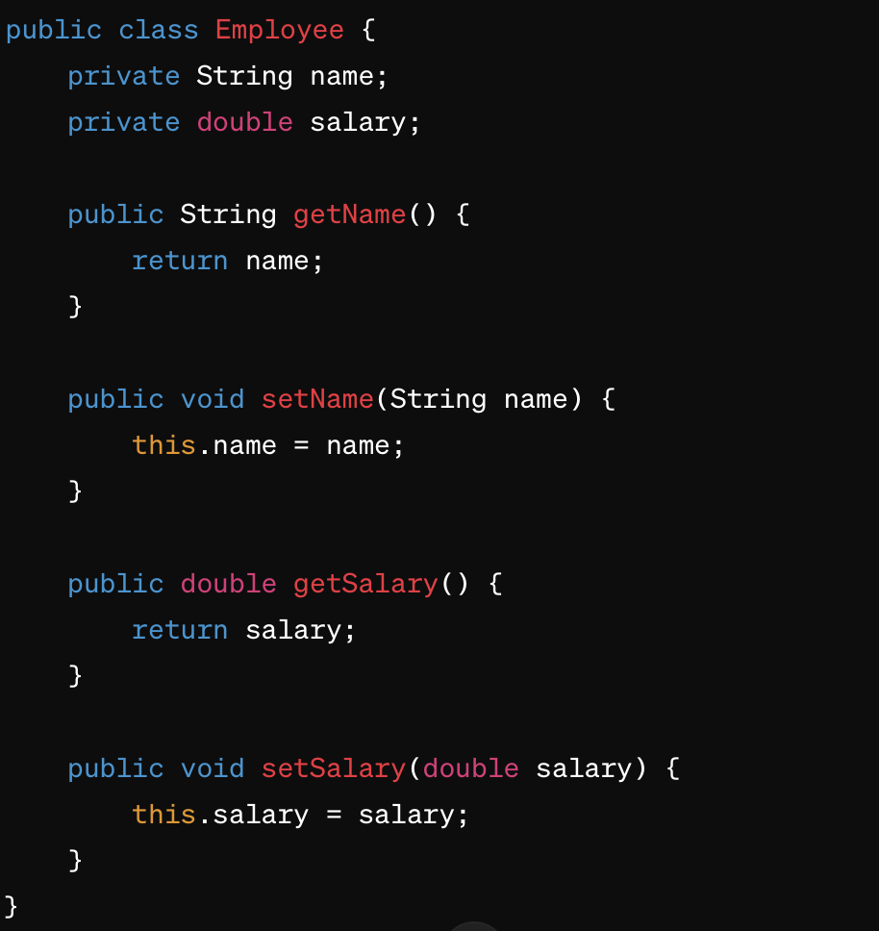
Encapsulation Example
Encapsulation is achieved by making the name and salary fields private and providing public getter and setter methods to access and update the values.

Slide 9
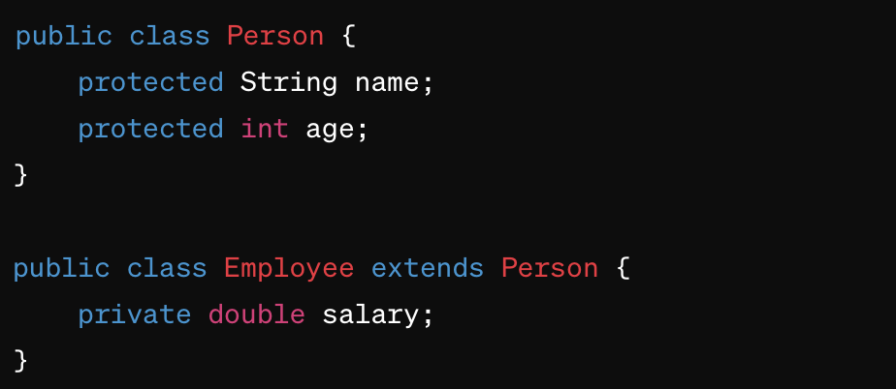
Inheritance Example
The Employee class inherits properties from the Person class, demonstrating inheritance.

Slide 10
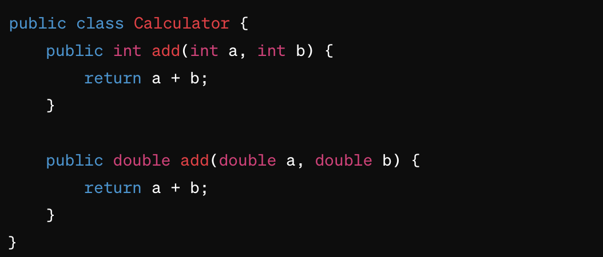
Polymorphism Example
Compile-time Polymorphism (Method Overloading)
Two add methods with different parameter types illustrate compile-time polymorphism.

Slide 11
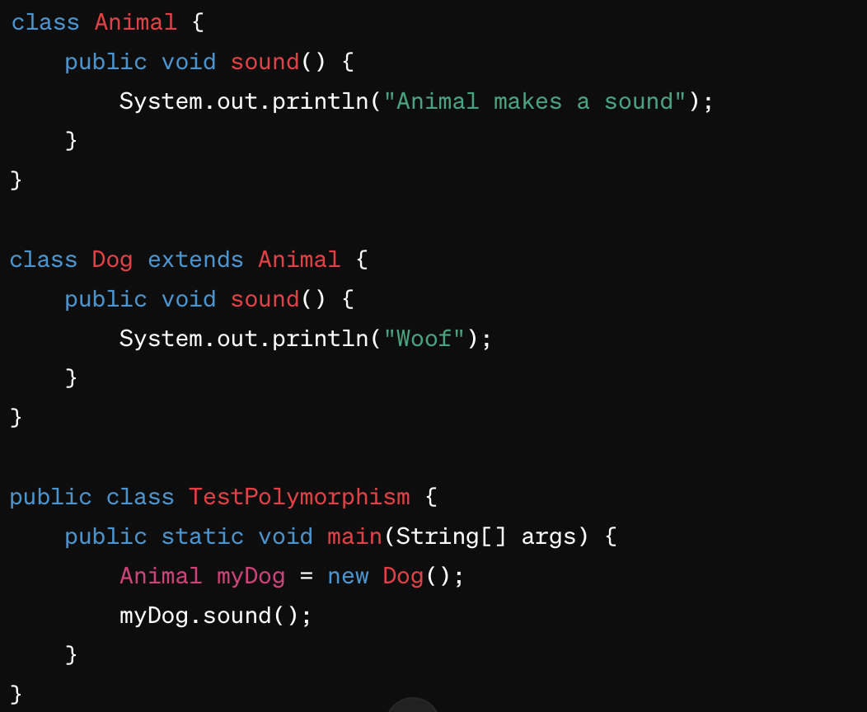
Runtime Polymorphism Example
Also known as method method overriding or dynamic polymorphism;
Dog class overrides sound method of Animal class.

Slide 12
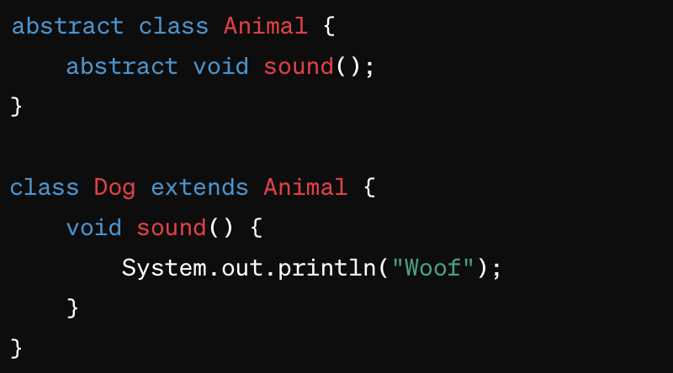
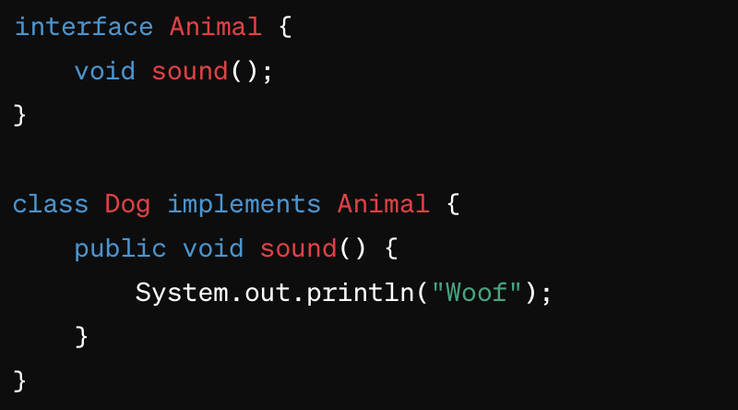
Abstraction Examples
Abstract classes in Java are a powerful tool for structuring and organizing your code
Abstraction can be achieved using abstract classes or interfaces.
The Animal class/interface defines the sound method without implementation, and the Dog class provides the implementation.
Notes:
Abstract classes in Java are a powerful tool for structuring and organizing your code, promoting code reuse, and facilitating polymorphic behavior. They are particularly useful in scenarios where you want to define a common interface for a group of related classes while providing flexibility for customization and extension.

Slide 13
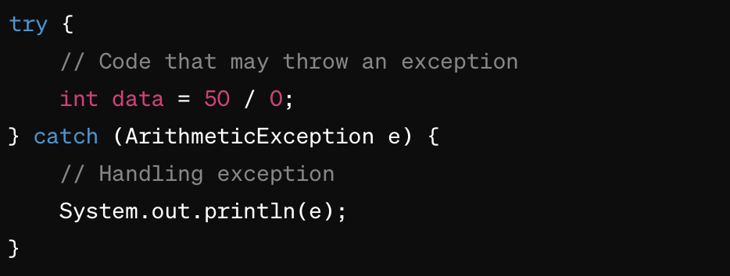
Try-Catch Block Example

Slide 14
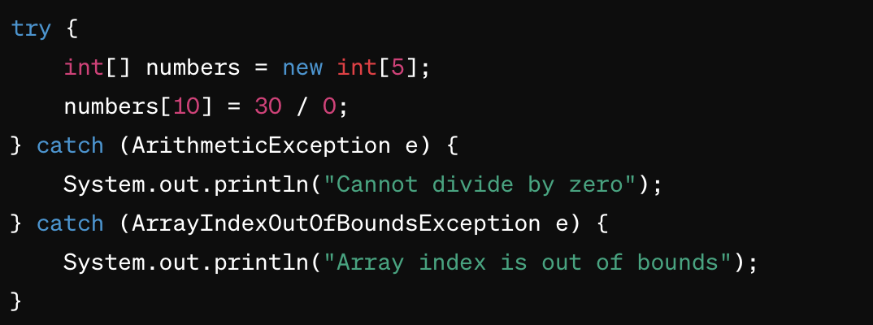
Multiple Catch Blocks Example

Slide 15
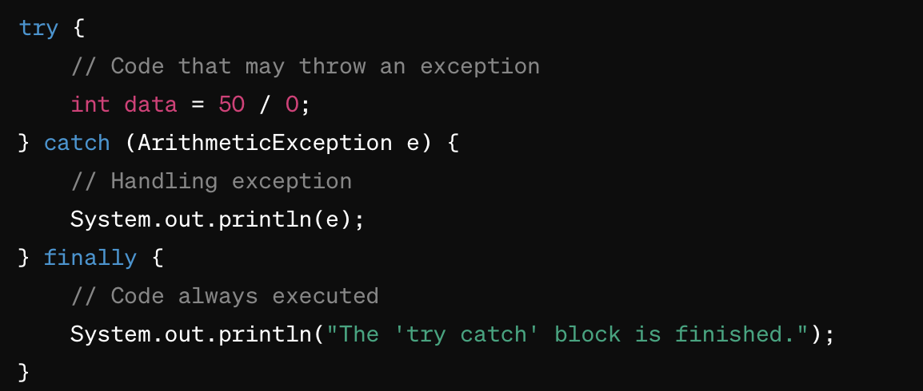
Finally Block Example

Slide 16
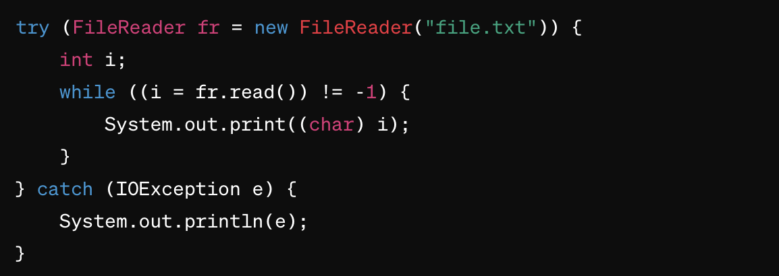
Try-With-Resources
A resource is an object that must be closed after finishing the program. The try-with-resources statement ensures that each resource is closed at the end of the statement execution.

Slide 17
Standard Java Exceptions
Throwable
Exception
Error
Runtime
Exception
IO Exception

Slide 18
Types of Exceptions
1. Unchecked exceptions: are like unforeseen events that your program wasn't really expecting (e.g., dividing by zero).
2. Checked exceptions: are like known risks in your plan (e.g., trying to read a file that might not be there).
Java insists that you prepare a Plan B for these known risks.

Slide 19
Unchecked Exceptions
Unchecked exceptions are the exceptions that the compiler does not check at compile-time. In other words, these are not checked at the time of coding.
Examples: ArithmeticException, NullPointerException, ArrayIndexOutOfBoundsException.
They usually indicate programming errors, such as bad logic or incorrect assumptions. Java assumes that your program should not catch these unless you have a very good reason to do so.
When They Happen: They occur during the execution of the program.

Slide 20
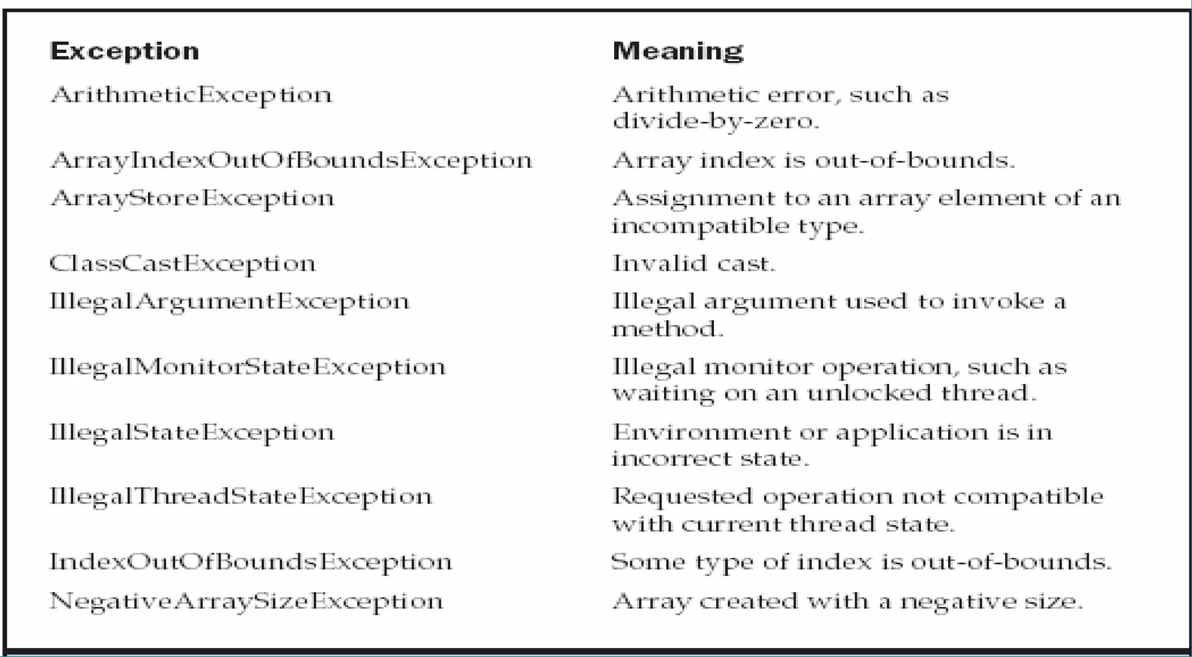
Unchecked Exceptions Examples

Slide 21
Checked Exceptions
Checked exceptions are checked at compile-time. This means you must handle or declare these exceptions when you write code that can potentially cause such exceptions.
Examples: IOException, FileNotFoundException.
They typically represent invalid conditions in areas outside the immediate control of the program. Java wants to ensure that you handle these exceptions to maintain the flow of the program.
They can occur during situations like reading a file that doesn't exist or network connection errors.

Slide 22
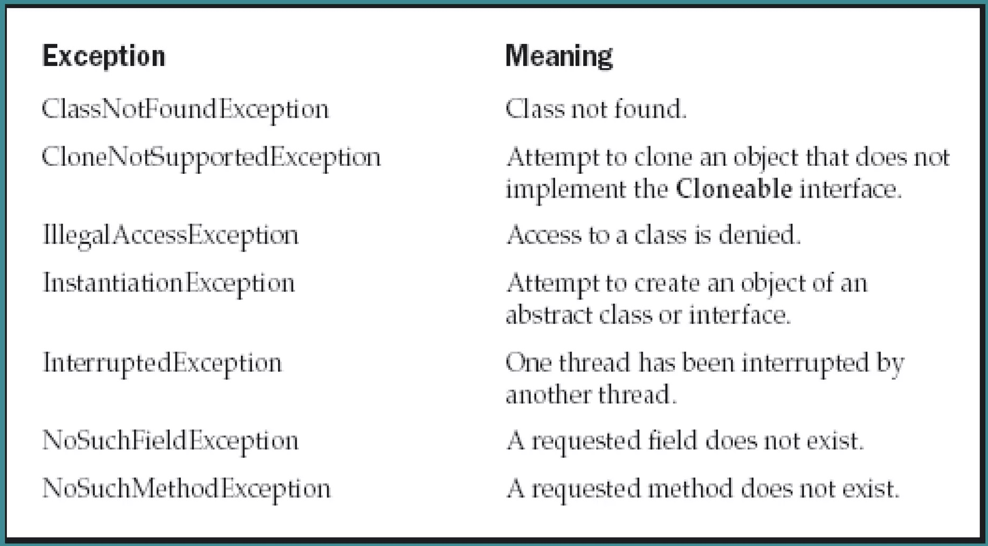
Checked Exceptions Examples

Slide 23
Generic Exception Block
public class Main {
public static void main(String[] args) {
try {
// Code that may throw exceptions
int result = divide(10, 0); // Division by zero will throw an ArithmeticException
System.out.println("Result: " + result);
} catch (Exception e) {
// Generic exception block to catch any type of exception
System.out.println("An error occurred: " + e.getMessage());
e.printStackTrace();
}
}
public static int divide(int dividend, int divisor) {
return dividend / divisor;
}
}

Slide 24
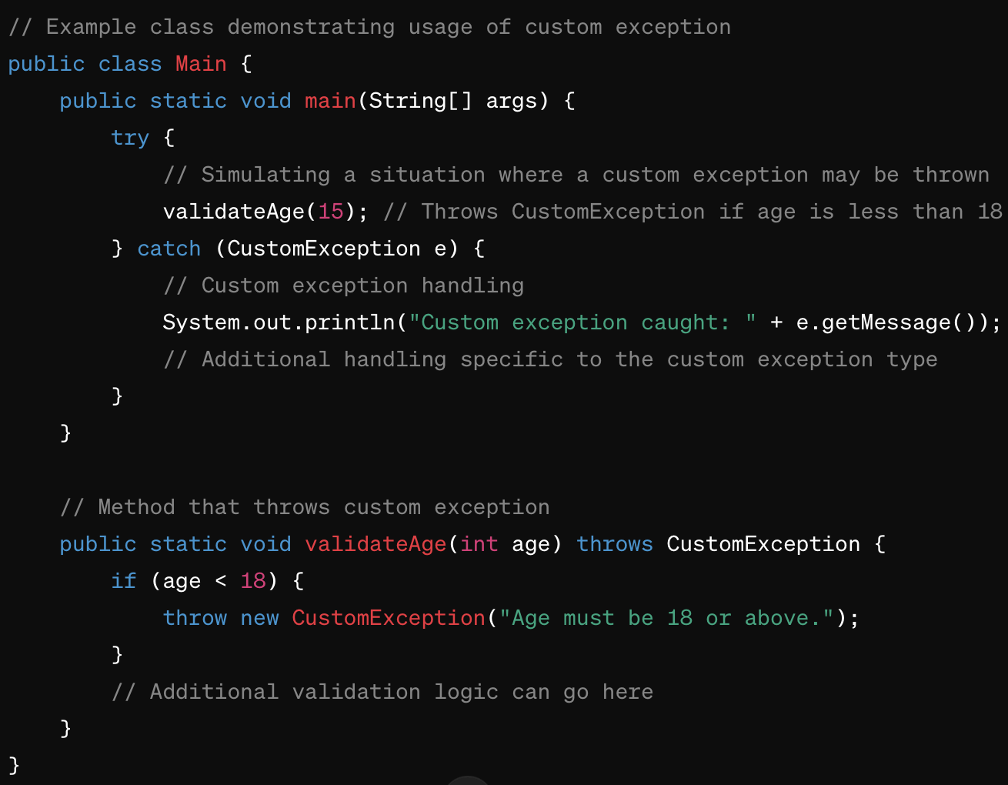
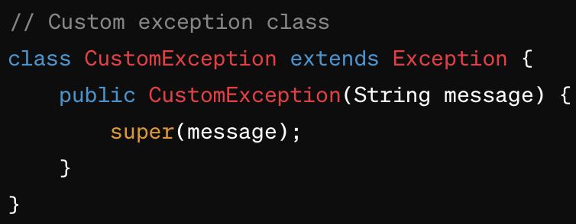
Custom Exception Block

Slide 25
Class Activity
Hands-on coding exercise.
Implement a class structure with inheritance and exception handling.
Practice -> Java 1

Slide 26
Introduction to Python for Testing
Python Syntax and Structure
Basic syntax, indentation, variables, data types, and operators.
Control structures: if-else, loops (for, while).
Python Functions
Defining functions, parameters, return statements.
Lambda functions.

Slide 27
Python - Basic Concepts & OOP
# Python program to illustrate simple functions
# Function to add two numbers
def add(num1, num2):
return num1 + num2
# Driver code
sum = add(10, 20)
print(f"The sum is: {sum}")

Slide 28
Object-Oriented Programming in Python
1. Classes and Objects
Understanding classes, objects, and initialization.
'self' keyword, class vs instance variables.
2. Core OOP Concepts in Python
Encapsulation: Using private attributes, getters, and setters.
Inheritance: Single, multiple, multilevel inheritance.
Polymorphism: Method overriding.
Abstraction: Abstract classes and methods.
3. Error and Exception Handling
Using try-except blocks, multiple exceptions.

Slide 29
Object-Oriented Programming (OOP) in Python
# Python program to illustrate OOP concepts
class Rectangle:
# constructor
def __init__(self, length, width):
self.length = length
self.width = width
# method to calculate area
def get_area(self):
return self.length * self.width
# Driver code
rect = Rectangle(10, 20)
print(f"Area of the rectangle: {rect.get_area()}")

Slide 30
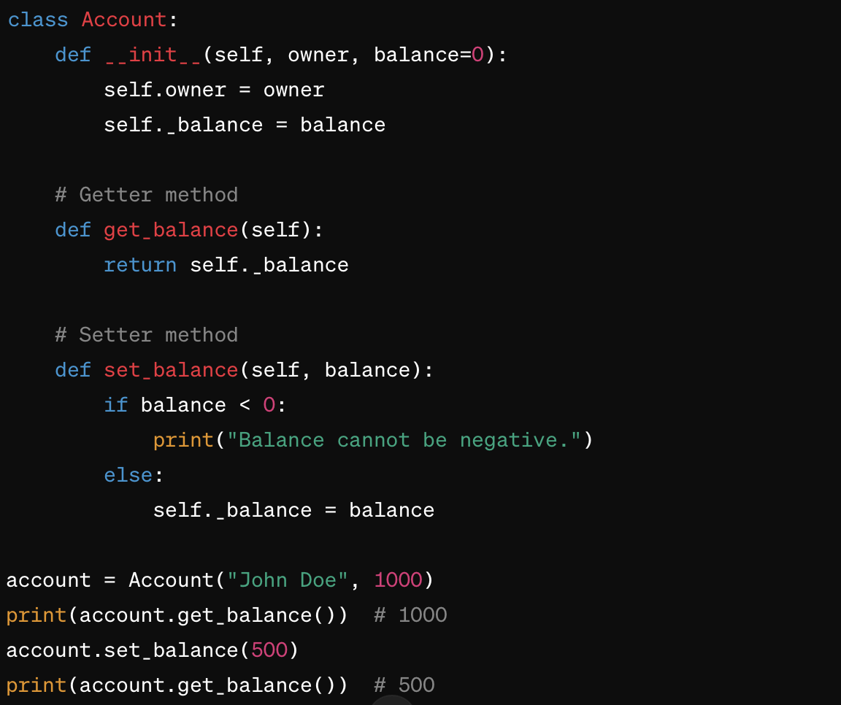
Encapsulation Example
This is achieved using private attributes (denoted by prefixing the attribute name with an underscore `_`), and providing public getter and setter methods to manipulate these attributes.

Slide 31
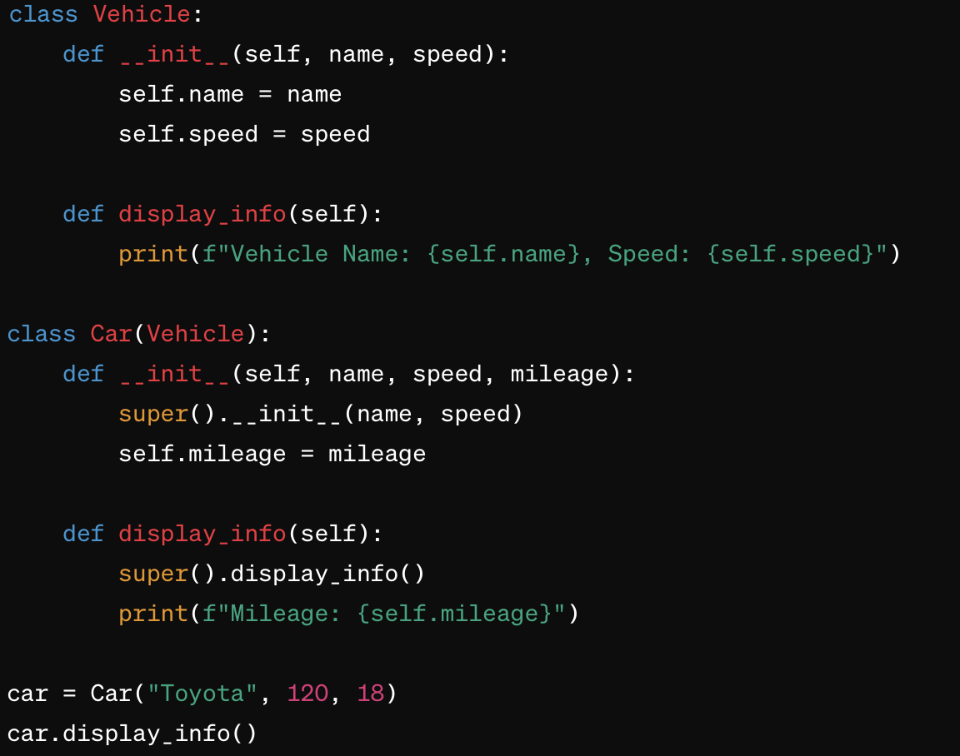
Inheritance Example
Python supports different types of inheritance, including single, multiple, and multilevel inheritance.
Example (Single Inheritance):

Slide 32
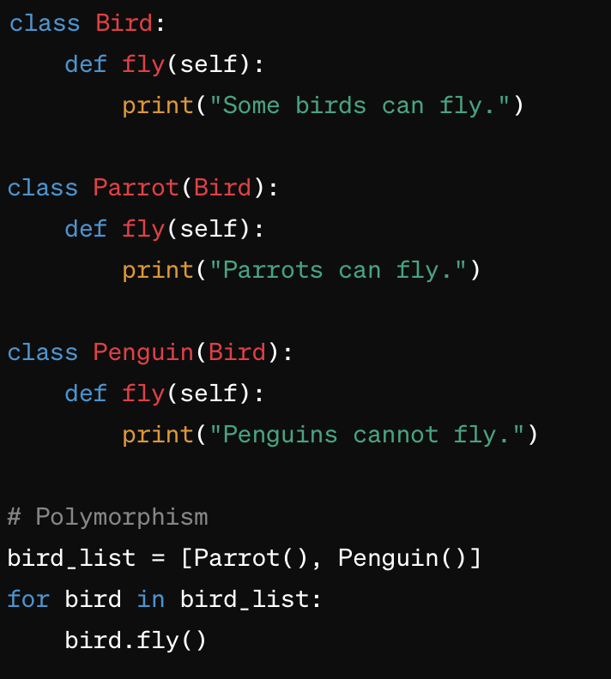
Polymorphism
Polymorphism in Python allows methods to do different things based on the object that is calling them.

Slide 33
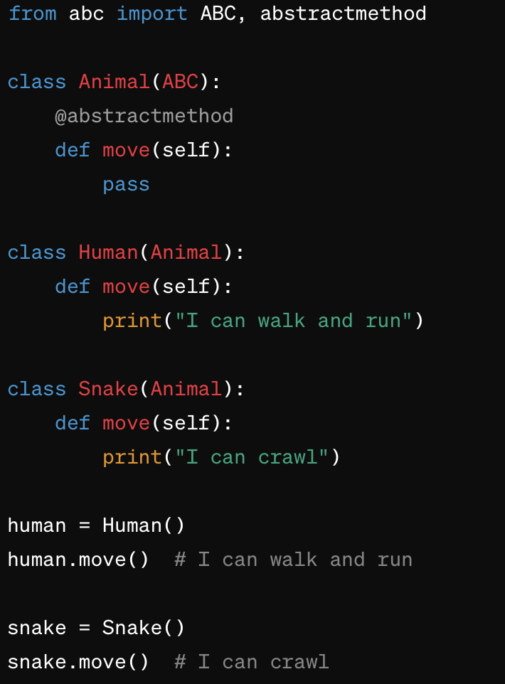
Abstraction
Abstraction in Python involves using abstract classes and methods to define a template for other classes.
An abstract class cannot be instantiated and requires subclasses to provide implementations for the abstract methods.

Slide 34
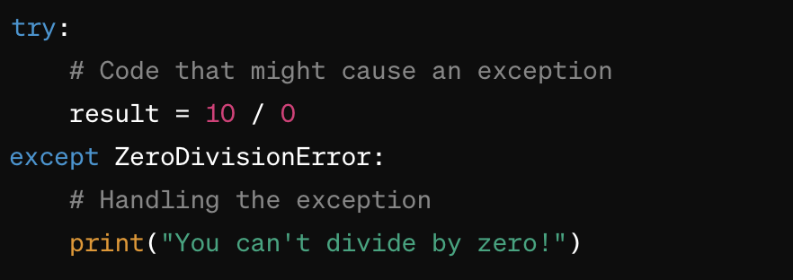
Using try-except Blocks

Slide 35
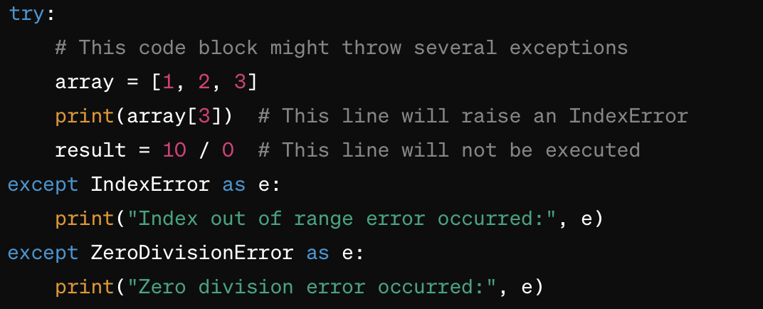
Handling Multiple Exceptions

Slide 36
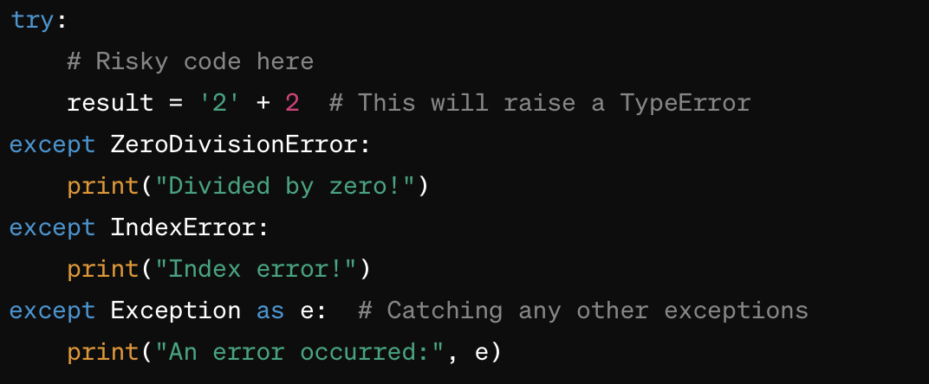
Using a Generic Exception Block
For a catch-all approach, you can use a generic except block without specifying an exception type.
This will catch any exception not caught by the previous blocks. However, using this approach should be done with care, as it can make debugging harder by catching unexpected errors silently.

Slide 37
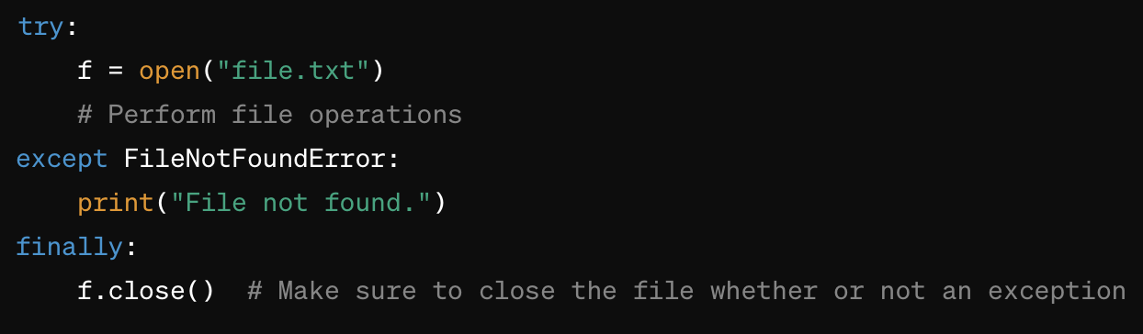
Finally Block
The finally block, if present, will be executed no matter what, whether an exception is raised or not. This is useful for cleaning up resources, like closing files or network connections.
Best Practices
Specificity: Always try to catch specific exceptions rather than using a generic except block. This helps in accurately handling errors and makes your code more understandable.
Minimize try Block Scope: Keep the code inside try blocks to a minimum. The more code inside a try block, the more points at which an unexpected exception can occur.
Resource Management: Use finally or context managers (with statement) to ensure resources are properly managed even if an error occurs.

Slide 38
Class Activity
Hands-on coding exercise.
Create a Python class structure with inheritance and exception handling.

Slide 39
Homework Assignments (To be completed before the next class)
Java Homework:
1. Implement a ‘Circle’ class with a method to calculate the circumference.
2. Create a Java program that simulates a simple banking system. Implement classes for Account, SavingsAccount, and CheckingAccount. Use inheritance and exception handling for error scenarios.
Python Homework:
1. Create a ‘BankAccount’ class with methods for deposit and withdrawal and maintaining the balance.
2. Develop a Python script to parse a CSV file and process data. Implement error handling for file operations and data validation.

Slide 40
Thank you

