Slide 1
Black Box Testing Decision Table Testing
Prepared by Chala Urgessa

Slide 2
Decision Table Testing
A decision table is a good way to deal with combinations of things (e.g. inputs). This technique is sometimes also referred to as a 'cause-effect' table. The reason for this is that there is an associated logic diagramming technique called 'cause-effect graphing' which was sometimes used to help derive the decision table

Slide 3
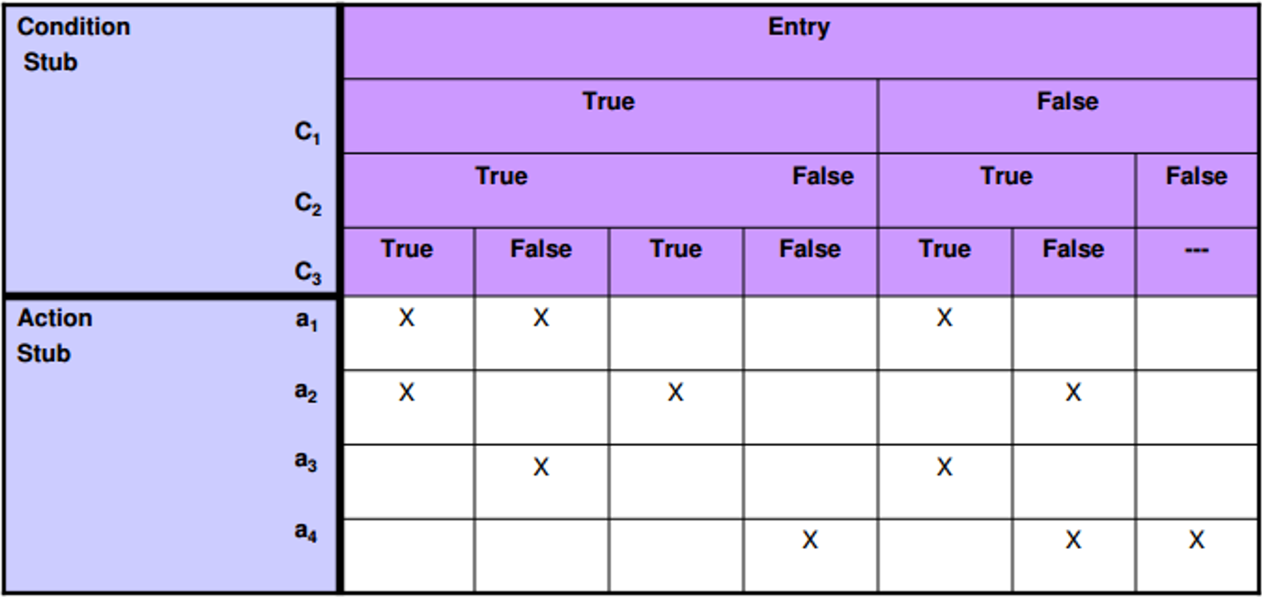
Decision Table Testing
Condition stub It is a list of input conditions for which the complex combination
is made.
Action stub It is a list of resulting actions which will be performed if a combination
of input condition is satisfi ed.

Slide 4
Decision Table Testing
Step 1. The first task is to identify a suitable function or subsystem that has a behavior which reacts according to a combination of inputs or events. It is better to deal with large numbers of conditions by dividing them into subsets and dealing with the subsets one at a time.
Step 2. Once you have identified the aspects that need to be combined, then you put them into a table listing all the combinations of True and False for each of the aspects.
Step 3. The next step is to identify the correct outcome for each combination.

Slide 5
Decision Table Testing
Credit card worked example
If you are a new customer opening a credit card account, you will get a 15% discount on all your purchases today. If you are an existing customer and you hold a loyalty card, you get a 10% discount. If you have a coupon, you can get 20% off today (but it can't be used with the 'new customer' discount). Discount amounts are added, if applicable.

Slide 6
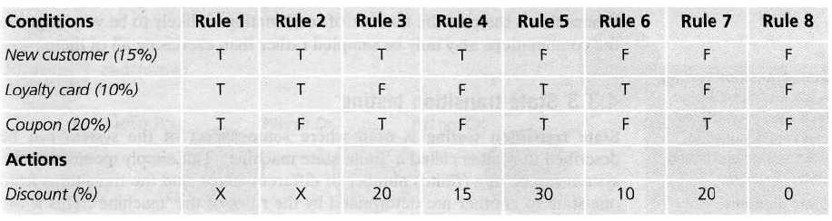
Decision Table Testing
Back to Main

Slide 7
Decision Table Testing cont…
Consider a simple program to classify a triangle. Its inputs is a triple of positive integers (say x, y, z). The program output may be one of the following words:
[Scalene; Isosceles; Equilateral; Not a triangle; Impossible]
Draw the Decision table and design the test cases.

Slide 8
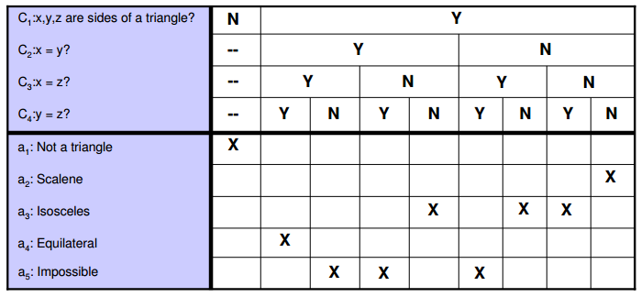
Decision Table Testing cont…
a. Decision Table

Slide 9
Decision Table Testing cont…
b. Test Cases
Test Case | x | Y | z | Output
1 | - | - | - | Not a Triangle
2 | 2 | 2 | 2 | Equilateral
3 | - | - | - | Impossible
4 | - | - | - | Impossible
5 | 2 | 2 | 1 | Isosceles
6 | - | - | - | Impossible
7 | 2 | 1 | 2 | Isosceles
8 | 1 | 2 | 2 | Isosceles
9 | 3 | 4 | 5 | Scalene

