Slide 1
GROUP D / PROJECT PRESENTATION
E-commerce
Sales Forecasting
From transaction records to an interactive dashboard and a seven-day outlook
Online Retail dataset · 1 Dec 2010–9 Dec 2011
Group leader: Fombutuh Nadia
Notes:
Introduce the project as an end-to-end analysis of historical online-retail transactions, including cleaning, exploratory analysis, forecasting, and a Power BI reporting layer. The records cover 1 December 2010 through 9 December 2011.

Slide 2
One team, one forecasting workflow
Why this project
Team and responsibilities
Retail teams need a clear view of daily net revenue and a short-term planning signal. We tested what one year of transaction history can support and brought the results into a single interactive report.
Ngwa Solange
Data Engineer
Cleaned transactions, set revenue rules, prepared daily series.
Veronica Wanjiku Gitau
Data Analyst
Analyzed time, product, country, and customer patterns.
What we completed
Khayelihle Ngubane
Cleaned daily series · sales-pattern analysis · time-aware model comparison · seven-day forecast · Power BI dashboard · written interpretation
Machine Learning Engineer
Built lag/calendar features; evaluated models and forecasts.
Fombutuh Nadia · GROUP LEADER
BI Developer
Integrated outputs into Power BI; prepared reporting materials.
Notes:
The project turns an operational problem into a shared workflow: Person 1 prepared transaction data, Person 2 analyzed patterns, Person 3 compared time-aware forecasting models, and Person 4 built the reporting layer. Fombutuh Nadia is the group leader.

Slide 3
A clean daily series anchors the analysis
536,638
374
£9.74M
sales transaction rows
daily observations
net revenue in the period
Revenue rule
Revenue = Quantity × UnitPrice. Three bad-debt adjustments were excluded; returns and negative revenue were retained.
Coverage
1 Dec 2010–9 Dec 2011. December 2011 contains only the first nine days, so it is not a full-month comparison.
Data limit
135,034 transaction rows have no CustomerID; customer-level findings therefore cover only identified customers.
Notes:
The original Online Retail dataset contains 541,909 records and eight variables. The team removed 5,268 exact duplicate rows and identified three “Adjust bad debt” records, which were excluded from the sales transaction output. Revenue was calculated as Quantity multiplied by UnitPrice. Returns remain in net revenue so the series reflects refunds/negative sales. Source: UCI Machine Learning Repository, Online Retail dataset, https://archive.ics.uci.edu/dataset/352/online%2Bretail

Slide 4
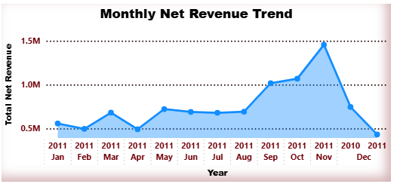
Revenue is uneven across days and months
Thursday leads the weekday average (£39.1k); November 2011 is the strongest complete month (£1.46m).
UK accounts for 84% of revenue. Regency Cakestand 3 Tier is the leading merchandise product (£164.5k). Saturday’s zero means no revenue recorded in this series.
* Dec 2011 includes 1–9 Dec only.
Notes:
Average weekday figures are calculated from the complete 374-row daily series, including days with zero revenue. Thursday is highest at £39,050 average; Saturday has zero in this dataset and should not be interpreted as proof that the retailer was closed. November 2011 totals £1,456,145.80. December 2011 totals £432,701.06 for 1–9 December only. The United Kingdom contributes about 84% of net revenue. The top merchandise product after excluding postage descriptions is Regency Cakestand 3 Tier (£164,459.49). All calculations come from the supplied team CSV outputs.

Slide 5
Use chronological validation to choose the model
Three rolling 14-day validation folds; final test held out for 28 days. Lower error is better.
Model | Validation MAE | Validation RMSE | Final-test MAE | Final-test RMSE
HistGradientBoosting | £10,117 | £13,106 | £13,380 | £19,426
Exponential smoothing | £11,665 | £14,565 | £12,459 | £16,482
Seasonal naive (7-day) | £12,269 | £15,544 | £10,881 | £14,455
Naive | £17,554 | £21,764 | £19,974 | £27,452
Validation winner
Held-out test winner
HistGradientBoosting · £10.1k MAE
Seasonal naive · £10.9k MAE / £14.5k RMSE
Notes:
Model candidates were Naive, SeasonalNaive_7, weekly-additive exponential smoothing, and HistGradientBoosting. Features for the boosted model use calendar fields, lags, and rolling summaries based only on prior observations. Chronological validation averaged three 14-day folds. HistGradientBoosting had the lowest mean validation MAE (£10,117.31). The final 28-day test was kept separate: SeasonalNaive_7 had the lowest MAE (£10,880.74) and RMSE (£14,454.91). Model selection should be based on validation; final test is an unbiased check, not a tuning target. Values from supplied model_comparison_summary.csv.

Slide 6
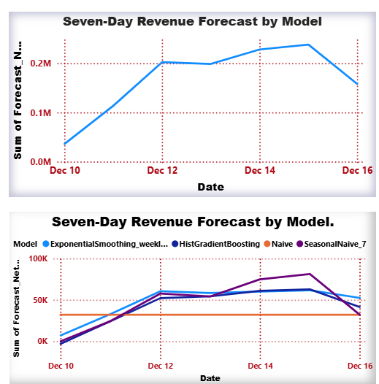
The seven-day outlook shows model uncertainty
Selected by validation
HistGradientBoosting
Its first forecast is −£3.0k for 10 Dec. Treat that as a model warning and review before operational use.
Training data through 9 Dec 2011
Different model paths show uncertainty; this is a short historical projection, not a guaranteed sales target.
Notes:
The forecast file contains 7-day outputs per model beginning 10 December 2011, using data through 9 December 2011. The chart compares four candidate forecasts. HistGradientBoosting was selected by mean validation MAE, but its first forecast is negative (£−3,036.79), which is not plausible as a retail revenue target and should be reviewed before operational use. SeasonalNaive_7 is shown for comparison; the final test performance winner is not automatically the chosen production model. Source: supplied seven_day_forecast.csv and model_comparison_summary.csv.

Slide 7
Power BI brings the workflow into one report
01 Sales overview
02 Sales patterns
03 Seven-day forecast
04 Model performance
Revenue KPIs and
daily revenue trend
Weekday and monthly
revenue; country view
Candidate model lines
and actual vs forecast
Validation and final-test
MAE / RMSE comparison
Interactive features
Page navigation keeps the four views connected. The model slicer lets viewers inspect forecast series and compare the selected model’s actual-versus-forecast behavior.
Designed for exploration: use the slicer and page navigator during the presentation rather than treating the report as a static set of charts.
Notes:
Walk through the four Power BI pages: Sales Overview; Sales Patterns; Seven-Day Forecast; Model Performance. Use the page navigator and the Model slicer to demonstrate interaction. The dashboard supports visual exploration of the supplied analysis outputs; the model comparison scores remain governed by the time-aware evaluation in the forecasting pipeline.

Slide 8
What the team learned — and what comes next
Project findings
Limits and next steps
• Net revenue totals £9.74M across the observed period.
• Thursday has the highest weekday average; November 2011 is the strongest complete month.
• Seasonal naive performs best on the final held-out test, while HistGradientBoosting leads validation.
The study covers one retailer and about one year; December 2011 is partial. Customer IDs are missing on many rows, and the models do not use promotions, stock availability, or external drivers.
For stronger planning support: add more years, incorporate promotions and inventory, review anomalous forecasts, then monitor error as new sales arrive.
Thank you
Group D · Group leader: Fombutuh Nadia
Notes:
Close with the practical conclusion: simple models remain strong benchmarks, and validation and final-test winners can differ. Avoid presenting the 7-day forecast as certainty; the negative first HistGradientBoosting value reinforces the need for review. This dataset is a single retailer’s historical sample and does not contain operational drivers such as inventory, promotions, or external events.

