Slide 1

CYBER ATTACK PREDICTION PLATFORM
Privacy-Preserving Provenance Graph Threat Detection & Cross-Machine Attack Scenario Reconstruction in Enterprise and ICS Networks
PROJECT TEAM MEMBERS:
• Muhammed Nasih K P (KNP23CS074)
• Sumayya Ershad (KNP23CS107)
• Najmunniza N (LKNP20CS056)
• K.S. Mahadev (KNP23CS066)
INSTITUTION & SUPERVISION:
• Project Guide: Mrs. SYAMA S R, Assistant Professor
• Department of Computer Science & Engineering
• College of Engineering Karunagappally
• APJ Abdul Kalam Technological University (KTU)
• Academic Year: 2026-2027

Slide 2
B.TECH CAPSTONE PROJECT STRUCTURE
Presentation Overview: Project Phases & Agenda
PHASES I - III: Foundations, Architecture & Models
PHASES IV - VI: Data, Algorithms & Implementation
PHASE I: FOUNDATIONS & PROBLEM FORMULATION
• 01. Introduction: Problem context, causal telemetry, core thesis
• 02. Problem Statement: Siloed logs, class imbalance, dependency explosion
• 03. Objectives: End-to-end telemetry reduction, edge AI, zero-day discovery
• 04. Literature Review: 16 peer-reviewed base papers (2024-2026)
• 05. Research Gaps & Solutions: 4 key enterprise vulnerabilities vs 4 proposed solutions
PHASE II: SYSTEM ARCHITECTURE & WORKFLOW
• 06. System Design Principles: Streaming ingestion, models, datasets, dual-tier DB
• 07. Workflow Diagram: End-to-end ingestion, detection, and tracing pipeline
PHASE III: MULTI-MODEL DETECTION PIPELINE
• 08. Proposed Methods: Edge-TGNN, Masked-GAT autoencoder, tracing logic
• 09. Model Responsibilities: Role separation between edge sentry, SOC analyzer, tracing
• 10. Inference Flow: Real-time edge screening and scenario attribution
PHASE IV: DATA ENGINEERING & MODEL TRAINING
• 11. Dataset Preparation: DARPA TC benchmarks, 85% compaction, CDM schema
• 12. Model Training & Evaluation: Chronological splitting, loss functions, metrics
PHASE V: DEEP SCHEMAS & CORE ALGORITHMS
• 13. System Architecture Diagram: 4-layer enterprise-grade SOC architecture
• 14. Development Flowchart: Lifecycle: Ingestion -> Training -> Testing -> Deploy
• 15. Database Schema: Neo4j graph property schema + PostgreSQL relational store
• 16. Algorithms & Pseudocode: Unified master pipeline + 3 detailed algorithms
PHASE VI: IMPLEMENTATION, PLAN & CONCLUSION
• 17. Implementation & Tech Stack: Frameworks (PyG, Neo4j, FastAPI, Cytoscape)
• 18. Project Work Plan & Gantt: Implementation schedule, phases, and milestones
• 19. Conclusion & Future Scope: Project summary, achievements, and roadmap
• 20. References: Complete academic literature bibliography
College of Engineering Karunagappally | Department of Computer Science & Engineering | B.Tech Capstone 2026-27

Slide 3
PHASE I: FOUNDATIONS & PROBLEM FORMULATION
1. Introduction
Project Essence: Holistic Provenance-Based Cyber Defense
Modern enterprise networks face hidden cyberattacks called Advanced Persistent Threats (APTs), which avoid traditional security systems by behaving like normal users over long periods. Traditional intrusion detection systems often analyze logs separately, missing important connections between processes, files, and network connections (Process → File → Socket).
Our system represents system activities as dynamic provenance graphs and combines Graph Attention Networks (GAT), Gated Recurrent Units (GRU), and Variational Graph Autoencoders (VGAE) to learn normal behavior and detect unknown attacks without labeled training data. It also uses TenSEAL CKKS-encrypted Federated Learning to enable secure collaboration between organizations while protecting their data.
Dynamic Provenance Graphs
Unsupervised AI Detection
TenSEAL CKKS Privacy
Captures exact kernel causality (Process → File → Socket), converting raw isolated audit events into directed execution dependency graphs.
Combines GAT + GRU + VGAE reconstruction loss to learn normal system behavior and detect unknown zero-day attacks without labeled data.
Applies homomorphic encryption to federated learning, enabling secure multi-organization collaboration without raw telemetry leakage.
College of Engineering Karunagappally | Department of Computer Science & Engineering | B.Tech Capstone 2026-27

Slide 4
PHASE I: FOUNDATIONS & PROBLEM FORMULATION
2. Problem Statement
Siloed Telemetry & Missed Connections
Proposed Graph AI & Privacy Framework
Traditional security systems struggle to detect stealthy, multi-stage cyberattacks because they analyze system logs separately, miss complex relationships and time-based attack patterns, and generate false alarms from normal activities.
They also struggle to detect unknown zero-day threats while protecting sensitive data across distributed enterprise endpoints.
This project proposes a spatio-temporal graph-based anomaly detection framework using GAT, GRU, and VGAE to detect suspicious activities, reconstruct attack paths, map threats to the MITRE ATT&CK framework, and enable privacy-preserving collaborative detection.
College of Engineering Karunagappally | Department of Computer Science & Engineering | B.Tech Capstone 2026-27

Slide 5
PHASE I: FOUNDATIONS & PROBLEM FORMULATION
3. Objectives
Primary Project Objective: Intelligent Privacy-Preserving APT Investigation
The main objective of this project is to develop an intelligent and privacy-preserving cybersecurity system that detects hidden, multi-stage APT attacks and traces their attack paths across enterprise networks.
The system converts raw kernel audit logs from the DARPA Transparent Computing dataset into provenance graphs and uses GAT, GRU, and VGAE to detect unknown attacks by identifying unusual graph patterns. It also supports secure collaborative training using TenSEAL CKKS encryption, reconstructs attack paths across multiple computers, maps detected threats to the MITRE ATT&CK framework, and displays the results on an interactive SOC dashboard.
>85% Telemetry Compaction
Spatio-Temporal Detection
TenSEAL CKKS Encryption
MITRE ATT&CK Attribution
Eliminates repetitive execution loops and redundant I/O operations with 0% causality loss.
Unsupervised GAT + GRU + VGAE flags zero-day anomalies via graph reconstruction error.
Enables encrypted federated aggregation without raw telemetry or model gradient leakage.
Reconstructs multi-host causal attack subgraphs with interactive real-time SOC triage.
College of Engineering Karunagappally | Department of Computer Science & Engineering | B.Tech Capstone 2026-27

Slide 6
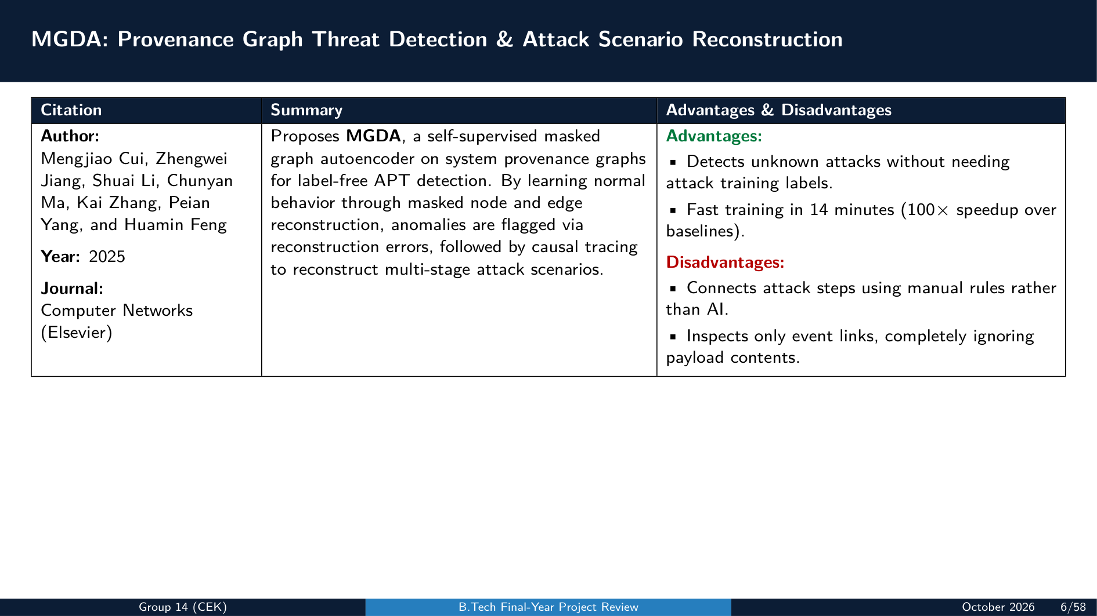

Slide 7
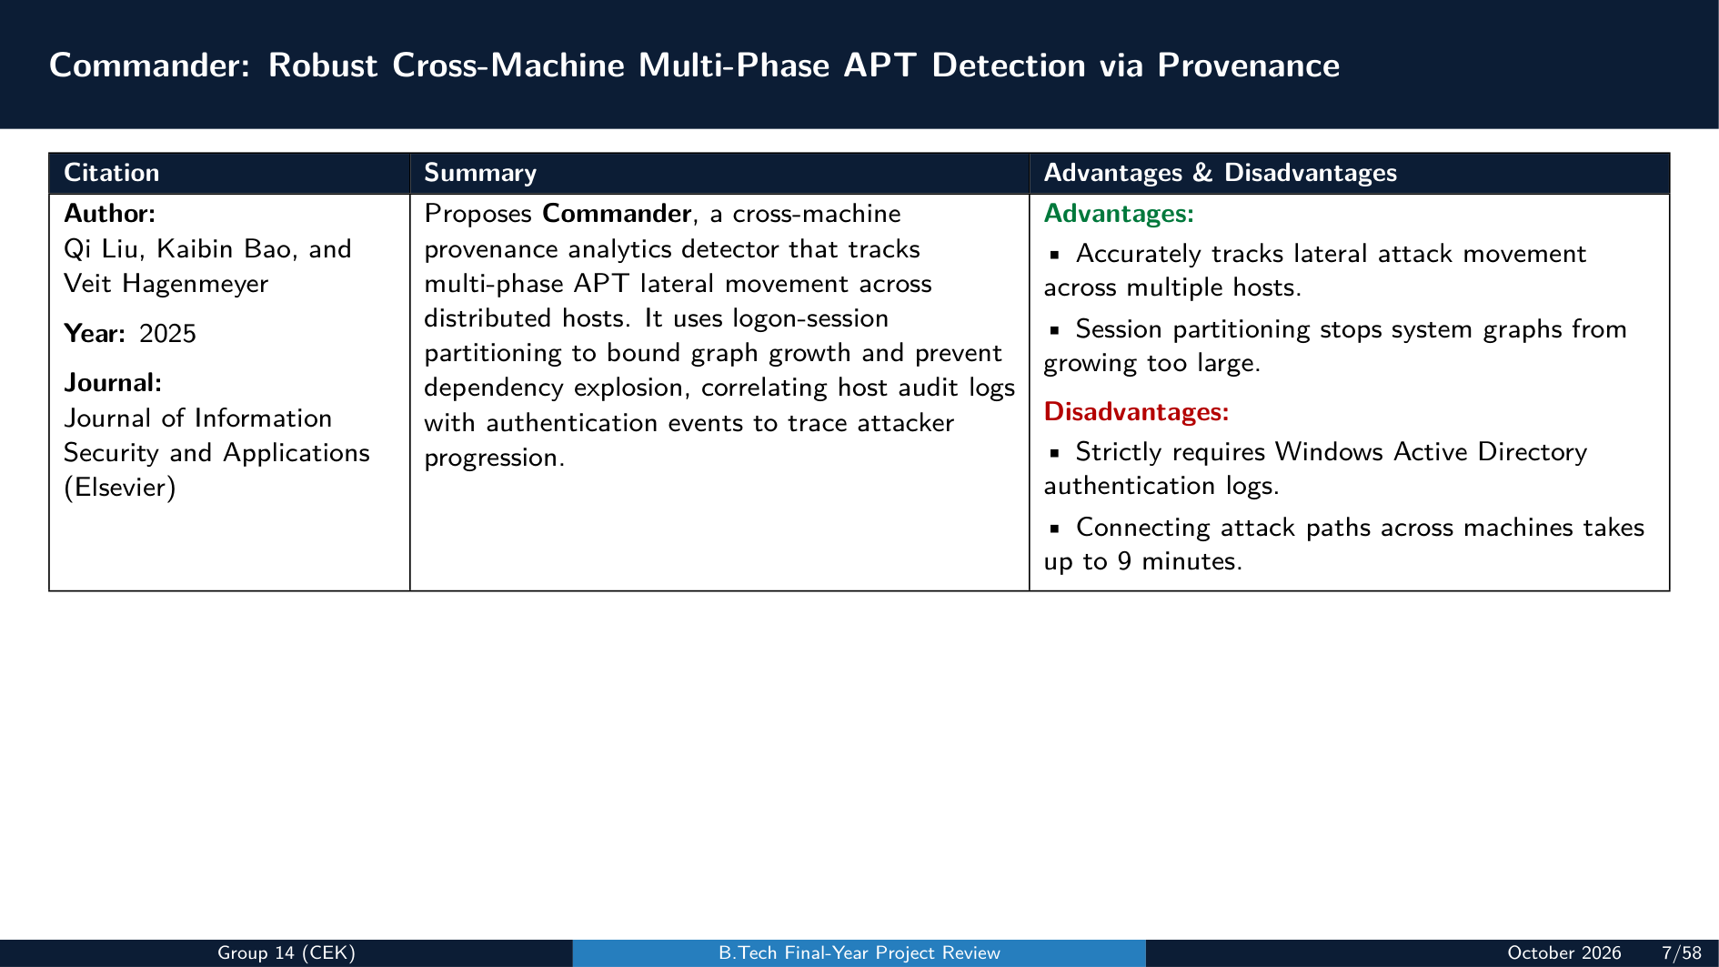

Slide 8
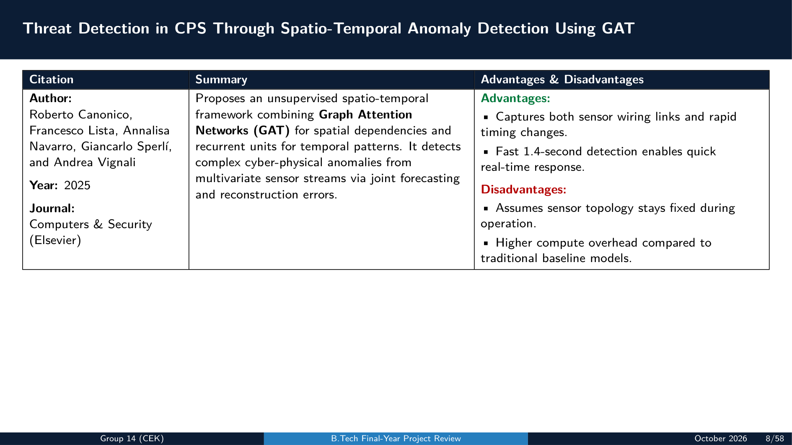

Slide 9
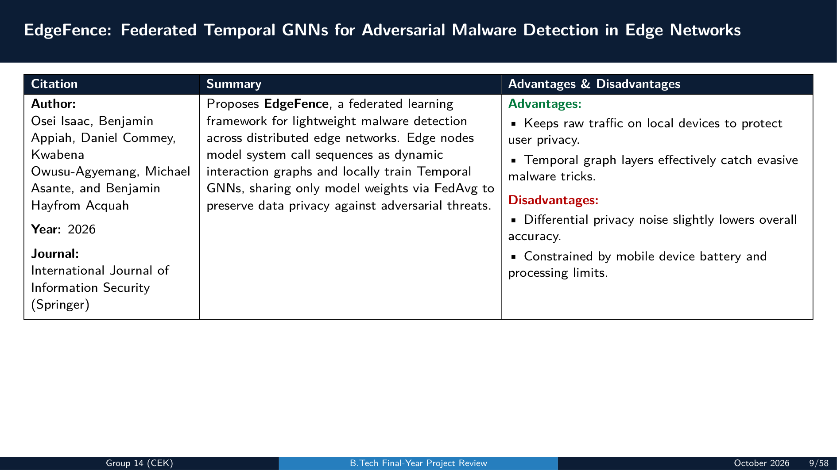

Slide 10
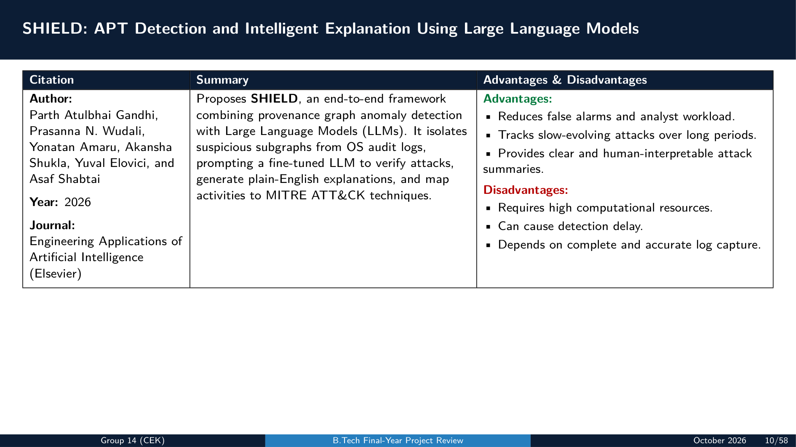

Slide 11
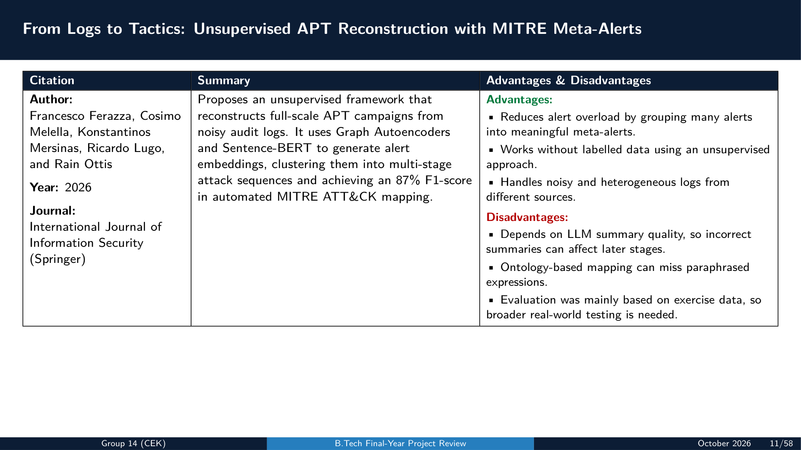

Slide 12
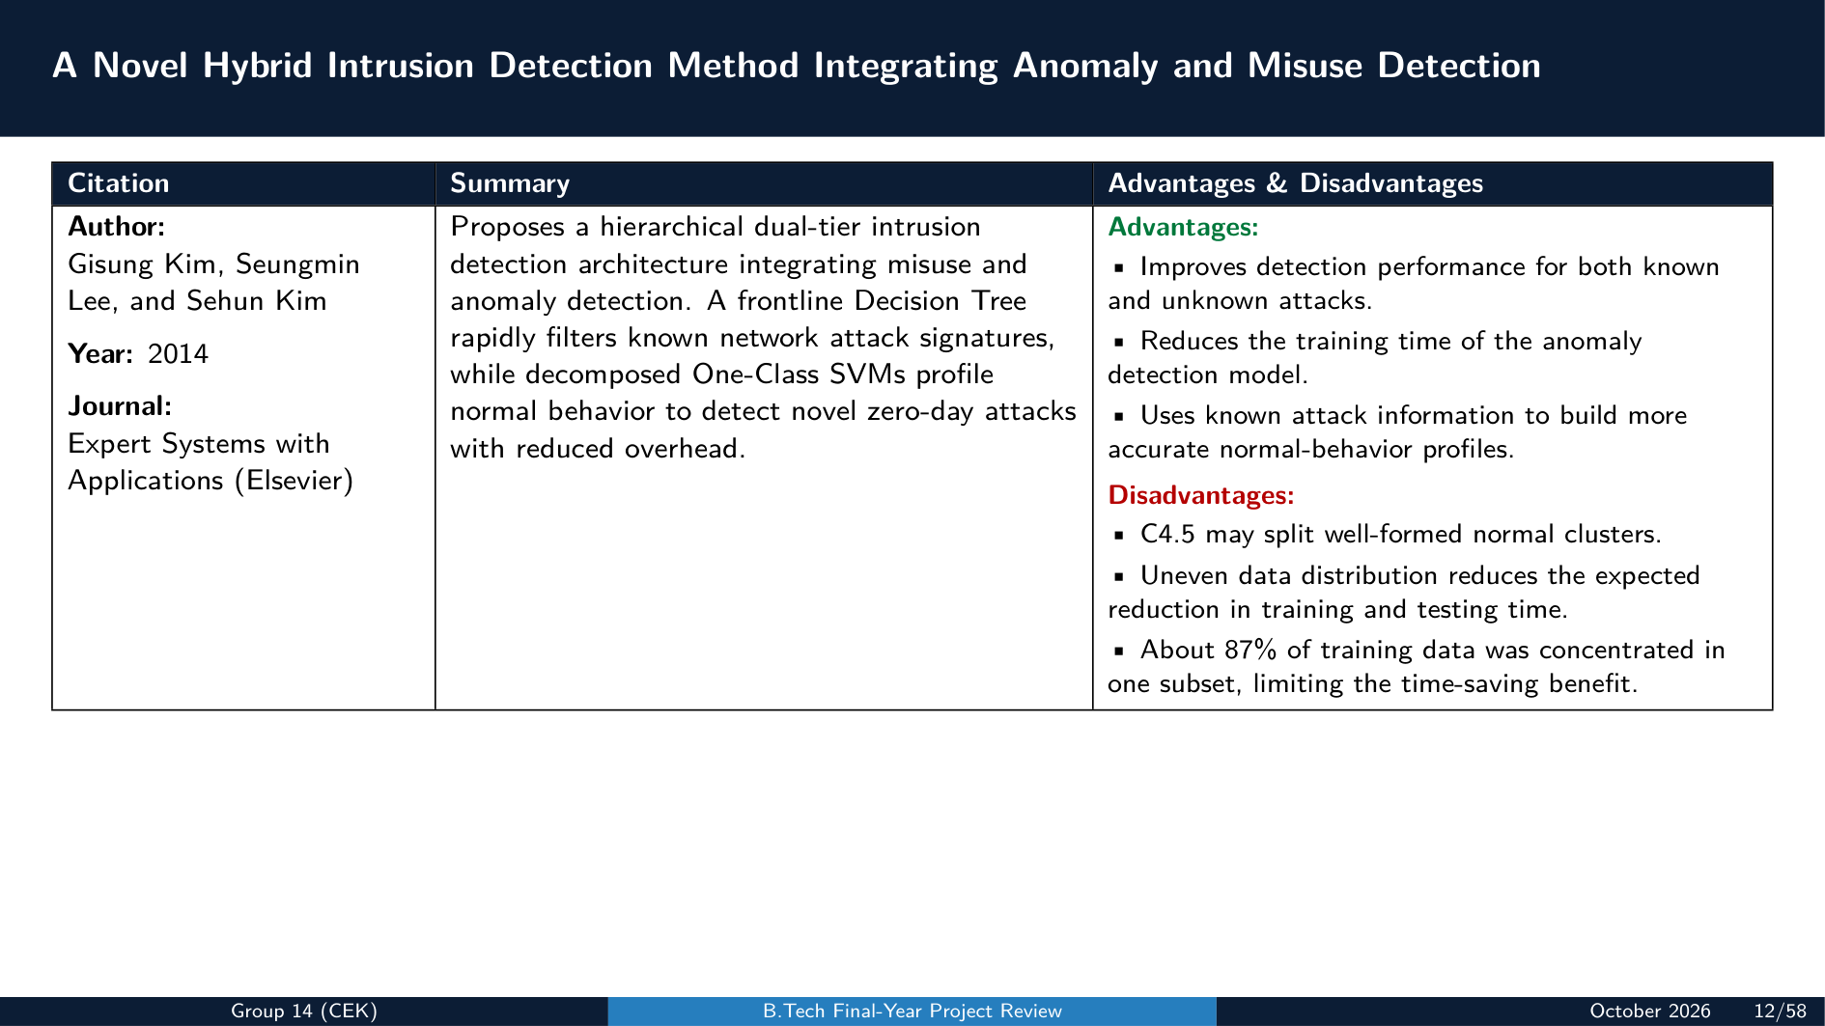

Slide 13
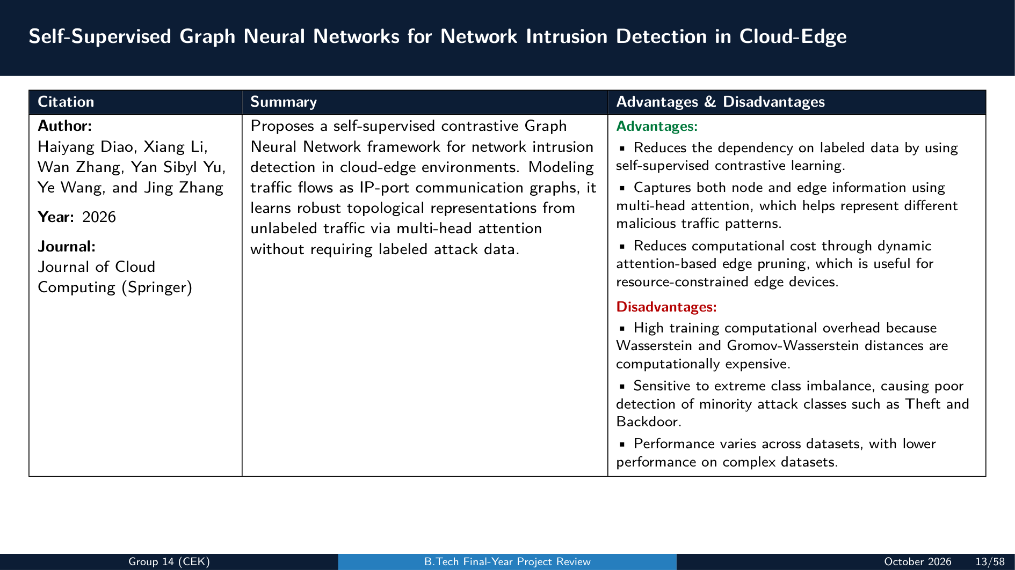

Slide 14
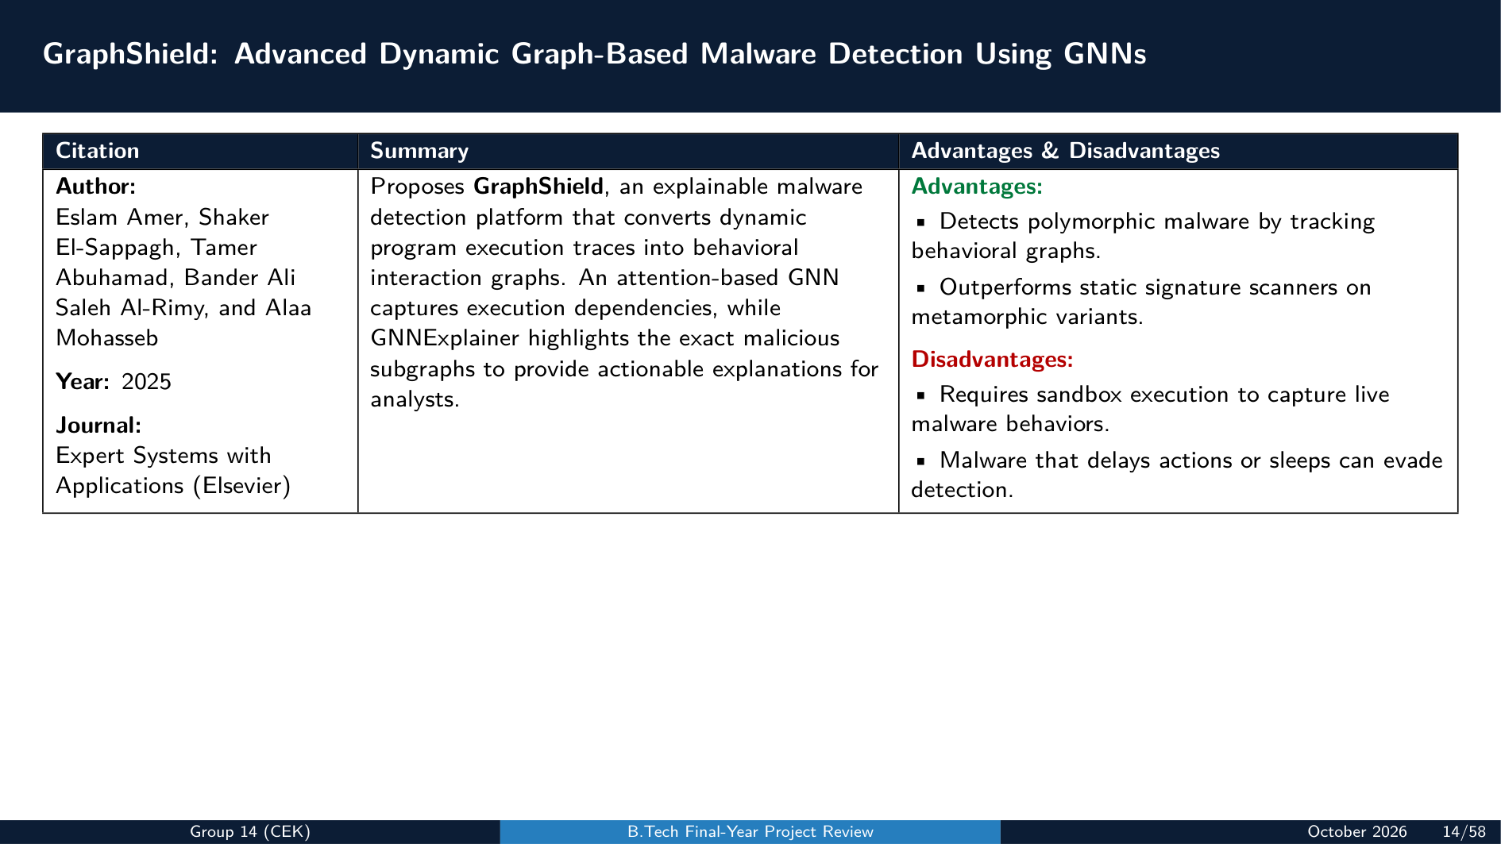

Slide 15
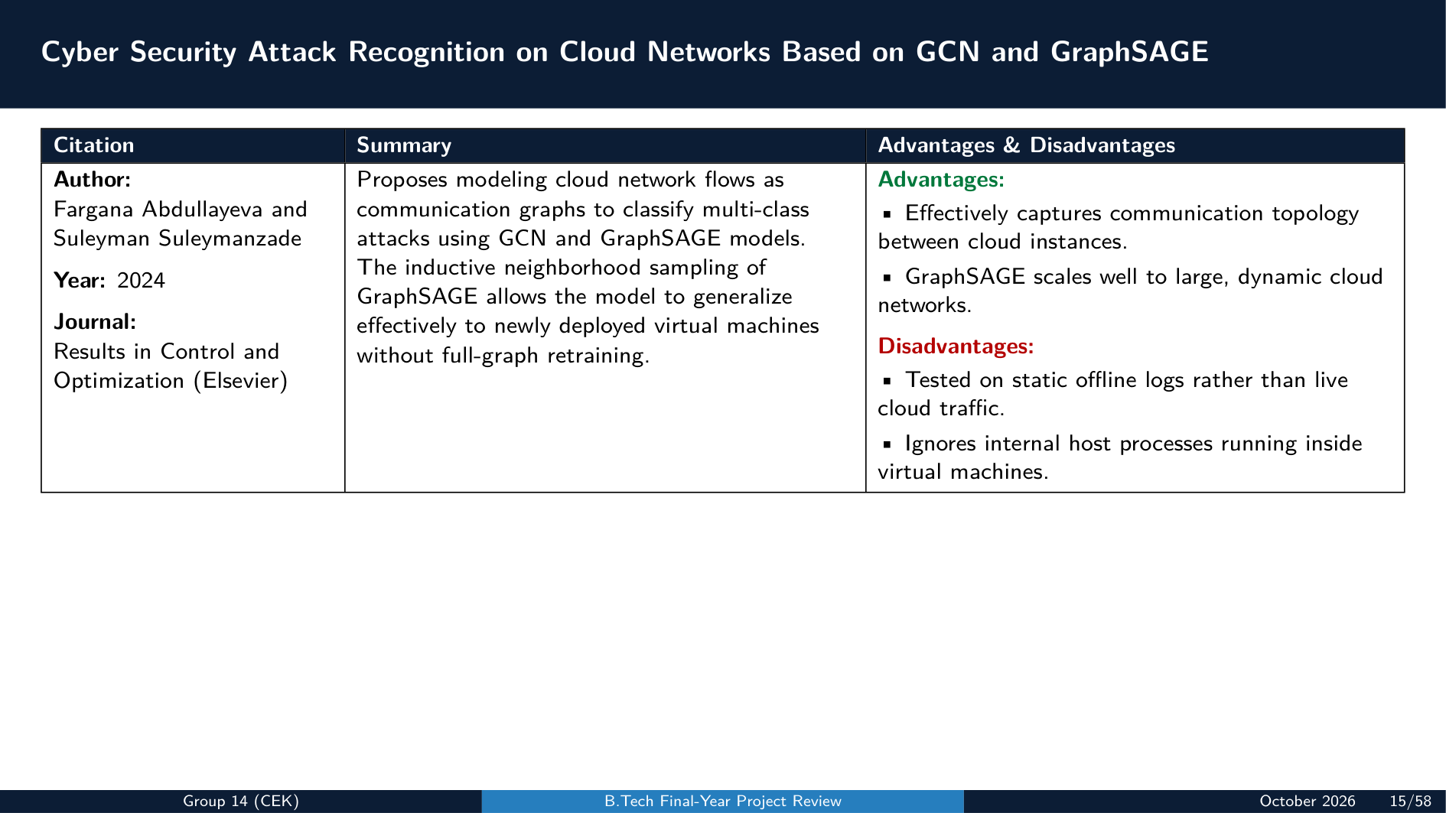

Slide 16
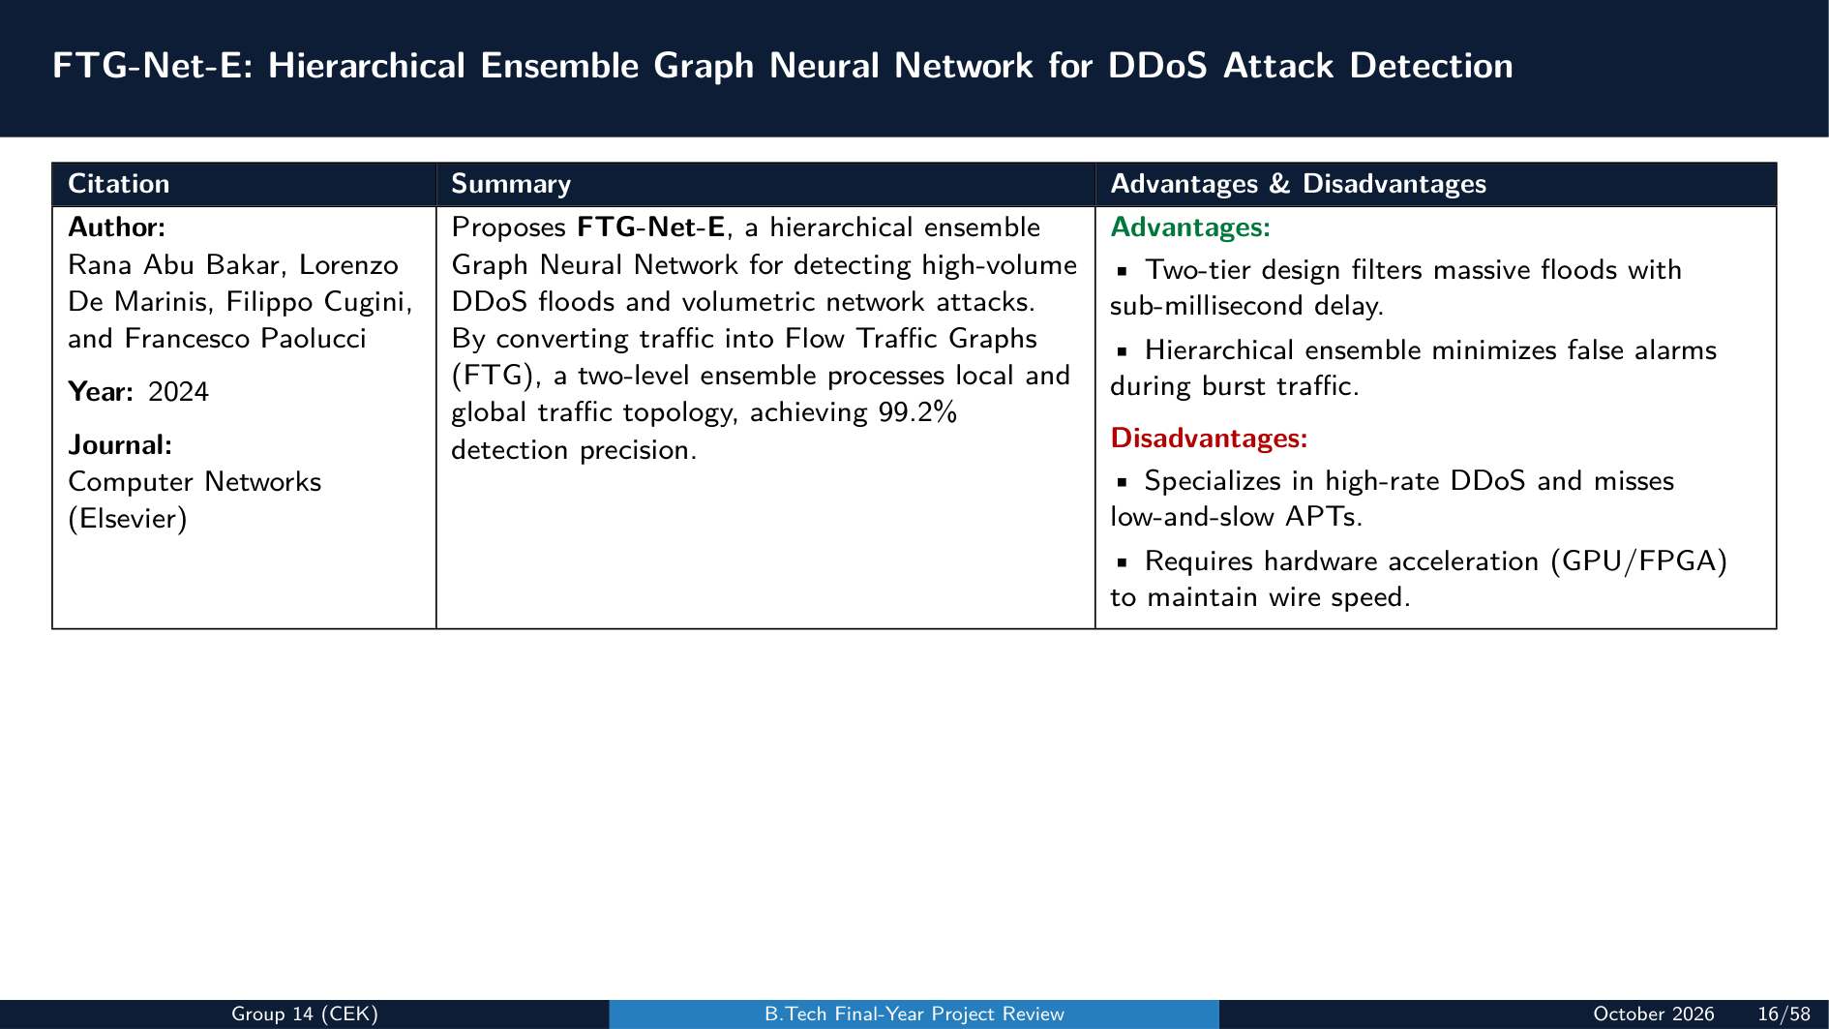

Slide 17
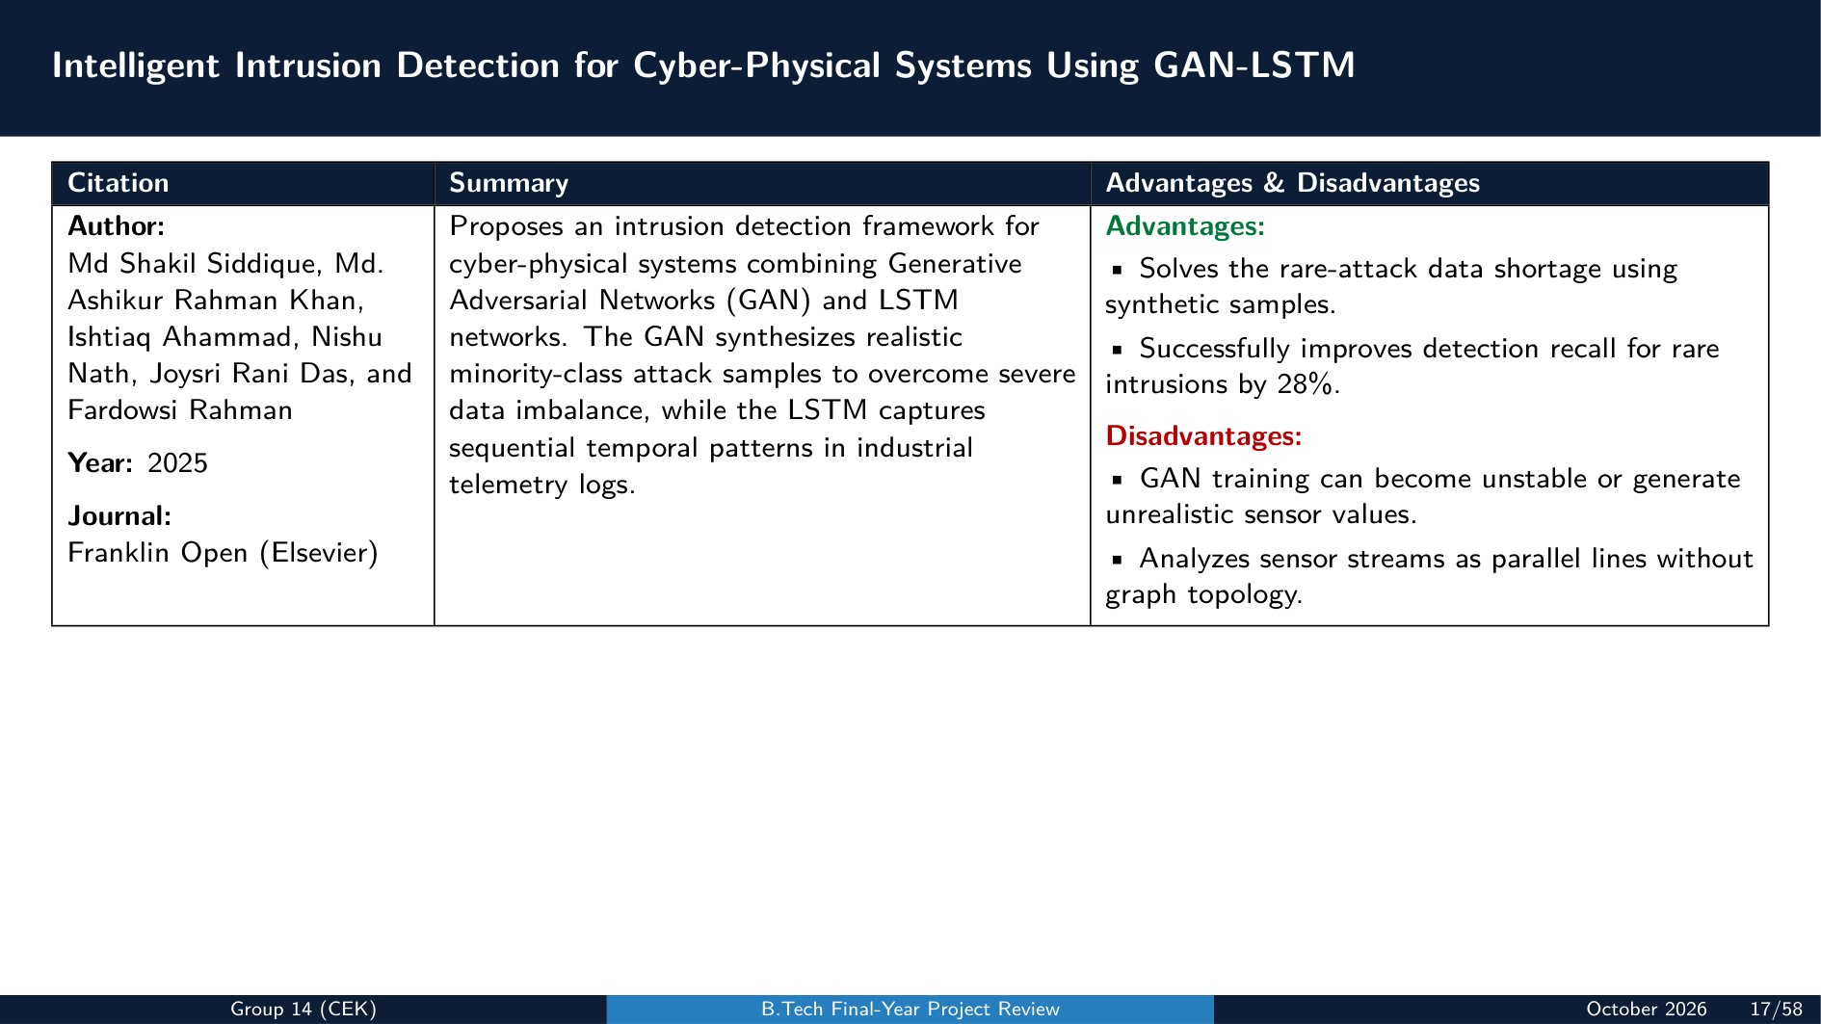

Slide 18
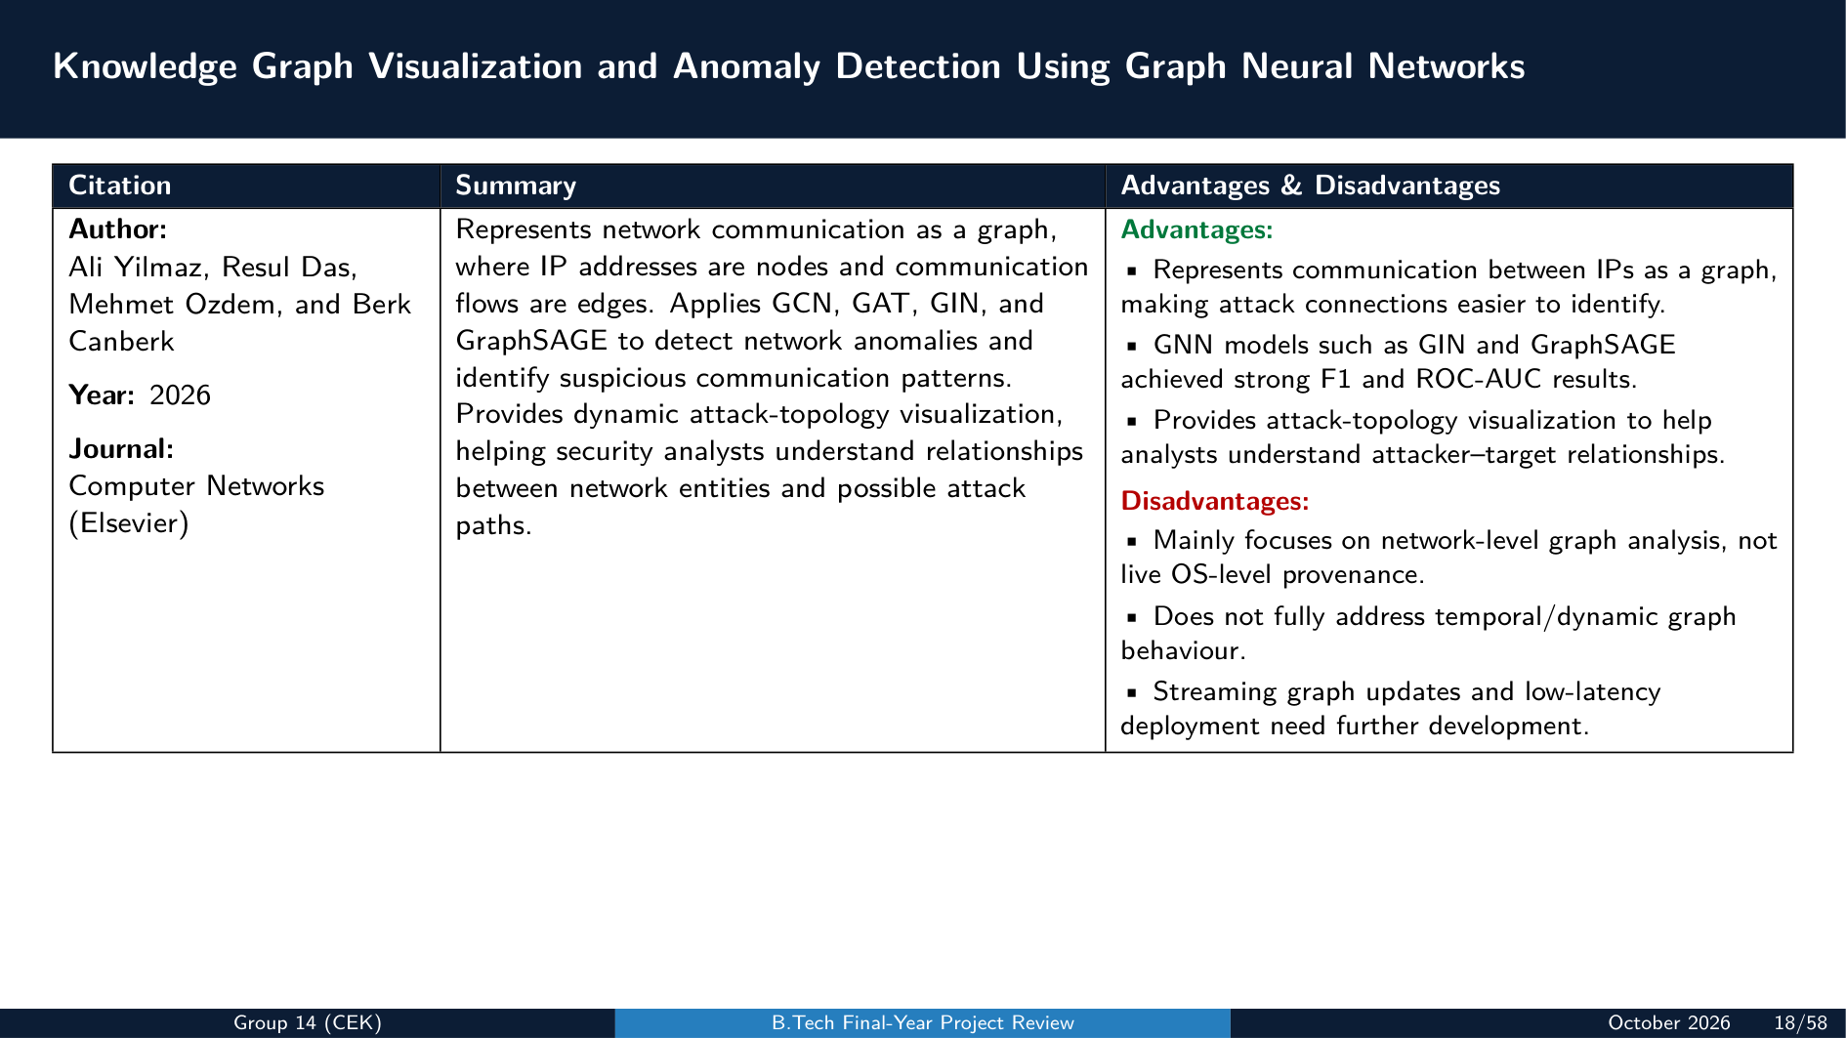

Slide 19
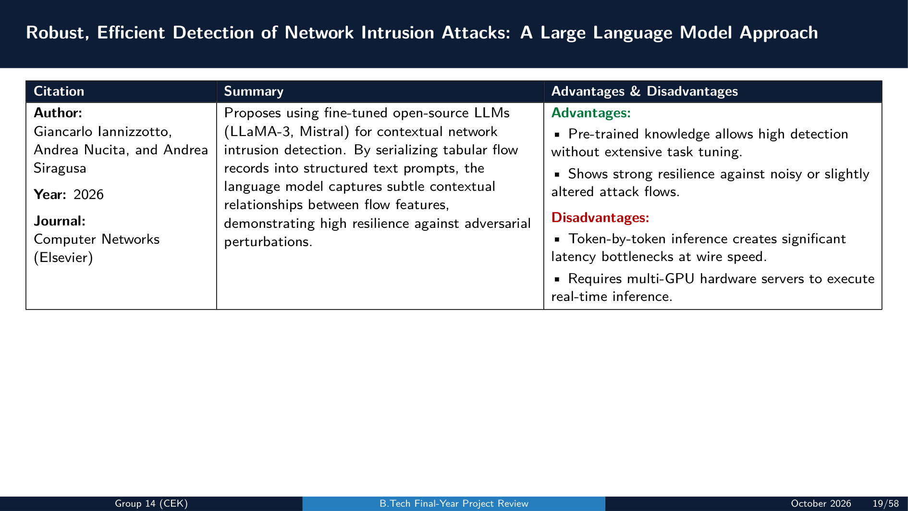

Slide 20
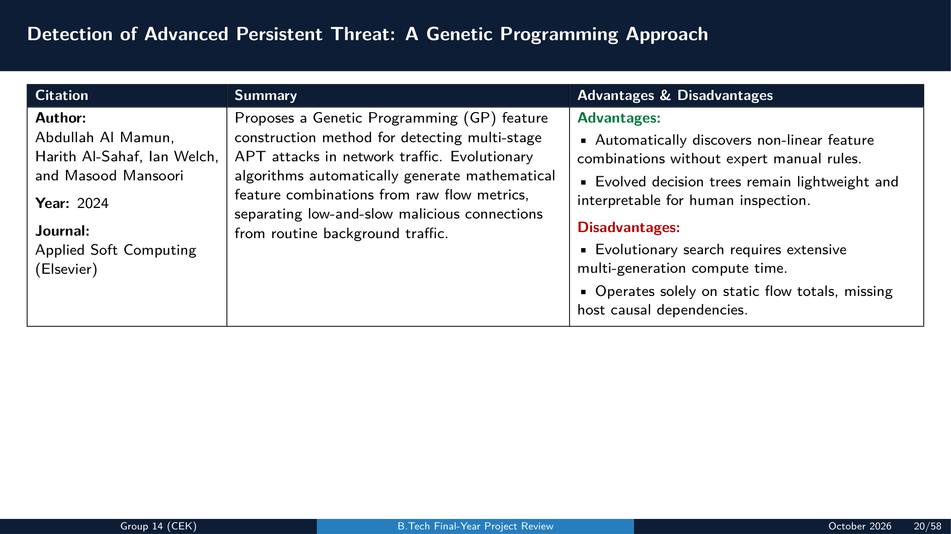

Slide 21
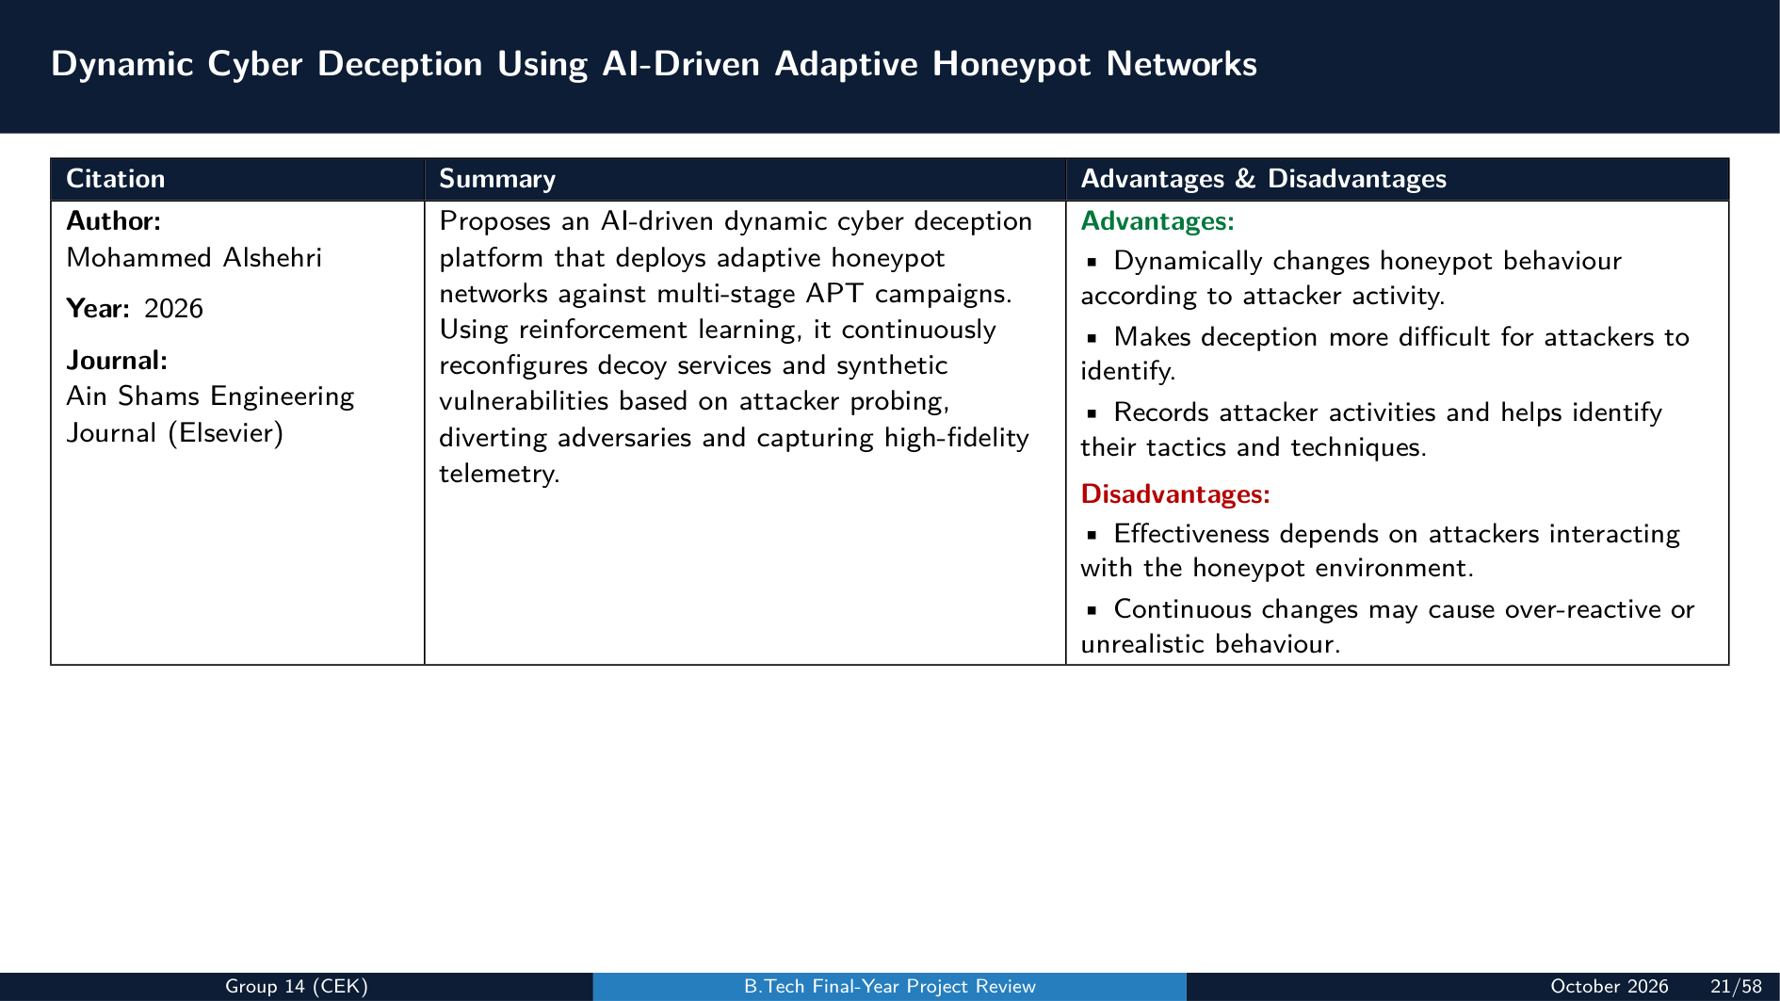

Slide 22
PHASE I: FOUNDATIONS & PROBLEM FORMULATION
5. Identified Research Gaps & Proposed Solutions
Research Gaps (Existing Systems)
Proposed Solutions (Our System)
• 1. Isolated Logs and Missed Attack Paths:
Existing tools analyze each computer separately, making it difficult to track attackers moving between machines. Combining all logs can also increase storage and processing costs.
• 2. Dependence on Known Attacks:
Many AI models require labeled attack data, making it difficult to detect new, unknown zero-day attacks and increasing false alarms.
• 3. Privacy Risks and High Resource Usage:
Sharing raw logs creates privacy risks, while complex graph AI models require too much time and computing power for resource-limited devices.
• 1. Network-Wide Attack Tracking:
Connect related events across multiple computers to reconstruct complete attack paths while reducing unnecessary graph complexity.
• 2. Unsupervised Zero-Day Detection:
Use Masked-GAT to learn normal system behavior and identify unknown attacks without requiring labeled attack data.
• 3. Lightweight and Privacy-Preserving AI:
Run a compact model locally for fast detection and use TenSEAL CKKS-encrypted Federated Learning to train collaboratively without sharing raw system logs.
College of Engineering Karunagappally | Department of Computer Science & Engineering | B.Tech Capstone 2026-27

Slide 23
PHASE II: SYSTEM ARCHITECTURE & WORKFLOW (PART 1/2)
6. System Design Principles: Core Features & Architecture
1. Core System Features & Architecture
2. Technologies, Frameworks & Core Libraries
• Continuous Telemetry Ingestion:
Streams DARPA TC CDM Avro/JSON logs, Linux Auditd, CamFlow LSM hooks, Windows Sysmon v14, Security Event Logs (4624, 4768, 4778), and ICS Modbus/DNP3 events.
• Semantics-Preserving Compaction:
Collapses high-frequency execution loops (reads, writes, socket polling) reducing volume >85% while guaranteeing 0% causality loss.
• Decoupled Feature Representation:
Encodes entities into 6D one-hot vectors for microsecond GPU tensor computation; offloads heavy string attributes to external lookup tables.
• Dual-Tier AI Detection Engine:
On-device Edge-TGNN (79.63 KB footprint, 3.2 ms latency) with 3-step PGD adversarial hardening + SOC Masked-GAT autoencoder with K-d tree anomaly scoring.
• Whole-Network Kill-Chain Tracing:
Logon-session partitioned bidirectional BFS with synthetic pseudo-edges, bridging disjoint attacks across Windows AD, Linux, and ICS networks.
• Deep Learning & Graph Frameworks:
- Python 3.10+, PyTorch v2.2.0, PyTorch Geometric (PyG v2.5.0)
- Deep Graph Library (DGL v1.1) for scalable message passing
- SciPy v1.12 for Spatial K-d Tree indexing (k=10 neighbor search)
- Scikit-Learn & NumPy for data modeling and vector math
• Privacy-Preserving Federated Cryptography:
- TenSEAL CKKS Homomorphic Encryption for secure model aggregation
- Decentralized FedAvg training preserving raw audit privacy
• Ingestion Sensors & Forensics Dashboard:
- FastAvro v1.9 for binary CDM stream ingestion
- Linux Auditd, CamFlow v0.5 LSM hooks, Windows Sysmon v14
- FastAPI async backend + Cytoscape.js interactive graph canvas
College of Engineering Karunagappally | Department of Computer Science & Engineering | B.Tech Capstone 2026-27

Slide 24
PHASE II: SYSTEM ARCHITECTURE & WORKFLOW (PART 2/2)
6. System Design Principles: Datasets & Database Architecture
3. Benchmark Dataset: DARPA Transparent Computing (TC)
4. Dual-Tier Database Architecture
• Gold Standard for APT Provenance Analytics:
The project exclusively utilizes the DARPA Transparent Computing (TC) Engagement 3 (E3) dataset, the authoritative benchmark for evaluating whole-system provenance-based intrusion detection.
• Subsets Evaluated (Real Multi-Stage Red-Team Attacks):
- E3-CADETS (FreeBSD / OpenBSM): 1.62M nodes, 3.30M edges
Nginx memory corruption exploit, dropper installation, and Drakon in-memory injection into sshd.
- E3-THEIA (Linux Ubuntu / LSM): 1.62M nodes, 2.87M edges
Browser drive-by exploits, root privilege escalation, credential theft, and sensitive file exfiltration.
- E3-TRACE (Linux CamFlow & Auditd): 3.28M nodes, 4.08M edges
Continuous 2-week recording featuring a stealthy Firefox backdoor, cron persistence, and SSH lateral movement.
• Why Exclusively DARPA TC? Ground-Truth Enterprise Provenance:
Contains authentic multi-stage cyber attacks executed by nation-state caliber red teams interleaved with dense benign background activity. It provides full kernel-level causal visibility under a unified Common Data Model (CDM).
• Neo4j Enterprise 5.x (Graph Provenance Store):
- Purpose: High-speed DAG indexing and causal traversal engine.
- Node Labels: :Process, :File, :Socket, :Host
- Relationship Types: [:FORK], [:EXEC], [:READ], [:WRITE], [:CONNECT]
- Synthetic Pseudo-Edges: [:PERSISTENCE_PSEUDO_EDGE], [:PORTFWD_CROSS_MACHINE]
- Performance: Native graph pointers deliver sub-second multi-hop causal reachability queries.
• PostgreSQL 16 (Relational Metadata Store):
- Purpose: Structured persistence of host assets, detection seeds, and federated updates.
- Key Tables: hosts (inventory), anomalies (AI seeds), attack_graphs (scenario DAGs), federated_updates (edge parameter weights)
- ACID Compliance: Guarantees transactional consistency for compliance audits and SOC forensics.
College of Engineering Karunagappally | Department of Computer Science & Engineering | B.Tech Capstone 2026-27

Slide 25
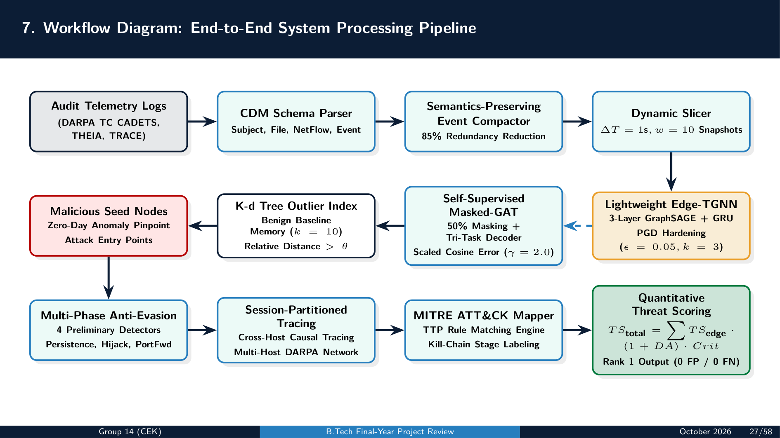

Slide 26
PHASE III: MULTI-MODEL DETECTION PIPELINE (PART 1/2)
8. Proposed Methods: Edge-TGNN & Masked-GAT Autoencoder
1. Lightweight Edge-TGNN with Adversarial Defense
2. Self-Supervised Masked-GAT Autoencoder
• Spatial GNN (3-Layer GraphSAGE):
Mean aggregation pooling local causal neighborhoods:
h_v^(l) = ReLU(W_self h_v^(l-1) + W_neigh (1/|N(v)|) ∑ h_u^(l-1))
Hidden dimension d_h = 32 maintains ultra-low memory footprint.
• Temporal Recurrence (Gated Recurrent Unit):
Captures sequential transitions across rolling graph snapshots:
h_(i,t)^temp = GRU(h_Gt, h_(i,t-1)^temp) with hidden size d_gru = 64.
• 3-Step Continuous PGD Adversarial Hardening:
Perturbation ascent maximizing classification loss:
δ* = argmax_(||δ||≤Ω) ℓ(f_θ(G+δ), y) with k_mod ≤ 3, ε = 0.05.
• On-Device Federated Learning (FedAvg):
Transmits only 79.63 KB parameter deltas Δθ_i to central SOC; raw kernel logs never leave endpoint devices.
• 50% Stochastic Attribute Masking:
Randomly corrupts node features while preserving structural causality, forcing the encoder to learn intrinsic contextual patterns.
• Multi-Layer Attention Message Passing:
Computes edge-type aware attention coefficients α_nu^(l) and concatenates layer representations: H_n = h_n^(1) || h_n^(2) || h_n^(3).
• Tri-Task Self-Supervised Decoder:
- Task 1: Multi-view re-masking with Scaled Cosine Error (SCE, γ = 2.0)
- Task 2: Latent target feature representation matching
- Task 3: Edge existence structural link prediction via BCE loss
• K-d Tree Spatial Outlier Scoring:
Evaluates distance ratio (D_test / D_train_neighbors) > θ across 10 nearest normal neighbors to flag stealthy zero-day attack seeds.
College of Engineering Karunagappally | Department of Computer Science & Engineering | B.Tech Capstone 2026-27

Slide 27
PHASE III: MULTI-MODEL DETECTION PIPELINE (PART 2/2)
8. Proposed Methods: Cross-Machine Tracing & Threat Scoring
3. Session-Partitioned Cross-Machine Tracing Engine
4. Quantitative ATT&CK Threat Scoring & Prioritization
• Logon-Session Boundary Isolation:
Partitions execution by Logon Session IDs to conquer dependency explosion; confines graph reachability to causal process lifecycles.
• Cyber Persistence Pseudo-Edges:
Connects malicious registry Run keys and Scheduled Tasks to their subsequent spawned processes across system reboots.
• Session Hijacking & Token Theft Resolution:
Detects privilege elevation by mapping Windows Security Events 4624/4768 and lsass token duplication into explicit causal edges.
• Reverse Proxy Port Forwarding Linking:
Correlates inbound listening sockets with outbound target connections, revealing multi-hop lateral pivots across jump hosts.
• Total Threat Scoring Formulation:
TS_total = ∑ [TS_edge(e) · (1 + DA_entity) · Crit_target]
- TS_edge: Edge severity weight based on operational criticality
- DA_entity: Domain Administrator and privileged account boost factor
- Crit_target: High-value asset criticality multiplier (e.g. Domain Controller, ICS PLC)
• MITRE ATT&CK Matrix Mapping:
Maps reconstructed provenance subgraphs across the full kill-chain (TA0001 Initial Access through TA0010 Exfiltration/Impact).
• Rank-1 Attack Prioritization:
Surfaces true multi-host red-team intrusion scenarios at Rank 1 (0 FP / 0 FN), eliminating analyst alert fatigue.
College of Engineering Karunagappally | Department of Computer Science & Engineering | B.Tech Capstone 2026-27

Slide 28
PHASE III: MULTI-MODEL DETECTION PIPELINE (SLIDE 1/5)
9. Model Responsibilities: Model 1 — Edge-TGNN (Perimeter Sentry)
1. Edge Architecture & Real-Time Specifications
2. Adversarial Hardening & Federated Defense
• Primary Operational Role:
First line of perimeter defense deployed on local edge nodes, IoT gateways, and endpoint agents for millisecond-level screening.
• Input Telemetry Stream:
Dynamic rolling temporal graph snapshots {G_(t-9), ..., G_t} with slice duration ΔT = 1.0s and historical window w = 10 (10s observation).
• Spatial GNN Feature Extraction:
3-Layer GraphSAGE encoder with mean aggregation (hidden dimension d_h = 32) pooling local causal neighborhoods.
• Temporal Sequence Modeling:
Single-layer Gated Recurrent Unit (GRU, hidden dimension d_gru = 64) with global mean pooling readout.
• Edge Operational Constraints:
Ultra-compact 79.63 KB parameter footprint, runs in <1 MB RAM, and executes inference in just 3.2 ms per snapshot.
• 3-Step Continuous PGD Adversarial Training:
Hardened against structural evasion via client-side Projected Gradient Descent:
δ* = argmax_(||δ||≤Ω) ℓ(f_θ(G + δ), y) with k_mod ≤ 3 and ε = 0.05.
• Privacy-Preserving Federated Aggregation:
Trained collaboratively across edge endpoints using Federated Averaging (FedAvg) over TenSEAL CKKS Homomorphic Encryption.
• Zero Telemetry Leakage:
Endpoints transmit only encrypted 79.63 KB weight deltas Δθ_i to central SOC; sensitive raw OS logs never leave local host memory.
• Edge Detection Criterion:
Outputs local maliciousness probability s_(i,t) ∈ [0, 1]. Whenever s_(i,t) ≥ τ_edge, an immediate isolation alarm is triggered and the compacted subgraph is forwarded to the SOC.
College of Engineering Karunagappally | Department of Computer Science & Engineering | B.Tech Capstone 2026-27

Slide 29
PHASE III: MULTI-MODEL DETECTION PIPELINE (SLIDE 2/5)
9. Model Responsibilities: Model 2 — Masked-GAT (SOC Deep Analyzer)
1. Neural Architecture & Self-Supervised Tri-Task Decoder
2. Unsupervised Zero-Day Detection & Spatial Outlier Criteria
• Primary Operational Role:
Centralized enterprise analyzer running on GPU clusters to pinpoint stealthy zero-day process execution anomalies without labeled training data.
• Multi-Scale Graph Attention Encoder:
Stacked multi-layer GAT with edge-type aware attention coefficients α_nu^(l) and layer concatenation:
H_n = h_n^(1) || h_n^(2) || h_n^(3)
• 50% Stochastic Attribute Masking:
Randomly masks 50% of node features while preserving structural causality, forcing the model to learn deep contextual execution patterns.
• Tri-Task Self-Supervised Decoder:
- Task 1: Multi-view re-masking with Scaled Cosine Error (SCE, γ = 2.0)
- Task 2: Latent target feature representation matching
- Task 3: Edge existence structural link prediction via BCE loss.
• 100% Benign Baseline Training:
Trained strictly on the earliest 70% chronological benign audit logs, mapping normal system behavior without requiring labeled attack samples.
• K-d Tree Benign Neighborhood Memory:
Builds a high-dimensional spatial K-d tree indexing normal node representations (k = 10 nearest normal neighbors).
• Anomaly Decision Criterion:
Evaluates relative spatial outlier distance ratio:
Score(v) = (D_test / D_train_neighbors) > θ
• Threshold Calibration:
Threshold θ = 1.5 is calibrated on the middle 10% validation split at the 99.9th percentile, ensuring a strict false positive rate FPR ≤ 0.1%.
• Seed Isolation Output:
Flags process nodes exceeding θ as anomalous attack seeds M, forwarded to the Tracing Engine.
College of Engineering Karunagappally | Department of Computer Science & Engineering | B.Tech Capstone 2026-27

Slide 30
PHASE III: MULTI-MODEL DETECTION PIPELINE (SLIDE 3/5)
9. Model Responsibilities: Model 3 — Causal Tracing Engine
1. Dependency Explosion Mitigation & Synthetic Pseudo-Edges
2. Multi-Host Attack Reconstruction & ATT&CK Attribution
• Primary Operational Role:
Connects disconnected attack steps across execution boundaries, machines, and network domains to reconstruct the complete multi-stage APT attack scenario.
• Logon-Session Boundary Isolation:
Partitions audit graphs by Logon Session IDs (L_id); confines causal traversal strictly to process lifecycles, fully eliminating dependency explosion.
• Anti-Evasion Synthetic Pseudo-Edge Insertion:
- Cyber Persistence: Connects startup registry Run keys and Scheduled Tasks to subsequent execution sessions across reboots.
- Session Hijacking: Connects SYSTEM token duplication (Event 4624/4768) to new unauthorized logon sessions.
- Port Forwarding: Remaps local proxy loopback sockets to remote target endpoints, exposing multi-hop lateral pivots across jump hosts.
• Bidirectional Causal Traversal:
Executes backward causality (tracking initial entry point and exploit) and forward causality (tracking data exfiltration and destruction) from seeds M.
• Cross-Domain IT-to-OT Correlation:
Correlates enterprise Windows/Linux jump hosts with industrial protocols (Modbus, IEC 60870-5-104, Siemens SIPROTEC, Hitachi RTU500).
• Quantitative ATT&CK Threat Scoring:
TS_total = ∑ [TS_edge(e) · (1 + DA_entity) · Crit_host]
Weights edges by operational severity, Domain Admin rights, and asset criticality.
• Rank-1 SOC Output:
Surfaces true multi-host red-team intrusion scenarios at Rank 1 (0 False Positives / 0 False Negatives) on Cytoscape.js interactive canvas.
College of Engineering Karunagappally | Department of Computer Science & Engineering | B.Tech Capstone 2026-27

Slide 31
PHASE III: MULTI-MODEL DETECTION PIPELINE (SLIDE 4/5)
10. Inference Flow: Phase 1 — Real-Time Edge Screening & Zero-Day Isolation
Step 1: Continuous Ingestion & Loop Compaction
Step 2: Sub-4ms Edge Screening & Masked-GAT Isolation
• OS Kernel Telemetry Ingestion:
Low-overhead audit hooks (Linux auditd, CamFlow, Windows Sysmon) capture high-fidelity process, file, and socket operations.
• Semantics-Preserving Event Compaction:
Repetitive I/O loops (consecutive read, write, recvfrom calls) are collapsed into weighted edges w(e) ← w(e) + 1.
• Compaction Performance:
- Over 85% data volume reduction across DARPA TC benchmarks
- Zero causality loss: 100% of causal attack chains are preserved.
• Dynamic Snapshot Construction:
Slices continuous event streams into rolling temporal snapshots G_(i,t) with ΔT = 1.0s and historical observation window w = 10.
• Real-Time Edge-TGNN Evaluation:
On-device 3-layer GraphSAGE + GRU evaluates each snapshot in 3.2 ms. If anomaly score s_(i,t) ≥ τ_edge, an immediate perimeter alert is raised.
• Compacted Telemetry Streaming:
Flagged subgraphs are uploaded to the centralized SOC cluster; non-anomalous background traffic is discarded, saving >95% network bandwidth.
• Centralized Masked Reconstruction:
SOC Masked-GAT autoencoder reconstructs masked node features across the uploaded candidate graph.
• Spatial K-d Tree Outlier Scoring:
Evaluates relative distance ratio (D_test / D_train_neighbors) > θ against normal baseline memory, isolating malicious process seeds M.
College of Engineering Karunagappally | Department of Computer Science & Engineering | B.Tech Capstone 2026-27

Slide 32
PHASE III: MULTI-MODEL DETECTION PIPELINE (SLIDE 5/5)
10. Inference Flow: Phase 2 — Whole-Network Tracing & Attack Scenario Attribution
Step 3: Session-Partitioned Bidirectional Traversal
Step 4: Synthetic Pseudo-Edge Stitching & Final ATT&CK Output
• Backward Causality Tracing (Root Cause Analysis):
Originates from anomaly seeds M and traverses backward along incoming edges to discover initial compromise vectors (e.g., Nginx web exploit, phishing attachment).
• Forward Causality Tracing (Blast Radius Analysis):
Traverses forward along outgoing edges to discover child processes, stolen credential files, modified registry keys, and exfiltration sockets.
• Logon-Session Boundary Confinement:
Traversal is restricted strictly within active Logon Session IDs (L_id), terminating at session boundaries to prevent branch explosion.
• Multi-Host Traversal:
Crosses network socket boundaries to correlate adjacent hosts in the enterprise network.
• Multi-Stage Pseudo-Edge Stitching:
Inserts synthetic edges bridging persistence mechanisms across reboots, SYSTEM token theft across logoffs, and reverse proxy port hops across jump hosts.
• IT-to-OT Industrial Correlation:
Traces attacker actions through engineering workstations into industrial field devices (Siemens SIPROTEC, Hitachi RTU500).
• Quantitative ATT&CK Threat Scoring:
Computes TS_total by multiplying edge severities with Domain Admin and host criticality multipliers, categorizing stages by MITRE ATT&CK tactics.
• Rank-1 Incident Presentation:
Surfaces the true APT attack DAG at Rank 1 (0 FP / 0 FN) on Cytoscape.js interactive SOC canvas for instant forensic triage.
College of Engineering Karunagappally | Department of Computer Science & Engineering | B.Tech Capstone 2026-27

Slide 33
PHASE IV: DATA ENGINEERING & MODEL TRAINING (PART 1/2)
11. Dataset Preparation: Acquisition & CDM Schema
1. Dataset Acquisition (DARPA TC Program)
2. Common Data Model (CDM) Schema & Subsets
• DARPA Transparent Computing (TC) Program:
Designed specifically to diagnose enterprise-scale APT attacks by capturing high-fidelity, whole-system audit provenance streams.
• Realistic Multi-Host Attack Engagements:
Blends high-volume benign enterprise workload (web browsing, document editing, compilation, background daemons) with sophisticated nation-state red-team campaigns.
• Multi-OS Platform Telemetry:
Encompasses heterogeneous operating systems including FreeBSD (CADETS), Linux (THEIA, TRACE), and Windows hosts across multi-week continuous evaluation cycles.
• Standardized CDM Schema (v18/v20 Entities):
- Subject: Process entities with PID, PPID, cmdLine, UID, credentials
- FileObject: Files with path, size, permissions, and cryptographic hash
- NetFlow: Sockets with local/remote IP and port numbers
- Event: Causal relationships (EXEC, FORK, READ, WRITE, CONNECT) with nanosecond timestamps
• Investigated Benchmark Subsets:
- CADETS (FreeBSD): 1.62M nodes, 3.30M edges (Nginx exploit & Drakon injection)
- THEIA (Linux): 1.62M nodes, 2.87M edges (Browser dropper & exfiltration)
- TRACE (Linux Auditd): 3.28M nodes, 4.08M edges (Continuous 2-week cycle, SSH pivot)
College of Engineering Karunagappally | Department of Computer Science & Engineering | B.Tech Capstone 2026-27

Slide 34
PHASE IV: DATA ENGINEERING & MODEL TRAINING (PART 2/2)
11. Dataset Preparation: Preprocessing & Feature Extraction
1. Semantics-Preserving Event Compaction
2. Decoupled Feature Representation
• Repetitive Loop Elimination:
High-frequency benign operations (e.g., repeated file cache reads, continuous socket polling loops) generate millions of redundant events.
• Execution State Equivalence Rule:
If two consecutive events e_1 = (s, r, o, t_1) and e_2 = (s, r, o, t_2) exhibit identical subject, object, and system state:
Merge e_2 into e_1 and increment edge weight: w(e) ← w(e) + 1.
• Quantitative Impact:
- Volume Reduction: Over 85% graph reduction across all DARPA TC benchmarks
- Causality Guarantee: 100% causal preservation (0% attack path loss)
- Memory Efficiency: Enables full-graph in-memory training on standard GPUs.
• Compact 6D One-Hot Tensor Vectors:
Each graph node v is mapped to a normalized 6-dimensional one-hot vector X_v encoding entity type (Process, File, Socket, Controller) and basic privilege state.
• Offloading Heavy String Metadata:
Variable-length string attributes (file system paths, command-line arguments, SHA-256 hashes) are detached from the tensor graph and indexed in an external key-value lookup store.
• Computational Advantages:
- Keeps message-passing tensors ultra-compact and cache-aligned
- Eliminates slow NLP/tokenization overhead in the real-time detection path
- Enables Edge-TGNN to operate within strict 1 MB embedded memory limits.
College of Engineering Karunagappally | Department of Computer Science & Engineering | B.Tech Capstone 2026-27

Slide 35
PHASE IV: DATA ENGINEERING & MODEL TRAINING (PART 1/2)
12. Model Training & Evaluation: Chronological Data Splitting
1. Temporal Splitting Protocol (Zero Data Leakage)
2. Dataset Split Allocations & Roles
• Strict Temporal Order Preservation:
Standard randomized k-fold cross-validation causes fatal future-to-past data leakage in temporal graph streams. Telemetry is partitioned strictly along the historical time axis.
• Realistic Operational Simulation:
Ensures that detection models are evaluated only on future events that occurred after the training window, accurately mimicking enterprise SOC deployment.
• Label Imbalance Reflection:
Preserves real-world enterprise class distribution where attacks constitute <0.001% of all system events.
• Training Split (Earliest 70% of Timeline):
- Content: 100% benign baseline enterprise activity (zero attacks present)
- Purpose: Trains self-supervised Masked-GAT autoencoder and builds K-d tree normal baseline neighborhood memory.
• Validation Split (Middle 10% of Timeline):
- Content: Benign operational logs
- Purpose: Calibrates anomaly decision threshold θ = 1.5, strictly ensuring false positive rate FPR ≤ 0.1%.
• Testing Split (Latest 20% of Timeline):
- Content: Unseen operational timeline containing actual red-team APT attacks (Nginx exploit, Drakon injection, browser droppers, SSH lateral hops) mixed with background noise.
College of Engineering Karunagappally | Department of Computer Science & Engineering | B.Tech Capstone 2026-27

Slide 36
PHASE IV: DATA ENGINEERING & MODEL TRAINING (PART 2/2)
12. Model Training & Evaluation: Training Algorithms & Metrics
1. Optimization Algorithms & Loss Formulations
2. Quantitative Evaluation Metrics
• Adversarial Training Loss (Edge-TGNN):
L_adv(θ) = BCE(f_θ(G), y) + 0.8 · BCE(f_θ(G + δ*), y)
- δ* generated via 3-step continuous PGD ascent with ε = 0.05 and k_mod ≤ 3.
- Optimizer: Adam (lr = 0.001, weight decay = 1e-4) over 100 epochs.
• Tri-Task Self-Supervised Loss (Masked-GAT):
L_total = L_input + L_latent + 0.5 L_struct
- L_input: Scaled Cosine Error (SCE) with scaling factor γ = 2.0:
SCE(x, x̂) = (1 - (x · x̂) / (||x|| ||x̂||))^γ
- L_latent: MSE between encoder representation and target projector
- L_struct: Binary Cross-Entropy edge link prediction loss.
• Anomaly Detection Performance:
- Precision, Recall, F1-Score, and False Positive Rate (target FPR ≤ 0.1%)
- Area Under the ROC Curve (AUROC) and Area Under Precision-Recall (AUPRC).
• Edge Operational Efficiency:
- Parameter Footprint: Model size in storage/RAM (79.63 KB)
- Inference Latency: Per-snapshot classification speed (3.2 ms).
• Scenario Attribution & Reconstruction:
- Provenance Scenario Accuracy: Recall of ground-truth attack nodes
- Ranking Precision: Top-1 ranking of the true red-team intrusion scenario via TS_total (0 False Positives / 0 False Negatives).
College of Engineering Karunagappally | Department of Computer Science & Engineering | B.Tech Capstone 2026-27

Slide 37
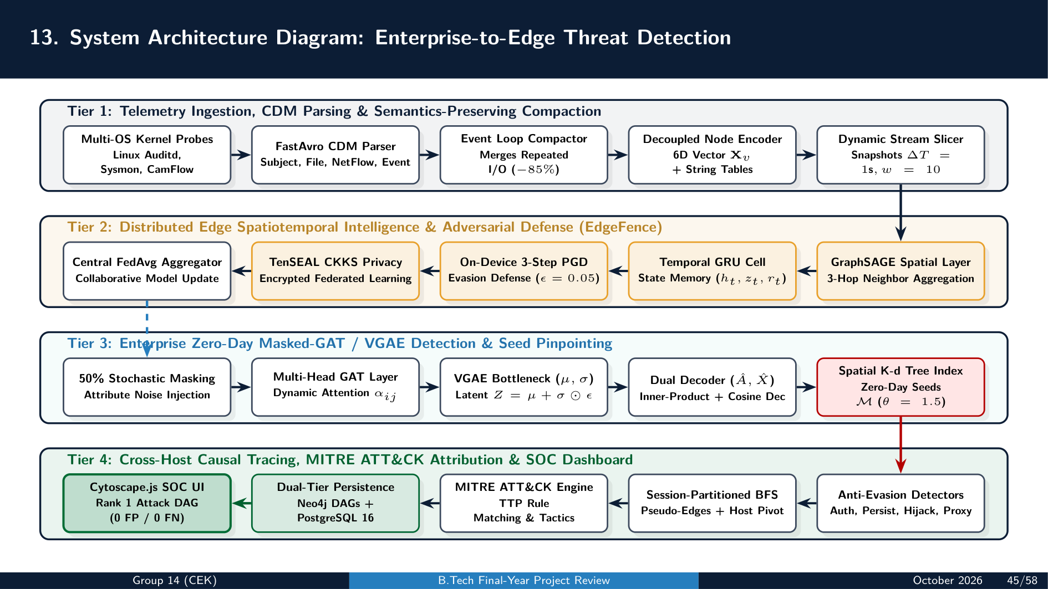

Slide 38
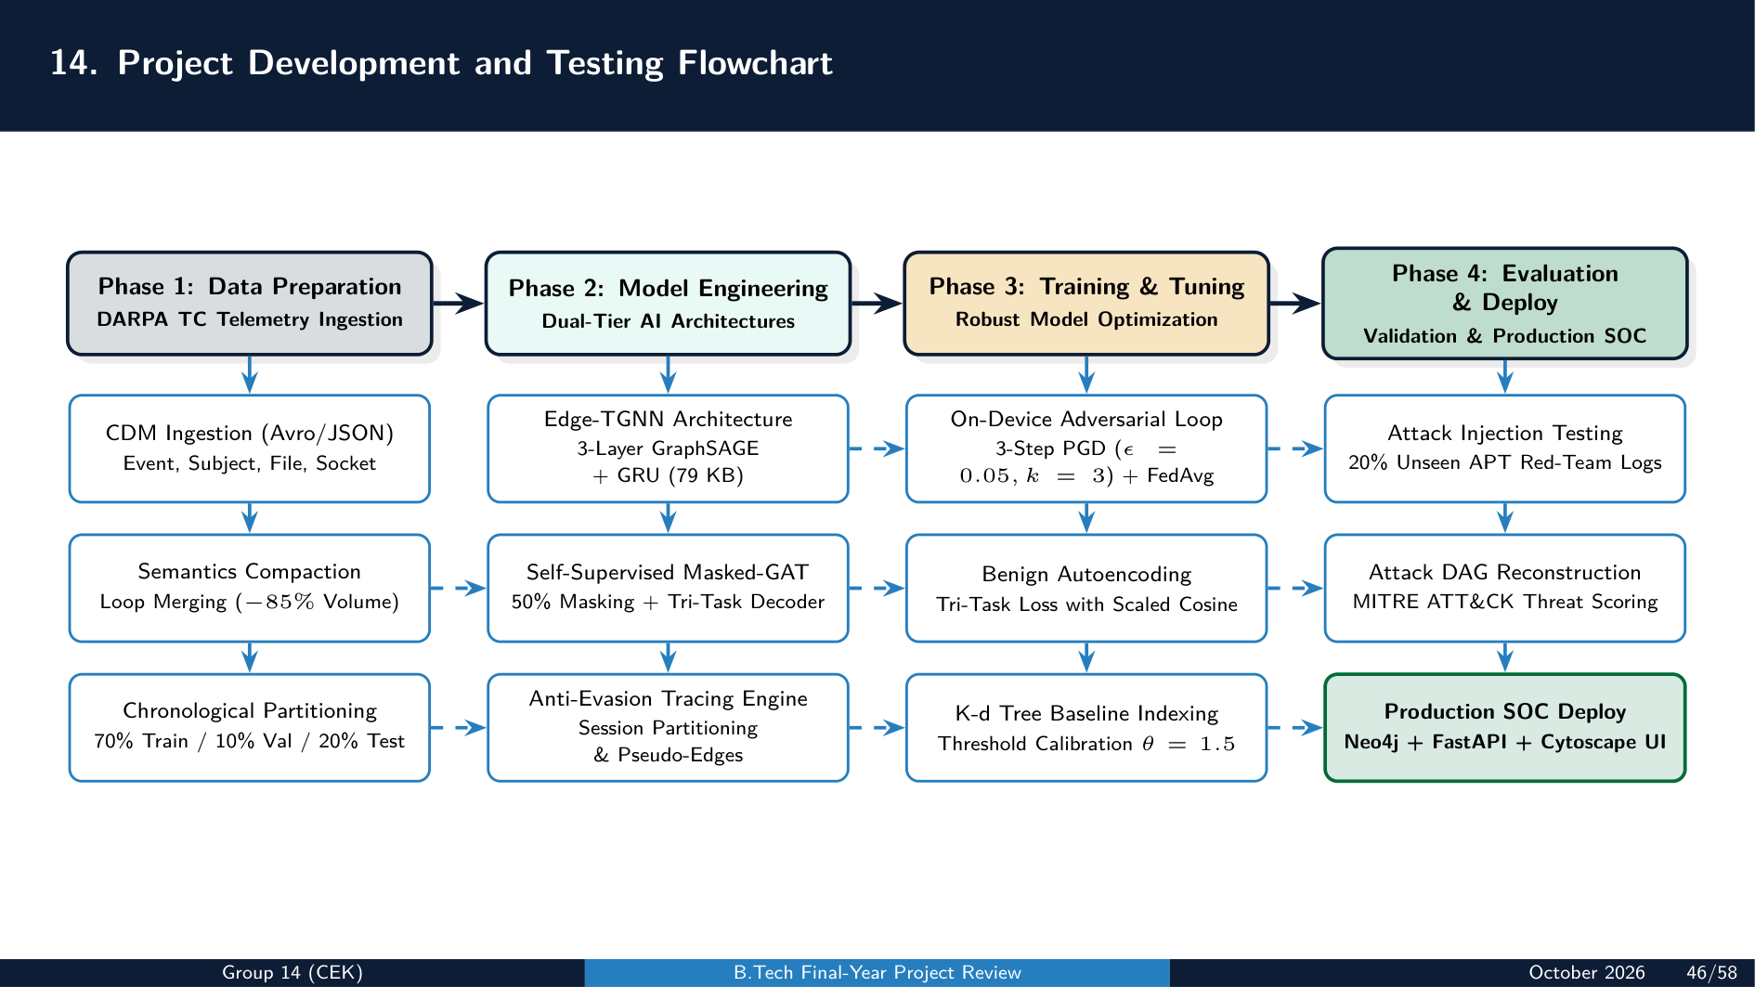

Slide 39
PHASE V: DEEP SCHEMAS & CORE ALGORITHMS
15. Database Schema: Neo4j Graph Database & Relational Store
1. Neo4j Graph Database Property Schema
2. Relational Metadata Store (PostgreSQL)
Node Labels & Key Properties:
• :Process: {uuid, pid, name, path, cmdline, uid, session_id, host}
• :File: {uuid, path, name, file_type, size_bytes, permissions, hash}
• :Socket: {uuid, src_ip, src_port, dst_ip, dst_port, protocol}
• :Controller: {uuid, model, ip, protocol, firmware, trip_curve}
Directed Relationship Types:
• [:FORK | :EXEC]: (Process) → (Process/File) {timestamp}
• [:READ | :WRITE]: (Process) → (File) {timestamp, count}
• [:CONNECT]: (Process) → (Socket) {timestamp, state}
• [:PERSISTENCE_PSEUDO_EDGE]: (SetupSession) → (ExecSession)
• [:PORTFWD_CROSS_MACHINE]: (ProxySrc) → (TargetDst)
Relational Tables & Schema Definition:
• hosts (Endpoint Inventory):
host_id (PK), hostname, os_platform, domain_name, ip_addr, is_dc, last_seen
• anomalies (AI-Flagged Seed Events):
anomaly_id (PK), host_id (FK), session_id, score, detector_source, timestamp
• attack_graphs (Reconstructed Scenarios):
graph_id (PK), seed_uuid, threat_score, tactics_list, node_count, edge_count, graph_json
• federated_updates (Edge-TGNN Training):
round_id (PK), client_id, loss_clean, loss_adv, param_norm, timestamp
College of Engineering Karunagappally | Department of Computer Science & Engineering | B.Tech Capstone 2026-27

Slide 40
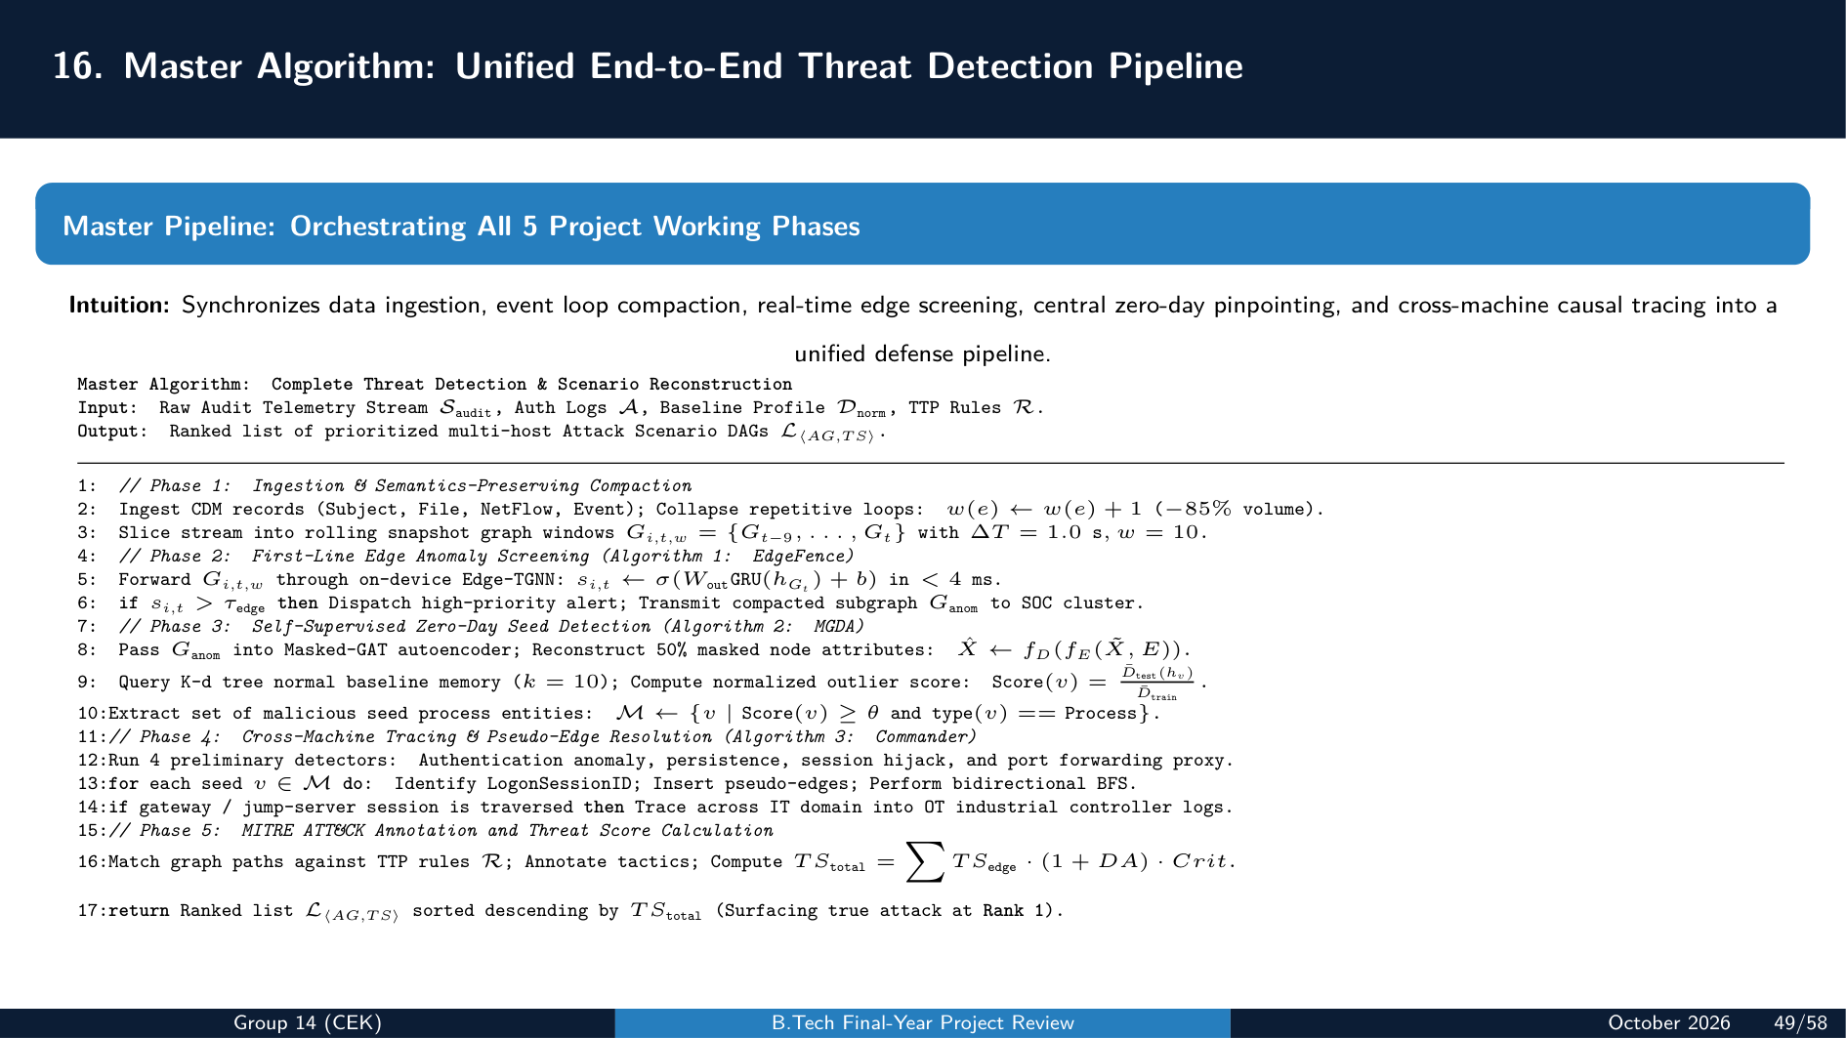

Slide 41
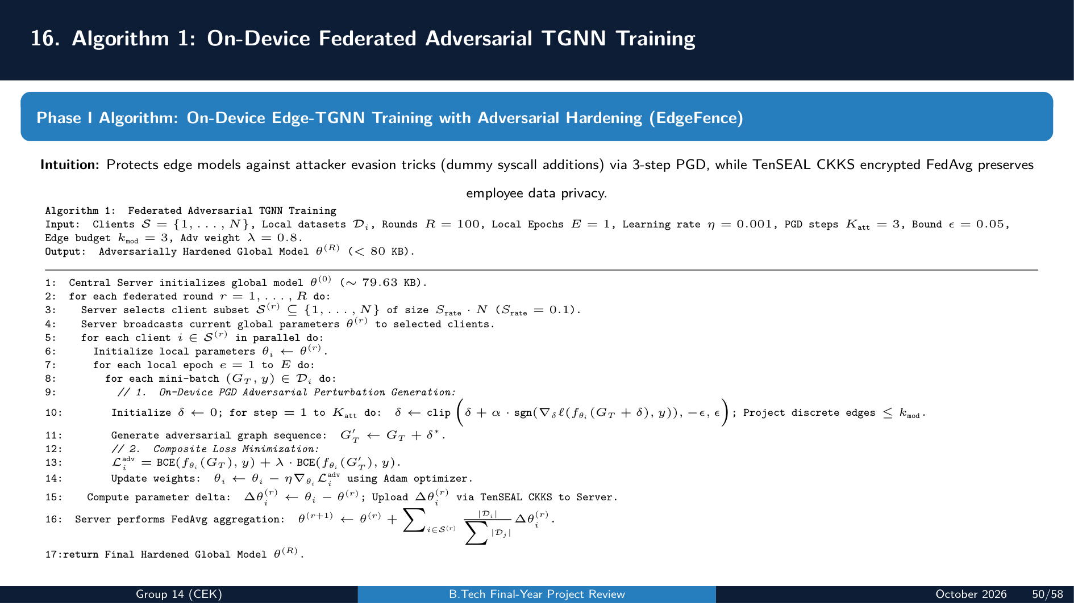

Slide 42
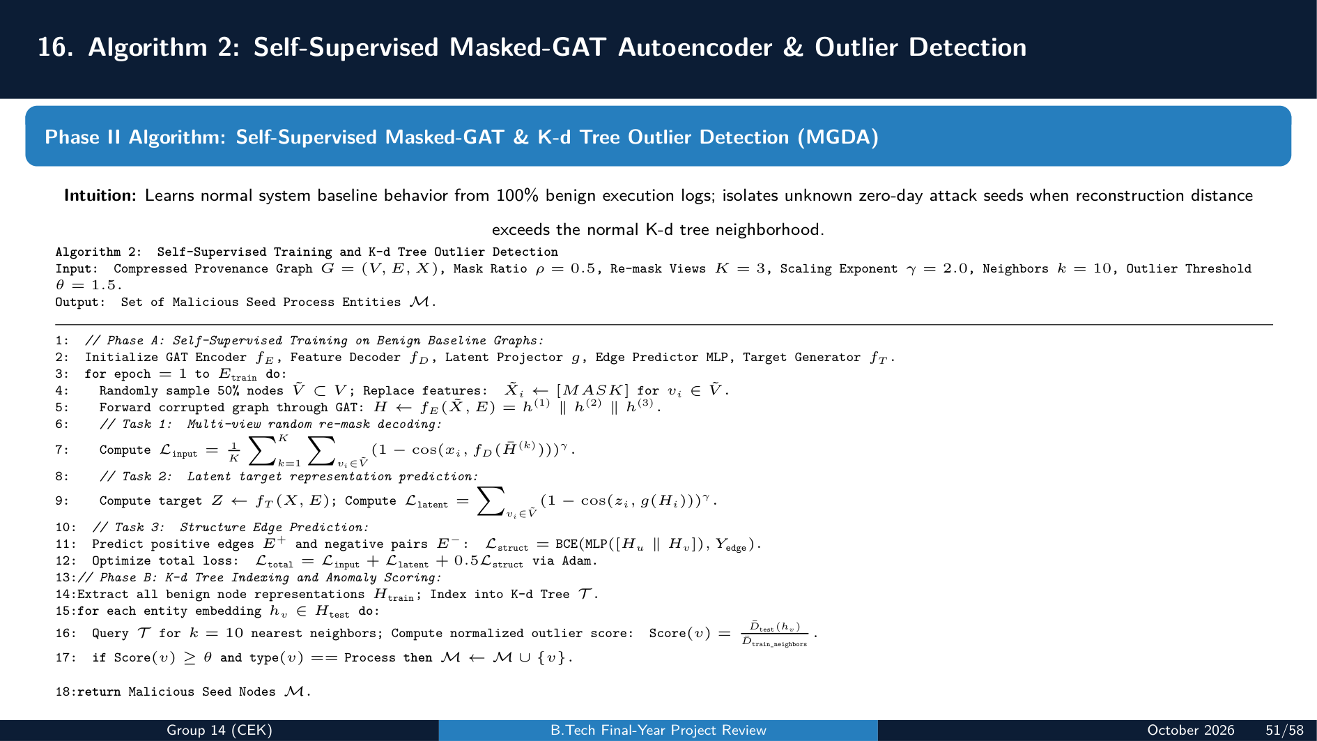

Slide 43
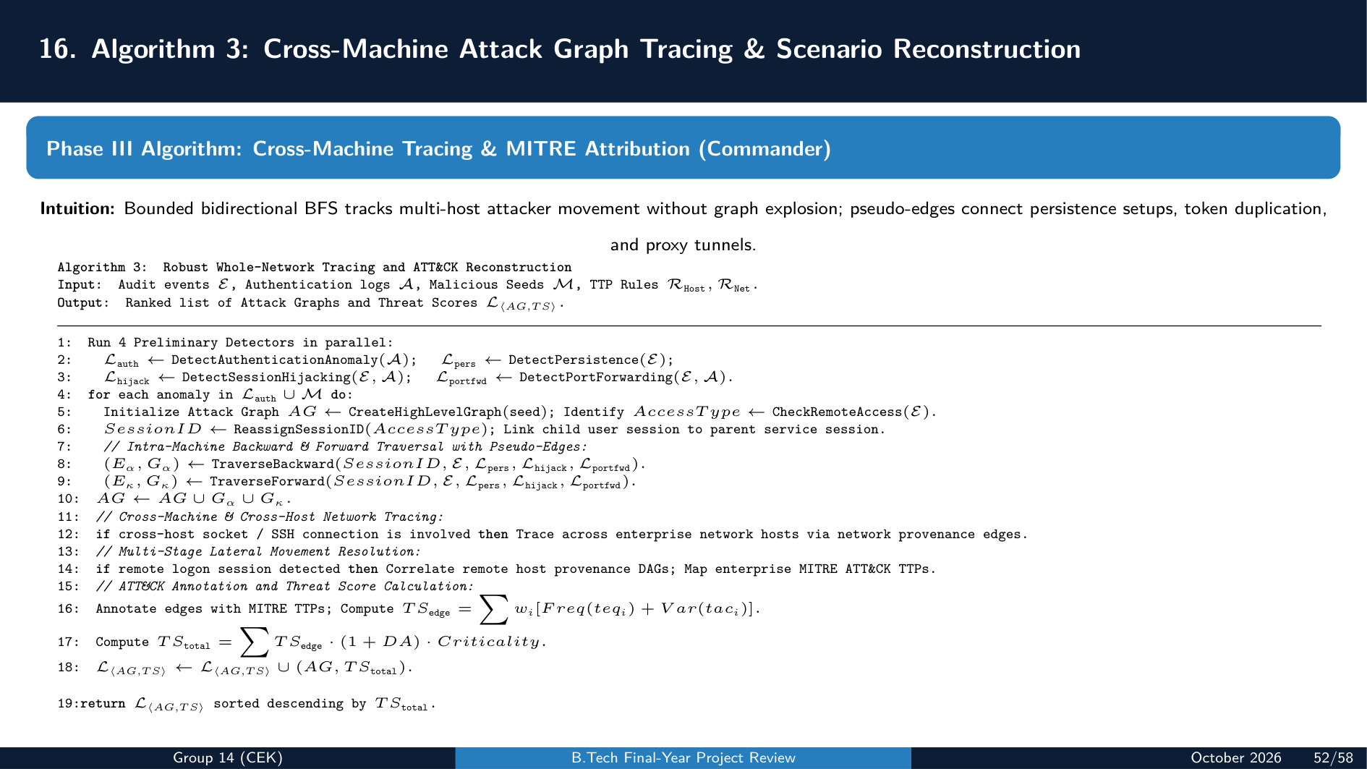

Slide 44
PHASE VI: IMPLEMENTATION, PROJECT PLAN & CONCLUSION
17. Implementation & Technology Stack: Modules & Integrations
1. Core Modules & Architecture Components
2. Technology Stack, Libraries & Frameworks
• Kernel Ingestion & Parsing Engine:
Low-overhead audit probe hooks (Linux auditd, CamFlow LSM hooks, Windows Sysmon v14). Ingests raw audit logs and converts to CDM JSON/Avro records.
• Semantics-Preserving Event Compactor:
High-throughput Rust/Python microservice evaluating execution state equivalence and collapsing repetitive I/O loops (reduces raw volume >85%).
• Dual-Tier AI Detection Server:
PyTorch Geometric microservice running lightweight Edge-TGNN (79.63 KB) on edge gateways and centralized self-supervised Masked-GAT on GPU cluster.
• Whole-Network Causal Tracing Engine:
Logon-session partitioned DFS/BFS crawler inserting pseudo-edges to bridge persistence, token hijacking, and reverse proxy tunnels.
• Deep Learning & Graph Frameworks:
Python 3.10+, PyTorch v2.2.0, PyTorch Geometric (PyG v2.5.0), DGL v1.1, SciPy v1.12 (K-d Tree spatial index), NumPy, Scikit-Learn.
• Privacy-Preserving Federated Cryptography:
TenSEAL CKKS Homomorphic Encryption for encrypted parameter updates without gradient or raw telemetry leakage.
• Dual-Tier Database & Graph Storage Engines:
Neo4j Enterprise 5.x with Cypher interface & APOC for high-speed DAG traversal; PostgreSQL 16 for metadata & inventory.
• Telemetry Sensors & Forensic Dashboard:
FastAvro v1.9, Linux Auditd, CamFlow v0.5 LSM hooks, Windows Sysmon v14; FastAPI REST backend + Cytoscape.js SOC canvas.
College of Engineering Karunagappally | Department of Computer Science & Engineering | B.Tech Capstone 2026-27

Slide 45
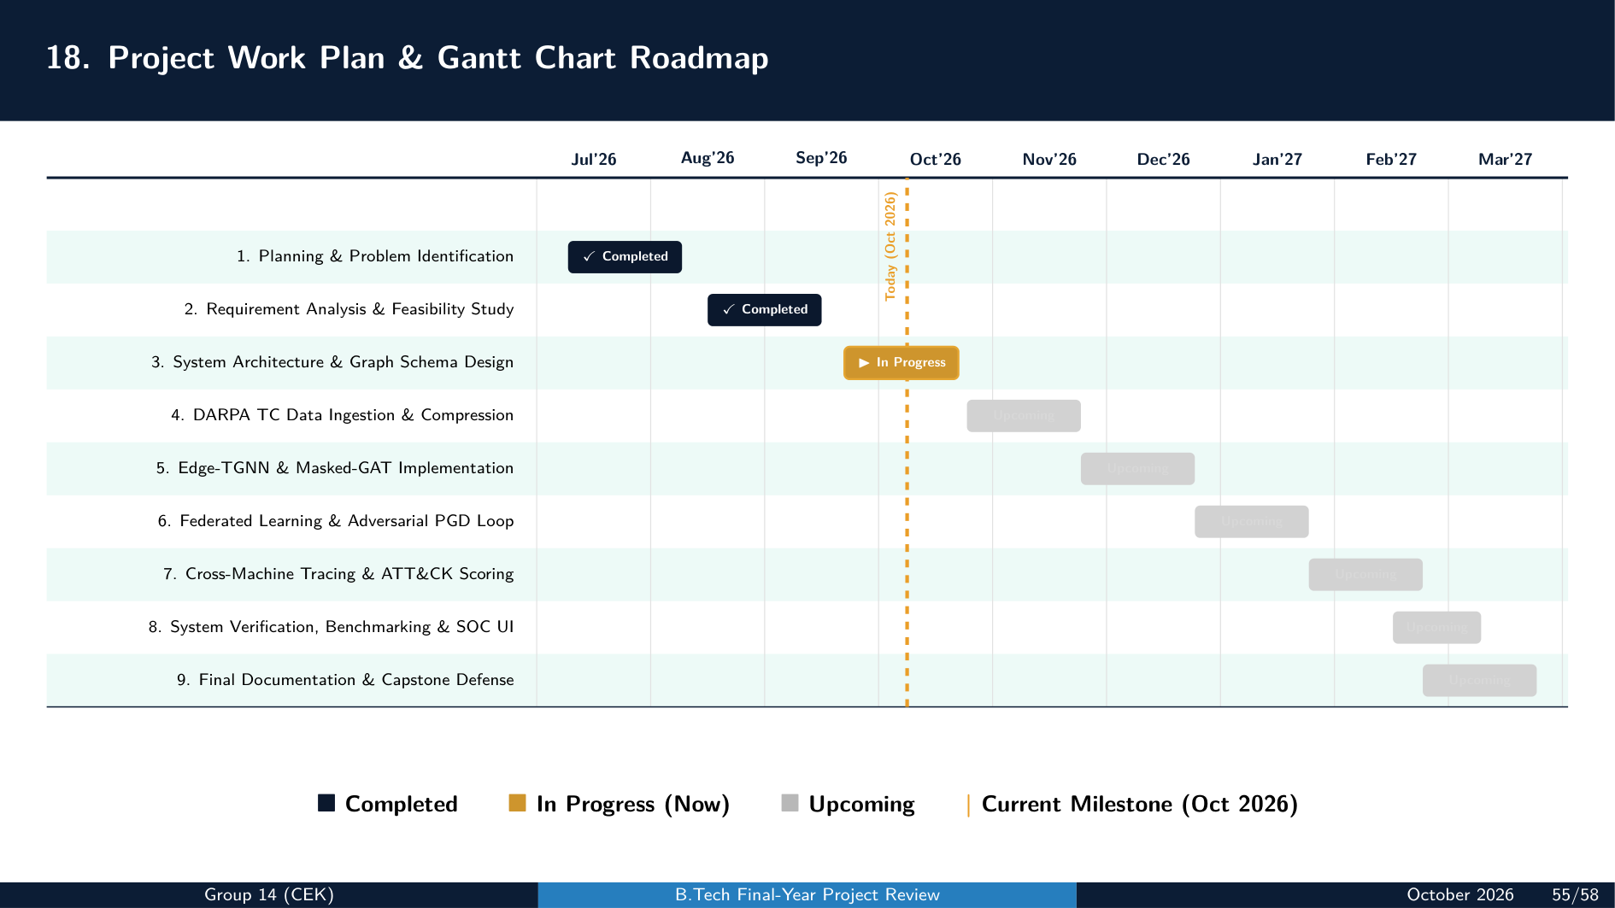

Slide 46
PHASE VI: REFERENCES & LITERATURE FOUNDATION
19. References: Primary Research Foundations
Key Literature Citations [1] - [8]
[1] Osei Isaac, Benjamin Appiah, Daniel Commey, Kwabena Owusu-Agyemang, Michael Asante, and Benjamin Hayfrom Acquah, 'EdgeFence: Federated Temporal Graph Neural Networks for Lightweight, Adversarial Malware Detection in Distributed Edge Networks,' International Journal of Information Security, vol. 25, p. 88, 2026. DOI: 10.1007/s10207-026-01237-x
[2] Mengjiao Cui, Zhengwei Jiang, Shuai Li, Chunyan Ma, Kai Zhang, Peian Yang, and Huamin Feng, 'MGDA: A provenance graph-based framework for threat detection and attack scenario reconstruction,' Computer Networks, vol. 274, p. 111806, 2026. DOI: 10.1016/j.comnet.2025.111806
[3] Qi Liu, Kaibin Bao, and Veit Hagenmeyer, 'Commander: A robust cross-machine multi-phase Advanced Persistent Threat detector via provenance analytics,' Journal of Information Security and Applications, vol. 91, p. 104057, 2025. DOI: 10.1016/j.jisa.2025.104057
[4] Roberto Canonico, Francesco Lista, Annalisa Navarro, Giancarlo Sperlí, and Andrea Vignali, 'Threat detection in reconfigurable Cyber–Physical Systems through Spatio-Temporal Anomaly Detection using graph attention network,' Computers & Security, vol. 156, p. 104509, 2025. DOI: 10.1016/j.cose.2025.104509
[5] Parth Atulbhai Gandhi, Prasanna N. Wudali, Yonatan Amaru, Akansha Shukla, Yuval Elovici, and Asaf Shabtai, 'SHIELD: Advanced persistent threats detection and intelligent explanation using large language models,' Engineering Applications of Artificial Intelligence, vol. 181, p. 115443, 2026.
[6] Francesco Ferazza, Cosimo Melella, Konstantinos Mersinas, Ricardo Lugo, and Rain Ottis, 'From logs to tactics: unsupervised reconstruction of APT campaigns with MITRE-enriched meta-alerts,' International Journal of Information Security, vol. 25, p. 79, 2026.
[7] Gisung Kim, Seungmin Lee, and Sehun Kim, 'A novel hybrid intrusion detection method integrating anomaly detection with misuse detection,' Expert Systems with Applications, vol. 41, no. 4, pp. 1690–1700, 2014.
[8] Haiyang Diao, Xiang Li, Wan Zhang, Yan Sibyl Yu, Ye Wang, and Jing Zhang, 'Self-supervised graph neural networks for network intrusion detection in cloud-edge,' Journal of Cloud Computing, vol. 15, no. 1, p. 24, 2026.
College of Engineering Karunagappally | Department of Computer Science & Engineering | B.Tech Capstone 2026-27

Slide 47
PHASE VI: REFERENCES & LITERATURE FOUNDATION
19. References: Additional Literature Sources
Additional Literature Citations [9] - [16]
[9] Eslam Amer, Shaker El-Sappagh, Tamer Abuhamad, Bander Ali Saleh Al-Rimy, and Alaa Mohasseb, 'GraphShield: Advanced dynamic graph-based malware detection using graph neural networks,' Expert Systems with Applications, vol. 268, p. 129812, 2025.
[10] Fargana Abdullayeva and Suleyman Suleymanzade, 'Cyber security attack recognition on cloud computing networks based on GCN and GraphSAGE models,' Results in Control and Optimization, vol. 16, p. 100423, 2024.
[11] Rana Abu Bakar, Lorenzo De Marinis, Filippo Cugini, and Francesco Paolucci, 'FTG-Net-E: A hierarchical ensemble graph neural network for DDoS attack detection,' Computer Networks, vol. 248, p. 110508, 2024.
[12] Md Shakil Siddique, Md. Ashikur Rahman Khan, Ishtiaq Ahammad, Nishu Nath, Joysri Rani Das, and Fardowsi Rahman, 'Intelligent intrusion detection for cyber-physical systems using GAN-LSTM,' Franklin Open, vol. 11, p. 100281, 2025.
[13] Ali Yilmaz, Resul Das, Mehmet Ozdem, and Berk Canberk, 'Knowledge graph visualization and anomaly detection using graph neural networks,' Computer Networks, vol. 278, p. 112632, 2026.
[14] Giancarlo Iannizzotto, Andrea Nucita, and Andrea Siragusa, 'Robust, efficient detection of network intrusion attacks: A large language model approach,' Computer Networks, vol. 276, p. 112559, 2026.
[15] Abdullah Al Mamun, Harith Al-Sahaf, Ian Welch, and Masood Mansoori, 'Detection of advanced persistent threat: A genetic programming approach,' Applied Soft Computing, vol. 167, p. 112447, 2024.
[16] Mohammed Alshehri, 'Dynamic cyber deception using AI-driven adaptive honeypot networks,' Ain Shams Engineering Journal, vol. 17, no. 3, p. 104061, 2026.
College of Engineering Karunagappally | Department of Computer Science & Engineering | B.Tech Capstone 2026-27

Slide 48
Thank You
Questions & Discussion
Muhammed Nasih K P (KNP23CS074) • Sumayya Ershad (KNP23CS107)
Najmunniza N (LKNP20CS056) • K.S. Mahadev (KNP23CS066)
Department of Computer Science & Engineering
College of Engineering, Karunagappally
Guide: Mrs. SYAMA S R, Assistant Professor

