Slide 1
Decision Tree with C4.5 algorithm Implementation In Python
Md Nasim Al Sajjad

Slide 2
Example of a Decision Tree
categorical
categorical
continuous
class
Splitting Attributes
Home
Yes
No
NO
MarSt
Single, Divorced
Married
TaxInc
NO
< 80K
> 80K
NO
YES
Training Data
Model: Decision Tree

Slide 3

The equation to compute GR is
where we use the class label as X, and each non-class attribute as Y.Lets assume X1 is an attribute and X10 is Class Label.

Slide 4
Load Data
Df_train = graphlab.Sframe(‘train_data.csv’)
Df_test = graphlab.Sframe(‘test_data.csv’)

Slide 5
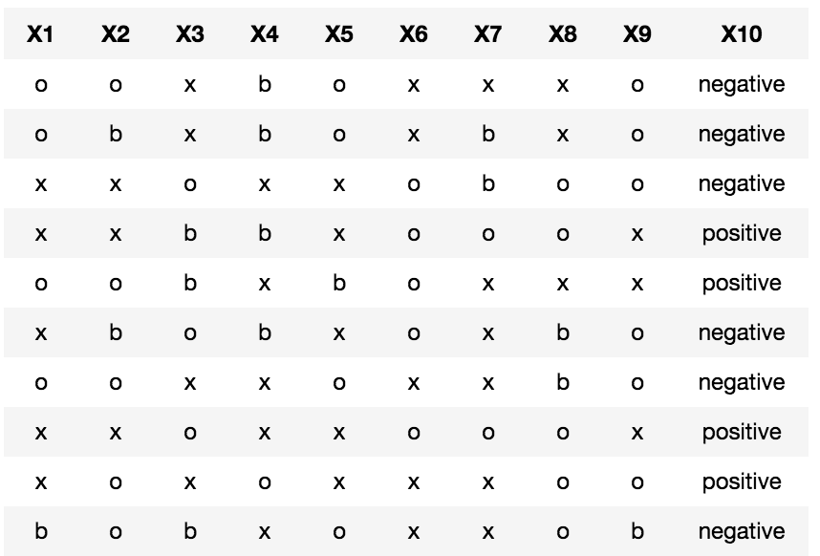
A glance of Data

Slide 6
Split Train Data
Df_positive = (df[df[‘Y’]]== ’positive’)
Df_negative = (df[df[‘Y’]]== ’negativetive’)

Slide 7
Count element
eliment_count = dict(Counter(df[column_name]))

Slide 8
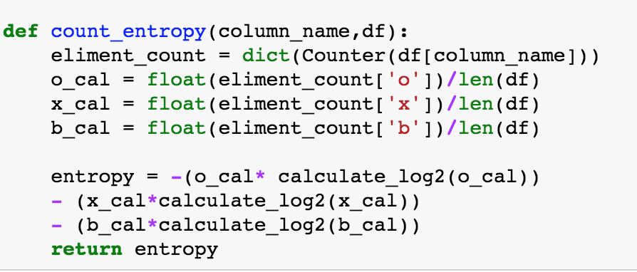
Count entropy

Slide 9
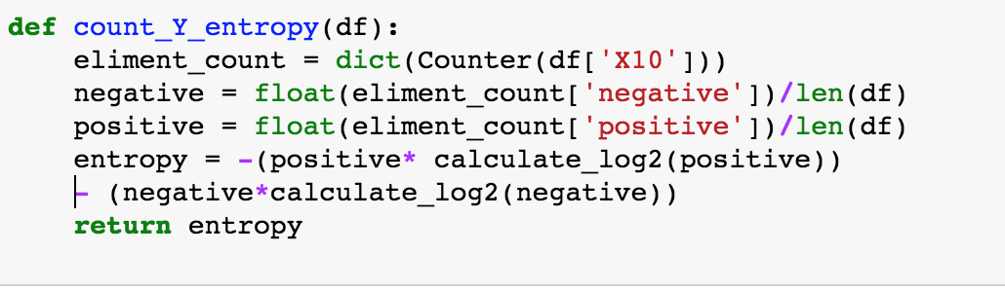
Count y entropy

Slide 10
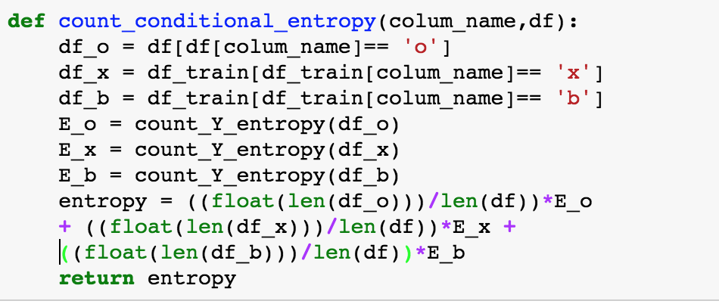
Count Conditional Entropy

Slide 11
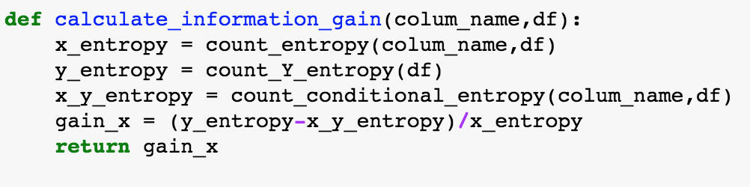
Calculate Information Gain

Slide 12
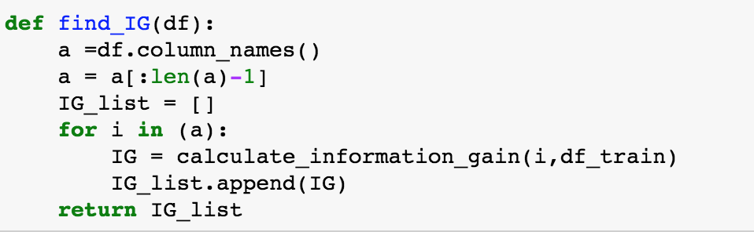
Get all Possible information Gain

Slide 13
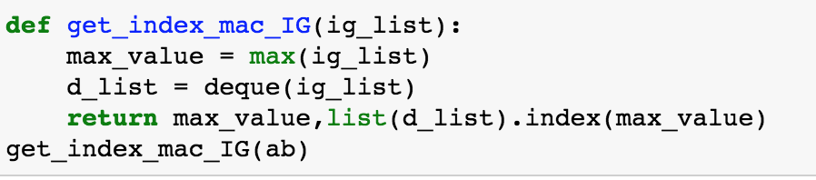
Get max(IG)

Slide 14
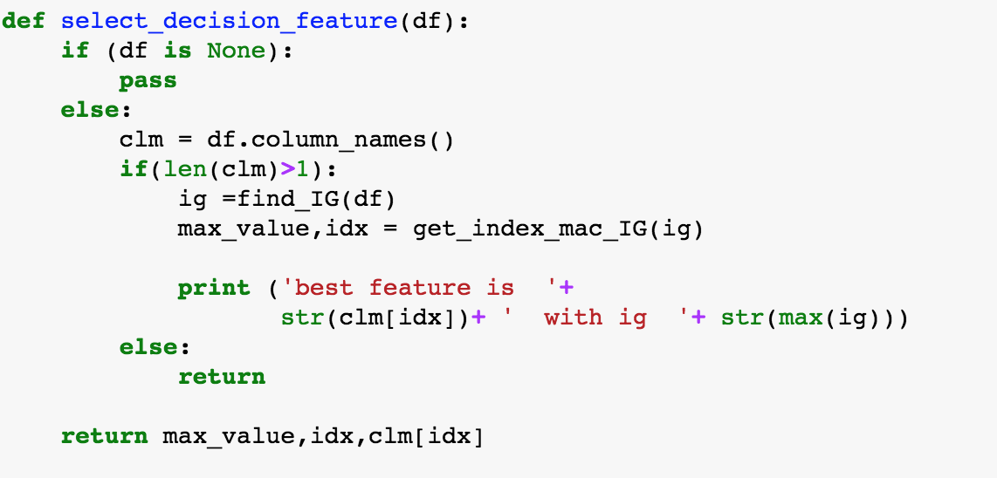
Get decision feature to split

Slide 15
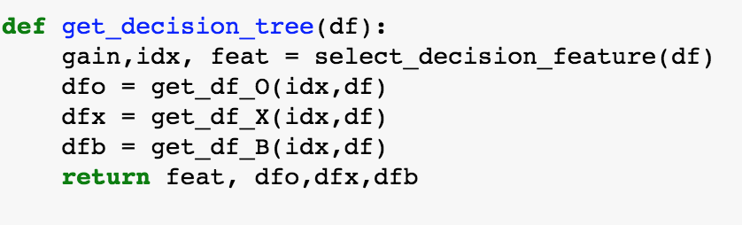
Get decision Tree with selected feature & Split Data

Slide 16
No of Feature to split
For N number of feature
# of Split = 3⁰+ 3¹+ 3²+.......+ 3^{n-1}
Our dataset has 9 features
Total # of features to split = 9841

Slide 17
Store features and split result
Each feature split the data into 3 data frames.
Total DF to count = 29523

Slide 18
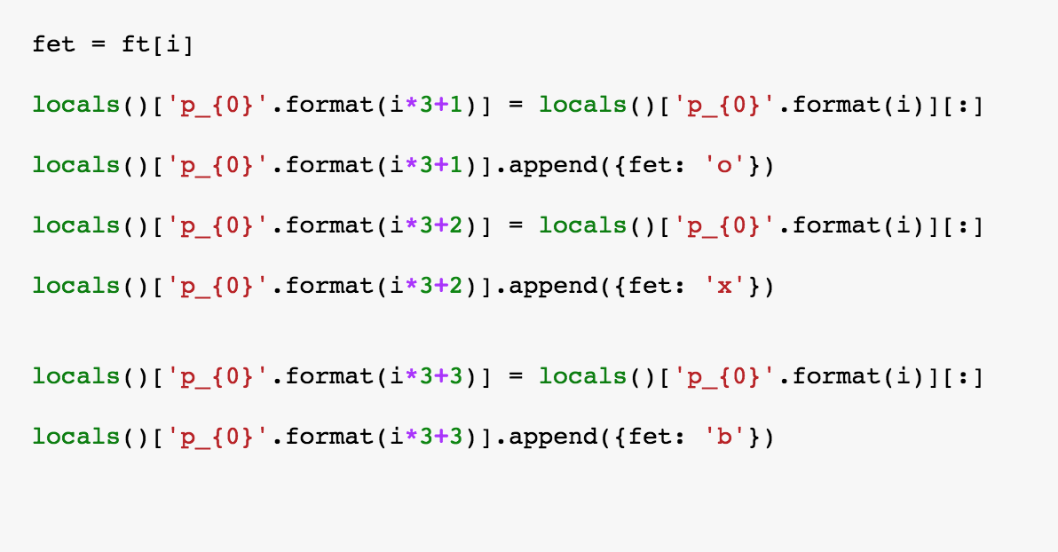
Get decision paths from features and splits

Slide 19
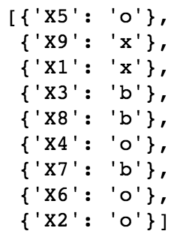
A sample path

Slide 20
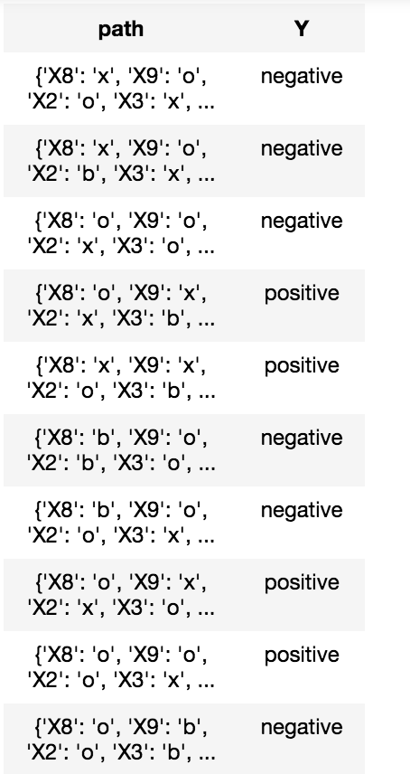
Train model with path and train Data

Slide 21
Predict Test Data
Match learned path with Each row of test data
If any path match, test_data[‘row] = learned prediction.
Count # of miss match of test data prediction with real output.

Slide 22
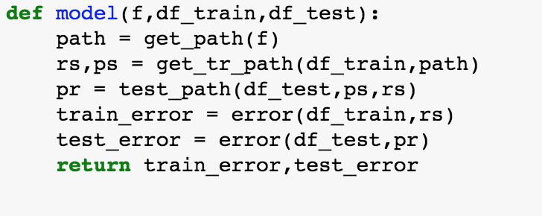
Build path with train data and feed Test data to predict

Slide 23
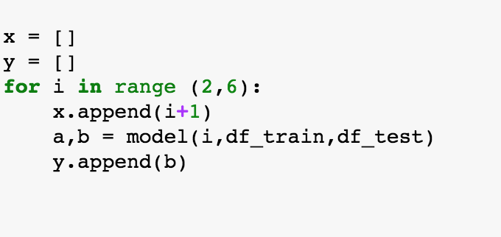
Prune
Test Model with different feature size

Slide 24
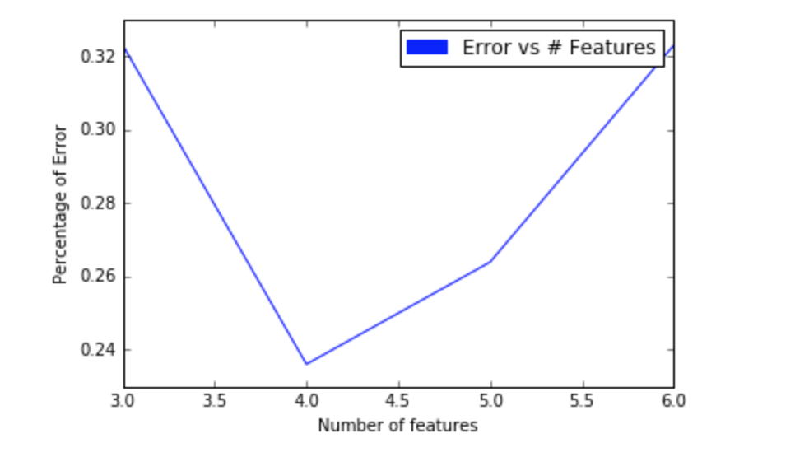
Model Performance

Slide 25
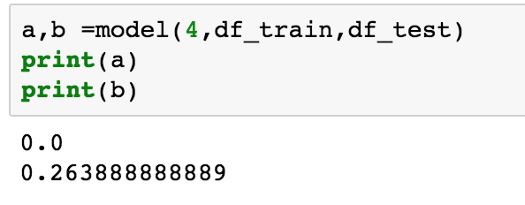
Model Performance

