Slide 1
Robot Navigation Anomaly Detection
Team 2 | AI Algorithms | Mid-term Presentation | January 6, 2026

Slide 2
Agenda
• 1. Requirements & Changes (~1 min)
• 2. Metrics Overview (~2 min)
• 3. Interesting Insights from Anomaly Detection (~3 min)
• 4. Methodology for Causal Analysis & Results (~3 min)
• 5. Ideas for Future Improvements (~1 min)

Slide 3
1. Requirements & Changes
~1 min
Initial Approach (Problem)
Current Approach (Solution)
• Log-based anomaly detection
• Dataset lacks RTF (Real-Time Factor) data
• Logs were not structured for analysis
• CSV-based anomaly detection
• Structured, reliable data format
• Consistent across all runs

Slide 4
Data Sources
~1 min
• poses.csv — Ground truth and estimated poses
• behaviors.csv — Behavior tree execution logs
• rosbag2.csv — Raw ROS topics (AMCL pose, transforms, velocity commands)
• scenario.config — Scenario parameters

Slide 5
2. Performance Metrics
~2 min
Category | Metric | Unit | Description
Localization | mean_pos_error | m | Average position error
Localization | rmse_pos | m | Root mean square error (spike sensitive)
Localization | mean_yaw_error | rad | Average orientation error
Path | executed_path_length | m | Total path traveled
Path | path_efficiency | ratio | gt_path / executed (1 is best)
Kinematics | mean_linear_velocity | m/s | Average movement speed
Kinematics | trajectory_smoothness | rad/s2 | Angular acceleration (lower = smoother)
Kinematics | duration | s | Total run time
AMCL | mean_amcl_uncertainty | m | Average localization confidence

Slide 6
Anomaly Detectors
~2 min
Rule-Based (8 types)
ML-Based (1 type)
• goal_failure - Goal not reached
• no_initiation - Robot didn't start
• position_error_spike - Sudden errors
• stuck - Robot stopped moving
• high_amcl_uncertainty - Poor localization
• high_yaw_error - Orientation issues
• path_inefficiency - Sub-optimal path
• oscillation - Jerky motion (smoothness > 2.0)
• Isolation Forest
• Captures multi-metric abnormal patterns that rules may miss.
• Uses all performance metrics

Slide 7
3. Interesting Insights from Anomaly Detection
~3 min
Anomaly Type | Count | % of Runs
goal_failure | 150 | 50.0%
stuck | 115 | 38.3%
Isolation Forest | 45 | 15.0%
position_error_spike | 15 | 5.0%
high_yaw_error | 9 | 3.0%
path_inefficiency | 7 | 2.3%
Key Findings
• Total occurrences: 341
• goal_failure is most common (50%)
• stuck follows at 38.3%
• Isolation Forest catches 15%
• Single run can have multiple anomalies

Slide 8
Door-Width (120 Runs): High incidence of Goal Failure (64% of runs).
Hallway-Window (120 Runs): Goal Failure remains the top anomaly (43% of runs).
Room-Size (60 Runs): Agents frequently getting Stuck (52% of runs).

Slide 9
Insights - Anomaly Co-occurrence
~3 min
• position_error_spike + high_yaw_error (Jaccard = 0.60)
• -> Poor orientation tracking leads to position drift
• high_yaw_error + path_inefficiency (Jaccard = 0.78)
• -> Orientation errors cause inefficient path execution

Slide 10
Insights - Early Detection (First 30% of Run)
~3 min
Anomaly | PR-AUC | ROC-AUC | Cases | Insight
goal_failure | 0.852 | 0.828 | 150 | Highly predictable early
stuck | 0.766 | 0.789 | 115 | Highly predictable early
Isolation Forest | 0.661 | 0.834 | 45 | Good detection capability

Slide 11
Insights - Feature Signatures
~3 min
Goal Failure :
Stuck :
path_length : r=-0.491 ***
std_velocity : r=-0.437 ***
path_efficiency : r=-0.384 ***
duration : r=+0.524 ***
mean_angular_vel : r=-0.283 ***
path_length : r=+0.276 ***

Slide 12
high_amcl_uncertainty:
rmse_pos : r=+0.291 ***
max_velocity : r=+0.277 ***
std_pos_error : r=+0.274 ***

Slide 13
4. Causal Analysis - (Ensemble + Model Distillation / Surrogate Modeling)
• Step 1: High-Capacity Model Training (Ensemble)
• -> Voting Classifier: Decision Tree+ Random Forest + Gradient Boosting
• -> Prioritizes F1-score
• Step 2: Surrogate Model Training (Distilled Decision Tree)
• -> Constrained tree (max_depth=4)
• -> Target: Ensemble predictions (not ground truth)
Step 3: Rule Extraction
• -> Extract paths with P(Anomaly) > 0.5
•
• Step 4: FOL Translation
• -> Map thresholds to semantic predicates

Slide 14
Derived FOL Rules - Examples
~3 min
Goal Failure:
(Cov=17.0%, Prec=1.00, Rec=0.34, n=51), Confusion: TP=51, FP=0, FN=99, TN=150
FOL: ∀t : in_corridor(t) ∧ min_wall_distance(t) > 0.737 ∧ obstacle_clearance_ratio(t) <= 17.970 ⇒ goal_failure
NL: IF robot is in corridor AND min wall distance > 0.737 AND obstacle clearance ratio ≤ 17.970 THEN goal_failure
Stuck:
(Cov=6.7%, Prec=1.00, Rec=0.17, n=20), Confusion: TP=20, FP=0, FN=95, TN=185
FOL: ∀t : min_door_distance(t) > 1.792 ∧ noise_level(t) <= 0.015 ∧ min_door_distance(t) > 2.104 ∧ room_area(t) <= 25.130 ⇒ stuck
NL: IF min door distance > 1.792 AND noise level ≤ 0.015 AND min door distance > 2.104 AND room area ≤ 25.130 THEN stuck

Slide 15
Derived FOL Rules - Examples
High_amcl_uncertainty:
(Cov=4.0%, Prec=1.00, Rec=0.52, n=12), Confusion: TP=12, FP=0, FN=11, TN=277
FOL: ∀t : obstacle_clearance_ratio(t) > 31.314 ∧ total_obstacle_area(t) <= 0.875 ∧ door_width(t) > 0.935 ⇒ high_amcl_uncertainty
NL: IF obstacle clearance ratio > 31.314 AND total obstacle area ≤ 0.875 AND door width > 0.935 THEN high_amcl_uncertainty
Path_inefficiency:
(Cov=3.3%, Prec=0.70, Rec=1.00, n=10), Confusion: TP=7, FP=3, FN=0, TN=290
FOL: ∀t : obstacle_clearance_ratio(t) <= 8.833 ∧ clearance_ratio(t) > 6.812 ∧ min_door_distance(t) <= 1.349 ⇒ path_inefficiency
NL: IF obstacle clearance ratio ≤ 8.833 AND clearance ratio > 6.812 AND min door distance ≤ 1.349 THEN path_inefficiency

Slide 16
Derived FOL Rules - Examples
Isolation Forest:
(Cov=4.0%, Prec=1.00, Rec=0.27, n=12), Confusion: TP=12, FP=0, FN=33, TN=255
FOL: ∀t : obstacle_clearance_ratio(t) > 31.314 ∧ total_obstacle_area(t) <= 0.875 ∧ door_width(t) > 0.935 ⇒ Isolation Forest
NL: IF obstacle clearance ratio > 31.314 AND total obstacle area ≤ 0.875 AND door width > 0.935 THEN Isolation Forest

Slide 17
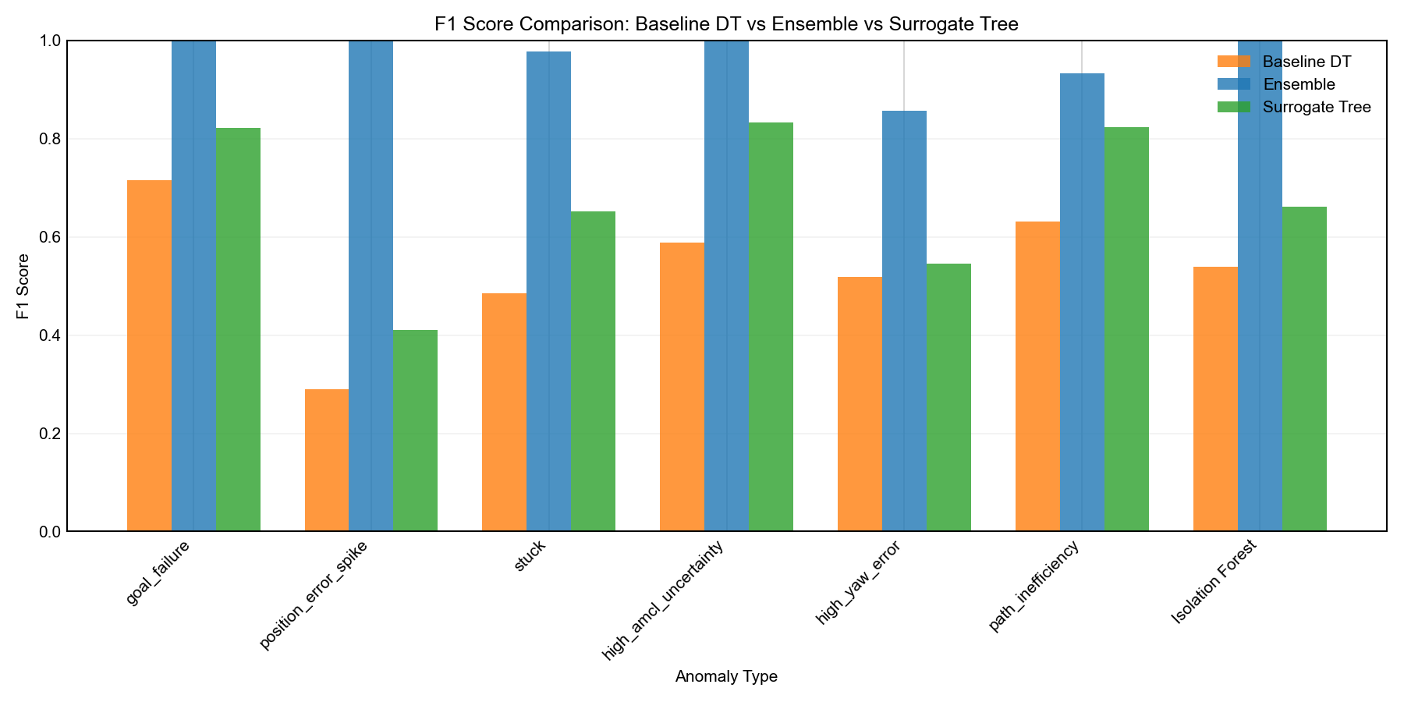

Slide 18
5. Ideas for Future Improvements
~1 min
Short-term
Long-term
• Hyperparameter tuning: on surrogate tree
• Optimize max_depth, min_samples_leaf
• Better balance: simplicity vs accuracy
• Feature engineering enhancements:
-> Initially we also considered path length but we removed it because of data leakage in the form of reverse causality
• -> Include temporal dynamics (robot's movement and error metrics change over time. While "Computable Functions" and "Atomic Relations" focus primarily on spatial context) , etc..
• Cross-validation on unseen scenarios
• Sensitivity analysis of rule thresholds

Slide 19
Thank You!

